Slide 1
Scrum Guide
Notes:
<number>

Slide 2
Outline
About Scrum
Scrum Values
Scrum Theory
Scrum Team
Scrum Event
Scrum Artifacts
Review

Slide 3
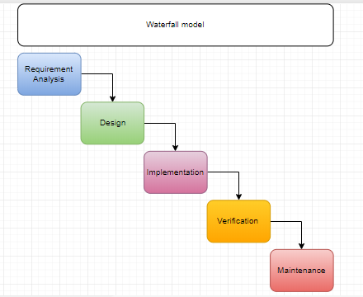
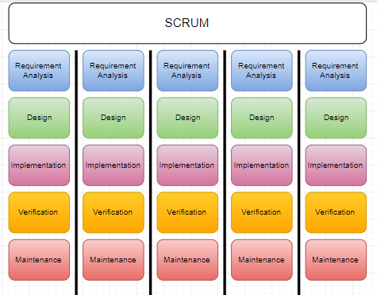
Software Development Process
Notes:
“Lightweight” means that the overhead of the process is kept as small as possible, to maximize the amount of productive time available for getting useful work done
<number>

Slide 4
About Scrum
Author
Ken Schwaber
Jeff Sutherland
Definition:
Framework
Address complex product
Productively and creatively delivery products of the highest possible value
Scrum:
Lightweight
Simple to understand
Difficult to master
Notes:
“Lightweight” means that the overhead of the process is kept as small as possible, to maximize the amount of productive time available for getting useful work done
<number>

Slide 5
Scrum theory
Empirical process control theory (Empiricism)
Transparency
Inspection
Adaptation
Notes:
Empiricism asserts that knowledge comes from experience and making decisions based on what is known
Transparency:
Significant aspects of the process must be visible to those responsible for the outcome
Transparency requires those aspects be defined by a common standard so observers share a common understanding of what is being seen
<number>

Slide 6

Scrum Values
Notes:
Courage to undertake greater challenge
Focus on few things at a time
Team define a commitment and team goal, each member have commitment to the team
Work together and sharing success and failure, respect each other and help each other to become worthy of respect.
No secret about the production between/among team member. Be open to suggestion from others.
Successful use of Scrum depends on people becoming more proficient in living these five values. People personally commit to achieving the goals of the Scrum Team. The Scrum Team members have courage to do the right thing and work on tough problems. Everyone focuses on the work of the Sprint and the goals of the Scrum Team. The Scrum Team and its stakeholders agree to be open about all the work and the challenges with performing the work. Scrum Team members respect each other to be capable, independent people.
<number>

Slide 7
Scrum Team

Slide 8
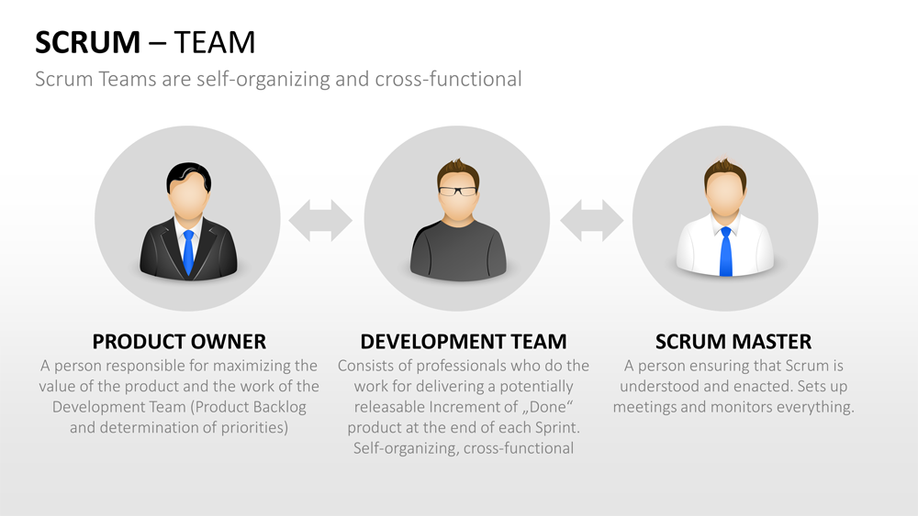
Scrum Team

Slide 9
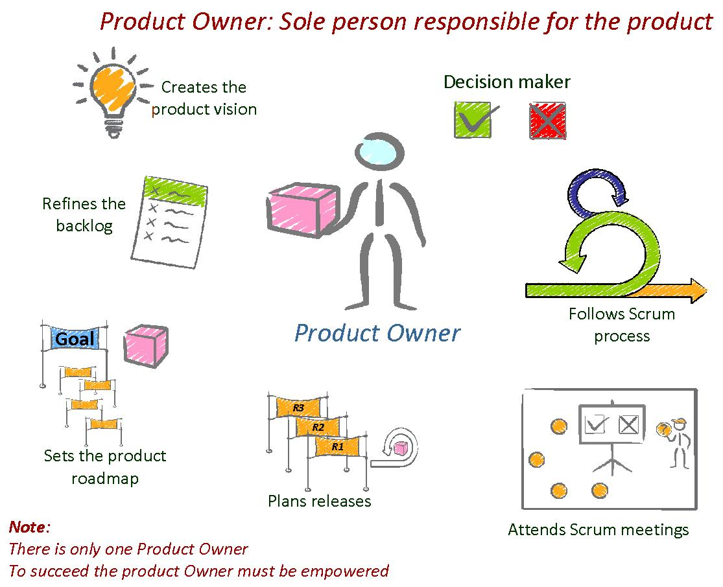

Product Owner
Person is responsible for maximizing value of product and work of Development team
Notes:
PO order backlog to team and no one is allow to order BL to team and vice versa.
PO could be a sole person, not a committee.
<number>

Slide 10

Development Team
Size:
3~9 members (without PO, ScM)
Characteristic:
Self-organizing
Cross-functional
Everyone is developer
Member skills accountability belong to whole team
Function:
Deliver a potentially releasable Increment of ‘Done’ product
Notes:
< 3: Encounter skill constraints
> 9: Too much coordination. Complex to for empiricism process to manage.
<number>

Slide 11



Scrum Master
Servant-leader help maximize value created by Development Team
Work with Scrum Masters
Increase productivity of Scrum Team
Help scrum team understand Product Backlog
Find technique for effective Backlog Management
Facilitate scrum event
Self-organization & cross-functionality
Create high-value products
Remove impediment
Facilitate scrum event
Facilitate change
Advise & coach
Coach

Slide 12
Scrum events

Slide 13
Sprint – The heart of Scrum
Consist of:
Sprint planning
Daily scrums
The development work
Sprint review
Sprint retrospective
Duration: < 1 month
Notes:
No changes are made that would endanger the Sprint Goal;
Quality goals do not decrease; and,
Scope may be clarified and re-negotiated between the Product Owner and Development Team as more is learned.
<number>

Slide 14
Sprint Events
Sprint planning
<= 8 hours
What can be done this sprint?
Estimation
How will the chosen work get done?
Daily Scrum
<= 15 minute
Is held at same time and place each day
Sprint velocity
Sprint Review
<= 4 hours
Kaizen and Sprint Retrospective
After Sprint Review
<= 3 hours
Notes:
Team conduct daily scrum and ScM teach Dev Temp to keep Daily Scrum within 15 minutes
Daily Scrums improve communications, eliminate other meetings, identify impediments to development for removal, highlight and promote quick decision-making, and improve the Development Team’s level of knowledge. This is a key inspect and adapt meeting.
Retrospective:
- Inspect how the sprint went
- Identify major item went well and potential improvement
- Create plan to implementing improvement
<number>

Slide 15
Scrum Artifacts

Slide 16
Product Backlog
User stories
Product Backlog’s attributes:
description, order, estimate, value.
Product Backlog refinement
Develop team is responsible for estimates.
Monitor by burndown, burnup chart
Notes:
Product Backlog refinement is the act of adding detail, estimates, and order to items in the Product Backlog
<number>

Slide 17
Sprint Backlog
Set of Product Backlog with detail
Only Development Team can change Sprint Backlog
Sum of all Product Backlog completed during Sprint and increments of all previous Sprints.
Increment
Notes:
The Sprint Backlog is the set of Product Backlog items selected for the Sprint, plus a plan for delivering the product Increment and realizing the Sprint Goal
<number>

Slide 18
Artifact Transparency
Scrum relies on transparency
Scrum Master’s job is to increase the transparency
Definition of “Done”
Potentially releasable increment
Notes:
Learning, convincing, and change
<number>

Slide 19
Reference

