Slide 1
Course Code: R1UC512C
INDUSTRY INTERNSHIP SUMMARY REPORT
By- AICTE, EduSkills
AWS CLOUD VIRTUAL INTERNSHIP
BACHELOR OF TECHNOLOGY IN
COMPUTER SCIENCE AND ENGINEERING
2024 - 2025
Name – Shreyash Upadhyay
Admission No - 23SCSE1012304
SUPERVISOR UNDER
Manish Verma sir

Slide 2
Internship Overview
Organized by:
Curriculum:
AICTE, EduSkills ,
AWS Academy
Cloud computing principles
and AWS tools
Duration:10 weeks

Slide 3
Learning Modules
Week 1-2: Introduction to AWS and Cloud Computing
Week 3-4: Core AWS Services (EC2, S3, RDS)
Week 5-6: Security and Identity (IAM, Cloud Watch )
Week 7-8: Networking and Deployment
Week 9-10: Capstone Project and Assessment

Slide 4
Cloud Platform Selection
AWS Academy
AWS Academy is a global initiative by Amazon Web Services (AWS) that provides higher education institutions with a ready-to-teach cloud computing curriculum. It is designed to help students develop the in-demand cloud skills needed to pursue careers in technology. AWS Academy courses and learning resources are developed and maintained by AWS experts and are regularly updated to reflect the latest services and industry trends.
.

Slide 5
Cloud Computing
Cloud computing refers to the delivery of computing services (such as storage, processing power, networking, databases, software, and analytics) over the Internet (the cloud), rather than using local servers or personal devices. These services are typically offered on a pay-as-you-go basis, which makes cloud computing highly flexible, scalable, and cost-efficient. Cloud computing offers several advantages over traditional on-premise IT infrastructure, making it a preferred choice for businesses and individual users alike.

Slide 6
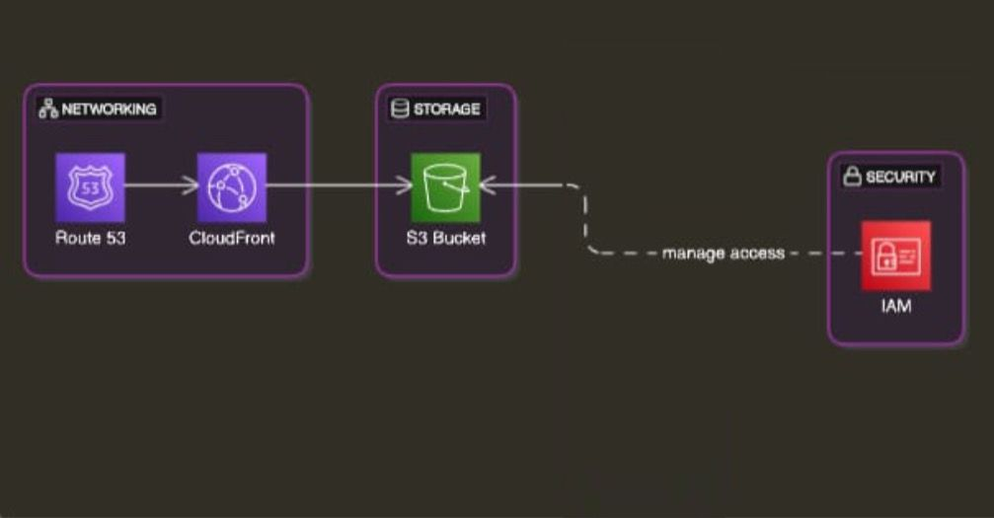
Proposed Architecture

Slide 7
Implementation Strategy
Phases of implementation (Planning, Development, Testing).
Identified project requirements, including file upload and retrieval functionalities. Researched and selected AWS S3 as the cloud storage solution for scalability and reliability. Defined the architecture, tools (Flask for backend, HTML/CSS/JS for frontend), and security measures (AWS IAM roles).Development Configured AWS S3 bucket and established IAM roles and permissions for secure access. Developed the Flask backend to handle file upload and retrieval via API endpoints. Created a responsive and intuitive frontend with drag-and-drop functionality using HTML, CSS, and JavaScript.
Testing: Conducted thorough local testing to ensure the application’s upload and download functionalities worked seamlessly. Verified integration with AWS S3 to confirm secure file storage and retrieval.

Slide 8
Tools
IAM : AWS Identity and Access Management (IAM) is a service that helps control access to AWS resources securely. It allows you to:
Manage Users and Groups: Create users and groups, assign permissions.
Define Roles: Provide temporary access to AWS services.
.
Amazon S3 : Use Amazon S3 to store, manage, analyze, and protect any amount of data for virtually any use case, such as data lakes, cloud-native applications, and mobile apps.

Slide 9
Project Video
Google drive link with shared access of Project working Video
https://drive.google.com/folderview?id=1NxpKW0JzL_qhW1w273IzkpvxFz7QC9Ju

Slide 10
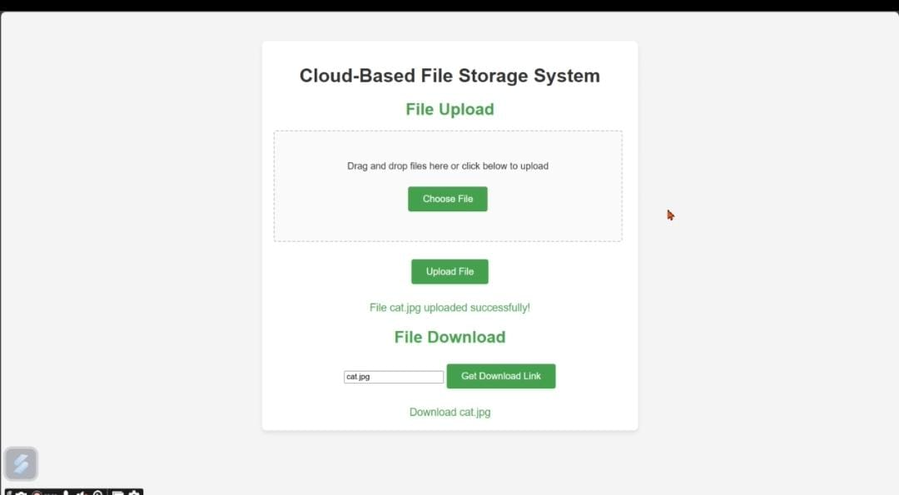
Screenshot of Work
Screenshot of Home page
Link of your Work
https://github.com/MonkeyDLuffy16Eren/Cloud_based_file_storage_system

Slide 11
Potential Challenges
Adapting to new tools and technologies
Managing time effectively for weekly tasks
Overcoming initial technical difficulties

Slide 12
Conclusion
Summarize the Project Conclusion
The Cloud-Based File Storage System effectively demonstrates the capabilities and advantages of leveraging AWS S3 for scalable, reliable, and cost-efficient file storage. The project successfully integrates cloud computing principles with a user-friendly interface, offering functionalities such as file upload and retrieval. By utilizing AWS IAM roles, secure access management ensures data safety and compliance with best practices. This system showcases the potential of cloud platforms in streamlining storage solutions, reducing operational overhead, and enabling real-time accessibility. It highlights the transformative impact of cloud technology in building modern, scalable, and efficient applications tailored to meet dynamic user needs

Slide 13
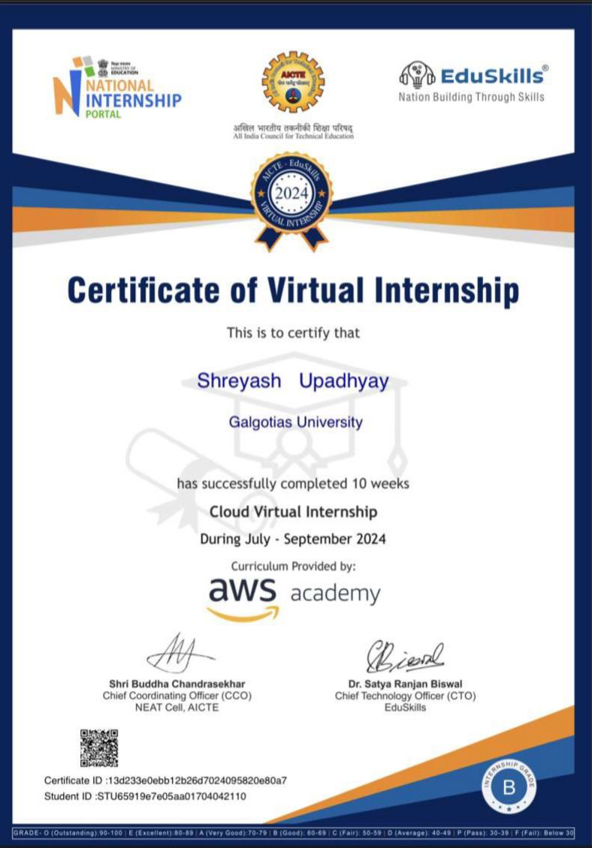
Certification

Slide 14
THANK
YOU

