Slide 1
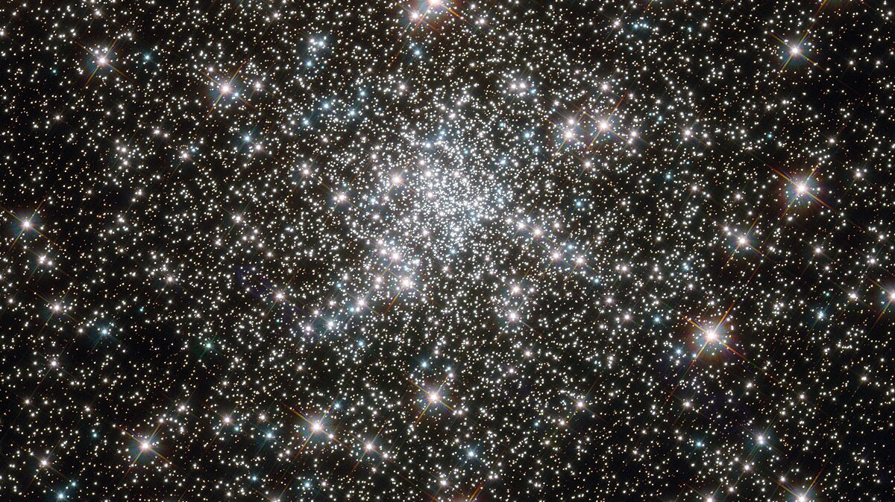
SHOTGLAS II. MUSE spectroscopy of blue horizontal branch stars in the core of ω Centauri and NGC 6752
By Marilyn Latour from „Institut für Astrophysik und Geophysik, Georg-August-Universität Göttingen“
A Review by Arthur Völkerer
Notes:
Spectroscopic and Hubble Observations of Tracers for Galactic Legacy Archival Science

Slide 2
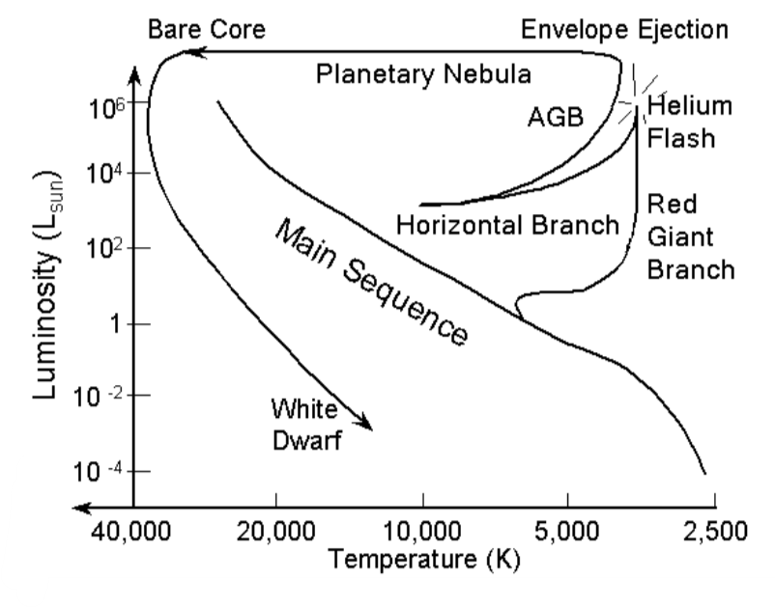
Horizontal Branch
Helium fusion -> He I and He II lines
In the paper
Chemestriy
Evolution
Temperature
Sterne und Planetensysteme „The evolution of the Sun.pdf”, Page 15
Notes:
A, F Stars were Analized,
Blue on the left
Jumps because of different phases, can be seen in fast changes in L, M, R, …

Slide 3
Data
MUSE (475−935 nm)
Hubble space telescope Photometrie
Smaller catalogs
More than 400 HB Stars (>8kK)
NGC 6752
ω Centauri
Notes:
Multi Unit Spectroscopic Explorer (Very Large Telecope) ,
(observeable, IR)
F435W(blue) F606W(yellow green), F275W(Uv) Filter von Hubble
. NGC Normal
. W centauri more spread metalicity, spread Helium ab undance (mabey forged by more clusters)
. NGC Variable stars green, blue blue stragglers brighter and hotter
. w centaurei: blue hook stars (at the end of the BHB) T high, L low

Slide 4
Models
Compared a model spectrum with the MUSE spectrum
Hybrid LTE/NLTE model atmosphere
LTE
NLTE
Back to LTE to improve the result
With model of the spectrum, some properties can be derived
Notes:
Local Thermal equilibrium
ADS (ATLAS12, DETAIL, SURFACE) <-Software

Slide 5
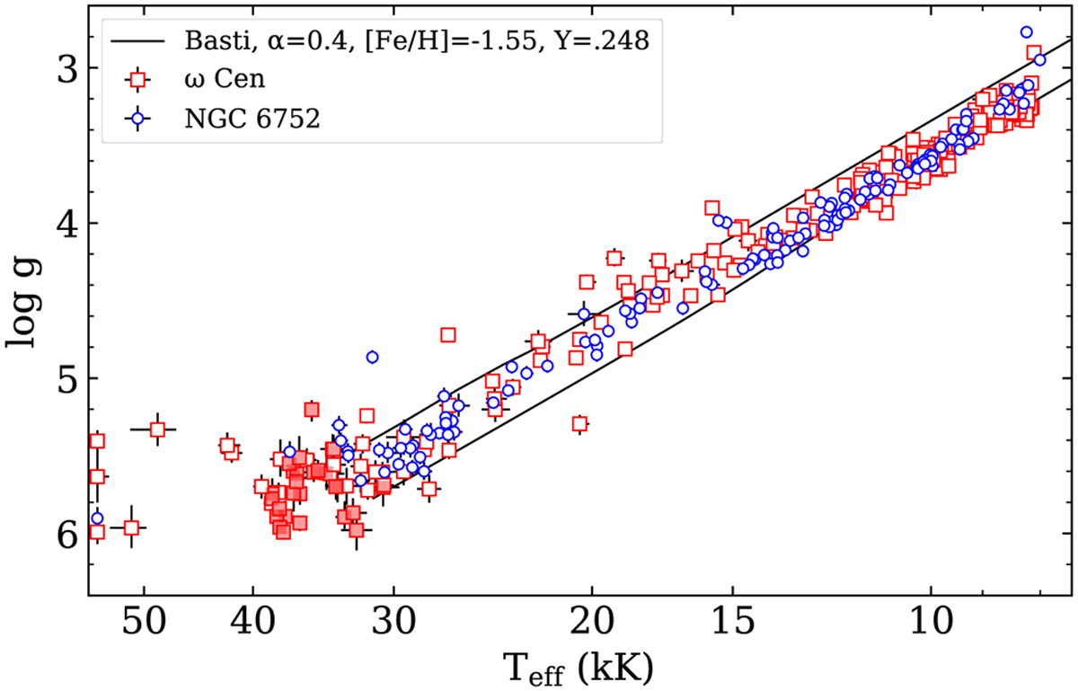
Results
Log g (surface gravity)
Effective temperature
Helium abundance
Average reddening
Radius
Luminosity
Mass
(Fig. 12. in the Paper)
Notes:
Log g=surface gravitation, Evolution of the stars, can be observerd at the spectral lines
Effective Temperature = ideal black body
Good result in T<15 000K
No differences between both clusters

Slide 6
Summary
Analyzed blue horizontal branch
Compared MUSE data with models
Good results in lower temperature and no differnece between the two clusters
Paper: https://ui.adsabs.harvard.edu/abs/2023A%26A...677A..86L/abstract

Slide 7
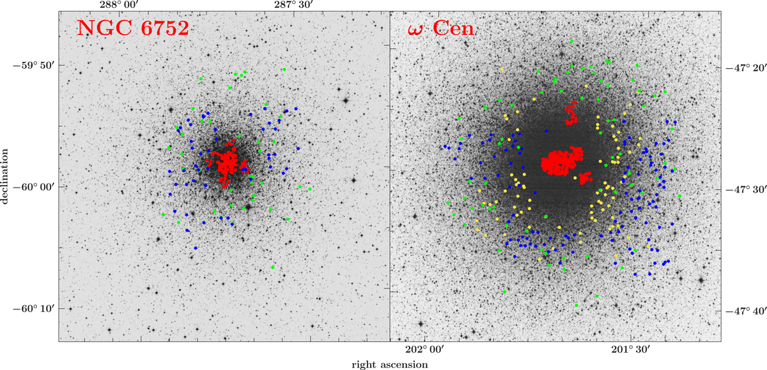
Copyright by Anglo-Australian Observatory/the Royal Observatory Edinburgh
(Fig. 1. in the Paper)
Notes:
Red from Muse,
Other colors from other catalogs

Slide 8
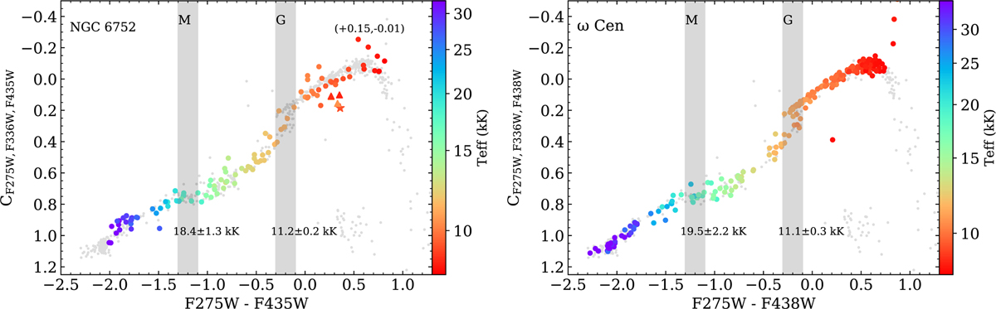
(Fig. 8. in the Paper)
Color-Color Diagram
Notes:
Multi Unit Spectroscopic Explorer (Very Large Telecope) ,
F435W(blue)
F606W(yellow green),
F275W(Uv) Filter von Hubble

