Slide 1


Final Thoughts
Wake Forest
School of Business
_______
7090

Slide 2
Remember when
Design pattern
Import
Get data into a common format
Tidy & Cleanse
Clean, Standardize & Shape
Transform
Create new and useful variables
Visualize
Tables, Statistics & Graphs
Model
Inferences & Predictions
Communicate
Inferences & Predictions

Slide 3
We’ve covered a lot
Variables
Lists
Dictionaries
Pandas
Matplotlib
Seaborn
Word Clouds
And a bunch more…

Slide 4
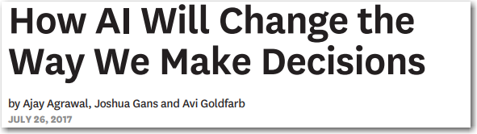
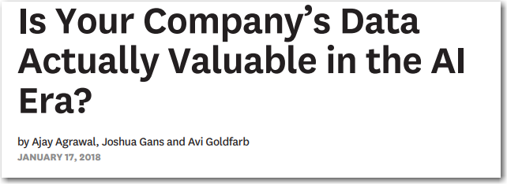
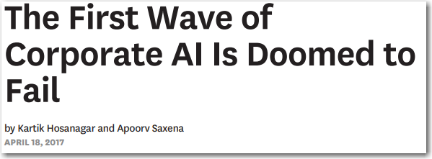
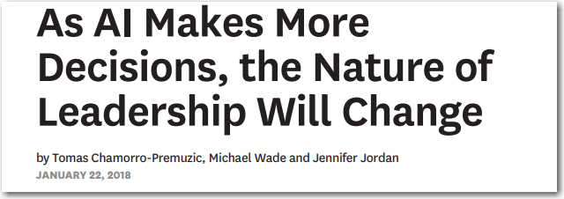
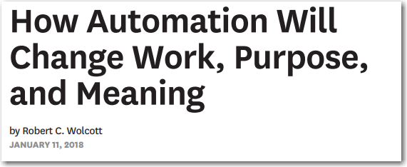
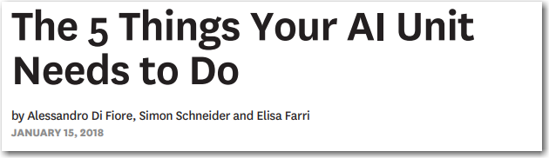
Notes:
Here is a small sample of the 30+ articles from Harvard Business Review on AI and machine learning … on one side AI spells doom and gloom, the other it promises everything from self-driving cars and medical breakthroughs…
A lot has been made of a computer beating the worlds best players at Go and Chess. Does anyone here play Go? Its complexity is masked in its simplicity.
But how do you separate hype from reality? How can your company apply AI and Machine Learning to solve real business problems in 2018?
Introduction: AI and Machine learning is powerful, ubiquitous and seemingly complex…
At the end of this presentation, I hope to leave you with a couple thoughts
It’s the system that’s important
A little AI can go a long way
Demand insights and interpretability
Automation is key to improving human decisions
Accountability is either going be demanded from us or legislated upon us.

Slide 5
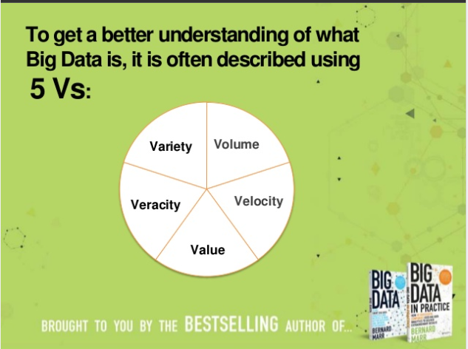
Who remembers…
3,4,or 5 V’s of Big Data?
Volume – the vast amounts of data our systems pump out every second, it adds up.
Variety – the different types of data we have access to, structured, unstructured, semi-structured, voice, text, image, video etc. it’s a lot.
Velocity – the speed at which data is created.
Veracity – the messiness or trustworthiness of data.
Value – which leads us to Analytics – how do create value from data?
Notes:
We’ve all seen these trends come and go… 8 years ago it was big data and Hadoop today it’s AI – like any trend we have peel back the onion to see what's really going on….
the real story about Big Data hype parts in my opinion can be divided into two themes:
First business woke up the potential of leveraging their data with analytics, we saw explosive growth in the interest in Data Processing, and Business Intelligence and now we’ve seen that with advanced analytics, machine learning and AI
Second was the cost of storage and computing nose dived giving rise to Cloud computing … I mean i just bought a 2 TB $50 the other day…

Slide 6
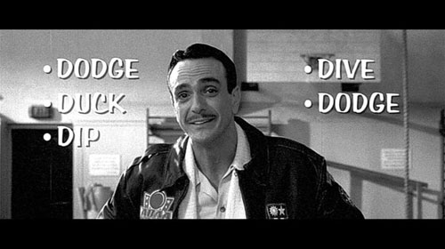
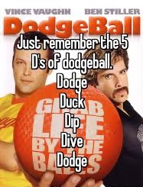
What about …
The 5 D’s of Dodgeball?
Dodge, Duck, Dip, Dive and Dodge
Notes:
So while I joke about the 3 V’s of big data – it was a great catch-phrase that we could latch onto, just like the 5 D’s of dodgeball. So I’ve come up with my own catch phrase….

Slide 7
4 A’s of AI
Automation, Accuracy, Adaptability & Accountability
Its the “system” that’s important …
Automation
Automation is key to reducing the decision lag ~ the time between observation and action, maximizing system effectiveness.
Accuracy
Accuracy is a function of problem definition, data engineering, breadth of supervised and unsupervised algorithms & best practices
Adaptability
Learning new and emerging patterns and threats within the data, minimizing detection lag, minimizing or eliminating model degradation overtime.
Accountability
Consistency, interpretability, and governance of the system. AI Systems should produce interpretable results and artifacts, digestible by both the business an layman, its is the governance of automated systems more than just algorithmic accountability.
Notes:
So I’ve coined the 4 V’s of AI,
AI is about building systems – systems that have a notion of automation, accuracy, adaptability and accountability:
Automation – we know the next big wave of productivity gains will come from automating mundane and complex processes, RPA robotic process automation is the next big frontier. We are already seeing it. Chatbots, Model driven RPA, automated decisioning systems.
Accuracy – AI is really about systems that have a measure of accuracy, that you can evaluate. You know I saw the other day a vendor talking about their advanced AI matching engine, so I asked some questions about accuracy – how accurate is the match? What is their F1 score? Could they give me a measure of accuracy if I gave them 10k known names and 10k unknown names how many matched? So they didn’t have a accuracy measure its just a process. It’s not AI if there is no measure of how accurate the system is.
Adaptability – the because we have an accuracy measure, we can determine if the system is improving or degrading over time. the key to a AI system is it’s abilty to adapt to new data, emerging patterns and threads within the data, minimizing the lag between event to disposition, but also the lag in trend spotting – think flash fraud.
Accountability – we are creating automated systems, sometimes autonomous systems no matter how much we’d like to completely eliminate the human factor we have to have humans in the loop. While a machine can make programed decisions it can’t

Slide 8
Typical Flow
Problem Definition, Model training, Integration to & Monitoring
1. Problem Formulation
2. Data Gathering & Structuring
12. Periodically Retrain
3. Data Exploration
4. Feature Engineering
5. Multi-Model Training
6. Model Simulation
8. Model Calibration & Deployment
10. Model Integration
11. Model Monitoring
7. Model Interpretability
9. Model Documentation
Notes:
This is what we’ve done as analytics professionals for decades. A nice 12 step process…

Slide 9
Evolution of Technology
It’s the system not the methods…
Rules
Analytics
Robotics
Semantic
AI
Rules & Scenarios | Pattern Analysis | Robotic Process Automation | Unstructured Analysis | Machine & Deep Learning
Threshold Tuning | Statistical Analysis | Alert / Case Triage | Entity & Network Analytics | Adaptive Computation
Name Matching | Visualization/ Exploration / Dashboards | Workflow / Process Orchestration | Natural Language Generation | Adversarial & Reinforcement Learners
Notes:
If it was the bleeding edge –
NLG – is already here, we’ve all seen the suggest a response from google and Microsoft in our emails… news papers have used a form of NLG for years to generate sports storys, we use templated NLG to generate mutual fund prospectuses, in some fraud systems we’ve generated comments and text for years. It’s the more autogenerated truly “NATURAL” part of language generation we are just seeing.
Machine Learning – for fraud and compliance we’ve done that for a while. Credit card fraud we were using neural networks dating back to the 80s
Adaptive, Adversarial, and Reinforcement learners – historically this comes from robotics but has applications is just where does it fit?

Slide 10
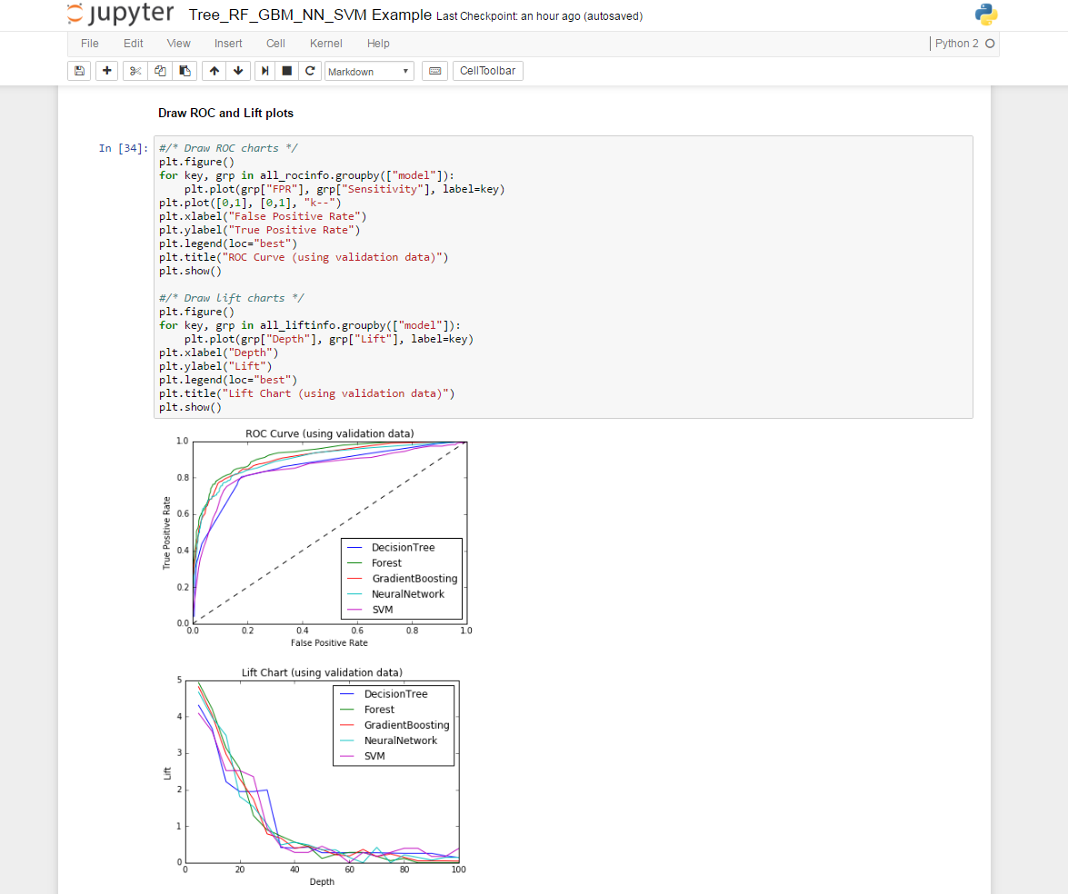
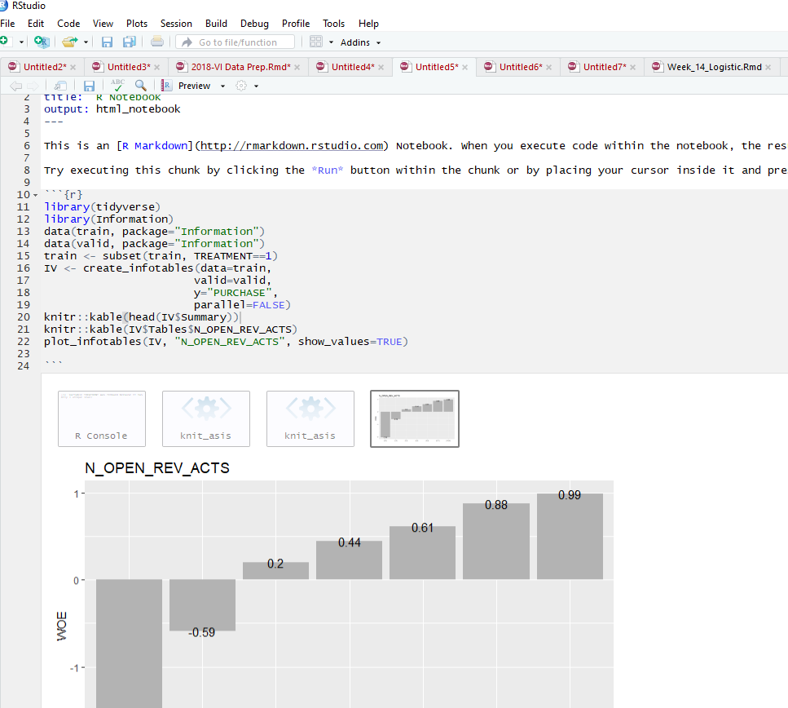
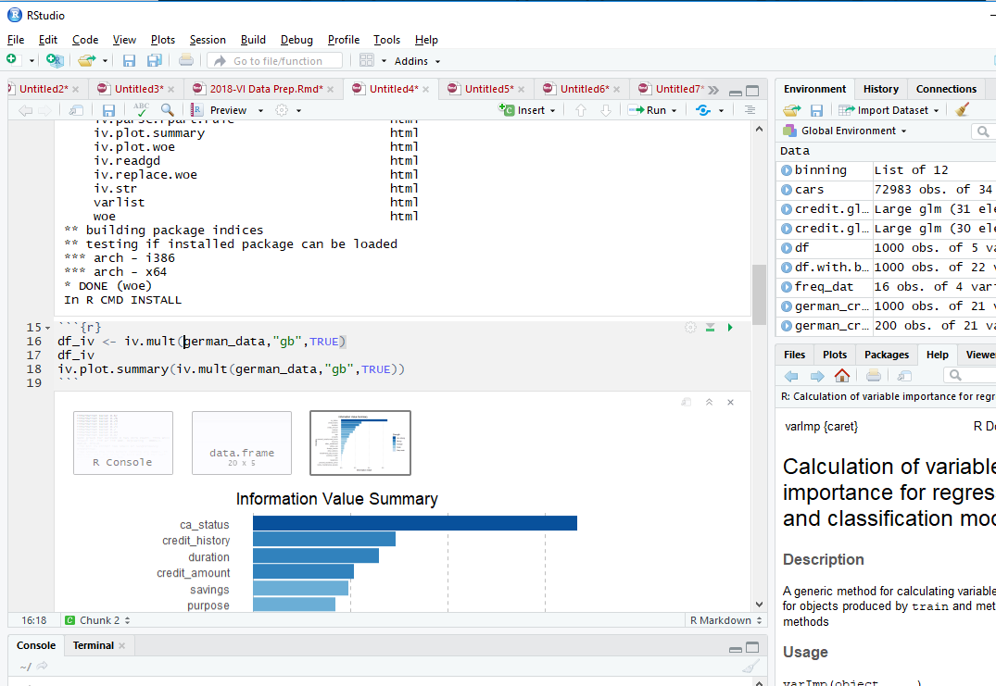
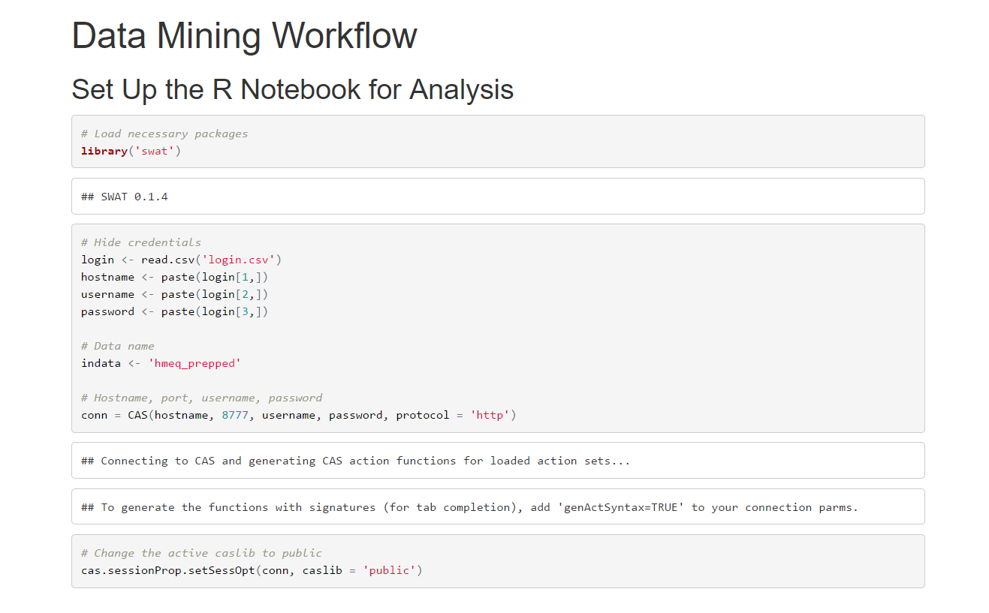
Free Range Data Science != Productivity
Notes:
As managers think about how you want your data scientists to work…

Slide 11
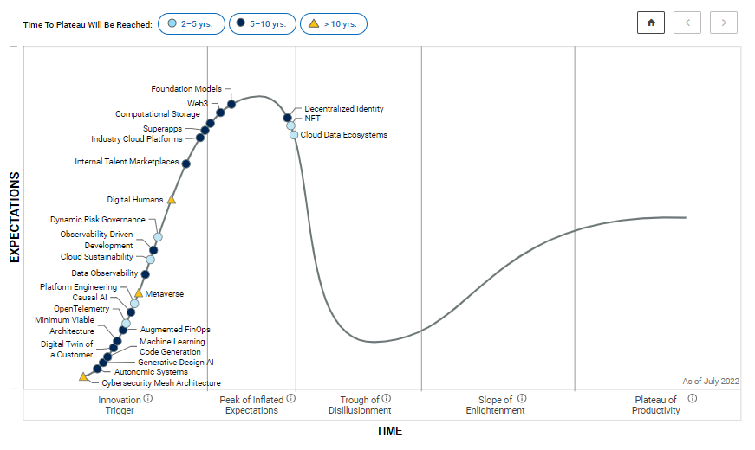
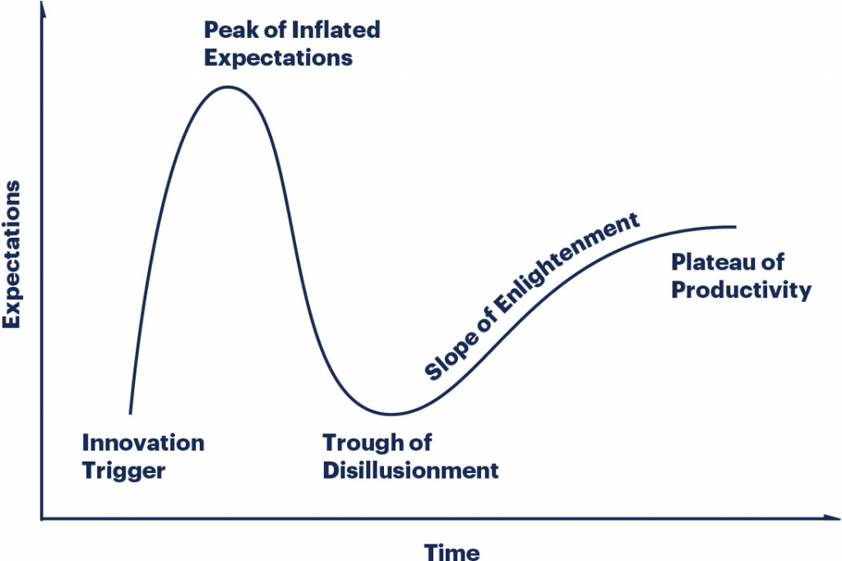

Slide 12
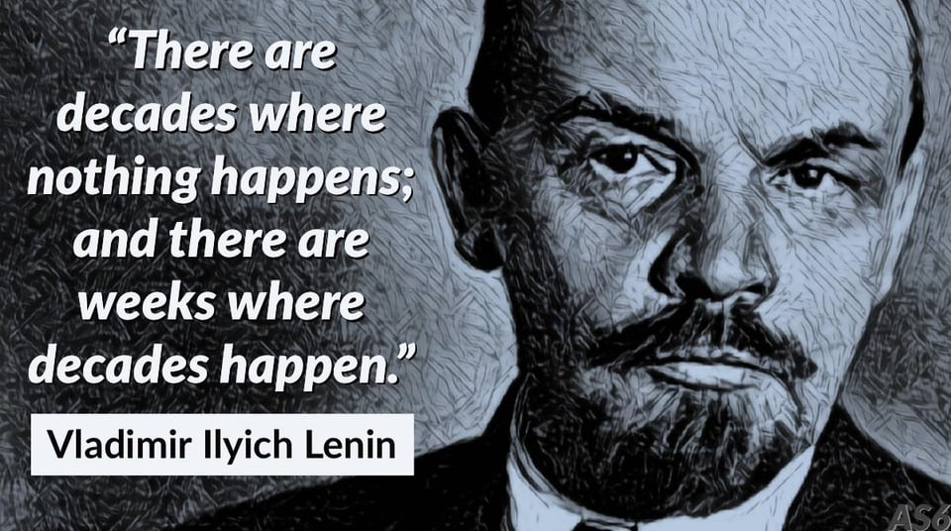
ChatGPT has caught people’s attention
Time it took to reach 1 million users
Netflix – 3.5 years
Airbnb – 2.5 years
Facebook – 10 months
Spotify – 5 months
Instagram – 74 days
ChatGPT – 5 days

Slide 13
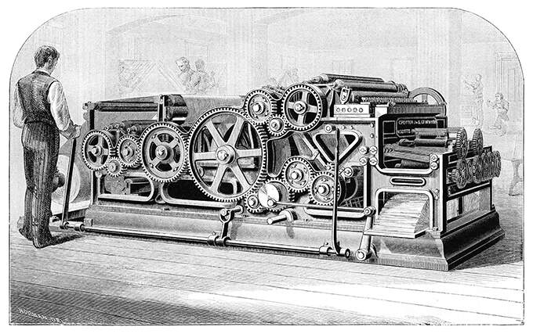
Our Predictions About AI Are Probably Wrong
When people can publish whatever, they want, they do. The printing press made individual books more uniform and more numerous, but it also put the idea of universal truth up for grabs – Eisenstein 1996
While ChatGPT and other AI technologies certainly have the potential to disrupt existing power structures, their implications are not necessarily rooted in challenging authority or disseminating information. Rather, they are more focused on improving and enhancing human capabilities, such as communication, problem-solving, and decision-making.
During the early days of the printing press, there were certainly those in positions of power who sought to suppress it. They recognized the potential for the printing press to disrupt existing power structures and challenge the status quo, and they sought to control the dissemination of information to maintain their authority.

Slide 14
Key Innovations
Powering AI Today
Convolutional Neural Networks (CNNs): CNNs were introduced in the late 1980s and have since become a fundamental building block in computer vision. CNNs can learn features from raw pixel data, making them effective at recognizing objects in images.
Recurrent Neural Networks (RNNs): RNNs were introduced in the 1990s and are particularly useful for processing sequential data such as text and speech. They can maintain an internal memory that captures context and history, making them effective for language modeling and other natural language processing tasks.
Long Short-Term Memory (LSTM): LSTMs are a type of RNN that can maintain long-term dependencies and avoid the vanishing gradient problem. They are particularly useful for speech recognition, machine translation, and other tasks that involve long-term dependencies.
Generative Adversarial Networks (GANs): GANs were introduced in 2014 and have revolutionized the field of generative modeling. They can generate new data that is similar to a given dataset, making them useful for image and text generation.
Attention Mechanisms: introduced in 2014 handle variable-length input and output sequences, which is essential for tasks such as machine translation, text summarization, and speech recognition.
Transformers: Transformers were introduced in 2017 and have become the state-of-the-art architecture for natural language processing tasks such as machine translation, text classification, and summarization. Transformers use self-attention mechanisms to selectively focus on relevant parts of the input sequence when making predictions.
Autoencoders: Autoencoders were introduced in 1980s and are neural networks that can learn to compress and reconstruct data, making them useful for data compression, denoising, and anomaly detection.

Slide 15
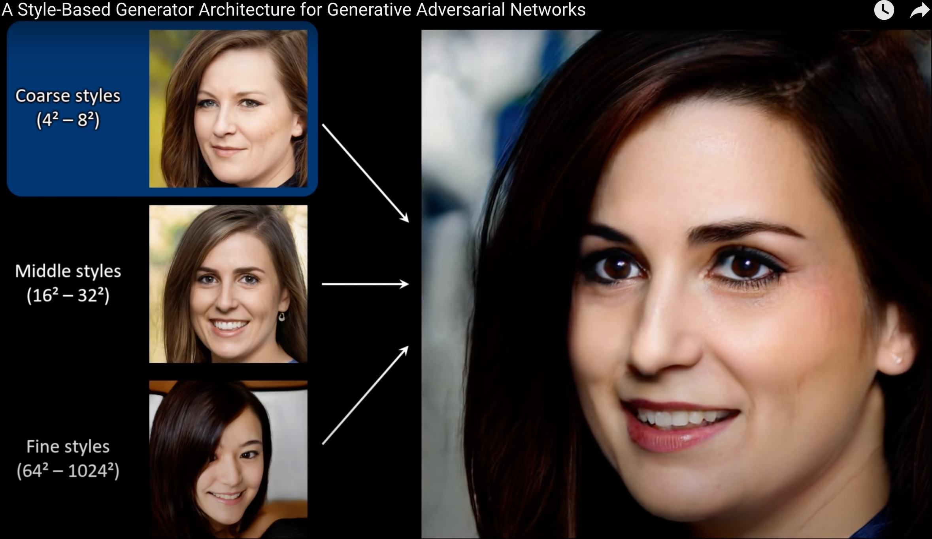
Generative AI
Generative artificial intelligence (AI) describes algorithms that can be used to create new content, including audio, code, images, text, simulations, and videos.
chatGPT
DALL-E
Boomy
StyleGAN3
Dozens of others…
https://www.mckinsey.com/featured-insights/mckinsey-explainers/what-is-generative-ai

Slide 16
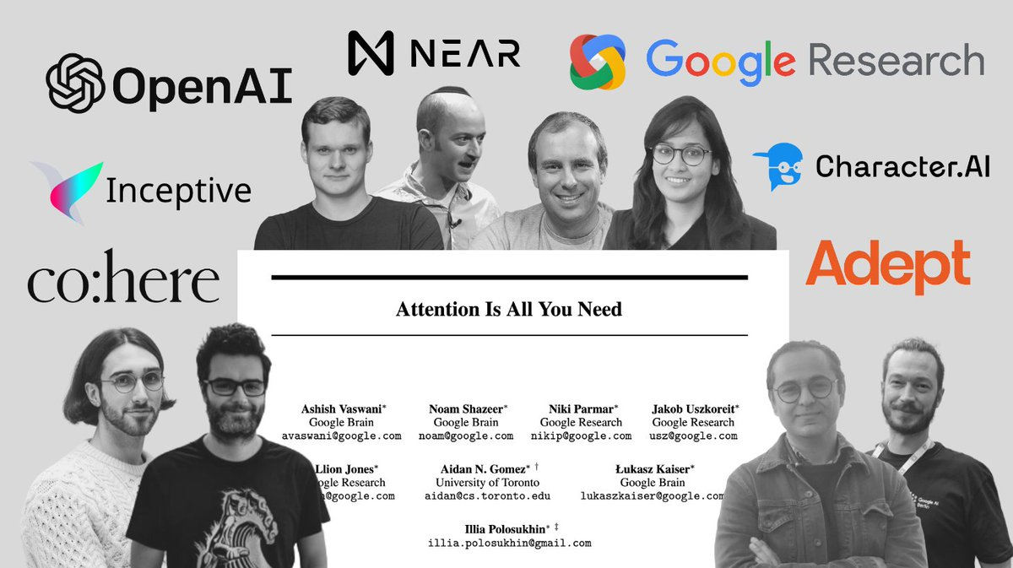
Key Paper in Language Models
Attention Is All You Need
"Attention Is All You Need" paper by Vaswani et al. 2017
https://arxiv.org/abs/1706.03762
Introduced the Transformer architecture,
The dominant architecture in Natural Language Processing
Attention allows the model to focus on different parts of the input sequence at different times, enabling it to capture long-range dependencies between words and generate more coherent and contextually relevant text.

Slide 17
Competition, Leaderboards & Innovation
Corpus, Architecture, Parameters, Tokens and Vocabulary
Measuring Massive Multitask Language Understanding Leaderboard
Model | Authors | Humanities | Social Sciences | STEM | Other | Average
Chinchilla (70B, few-shot) | Hoffmann et al., 2022 | 63.6 | 79.3 | 54.9 | 73.9 | 67.5
Gopher (280B, few-shot) | Rae et al., 2021 | 56.2 | 71.9 | 47.4 | 66.1 | 60
GPT-3 (175B, fine-tuned) | Brown et al., 2020 | 52.5 | 63.9 | 41.4 | 57.9 | 53.9
flan-T5-xl | Chung et al., 2022 | 46.3 | 57.7 | 39 | 55.1 | 49.3
UnifiedQA | Khashabi et al., 2020 | 45.6 | 56.6 | 40.2 | 54.6 | 48.9
GPT-3 (175B, few-shot) | Brown et al., 2020 | 40.8 | 50.4 | 36.7 | 48.8 | 43.9
GPT-3 (6.7B, fine-tuned) | Brown et al., 2020 | 42.1 | 49.2 | 35.1 | 46.9 | 43.2
flan-T5-large | Chung et al., 2022 | 39.1 | 49.1 | 33.2 | 47.4 | 41.9
flan-T5-base | Chung et al., 2022 | 34 | 38.1 | 27.6 | 37 | 34.2
GPT-2 | Radford et al., 2019 | 32.8 | 33.3 | 30.2 | 33.1 | 32.4
flan-T5-small | Chung et al., 2022 | 29.9 | 30.9 | 27.5 | 29.7 | 29.5
Random Baseline | N/A | 25 | 25 | 25 | 25 | 25
Model | # Parameters | Training Tokens
LaMDA | 137 Billion | 168 Billion
GPT-3 | 175 Billion | 300 Billion
Jurassic | 178 Billion | 300 Billion
Gopher | 280 Billion | 270 Billion
Chinchilla | 70 Billion | 1.4 Trillion
The MMLU (Minimal Massively Multilingual Language Understanding) test is a benchmark designed to evaluate the language understanding capabilities of machine learning models. It consists of 57 tasks covering a wide range of topics, including mathematics, history, computer science, law, and more. The test is intended to assess a model's ability to comprehend and reason about natural language, as well as its general knowledge and problem-solving skills. The MMLU test is particularly challenging because it requires models to have a broad range of knowledge and the ability to apply that knowledge to various contexts.

Slide 18
Allegedly, AI wants to be transparent
Examples
“Explain quantum computing in simple terms” →
“Got any creative ideas for a 10-year old’s birthday?” →
“How do I make an HTTP request in Javascript” →
Capabilities
Remembers what user said in the conversation
Allows user to provide follow-up corrections
Trained to decline inappropriate requests
Limitations
May generate incorrect information
May produce harmful instructions or biased content
Limited knowledge based on training data
Notes:
Russian invasion of Ukraine for example

Slide 19
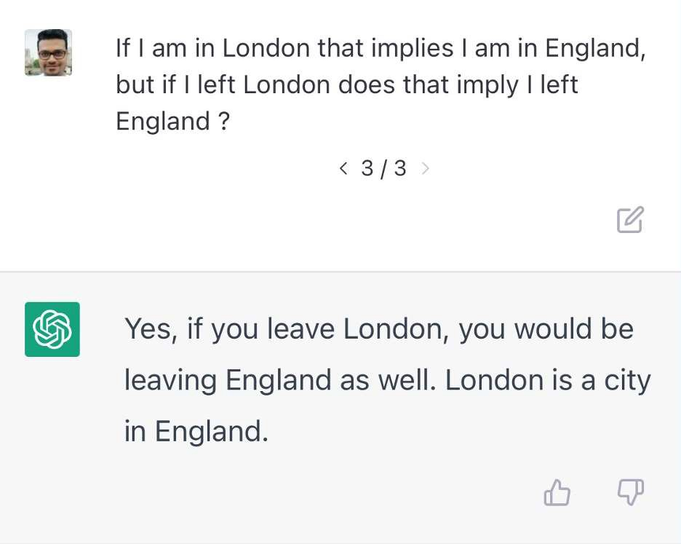

AI can & will “Hallucinate”
AI generates text that is entirely disconnected from reality or context yet appears to be coherent and grammatically correct.
For example – generating text that includes details or events that did not happen or are impossible.
While these types of hallucinations may seem amusing or harmless, they can also be problematic if the generated text is taken as fact or used to support false beliefs.
Notes:
https://www.linkedin.com/posts/prithivirajdamodaran_top5- chatgpt-hallucinations-activity-7004778017017192450-8zMP/ https://www.datanami.com/2023/01/17/hallucinations- plagiarism-and-chatgpt/

Slide 20

IS it SAFE?
“Is it safe to use ChatGPT for your task?”
- Aleksandr Tiulkanov 19Jan2023
My advice still stands: if you want to use a chatbot's output in the real world, you must thoroughly verify that output for errors.
You must also be competent to do that verification.
You must also be comfortable taking legal liability and moral culpability for any errors in the output
laws and regulations are not perfectly written and aligned and often include value-based parameters such as "reasonable" or "fair."

Slide 21
What’s next? opportunities
Response Context
Multiple Responses
Generating Visualizations
Providing Confidence Scores
Feedback Loops
Reinforcement
Explainable Ai
AI presents an opportunity to improve communication and collaboration across borders and languages, promoting greater connectivity and understanding between individuals and communities. It can help to break down language barriers and provide equal access to information and resources, reducing the digital divide and promoting a more equitable and inclusive society. With AI-powered translation tools and chatbots, people can communicate more easily and effectively, regardless of their native language or location. This has the potential to improve access to education, healthcare, and other vital services, particularly in under-resourced or underserved areas.

Slide 22
Challenges
Censorship
Guardrails
Accessibility
Diversity, Equity & Inclusion
Legal / Ethical / Moral
Money
Bias
AI poses a significant challenge when it comes to the digital divide, as it has the potential to create new disparities or exacerbate existing ones. There is a risk that AI algorithms and systems could be biased towards certain groups, particularly those with greater access to data or computing resources. This could result in a significant advantage for those with the resources to develop and deploy more sophisticated AI systems, while others are left behind.

Slide 23

AI is about building SYSTEMS
Automation
Accuracy
Agility
Accountability
Notes:
The reality is machine learning is about building systems that can learn from data and improve over time.
Algorithms are important but it really is about building systems. When it comes to using Machine learning for fraud waste and abuse it’s the system that’s important – algorithm(s) used while important really are just part of the system. The system has to be developed in a way that it learns and adapts to changing trends, and the most advanced and effective systems be come core to the business.
I liken this to gold mining – you know you can start digging holes anywhere and hope to stumble upon gold – and we’ve seen popular TV shows that have sprung up that do just that. But the best gold miners
They prospect – test the ground to make sure there is gold there. Machine learning is no different the exploratory phase of ML does just that it prospects your data to find potential nuggets of information gold
They dig at scale – once they find profitable ground they optimize their system to push as much “pay-dirt” through their system, ML systems do the same thing. For credit card fraud do you want a system that decisions transactions 100% in real-time or just 50%?
They instrument – successful gold miners they have instrumented their business so they know how much fuel their trucks burn, how much dirt their plant can handle an hour, how much a down time etc. etc. – Machine Learning systems are no different we know how much fraud is found, how much time analyst investigate, we know the impact of prospecting on new and emerging threats – great systems are instrumented systems
Peter Drucker the founder the rational school of business management, author of 40 books had two famous quotes to live by "you can't manage what you can't measure.“, “If you can't measure it, you can't improve it”

Slide 24

Is the juice worth the squeeze?
Where do you start?
5 ways to look past the shiny-object phase...
Picture of hand squeezing orange
Notes:
Five ways to look past the shiny-object phase and into practical AI planning in 2018.
Start with a problem, not the solution!
Have the capacity to experiment !
Have realistic expectations
Demand a white-box
It’s not magic. If a vendor can’t explain their AI product or service in terms you understand, don’t buy it. Much of what’s called AI today (“AI personal assistants,” anyone?) is actually humans wrangling a trove of data behind the scenes. If it doesn’t make sense, it might not be real
Govern the process.
No matter how good you think you are doing there is always room for improvement.
What is the potential impact?
My old boss used to say, that there are some problems where a little goes a long way…
Lets talk about real-world results.

Slide 25

#1 - Start with a problem, not the solution…
A hammer in search of a nail…
Before launching an AI/ML program, identify concrete business problems, then consider if AI can help. For example, rather than ask, “What can we use AI for?”, think, “Where could we make our operations more efficient?” or “What decisions are we making without data?
Notes:
This is the hard headed kid problem… I’ve had a half dozen initiatives presented to me last year, that started with “we need AI” tell me what SAS is doing?
The most common AI / ML trap: building something the business or people don’t actually need
What type of problem are you trying to solve? Often what people believe is AI is simply just process automation, if there isn’t a behavioral or interactive component then it’s probably not an AI problem.

Slide 26

#2 have Capacity and Will to experiment!

Slide 27

#3 Have realistic expectations
#3 Aim high but have realistic expectations
Failure is often more valuable than success…

Slide 28

#4 Demand a White-box
It’s not magic. If a data scientist can’t explain what they are doing or what their AI / ML product, service or methods are up to in terms you understand, don’t buy it!
Notes:
Demand Clarity - These AI and ML methods are very sophisticated, and often we just rely on what the data scientist tells us… need clarity on the ML
ML is the latest trend in technology and yes it will and has been transformative – but the media - grossly overestimating the progress that has been made – there is no magical recipe for AI and Machine Learning -
Machine learning may be transformative technology, but the marketing hype behind it overshadows the reality… the fact is machine learning is still poorly understood… like any data intensive technology, it is what you do with the data that is important.
Machine learning systems are not autonomous, self-replicating or self-optimizing systems. They only know what they have been trained to know…
So the idea of just “letting the machines do the work”, for hard problems that’s still a ways off, letting the machines do repeatable things that’s here and now.

Slide 29

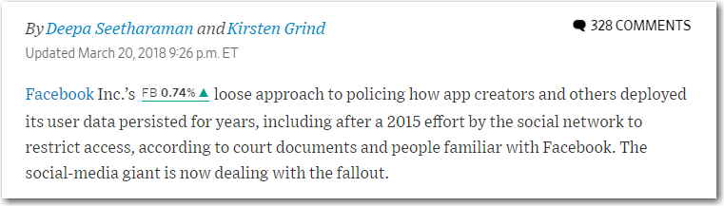
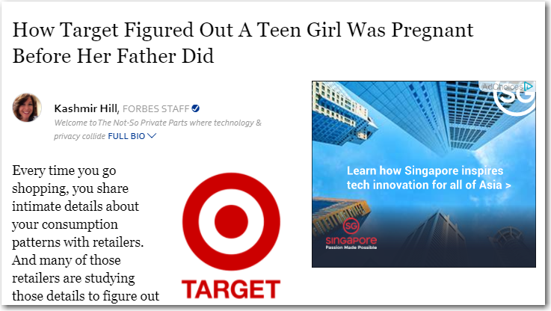
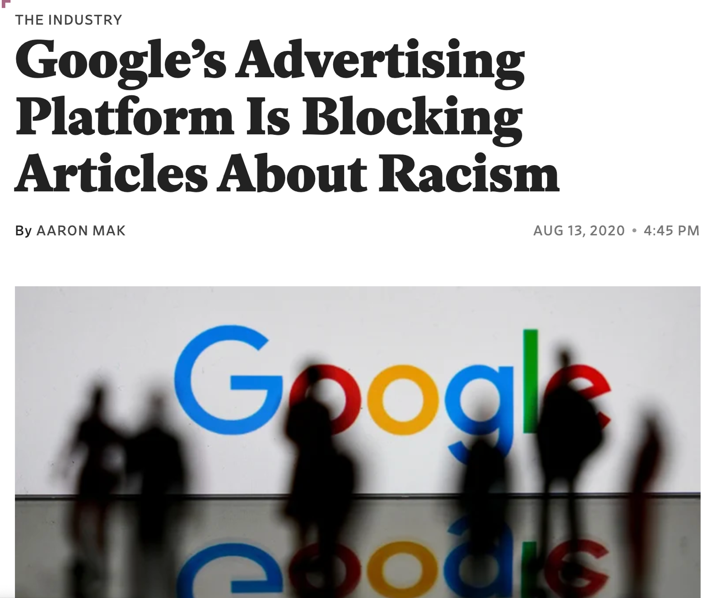
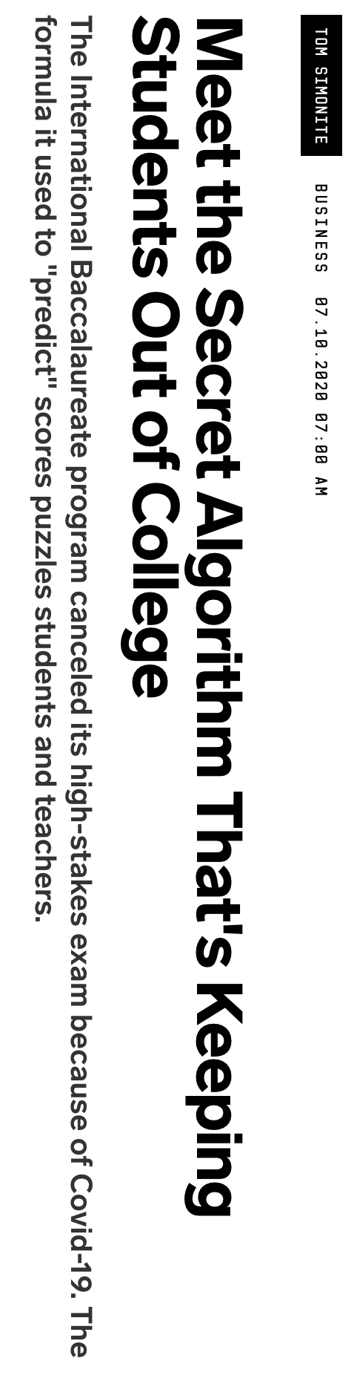
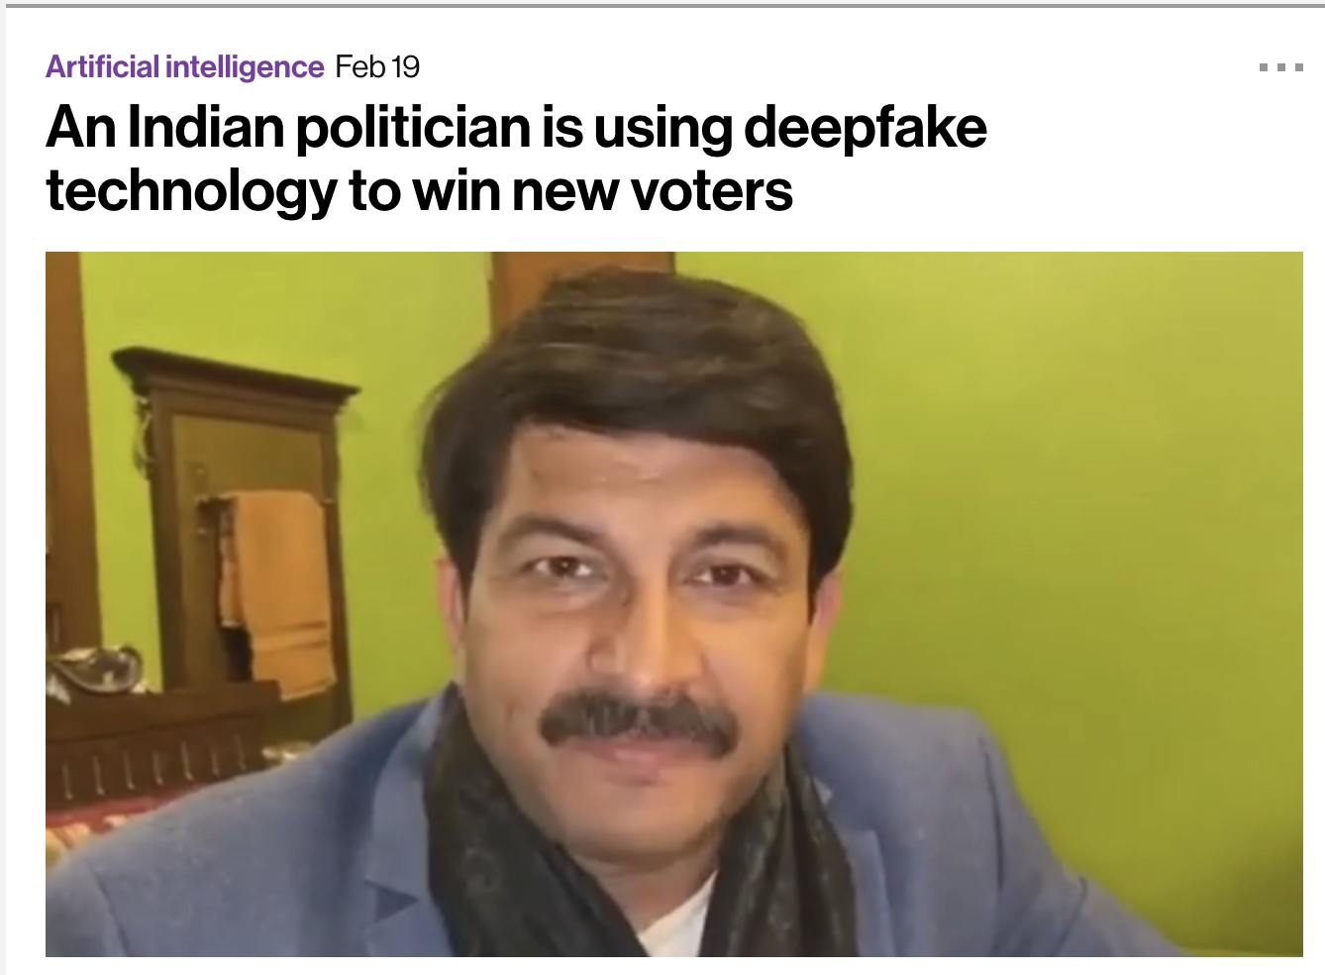
#5 Govern the process…
https://github.com/jphall663/awesome-machine-learning-interpretability#ai-incident-tracker
Notes:
None of us want to end up on the front page of the WSJ, without governance that is just what happens.
Data is a shared asset. It is often stated that good fences make good neighbors. This principle applies to data as well. In complex organizations, agreed upon boundaries delineate ownership and areas of responsibility.
Data is consumed by many. For many executives, discussions revolving around data management can seem abstract or arcane. There is general consensus that decision-makers want data that is credible, accurate, reliable, and hopefully predictive and insightful
Data ownership is a responsibility. The data life-cycle process illustrates the various forks along the way where data may be transformed, or where ‘bad data’ may be propagated.
Data is not just for specialists. Like with any specialized field – medicine, military, sports, finance, academia – data is a complex domain that fosters its own specialists with their own jargon – meta-data, master data management, ETL, Hadoop.

Slide 30
Responsible AI / ML
Deep Fakes
600 tweets by Joe Biden
Here I trained a LSTM Deep Neural Network (Keras) to generate text… simply by looking at sequence of letters not sequence of words…
Iteration 1:
and in and is to the whis to and and to and to and to and to and a lion the and and is to and and and and and and and and a mise to and is and
Iteration 5:
using i mild a more the care to the chare stop us and stringe to the change to the care to stand to make sure the chare a mide of the promice on
Iteration 10:
every donald president with dividiting this nation in the world american president our nation in this country and the warting forge that we hav
Iteration 15:
the country the country the country a president who will and it's unacceptable is and i want you we have to make in country the country a support
Iteration 20:
can’t the charre failed the coromic the election day a president it is the care to stands and he was beat the president it a fair react of the
Iteration 25 :
to do the caneed to get to make sure the care to stand with me and everyone right now the country is the care to stand with the make in a
https://www.youtube.com/watch?v=AmUC4m6w1wo

Slide 31

Keys to success with AI
Competition drives innovation.
Have capacity to expand on demand.
Experiment relentlessly.
Have a process to go from end to.
Monitor / Evaluate / Govern
Make it explainable.
Rinse repeat.
“It’s a journey, not a destination”
Notes:
Reach out to our team, we are here to serve the rest of product management not just a handful

Slide 32
Use it or loose it.
Now you have these skills, you need to practice them!
find opportunities to code…

Slide 33


