Slide 1


Introduction to ML
Wake Forest
School of Business
_______
BAN 6053

Slide 2
Agenda
Syllabus
Book
Grading
What to turn in
Basics of Machine Learning
Scikit-Learn models
Evaluation of ML Models
Resources

Slide 3
Syllabus
Course Description: This hands-on course offers a comprehensive introduction to the principles, concepts, and applications of modern artificial intelligence (AI) and machine learning (ML) for business. Students will dive deep into the technical aspects of AI/ML, exploring key components such as machine learning, collaborative filtering, natural language processing, and computer vision. Additionally, the course will address the ethical and social implications of AI, and how to effectively integrate AI/ML into business strategy.
Learning Objectives: After this course, students will be able to:
Understand the basic principles and concepts of AI & ML.
Evaluate the potential impact of AI/ML on different industries.
Develop a strategy for integrating AI/ML into business operations.
Effectively evaluate AI/ML from both technical and business perspectives.
Apply machine learning algorithms and pre-trained models to solve business challenges ranging from recommendation systems and classification tasks to computer vision for object detection and generative text generation for AI.
Leverage the latest advances in Automated Machine Learning for Classification, Regression, Text and Image.

Slide 4
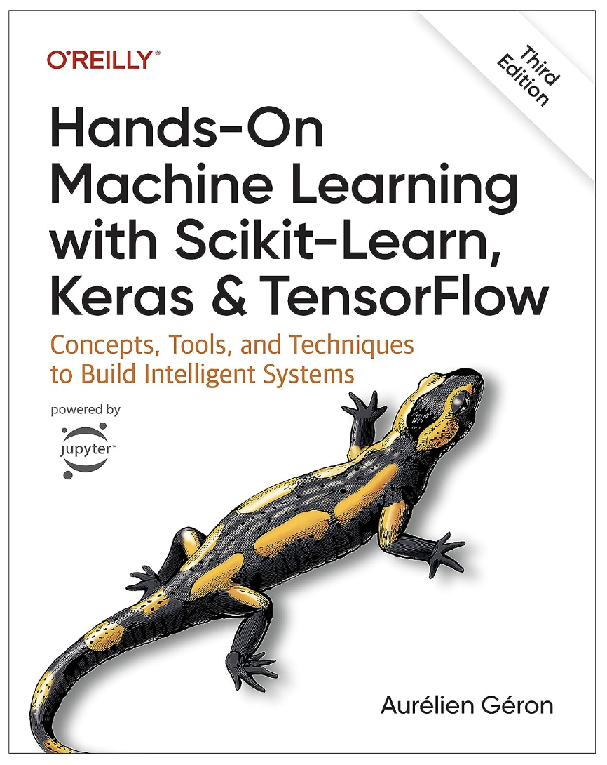
Book(s)
Course Texts
Hands-On Machine Learning with Scikit-Learn, Keras, and TensorFlow: Concepts, Tools, and Techniques to Build Intelligent Systems 3rd Edition
by Aurélien GéronLinks

Slide 5
Grading
Quizzes | 20%
Projects(3) | 50%
Final Project | 30%
Quizzes / Challenges– there will be a handful weekly quizzes. Quizzes are typically in the form of 5-10 questions OR they are in the form of a ML challenge
Project – we will have 3 projects currently the topics are on: recommendations, neural networks, and AI .
Final Project - The final project is a culmination of your ML knowledge; you’ll apply your newly acquired knowledge and skills to one of several real-world analytic problems. You’ll write a professional modeling report including an executive summary and appendix detailing your analysis as well as submitting your model’s predictions in a competitive shootout of your peers.
-- LATE POLICY –
I do not accept late work

Slide 6
What to turn in – Quizzes & Challenges
It should go without saying but turn in your own work.
Model Report
Challenge Model Summary
Be well organized with your NAME and DATE & Section on it!
Restate the business problem
Model performance
Key findings (3-4)
Provide CLEAR & ACTIONABLE recommendations (2-3),
addressing data quality doesn’t count as a recommendation.
Graphs, Charts, Tables and Summaries
Should have titles, labels, and description of why it’s important
Code
Your own work and we should be able to repeat your results.
Kaggle Position (up to 5 points)
Every project will have a competitive posting
Evaluation metric and submit time, in case a tie (same metric) then earlier submit wins.

Slide 7


Kaggle
Many quizzes will be competition based.
Competition
Makes you and everyone who participates better
Activates reward center
Key driver of innovation
“the sole defense against the capitalists is competition, which according to the evidence of political economy acts beneficently by both raising wages and lowering the prices of commodities to the advantage of the consuming public.". – Karl Marx 1844
“There is of course an anti-System which is called Libertarianism, which means to tear down everything which creates some kind of influence of government into private lives” – Klaus Schwab 2024

Slide 8

WHAT IS MACHINE LEARNING?
Statistics quantifies numbers
Describes data (mean, median, mode, standard deviation etc.)
Draws conclusions from data (hypothesis test, deriving estimates etc.)
Machine Learning predicts with models
Process of fitting models to data with the goal of predictive accuracy
“Deep Learning” is a specific class of machine learning models
Artificial Intelligence provides the appearance of behavior through automation
Computer programs to mimic “human” behavior and interactions
Automate processes for productivity, efficiency and accuracy
Data Mining & Data Science finds patterns to explain a phenomenon
Practical application of computer programs, Statistics and Machine Learning
Notes:
You’ll also hear about statistics and artificial intelligence, data mining and data science – here is my take… and let me say this is one person’s opinion don’t’ start sending me hate mail…
there is no “evaluation” or way to measure the accuracy of the algorithm – then you don’t have ML and AI
Statistics is about describing distributions, and inferring relationships, testing hypothesis, deriving estimates, , and quantifying the data. – statistics is a science,
a discipline where data mining, ml and ai are an amalgam of statistics and computer science.
Statistical models are about description and inference not necessarily about predictive accuracy – problems like speech recognition, image recognition, handwriting recognition are tough to accurately do with statistical techniques alone. However, statistical models are really useful in evaluating the effectiveness of a machine learning system.
Data Mining is about using statistics and other methods to find patterns hidden in the data so that you can explain some phenomenon.
Machine Learning uses Data Mining techniques and other learning algorithms to build models of what is happening behind some data so that it can predict future outcomes. Math is the basis for many of the algorithms, but this is more towards programming.
Artificial Intelligence uses many models built by Machine Learning and other ways to reason about the world and give rise to intelligent behavior or behavior that mimics behavioral human or other interaction whether this is playing a game or driving a robot/car. Artificial Intelligence has some goal to achieve by predicting how actions will affect the model of the world and chooses the actions that will best achieve that goal. Very programming based.
Anyway, the statisticians, mathematicians, and scientists out there will probably take issue with my descriptions – you can send hate mail
Machine Learning has 4 basic ingredients – to be considered Machine Learning or Computer Learning
Train an algorithm to recognize some pattern
Evaluate the “accuracy” of the algorithm
Apply of the algorithm on new and unseen data within a system
Learn from outcomes of the algorithm on new and unseen data – repeating steps 1 – 3
You can use this to evaluate reality from the hype…
If there is no “algorithm” there is no “machine”, an algorithm can be as simple as IF this THEN that.
If there is no evaluation then you just have a computer program
If you can’t apply it to new data you’ve just made a execute once computer program –
If you can’t learn and improve from the outcomes you just have a computer program

Slide 9
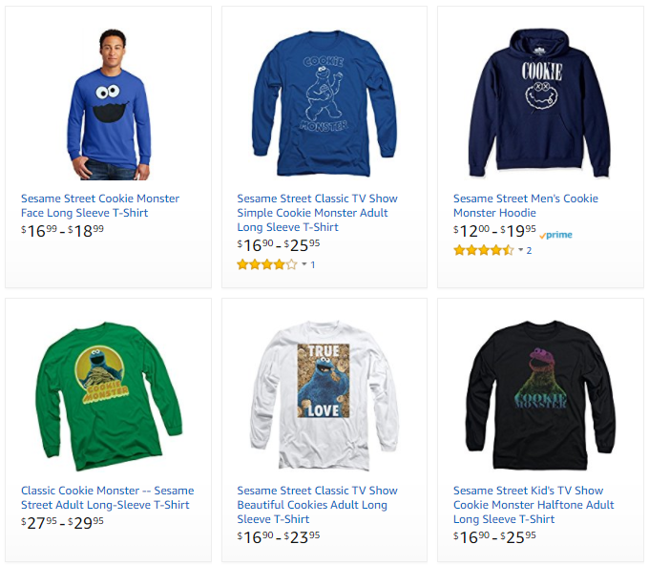
Machine Learning Applications
Business/ML Problem
Description
Example
Ranking
Helping users find the most relevant thing
Ranking algorithm within Amazon Search
Recommendation
Giving users the thing they may be most interested in
Classification
Figuring out what kind of thing something is
Regression
Predicting a numerical value of a thing
Clustering
Putting similar things together
Anomaly Detection
Finding uncommon things

Slide 10


Machine Learning Applications
Business/ML Problem
Description
Example
Ranking
Helping users find the most relevant thing
Recommendations across the website
Amazon’s Choice
Recommendation
Giving users the thing they may be most interested in
Classification
Figuring out what kind of thing something is
Regression
Predicting a numerical value of a thing
Clustering
Putting similar things together
Anomaly Detection
Finding uncommon things

Slide 11




Machine Learning Applications
Business/ML Problem
Description
Example
Ranking
Helping users find the most relevant thing
Product classification for our catalog
Recommendation
Giving users the thing they may be most interested in
Classification
Figuring out what kind of thing something is
High-Low Dress
Straight Dress
Regression
Predicting a numerical value of a thing
Clustering
Putting similar things together
Anomaly Detection
Finding uncommon things
Striped Skirt
Graphic Shirt

Slide 12

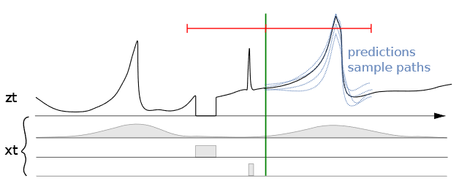
Machine Learning Applications
Business/ML Problem
Description
Example
Ranking
Helping users find the most relevant thing
Predicting sales for specific ASINs
Recommendation
Giving users the thing they may be most interested in
Classification
Figuring out what kind of thing something is
Regression
Predicting a numerical value of a thing
Clustering
Putting similar things together
Anomaly Detection
Finding uncommon things
Seasonality | Out of stock | Promotions

Slide 13
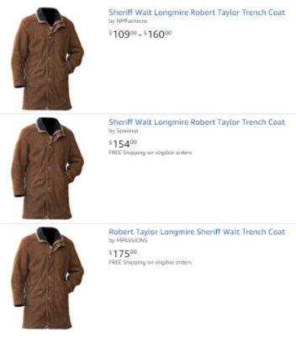
Machine Learning Applications
Business/ML Problem
Description
Example
Ranking
Helping users find the most relevant thing
Close-matching for near-duplicates
Recommendation
Giving users the thing they may be most interested in
Classification
Figuring out what kind of thing something is
Regression
Predicting a numerical value of a thing
Clustering
Putting similar things together
Anomaly Detection
Finding uncommon things

Slide 14


Machine Learning Applications
Business/ML Problem
Description
Example
Example
Ranking
Helping users find the most relevant thing
Fruit freshness
Recommendation
Giving users the thing they may be most interested in
Before
After
Classification
Figuring out what kind of thing something is
Regression
Predicting a numerical value of a thing
Clustering
Putting similar things together
Good
Damage
Serious Damage
Decay
Anomaly Detection
Finding uncommon things

Slide 15
What is Data Science?
Machine Learning
Wikipedia describes Data Science as:
“a multi-disciplinary field that uses scientific methods, processes, algorithms and systems to extract knowledge and insights from structured and unstructured data.”
MACHINE LEARNING
MATHEMATICS
COMPUTER
SCIENCE
DATA
SCIENCE
STATISTICAL
RESEARCH
DATA
PROCESSING
DOMAIN
EXPERTISE
https://en.wikipedia.org/wiki/Data_science

Slide 16
What is Machine Learning?
“Programming computers to learn from experience should
eventually eliminate the need for much of this detailed
programming effort”
Arthur Samuel (1959) – Computer Scientist
Data
Classical Programming (Rules, if/else, etc.)
Answers
Rules
Data
ML Algorithms
Trained ML Models (Rules)
Answers
Answers
New Similar Data

Slide 17
Why ML? Why now?
Data
larger amounts of data, easy to produce, collect and store
Compute
powerful processing units, hardware acceleration, parallelization
Algorithms
ML frameworks, libraries, improved and more efficient techniques
Data
ML Algorithms
Trained ML Models (Rules)
Answers
Answers
New Similar Data

Slide 18
Machine Learning Lifecycle old view
Answer
New Data/Re-training
Deployment
Business Problem
Data Processing
Data Collection
Data Preprocessing
Data Visualization
Data Augmentation
Feature Engineering
Etc.
Yes
Model
Training
Tuning
Evaluation
Meets
Business
Goal?
ML Problem Formulation
Algorithm
No

Slide 19
Machine Learning - Lifecycle
Problem Definition, Model training, Integration to & Monitoring
1. Problem Formulation
2. Data Gathering & Structuring
12. Periodic Retraining
3. Data Exploration
4. Feature Engineering
5. Multi-Model Training
6. Model Evaluation
8. Model Calibration
10. Model Integration
11. Model Monitoring
7. Model Interpretability
9. Model Documentation
Notes:
This is what we’ve done as analytics professionals for decades. A nice 12 step process…

Slide 20
Some Important ML Terms
ML | Statistics/Math/other | Simply Put
Label/Target/y | Dependent/Response/Output Variable | The thing you’re trying to predict
Feature/x | Independent/Explanatory/Input Variable | Data that help you make predictions
Feature Engineering | Transformation | Reshaping data to get more value
1d, 2d,… nd | Dimensionality | Number of features
Model Parameters | Weights | A set of numbers embedded in a model that can predict the labels
Model Training | Optimization / Fitting | Finding the ‘best’ set of model weights
Hyper Parameter Optimization | Optimizatoin | Finding the best set of model parameters

Slide 21
Some Machine Learning Problems
Supervised: Classification
Supervised: Regression
Unsupervised
Label is binary or multi-class
Explainable:
Logistic Regression
Decision Tree
Predictive Power
KNN
Random Forest
Boosting Trees
Neural Networks
Label is continuous
Explainable
Linear Regression
Decision Tree
Predictive Power
KNN
Random Forest
Gradient Boosting
Neural Networks
No Label
Dimension Reduction
Principal Component Analysis(PCA)
Factor Analysis w. Rotation(FCA)
Singular Value Decomposition(SVD)
Anomaly Detection
Isolation Forest
Clustering
K-Means
DB-Scan
Hierarchical

Slide 22

What is scikit-learn?
A python library for machine learning
Provides a range of supervised and unsupervised learning algorithms
Includes tools for model selection and evaluation, data preprocessing, and data visualization
As well as: feature selection, feature extraction, and feature scaling techniques
Built on top of other Python libraries including: NumPy, SciPy, and matplotlib
Simple and consistent API that makes it easy to use and learn
Widely used in industry for machine learning projects
Highly extensible!
allowing users to implement their own machine learning algorithms and custom preprocessing functions.

Slide 23
Key features of scikit-learn
Simple and consistent API for easy use and learning
High-quality documentation with code examples and tutorials
Built-in support for cross-validation and hyperparameter tuning
Easy integration with other Python libraries for data processing and analysis
Supports a variety of input formats, including NumPy arrays and Panda's data frames
Offers efficient algorithms for large-scale datasets and online learning
Robust and well-tested codebase for reliable results
Active community of developers and users for ongoing support and updates.

Slide 24
Model Pipelines
A model = inputs + transformations + algorithm(s)
A model pipeline is a series of steps that are used to process and transform data before fitting a machine learning model
Each step in the pipeline can be a data preprocessing step or a machine learning algorithm
Pipelines can help simplify the machine learning workflow and reduce the risk of data leakage
Leakage occurs when the target variable is inadvertently leaked into the features used to train the model.
Target leakage typically occurs when the features used to train the model are derived from information that is only available after the target variable has been determined.
Scikit-learn provides a Pipeline class that allows users to create and manage model pipelines
Pipelines can be used to improve model performance by ensuring that the same preprocessing steps are applied consistently to both the training and testing data
Pipelines can be combined with other Scikit-learn tools, such as Grid Search, to optimize hyperparameters for the entire pipeline.

Slide 25
What is a pipeline?
A Scikit-learn pipeline is a way to chain multiple machine learning steps together into a single object. The pipeline is used to automate the machine learning workflow by taking care of the data preprocessing and model training steps in one step. The pipeline sequentially applies a list of transforms and a final estimator.
Pipelines are a set of utilities and transformers
Linear sequence of transformations
Supports custom transformers
Supports hyper parameter optimization
Supports cross folds, grid searches, and other schemes
ENCAPSULATES the PREPROCESSING + MODEL(s)

Slide 26
Pipeline
Inputs X,y
Inputs: simply the raw input data
Categorical transformers convert from categorical features to numeric representations
Numeric transformers perform steps like scaling & normalization, binning, handling missing values and more
Model algorithm is the specific ML algorithm(s) that you want to apply to the transformed data.
Categorical Transformers
PIPELINE
Numeric Transformers
Model Algorithm

Slide 27
Steps in Creating a Model Pipeline
Identify features and their role
Target variable for “Supervised Learning”, optional for “unsupervised”
Numeric features (continuous numeric variables )
Categorical features (limited number of possible values)
Nominal - do not have any inherent ordering or ranking
Ordinal – have an inherent ordering or ranking
Freeform Text ( data is presented in natural language format ex. News articles, customer feedback, social media posts, etc.)
Identify pre-processing transformation steps : more later
Identify algorithm to apply
Train (.fit(X,y)) / Predict (.predict(X) and .predict_proba(X))

Slide 28
Why pipelines
Consistent data preprocessing: By using a pipeline, you can ensure that the same preprocessing steps are applied to both the training and testing data, avoiding data leakage and improving the reliability of your model.
Simplified workflow: A pipeline can help streamline the machine learning workflow by automating the process of data transformation and model training, reducing the need for manual intervention and saving time.
Reduced risk of errors: By eliminating the need to manually apply preprocessing steps to the data, pipelines can reduce the risk of human error and improve the accuracy of the results.
Reproducibility: By defining a pipeline that includes all the necessary steps, you can ensure that the model can be easily reproduced, allowing others to replicate your results and validate your findings.
Hyperparameter optimization: Pipelines can be combined with hyperparameter optimization techniques, such as Grid Search, to automatically optimize the hyperparameters of the entire pipeline, improving the performance of the model.
Flexibility: Pipelines can be easily modified by adding or removing steps, allowing you to experiment with different combinations of preprocessing steps and machine learning algorithms. This makes it easy to try out different models and find the best approach for your specific problem.

Slide 29
Example Pipeline
# Define the preprocessing steps for numeric and categorical data
numeric_transformer = Pipeline(steps=[
('scaler', StandardScaler())]) categorical_transformer = Pipeline(steps=[
('encoder', OneHotEncoder(handle_unknown='ignore'))])
# Define the ColumnTransformer to apply the transformers to the appropriate columns
preprocessor = ColumnTransformer(transformers=[
('num', numeric_transformer, numeric_features),
('cat', categorical_transformer, categorical_features)])
# Define the pipeline
pipeline = Pipeline(steps=[
('preprocessor', preprocessor),
('classifier', RandomForestClassifier())])

Slide 30
Categorical Transformations
Just the basics!
Categorical features must be transformed into a numerical representation that can be used by machine learning algorithms
SimpleImputer(): handles missing values. a common approach is to impute the missing values using the most frequent category in the data.
OneHotEncoder(): creates a new binary feature for each category in the original feature, indicating the presence or absence of that category.
LabelEncoder (): assigns a unique integer value to each category in the original feature, based on the frequency of each category in the data.
OrdinalEncoder(): assigns a unique integer value to each category in the original feature, based on its order or ranking.

Slide 31
Numeric Transformations
Just the basics!
Numeric features sometimes / often need to be transformed so that they can be used by specific machine learning algorithms
SimpleImputer(): Handles missing values. a common approach is to impute the missing values using the mean or median of the data. .
StandardScaler(): Standardizes the data by subtracting the mean and scaling to unit variance.
MinMaxScaler(): Scales the data to a specified range, typically between 0 and 1.
Normalizer(): Scales the data so that each sample has a unit norm. It is commonly used for text data or sparse data.
Notes:
Numeric features can be transformed using various techniques to standardize, scale, or normalize the data, such as StandardScaler, MinMaxScaler, MaxAbsScaler, and RobustScaler.

Slide 32
Column Transformer
Column transformers apply different preprocessing steps(ex. numeric and categorical transformations) to different columns in the data, allowing you to handle both numeric and categorical features in the same pipeline.
Ties related pre-processing steps together
Simplifies the workflow
preprocessor = ColumnTransformer(transformers=[
('num', numeric_transformer1, numeric_features),
(‘num2', numeric_transformer2, numeric_features2),
('cat', categorical_transformer, categorical_features)
(‘cat2', categorical_transformer2, categorical_features2)
])

Slide 33
Pipeline
Simply ties everything together
A pipeline is a series of data processing steps and model specifications that are chained together to create a complete machine learning workflow. Pipelines can include any combination of data preprocessing steps, such as scaling, encoding, imputation, and feature selection, as well as machine learning algorithms for modeling and prediction.
The Pipeline class allows you to define a sequence of transformers and a final estimator, which can be any Scikit-learn transformer or machine learning algorithm.
Estimator = Machine Learning Model
Pipelines ensure that the same preprocessing steps are applied consistently to both the training and testing data, reducing the risk of data leakage and improving the accuracy of the model.
Pipelines can be easily modified by adding or removing steps, allowing you to experiment with different combinations of preprocessing steps and machine learning algorithms.
Pipelines can be saved and loaded using the joblib library, allowing you to easily reuse pipelines across different projects or share them with others.

Slide 34
Two Phases of Machine Learning Models
Fit / Predict
fit() method, with pipelines Scikit-learn first applies the data transformations defined in the pipeline to the training data, and then fits the model to the transformed data.
This is the beauty of using pipelines in Scikit-learn!
By defining a series of preprocessing steps and a final estimator, you can ensure that all the necessary transformations are applied consistently to both the training and testing data.
The pipeline takes care of all the data transformations and modeling steps in a single, easy-to-use object.
predict()/predict_proba() methods take as input the features of the new data and returns a predicted target or predicted probably based on the model that was trained using the fit() method.

Slide 35
Two phases of pipelines
Fit / Predict
Pipeline.fit(X_train,y)- “Trains” the model by first applying the pre-processing steps in the pipeline then applying the model training step.
Pipeline.predict(X_new)- “makes a prediction” for estimation tasks it returns a continuous prediction, for classification or clustering tasks it returns class or cluster assignment
Pipeline.predict_proba(X_new) - “makes a prediction” returning a probability of class assignment for classification tasks.

Slide 36
Machine Learning
Supervised Learning
Estimation / Regression (continuous outcome)
Classification (binary or multi-class outcome)
Unsupervised Learning
Dimension Reduction
Segmentation/Clustering
Anomaly Detection
Recommender Systems
Predict ratings a user might give to a specific item. These predictions will then be ranked and returned to the user.
Reinforcement Learning
Taking suitable action to maximize reward for given situation

Slide 37
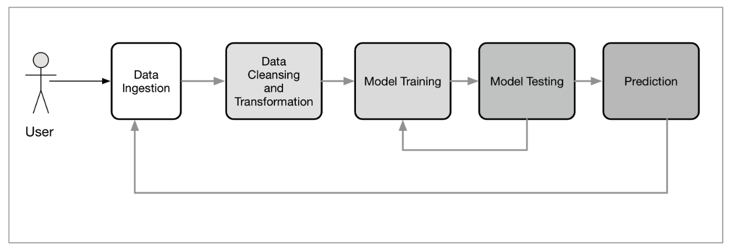
Machine Learning Model Building
Basic machine learning model building, and testing workflow is a batch process
Making sure of data integrity, especially the independent variable
Cross validate on training set on test set i.e., unseen dataset
Choose proper metrics that match the KPI goals

Slide 38

Evaluation of CLASSIFICATION
Classification is about Probably of belonging to a given class
Score Distribution from 0 – 1
Evaluation of Classification Models:
Confusion Matrix
Accuracy
Precision
Recall

Slide 39

Understanding the Confusion Matrix
 |  | Actual
Predicted |  | Sick | Not Sick
 | Sick | True Positive | False Negative
 | Not Sick | False Positive | True Negative
I tested positive and
I was sick
I tested positive but
I was not sick
I tested negative but
I was sick
I tested negative and
I was not sick

Slide 40
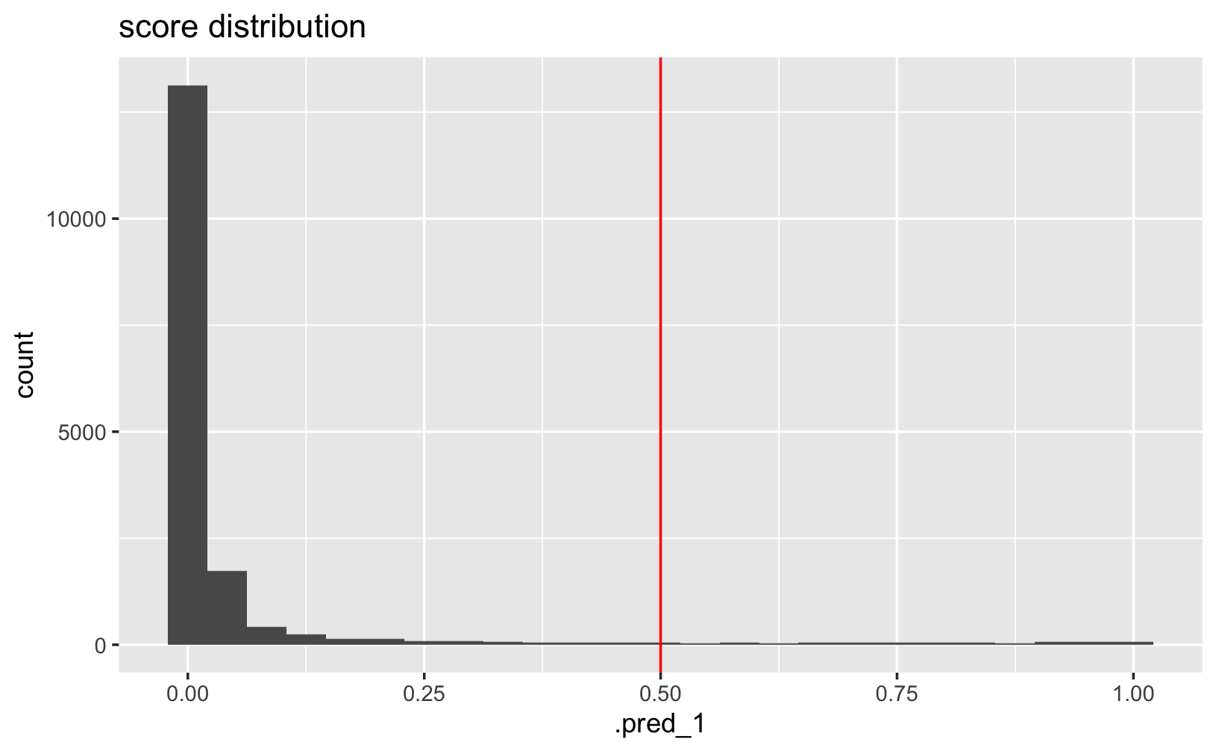
Score Distribution
Score “Threshold” 0.5
Every decision hinges on the “PREDICTION” and “Threshold”
Predicted Negative Class
IF
.pred_1 < 0.5
THEN
predicted negative class
Predicted Positive Class
IF
.pred_1 >= 0.5
THEN
predicted positive class

Slide 41
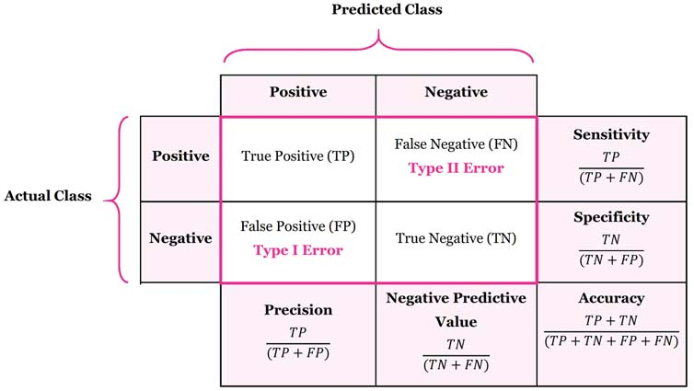
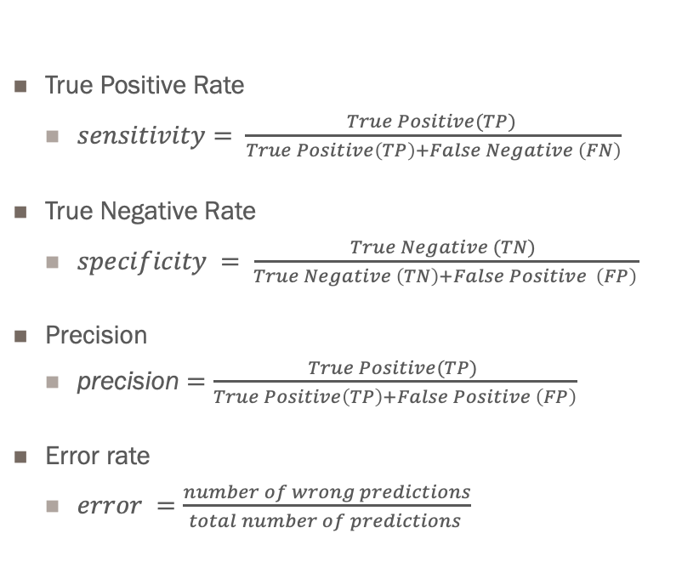
Confusion Matrix
True Positive Rate
$sensitivity= \frac{True Positive(TP) }{True Positive\left(TP\right)+False Negative \left(FN\right)}$
True Negative Rate
$specificity = \frac{True Negative (TN) }{True Negative \left(TN\right)+False Positive \left(FP\right)}$
Precision
precision $=\frac{True Positive(TP) }{True Positive\left(TP\right)+False Positive \left(FP\right)}$
Error rate
$error =\frac{number of wrong predictions}{total number of predictions }$

Slide 42
Evaluation #1 thing to learn
Metric | Description
Accuracy | The proportion of true results (both true positives and true negatives) among the total number of cases examined. It's a basic measure that answers, "How often is the classifier correct?"
Precision | The ratio of true positives to all predicted positives. It answers, "Of all the instances classified as positive, how many are actually positive?"
Recall (Sensitivity) | The ratio of true positives to all actual positives. It answers, "Of all the actual positives, how many did we classify correctly?"
F1 Score | The harmonic mean of precision and recall, providing a balance between the two. It's useful when you need a balance between precision and recall.
Confusion Matrix | A table layout that allows visualization of the performance of an algorithm. It shows the counts of true positives, true negatives, false positives, and false negatives.
ROC Curve (AUC) | Receiver Operating Characteristic curve (Area Under Curve) is a plot of the true positive rate against the false positive rate. It shows the tradeoff between sensitivity and specificity.
Log Loss | A performance metric based on the probability estimates and is particularly useful when you need well-calibrated predicted probabilities.
Matthews Correlation Coefficient (MCC) | A measure of the quality of binary classifications, which considers true and false positives and negatives, it is generally regarded as a balanced measure.

Slide 43
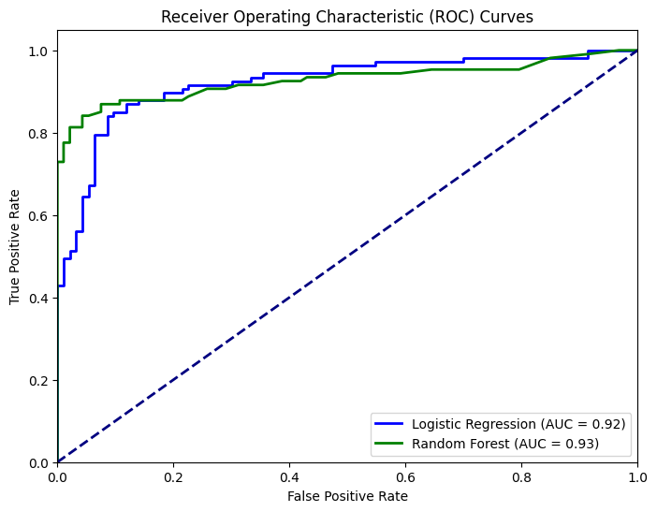
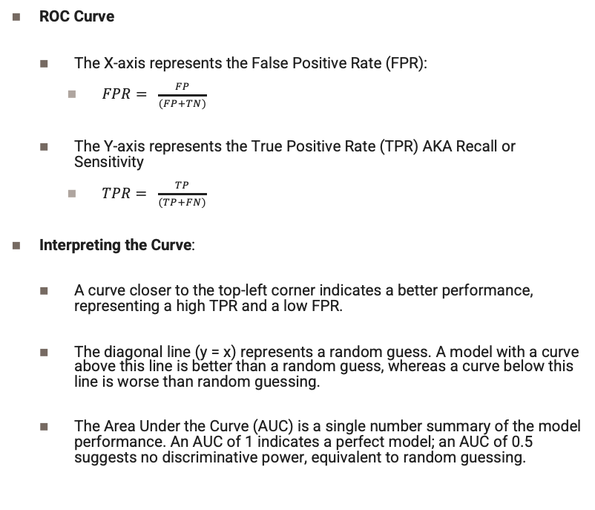
ROC Curve and AUC
ROC Curve
The X-axis represents the False Positive Rate (FPR):
$FPR= \frac{FP}{(FP+TN)}$
The Y-axis represents the True Positive Rate (TPR) AKA Recall or Sensitivity
$TPR= \frac{TP}{(TP+FN)}$
Interpreting the Curve:
A curve closer to the top-left corner indicates a better performance, representing a high TPR and a low FPR.
The diagonal line (y = x) represents a random guess. A model with a curve above this line is better than a random guess, whereas a curve below this line is worse than random guessing.
The Area Under the Curve (AUC) is a single number summary of the model performance. An AUC of 1 indicates a perfect model; an AUC of 0.5 suggests no discriminative power, equivalent to random guessing.

Slide 44
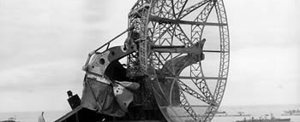

Fun Fact ROC curve comes from WW2
The ROC curve was first developed by electrical engineers and radar operators during World War II.
The primary goal was to detect enemy objects in battlefields and distinguish them from noise (like birds or clouds).
Operators had to decide whether a blip on the radar screen was an enemy object or not, based on the signal's strength
Receiver Operating Characteristic curve was a graphical plot used to show the trade-off between hit rates (true positives) and false alarm rates (false positives) of a radar system. It was a tool for measuring the ability of radar operators to make these important distinctions under different conditions.

Slide 45
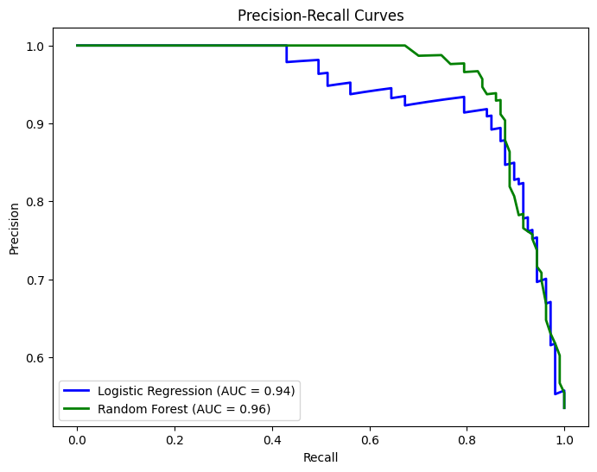
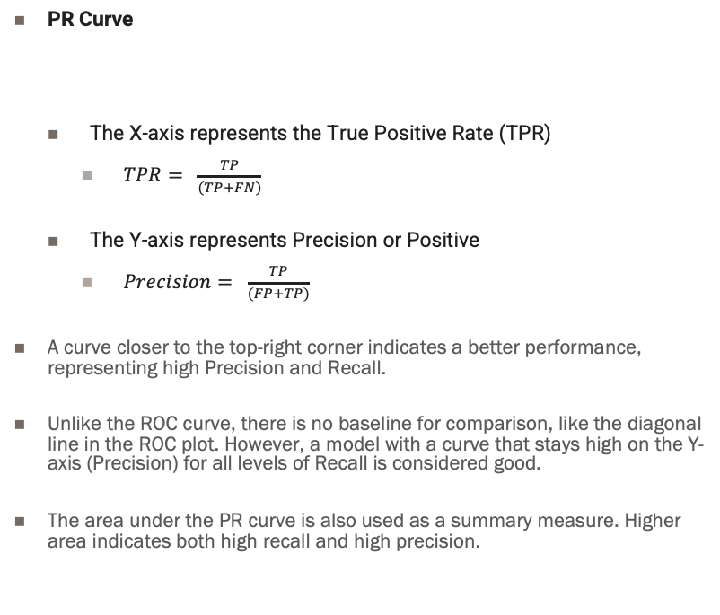
Precision Recall Curve (PR Curve)
PR Curve
The X-axis represents the True Positive Rate (TPR)
$TPR= \frac{TP}{(TP+FN)}$
The Y-axis represents Precision or Positive
$Precision= \frac{TP}{(FP+TP)}$
A curve closer to the top-right corner indicates a better performance, representing high Precision and Recall.
Unlike the ROC curve, there is no baseline for comparison, like the diagonal line in the ROC plot. However, a model with a curve that stays high on the Y-axis (Precision) for all levels of Recall is considered good.
The area under the PR curve is also used as a summary measure. Higher area indicates both high recall and high precision.

Slide 46
Resources
Documentation and Examples of Tidymodels
https://scikit-learn.org
https://scikit-learn.org/stable/modules/generated/sklearn.pipeline.Pipeline.html
Tutorials
https://towardsdatascience.com/step-by-step-tutorial-of-sci-kit-learn-pipeline-62402d5629b6
https://medium.com/ai-made-simple/pipelines-in-scikit-learn-46c61c5c60b2
https://www.datacamp.com/tutorial/machine-learning-python
https://www.youtube.com/watch?v=pqNCD_5r0IU&ab_channel=freeCodeCamp.org
https://www.youtube.com/watch?v=0B5eIE_1vpU&ab_channel=freeCodeCamp.org
https://www.freecodecamp.org/news/machine-learning-pipeline/
https://www.turing.com/kb/building-ml-pipeline-in-python-with-scikit-learn

Slide 47
To Do
Watch and Follow
https://www.youtube.com/watch?v=xIqX1dqcNbY
https://www.youtube.com/watch?v=9vz0n1cyMbc&ab_channel=JosephE.Gonzalez
Create a NOTEBOOKs and follow along!
Read
https://scikit-learn.org/stable/tutorial/basic/tutorial.html
Why Pipelines! Watch.
https://www.youtube.com/watch?v=URdnFlZnlaE&ab_channel=PyData

Slide 48


