Slide 1
Unified Payments Data Model
JHBI | Gold Layer Schema
ACH
Transactions
Bill Pay &
P2P
SEC code, batch ID
effective date, trace#
Payee, Zelle / RTP
clearning network
PAYMENT
EVENT
Wire
Transfers
ATM &
Branch Cash
IMAD/OMAD, SWIFT
beneficiary, FedWire ref
Terminal ID, vault
denomination splits
Debit / Credit
Card
Loan
Payments
MCC, auth code
network (Visa/MC)
Loan#, escrow split
principal / interest
UNIVERSAL FIELDS (ALL PAYMENT TYPES):
member_id · account_id · txn_datetime_utc · channel · amount_usd · direction (CR/DR) · status · risk_score

Slide 2
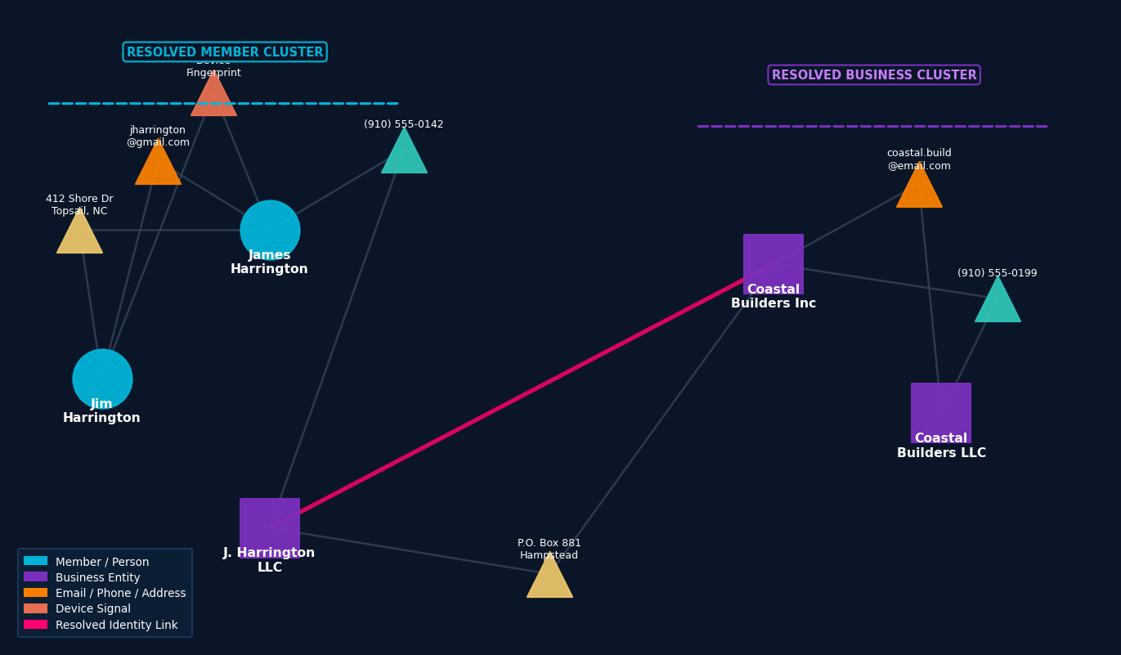
Member & Business Entity Resolution
JHBI | Identity Graph Engine
HOW IT WORKS
01
Ingest
Member, account, and business records land in Bronze layer via core system CDC feeds.
02
Tokenize
PII fields (name, email, phone, address, SSN/EIN) are phonetically normalized and hashed.
03
Match
Blocking + probabilistic scoring links records using Fellegi-Sunter / ML classifier.
04
Cluster
Connected-components algorithm groups matched records into a resolved entity cluster.
05
Publish
Golden record written to Gold layer with entity_id, confidence score, and lineage.
~15–25%
of member records
have duplicates
3–5×
more cross-sell
opportunities surfaced
360°
member view
enabled
Real-time
risk deduplication
at onboarding

