Slide 1
Data Science
for Banking
Explaining things with analytics. Driving decisions with data.
Jack Henry Associates | Data Science Team

Slide 2
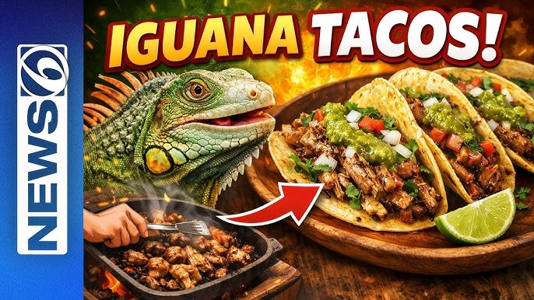
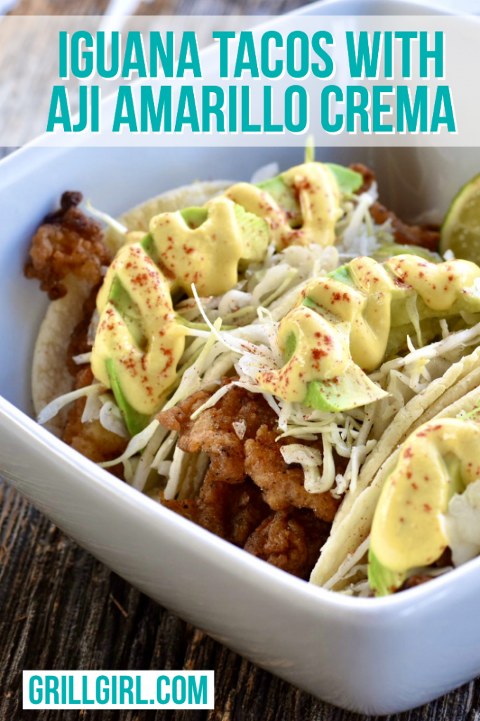
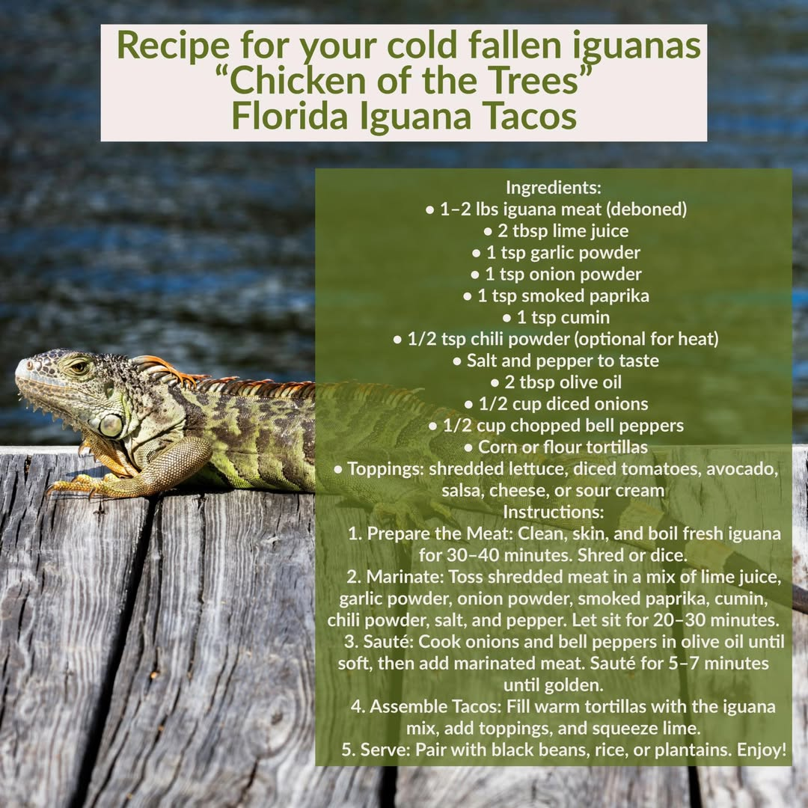
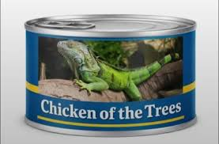

Slide 3
What is Data Science?
How is it different from Statistics, Machine Learning, and AI?
Statistics
Quantifies numbers. Describes distributions, tests hypotheses, derives estimates, and draws conclusions from data.
Inference
Machine Learning
Predicts with models. Fits algorithms to data with the goal of predictive accuracy. Deep Learning is a specific class of ML models.
Prediction
Artificial Intelligence
Provides the appearance of intelligent behavior. Computer programs that automate processes and mimic human interaction — chat, image recognition, decision-making.
Automation
Data Science
Finds patterns to explain a phenomenon. The practical application of statistics, ML and AI — turning raw data into actionable insight and better decisions.
Insight

Slide 4
Today's Agenda
01
What Is Data Science?
Definitions, the DS loop, types of questions
02
Model Types & Learning Methods
Classification, prediction, clustering, anomaly, recommend + AI vs. ML
03
Banking Churn Case Study
Data → Label → Explore → Partition → Engineer → Train → Evaluate → Explain
~50 minutes | Questions welcome throughout

Slide 5
01
What Is Data Science?
Explaining things with analytics — driving decisions with data

Slide 6
The Data Problem in Banking
5–9×
< 1%
73%
more expensive to acquire a new banking customer than to retain one
of the data banks collect is ever analyzed or acted upon
of customers expect companies to understand their unique needs
Bain & Company
Forrester Research
Salesforce Connected Customer Report
Data science is the bridge between raw data and decisions that matter.

Slide 7
Data science is
explaining things
with analytics
and driving decisions with data.
Not magic. Not a replacement for domain expertise. A tool for better decisions.

Slide 8
The Data Science Loop
1
2
3
4
Data
Insight
Decision
Outcome
Collect, store,
clean
Analyze, model,
explain
Recommend,
act, automate
Measure, learn,
improve
The loop never stops — each outcome feeds the next iteration of understanding.

Slide 9
Data science is just
following a recipe.
Ask a question. Gather data. Explore it. Model it. Evaluate it. Visualize it. Tell the story.
A cooking recipe has...
A data science project has...
— A question (what am I making?)
— An interesting question to answer
— Ingredients (your data)
— Data gathered and cleaned
— A technique (your algorithm)
— A model trained and tuned
— Tasting as you go (evaluation)
— Metrics evaluated honestly
— Plating (visualization)
— Charts that reveal the truth
— Serving to guests (storytelling)
— Insights delivered to decision-makers
The recipe doesn’t change whether you’re predicting churn, diagnosing cancer, or detecting fraud. Master the recipe, apply it anywhere.

Slide 10
The 12-Step Data Science Workflow
01
Problem Formulation
Define business question & success metrics
08
Model Calibration
Reliability diagram, Brier, isotonic
09
Model Documentation
SR 11-7 model card, governance
02
Data Gathering
Extract, join, and clean behavioural data
07
Model Interpretability
SHAP global, PDP, case-level waterfall
10
Model Integration
REST API: /predict /explain /label
03
Data Exploration
Distributions, correlations, EDA
06
Model Evaluation
AUC, PR-AUC, lift, threshold analysis
11
Model Monitoring
PSI, KS drift, Brier decay
04
Feature Engineering
Temporal split, derived features
05
Multi-Model Training
CatBoost, XGBoost, MLP champion/challenger
12
Periodic Retraining
Walk-forward, champion/challenger
Steps 1-4: Define & Data | Steps 5-8: Build & Validate | Steps 9-12: Deploy & Govern | churn_master.ipynb follows all 12 steps

Slide 11
Four Types of Questions Data Science Answers
Descriptive
Diagnostic
What happened?
Why did it happen?
e.g. Churn rate last quarter by segment
e.g. Which features correlate with churn?
Predictive
Prescriptive
What will happen?
What should we do?
e.g. Which customers will churn next 90 days?
e.g. Which retention offer has the best ROI?
Most organizations are strong on descriptive; value explodes when you reach predictive + prescriptive.

Slide 12
Why Is Data Science Having Its Moment Now?
📊 Explosion of Data
⚡ Cheap Compute
Core banking systems, digital channels, and third-party feeds produce more structured data than ever before.
Cloud infrastructure makes training complex models on millions of records routine and affordable.
🔓 Open-Source Tooling
🏦 Banking Is Behind
CatBoost, XGBoost, SHAP — world-class ML is free. The moat is knowing how to use it.
Most industries automated decisions years ago. Banking is still rich with opportunity — and pressure from fintechs.

Slide 13
What Data Science Is NOT
Just Business Intelligence
Only for big tech companies
— BI describes the past. DS predicts the future and recommends actions.
— Community banks and credit unions are running churn models today with open-source tools.
Magic or a black box
One-and-done project
— Modern explainability (SHAP) makes model logic transparent and auditable.
— Models drift. Data changes. DS is a continuous feedback loop, not a deliverable.
A replacement for domain knowledge
More data always means a better model
— Domain expertise shapes the question, the features, and the label. The model amplifies it.
— Data quality beats quantity. Clean, relevant, well-labeled data outperforms 10× more noise.

Slide 14
02
Model Types & Learning Methods
From classification to recommendation — and when to use each

Slide 15
ML in Banking — Ranking
ML / Business Problem
What the model does
Banking Example
Ranking
Orders a list so the most relevant or high-value items appear first
Retention Priority Queue
Ranked by P(churn) × Lifetime Value
Recommendation
Surfaces the right next product or action for each individual customer
Rank
Customer
P(churn)
LTV
Action
#1
Johnson, M.
0.91
$82K
CALL TODAY
Classification
Assigns each customer or event to a category — churn/retain, fraud/clean, default/performing
#2
Chen, R.
0.87
$104K
CALL TODAY
Regression
Predicts a continuous number — a balance, a value, a probability score
#3
Williams, S.
0.78
$61K
HYSA OFFER
#4
Davis, T.
0.71
$38K
Email nudge
Clustering
Groups similar customers together without predefined labels — discovers natural segments
#5
Martinez, K.
0.64
$29K
Email nudge
Anomaly Detection
Finds observations that deviate significantly from normal patterns
86,110 customers below threshold — no outreach

Slide 16
ML in Banking — Recommendation
ML / Business Problem
What the model does
Banking Example
Ranking
Orders a list so the most relevant or high-value items appear first
Customer #7841 · P(churn)=0.78 · LTV $61K
Next-Best-Offer — ranked by P(accept) × retention value
Recommendation
Surfaces the right next product or action for each individual customer
#1
HYSA Promo
91%
Classification
Assigns each customer or event to a category — churn/retain, fraud/clean, default/performing
4.50% APY · limited time
Regression
Predicts a continuous number — a balance, a value, a probability score
#2
Fee Reversal
78%
$35 monthly fee waived once
Clustering
Groups similar customers together without predefined labels — discovers natural segments
#3
Banker Call
65%
Anomaly Detection
Finds observations that deviate significantly from normal patterns
Relationship review, 20 min

Slide 17
ML in Banking — Classification
ML / Business Problem
What the model does
Banking Example
Ranking
Orders a list so the most relevant or high-value items appear first
Churn Risk Score
Will this customer leave in the next 30 days?
Recommendation
Surfaces the right next product or action for each individual customer
P(churn)
Classification
0.78
Assigns each customer or event to a category — churn/retain, fraud/clean, default/performing
Regression
Predicts a continuous number — a balance, a value, a probability score
Clustering
HIGH RISK
Groups similar customers together without predefined labels — discovers natural segments
Model
WeightedEnsemble
Anomaly Detection
Finds observations that deviate significantly from normal patterns
AUC-ROC
0.883
Threshold
0.18
Decile
Top 10%

Slide 18
ML in Banking — Regression
ML / Business Problem
What the model does
Banking Example
Ranking
Orders a list so the most relevant or high-value items appear first
Balance & Lifetime Value Forecast
How much is this customer worth — and where are they heading?
Recommendation
Surfaces the right next product or action for each individual customer
$54K
Classification
Assigns each customer or event to a category — churn/retain, fraud/clean, default/performing
Regression
Predicts a continuous number — a balance, a value, a probability score
$0
Historical
Forecast
Clustering
Groups similar customers together without predefined labels — discovers natural segments
Avg balance (12 mo)
$47,300
30-day forecast
$43,100 (−4,200)
Anomaly Detection
Finds observations that deviate significantly from normal patterns
LTV estimate (36 mo)
$67,400

Slide 19
ML in Banking — Clustering
ML / Business Problem
What the model does
Banking Example
Ranking
Orders a list so the most relevant or high-value items appear first
Customer Microsegments
Discovering natural groups without predefined labels
Recommendation
Surfaces the right next product or action for each individual customer
Active Digital Users
35%
n=31,937 · avg bal $3,400 · churn 5%
Classification
Assigns each customer or event to a category — churn/retain, fraud/clean, default/performing
DD-Dependent Savers
28%
Regression
n=25,549 · avg bal $5,100 · churn 6%
Predicts a continuous number — a balance, a value, a probability score
Rate-Sensitive Movers
18%
Clustering
Groups similar customers together without predefined labels — discovers natural segments
n=16,424 · avg bal $8,200 · churn 9%
At-Risk Dormant
8%
Anomaly Detection
Finds observations that deviate significantly from normal patterns
n=7,337 · avg bal $1,200 · churn 26%
► At-Risk Dormant = primary churn model target population

Slide 20
ML in Banking — Anomaly Detection
ML / Business Problem
What the model does
Banking Example
Ranking
Orders a list so the most relevant or high-value items appear first
BSA / AML Transaction Alert
Did this customer do something outside their normal pattern?
Recommendation
Surfaces the right next product or action for each individual customer
Transaction volume
!
Classification
Assigns each customer or event to a category — churn/retain, fraud/clean, default/performing
Regression
Predicts a continuous number — a balance, a value, a probability score
12 weeks
⚠ FLAGGED — Wire Transfer
Clustering
Groups similar customers together without predefined labels — discovers natural segments
$9,800 · Intl wire · 23:47 · Anomaly score: 0.94
Customer avg wire (monthly)
$850
Anomaly Detection
Finds observations that deviate significantly from normal patterns
Deviation
3.8σ above avg
Model threshold
0.75

Slide 21
The Model Taxonomy — Six Core Problem Types
Problem type
The question it answers
Banking example
Classification
Is it / Will it happen?
Churn, fraud, loan default, AML suspicious activity
Regression
How much? How many? When?
Customer LTV, balance forecast, days-to-attrition
Clustering
Who are my natural groups?
Behavioral microsegments: dormant, digital-only, rate-sensitive
Anomaly Detection
What looks abnormal here?
BSA structuring, unusual wire activity, card fraud rings
Ranking
What’s the priority order?
Sort retention queue by P(churn) × LTV — call highest risk first
Recommendation
What should we offer next?
Next-best-offer: HYSA promo, fee reversal, or banker call
Our case study: Classification (churn in next 30 days) → Ranking (who to call first) → Recommendation (which offer to make). Three types, one pipeline.

Slide 22
Classification — Is This Customer Going to Churn?
What it does
Output
Assigns each customer a probability (0–1) of belonging to a class — churned or retained, fraud or legitimate, default or performing.
P(churn) = 0.78
Key metrics
Banking examples
— AUC-ROC — ranking quality
— PR-AUC — imbalance-aware summary
— Churn prediction (our case study)
— Precision / Recall curve
— Fraud detection on card transactions
— Calibration (reliability)
— Lift @ K% — campaign ROI
— Loan default / credit risk scoring
— KS Statistic — separation
— AML / BSA suspicious activity
— Brier Score — prob. accuracy
— F1 / F-beta — imbalanced data
— Log Loss — confidence penalty

Slide 23
Calibration — Does P(churn) = 0.78 Really Mean 78%?
What it means
100%
A calibrated model is honest: when it says P(churn) = 0.70, roughly 70 % of customers with that score actually churn. Miscalibration means the number looks precise but is systematically wrong.
Actual churn rate
Why it matters in banking
— Threshold math breaks — break-even at p > 6.25% assumes honest probabilities
50%
— Cost-benefit curves shift if scores are systematically high or low
— SR 11-7 model validation requires documented probability reliability
How to recalibrate
— Platt scaling — logistic regression on raw scores
— Isotonic regression — non-parametric, more flexible
0%
0.0
Uncalibrated (overconfident)
Perfect calibration
1.0
After isotonic calibration
Predicted probability

Slide 24
Prediction / Estimation — How Much, How Many, When?
What it does
Output
Outputs a continuous number — a dollar amount, a date, a count — rather than a category. Sometimes called regression.
LTV = $4,820
Key metrics
Banking examples
— RMSE / MAE
— R² (explained variance)
— Customer lifetime value (LTV)
— MAPE
— RMSSE — scale-invariant
— Deposit balance 90-day forecast
— Huber Loss — robust to outliers
— Next transaction amount
— Tweedie Deviance — zero-inflated targets
— Time-to-close estimate
— Quantile Loss (Pinball) — P10/P50/P90
— CRPS — distributional forecast accuracy
— NLL — probabilistic NN training loss
— MDA — directional accuracy
— Residual distribution / calibration

Slide 25
Cluster / Segment — Who Are My Natural Customer Groups?
What it does
Output
Groups customers by similarity — with no predefined labels. The model discovers natural patterns in behavior, balances, and product usage.
Cluster 3
(At-Risk Dormant)
Banking examples
Key metrics
— Digital-First Savers — high mobile, DD active, low branch
— Silhouette Score
— Transactors — high debit velocity, low balance
— Davies-Bouldin Index
— At-Risk Dormant — low engagement, high NSFs, no DD
— Calinski-Harabasz
— Mature Relationships — multi-product, long tenure
— Elbow / WCSS curve
— Gower Distance (mixed types)
Unsupervised — no label needed. Common algorithms: k-Means, DBSCAN, Hierarchical, Gaussian Mixture Models.

Slide 26
Anomaly Detection — What Looks Suspicious?
What it does
Output
Learns what 'normal' looks like, then flags deviations — no pre-labeled anomalies required. Useful when fraud or rare events can't be fully enumerated.
Anomaly score
= 0.92
Common methods
(threshold: 0.75)
— Autoencoder — neural net learns to reconstruct; high error = anomaly
Key metrics
— Isolation Forest — trees isolate outliers in fewer splits
— Reconstruction error (MSE)
— One-Class SVM — boundary around 'normal' in feature space
— AUROC (if labels available)
— Statistical z-score — simple, fast, interpretable baseline
— Precision@K anomalies
Banking examples: Card fraud | AML structuring | BSA alerts | Login anomalies
— F1 / False positive rate
— Contamination rate tuning

Slide 27
Rank / Recommend — What Should I Show This Customer Next?
What it does
Output
Scores and ranks items for each customer — personalized product recommendations, targeted offers, or next-best-action sequences.
#1 HYSA 92%
#2 Auto Loan 71%
#3 CD Ladder 58%
Banking examples
Key metrics
— Next-best-offer (savings, CD, loan)
— NDCG — position-weighted ranking
— Card rewards personalization
— MAP — mean avg. precision
— MRR — rank of first relevant item
— Financial wellness content ranking
— Precision@K / Recall@K
— Advisor outreach prioritization
— CTR — click-through rate
— Conversion / acceptance rate
— Revenue uplift
— Incremental lift (A/B vs. control)
— Coverage — % of catalog surfaced
— Novelty — items not already owned

Slide 28
Learning Methods — The High-Level Picture
Supervised
Unsupervised /
Semi-Supervised
Self-Supervised
Reinforcement
Learns from labeled examples
No labels — or only a few
Creates its own training signal
Learns from rewards over time
Classification, Regression
You provide the answer key
Clustering, Anomaly Detection
Semi: small labeled + large unlabeled set
Pre-training, Transfer Learning
Foundation models (LLMs)
Pricing, offer sequencing
Agent learns by trial/error
Boosted Trees (XGBoost / LightGBM / CatBoost) — Neural Networks & Transformers — Linear / Logistic Models — Kernel Methods (SVM) — Distance-based (k-NN)
Probabilistic (Naive Bayes / Bayesian Networks) — Autoencoders — Isolation Forest — Gaussian Mixture Models

Slide 29
AI vs. ML — Better Together, Not Interchangeable
Structured ML Models
Generative AI / LLMs
CatBoost · XGBoost · LightGBM
GPT-4 · Claude · Gemini
— Tabular data — the kind banks actually have
— Explain model outputs in plain English
— Calibrated probabilities (0.78, not 'high')
— Generate banker-readable risk narratives
=
— Handles millions of rows fast
— Surface patterns from unstructured text
— Auditable via SHAP / feature importance
— Answer ad-hoc questions about the model
— Consistent, reproducible predictions
— Write intervention recommendations
ML handles precision at scale. AI handles communication and nuance. Neither alone is the full solution.

Slide 30
Why Classical ML First — Especially in Banking
Where classical ML wins
Where GenAI adds value
— Tabular data — rows and columns are what banks have
— Translating ML output into plain-English narratives
— Calibrated probabilities: P(churn)=0.78 is actionable
— Answering ad-hoc questions about model decisions
— Explainability: ECOA and Fair Lending require it
— Summarizing SHAP explanations for non-technical users
— Model risk management (SR 11-7) demands audit trails
— Processing notes, calls, emails — unstructured signals
— Low latency: score millions of customers in seconds
— Drafting intervention messages personalized by risk tier
— Reproducibility: same input = same output, always
In this talk: ML handles the precision. GenAI handles the communication. You'll see both in the notebook.

Slide 31
03
Banking Churn Case Study
From raw data to explainable predictions — live notebook walkthrough

Slide 32
The Problem: Why Churn Prediction Matters
5–9×
8–15%
$200–500
more expensive to acquire a new customer than retain one
annual churn rate at a typical retail bank
approx. annual net revenue per retail checking customer
Bain & Company
Bain / Accenture banking surveys
FDIC call report data
Goal: Build a model that identifies at-risk customers 90 days before they leave —
giving the retention team time to intervene with a targeted offer.

Slide 33
The Mystery Customer
Will they close their account in the next 90 days?
Tenure:
34 months
Digital Logins (30d):
2
Products:
2
Days Since Last Login:
18
Avg Daily Balance:
$1,240
NSF Events (12m):
3
DD Count (30d):
0
Fee Waiver Requests:
2
We'll return to this customer at the end of the case study with a full explanation.

Slide 34
The Data — Banking Features That Actually Matter
DD Velocity
dd_count_30d, dd_amount_30d, days_since_last_dd, dd_velocity_ratio
→ Is this their primary bank?
Digital Engagement
digital_login_30d, mobile_login_30d, days_since_last_login
→ Are they actively using the bank?
Balance Patterns
avg_daily_balance, balance_volatility, min_balance_30d, overdraft_count_12m
→ Financial health signals
Products & Relationship
product_count, tenure_months, has_savings, has_loan
→ Depth of relationship
Service Friction
nsf_count_12m, fee_waiver_req_12m, cust_service_calls_6m
→ Dissatisfaction signals
6,000 synthetic customers with realistic feature distributions. Churn label: account closure or full dormancy within 90 days.

Slide 35
Labeling — Getting the Definition Right
Definition: Customer closed account OR had zero transactions AND zero digital logins for 90+ days
Look-forward window: 90 days from observation snapshot date
Common Pitfalls
Label Leakage
Look-Back Contamination
Features computed AFTER the churn event pollute training. e.g. 'balance at close' isn't knowable at prediction time.
Feature windows that overlap the look-forward window introduce future signal into training features.
Class Imbalance
Survivorship Bias
Typical churn: 8–15%. A model predicting 'nobody churns' is 87% accurate — and useless. Use precision-recall, not accuracy.
Exclude already-churned customers from the observation set — their features are post-churn, not pre-churn.

Slide 36
Exploratory Data Analysis — Key Findings
3–4×
Higher churn rate in customers with no primary direct deposit vs. DD-active customers
< 5
Digital logins/month is the inflection point below which churn risk spikes sharply
−18%
Each additional product reduces churn probability by ~18 percentage points
2.3×
Customers with 3+ NSF events in 12 months churn at 2.3× the base rate
EDA shapes feature engineering and informs which model types to prioritize. Never skip it.

Slide 37
Partitioning by Date — Not Randomly
The most common mistake in banking ML: random train/test splits.
Customer behavior changes over time. A random split lets the model 'see' future customers during training — inflating performance metrics that collapse in production.
TRAIN
VAL
TEST
Jan 2022 – Mar 2023
Apr – Jun 2023
Jul – Sep 2023
↑ Model only sees past data | Future is always held out ↑

Slide 38
Feature Engineering — Raw Counts → Meaningful Signals
dd_velocity_ratio
from: dd_count_30d ÷ 90d monthly avg
Is DD activity trending down? Declining ratio = early warning of primary bank shift.
digital_engagement_score
from: digital_login_30d + days_since_last_login
Composite 0–100 score — frequency (60%) + recency (40%). Drops before churn.
balance_stress_index
from: balance_volatility + overdraft_cnt + nsf_cnt
Combined financial stress signal. Predicts friction before it triggers a call.
relationship_depth_score
from: product_count + tenure_months
How embedded is this customer? High depth = significantly lower churn probability.
friction_score
from: fee_waiver_requests + cust_service_calls
Dissatisfaction proxy. Leading indicator of churn intent — often signals 30–60 days out.
Engineered features typically outperform raw counts — they capture behavior and trajectory, not just point-in-time events.

Slide 39
Model Training — Automated Ensemble Leaderboard
What AutoML ensemble training does
Leaderboard (AUC)
— Trains CatBoost, XGBoost, LightGBM, Neural Net, Random Forest — all at once
WeightedEnsemble
0.891
— Validates each on your held-out validation set
CatBoost
0.883
— Stacks and ensembles the best performers
LightGBM
0.879
XGBoost
0.871
— Returns a ranked leaderboard — no guesswork
RandomForest
0.852
— Best model wins; you explain it with SHAP
NeuralNet
0.834
time_limit=120s for demo. Production runs: 600–3600s for best quality.

Slide 40
A single evaluation metric
is always misleading.
You need ML metrics to understand model quality.
You need business metrics to understand model value.
Neither alone is sufficient.
A model with 95% accuracy on a 95/5 class split is useless.
AUC-ROC of 0.92 on clean test data may collapse to 0.67 in production after drift.

Slide 41
ML Evaluation — Four Metrics, Four Different Questions
AUC-ROC
Precision-Recall
How well does the model rank customers?
When we predict churn, how often are we right?
Always compute. Best single-number summary for class-imbalanced data.
Critical when false positives are costly (wasted offer budget).
Calibration
Lift @ Top K%
Does P(churn)=0.8 actually mean 80% churn?
How much better than random if we target the riskiest 10%?
Essential if probability scores drive dollar-value decisions.
The business metric translation — connects ML to campaign ROI.

Slide 42
Business Metrics — Translating ML into Dollars
Assumptions:
avg customer value = $1,200/yr | retention offer cost = $75 | test set: 1,200 customers
Targeting the top 10% riskiest customers → ~84% precision → captures $120K+ revenue at risk for only $9K in offer cost
Target Group
Accuracy
Revenue at Risk
Offer Cost
Net Benefit
Top 5%
91% precision
$66,000
$4,125
$61,875
Top 10%
84% precision
$121,200
$9,000
$112,200
Top 20%
72% precision
$207,600
$18,000
$189,600
Top 30%
61% precision
$264,000
$27,000
$237,000
Optimal decision threshold balances false positives (wasted offers) vs. false negatives (missed churners). Use the cost-benefit curve.

Slide 43
Optimal Threshold — Finding the Cost-Benefit Peak
The break-even formula
Marginal ROI by Tier
Target a customer when:
Tier
Marg. Spend
Marg. Benefit
ROI
p(churn) > offer_cost ÷ LTV
0–5%
$4,125
$61,875
15.0×
At our numbers: 75 ÷ 1,200 = 6.25%
5–10%
$4,875
$50,325
10.3×
10–20%
$9,000
$77,400
8.6×
Mathematically, target anyone predicted above 6.25% churn probability — that's far more than 10%.
20–30%
$9,000
$47,400
5.3×
Practical constraints push the threshold higher:
Find the tier where marginal ROI drops below your campaign hurdle rate.
— Retention team capacity — finite outreach bandwidth
— False-positive fatigue — loyal customers learn to ask for discounts
Optimal = peak of the Net Benefit curve
Plot it before every campaign. It shifts with offer cost + LTV.
— Fair lending defensibility — narrower targeting is more auditable
A/B test against a holdout group to measure true incremental lift vs. control — distinguish model lift from seasonal effects.

Slide 44
Global Explainability — SHAP Beeswarm Plot
Top Churn Drivers
← reduces churn
increases churn →
days_since_last_dd
days_since_last_dd
▲
digital_engagement_score
digital_engagement_score
▼
dd_count_30d
dd_count_30d
▼
friction_score
friction_score
▲
balance_stress_index
balance_stress_index
▲
relationship_depth_score
relationship_depth_score
▼
Warm dots = high feature value | Cool dots = low feature value
▲ increases | ▼ decreases
TreeSHAP — exact, not approximate. O(TLD) time complexity on tree ensembles. Much faster than KernelSHAP for tabular data.

Slide 45
SHAP — Two Levels of Explainability
Global
Local
Why does the model score customers the way it does?
Why did this specific customer get a score of 0.78?
— Beeswarm plot — one dot per customer, shows distribution of SHAP values for every feature
— Waterfall plot — shows how each feature pushed one customer above or below the baseline
— Mean |SHAP| bar chart — overall feature importance ranking across the entire dataset
— "days_since_dd=18" added +0.31 — "product_count=2" subtracted −0.09
— Identifies which features consistently drive churn vs. retention across all customers
— Banker-readable narrative generated directly from these SHAP values by the LLM
— Used by model developers and risk managers to validate that model logic makes business sense
— Used by relationship managers and compliance to explain any individual model decision
All customers
One customer
TreeSHAP is exact and fast for tree-based models (CatBoost, XGBoost, LightGBM). pip install shap

Slide 46
Mystery Customer — Revealed
Predicted churn probability: 78% — HIGH RISK
What drove this prediction? (SHAP Waterfall)
Feature
SHAP contribution (→ increases churn risk)
days_since_last_dd = 18
+0.31
digital_login_30d = 2
+0.24
dd_count_30d = 0
+0.22
friction_score = 0.62
+0.18
product_count = 2
-0.09
tenure_months = 34
-0.07

Slide 47
ML + AI: Score → Drivers → Narrative → Action
1
2
3
4
ML Score
SHAP Drivers
AI Narrative
Next Action
P(churn)
days_since_dd = 18
“No DD activity in 18 days — primary bank shift likely. Only 2 logins and 2 fee requests signal both dormancy and friction. High churn risk.”
#1 HYSA promo
91%
+0.31
0.78
#2 Fee reversal
78%
digital_logins = 2
+0.24
dd_count_30d = 0
#3 Banker call
65%
HIGH RISK
+0.22
friction = 0.62
This is also ML —
Rank / Recommend
model
CatBoost
WeightedEnsemble
AUC = 0.883
+0.18
product_cnt = 2
−0.09
Generated by LLM
from SHAP values
+ customer features
Trained on past
intervention outcomes
The loop: Classification → SHAP explainer → LLM narrative → Rank/Recommend intervention. ML + AI + ML. Each stage is its own model.

Slide 48
Lessons Learned — What We'd Do Differently
01
Start with the label, not the algorithm
We spent weeks on model selection before realizing our churn definition was leaking. Fix your label first.
02
Evaluation is a product decision, not a metric
AUC-ROC told us we had a good model. Lift @ 10% told us whether it was worth deploying.
03
Feature engineering beats model complexity
dd_velocity_ratio outperformed raw DD counts by a wider margin than switching from XGBoost to ensemble.
04
Explainability isn't optional in banking
Regulators, compliance, and bankers all need to understand why. SHAP makes that possible.

Slide 49
Key Takeaways
1. Data science is about decisions, not algorithms
The method matters less than the question you're answering and the label you're predicting.
2. ML models beat AI on structured prediction tasks
Tabular banking data belongs to gradient-boosted tree ensembles — not LLMs. Use AI to explain, not predict.
3. One metric is never enough
AUC-ROC + Precision-Recall + Calibration + Lift @ K% + Business cost-benefit — all tell different parts of the story.
4. Explainability is your competitive advantage
SHAP turns a black-box score into an actionable banker narrative. That's what closes the loop from model to revenue.

Slide 50
Questions?
Data Science for Banking — Jack Henry Associates
RESOURCES
Notebook · churn_demo.ipynb + churn_utils.py
SHAP · shap.readthedocs.io
churn_utils.py · github.com/mikeames
Mike Ames · github.com/mikeames · michael.ames@gmail.com

Slide 51
APPENDIX
SR 11-7
Model Risk Management Guidance
Federal Reserve Board · Office of the Comptroller of the Currency · April 2011
The governing standard for how banks must develop, validate, and monitor any quantitative model used in decision-making.
Reference material — not required for the main talk

Slide 52
SR 11-7 — What It Requires and What Goes in the Report
The Three Pillars of Model Risk Management
What Belongs in a Model Validation Report
1
Model Development & Implementation
IDENTITY
— Conceptual soundness — theory and assumptions documented
Model name, ID, owner, business line
Intended use and population in scope
— Data quality review — lineage, gaps, proxies disclosed
DEVELOPMENT
— Testing — in-sample, out-of-time, sensitivity
Conceptual framework and literature basis
— Intended use explicitly defined and bounded
Training data: source, date range, exclusions
2
Model Validation (Independent)
Feature engineering decisions and rationale
Algorithm selection — alternatives considered
— Separate team — no developer involvement
PERFORMANCE
— Conceptual challenge — alternative approaches considered
AUC-ROC, PR-AUC, KS, Calibration, Brier Score
— Backtesting + benchmarking against simpler models
In-time vs. out-of-time holdout results
— Written findings, ratings, and required remediations
Lift @ K% and business cost-benefit validation
Sensitivity / stress tests on key assumptions
3
Ongoing Monitoring & Governance
RISK & LIMITS
— Performance tracking on live data (PSI, KS, AUC drift)
Known limitations and compensating controls
— Model inventory — every model registered and owned
Population Stability Index (PSI) thresholds
ECOA / Fair Lending disparate impact analysis
SR 11-7 applies to any model used to inform a “material business decision.” A churn model driving retention spend qualifies. OCC 2011-12 is the parallel OCC guidance.
— Periodic re-validation (typically annual or on trigger)
Re-validation trigger conditions
— MRM committee sign-off before deployment changes
GOVERNANCE
Validation team independence attestation
Open findings, severity ratings, remediation plan
Approval signatures — MRM committee + LOD2

Slide 53
SR 11-7 Applied — How Our Churn Model Satisfies Each Requirement
Conceptual soundness
Temporal train / validation / test split prevents leakage. Features derived from behavioral theory (recency, frequency, friction). Gradient boosting chosen over logistic regression with documented performance rationale.
Strong
Data quality & lineage
churn_utils.py logs source tables, date ranges, and row counts. dd_velocity_ratio and digital_engagement_score definitions are version-controlled. Missing value treatment and proxy disclosure in notebook.
Strong
Performance documentation
AUC-ROC 0.883, PR-AUC, KS, Calibration curve, Lift @ 10%, Brier Score all computed and logged. Out-of-time holdout (last 3 months of data held back) mirrors live deployment conditions.
Strong
Explainability & fair lending
SHAP TreeExplainer provides per-prediction attribution (global beeswarm + local waterfall). Disparate impact analysis across protected classes is required before deployment — run cu.fair_lending_check().
Required
Ongoing monitoring
PSI and KS tracked monthly. Re-train triggers: PSI > 0.20 or AUC drop > 5 pts. Model inventory entry, business owner, and scheduled annual re-validation should be formalized before production.
Required
cu.fair_lending_check() stub exists in churn_utils.py — implement before any production deployment. Document findings in the model validation report.

