Slide 1


Gradient Boosting
Wake Forest
School of Business
_______
Classification

Slide 2
Agenda
Churn
Improving Model Performance
Feature Engineering
Sampling (Up, Down, Synthetic)
Hyper Parameter Tuning
Ensemble Learners
Gradient Boosting Machines (GBM)
Random Forests

Slide 3

Churn
"Will incentives like freebies and entertainment be enough to keep people from switching?
They’re making you this data offer, but will that really help you if you’re still paying the same high monthly bill?” – telco executive

Slide 4
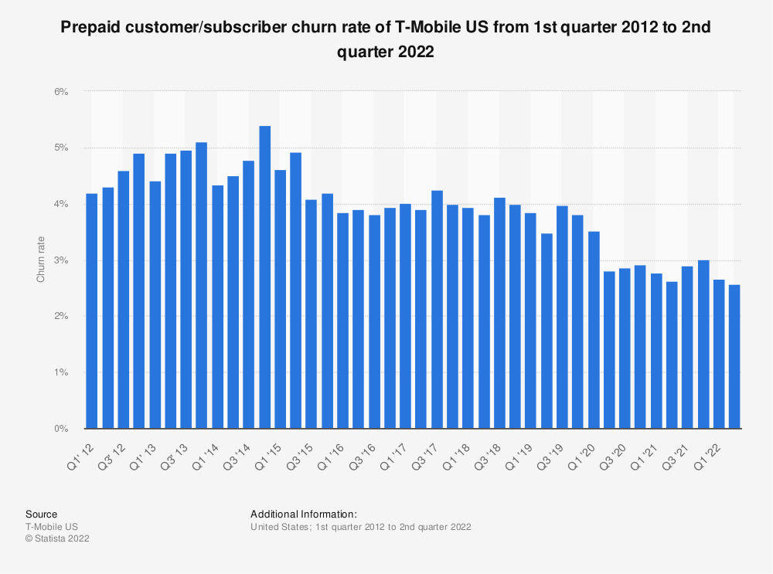
Churn and wireless carriers
Churn—the measurement of how many customers discontinue their wireless service and switch to a different carrier. Churn rates by carrier:
0.77% Verizon
0.85% ATT
2.58% T-Mobile
307 million smartphone users in US
142 million new sales in US

Slide 5
Churn and some basic Math
Suppose you are ATT
0.85% Churn Rate
222.3 Million Subscribers
$546 Average annual bill
$121.7 Billion revenue
1.0 billion cost of churn
Suppose you can reduce churn by…
1 basis point 1/100th of a percent ~ $121.75 Million
10 basis points 1/10th of a percent – $1.2Billion!
The question is how!

Slide 6
Suppose…
The executive team recommends we use Accuracy as the key measure to evaluate the performance of both the “heuristic” rules and your machine learning model.
Is there an issue with using accuracy?
What are other measures that are likely more useful?
The executive team wants something actionable :
What is your recommendation
What sort of tests can you perform to prove / disprove success
How would you measure success?
How much is this going to cost them?
given “offering $50 voucher to everyone your model identifies as likely to churn, for every correct classification (churners identified) they expect to make $500 and for every false positive they’ll lose $50(the voucher) and for every false negative they’ll lose $500”

Slide 7
How do I improve Prediction Performance?
Down Sampling
Up Sampling
SMOTE
#1 Feature Engineering
#2 Play with Samples
#3 Hyper Parameter Tuning

Slide 8
Feature Engineering
Text Features Engineering: creating features from text such as TF-IDF scores, word embeddings (e.g., Word2Vec, GloVe), or using pre-trained language models like BERT for contextual embeddings can capture the semantic meaning of the text.
Feature Hashing: For high-dimensional categorical data, feature hashing (or the hashing trick) can be a space-efficient alternative to one-hot encoding, especially when the number of categories is large.
Clustering as Feature: Using clustering algorithms (e.g., k-means) to create new features that indicate the cluster memberships of data points can help uncover latent structures within the data.
Window Features: features based on expanding or rolling windows with various statistics (min, max, variance) can capture trends and volatility in data.
Frequency Encoding: For categorical variables with a lot of categories, frequency encoding replaces categories with their frequencies
Target Encoding: replacing a categorical value with a statistic derived from the target variable, usually the mean.
There is a whole art and science behind Feature Engineering – reality is that you have to be creative

Slide 9
Play with Sampling
Degree of imbalance | Proportion of Minority Class
Mild | 20-40% of the data set
Moderate | 1-20% of the data set
Extreme | <1% of the data set
An effective way to handle imbalanced data is to down sample and upweight the majority class:
Down sampling (in this context) means training on a disproportionately low subset of the majority class examples.
Upweighting means adding an example weight to the down sampled class equal to the factor by which you down sampled.

Slide 10
Down-Sampling AKA Under-Sampling
Simply remove % of majority case
hours_played_sitting | number_of_tables | vluntarily_put_money_into_pot | pot_preflop_raising | went_to_showdown | player_country | EVENT_LABEL
30 | 649 | 30 | 39 | 105 | CAN | legit
30 | 312 | 71 | 29 | 26 | UK | legit
35 | 694 | 22 | 35 | 58 | CAN | legit
36 | 573 | 42 | 58 | 202 | CAN | legit
34 | 617 | 33 | 45 | 105 | CAN | legit
19 | 816 | 36 | 42 | 434 | UK | fraud
32 | 611 | 51 | 53 | 185 | USA | fraud
24 | 939 | 49 | 42 | 181 | USA | legit
34 | 666 | 40 | 52 | 171 | CAN | legit
25 | 812 | 51 | 52 | 90 | USA | legit
38 | 602 | 32 | 36 | 110 | CAN | legit
38 | 626 | 57 | 32 | 386 | UK | fraud

Slide 11
Down-Sampling AKA Under-Sampling
Remove % of majority case
Split your data into features (X) and target (y).
Identify the majority and minority classes.
Randomly sample from the majority class to match the size of the minority class.
# Separating majority and minority classes
majority_class = train_data[train_data.target == 0]
minority_class = train_data[train_data.target == 1]
# Downsampling majority class
majority_downsampled = majority_class.sample(len(minority_class), random_state=42)
# Combining minority class with downsampled majority class
downsampled_data = pd.concat([majority_downsampled, minority_class])
https://imbalanced-learn.org/stable/references/under_sampling.html#module-imblearn.under_sampling

Slide 12
Up-Sampling AKA Over Sampling
Simply duplicate % of minority case
hours_played_sitting | number_of_tables | vluntarily_put_money_into_pot | pot_preflop_raising | went_to_showdown | player_country | EVENT_LABEL
30 | 649 | 30 | 39 | 105 | CAN | legit
30 | 312 | 71 | 29 | 26 | UK | legit
35 | 694 | 22 | 35 | 58 | CAN | legit
36 | 573 | 42 | 58 | 202 | CAN | legit
19 | 816 | 36 | 42 | 434 | UK | fraud
32 | 611 | 51 | 53 | 185 | USA | fraud
19 | 816 | 36 | 42 | 434 | UK | fraud
19 | 816 | 36 | 42 | 434 | UK | fraud
32 | 611 | 51 | 53 | 185 | USA | fraud
32 | 611 | 51 | 53 | 185 | USA | fraud
32 | 611 | 51 | 53 | 185 | USA | fraud
32 | 611 | 51 | 53 | 185 | USA | fraud

Slide 13
Up Sampling AKA Over-Sampling
Generate new samples in the classes which are under-represented. The most naive strategy is to generate new samples by randomly sampling with replacement the current available samples.
https://imbalanced-learn.org/stable/references/over_sampling.html
from imblearn.over_sampling import RandomOverSampler
from sklearn.model_selection import train_test_split
# Split your dataset into training and testing set to avoid overfitting
X_train, X_test, y_train, y_test = train_test_split(X, y, test_size=0.2, random_state=42)
# Initialize RandomOverSampler
ros = RandomOverSampler(random_state=42)
# Resample the training data
X_train_ros, y_train_ros = ros.fit_resample(X_train, y_train)

Slide 14
SMOTE
Synthetic Minority Oversampling Technique
Synthetically generate new examples of the minority class. This is can be very effective.
Specifically, a random example from the minority class is first chosen. Then k of the nearest neighbors for that example are found (typically k=5). A randomly selected neighbor is chosen and a synthetic example is created at a randomly selected point between the two examples in feature space.
The approach is effective because new synthetic examples from the minority class are created that are plausible, that is, are relatively close in feature space to existing examples from the minority class.

Slide 15
How SMOTE works
For each instance in the minority class, SMOTE finds its k nearest neighbors in the minority class.
A synthetic record is then created by choosing one of the k nearest neighbors and connecting the line segment between the instance and its neighbor.
The synthetic instance is generated as a point along this line, typically based on a randomly chosen weight, thereby producing a sample that is similar but not identical to existing instances.

Slide 16
17July2024_UpDownAndSmoteSampling
https://github.com/MonkeyWrenchGang/2024_BAN7040/blob/main/17July2024_UpDownAndSmoteSampling.ipynb

Slide 17


How do I improve my model performance?
have tegridy, tune your hyperparameters!

Slide 18

How do I,
improve my model’s performance?
Mess with the data, make features, down / over sampling, balancing, SMOTE etc.
Works well for rare events
Do nothing, the defaults are good enough
Starting point, it’s simple but leaves a lot of performance on the table.
Change Hyperparameters by Hand
Good for fine tuning, not good for finding good starting point
Time consuming
Brute force grid search - try all possible combination of the set of Hyperparameters from searchable space
Good for finding a “good” model
Time consuming

Slide 19
Tuning Grid
Each row is an experiment
For each Parameter Permutation
N_estimators | Min_Samples_split
100 | 5
125 | 5
150 | 5
175 | 5
200 | 5
100 | 6
125 | 6
150 | 6
175 | 6
200 | 6
param_grid = {
'n_estimators’: [100,125,150,175,200],
'min_samples_split': [ 5, 6],}
5 levels X 2 parameters = 10 permutations
Total model fittings = Number of experiments × n x folds
Fit your model
K-times,
Average results
on hold out
Each row in the tuning grid gets fit K times (i.e. 5 times)
5 X 10 tests = 50 model fits

Slide 20
K-Fold & Hyper Parameter Tuning
Sugar cookie recipe Part1.
Split Your Data 70/30 (train/test)
Ensure you have a separate dataset for model evaluation.
Define Your Pipeline
Construct a pipeline that includes the preprocessing steps and the estimator (model). This encapsulation simplifies the experiment.
Fit it to Get Baseline Performance
Fit the pipeline to the training data to establish a baseline performance. This step helps in comparing the effect of hyperparameter tuning.
Identify Which Parameters to Tune
RandomForestClassifier: n_estimators, max_depth, and min_samples_split are commonly tuned.
Define Your Tuning Grid Experiments
Create a hyperparameter grid for the parameters you've identified. Keep the grid manageable to avoid excessive computation time.
Kick it off! Grab a diet coke and a smile
Using: GridSearchCV or RandomizedSearchCV to search through the parameter grid.
This process automates the experimentation across the specified K-folds of the data.

Slide 21
K-Fold & Hyper Parameter Tuning
Sugar cookie recipe Part2.
Evaluate the Tuning Results
evaluate the tuning results to understand which hyperparameter combinations performed best.
Pick the Best Performing Parameters on the Folds
Finally REFIT with the Best Parameters
Evaluate Your Baseline Fit with the “HPO” Fit on /Test
Compare the performance of the “tuned model” on the test set to get an unbiased estimate of its performance.
Random Forest Model Evaluation:
Accuracy: 0.9479
AUC: 0.8409
Precision: 0.8462
--------
Random Forest Model Evaluation with HPO: Accuracy: 0.9446
AUC: 0.8522**
Precision: 0.8462

Slide 22

And now…
Decision Boundaries
Logistic vs. Decision Tree
Ensemble-ing
Voting vs. Averaging
Random Forest
Area under the Curve
Operating Ranges

Slide 23
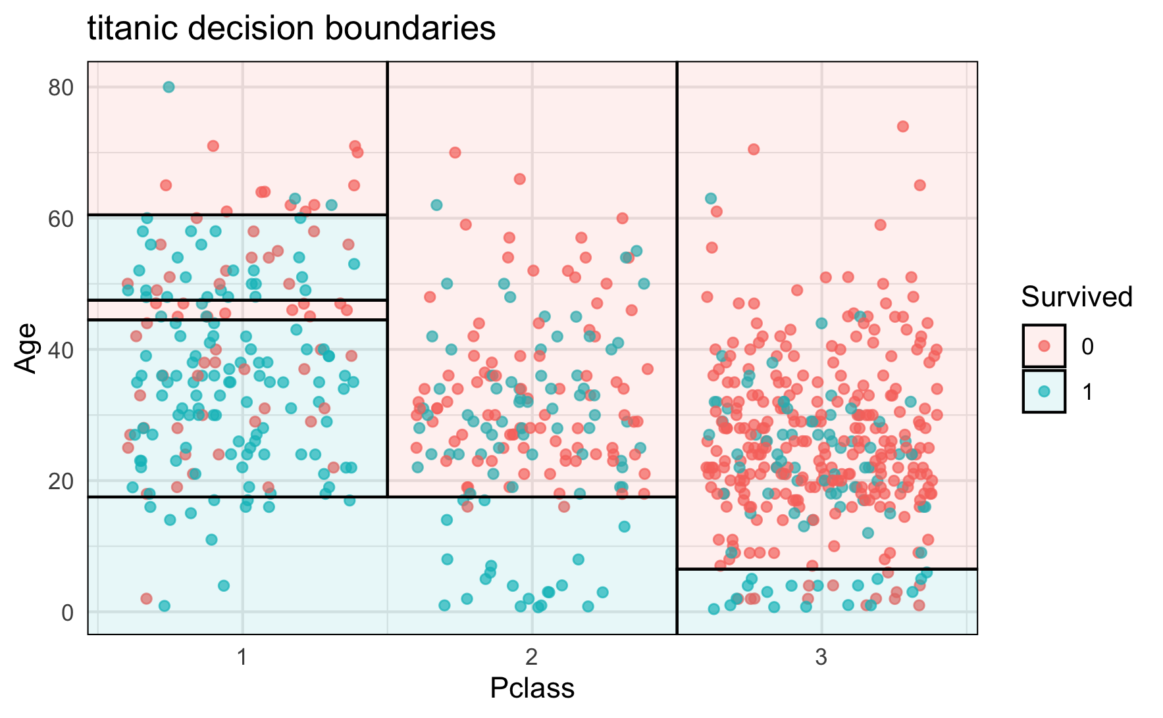
Decision Boundary / Surface
Diagnostic for creating for understanding the decisions made by a classification algorithm is the decision surface. This is a plot that shows how a fit machine learning algorithm predicts a coarse grid across the input feature space.
A decision surface plot is a powerful tool for understanding how a given model “sees” the prediction task and how it has decided to divide the input feature space by class label.

Slide 24
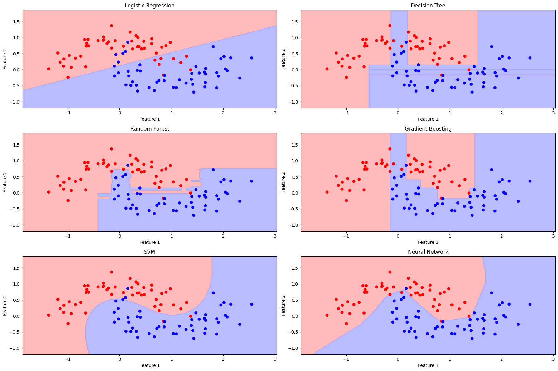

Slide 25

Power of Crowds
In the book: The Wisdom of Crowds: Why the Many Are Smarter Than the Few and How Collective Wisdom Shapes Business, Economies, Societies and Nations, Surowiecki argues that the aggregation of information results in decisions that are often better than could have been made by any single member of the group.

Slide 26

Combining Predictions
Voting
# Initialize individual models
dt1 = DecisionTreeClassifier(max_depth=5, random_state=42)
dt2 = DecisionTreeClassifier(max_depth=10, min_samples_leaf=4, random_state=42)
lr = LogisticRegression(random_state=42)
# Create the voting ensemble model
voting_clf = VotingClassifier(
estimators=[('dt1', dt1), ('dt2', dt2), ('lr', lr)],
voting='hard’
)
Decision Tree 1 Accuracy: 0.875
Decision Tree 2 Accuracy: 0.845
Logistic Regression Accuracy: 0.855
Ensemble Model Accuracy: 0.880
2 out of 3 dentist agree

Slide 27
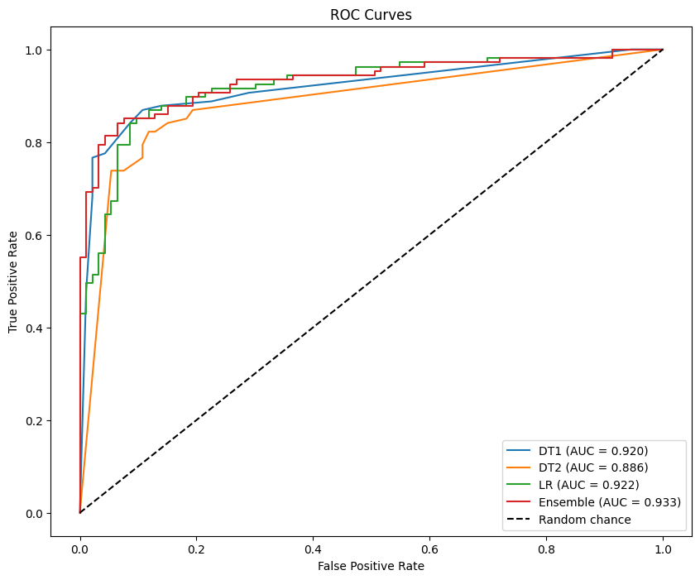
Combining Predictions
Averaging
# Initialize and train the individual models
dt1 = DecisionTreeClassifier(max_depth=5, random_state=42)
dt2 = DecisionTreeClassifier(max_depth=10, min_samples_leaf=4, random_state=42)
lr = LogisticRegression(random_state=42)
dt1.fit(X_train, y_train)
dt2.fit(X_train, y_train)
lr.fit(X_train, y_train)
# Predict probabilities on the test set for each model
dt1_probs = dt1.predict_proba(X_test)[:, 1]
dt2_probs = dt2.predict_proba(X_test)[:, 1]
lr_probs = lr.predict_proba(X_test)[:, 1]
# Create an averaged ensemble of the three models
ensemble_probs = (dt1_probs + dt2_probs + lr_probs) / 3
Decision Tree 1 AUC: 0.920
Decision Tree 2 AUC: 0.886
Logistic Regression AUC: 0.922
Ensemble Model AUC: 0.933

Slide 28
The problem with Decision Trees
You can get the same / similar / sometimes better / worse accuracy depending on Input Variables?
Decision Trees are “Weak Learners”
Sensitive to the Sample of Data they are Trained on
Different samples yield different trees
Sensitive to the variables presented
Different features yield different trees
Tend to overfit
In the quest for homogeneity end to make a lot of splits ~ yields over fitting

Slide 29
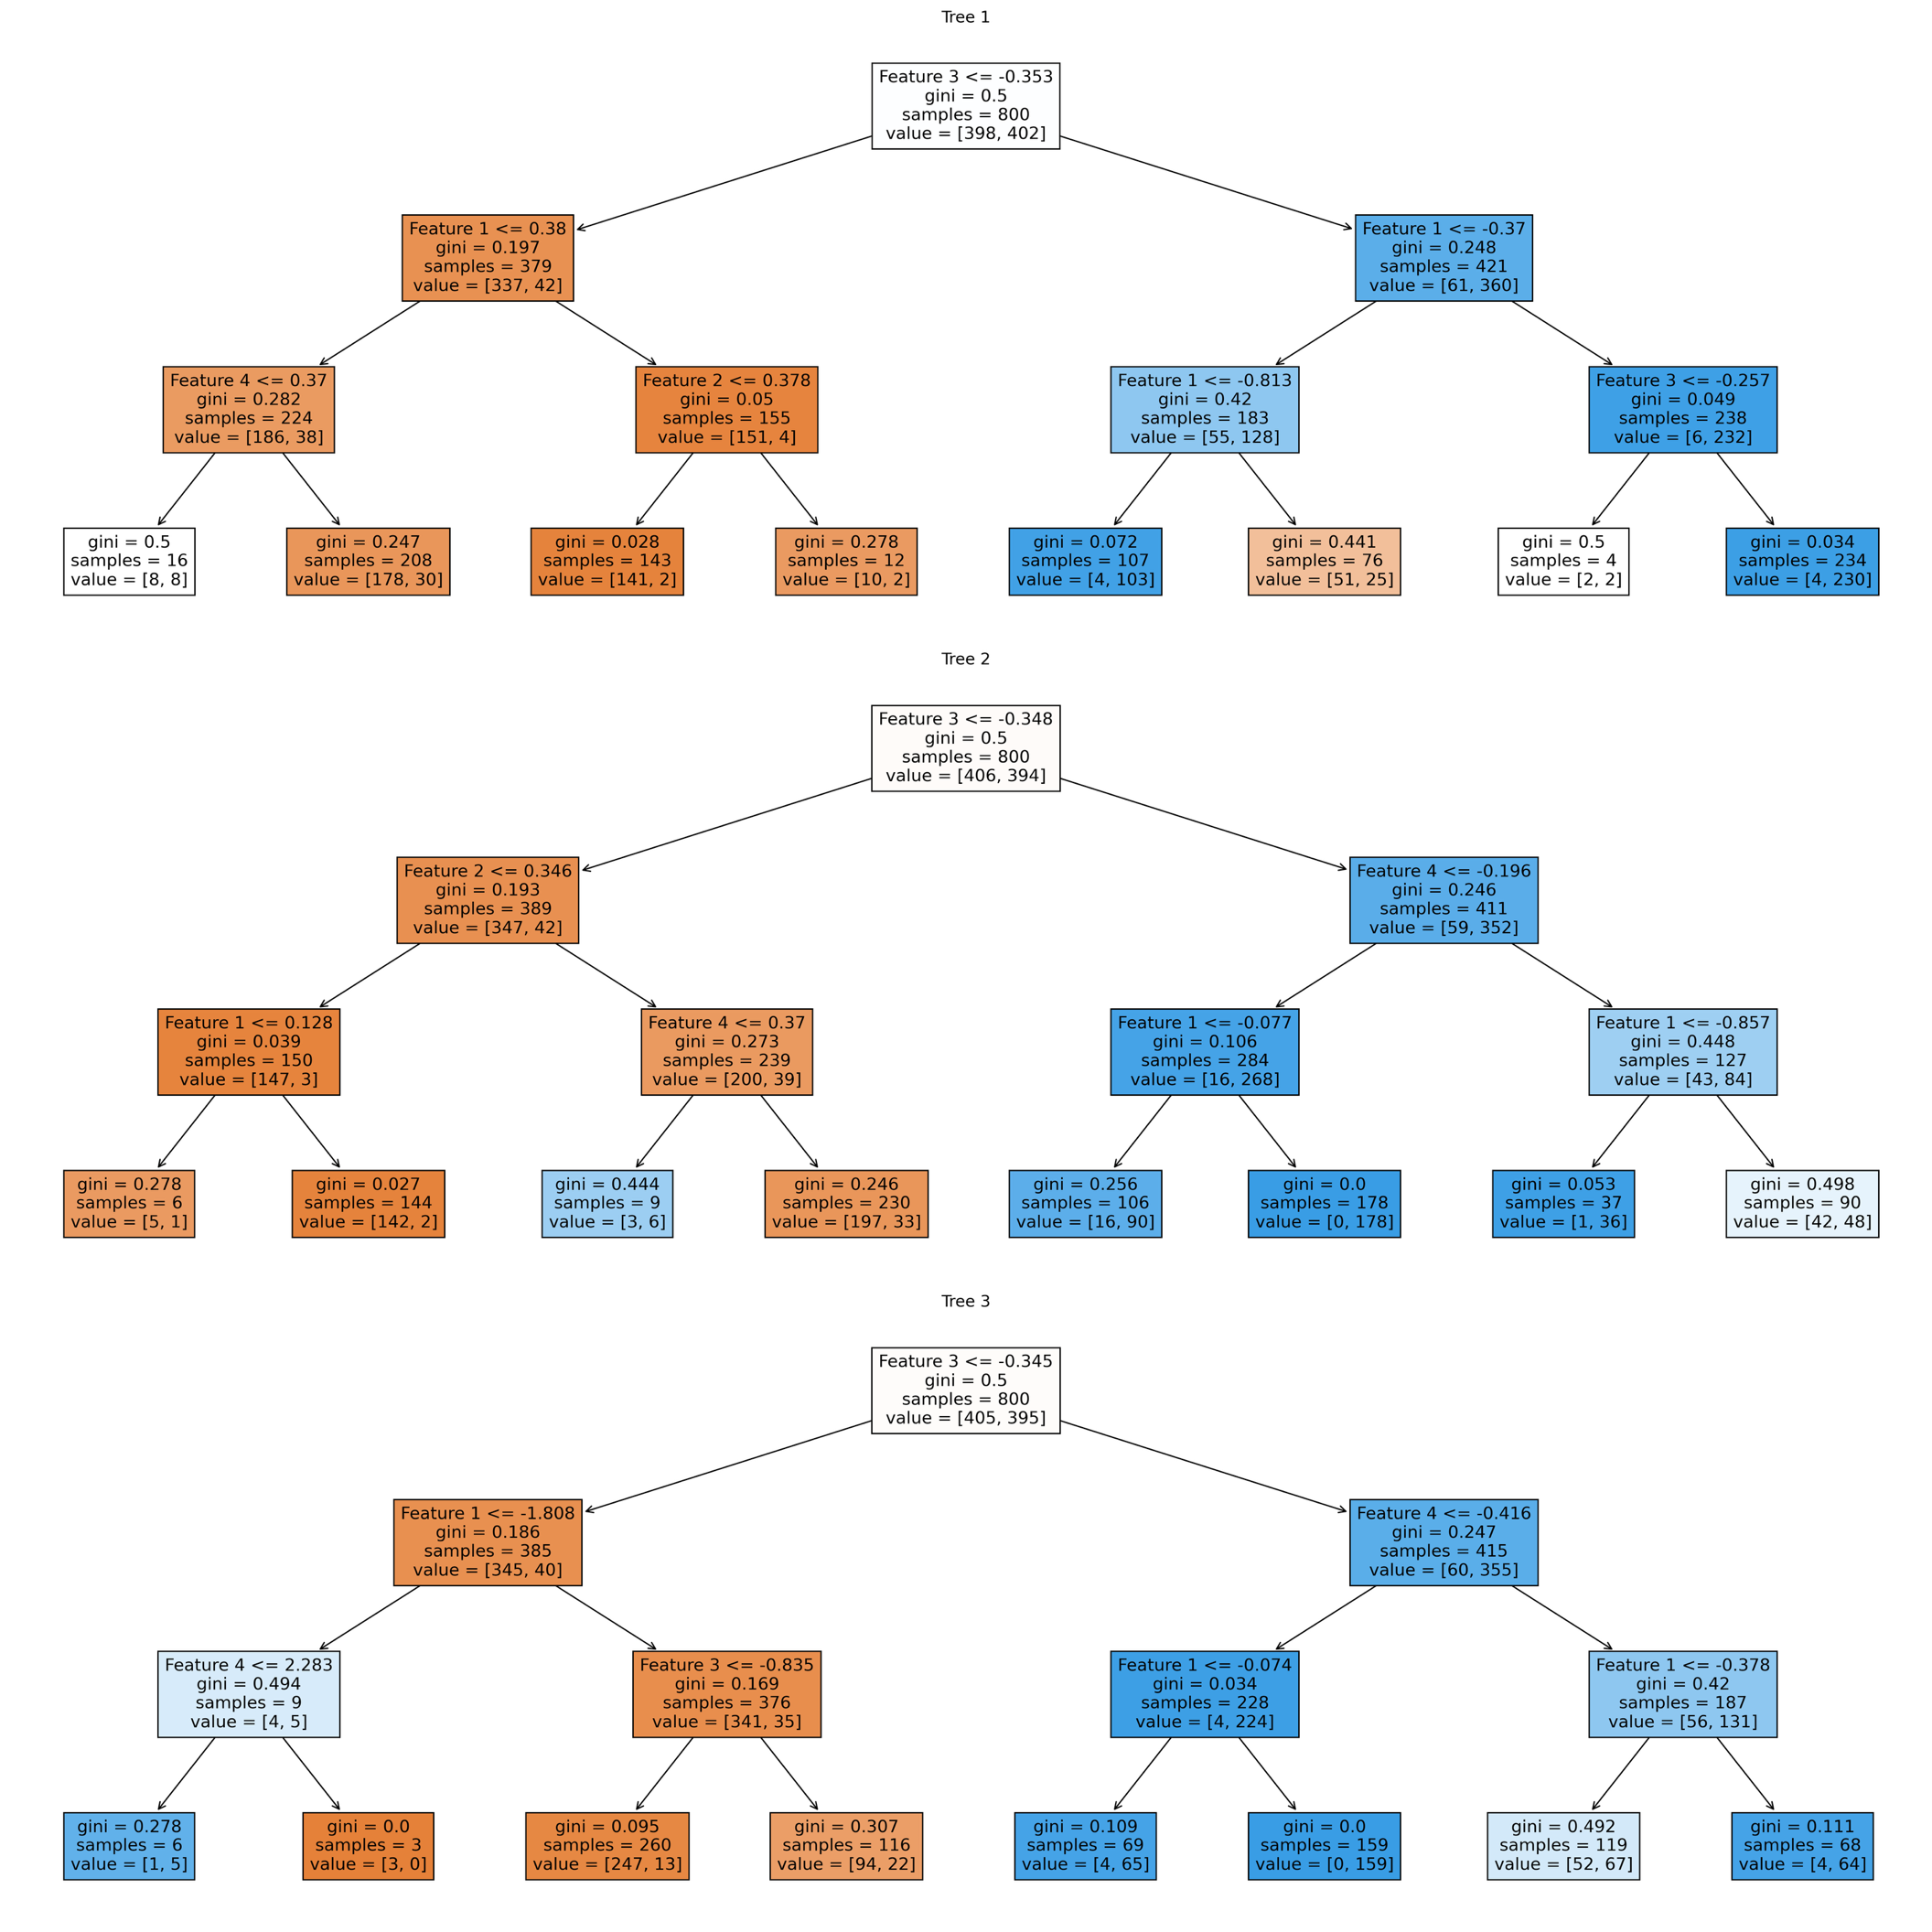
3 Different Samples = 3 Different Trees

Slide 30
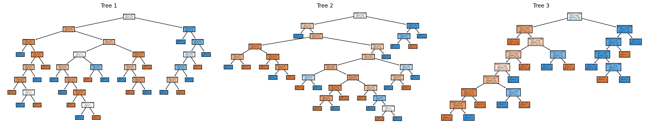
Construct Random Trees?
Suppose Train 3 Trees :
3 Bootstrap samples: bootstrap sampling to generate different subsets of the dataset for training each tree. This means that each tree in the forest is trained on a random subset of the data, with replacement.
Inject Feature randomness: When splitting a node during the construction of a tree, select a random subset of the features to consider for the best split. This increases diversity among the trees, which results in a more robust overall model.

Slide 31
Then them THEN ensemble them
Each Tree Performance
Tree 1 - Accuracy: 0.87, AUC: 0.87
Tree 2 - Accuracy: 0.90, AUC: 0.91
Tree 3 - Accuracy: 0.77, AUC: 0.75
Combine by AVERAGING each TREE’s prediction
Averaged Model - Accuracy: 0.93, AUC: 0.94
Notice,
Combined set of Trees produces higher performance over any single tree
Increases diversity, resulting in a more robust overall model.

Slide 32
Random Forest
How it Works
Bootstrap Sampling of Rows: Each tree in the Random Forest is trained on a bootstrap sample of the original dataset. This means that each tree is trained on a random sample of the data where some observations may be repeated and some may be left out. This technique helps in creating diverse trees.
Random Subset of Columns at Each Split: When splitting a node, Random Forest does not consider all features for the best split. Instead, it randomly selects a subset of features to evaluate for the best split.
This subset is typically the square root of the total number of features for classification problems, and one-third for regression problems.
This technique helps in making the trees less correlated and increases the overall diversity of the forest.
Combine Predictions
Classification = Majority Voting
Regression = Averaging

Slide 33
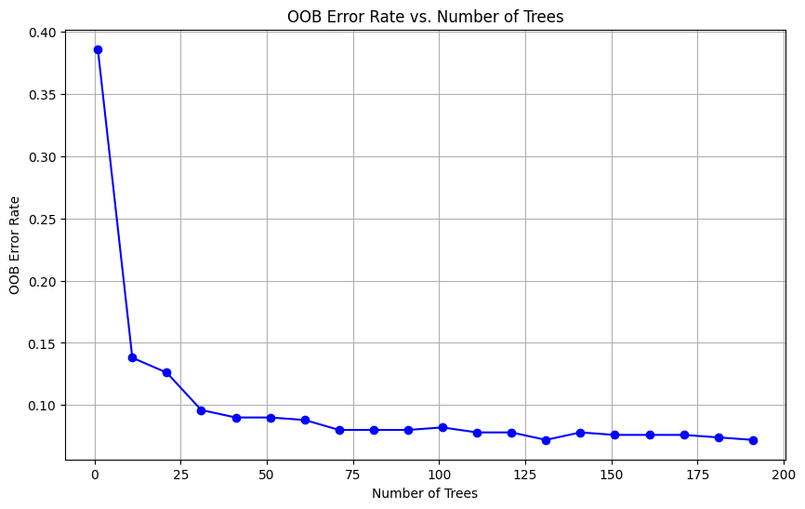
Advantages
It is one of the most accurate learning algorithms available.
n_estimators = number of trees to grow
max_features = number of columns to sample
min_samples_split = minimum number of observations to consider for split
Robust to overfitting
It runs efficiently on large data and can hand thousands of input features
Easily parallelizable
It provides an estimate of variables importance.
Though there is some debate in the community about the default variable importance calculation
It generates an internal unbiased estimate of the generalization error as the forest building progresses.
OOB error can be used to stop training,
It has an effective method for estimating missing data.
But generally pre-processing steps take care of that for you.

Slide 34
Forests and Tuning Churn

Slide 35
Boosting
Sequential AKA forward learning ensemble method
Boosting is an ensemble technique in which the predictors are trained sequentially.
Essentially subsequent predictors learn from the mistakes of the previous predictors.

Slide 36
How Boosting Works
Boosting involves three elements:
A loss function to be optimized – essentially every ML model is minimizing a loss function
A weak learner to make predictions –
A weak learner is a model that performs slightly better than random guessing.
Typical algorithms with restrictions: trees, knn, mlp(nnet), naïve bayes,
An additive model to add weak learners to minimize the loss function.
Loss Function
Regression: mean squared error.
Classification: logarithmic loss.
Weak Learner
regression decision trees are used that output real values
Additive model
Trees are added one at a time (sequentially)

Slide 37
Gradient Boosting
Key components
Number of Trees
Constrains the algorithm, it learns sequentially
Tree Constraints (our standard set)
Tree depth, deeper trees are more complex trees and shorter trees are preferred. Generally, better results are seen with 4-8 levels.
Number of nodes or number of leaves, like depth, this can constrain the size of the tree, but is not constrained to a symmetrical structure if other constraints are used.
Number of observations per split imposes a minimum constraint on the amount of training data at a training node before a split can be considered
Weighted Updates
The predictions of each tree are added together sequentially. The contribution of each tree to this sum can be weighted to slow down the learning by the algorithm. This weighting is called a shrinkage or a learning rate.
Stochastic Gradient Boosting
At each iteration a subsample of the training data is drawn at random (without replacement) from the full training dataset. The randomly selected subsample is then used, instead of the full sample, to fit the base learner.
Subsample rows and columns before creating each tree.
Subsample columns before considering each split.

Slide 38
Gradient Boosting Machine
Steps of Gradient Boosting
Step 1 – make initial prediction
Step 2 – compute pseudo residuals
Step 3 – predict pseudo residuals
Step 4 – make a prediction
Step 5 – rinse repeat

Slide 39
Gradient Boosting
Step 1 – make initial prediction
Make Initial Prediction – Average of the Target Variable
av_total | land_sf | living_area | num_floors | bld_age | avg_pred
321200 | 10288 | 1681 | 1 | 29 | 448563.6
450500 | 3187 | 1868 | 2 | 20 | 448563.6
794300 | 6007 | 2146 | 2 | 20 | 448563.6
342100 | 5500 | 1357 | 1.5 | 19 | 448563.6
444700 | 3026 | 2346 | 2.5 | 121 | 448563.6
518500 | 4950 | 2032 | 2 | 9 | 448563.6
467200 | 7500 | 1648 | 2 | 134 | 448563.6
432600 | 5000 | 1772 | 2 | 111 | 448563.6
294900 | 6400 | 1532 | 2 | 88 | 448563.6
329200 | 4449 | 1224 | 2 | 96 | 448563.6
Here our initial prediction is the AVERAGE of AV_TOTAL

Slide 40
Gradient Boosting
Step 2 – compute pseudo residuals
Compute pseudo residuals
Pseudo_residual_1 = av_total – avg_pred
Pseudo_residual_1 becomes our target variable for step 3
av_total | land_sf | living_area | num_floors | bld_age | avg_pred | Pseudo_residual_1
321200 | 10288 | 1681 | 1 | 29 | 448563.6 | -127363.64
450500 | 3187 | 1868 | 2 | 20 | 448563.6 | 1936.361
794300 | 6007 | 2146 | 2 | 20 | 448563.6 | 345736.361
342100 | 5500 | 1357 | 1.5 | 19 | 448563.6 | -106463.64
444700 | 3026 | 2346 | 2.5 | 121 | 448563.6 | -3863.639
518500 | 4950 | 2032 | 2 | 9 | 448563.6 | 69936.361
467200 | 7500 | 1648 | 2 | 134 | 448563.6 | 18636.361
432600 | 5000 | 1772 | 2 | 111 | 448563.6 | -15963.639
294900 | 6400 | 1532 | 2 | 88 | 448563.6 | -153663.64
329200 | 4449 | 1224 | 2 | 96 | 448563.6 | -119363.64

Slide 41
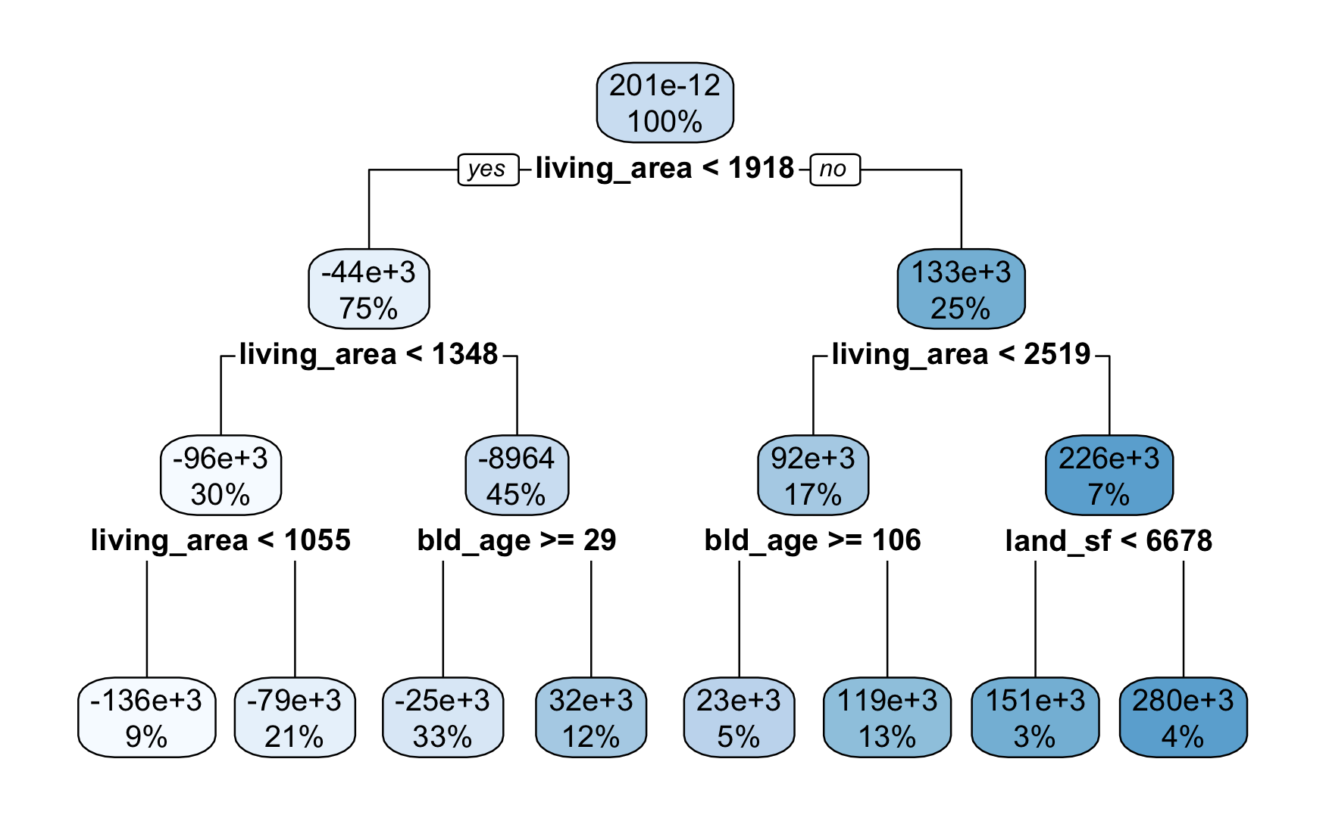
Gradient Boosting
Step 3 – predict pseudo residuals
Step 3 – Predict Pseudo Residuals
Using the residuals from step 2 as the target, train a tree to predict the residuals
av_total | land_sf | living_area | num_floors | bld_age | avg_pred | Pseudo_residual_1 | res_pred_1
321200 | 10288 | 1681 | 1 | 29 | 448563.6 | -127363.64 | -37845.902
450500 | 3187 | 1868 | 2 | 20 | 448563.6 | 1936.361 | 40836.953
794300 | 6007 | 2146 | 2 | 20 | 448563.6 | 345736.361 | 127415.925
342100 | 5500 | 1357 | 1.5 | 19 | 448563.6 | -106463.64 | -14587.324
444700 | 3026 | 2346 | 2.5 | 121 | 448563.6 | -3863.639 | -17700.553
518500 | 4950 | 2032 | 2 | 9 | 448563.6 | 69936.361 | 127415.925
467200 | 7500 | 1648 | 2 | 134 | 448563.6 | 18636.361 | 9356.077
432600 | 5000 | 1772 | 2 | 111 | 448563.6 | -15963.639 | 9356.077
294900 | 6400 | 1532 | 2 | 88 | 448563.6 | -153663.64 | 9356.077
329200 | 4449 | 1224 | 2 | 96 | 448563.6 | -119363.64 | -84966.862
Target
prediction
Inputs

Slide 42

Gradient Boosting
Step 4 - Make a prediction and compute the residuals
Step 4. Make a Prediction and compute Residuals
Prediction = Avg Predicted + learning Rate * pseudo residual 1
$res_{pred}=avg_{pred}+learn_{rate}∗res_1$
av_total | land_sf | living_area | num_floors | bld_age | avg_pred | Pseudo_residual_1 | res_pred_1 | pred_1 | Pseudo_residual_2
321200 | 10288 | 1681 | 1 | 29 | 448563.6 | -127363.64 | -37845.902 | 410717.7 | -89517.737
450500 | 3187 | 1868 | 2 | 20 | 448563.6 | 1936.361 | 40836.953 | 489400.6 | -38900.592
794300 | 6007 | 2146 | 2 | 20 | 448563.6 | 345736.361 | 127415.925 | 575979.6 | 218320.436
342100 | 5500 | 1357 | 1.5 | 19 | 448563.6 | -106463.64 | -14587.324 | 433976.3 | -91876.315
444700 | 3026 | 2346 | 2.5 | 121 | 448563.6 | -3863.639 | -17700.553 | 430863.1 | 13836.914
518500 | 4950 | 2032 | 2 | 9 | 448563.6 | 69936.361 | 127415.925 | 575979.6 | -57479.564
467200 | 7500 | 1648 | 2 | 134 | 448563.6 | 18636.361 | 9356.077 | 457919.7 | 9280.284
432600 | 5000 | 1772 | 2 | 111 | 448563.6 | -15963.639 | 9356.077 | 457919.7 | -25319.716
294900 | 6400 | 1532 | 2 | 88 | 448563.6 | -153663.64 | 9356.077 | 457919.7 | -163019.72
329200 | 4449 | 1224 | 2 | 96 | 448563.6 | -119363.64 | -84966.862 | 363596.8 | -34396.776

Slide 43
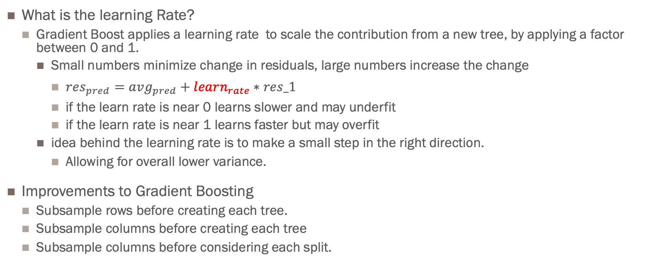
More on Boosting
Improving performance
What is the learning Rate?
Gradient Boost applies a learning rate to scale the contribution from a new tree, by applying a factor between 0 and 1.
Small numbers minimize change in residuals, large numbers increase the change
$res_{pred}=avg_{pred}+learn_{rate}∗res_1$
if the learn rate is near 0 learns slower and may underfit
if the learn rate is near 1 learns faster but may overfit
idea behind the learning rate is to make a small step in the right direction.
Allowing for overall lower variance.
Improvements to Gradient Boosting
Subsample rows before creating each tree.
Subsample columns before creating each tree
Subsample columns before considering each split.

Slide 44
Boosting
Sequential Learners, where several models are generated sequentially by training the model on the mistakes of previous model(s). This aims at exploiting the dependency between models by giving the mislabeled examples higher weights (e.g. AdaBoost).
We first model data with simple models and analyze data for errors.
These errors signify data points that are difficult to fit by a simple model.
Then for subsequent models, we focus on those hard to fit data to get them right.
Combine all the predictors by giving some weights to each predictor.
Trevor Hastie in all his Glory!
https://www.youtube.com/watch?v=wPqtzj5VZus
https://www.youtube.com/watch?time_continue=215&v=sRktKszFmSk&feature=emb_logo

Slide 45
XGBoost
Extreme Gradient Boosting
XGBoost was developed by Tianqi Chen and Carlos Guestrin and it is an ensemble machine learning technique that uses the Gradient boosting framework for machine learning prediction and XGBoost is well known for its fast execution and Scalability.
Gradient Boosting is a boosting technique for each iteration the new predictor is built to fit on the pseudo-residuals of the previous predictor
XGBoost fits a model on the gradient of loss generated from the previous predictor. XGBoost is just a modification of the gradient boosting algorithm so that it works with any differentiable loss function.
https://github.com/dmlc/xgboost/tree/master/demo
http://datascience.la/xgboost-workshop-and-meetup-talk-with-tianqi-chen/
https://xgboost.readthedocs.io/en/latest/

Slide 46
Boosting
Key components
Number of Trees
Constrains the algorithm, it learns sequentially
Tree Constraints (our standard set)
Tree depth, deeper trees are more complex trees and shorter trees are preferred. Generally, better results are seen with 4-8 levels.
Number of nodes or number of leaves, like depth, this can constrain the size of the tree, but is not constrained to a symmetrical structure if other constraints are used.
Number of observations per split imposes a minimum constraint on the amount of training data at a training node before a split can be considered
Weighted Updates
The predictions of each tree are added together sequentially. The contribution of each tree to this sum can be weighted to slow down the learning by the algorithm. This weighting is called a shrinkage or a learning rate.
Stochastic Gradient Boosting
At each iteration a subsample of the training data is drawn at random (without replacement) from the full training dataset. The randomly selected subsample is then used, instead of the full sample, to fit the base learner.
Subsample rows and columns before creating each tree.
Subsample columns before considering each split.

Slide 47
GBM From Scratch GBM & Churn

Slide 48
Watch and Read
Video
https://www.youtube.com/watch?v=9wDoiSo8trc
https://www.youtube.com/watch?v=Nol1hVtLOSg
Read
https://uc-r.github.io/gbm_regression
Book Chapter 7 pages 222 – 235
Looking ahead
Read Chapter 10 pages 299 – 317

Slide 49


