Slide 1
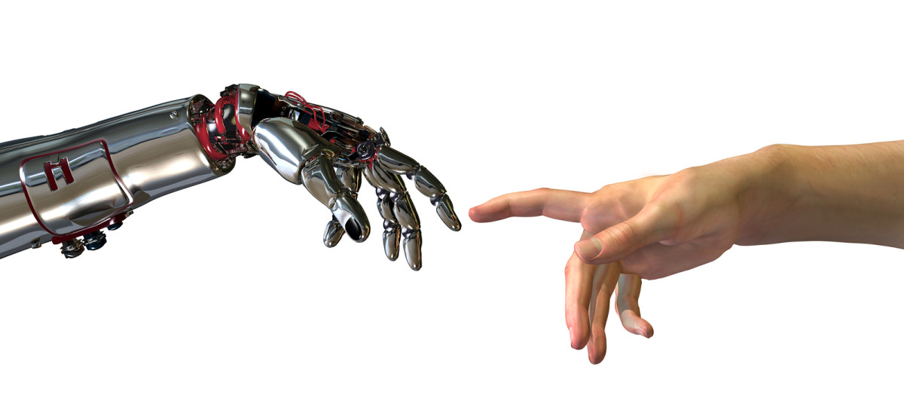
PCA+SVM Based Face Recognition
Yan Ma
(40024856)

Slide 2
Outline
Introduction
How to extract features from an image?
How to construct the classifier?
Results
Future work
This project is base on:
Face Recognition Using PCA and SVM
Face Recognition by Support Vector Machine

Slide 3
Introduction
Face recognition widely used in public security, security authentication system, credit card verification, file management and Interactive system, etc.
Current hot research topic in the field of pattern recognition and artificial intelligence.
How to use Principle Component Analysis (PCA) and Support Vector Machine (SVM) to implement face recognition？

Slide 4
Feature Extract
Principle Component Analysis (PCA)
What is PCA and how does it work?
How to select the best k?

Slide 5
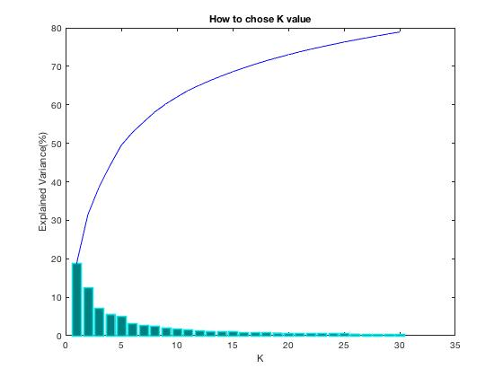
How to select k in PCA?
Explained Variance ratio
X - axis is the number of k. each bar represent the kth highest eigenvalues of scatter matrix.
Y- axis is the explained variance ratio, which is defined as follows:
Explained Variance ratio is how good I can represent the original value
k = 20 is a good option
Notes:
Data

Slide 6
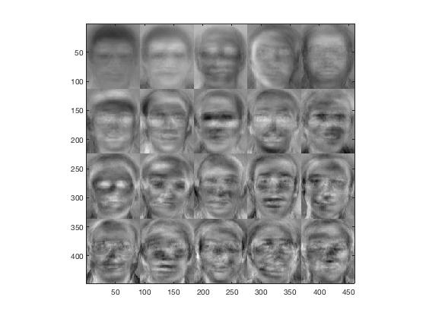
PCA Result

Slide 7
Preprocessing Data
Split the data into training data (5 for each) and test data (5 for each)
Read the data and use PCA to decrease the dimension (down to 20)
Normalize the data
Feed the data into SVM

Slide 8
How to Construct SVM
Which kernel to use?
How to select the parameter values in SVM?
How to construct multi-classifier SVM?

Slide 9
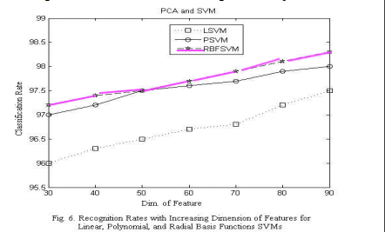
Which kernel we are going to use?
P-SVM: memory overflow because of dot product
Sigmoid-SVM: more parameters to determine
L-SVM: particular case of RBFSVM
Method Supported by:
Face Recognition Using PCA and SVM

Slide 10
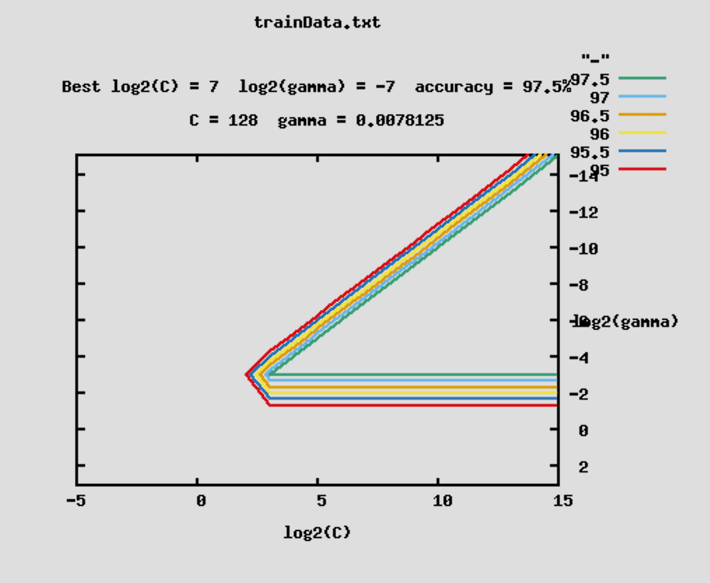
How to select parameters in SVM
We have 2 parameters to consider in RBFSVM
C is the constraint violation in soft margin SVM (lecture 8)
And from the kernel function
Method Supported by:
How to do the cross-validation for SVM?

Slide 11
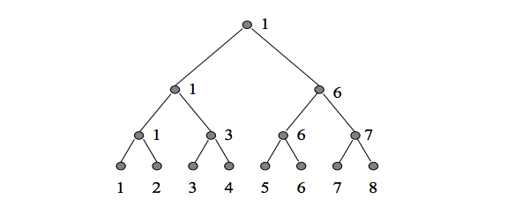
How to construct multi-classifier
Bottom-up decision tree
Boxing match
How many classifiers? (n labels)
The process is fast as each test just compute the inner product and just n-1comparisons.
Method Supported by:
Face Recognition Using PCA and SVM
Face Recognition by Support Vector Machines

Slide 12
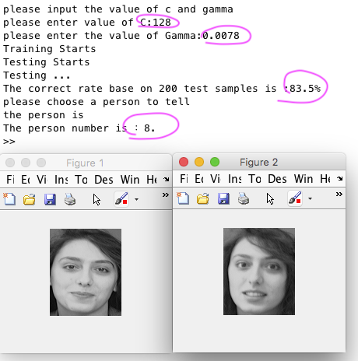
Result
I use 5 pictures for each person to train the dataset and 5 pictures for each person to test the data.
I choose the C=128 and Gamma = 0.0078
The test correct rate is 83.5%
And I choose person number 8 into PCA-SVM classifier, I got a correct match

Slide 13
Future work
Improve the code
Consider real time constraints

