Slide 1
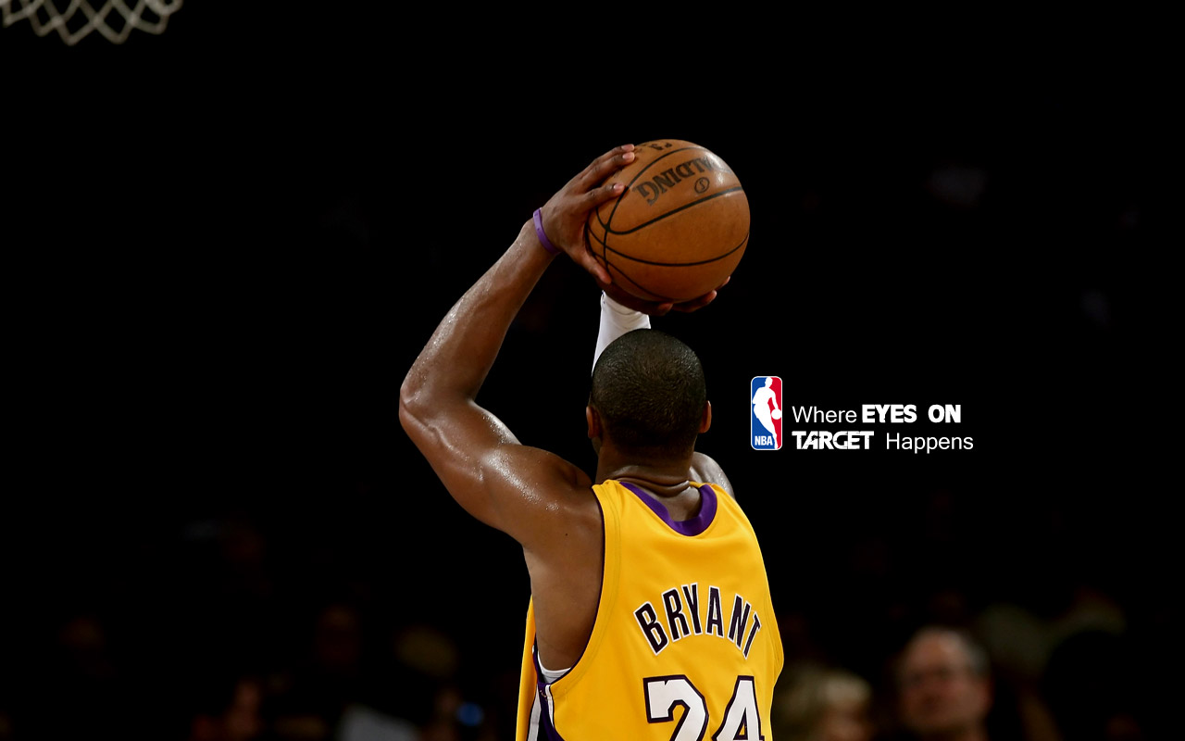
Analyzing NBA Teams Using Big Data Technologies
Yan Ma
(40024856)

Slide 2
Outline
Introduction
Player Clustering
Team Features Constructing and Team Clustering
Team Construction Discovery
Future work

Slide 3
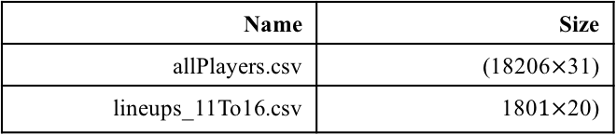
Introduction
Background: National Basketball Association (NBA) has entered a faster-paced offensive era, the league has skewed towards taking more 3-point shots due to their high efficiency as measured by points per field goal attempt. Therefore, there is a huge difference between a team in the 90s and a team in the year 2010.
Objective: How to construct a ‘New era’ basketball teams?
Technology: K-means, Frequent item sets, PageRank
Databases:
Name | Size
allPlayers.csv | (18206$×$31)
lineups_11To16.csv | 180$1×$20)

Slide 4
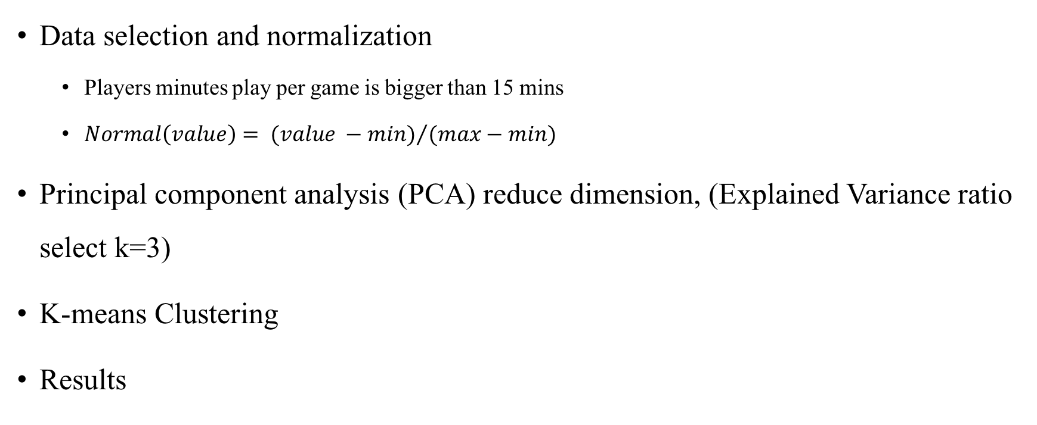
Player Clustering
Data selection and normalization
Players minutes play per game is bigger than 15 mins
$Normal\left(value\right)= {(value −min)}/{(max−min)}$
Principal component analysis (PCA) reduce dimension, (Explained Variance ratio select k=3)
K-means Clustering
Results

Slide 5
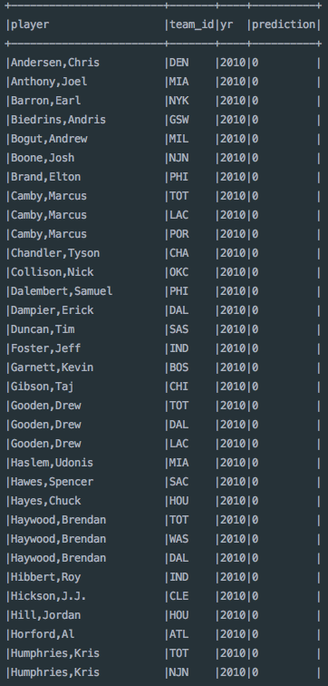
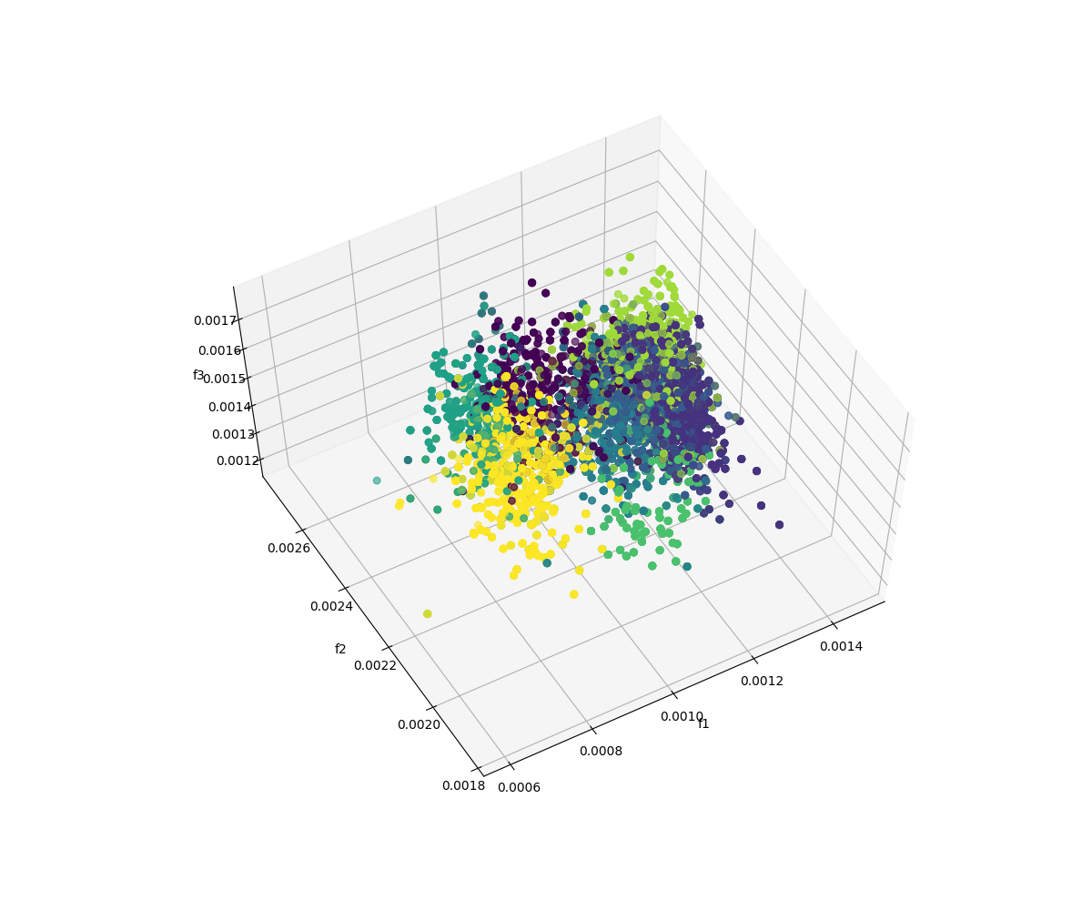
Player Clustering Results
label | explain
0 | Traditional Big Center
1 | All –round Forward
2 | Guard
7 | Shooter

Slide 6
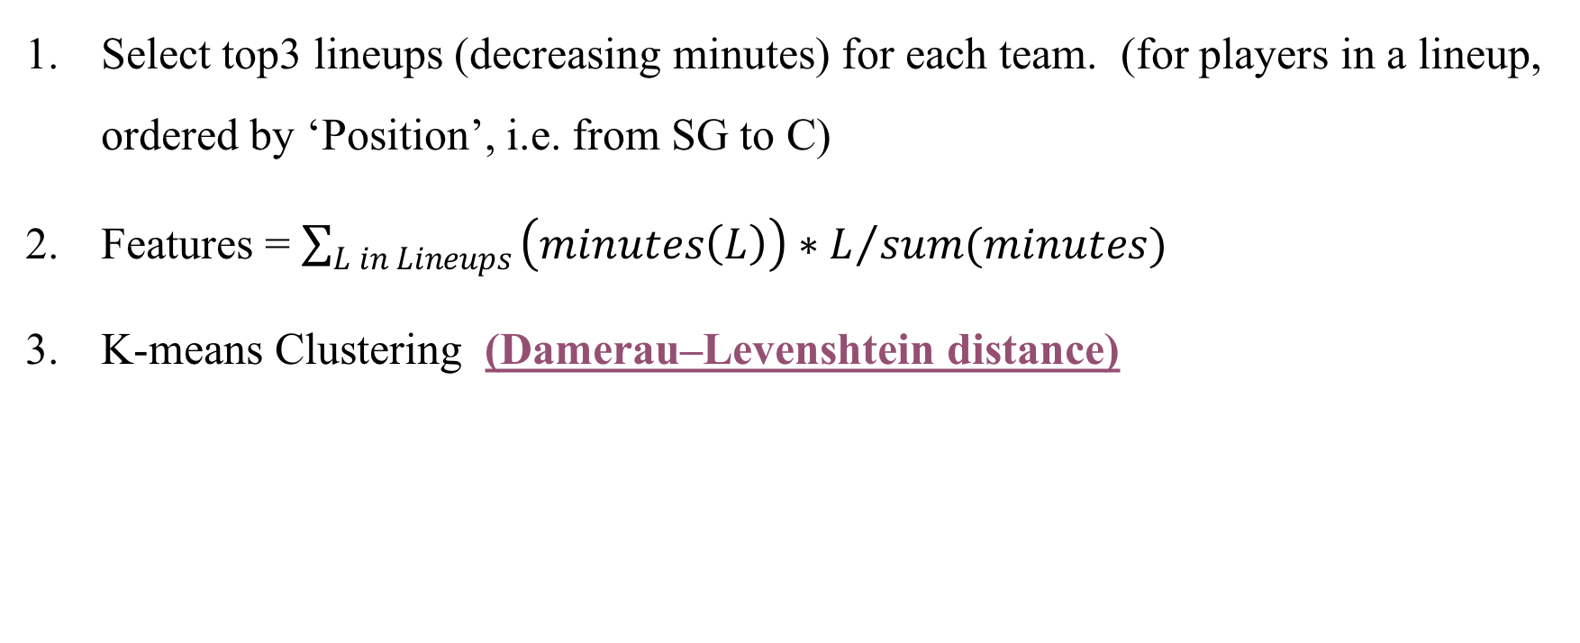
Team Features Constructing and Team Clustering
Select top3 lineups (decreasing minutes) for each team. (for players in a lineup, ordered by ‘Position’, i.e. from SG to C)
Features = $\sum_{L in Lineups}{{\left(minutes\left(L\right)\right)∗L}/{sum(minutes)} }$
K-means Clustering (Damerau–Levenshtein distance)

Slide 7
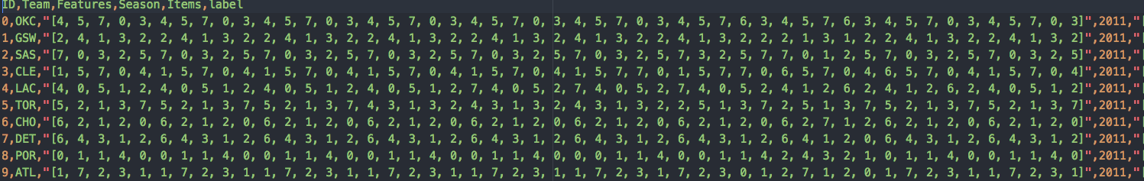

Some Explanation
Features: For a lineup [p1, p2, p3, p4, p5], $p_{i}$ is ordered by it position, from SG to C
Damerau–Levenshtein distance between two words is the minimum number of operations (consisting of insertions, deletions or substitutions of a single character, or transposition of two adjacent characters) required to change one word into the other.
Centroid: A String which has min distance to other strings in a cluster

Slide 8
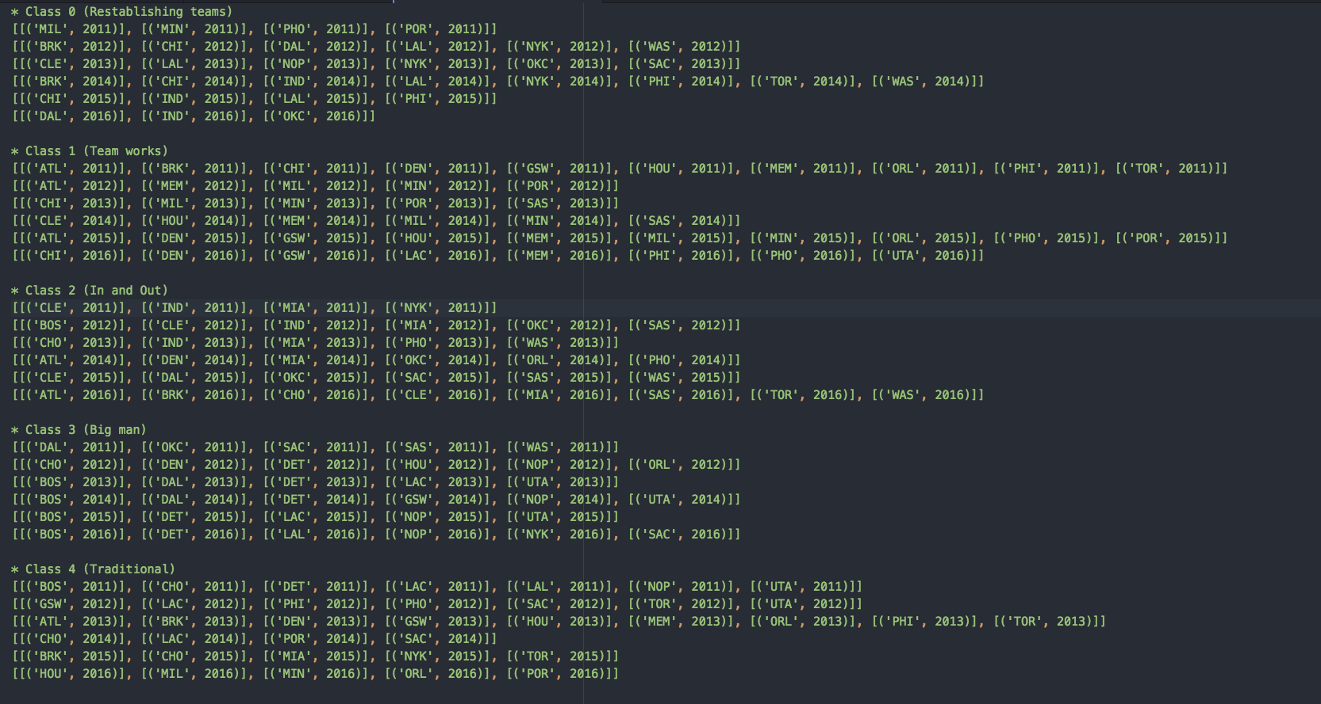
Team Clustering Results

Slide 9
Team Construction Discovery
Discovering teams in different clusters base on:
Frequent item sets: Find players combination
PageRank on passing network: Find the importance for each kind of players

Slide 10
Team Construction Discovery Results
class | items | freq | Association Rule | antecedent | Consequent | Confidence
0 | 7 | 26 |  | 3 | 2 | 0.818
 | [7, 2] | 22 |  | 3 | 1 | 0.863
 | [7, 2, 1] | 20 |  | 7 | 2 | 0.846
 | [7, 1] | 24 |  | 7 | 1 | 0.923
 | 3 | 22 |  | 0 | 2 | 0.833
 | [3, 2] | 18 |  | 0 | 1 | 0.875
 | [3, 1] | 19 |  | [7, 1] | 2 | 0.75
class | items | freq | Association Rule | antecedent | Consequent | Confidence
1 | 2 | 31 |  | 3 | 7 | 0.76
 | [7, 2] | 25 |  | 3 | 1 | 0.84
 | [7, 2, 1] | 21 |  | 7 | 2 | 0.81
 | [2 1] | 26 |  | 7 | 0 | 0.645
 | 6 | 23 |  | 7 | 1 | 0.806
 | 0 | 24 |  | 7 | 3 | 0.613
 | [0, 2] | 21 |  | [7, 2] | 1 | 0.875

Slide 11
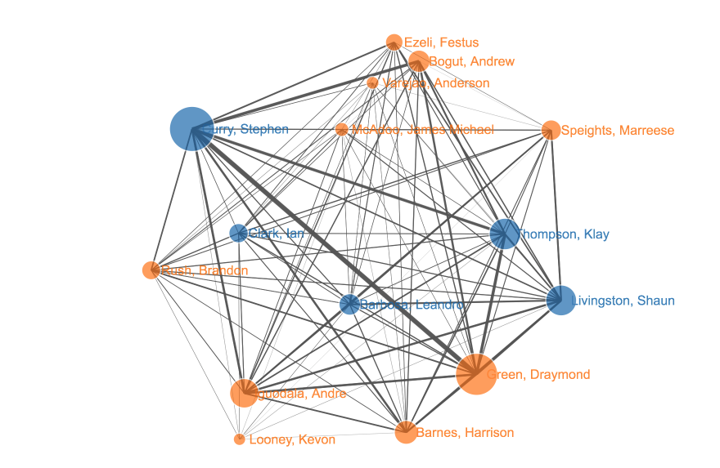
PageRank result
name | value | label
curry | 2.17 | 2
Green | 1.99 | 1
Thompson, Klay | 1.34 | 7
Livingston, Shaun | 1.29 | 2
Iguodala, Andre | 1.21 | 1
Barnes, Harrison | 0.86 | 1
Bogut, Andrew | 0.77 | 0

Slide 12
Future Work
For different teams in each clusters, calculate the importance ratio for different players in different cluster.
Continue analysing team constructions base on page-rank and frequent itemsets.

