Slide 1
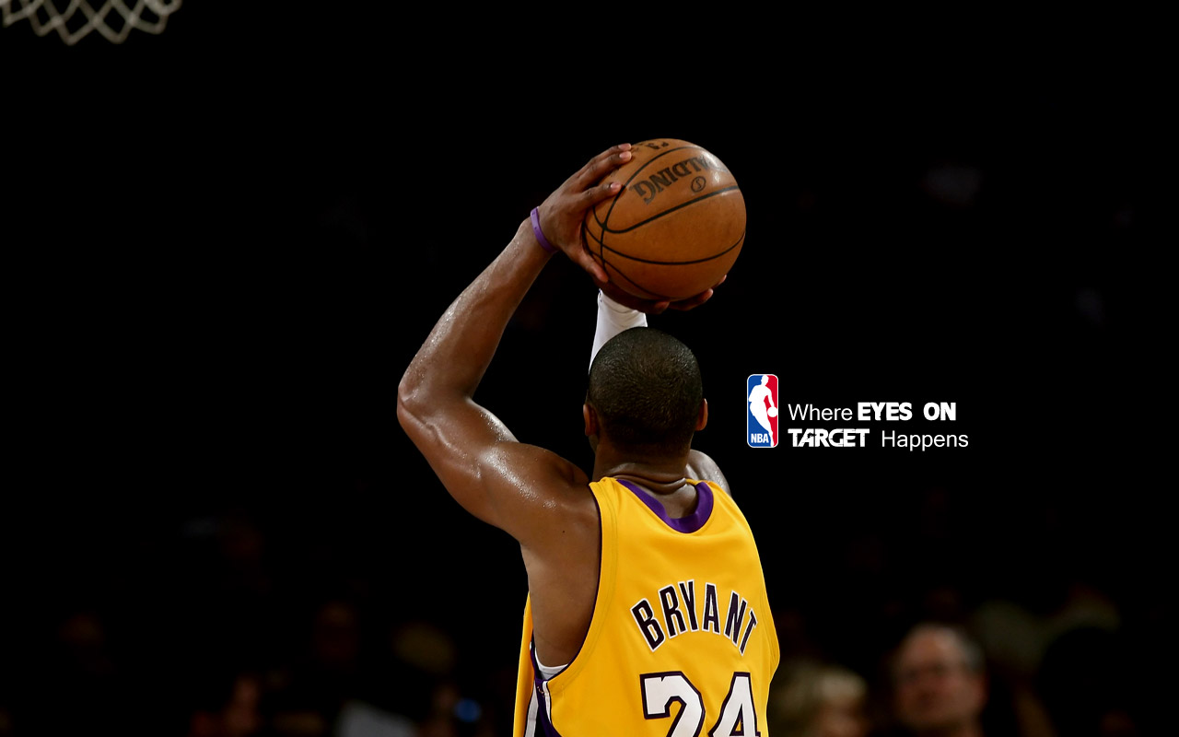
PCA+SVM Based Face Recognition
Yan Ma
(40024856)

Slide 2
Outline
Introduction
Player Clustering
Team Features Constructing and Team Clustering
Team Construction Discovery
Future work
This project is base on:
Face Recognition Using PCA and SVM
Face Recognition by Support Vector Machine

Slide 3
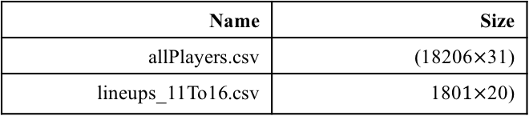
Introduction
Background: National Basketball Association (NBA) has entered a faster-paced offensive era, the league has skewed towards taking more 3-point shots due to their high efficiency as measured by points per field goal attempt. Therefore, there is a huge difference between a team in the 90s and a team in the year 2010.
Objective: How to construct a basketball teams which is fit in the new era?
Technology: K-means, Frequent item sets, PageRank
Databases:
Name | Size
allPlayers.csv | (18206$×$31)
lineups_11To16.csv | 180$1×$20)

Slide 4
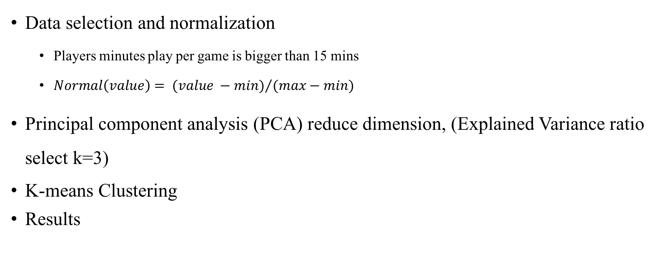
Player Clustering
Data selection and normalization
Players minutes play per game is bigger than 15 mins
$Normal\left(value\right)= {(value −min)}/{(max−min)}$
Principal component analysis (PCA) reduce dimension, (Explained Variance ratio select k=3)
K-means Clustering
Results

Slide 5
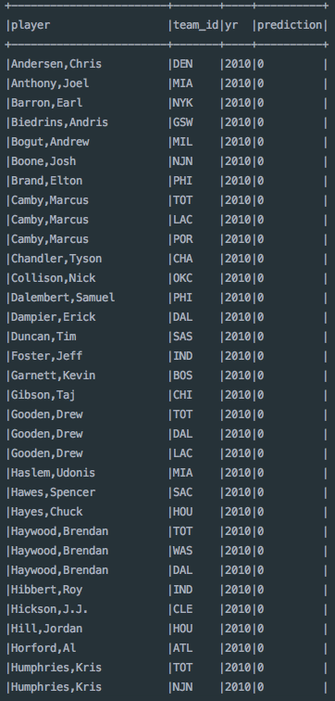
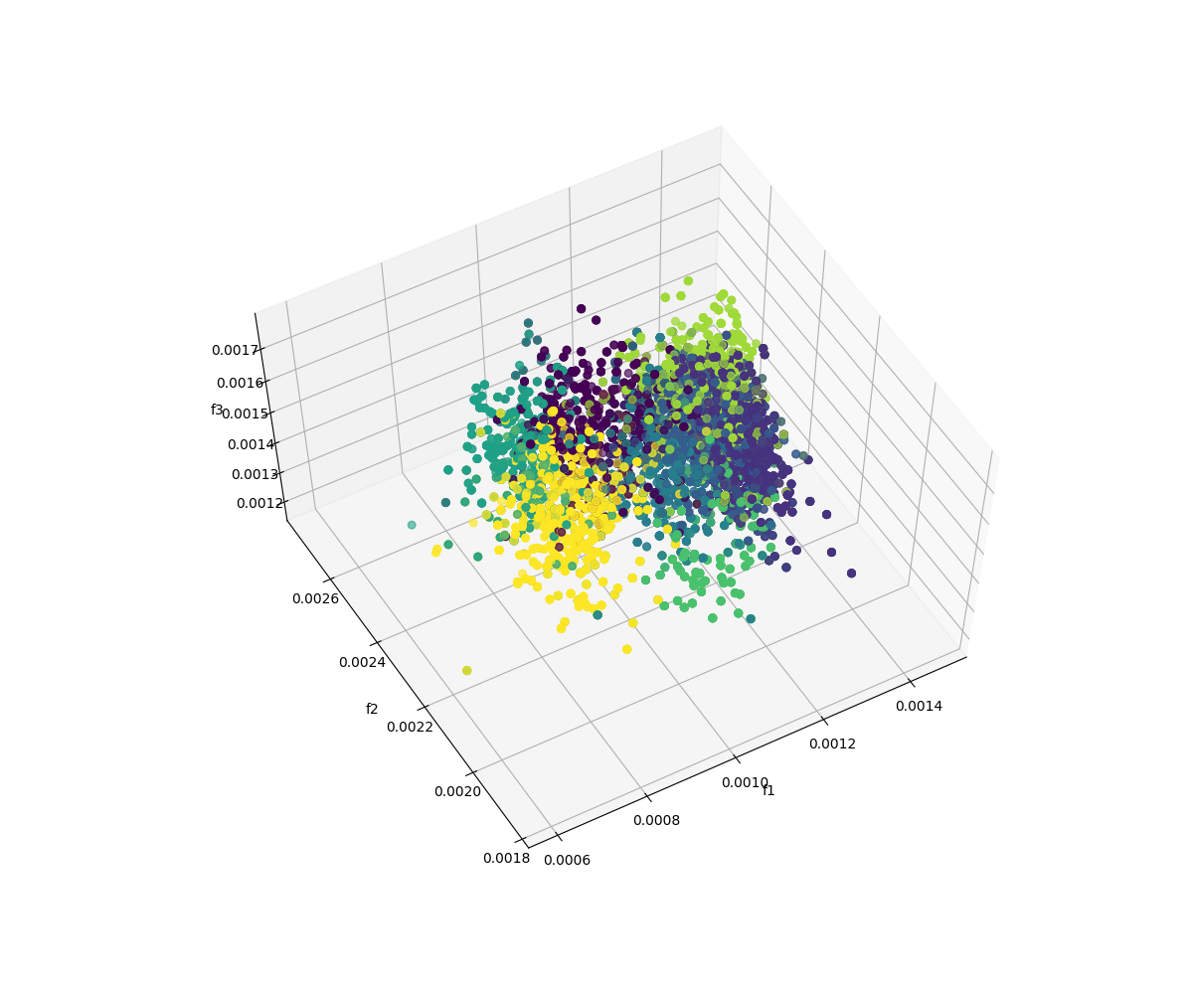
Player Clustering Results

Slide 6
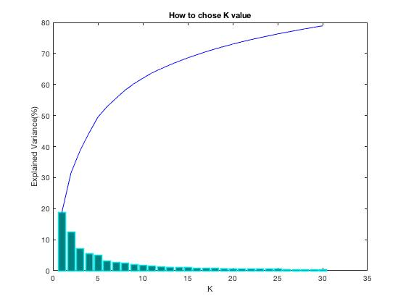
How to select k in PCA?
Explained Variance ratio
X - axis is the number of k. each bar represent the kth highest eigenvalues of scatter matrix.
Y- axis is the explained variance ratio, which is defined as follows:
Explained Variance ratio is how good I can represent the original value
k = 20 is a good option
Notes:
Data

Slide 7
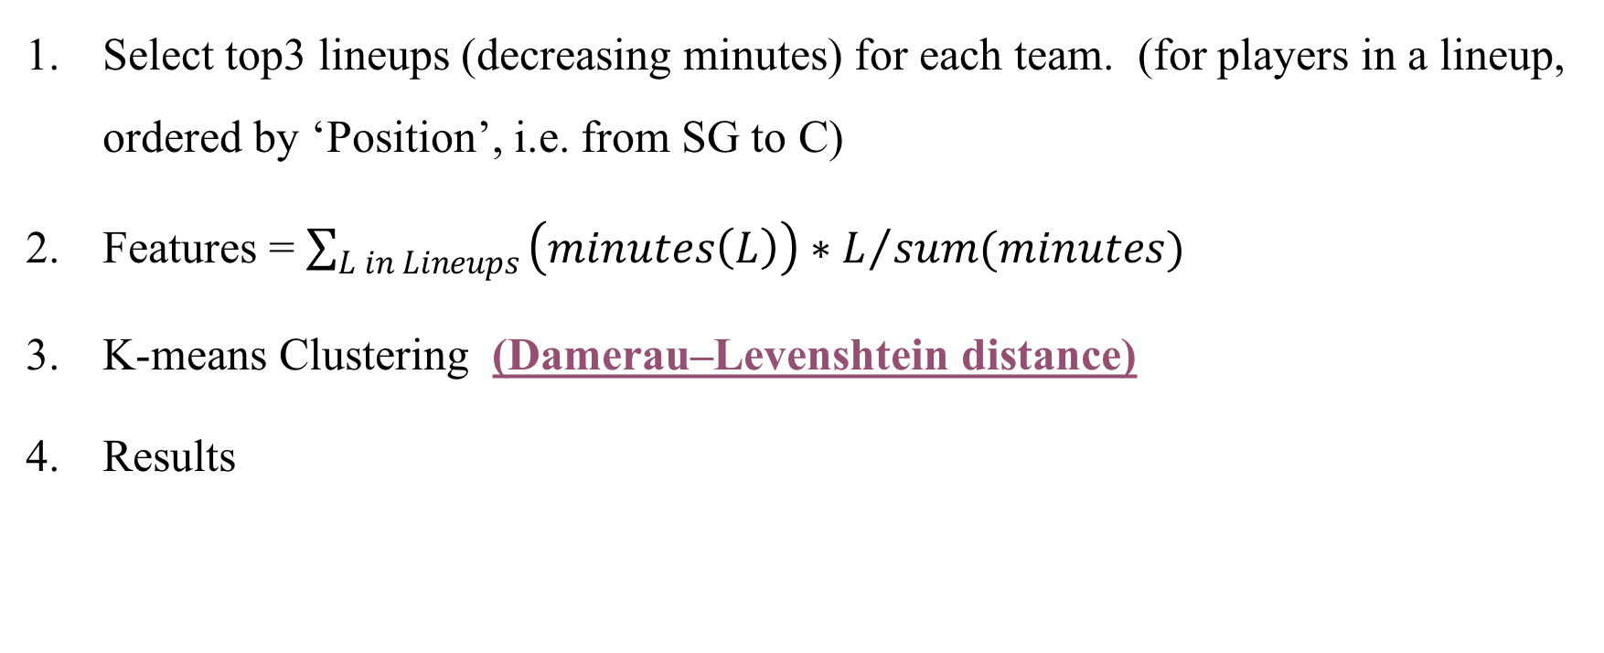
Team Features Constructing and Team Clustering
Select top3 lineups (decreasing minutes) for each team. (for players in a lineup, ordered by ‘Position’, i.e. from SG to C)
Features = $\sum_{L in Lineups}{{\left(minutes\left(L\right)\right)∗L}/{sum(minutes)} }$
K-means Clustering (Damerau–Levenshtein distance)
Results

Slide 9
Team Clustering Results
Which kernel to use?
How to select the parameter values in SVM?
How to construct multi-classifier SVM?

Slide 10
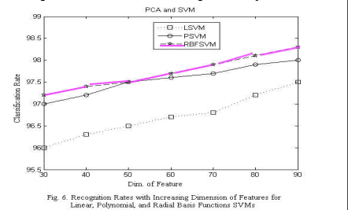
Which kernel we are going to use?
P-SVM: memory overflow because of dot product
Sigmoid-SVM: more parameters to determine
L-SVM: particular case of RBFSVM
Method Supported by:
Face Recognition Using PCA and SVM

Slide 11
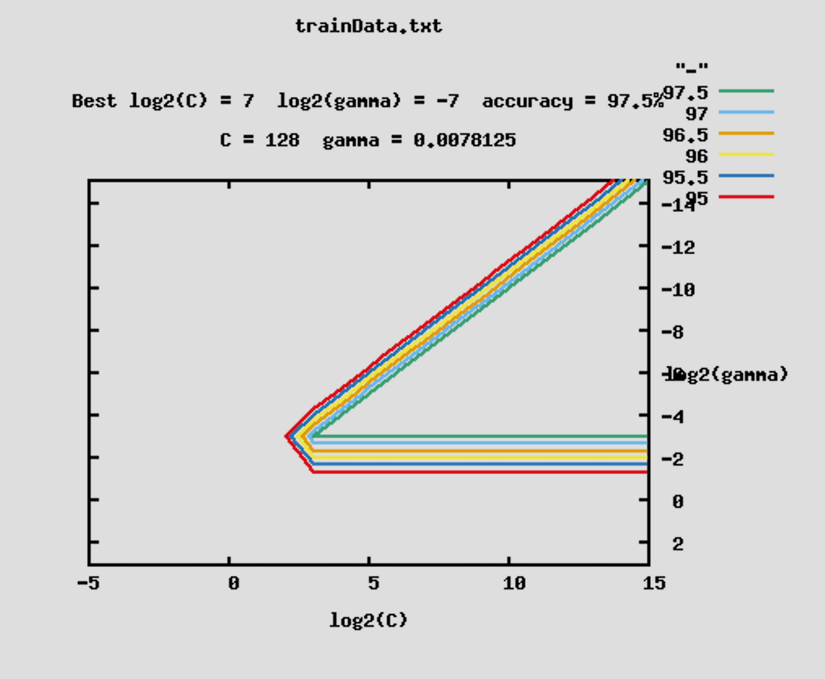
How to select parameters in SVM
We have 2 parameters to consider in RBFSVM
C is the constraint violation in soft margin SVM (lecture 8)
And from the kernel function
Method Supported by:
How to do the cross-validation for SVM?

Slide 12
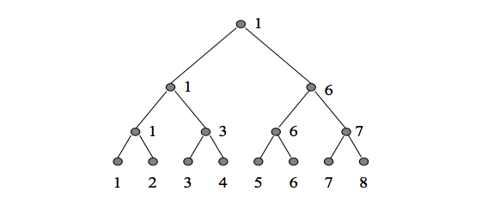
How to construct multi-classifier
Bottom-up decision tree
Boxing match
How many classifiers? (n labels)
The process is fast as each test just compute the inner product and just n-1comparisons.
Method Supported by:
Face Recognition Using PCA and SVM
Face Recognition by Support Vector Machines

Slide 13
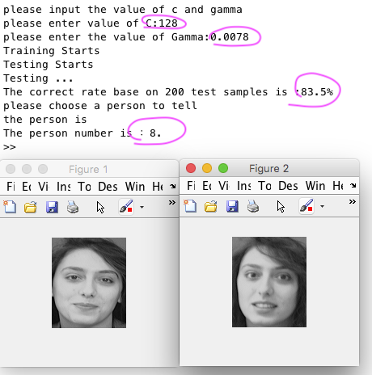
Result
I use 5 pictures for each person to train the dataset and 5 pictures for each person to test the data.
I choose the C=128 and Gamma = 0.0078
The test correct rate is 83.5%
And I choose person number 8 into PCA-SVM classifier, I got a correct match

Slide 14
Future work
Improve the code
Consider real time constraints

