Slide 1
Advanced Data Analytics Project
Types of Football Winning Strategies: A Dive into Team Performance Metrics
By: ADA_29 Sai Arya RB - PES1UG22AM142
Samarth S Kulkarni - PES1UG22AM144
Siddharth Gandhi - PES1UG22AM157
Sudarshan Srinivasan - PES1UG22AM166

Slide 2
Problem Statement
Football is an ancient sport with a varied and extensive history. Over the years it has spread across the entire world with vastly different styles and beliefs. This project aims to develop a win prediction model on a highly descriptive statistical dataset, across three different leagues: Premier League, Bundesliga and La Liga. The project also applies SHAP (SHapley Additive exPlanations) to discover the most influential features that contributed to the prediction of match outcomes. These features are also analysed and compared between the different leagues to provide insights into the unique dynamics and styles of each league.

Slide 3
Approach
The project employs a systematic approach to predict match outcomes and analyze the key contributing factors:
Data Preparation
The dataset is loaded, and the match outcome is calculated as Winner (Home Win, Away Win, Draw) based on the goals scored.
Numerical and categorical columns are identified. Missing values in the Winner column are dropped.
Categorical columns are one-hot encoded, and numerical features are scaled for consistency.
Feature Selection
Features are selected as - All Features, use of SVD, Features are selected based on domain knowledge and analysis performed prior.
Model Training
Logistic Regression is a linear model used for classification tasks,especially for binary
Support Vector Machines are designed to find the hyperplane that best separates classes in the feature space
Random Forest is an ensemble learning method that combines multiple decision trees to improve accuracy and control overfitting.
VotingClassifier aggregates predictions from the Logistic Regression, SVM, and Random Forest models.
Performance Evaluation
Accuracy_score displays the accuracy of the Voting Classifier
Y_pred_voting displays the predicted Winner for each test example
Explainability Using SHAP
SHAP (SHapley Additive exPlanations) is applied to the trained Winner prediction model to interpret feature importance.
Mean absolute SHAP values are calculated for each feature, identifying the top contributors to the model's predictions.
Visualization
The top 10 features with the highest SHAP values are visualized using a bar graph, providing insights into the most critical predictors for match outcomes.
Cross-League Validation & Comparison
Test the Model on data from other leagues to ensure robustness & adaptability, which ensures accurate, interpretable & generalizability.
Differences in feature importance are analyzed between leagues (Premier League, Bundesliga, La Liga) to understand the unique factors influencing match outcomes in each competition.

Slide 4
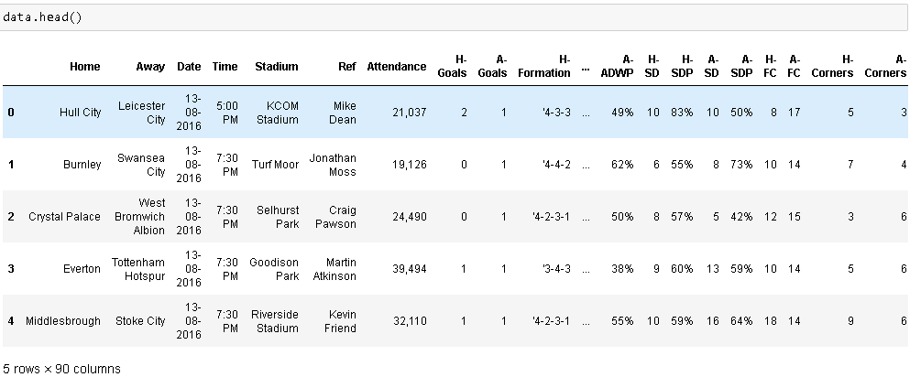
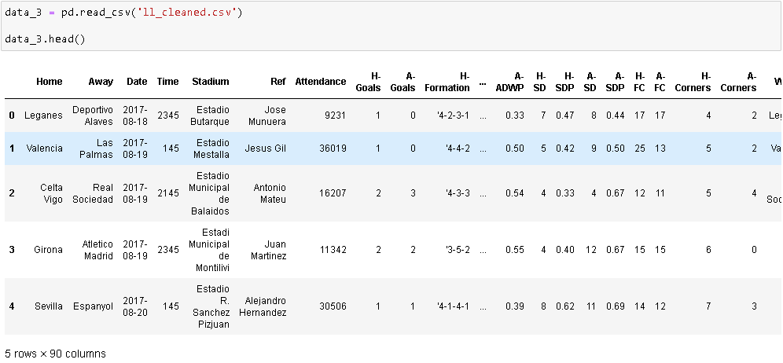
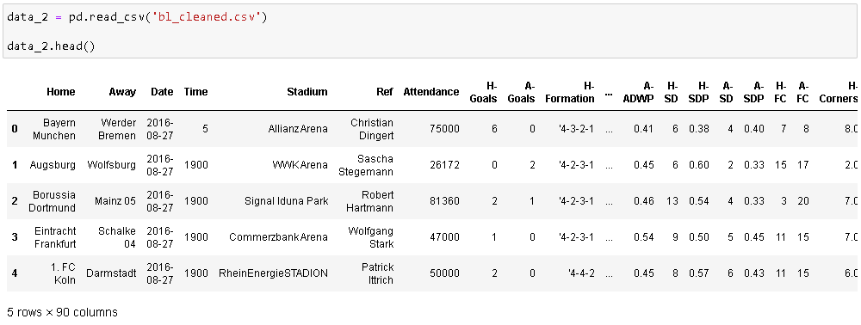
Dataset
We web-scraped football reference websites to gather data for our dataset. The dataset was collected for three different first division football leagues, namely:
English Premier League
Bundesliga
La Liga
The dataset consists of 41 Team Based Statistics showcasing performance of Home & Away teams.
Shape of Datasets
EPL - 2660x90
Bundesliga - 2142x90
La Liga - 2280x90

Slide 5
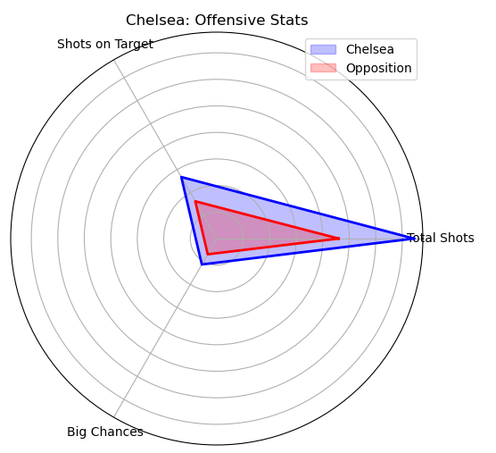
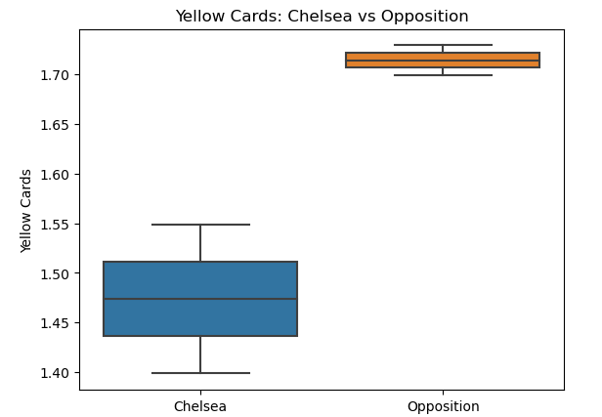
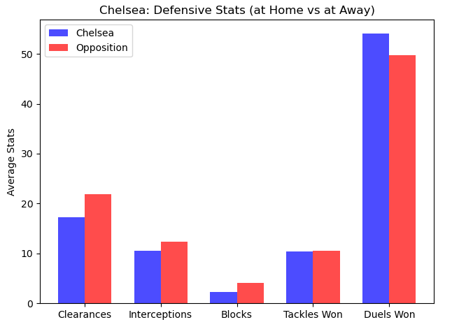
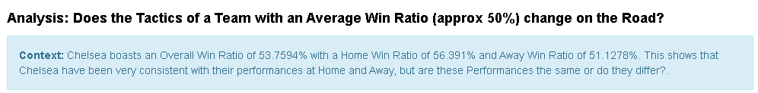
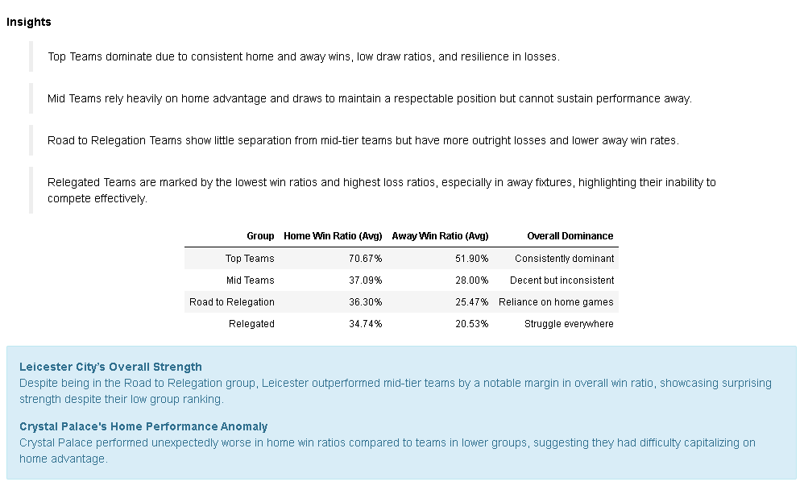
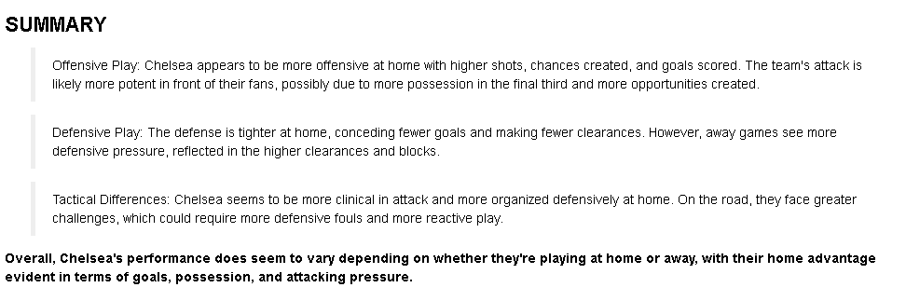
Analysis

Slide 6
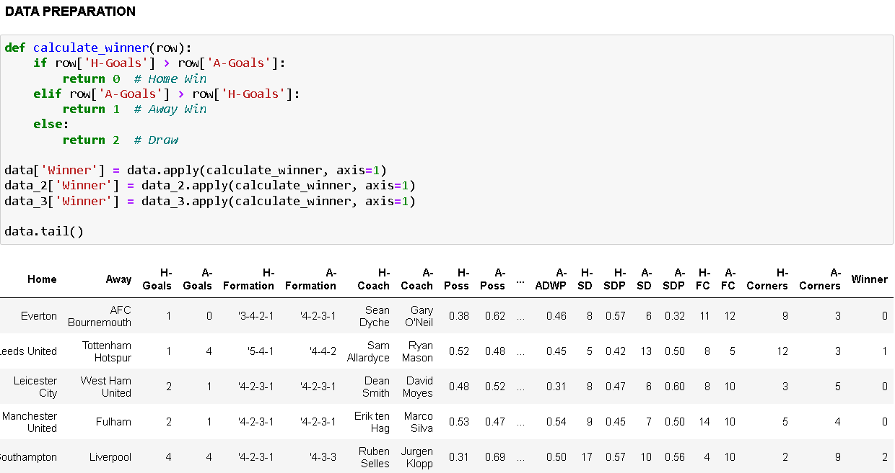
Detailed Solution
This project follows a structured approach to predict match outcomes (Win, Draw, or Loss) for three major football leagues (Premier League, Bundesliga, and La Liga). Additionally, it explains the most critical factors influencing predictions using SHAP (SHapley Additive exPlanations) and compares these factors across leagues.
1. Data Preparation
Steps:
Create a new column Winner:
0: Home team win.
1: Away team win.
2: Draw.
Identify and remove rows with missing values
in critical columns.
Handle numerical and categorical features
separately, and address multicollinearity.

Slide 7
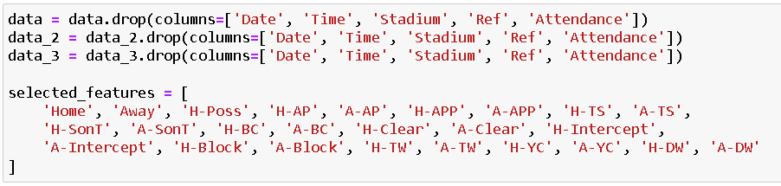
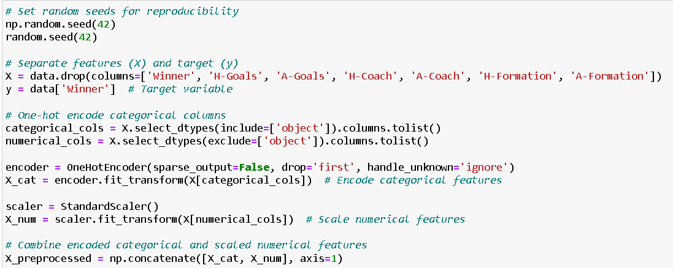
Detailed Solution
2. Feature Selection
For Feature Selection we have tried 3 different
methods,
Using all features
Selecting Features through insights from our Analysis
SVD
3. Data Preparation
Split features (X) and target variable (y).
Apply one-hot encoding to categorical variables.
Scale numerical variables using StandardScaler.
Combine preprocessed features.

Slide 8
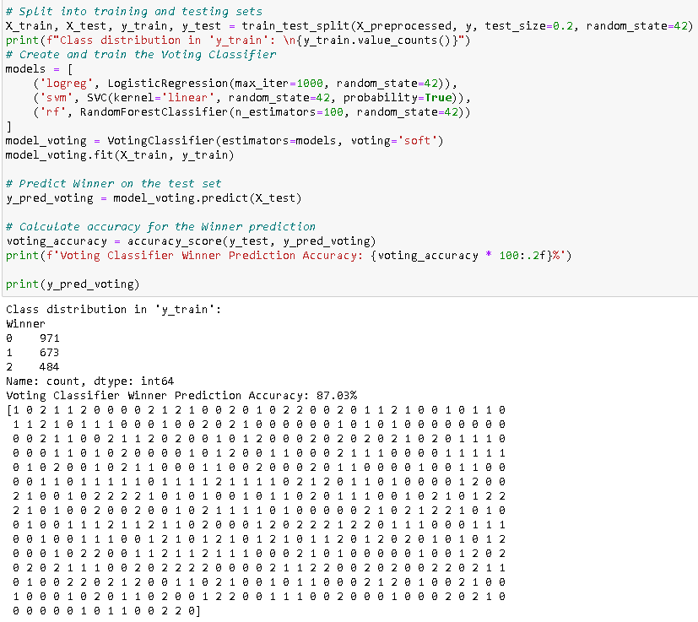
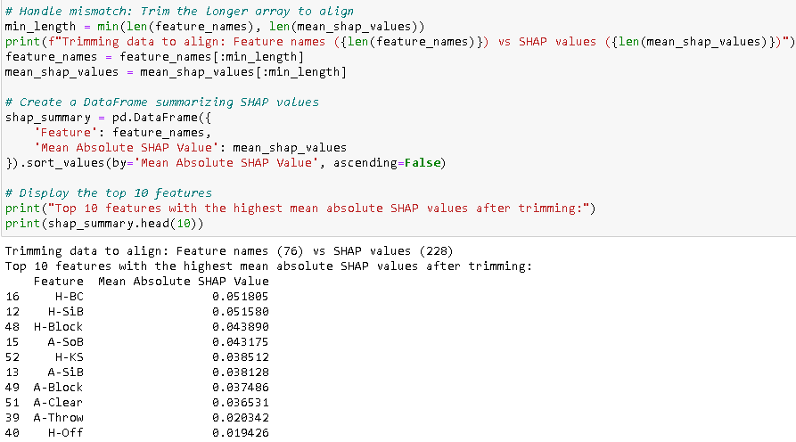
Detailed Solution
4. Model Training & Evaluation
Logistic Regression is a linear model used for classification tasks,especially for binary
Support Vector Machines are designed to find the hyperplane that best separates
classes in the feature space
Random Forest is an ensemble learning method that combines multiple decision trees
to improve accuracy and control overfitting.
VotingClassifier aggregates predictions from the Logistic Regression, SVM,
and Random Forest models.
Accuracy_score displays the accuracy of the Voting Classifier
Y_pred_voting displays the predicted Winner for each test example
5. Explainability Using SHAP
Use SHAP to calculate feature contributions for the Winner model.
Identify the top features with the highest mean absolute SHAP values.
Visualize the results using a bar chart.

Slide 9
Future Direction
We would like to implement this project on individual teams and analyse their styles, which would provide crucial data on what makes that team win, lose or draw. We would also like to analyse players and their impacts on their teams. This could help teams in scouting, strategic planning and training. Currently we were not able to execute this because of data constraints.

