Slide 1
HCI Lab 2
TransitScope
Malaysia
A human-centred public transport monitoring dashboard
Student Name: [ENTER FULL NAME]
Matric Number: [ENTER MATRIC NUMBER]
Mobile Phone Number: [ENTER MOBILE NUMBER]
Email Address: [ENTER EMAIL ADDRESS]
Notes:
Suggested spoken explanation: Introduce the project and leave the personal fields editable for completion. Estimated time: 25 seconds.
Transition: Continue to the next slide.

Slide 2
Problem and project objective
Public transport information remains distributed across different services.
●
Commuters may switch between operator apps, sites and maps.
●
Inconsistent information makes mode comparison difficult.
●
TransitScope consolidates available transport records into one monitoring interface.
●
The dashboard makes data mode and freshness visible before a user acts.
Notes:
Suggested spoken explanation: Explain the fragmentation problem and the goal of a unified but transparent dashboard. Estimated time: 35 seconds.
Transition: Continue to the next slide.

Slide 3
Users and requirements
The design prioritises daily commuters while supporting students and observers.
User role | Primary goal
Daily commuter | Locate a service and check freshness
University student | Compare modes and locate shared bikes
Transport observer | Inspect records, source and availability
●
Eight functional requirements cover search, filters, map, details, alerts, charts and reset.
●
Seven usability requirements address responsive use, feedback, recovery, keyboard access and source transparency.
Notes:
Suggested spoken explanation: Describe users as design assumptions to validate rather than completed research findings. Estimated time: 35 seconds.
Transition: Continue to the next slide.

Slide 4
Predefined user tasks
The study preserves three fixed tasks and time limits.
Task | Goal | Correct outcome | Limit
A | Locate a bus | Find DEMO-BUS-101 or D100 and state location and freshness | 60 sec
B | Filter services | Show only shared-bicycle records on map and list | 45 sec
C | Investigate alert | State severity, meaning, affected service and timestamp | 60 sec
No task definition changes after testing. Demonstration records keep the tasks available without external data.
Notes:
Suggested spoken explanation: Summarise the three fixed usability tasks and explain the deterministic records. Estimated time: 35 seconds.
Transition: Continue to the next slide.

Slide 5
Architecture and data status
One typed model drives every dashboard view.
Future provider adapters
GTFS, GTFS-Realtime, GBFS
Map, KPIs, charts, table and detail panel
Common TypeScript record and alert model
●
Current release: deterministic fictional SIMULATED records plus SCHEDULED station references.
●
No live Malaysian provider feed is connected. A failed live source would stay unavailable or stale.
●
Rail records are stations, not fabricated train positions.
Notes:
Suggested spoken explanation: Explain modular adapters and distinguish present simulated data from possible live standards. Estimated time: 40 seconds.
Sources: GTFS https://gtfs.org/documentation/schedule/reference/; GTFS-Realtime https://gtfs.org/documentation/realtime/reference/; GBFS https://www.gbfs.org/documentation/
Transition: Continue to the next slide.

Slide 6
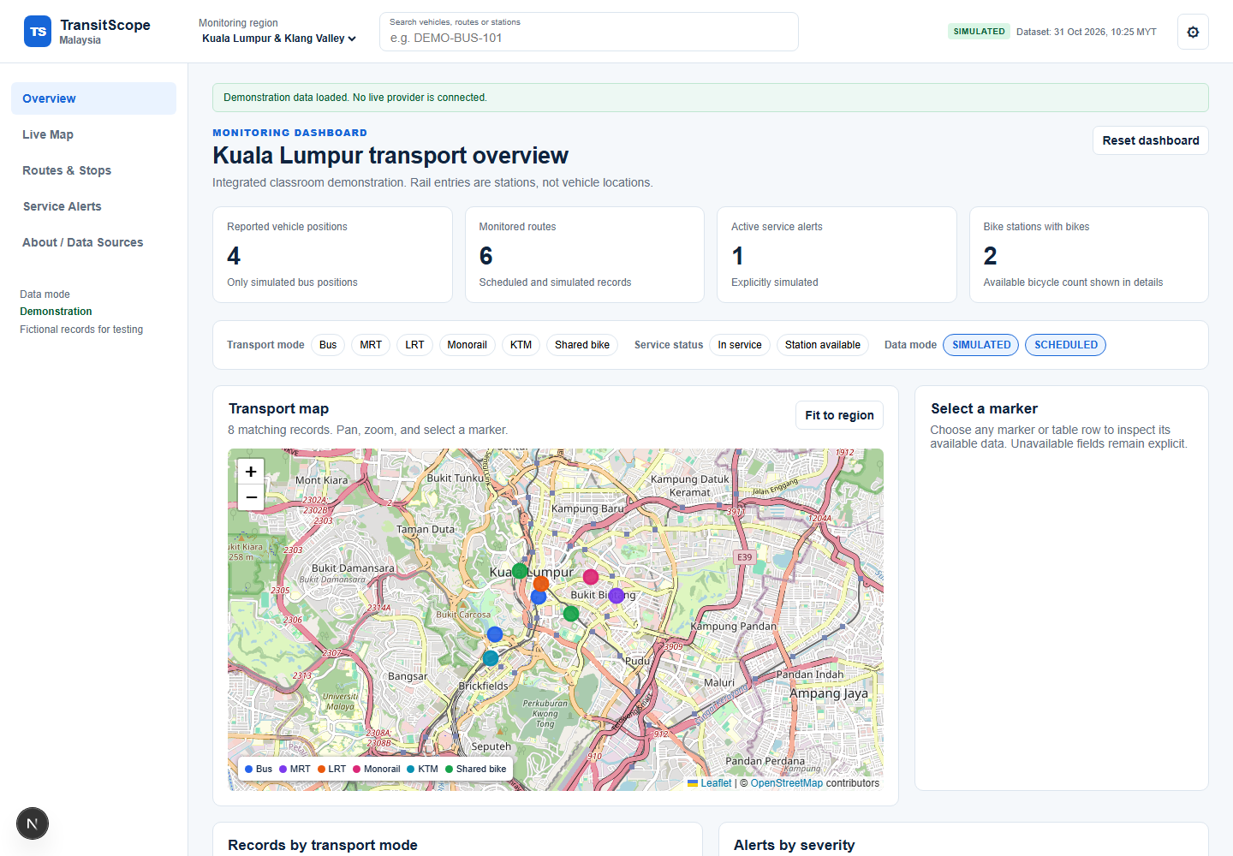
Interface design
Dashboard hierarchy gives essential information before detail.
●
Header search supports the primary locate-a-bus task.
●
KPIs and filters update from the same data subset.
●
Map selection and table rows reveal the same detail model.
●
The table provides an alternative to map interaction.
Notes:
Suggested spoken explanation: Walk through the actual dashboard screenshot: search, indicators, filters, map and detail. Estimated time: 40 seconds.
Transition: Continue to the next slide.

Slide 7
HCI principles and standards
Seven design principles guide the visible interactions.
Principle | Interface evidence
Visibility and feedback | Status message, timestamps, selected filters and alert state.
Consistency and affordance | Shared labels, pressed filter state and recognisable controls.
Control and recovery | Reset, clear search, close alert and empty-state recovery.
Cognitive load | KPI-first hierarchy and selected detail on demand.
Accessibility inspection | Focus rings, semantic controls, labels and non-map table.
Reference frame: ISO 9241-210, ISO 9241-11 and WCAG 2.2. The inspection does not claim full conformance.
Notes:
Suggested spoken explanation: Connect HCI principles directly to implementation evidence and state the scope of the accessibility inspection. Estimated time: 40 seconds.
Sources: ISO 9241-210:2019; ISO 9241-11:2018; WCAG 2.2 https://www.w3.org/TR/WCAG22/
Transition: Continue to the next slide.

Slide 8
Functional website demonstration
Actual screenshot from the local implementation.
Data mode
SIMULATED
Demo records are fictional.
No live provider is connected.
Map tiles: © OpenStreetMap contributors
Notes:
Suggested spoken explanation: Demonstrate the default page and draw attention to the explicit simulation disclosure. Estimated time: 35 seconds.
Sources: OpenStreetMap attribution: https://www.openstreetmap.org/copyright
Transition: Continue to the next slide.

Slide 9
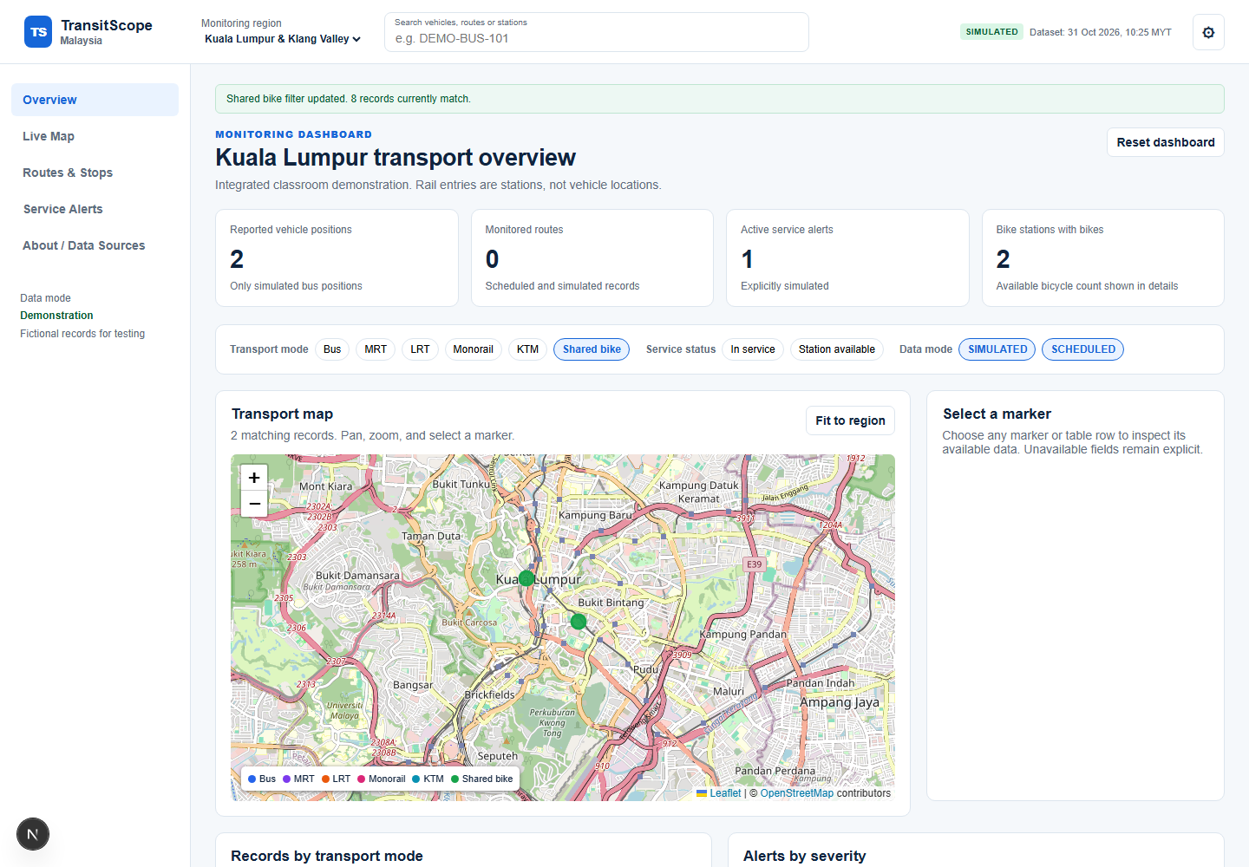
Interactions and data visualisation
Filters update the map, KPI values, chart and results list together.
●
Search by identifier, route or station
●
Transport-mode and status filters
●
Marker and table-row selection
●
Reset dashboard
●
Alert inspection
●
Data mode visible in every record
Notes:
Suggested spoken explanation: Show the shared-bike filter as a direct support for Task B. Briefly mention other tested interactions. Estimated time: 35 seconds.
Transition: Continue to the next slide.

Slide 10
Usability testing methodology
Planned study uses task performance, SUS and an accessibility inspection.
●
Aim for at least five representative commuters or students where feasible.
●
Record only anonymous ID, device, task result, timing, errors, observations and comments.
●
Measure completion rate, successful-task mean time, errors per task attempt and SUS.
●
Use the standard ten-question SUS and its published scoring method.
Privacy: no names or contact details in the results sheet. Consent precedes data collection.
Notes:
Suggested spoken explanation: Explain recruitment, task timing, privacy and the four quantitative measures plus accessibility inspection. Estimated time: 40 seconds.
Transition: Continue to the next slide.

Slide 11
Results and HCI metrics
Participant evaluation remains pending.
No participant attempts have been collected.
Task completion rate, completion time, error rate and SUS must remain blank until actual testing occurs.
●
Implemented inspection evidence: focus visibility, labels, status feedback, recovery action and responsive breakpoints.
●
Remaining: participant results, screen-reader check, formal contrast audit and deployed-device checks.
Notes:
Suggested spoken explanation: Be explicit that no numerical testing results exist. Present the completed plan and implementation inspection only. Estimated time: 35 seconds.
Transition: Continue to the next slide.

Slide 12
Discussion and improvements
The current implementation addresses anticipated risks; participant evidence is still required.
Observed / anticipated issue | Implemented change | Evidence still needed
Potential misunderstanding | Simulation disclosure and data mode badge | Validate comprehension in Task A
Filter recovery | Reset dashboard and empty-state restore | Measure errors and backtracking
Map accessibility | Alternative table list and focus indicators | Screen-reader and keyboard testing
One implemented improvement: persistent source transparency prevents demo data from appearing live. Before/after participant evidence remains pending.
Notes:
Suggested spoken explanation: Separate implemented safeguards from improvements that must be supported by forthcoming study data. Estimated time: 35 seconds.
Transition: Continue to the next slide.

Slide 13
Conclusion and reflection
A functional local dashboard establishes a transparent baseline for evaluation.
●
Search, mode filtering and alert inspection implement the three predefined tasks.
●
The system uses a consistent data model across map, indicators, charts and table.
●
The main limitation is the absence of verified live Malaysian transport feeds.
●
Next steps: recruit participants, analyse SUS and task metrics, then deploy and record the presentation.
Notes:
Suggested spoken explanation: Summarise what works, the main limitation and the next research steps. Estimated time: 30 seconds.
Transition: Continue to the next slide.

Slide 14
Website, video and references
Submission links stay editable until the student completes deployment and recording.
Website URL: [PENDING PUBLIC DEPLOYMENT]
Recorded Presentation: [INSERT ACTUAL VIDEO LINK]
References (APA 7):
International Organization for Standardization. (2019). ISO 9241-210:2019. https://www.iso.org/standard/77520.html
International Organization for Standardization. (2018). ISO 9241-11:2018. https://www.iso.org/standard/63500.html
World Wide Web Consortium. (2023). Web Content Accessibility Guidelines (WCAG) 2.2. https://www.w3.org/TR/WCAG22/
MobilityData. (n.d.). General Bikeshare Feed Specification. https://www.gbfs.org/documentation/
MobilityData. (n.d.). GTFS Schedule and GTFS Realtime references. https://gtfs.org/documentation/
OpenStreetMap contributors. (n.d.). Copyright and license. https://www.openstreetmap.org/copyright
Notes:
Suggested spoken explanation: Close with pending public URL and video placeholder, then cite the standards and map sources. Estimated time: 30 seconds.
Transition: Continue to the next slide.

