Slide 1
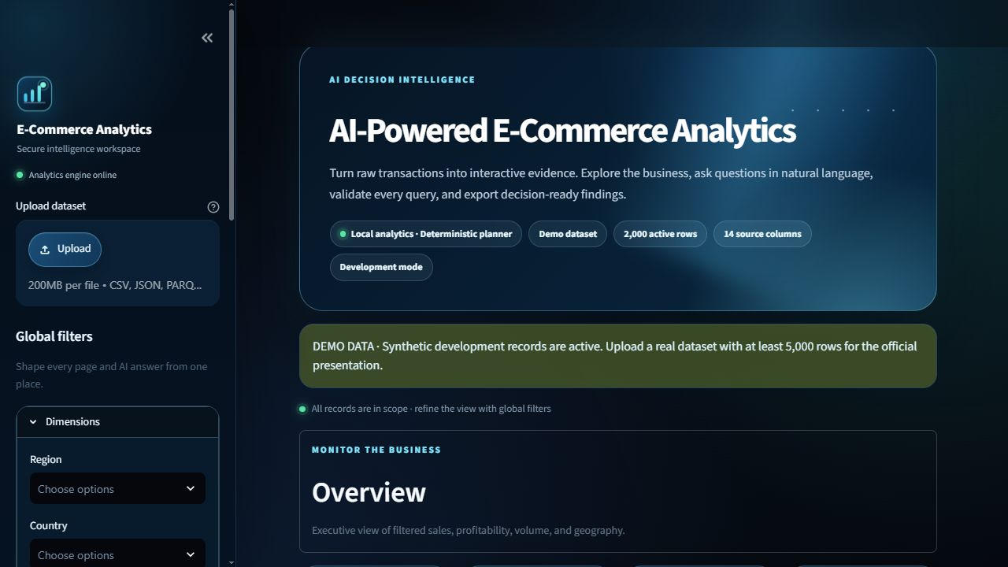
CAPSTONE PROJECT
AI-Powered
E-Commerce Analytics
From raw transactions to validated, interactive evidence
S. M. Monowar Kayser
MSc Summer 2026 · Data Visualization
Student ID: [INSERT] · Submission date: [INSERT]
github.com/Monokayser/ai-ecommerce-analytics
Notes:
Open with the decision problem: analysts need flexible questions, but every answer must remain reproducible and safe. State that the presentation distinguishes verified local evidence from final external verification gates.
[Sources]
- https://github.com/Monokayser/ai-ecommerce-analytics
[/Sources]

Slide 2
PROBLEM AND OBJECTIVE
Analytics is accessible only when trust is designed in
How can a user ask ordinary business questions without giving an AI model direct control of data execution?
DESIGN TARGET
•
Natural-language access
•
Deterministic computation
•
Visible validation
Interpretation ≠ execution
•
Decision-ready exports
The model proposes. The application validates, computes, summarizes, and visualizes.
MSC DATA VISUALIZATION CAPSTONE
02
Notes:
Frame the project as a controlled evidence pipeline rather than a chatbot. The objective is to combine flexibility with auditable computation, safe execution, and clear communication.
[Sources]
- Official capstone assignment brief, 2026
[/Sources]

Slide 3
SCOPE
Four rubric tasks — one integrated platform
The implementation connects dashboarding, secure AI, advanced analytics, and reporting.
A
B
C
D
Interactive dashboard
AI assistant
Evaluation
Advanced analysis
6 sections
8 chart families
global filters
typed plans
SQL/pandas sandbox
conversation memory
tests + coverage
performance
10-question benchmark
IQR + Isolation Forest
subset comparison
exports
Production layer
multi-format ingestion · security controls · responsive UI · Docker/CI · GitHub release
MSC DATA VISUALIZATION CAPSTONE
03
Notes:
Use this slide to map the demonstration to the assessment structure. Explain that the production layer is cross-cutting: data controls, tests, deployment files, documentation, and release packaging support every rubric task.
[Sources]
- Official capstone assignment brief, 2026
- https://github.com/Monokayser/ai-ecommerce-analytics
[/Sources]

Slide 4
METHODOLOGY
Evidence gates shaped every development phase
1
›
2
›
3
›
4
›
5
Discover
Build
Harden
Evaluate
Package
rubric + risks
vertical slices
allowlists + limits
tests + benchmarks
docs + release
Security and verification were implementation boundaries—not final-stage add-ons.
MSC DATA VISUALIZATION CAPSTONE
04
Notes:
Describe the incremental method. Contracts and deterministic services came first, followed by UI integration, negative security tests, measured evaluation, and delivery packaging. Each phase had an evidence-based exit condition.
[Sources]
- Project repository and measured local evidence
[/Sources]

Slide 5
SYSTEM ARCHITECTURE
Two paths converge at one security and evidence boundary
DIRECT ANALYTICS
Upload
Engineer
DuckDB
Dashboard
CSV · JSON · Parquet
clean · profile · alias
parameterized SQL
KPIs · charts · filters
Export
Word · PDF
PNG · SVG
AI-ASSISTED ANALYTICS
Question
Planner
Security gate
Evidence
natural language
local · hosted · Ollama
Pydantic · AST · limits
table · chart · narrative
MSC DATA VISUALIZATION CAPSTONE
05
Notes:
Trace the top direct-analytics path and the lower AI-assisted path. Emphasize that both use the same data contracts and evidence surfaces. The AI route must pass the security gate before anything executes.
[Sources]
- https://duckdb.org/docs/stable/clients/python/overview
- https://docs.streamlit.io/develop/api-reference/caching-and-state/st.session_state
- https://github.com/Monokayser/ai-ecommerce-analytics
[/Sources]

Slide 6
DATA ENGINEERING
Reversible cleaning preserves analytical evidence
2,000
14
18
0
0
synthetic rows
source columns
cleaned columns
missing cells
duplicates
RAW
parse dates
→
convert numerics
→
normalize text
→
flag outliers
→ CLEAN
Sales IQR flags
Profit IQR flags
Marked, not deleted or capped
161 · 8.05%
251 · 12.55%
MSC DATA VISUALIZATION CAPSTONE
06
Notes:
Explain why raw and cleaned views are preserved. The cleaner records every action, rejects ambiguous aliases, and marks outliers instead of removing potentially meaningful records. The official-ready badge requires at least 5,000 rows.
[Sources]
- https://pandas.pydata.org/docs/
- https://duckdb.org/docs/stable/clients/python/overview
- https://github.com/Monokayser/ai-ecommerce-analytics
[/Sources]

Slide 7
VERIFIED DEMO EVIDENCE
The development dataset produces a coherent executive view
$786.2k
$73.3k
2,000
12,030
9.33%
total sales
total profit
orders
units
profit margin
West leads sales
$213,841.94
Technology leads category profit at $25,339.79 — narrowly ahead of Office Supplies.
MSC DATA VISUALIZATION CAPSTONE
07
Notes:
These metrics are measured from the deterministic synthetic development data. Use them to demonstrate that dashboard KPIs, charts, and advanced analysis are grounded in one consistent cleaned frame. Do not describe this as the official dataset result.
[Sources]
- https://github.com/Monokayser/ai-ecommerce-analytics
[/Sources]

Slide 8
AI MODEL STRATEGY
Hosted flexibility — deterministic fallback — one validation boundary
LOCAL
HOSTED / LOCAL MODEL
Deterministic planner
Gemini · OpenAI · Ollama
No key · private · reproducible
Covers known e-commerce intents
Schema-constrained GeneratedQuery
Provider-neutral adapter · bounded retry
FAST
BALANCED
DEEP
low effort
default
high effort
No foundation model was trained or fine-tuned in this project.
MSC DATA VISUALIZATION CAPSTONE
08
Notes:
Explain the provider-neutral decision. The default hosted configuration uses structured output, but the system remains fully functional without a key. Fast, Balanced, and Deep modes trade latency for planning effort. Model output always enters the same validation path.
[Sources]
- https://ai.google.dev/gemini-api/docs/structured-output
- https://platform.openai.com/docs/api-reference/responses
- https://docs.ollama.com/capabilities/structured-outputs
- https://github.com/Monokayser/ai-ecommerce-analytics
[/Sources]

Slide 9
SECURE NATURAL-LANGUAGE WORKFLOW
One corrected-query attempt — never eval or exec
1
2
3
4
5
→
→
→
→
GROUND
PLAN
VALIDATE
EXECUTE
EVIDENCE
schema · aliases
active filters
typed SQL or
restricted pandas
Pydantic + SQL/
pandas AST allowlist
parameters · 10 s
1,000-row ceiling
summary · chart
grounded answer
•
Single SELECT/WITH · dataset table only
•
No filesystem, network, imports, DDL, DML, or multiple statements
•
Cell text is quoted, truncated, and treated as untrusted data
MSC DATA VISUALIZATION CAPSTONE
09
Notes:
Walk through the five stages. The generated query is visible, but hidden reasoning is not. A sanitized execution error may trigger exactly one corrected plan, followed by full revalidation. Explain that the pandas fallback is a custom interpreter and never uses eval or exec.
[Sources]
- https://github.com/tobymao/sqlglot
- https://cheatsheetseries.owasp.org/cheatsheets/LLM_Prompt_Injection_Prevention_Cheat_Sheet.html
- https://github.com/Monokayser/ai-ecommerce-analytics
[/Sources]

Slide 10
USER EXPERIENCE
Responsive, accessible, explicit about data and AI state
Six sections
•
Overview
•
Data Exploration
•
AI Assistant
•
Advanced Analytics
•
Quality & Performance
•
Report Export
Persistent filters · five-turn memory · reduced-motion support
MSC DATA VISUALIZATION CAPSTONE
10
Notes:
Point out the consistent sidebar filters, explicit synthetic-data banner, current AI/fallback status, accessible contrast, and responsive layout. Current filters override conversation context. Reset controls clear state without changing the source dataset.
[Sources]
- https://docs.streamlit.io/develop/api-reference/caching-and-state/st.session_state
- https://github.com/Monokayser/ai-ecommerce-analytics
[/Sources]

Slide 11
VISUALIZATION SYSTEM
Eight analytical views — one selection and validation policy
8
•
Time series
•
Sunburst / treemap
•
Choropleth + fallback
•
Grouped / stacked bar
•
Correlation heatmap
•
Scatter + trend line
required chart families
•
Histogram / box
•
Animated time chart
Typed columns determine the recommendation. Users can override it. Captions are checked against computed summaries.
MSC DATA VISUALIZATION CAPSTONE
11
Notes:
Summarize the visualization portfolio and selection rules. Dates prioritize trends, geography prefers maps with a bar fallback, two numeric columns suggest scatter, and categorical aggregations suggest bars or hierarchy. All charts inherit the same number formatting, filter context, and accessible theme.
[Sources]
- https://plotly.com/python/
- https://github.com/Monokayser/ai-ecommerce-analytics
[/Sources]

Slide 12
ADVANCED ANALYTICS I
Anomaly detection separates statistical facts from interpretation
IQR
251 rows
Transparent quartile rule
1.5×IQR threshold
Isolation Forest
100 rows
150 trees · contamination 0.05
random_state 42
No labels → no valid confusion matrix or accuracy claim
MSC DATA VISUALIZATION CAPSTONE
12
Notes:
Compare the methods rather than declaring a winner. IQR detects distributional extremes; Isolation Forest ranks unusual values and returns an approximate proportion based on contamination. With no labelled ground truth, precision, recall, ROC, and confusion matrices are not valid.
[Sources]
- https://scikit-learn.org/stable/modules/generated/sklearn.ensemble.IsolationForest.html
- https://doi.org/10.1109/ICDM.2008.17
- https://github.com/Monokayser/ai-ecommerce-analytics
[/Sources]

Slide 13
ADVANCED ANALYTICS II
West creates more value with fewer orders
+15.23%
+50.39%
sales
profit
+17.81%
+2.45 pp
AOV
margin
491 West rows vs 502 East rows
Descriptive association — not causation
MSC DATA VISUALIZATION CAPSTONE
13
Notes:
State the measured findings: West sales are 15.23% higher and profit is 50.39% higher despite 2.19% fewer orders. AOV and margin are higher, while average discount is lower. Similar sample sizes reduce—but do not eliminate—composition bias.
[Sources]
- https://github.com/Monokayser/ai-ecommerce-analytics
[/Sources]

Slide 14
TESTING AND SECURITY
Correctness, resilience, and negative controls were automated
72
84%
0
0
tests passed
statement coverage
Bandit findings
known vulnerabilities
•
Loaders, aliases, cleaning logs, profiling, duplicates, and source immutability
•
Every aggregation/filter mode, empty results, row limits, interruption, and timings
•
DDL/DML, multiple SQL, external scans, imports, dangerous attributes, and injection cells
•
Eight Plotly constructors, advanced edge cases, Word/PDF/PNG/SVG, and Streamlit AppTest
Docker runtime build: not run — Docker was unavailable on the test workstation
MSC DATA VISUALIZATION CAPSTONE
14
Notes:
Summarize the verification matrix. The health endpoint returned HTTP 200, the secret scan was clean, and export smoke tests produced valid artifacts. Be explicit that Docker runtime validation remains a documented gate.
[Sources]
- https://github.com/Monokayser/ai-ecommerce-analytics
[/Sources]

Slide 15
PERFORMANCE EVALUATION
Warmed local analytics remains comfortably below the target
< 500 ms
official target
31–34×
median headroom
21 measured runs
2,000 rows · 14 columns
Official-dataset pass is not claimed
MSC DATA VISUALIZATION CAPSTONE
15
Notes:
Report median and p95, not a single run. The three medians are 14.85–15.80 ms across 21 measured runs. Load time was 304.9 ms and profiling took 71.7 ms. These results apply only to the stated synthetic dataset and workstation; hosted-model latency was not measured.
[Sources]
- https://github.com/Monokayser/ai-ecommerce-analytics
[/Sources]

Slide 16
CRITICAL REFLECTION
The system validates computation — not business truth
EVIDENCE
GOVERNANCE
INTERPRETATION
•
2,000-row synthetic data
•
Hosted data terms vary
•
Anomaly ≠ fraud
•
Live LLM benchmark not run
•
Sensitive data needs governed endpoint
•
Association ≠ causation
•
No labelled anomaly truth
•
Manual accessibility and security audits remain
•
Users verify material decisions
Responsible AI disclosure
AI assistance supported scaffolding, implementation, testing, review, and documentation. The author remains responsible for every submitted claim and artefact.
MSC DATA VISUALIZATION CAPSTONE
16
Notes:
Do not rush this slide. Explain that security controls validate allowed syntax and deterministic results, but cannot determine whether a question is conceptually correct or a dataset is representative. State the privacy choice and AI-assistance disclosure clearly.
[Sources]
- https://ai.google.dev/gemini-api/docs/structured-output
- https://github.com/Monokayser/ai-ecommerce-analytics
[/Sources]

Slide 17
OUTCOME AND ROADMAP
A complete local platform — with transparent final gates
DELIVERED
NEXT
•
Multi-format ingestion and reversible cleaning
•
Load approved 5,000+ row dataset
•
Six responsive application sections
•
Run live-provider benchmark and telemetry
•
Secure offline/hosted AI planning
•
Add governed auth, storage, and audit events
•
Eight visualizations + two advanced analyses
•
Extend to multivariate/seasonal anomalies
•
Word/PDF/PNG/SVG export
•
Conduct WCAG 2.2 and user study
•
Tests, CI, Docker, docs, GitHub release
•
Deploy with observability and recovery
Release v1.4.0
MSC DATA VISUALIZATION CAPSTONE
17
Notes:
Separate completed engineering from the next evidence gates. The repository is complete and released, but the approved dataset, live model benchmark, governed public deployment, and manual audits are future verification steps.
[Sources]
- https://github.com/Monokayser/ai-ecommerce-analytics
- https://github.com/Monokayser/ai-ecommerce-analytics/releases/tag/v1.4.0
[/Sources]

Slide 18
CONCLUSION
Flexible questions.
Controlled computation.
Visible evidence.
LIVE DEMO
1
Upload + filters
2
Ask + validate
3
Analyze + export
The AI proposes a plan. The platform decides what is safe, computes the result, and shows the evidence.
Questions?
github.com/Monokayser/ai-ecommerce-analytics
THANK YOU
18
Notes:
Close by returning to the core design boundary: flexible interpretation is separated from controlled computation. Transition into the live demo: upload the approved dataset, apply filters, ask a question, inspect validation, run anomaly/comparison analysis, and export a report. Then invite questions.
[Sources]
- https://github.com/Monokayser/ai-ecommerce-analytics
[/Sources]

