Slide 1
EE 669 VLSI Technology
Assignment 3:
Solution of exercise questions lecture 9 - 13
Kartik Chikkanagoudar
21D170023

Slide 2
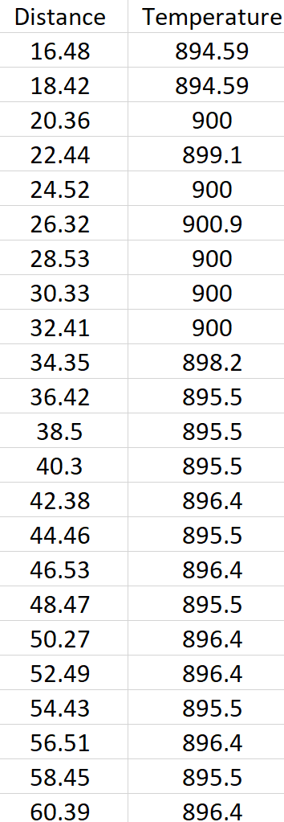
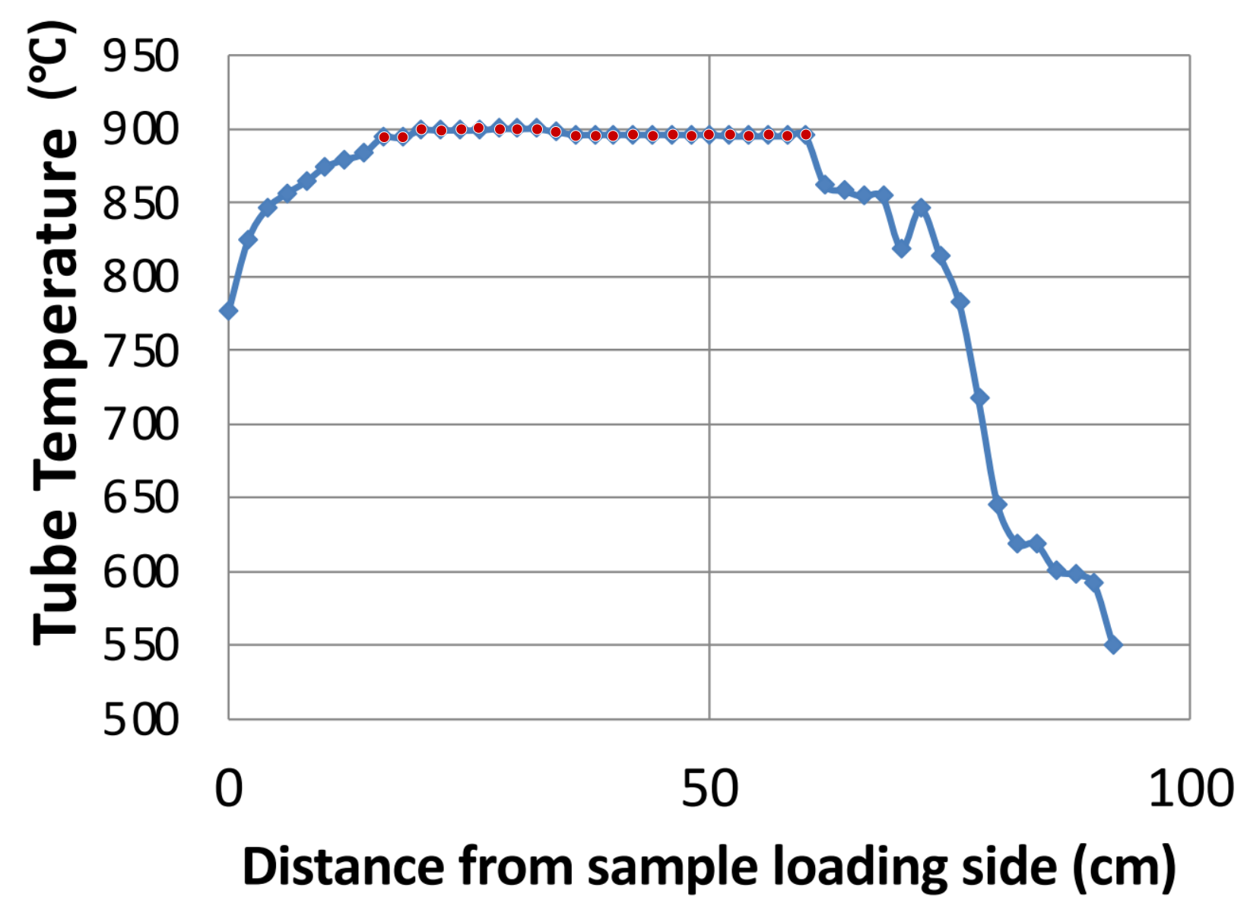
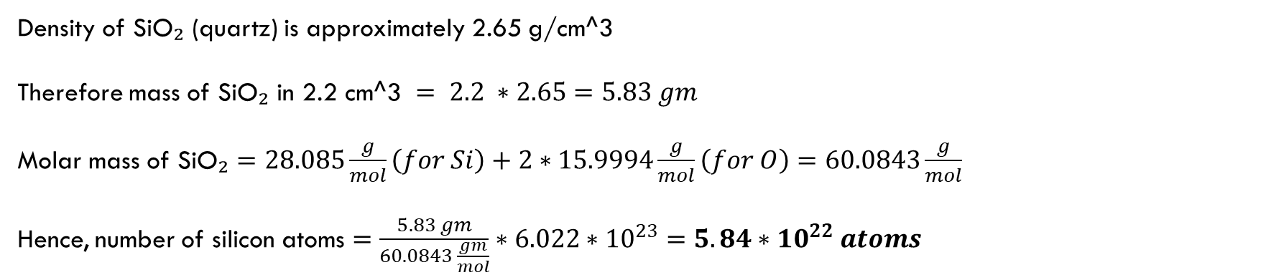
Exercise Answers
L9_11- S6
Density of SiO₂ (quartz) is approximately 2.65 g/cm^3
Therefore mass of SiO₂ in 2.2 cm^3 $= 2.2 ∗2.65=5.83 gm$
Molar mass of SiO₂ $=28.085\frac{g}{mol}\left(for Si\right)+2∗15.9994\frac{g}{mol}\left(for O\right)=60.0843\frac{g}{mol}$
Hence, number of silicon atoms $=\frac{5.83 gm}{60.0843 \frac{gm}{mol}}∗6.022∗{10}^{23}=$ $5.84∗{10}^{22} atoms$
L9_11- S9
I used webplot digitizer (https://automeris.io) to extract the distances from sample loading side where the flat zone starts and ends. Data extracted is shown on the right.
Flat-zone length = 60.39 – 16.48 = 43.91 cm
The answer can have an error of ±0.5 cm.
1

Slide 3
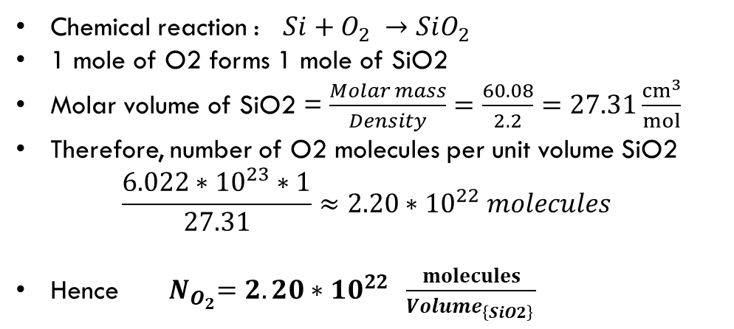
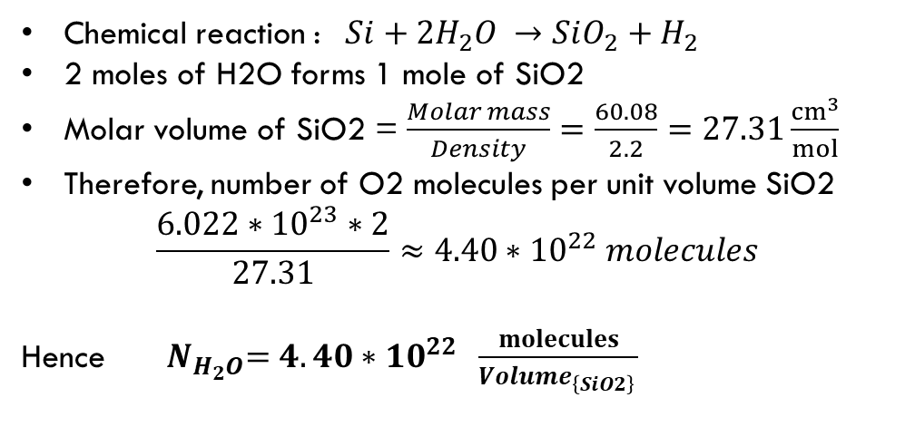
Exercise Answers
L9_11- S11
No, silicon atoms do not diffuse to the surface. Rather the O2 atoms diffuse through the growing layer of oxide and react with the silicon. Transport through the oxide takes place through diffusion. The oxygen enters the oxide through diffusion at the surface but this diffusion is not rate-limiting to the process.
As the SiO2 layer is formed silicon atoms get pushed deeper into the substrate due to pressure from the growing oxide and they fill up vacancies and interstitial sites in the bulk of the substrate.
L9_11- S15
N is defined as the number of oxidant consumed per unit volume of the film grown
For O2 (Dry oxidation)
For H2O (Wet oxidation)
Chemical reaction : $Si+O_{2} →SiO_{2}$
1 mole of O2 forms 1 mole of SiO2
Molar volume of SiO2 = $\frac{Molar mass}{Density}=\frac{60.08}{2.2}=27.31\frac{{cm}^{3}}{mol}$
Therefore, number of O2 molecules per unit volume SiO2
$$\frac{6.022∗{10}^{23}∗1}{27.31}≈2.20∗{10}^{22} molecules$$
Hence ${ N}_{O_{2}}=2.20∗{10}^{22 }\frac{molecules}{{Volume}_{\left\{SiO2\right\} }}$
Chemical reaction : $Si+2H_{2}O →SiO_{2}+H_{2}$
2 moles of H2O forms 1 mole of SiO2
Molar volume of SiO2 = $\frac{Molar mass}{Density}=\frac{60.08}{2.2}=27.31\frac{{cm}^{3}}{mol}$
Therefore, number of O2 molecules per unit volume SiO2
$$\frac{6.022∗{10}^{23}∗2}{27.31}≈4.40∗{10}^{22} molecules$$
Hence ${ N}_{H_{2}O}=4.40∗{10}^{22 }\frac{molecules}{{Volume}_{\left\{SiO2\right\} }}$
1

Slide 4
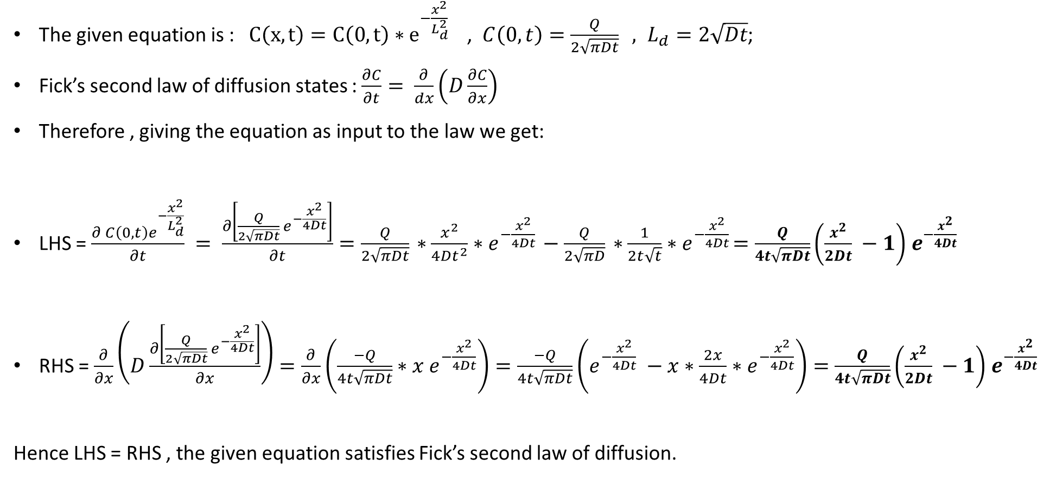
Exercise Answers
L12- S7
The given equation is : $C\left(x,t\right)=C\left(0,t\right)∗e^{−\frac{x^{2}}{L_{d}^{2}} }$ , ${C\left(0,t\right)=\frac{Q}{2\sqrt{πDt}} , L}_{d}=2\sqrt{Dt}$;
Fick’s second law of diffusion states : $\frac{∂C}{∂t}= \frac{∂}{dx}\left(D\frac{∂C}{∂x}\right)$
Therefore , giving the equation as input to the law we get:
LHS = $\frac{∂ C\left(0,t\right)e^{−\frac{x^{2}}{L_{d}^{2}}}}{∂t} = \frac{∂\left[\frac{Q}{2\sqrt{πDt}}{ e}^{−\frac{x^{2}}{4Dt}}\right]}{∂t}=\frac{Q}{2\sqrt{πDt}}{ ∗\frac{x^{2}}{4Dt^{2}}∗e}^{−\frac{x^{2}}{4Dt}} −\frac{Q}{2\sqrt{πD}}{ ∗\frac{1}{2t\sqrt{t}}∗e}^{−\frac{x^{2}}{4Dt}}=\frac{Q}{4t\sqrt{πDt}}\left(\frac{x^{2}}{2Dt} −1\right){ e}^{−\frac{x^{2}}{4Dt}}$
RHS = $\frac{∂}{∂x}\left(D\frac{∂\left[\frac{Q}{2\sqrt{πDt}}{ e}^{−\frac{x^{2}}{4Dt}}\right]}{∂x}\right)=\frac{∂}{∂x}\left(\frac{−Q}{4t\sqrt{πDt}}∗x{ e}^{−\frac{x^{2}}{4Dt}}\right)=\frac{−Q}{4t\sqrt{πDt}}\left(e^{−\frac{x^{2}}{4Dt}} −x∗\frac{2x}{4Dt}∗{ e}^{−\frac{x^{2}}{4Dt}}\right)=\frac{Q}{4t\sqrt{πDt}}\left(\frac{x^{2}}{2Dt} −1\right){ e}^{−\frac{x^{2}}{4Dt}}$
Hence LHS = RHS , the given equation satisfies Fick’s second law of diffusion.
1

Slide 5
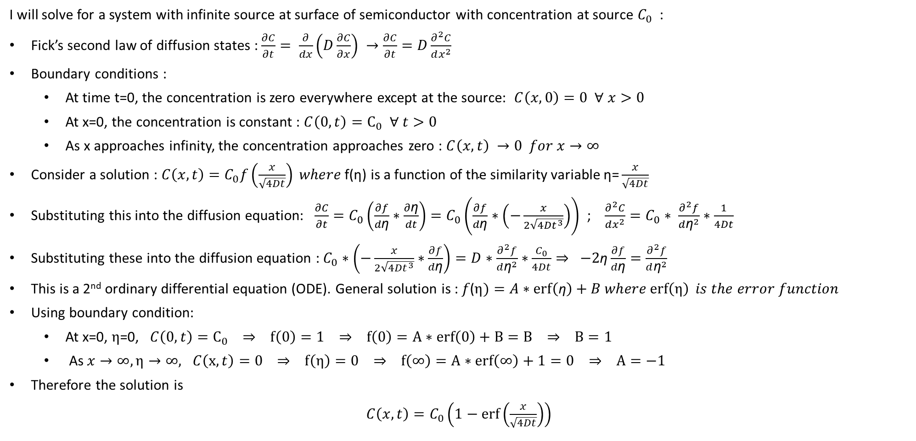
Exercise Answers
L12- S10
I will solve for a system with infinite source at surface of semiconductor with concentration at source $C_{0}$ :
Fick’s second law of diffusion states : $\frac{∂C}{∂t}= \frac{∂}{dx}\left(D\frac{∂C}{∂x}\right) →\frac{∂C}{∂t}=D\frac{∂^{2}C}{dx^{2}}$
Boundary conditions :
  At time t=0, the concentration is zero everywhere except at the source: $C\left(x,0\right)=0 ∀ x>0$
  At x=0, the concentration is constant : $C\left(0,t\right)=C_{0} ∀ t>0$
  As x approaches infinity, the concentration approaches zero : $C\left(x,t\right) →0 for x→∞$
Consider a solution : $C\left(x,t\right)=C_{0}f\left(\frac{x}{\sqrt{4Dt}}\right) where \text{f}\text{(}\text{η}\text{) }\text{is} \text{a} \text{function} \text{of} \text{the} \text{similarity} \text{variable} \text{η}\text{=}\frac{x}{\sqrt{4Dt}}$
Substituting this into the diffusion equation: $\frac{∂C}{∂t}=C_{0}\left(\frac{∂f}{d\text{η}}∗\frac{∂\text{η}}{dt}\right)=C_{0}\left(\frac{∂f}{d\text{η}}∗\left(−\frac{x}{2\sqrt{4{Dt}^{3}}}\right)\right)$ ; $\frac{∂^{2}C}{dx^{2}}=C_{0}∗ \frac{∂^{2}f}{d{\text{η}}^{2}}∗\frac{1}{4Dt}$
Substituting these into the diffusion equation : $C_{0}∗\left(−\frac{x}{2\sqrt{4{Dt}^{3}}}∗\frac{∂f}{d\text{η}}\right)=D∗$ $\frac{∂^{2}f}{d{\text{η}}^{2}}∗\frac{C_{0}}{4Dt}⇒ −2\text{η}\frac{∂f}{d\text{η}}=\frac{∂^{2}f}{d{\text{η}}^{2}}$
This is a 2nd ordinary differential equation (ODE). General solution is : $f\text{(}η)=A∗\operatorname{erf}\left(\text{η}\right)+B where\operatorname{erf}\left(η\right) is the error function$
Using boundary condition:
  At x=0, $η$=0, $C\left(0,t\right)=C_{0} ⇒ f\left(0\right)=1 ⇒ f\left(0\right)=A∗erf\left(0\right)+B=B ⇒ B=1$
  As $x→∞,η→∞, C\left(x,t\right)=0 ⇒ f\left(η\right)=0 ⇒ f\left(∞\right)=A∗erf\left(∞\right)+1=0 ⇒ A=−1$
Therefore the solution is
$C\left(x,t\right)=C_{0}\left(1−\operatorname{erf}\left(\frac{x}{\sqrt{4Dt}}\right)\right)$
1

Slide 6
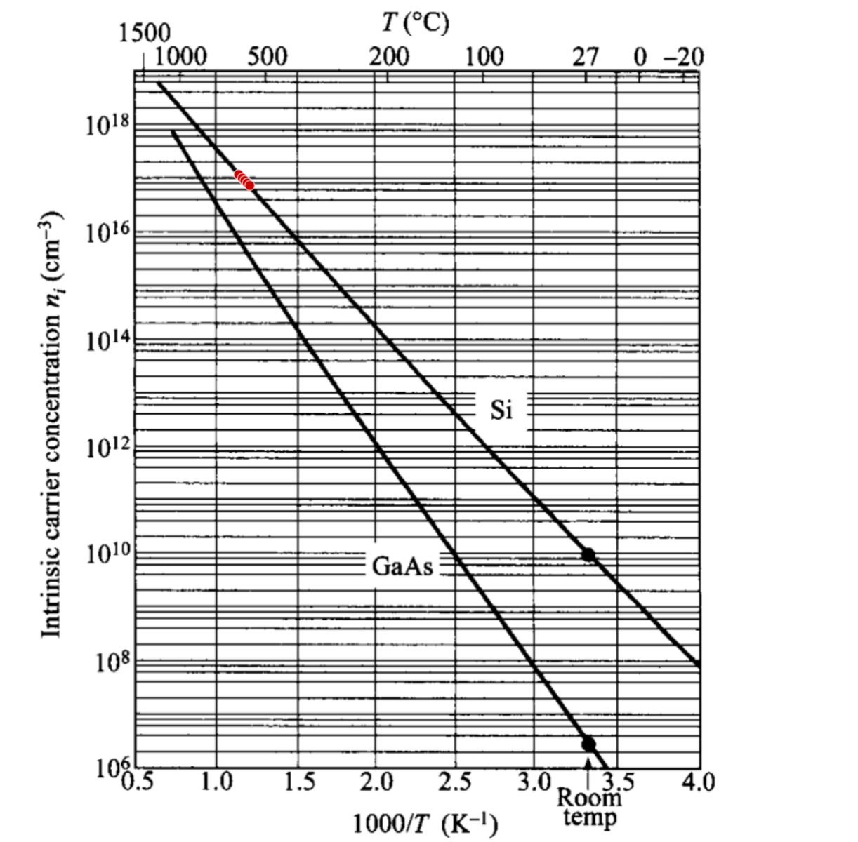
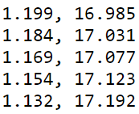
Exercise Answers
L12- S11
I assumed completion ionization of dopant atoms. So the doping concentration would be 10^17 cm^-3. Using webplot digitizer I found the approximate point where we get this concentration.
Temperature = 1000/1.19 = 840.336 K
The answer can have an error of ±3 K
1000/T | Conc(cm-3)

Slide 7
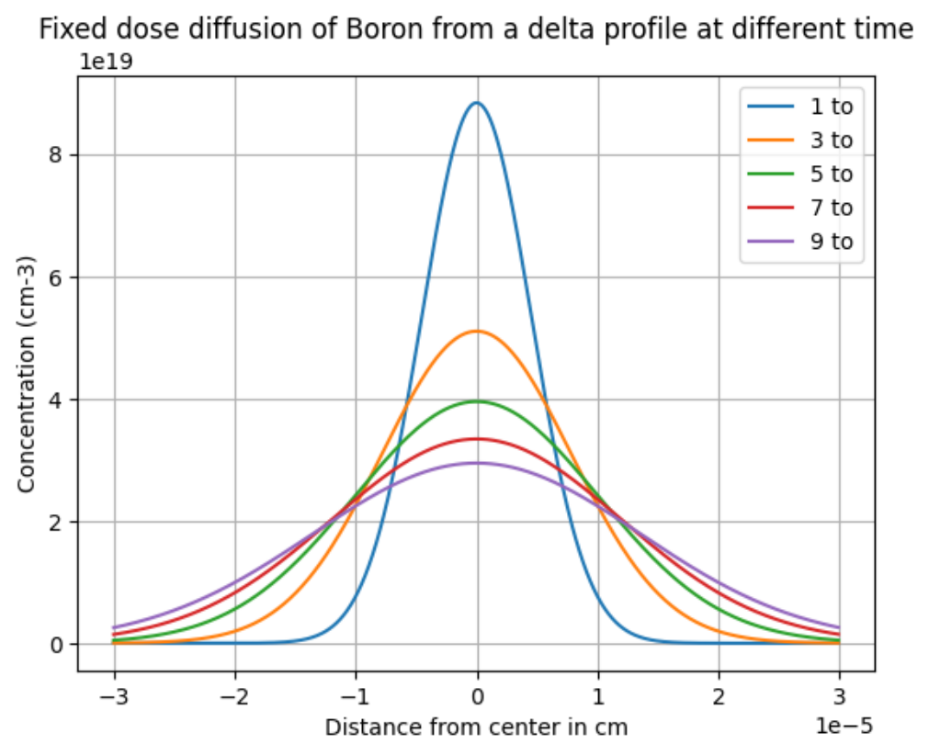
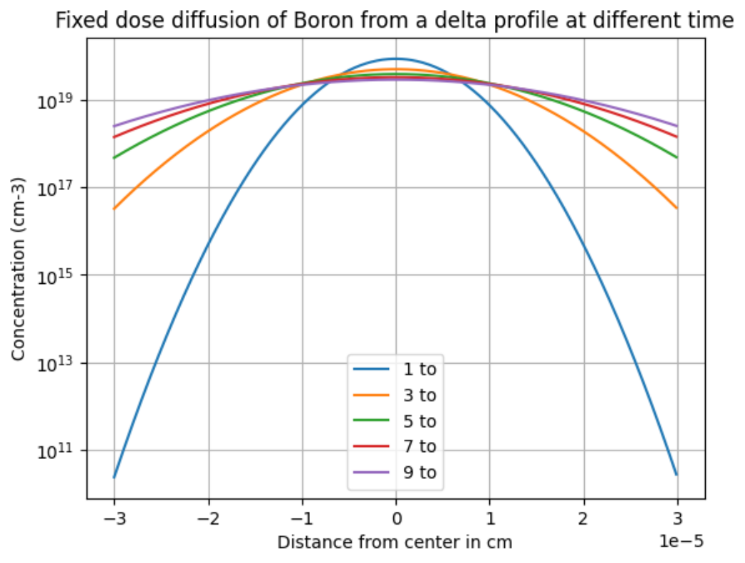
Exercise Answers
L12- S13
The equation is given as : $C\left(x,t\right)=\frac{Q}{L_{d}\sqrt{π}}∗e^{−\frac{x^{2}}{L_{d}^{2}} }$ and parameters are given: Q = 1e15 cm-2, T = 1000℃, t = 30 min
Therefore D0 = 1.0, Ea = 3.5 eV, D = 5.67e-15, t0 = 1800 sec, Ld = 6.39e-6 cm

Slide 8
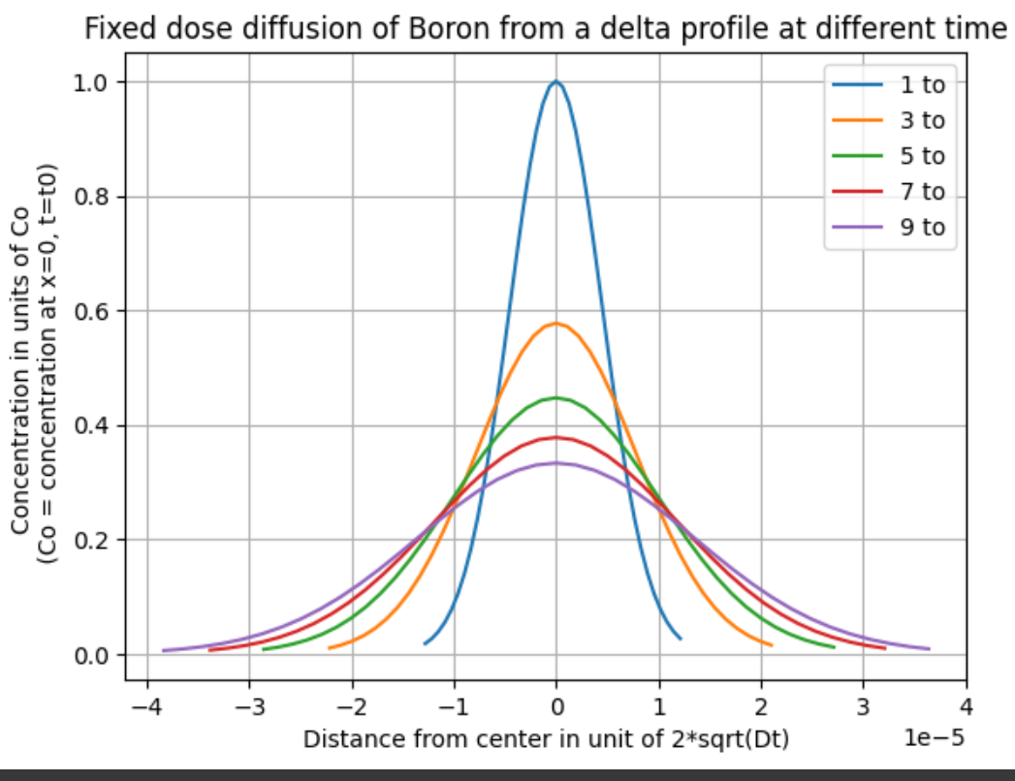
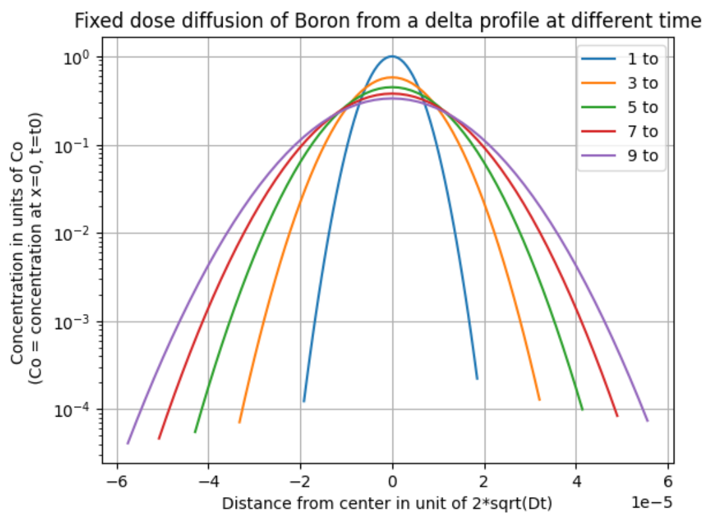
Exercise Answers
L12- S13
The equation is given as : $C\left(x,t\right)=\frac{Q}{L_{d}\sqrt{π}}∗e^{−\frac{x^{2}}{L_{d}^{2}} }$ and parameters are given: Q = 1e15 cm-2, T = 1000℃, t0 = 30 min
Normalized plots :

Slide 9
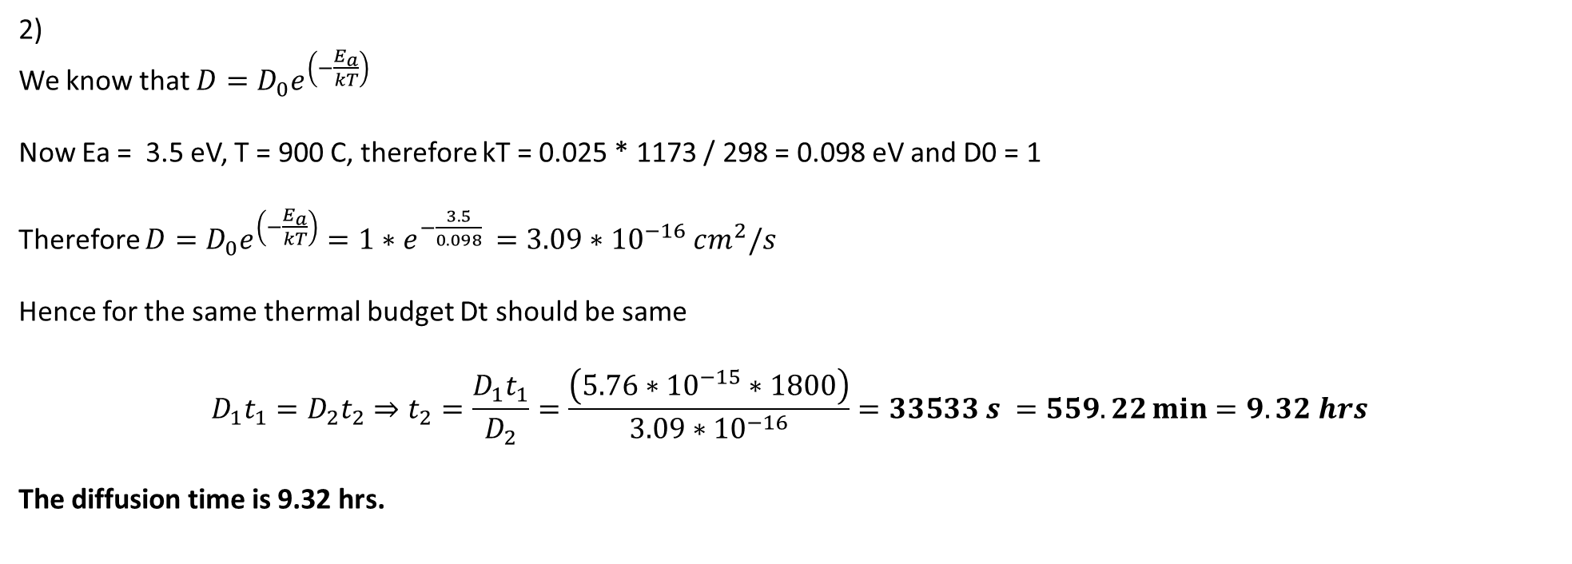
Exercise Answers
L12- S13
2)
We know that $D=D_{0}e^{\left(−\frac{E_{a}}{kT}\right)}$
Now Ea = 3.5 eV, T = 900 C, therefore kT = 0.025 * 1173 / 298 = 0.098 eV and D0 = 1
Therefore $D=D_{0}e^{\left(−\frac{E_{a}}{kT}\right)}=1∗e^{−\frac{3.5}{0.098} }=3.09∗{10}^{−16} cm^{2}/s$
Hence for the same thermal budget Dt should be same
$$D_{1}t_{1}=D_{2}t_{2}⇒t_{2}=\frac{D_{1}t_{1}}{D_{2}}=\frac{\left(5.76∗{10}^{−15}∗1800\right)}{3.09∗{10}^{−16}}=33533 s =559.22\min{=9.32 hrs}$$
The diffusion time is 9.32 hrs.

Slide 10
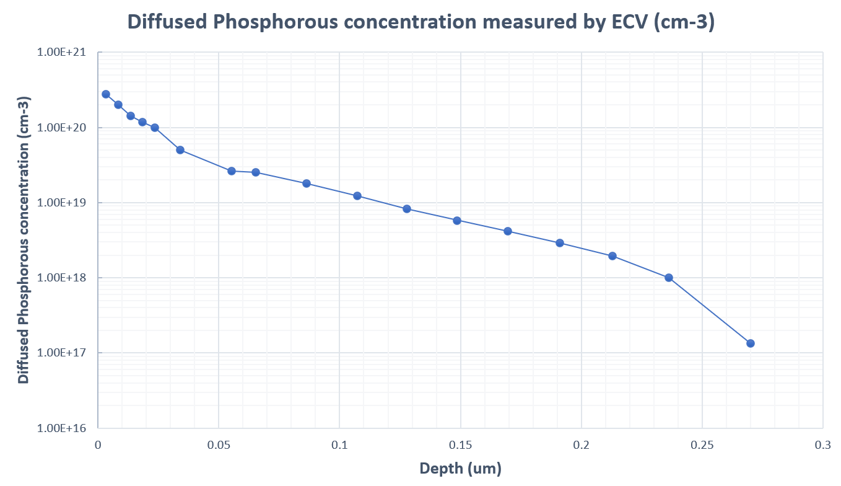
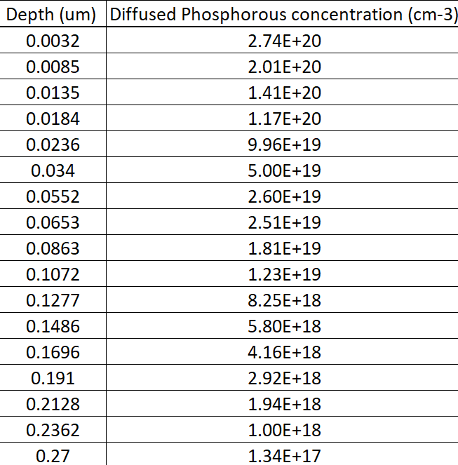
Exercise Answers
L13- S29 : Additional problem : Concept of sheet resistance

Slide 11
Exercise Answers
L13- S29 : Additional problem : Concept of sheet resistance
The sheet resistance is calculated in two cases, one with background doping and one without background doping
The background dopant is Boron with a constant concentration of 1e16/cm3 along the depth of the substrate and provides resistivity of 1.45 Ω.cm
Model | Sheet resistance without background dopant ( Ω/sq ) | Sheet resistance without background dopant ( Ω/sq )
Klaassen1992 | 107.97 | 108.03
Arora1982 | 89.09 | 89.13
Dorkel1981 | 96.33 | 96.38

