Slide 1
Descriptive Statistics in SPSS
Lecture 04
md. Monowar Hossain
ISRT, DU

Slide 2
Agenda
Frequency Distributions and Tables
Measures of Central Tendency
Measures of Dispersion
Skewness and Kurtosis

Slide 3
Frequency Distributions and Descriptive Tables

Slide 4
Understanding Frequency Distributions
Definition: A summary of how often each value occurs.
Purpose: Identify patterns and outliers.

Slide 5
Creating Frequency Tables in SPSS
Steps:
  Go to Analyze > Descriptive Statistics > Frequencies.
  Select variables of interest.
  Generate output for review.

Slide 6
Benefits of Frequency Tables
Advantages:
  Easy to interpret.
  Useful for categorical data.
SPSS Output Example:

Slide 7
Measures of Central Tendency

Slide 8
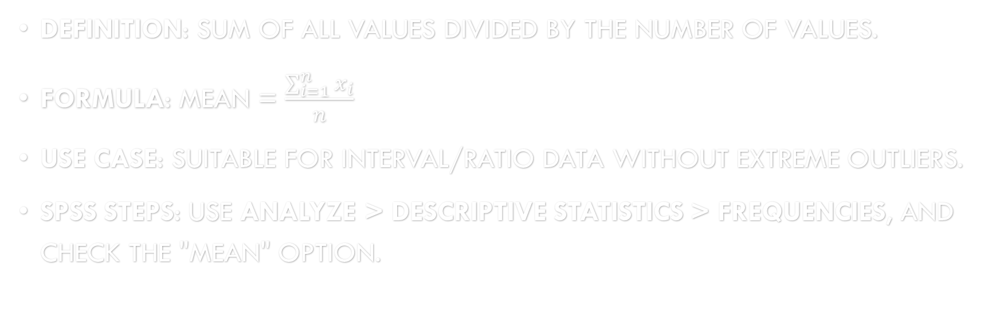
Mean (Arithmetic Average)
Definition: Sum of all values divided by the number of values.
Formula: Mean = $\frac{\sum_{i=1}^{n}{x_{i}}}{n}$​
Use Case: Suitable for interval/ratio data without extreme outliers.
SPSS Steps: Use Analyze > Descriptive Statistics > Frequencies, and check the "MEAN" option.

Slide 9
Median (Middle Value)
Definition: The middle value when data is sorted.
Use Case: Best for ordinal data or skewed distributions.
SPSS Steps: Use Analyze > Descriptive Statistics > Frequencies, and check the "Median" option.

Slide 10
Mode (Most Frequent Value)
Definition: The value that appears most often.
Use Case: Suitable for nominal data.

Slide 11
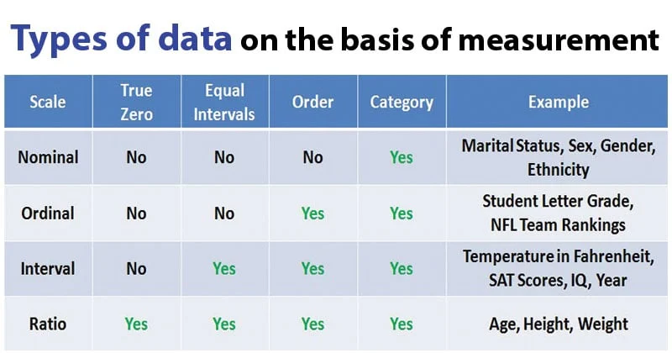

Slide 12
Measures of Dispersion

Slide 13
Range
Definition: Difference between the maximum and minimum values.
Formula: Range= Max − Min
Use Case: Provides a quick measure of data spread.

Slide 14
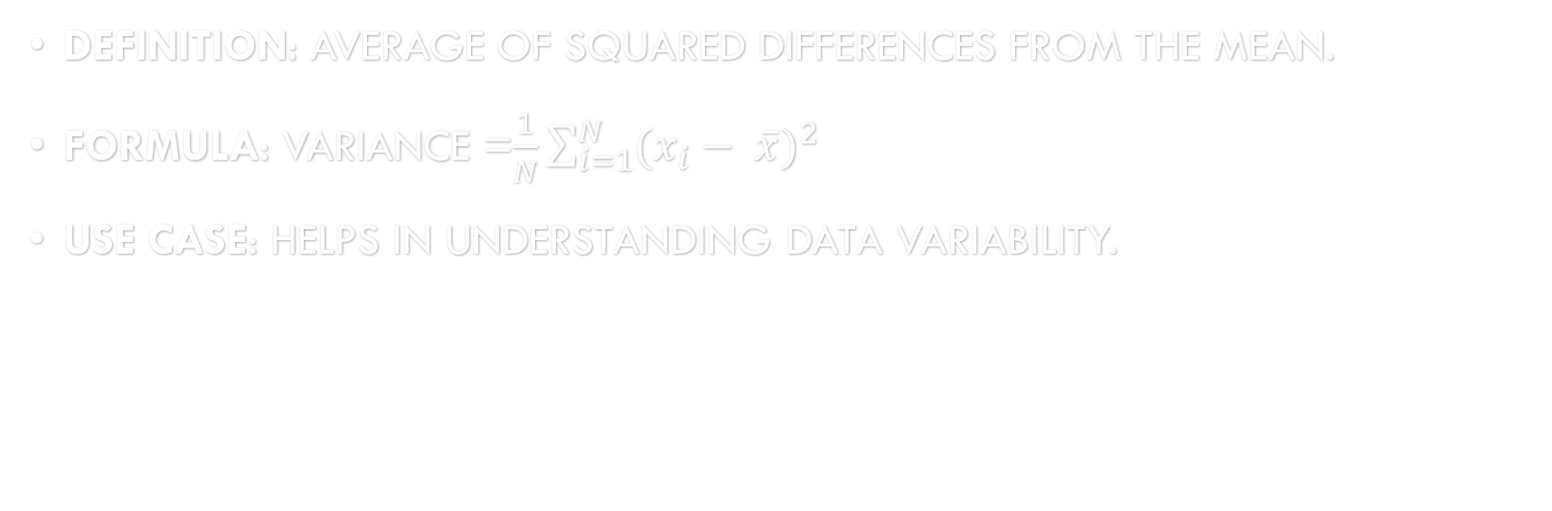
Variance
Definition: Average of squared differences from the mean.
Formula: Variance =$\frac{1}{N}\sum_{i=1}^{N}{(x_{i}− \overline{x}})^{2}$
Use Case: Helps in understanding data variability.

Slide 15
Standard Deviation
Definition: Square root of variance, indicating average deviation from the mean.
Use Case: Best for interval/ratio data.
SPSS Steps: Use Analyze > Descriptive Statistics > Descriptives and select "Std. Deviation."

Slide 16
Skewness and Kurtosis

Slide 17
Understanding Skewness
Definition: Measure of asymmetry in data distribution.
  Positive Skew: Tail on the right.
  Negative Skew: Tail on the left.
SPSS Steps: Use Analyze > Descriptive Statistics > Frequencies and select "Skewness."

Slide 18
Interpreting Skewness Values
Skewness = 0 denotes Symmetrical distribution.
Skewness > 0 denotes Positively skewed.
Skewness < 0 denotes Negatively skewed.

Slide 19
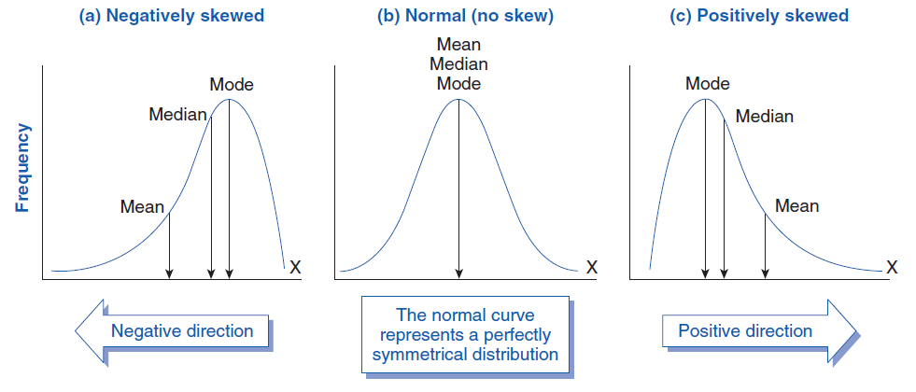
Interpreting Skewness Values

Slide 20
Understanding Kurtosis
Definition: Measure of data peakiness.
  High Kurtosis: Sharp peak (leptokurtic).
  Low Kurtosis: Flat peak (platykurtic).
SPSS Steps: Use Analyze > Descriptive Statistics > Frequencies and select "Kurtosis."

Slide 21
Interpreting Kurtosis Values
Kurtosis = 0 denotes Normal peak.
Kurtosis > 0 denotes High peak.
Kurtosis < 0 denotes Low peak.

Slide 22
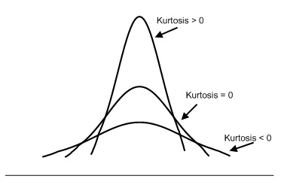
Interpreting Kurtosis Values

Slide 23
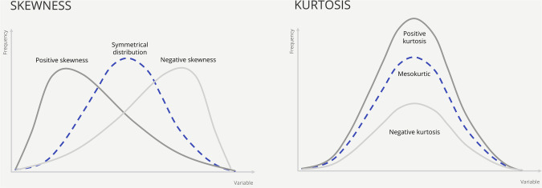
Skewness and Kurtosis

Slide 24
Combining Measures for Analysis

Slide 25
Comprehensive Descriptive Statistics
SPSS Steps:
  Use Analyze > Descriptive Statistics > Descriptives.
  Select all statistics (Mean, Std. Dev, Skewness, etc.).
Output: Single table summarizing key metrics.

Slide 26
Challenges and Solutions

Slide 27
Challenges in Descriptive Statistics
Outliers affecting mean and variance.

Slide 28
Solutions
Use median and mode for skewed data.
Visualize data (histograms, boxplots) for clarity.
Report both skewness and kurtosis values.

Slide 29
Summary
Descriptive statistics summarize and describe key data features.
Measures: Central Tendency, Dispersion, Skewness, and Kurtosis.
Use SPSS to calculate and interpret these metrics efficiently.

Slide 30
Q&A

Slide 31
Thank You

