Slide 1
Graphical Presentation of Data in SPSS
Lecture 05
md. Monowar Hossain
ISRT, DU

Slide 2
Agenda
Visualizing Categorical and Numerical Data
Customizing Graphs in SPSS

Slide 3
Visualizing Categorical Data

Slide 4
Bar Charts
Definition: A graphical display of data using bars to show frequencies or percentages for categories.
Use Case: Compare categories of a variable (e.g., survey responses).
SPSS Steps:
  Go to Graphs > Legacy Dialogs > BAR.
  Drag a bar chart template.
  Assign the variable to the category axis.

Slide 5
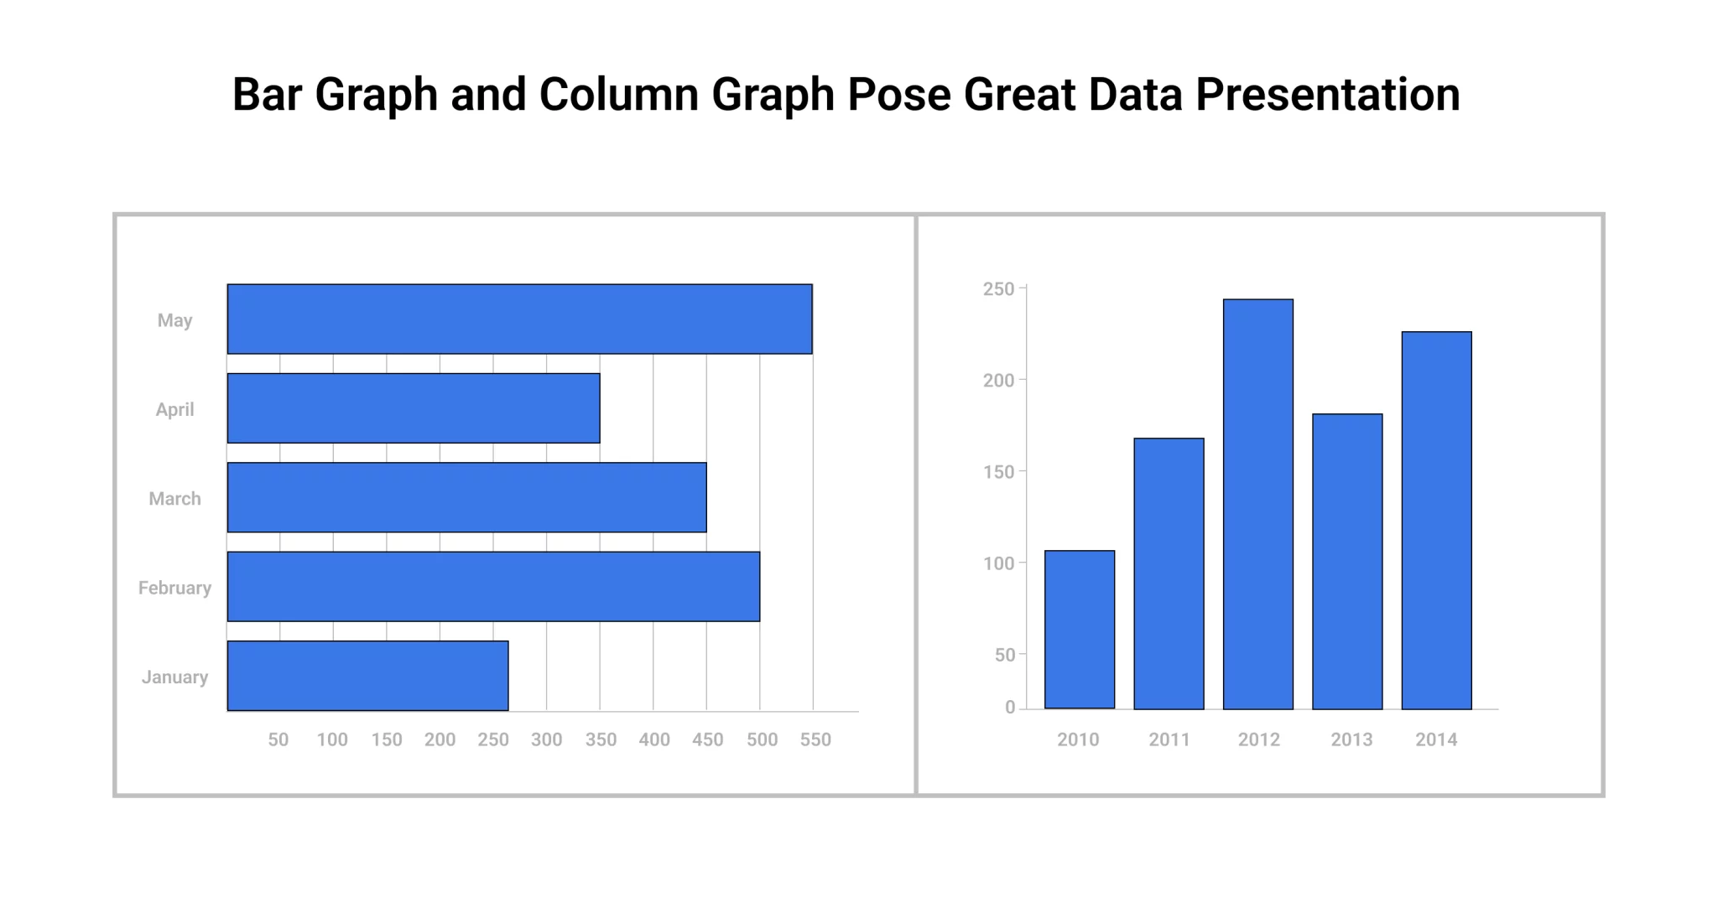

Slide 6
Pie Charts
Definition: A circular chart divided into slices to illustrate proportions.
Use Case: Display percentage contributions of categories.
SPSS Steps:
  Navigate to Graphs > Legacy Dialogs > Pie.
  Select a pie chart template.
  Assign a variable to the category axis.
Customization: Add labels, percentages, and colors.

Slide 7
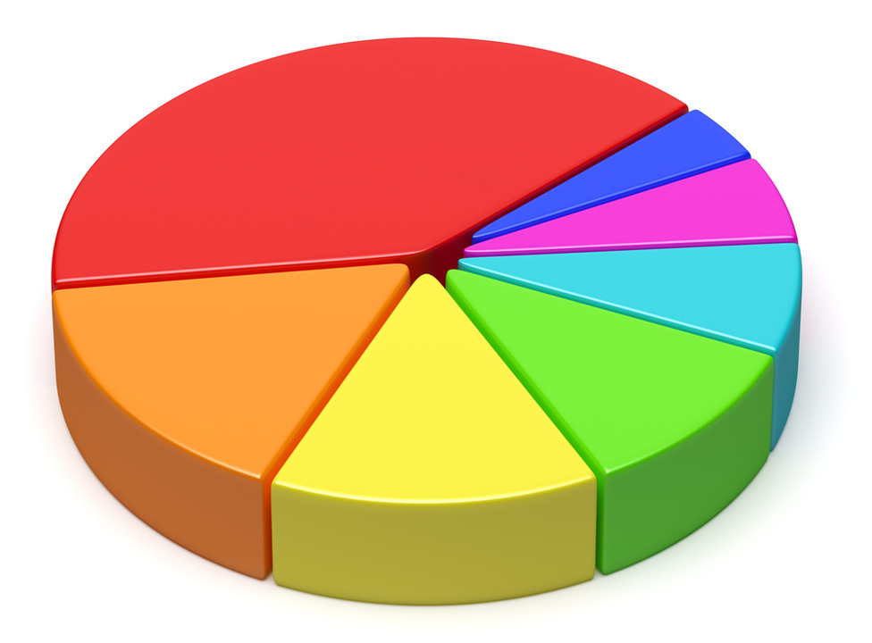
Pie Chart

Slide 8
Histograms
Definition: A graphical representation of the distribution of a dataset.
Use Case: Analyze frequency distribution for numerical variables.
SPSS Steps:
  Use Graphs > Legacy Dialogs > Histogram.
  Select a numerical variable.
  Generate the output.
Example: Show a histogram for exam scores.

Slide 9
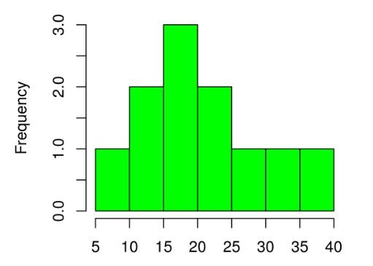
Histogram

Slide 10
Visualizing Numerical Data

Slide 11
Scatterplots
Definition: Displays data points on a Cartesian plane to observe relationships between two numerical variables.
Use Case: Identify correlations or trends.
SPSS Steps:
  Go to Graphs > Legacy Dialogs > Scatterplot.
  Drag a scatterplot template.
  Assign variables to X and Y axes.
Example: Show a scatterplot for study hours vs. exam scores.

Slide 12
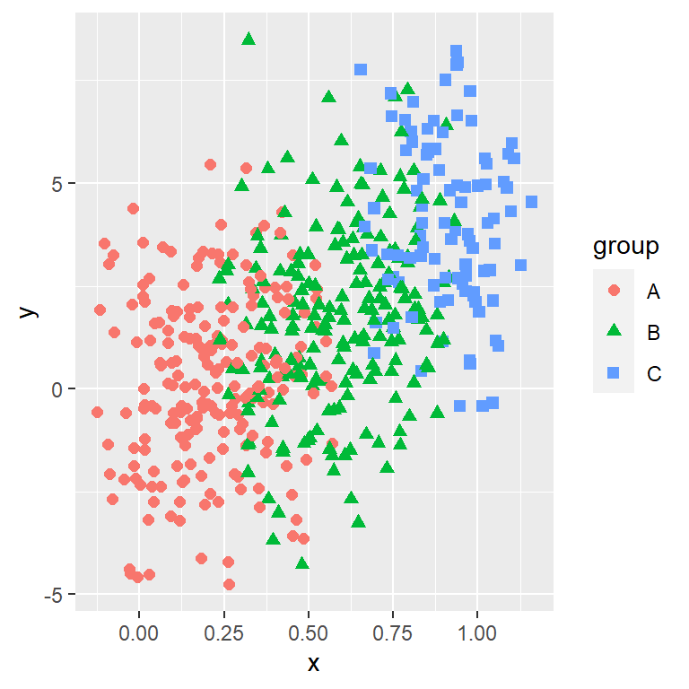
Scatterplot

Slide 13
Line Graphs
Definition: Connects data points with lines to display trends over time.
Use Case: Visualize time-series data.
SPSS Steps:
  Navigate to Graphs > Legacy Dialogs > LINE.
  Drag a line graph template.
  Assign a time variable to the X-axis and another variable to the Y-axis.
Example Output: Include a line graph for monthly sales trends.

Slide 14
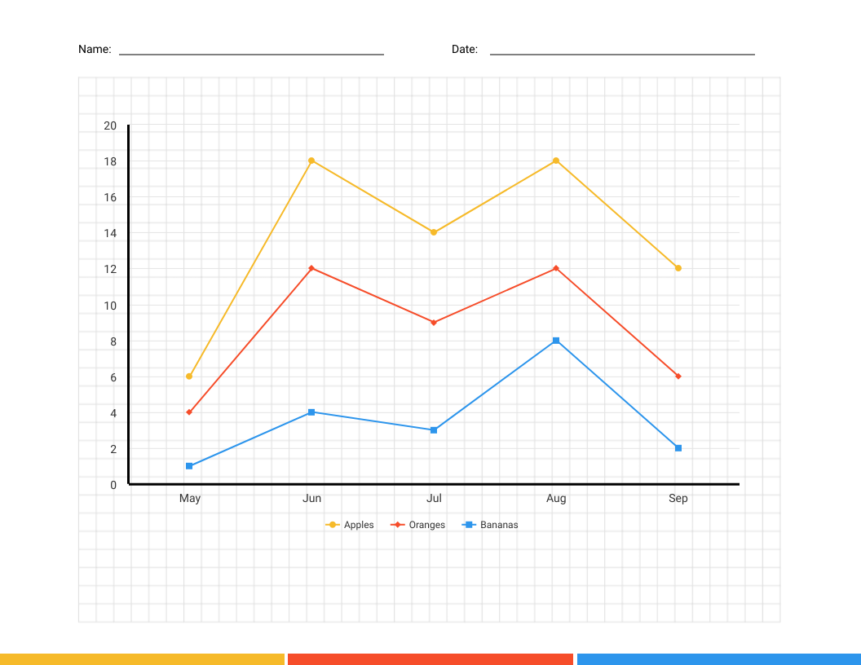
Line Graph

Slide 15
Boxplots
Definition: Displays a summary of a dataset using minimum, Q1, median, Q3, and maximum values.
Use Case: Compare distributions across groups.
SPSS Steps:
  Go to Graphs > Legacy Dialogs > Boxplot.
  Select "Simple" or "Grouped" boxplot.
  Assign variables accordingly.
Example Output: Show boxplots comparing exam scores by gender.

Slide 16
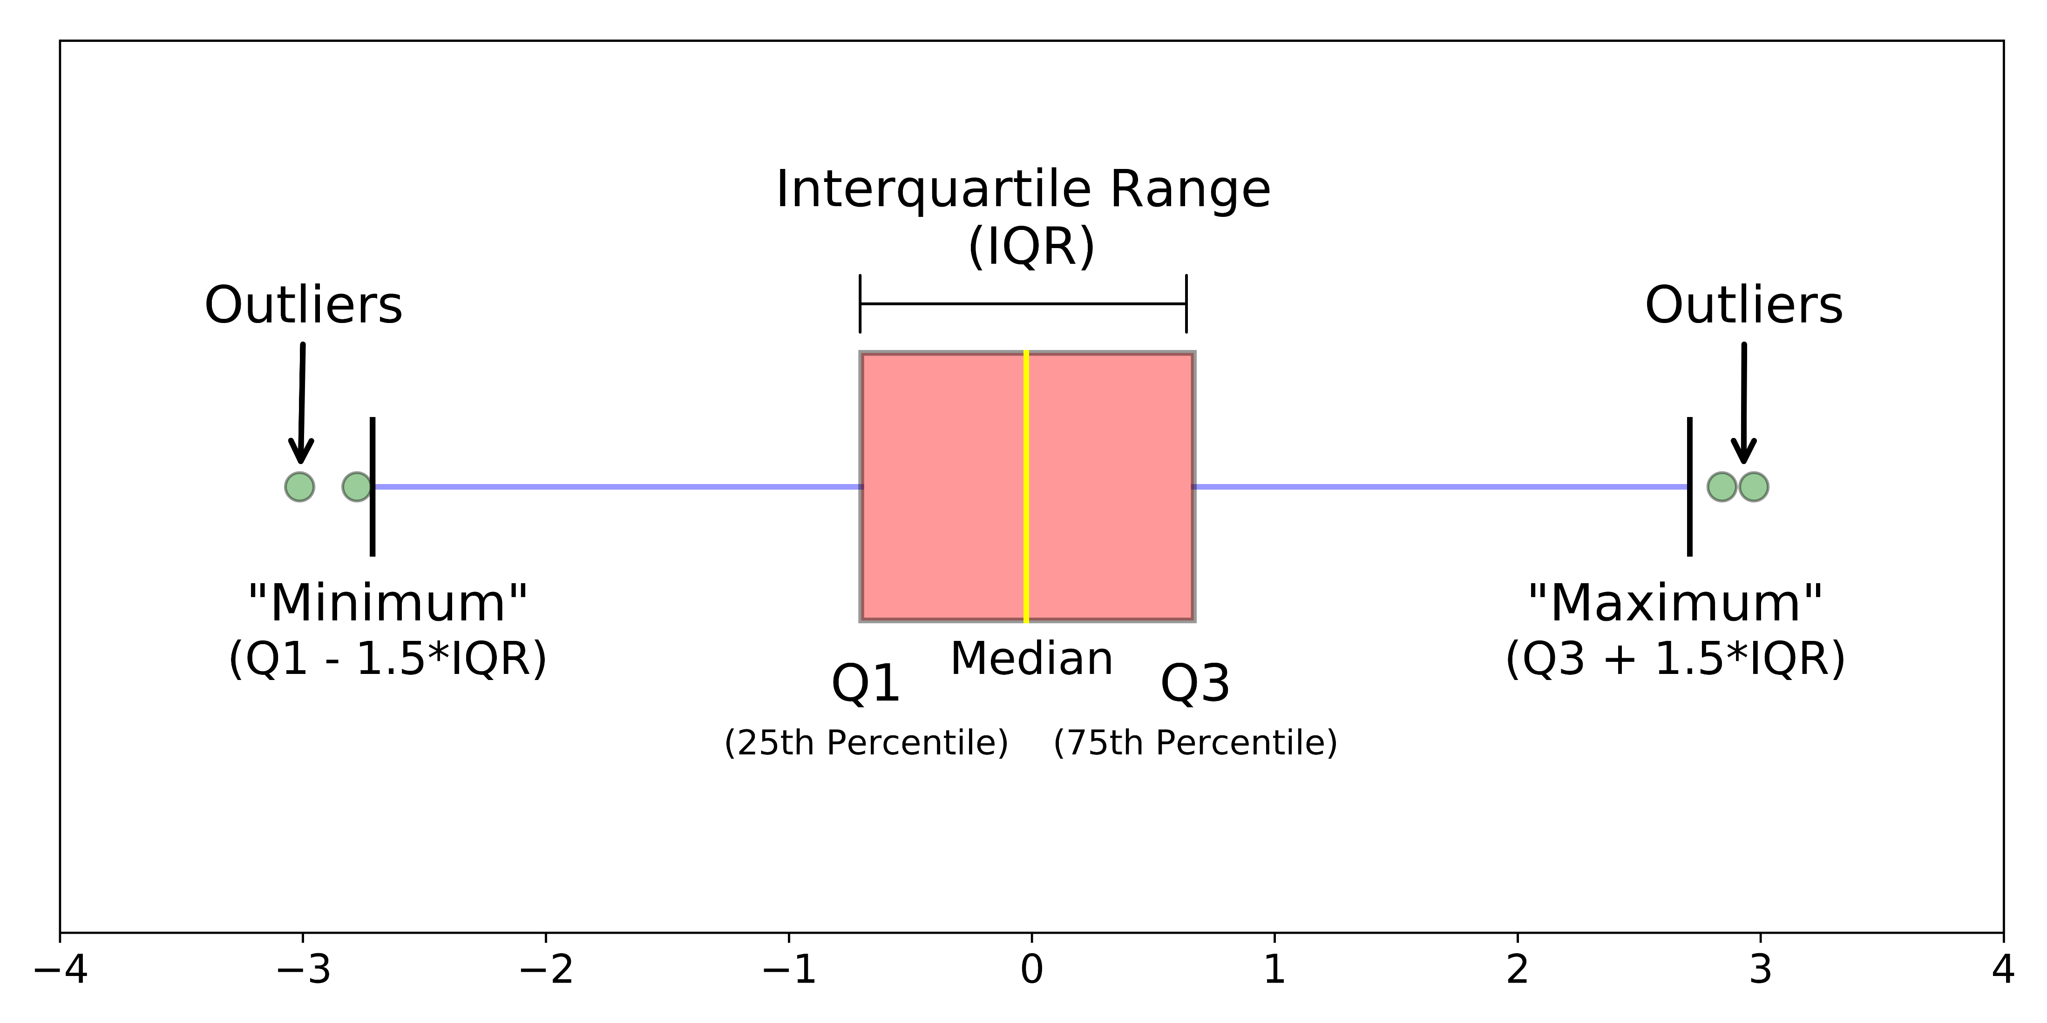
Box plot

Slide 17
Customizing Graphs in SPSS

Slide 18
Basic Customization
Change colors, titles, and labels.
Steps:
  Double-click on the graph in the Output Viewer.
  Open the Chart Editor for customization.

Slide 19
Advanced Editing
Add annotations or data labels.
Modify axes scales and tick marks.
Adjust legend placement.

Slide 20
Exporting Graphs
Steps:
  Right-click the graph in the Output Viewer.
  Choose Export or Copy as Image.
  Save as PNG, JPG, or other formats.
Use Case: Incorporate graphs into reports or presentations.

Slide 21
Practical Example
Dataset: Student attendance and grades.
Visualize using a combination of bar charts, histograms, and scatterplots.
Interpretation of the results.

Slide 22
Challenges and Solutions
Challenges:
  Choosing the right chart type.
  Interpreting graphs effectively.
Solutions:
  Match the chart to the data type (categorical or numerical).
  Use SPSS customization tools to enhance clarity.

Slide 23
Summary
Categorical Data: Bar charts, pie charts, histograms.
Numerical Data: Scatterplots, line graphs, boxplots.
Customization enhances clarity and communicative power.

Slide 24
Q&A

Slide 25
Thank You

