Slide 1
E-COMMERCE
Sales Data Analysis,
Prediction & Customer
Segmentation Using Python
Programming for Data Science Project
UCI Online Retail Dataset | Python • Pandas • Scikit-learn
Presented By: Monpreet Singh | Roll Number: 26IM91R03

Slide 2
Project at a Glance
One dataset, three complementary analytical tasks.
DATA ANALYSIS
PREDICTION
SEGMENTATION
EDA
Random Forest
RFM + K-Means
Sales Patterns, Time Trends and Analysis
Historical one-day-ahead daily sales estimates
Behaviour-based customer groups
• Analyzed Transaction-Level retail data and Derive sales values.
• Predicted daily sales using lagged and calendar-based features.
• Segmented the customers using Recency, Frequency and Monetary behaviour.
PROGRAMMING FOR DATA SCIENCE • UCI ONLINE RETAIL
02

Slide 3
Dataset & Preparation
UCI Online Retail • transaction-level records
ORIGINAL ROWS
CLEAN ROWS
CUSTOMERS
INVOICES
541,909
397,884
4,338
18,532
• Removed rows without CustomerID and cancelled invoices (InvoiceNo beginning with C).
• Kept positive Quantity and UnitPrice records.
• Computed Transaction-Line Sales = Quantity × UnitPrice.
• Observation Period: 1 Dec 2010 to 9 Dec 2011; cleaned sales total: £8,911,407.90.
PROGRAMMING FOR DATA SCIENCE • UCI ONLINE RETAIL
03

Slide 4
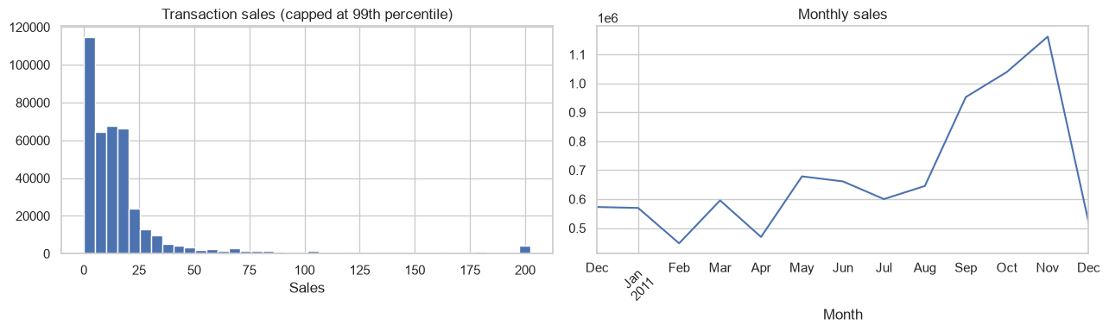
Exploratory Sales Analysis
.
• Transaction sales are highly right-skewed.
• Monthly sales vary over the observation period.
• The distribution plot caps the display at the 99th percentile for readability.
PROGRAMMING FOR DATA SCIENCE • UCI ONLINE RETAIL
04

Slide 5
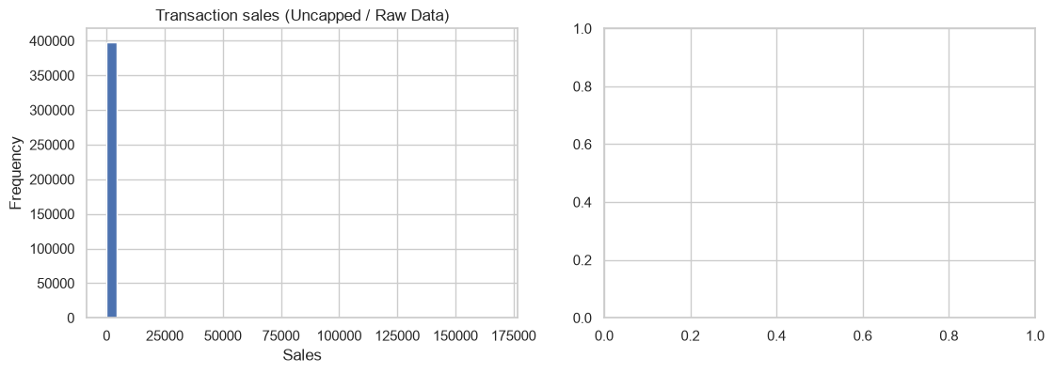
Transaction-level distribution
Both uncapped and capped views are retained in the notebook.
PROGRAMMING FOR DATA SCIENCE • UCI ONLINE RETAIL
05

Slide 6
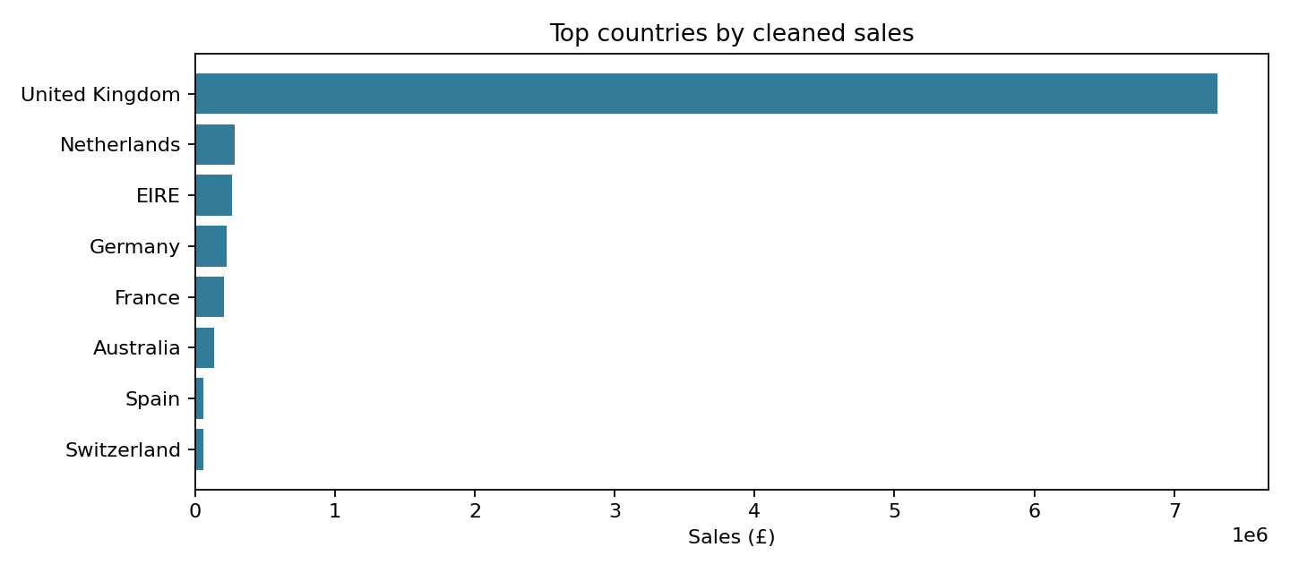
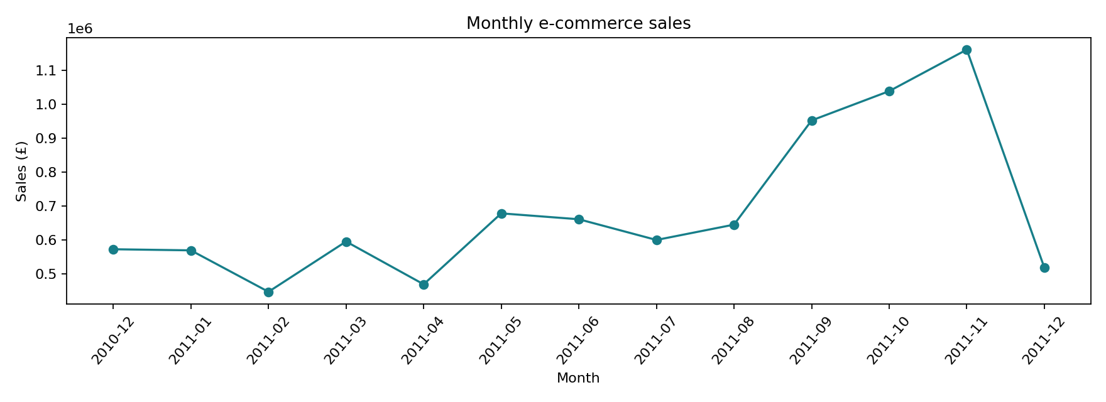
Sales Patterns across Time and Markets
Monthly sales trend
Country-level sales
PROGRAMMING FOR DATA SCIENCE • UCI ONLINE RETAIL
06

Slide 7
Customer-Level RFM Features
RECENCY
FREQUENCY
MONETARY
Days
Invoices
GBP
Days since the most recent purchase; lower is more recent.
Number of distinct invoices; higher means more purchase occasions.
Total recorded transaction sales for the customer.
• RFM table: 4,338 customers × 3 behavioural features.
• log1p transformation reduces skew; StandardScaler puts features on comparable scales.
• The clustering model uses all three scaled RFM variables.
PROGRAMMING FOR DATA SCIENCE • UCI ONLINE RETAIL
07

Slide 8
RFM Descriptive Statistics
Customer-level distribution before transformation.
Statistic | Recency (days) | Frequency (invoices) | Monetary (£)
Mean | 93.06 | 4.27 | 2,054.27
Median | 51 | 2 | 674.49
75th percentile | 142.75 | 5 | 1,661.74
Maximum | 374 | 209 | 280,206.02
PROGRAMMING FOR DATA SCIENCE • UCI ONLINE RETAIL
08

Slide 9
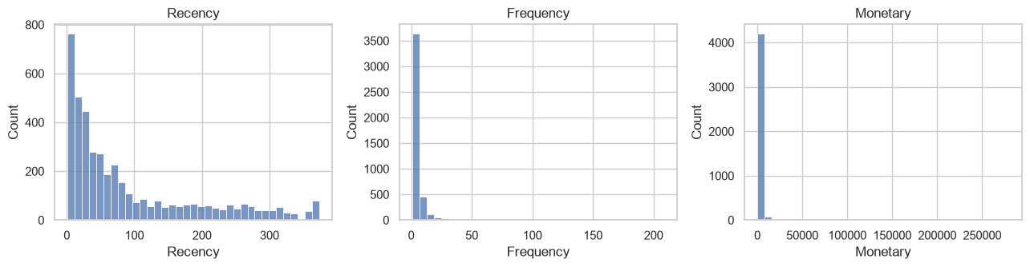
RFM Feature Distributions
Log1p and standardisation are applied after inspecting the original distributions.
Model matrix shape: 4,338 × 3
PROGRAMMING FOR DATA SCIENCE • UCI ONLINE RETAIL
09

Slide 10
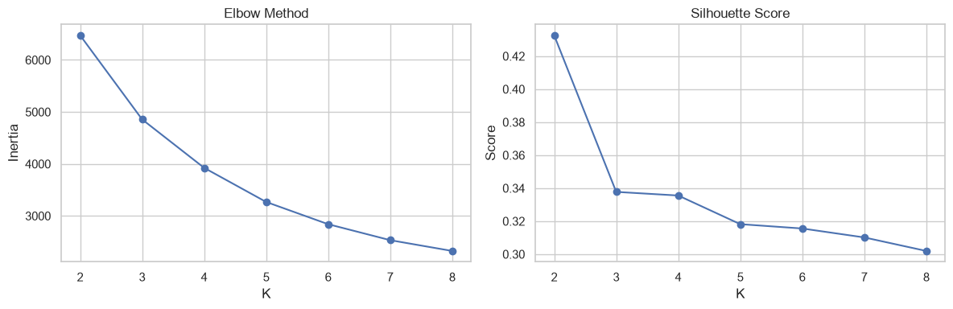
Selecting the Number of Clusters
Candidate K values from 2 to 8 were compared using inertia and silhouette score.
• K = 2 has the highest silhouette score: 0.4326.
• K = 3 score: 0.3377.
• K = 3 is retained for three interpretable business profiles—not as the silhouette optimum.
PROGRAMMING FOR DATA SCIENCE • UCI ONLINE RETAIL
10

Slide 11
Three Customer Segments
K-Means fitted with K = 3; segment names are assigned after inspecting RFM profiles.
Segment | Customers | Share | Median R (days) | Median F | Median M
Toppers / High-value | 757 | 17.45% | 10 | 10 | £3,722.82
Moderated / Mid-value | 1,695 | 39.07% | 30 | 3 | £982.38
Churn-risk / Low-engagement | 1,886 | 43.48% | 158 | 1 | £299.81
• High-value: retain through relevant loyalty and personalised engagement.
• Mid-value: encourage repeat purchases and cross-selling.
• Low-engagement: test selective win-back campaigns; this is not a churn prediction.
PROGRAMMING FOR DATA SCIENCE • UCI ONLINE RETAIL
11

Slide 12
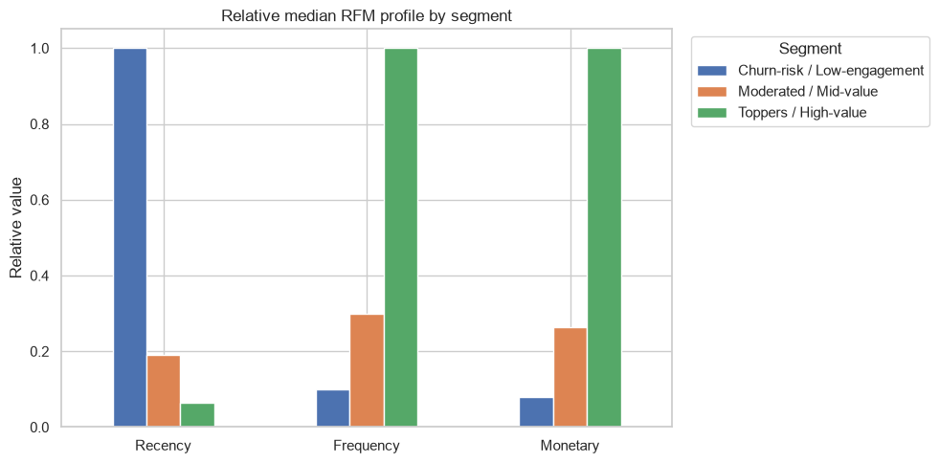
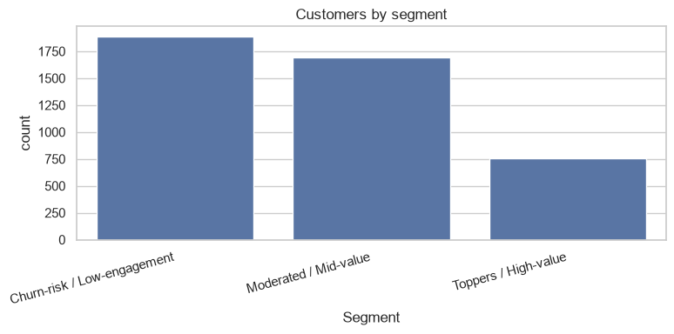
Segment Visualizations
Customer counts and relative median RFM profiles.
PROGRAMMING FOR DATA SCIENCE • UCI ONLINE RETAIL
12

Slide 13
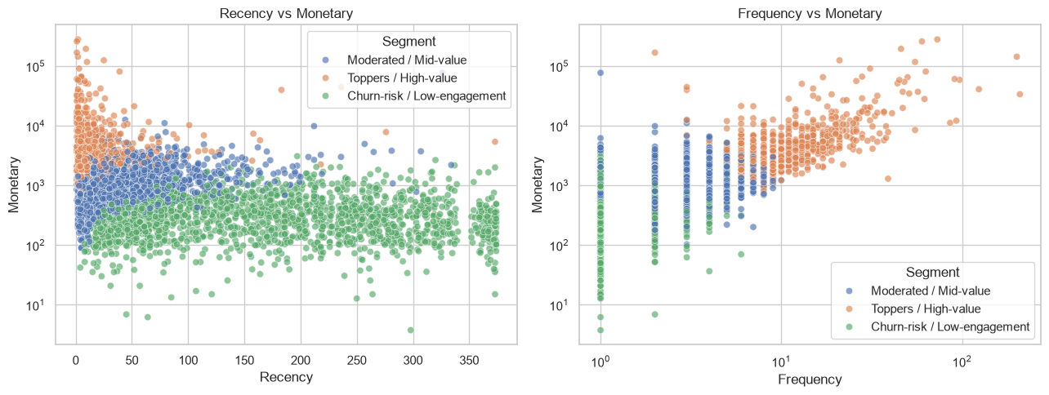
Customer-Level RFM Relationships
PROGRAMMING FOR DATA SCIENCE • UCI ONLINE RETAIL
13

Slide 14
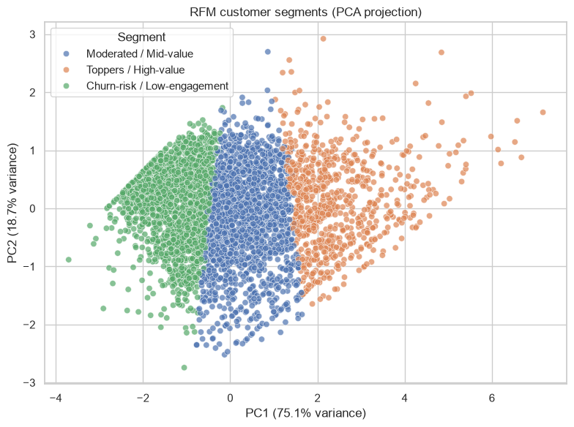
PCA visualisation
The first two principal components explain 93.86% of variance.
• PCA is used only to visualise the three-dimensional RFM data.
• K-Means assignments are trained on all three standardised RFM features.
• K = 3 silhouette score: 0.3377.
PROGRAMMING FOR DATA SCIENCE • UCI ONLINE RETAIL
14

Slide 15
Segmentation Consistency Check
A sample-based check across five random initialisations.
SAMPLE SIZE
RANDOM SEEDS
AGREEMENT
1,200
5
0.9997
Customers sampled for the consistency check
11, 22, 33, 44 and 55
Mean co-membership agreement vs first run
Interpretation: very high agreement for the tested sample and settings; it does not guarantee stability across other samples, periods or retailers.
PROGRAMMING FOR DATA SCIENCE • UCI ONLINE RETAIL
15

Slide 16
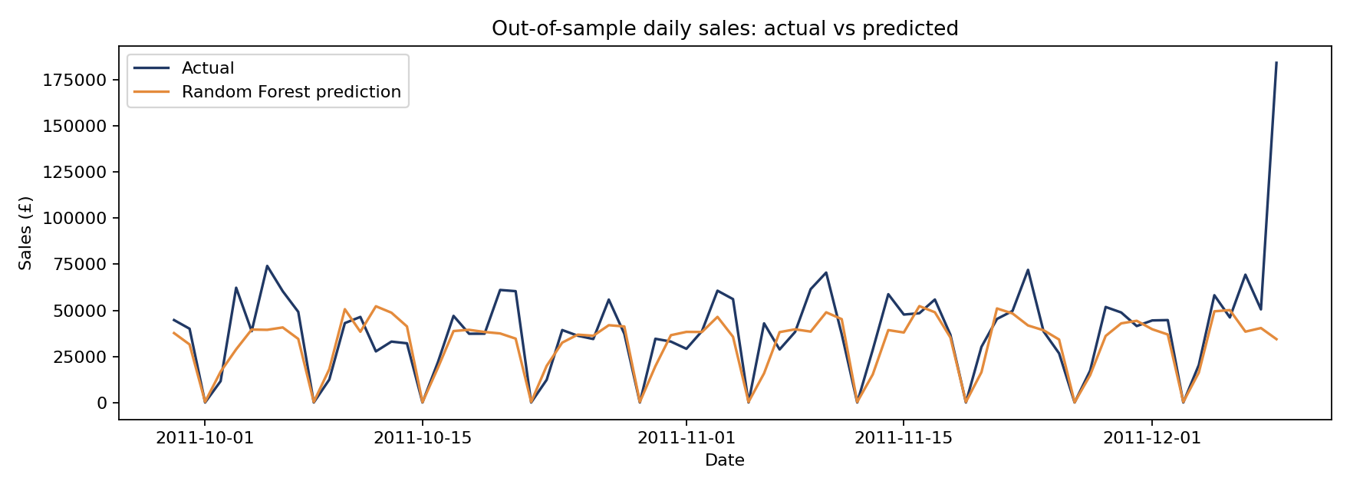
Daily Sales Prediction
New predictive component: Random Forest Regression.
• Daily sales series created from cleaned transaction-line sales.
• Time-ordered split: 288 training days and 72 testing days.
• Test interval: 29 September 2011 to 9 December 2011.
• Features include lagged sales and calendar information.
• A seasonal-naive benchmark is used for comparison.
PROGRAMMING FOR DATA SCIENCE • UCI ONLINE RETAIL
16

Slide 17
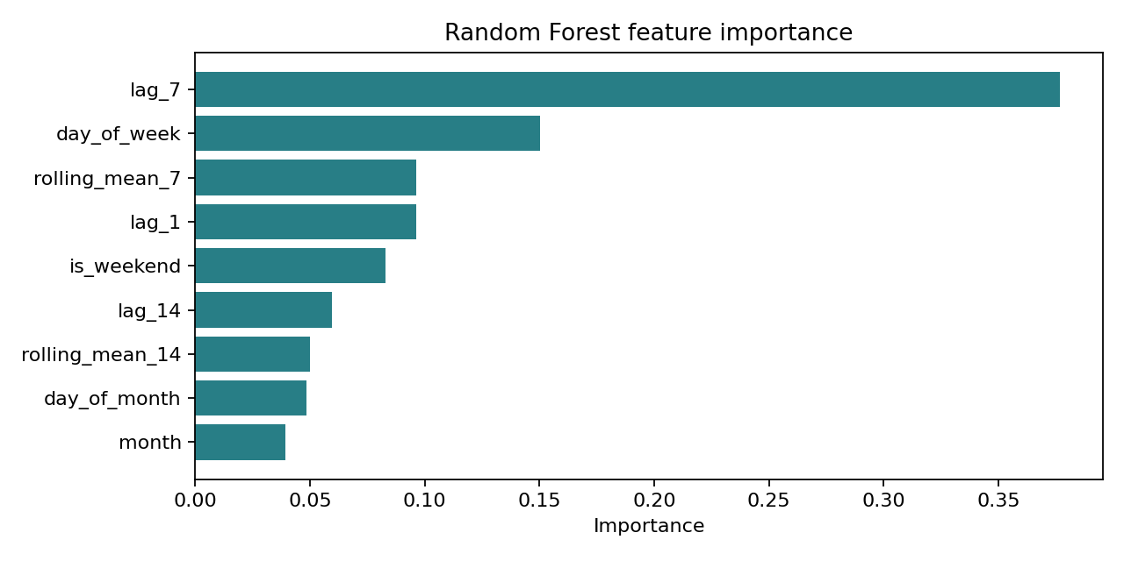
What influenced the sales predictions?
Random Forest feature importance from the notebook's fitted model.
• Feature importance describes the model's relative reliance on inputs.
• It is not evidence of causation.
• Historical lags and calendar patterns help the model estimate daily sales.
PROGRAMMING FOR DATA SCIENCE • UCI ONLINE RETAIL
17

Slide 18
Sales Prediction Performance
Historical holdout evaluation; predictions are one-day-ahead estimates.
Metric | Random Forest | Seasonal-naive baseline
MAE | £11,257.85 | £13,155.37
RMSE | £21,906.92 | £22,451.47
R² | 0.3139 | —
WAPE | 28.91% | —
The Random Forest improves MAE and RMSE modestly over the baseline. R² = 0.3139 indicates moderate explanatory performance; forecasting remains challenging.
PROGRAMMING FOR DATA SCIENCE • UCI ONLINE RETAIL
18

Slide 19
Key Takeaways & Limitations
What the analysis supports—and what it does not.
• Transaction data can support both descriptive customer profiling and short-horizon sales prediction.
• Three RFM segments offer distinct historical purchase profiles for differentiated marketing.
• Random Forest outperformed the seasonal-naive baseline on MAE and RMSE in this holdout period.
• The dataset covers one retailer and about one year; results may not generalise.
• Churn-risk is a descriptive label, not a validated churn forecast; model performance is moderate.
PROGRAMMING FOR DATA SCIENCE • UCI ONLINE RETAIL
19

Slide 20
References & data source
Selected sources used in the original analysis and modelling.
• Chen, D. (2015). Online Retail [Dataset]. UCI Machine Learning Repository. https://doi.org/10.24432/C5BW33
• Chen, D., Sain, S. L., & Guo, K. (2012). Data mining for the online retail industry: A case study of RFM model-based customer segmentation using data mining. Journal of Database Marketing & Customer Strategy Management, 19(3), 197–208.
• Rousseeuw, P. J. (1987). Silhouettes: A graphical aid to the interpretation and validation of cluster analysis. Journal of Computational and Applied Mathematics, 20, 53–65.
• Mehta, D., & Sehgal, S. (2024). A study on micro-segmentation of retail customers using K-means clustering. Journal of Business Thought, 15, 75–87.
PROGRAMMING FOR DATA SCIENCE • UCI ONLINE RETAIL
21

