Slide 1

Social Media API

Slide 2


Assignment 2
Social Data Mining Techniques
BDAT1007 – 21F
Prof. Rick Lambroff
YouTube Link
https://youtu.be/Ua4vQ-2i7nc

Slide 3

Hello..
I am Monse Michael
M.Sc. In Statistics
Graduate Certificate in Big Data Analytics
Student ID : 200465690

Slide 4


Social Media Platforms

Slide 5








Tools used
Programming Language
API Libraries
Web Application
Cloud Database
Frontend
IDE

Slide 6

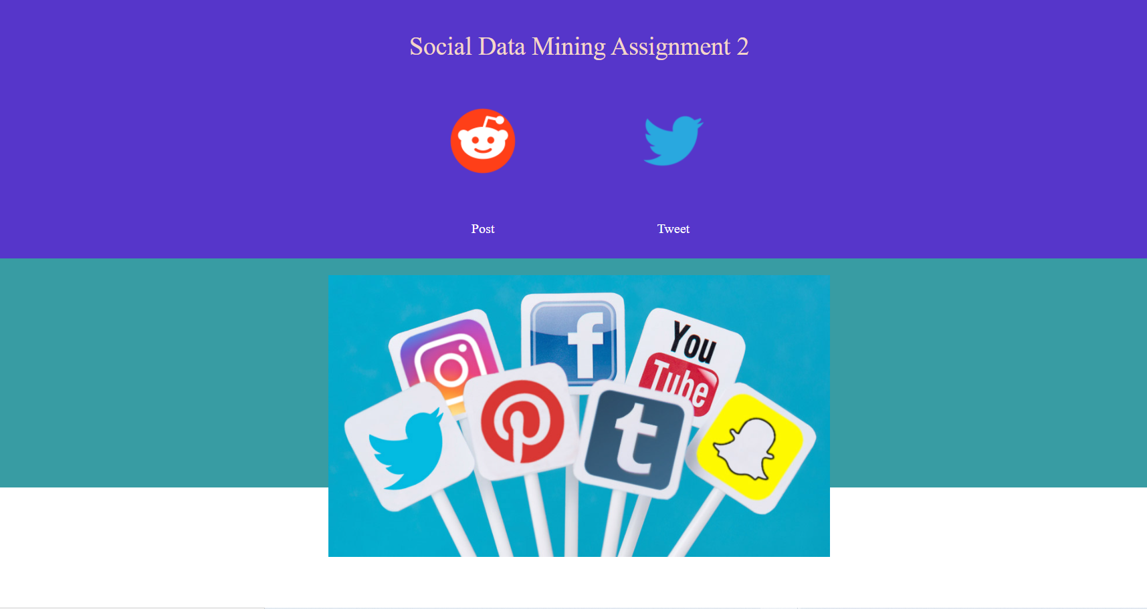
Frontend Dashboard

Slide 7



Data Model
{
"ID":Unique ID
"TweetAuthor": Author Name
"TweetText": Tweet Content
"DateandTime":Posted Date and Time
}
{
"PostId": Unique ID,
"PostAuthor": Author Name,
"PostTitle": Title,
"PostText": Content,
"Dateandtime": Posted Date and Time
}

Slide 8

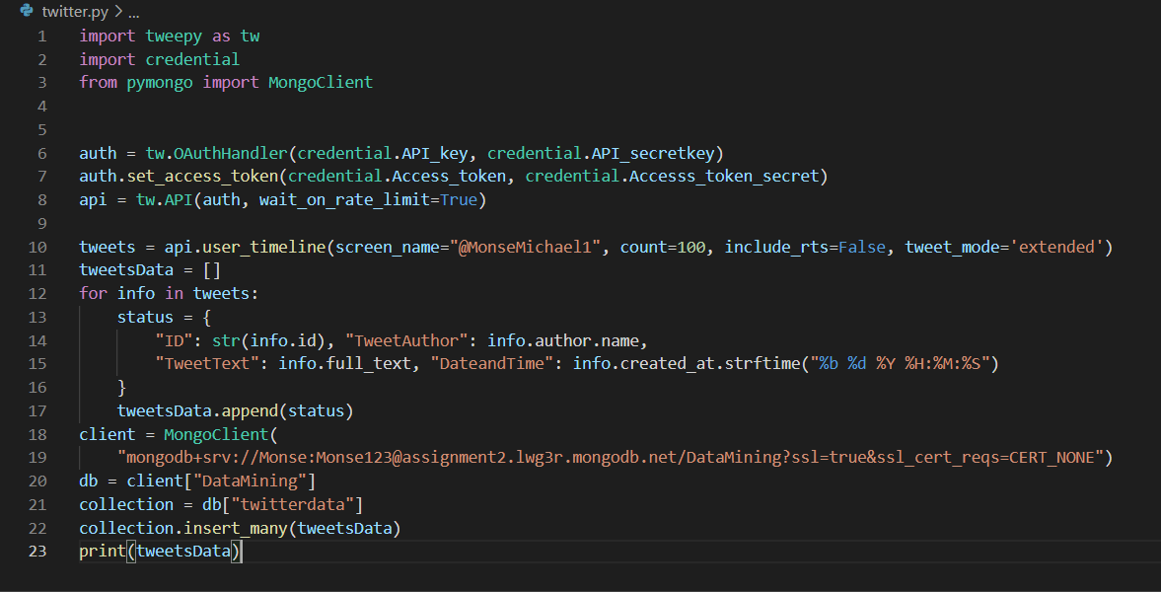
Scraping Data
The data from twitter is scrapped using the Python’s library for Twitter : Tweepy

Slide 9
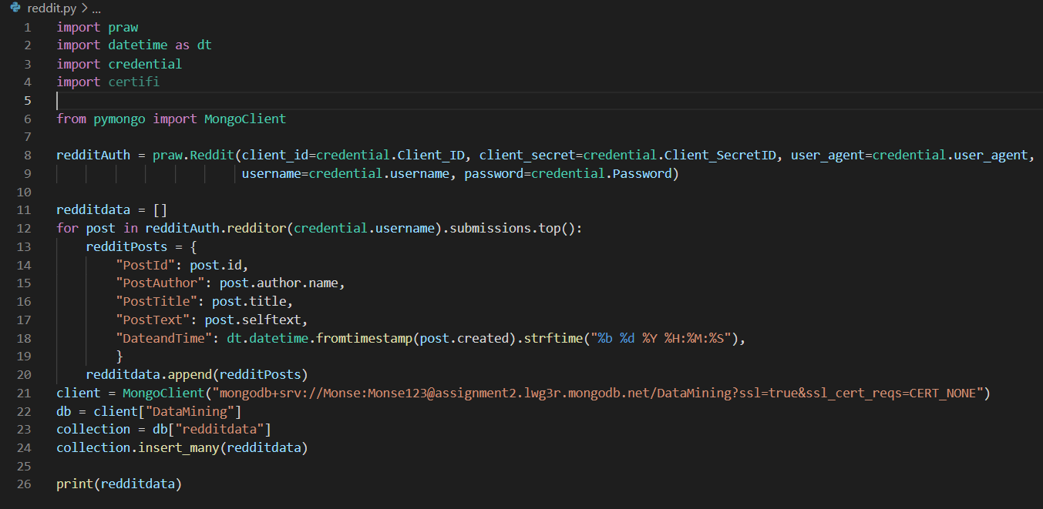
Scraping Data
The data from Reddit is scrapped using the Python’s library for Reddit : praw

Slide 10
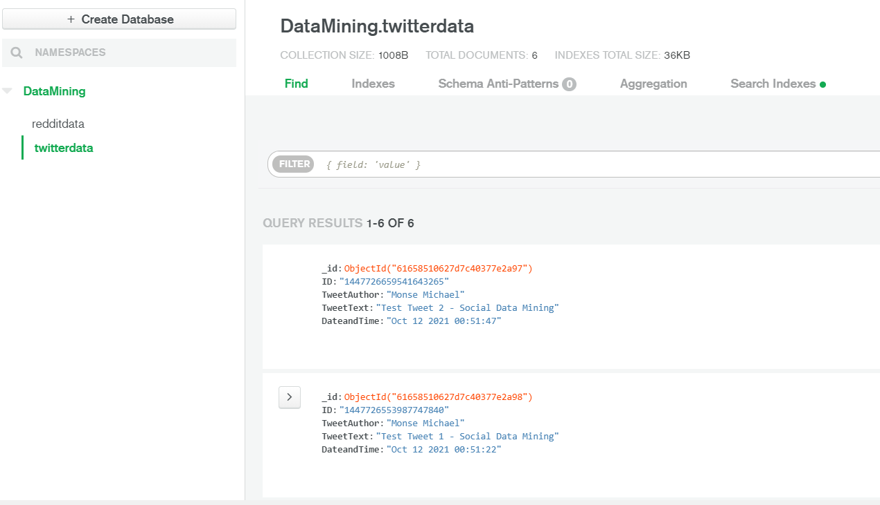
View data stored in MongoDB

Slide 11
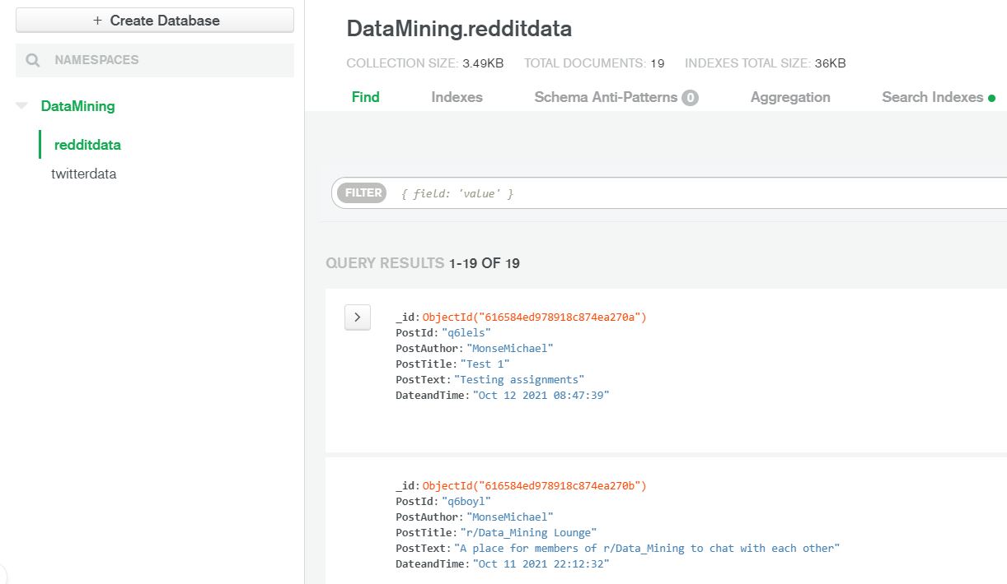
View data stored in MongoDB

Slide 12

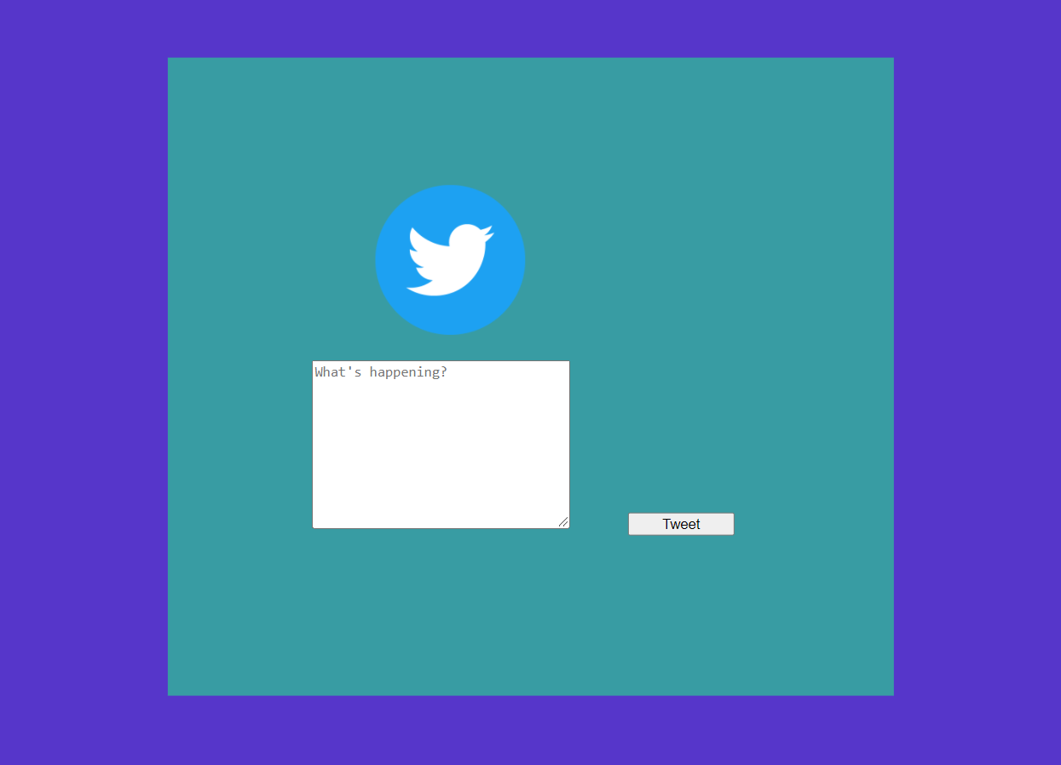
Post Data

Slide 13
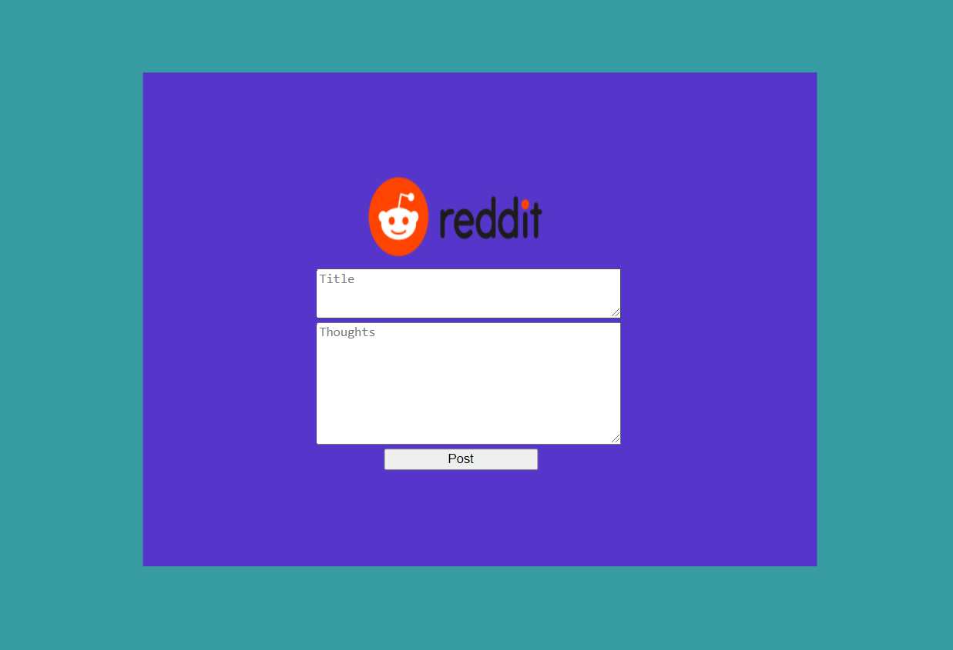
Post Data

Slide 14

DEMO..

Slide 15
Thank You

