Slide 1
Betterchegg
Yoel dwi miryano-2206059534

Slide 2
Outline
Background
Purpose
UML
Flowchart
ERD
Features
Backend
Frontend
Database

Slide 3
BAckground
Free Digital Academic Library
JavaScript, Android Studio, Java dan PostgreSQL
Mengembangkan sistem upload/download yang lebih efektif

Slide 4
purpose
Memenuhi mahasiswa
Ease of access
System assisted management

Slide 5
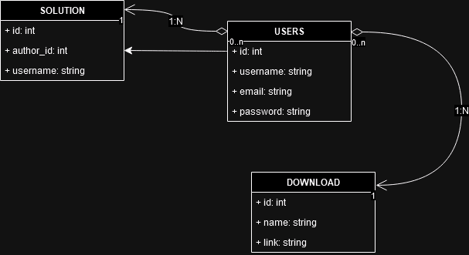
UML

Slide 6
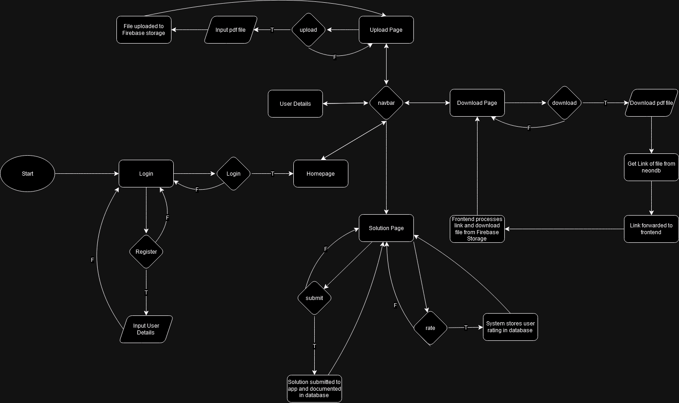
FlowChart

Slide 7
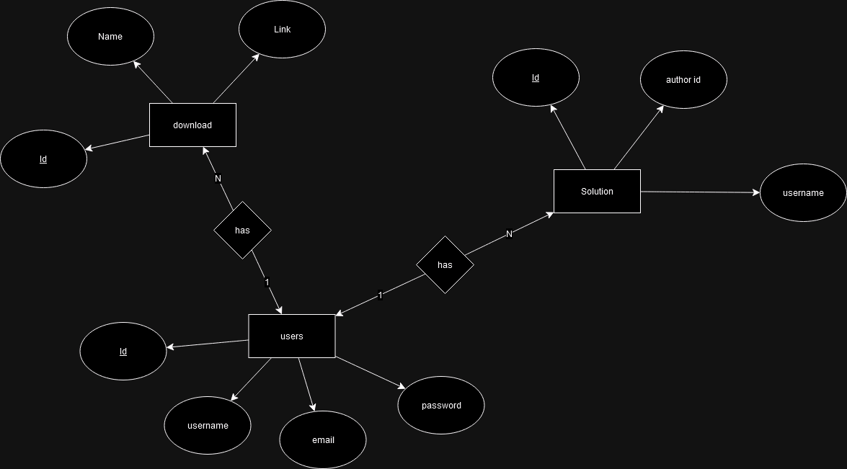
erd

Slide 8






Features
backend | frontend | Database
JavaScript | Java | PostgreSQL
Node JS | Android Studio | NeonDB/Firebase

Slide 9




features
Home
Profile
Upload
download

Slide 10
backend
downloadController
loginController
profileController
registerController
uploadController
Index.js
Pool.js

Slide 11
frontend
API
Retrofitclient
LoginResponse
ProfileResponse
User
homeActivity
loginActivity
profileActivity
registerActivity
uploadActivity

Slide 12
Database
PostgreSQL
NeonDB
Firebase Storage

Slide 13
Thank you!

