Slide 1
Boulder Dash Java Project
Charles HOMO | Etienne JOUVENCON | Nils MONTIER | Arthur CASTAING
Notes:
CHARLES We had 1.5 week to do a remake of the abandonware "Boulder Dash" in team of 4 with ETIENNE, NILS, ARTHUR.
The objective of the game is to pick up 10 diamonds without dying but some monsters and obstacles will make the game more difficult.

Slide 2
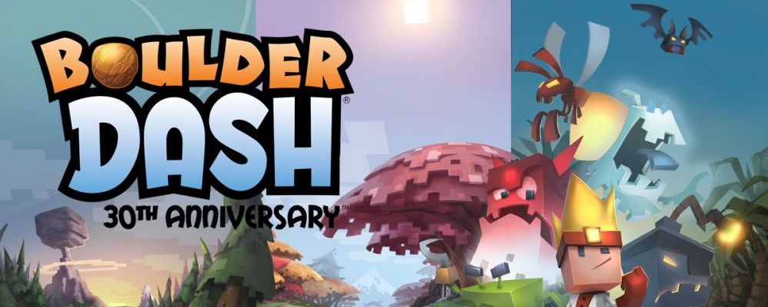
Trailer
Notes:
ARTHUR : show the trailer

Slide 4
Summary
Planning
Conception
Realization
Demonstration
Conclusion
Notes:
I will introduce you the step of the project :

Slide 5
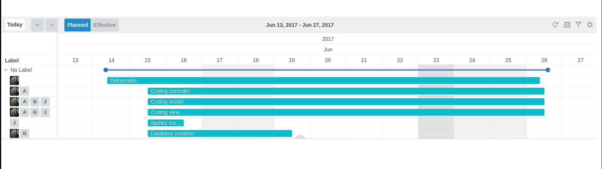
Initial Schedule
Notes:
CHARLES We make a Initial Schedule :
Horraire : FROM … TO ...

Slide 6
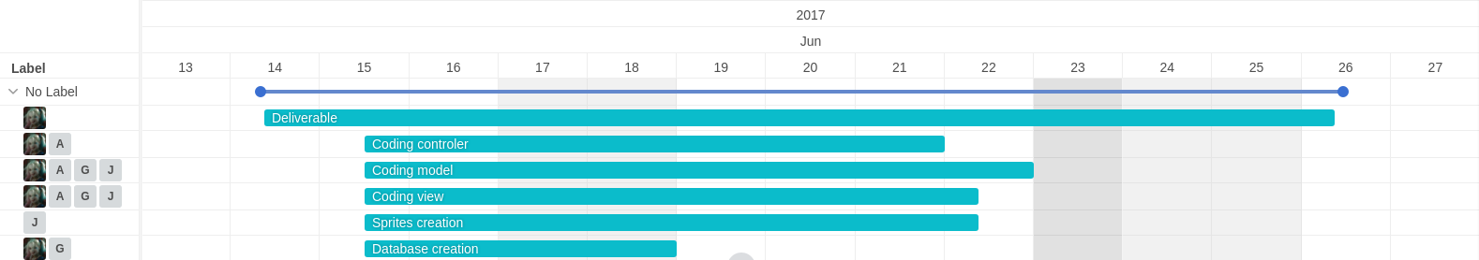
Final Schedule
Notes:
CHARLES Final Schedule

Slide 7
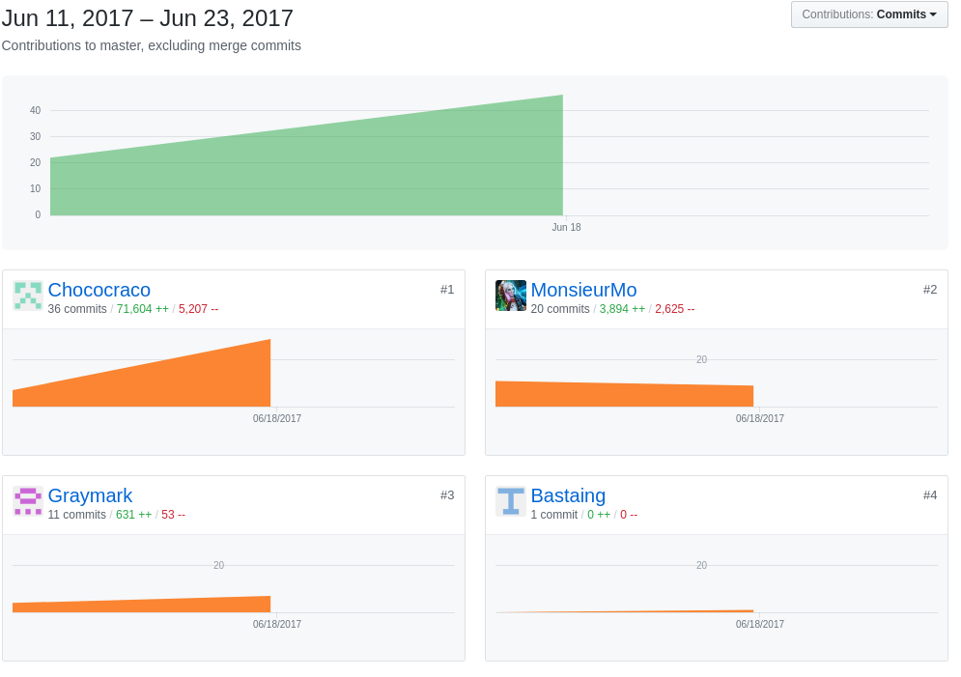
Commits

Slide 8
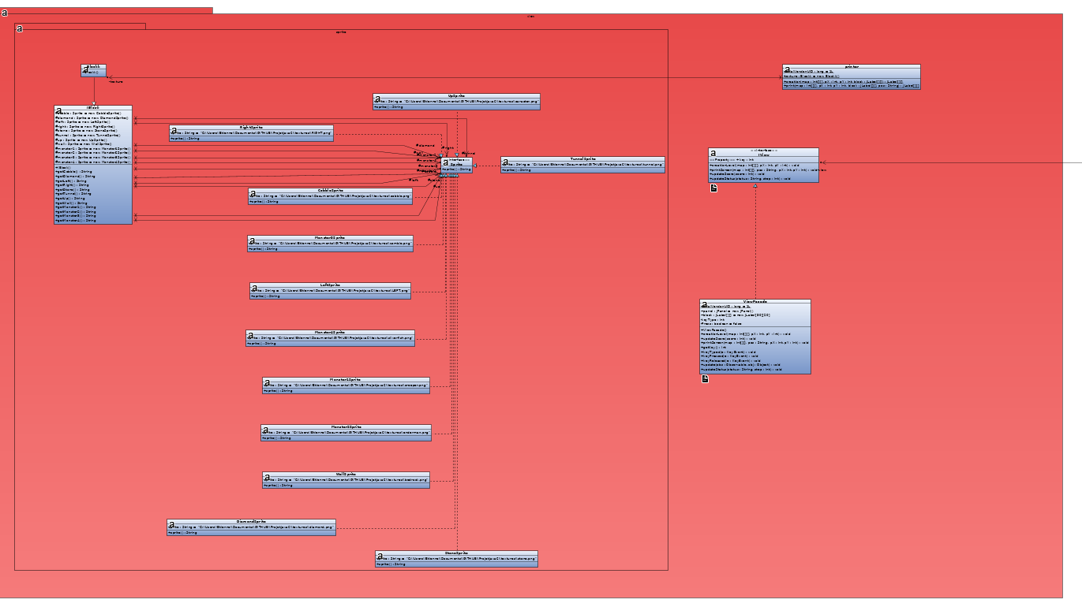
Conception
View
Notes:
CHARLES Présente vite fais la vue

Slide 9
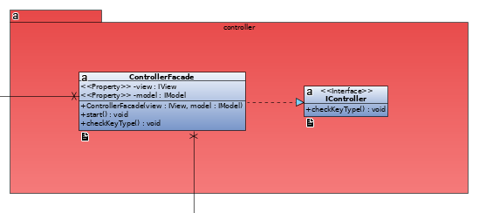
Conception
Controller
Notes:
ARTHUR

Slide 10
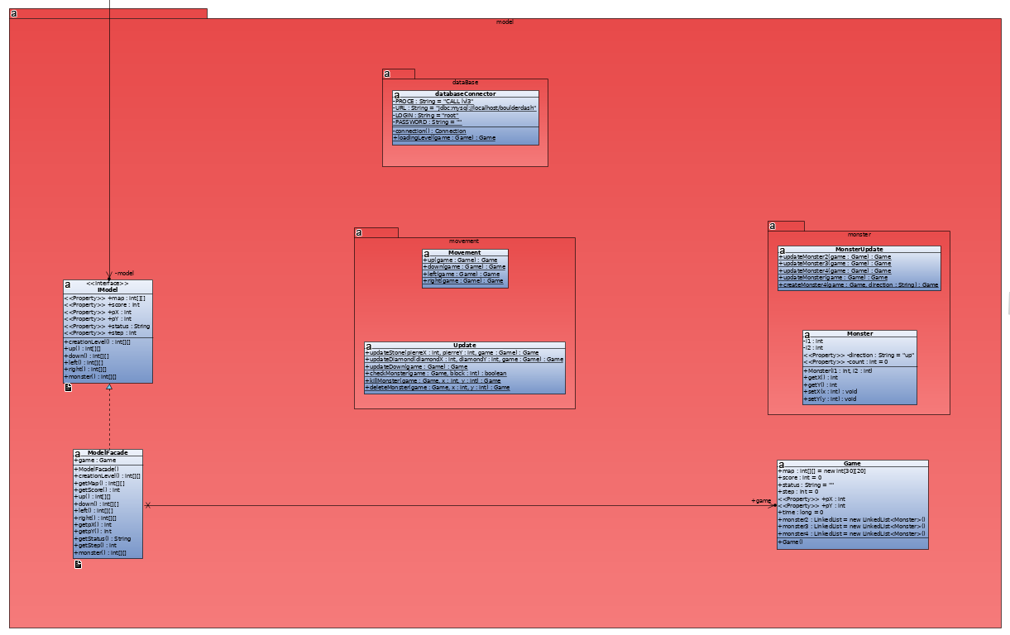
Conception
Model
Notes:
CHARLES idem

Slide 11
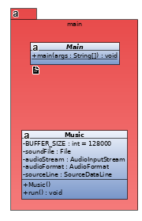
Conception
Main
Notes:
ARTHUR

Slide 12
Realization
View
Controller
Model
Design Pattern
Database
Notes:
ETIENNE View, Controller, Model, DP
NILS : Database

Slide 13
Demonstration
Let's play :D

Slide 14
Conclusion
Do you have any questions ?

