Slide 1
QUANDELA · APPLICATION CASE STUDY
I would investigate few-label industrial
defect inspection with a photonic reservoir
A measurable 12-week path from public data to a conditional hardware test
NGUYEN NGO NHAT NAM · R&D QUANTUM OPTICS ENGINEER CANDIDATE · 15 SEP 2026 · 15:30 GMT+7
REAL INDUSTRIAL NEED
PHOTONIC FIT
12-WEEK TEST
Scarce expert labels
Fixed nonlinear map
Decision-ready result
Quality inspection needs useful
accuracy from small labelled sets.
Interference transforms compact
phase-encoded image features.
Public data · matched controls
simulator → conditional QPU run
COMPLETED DE-RISKING PILOT
Useful signal; no advantage yet
Q1 0.8708
macro-F1 · 48 labels per class
Evidence informs the next test; it does not support
a quantum-advantage claim.
01 / 10
Notes:
Good afternoon. I am Nguyen Ngo Nhat Nam. I would investigate few-label industrial defect inspection with a fixed photonic reservoir. Expert labels are costly, interference offers a compact nonlinear map, and the question can be tested in twelve weeks with public data, matched controls, and a simulator-to-hardware path. My completed pilot reached 0.8708 macro-F1 at forty-eight labels per class. That demonstrates useful signal in simulation, not practical or quantum advantage. The choice matters only if the constraint is real and the test is measurable.

Slide 2
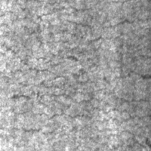
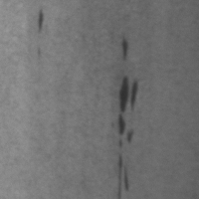
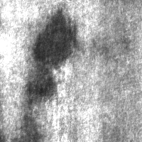
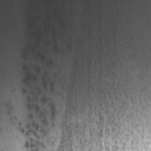
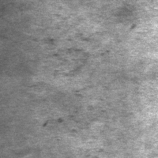
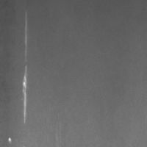
WHY THIS APPLICATION · REAL NEED, MEASURABLE TEST
Why this is a good 12-week feasibility study
Crazing
Inclusion
Patches
Pitted surface
Rolled-in scale
Scratches
REAL NEED
TRACTABLE BENCHMARK
LEAKAGE-SAFE EVIDENCE
Labels are expensive
1,800 images
One duplicate group
The target is useful accuracy from
12 · 24 · 48 labels per class.
Sample efficiency is measurable.
Six balanced defect classes
300 images per class
Public data · macro-F1 target
Pa_101 · Pa_105 never cross splits.
Fold 0: 60 test images per class.
Real need · data · decision metric
Source: dataset_audit.csv · frozen experiment protocol
02 / 10
Notes:
The operational constraint is label scarcity: inspection images may be plentiful, while reliable labels require expert time. NEU-CLS provides 1,800 audited images across six balanced defect classes, so the study can begin without proprietary collection. The exact duplicate pair Pa_101 and Pa_105 remains in one group, and the pilot test fold has sixty images per class with no overlap. The application therefore has a real need, accessible evidence, and a measurable failure condition. Now I will show where photonics enters.

Slide 3
WHY QUANDELA · SIMULATOR-TO-HARDWARE PATH
A small reservoir fits Quandela’s path to hardware
6 MODES · 2 PHOTONS
FROZEN
TRAIN ONLY
POSTSELECT
CLASSICAL READOUT
U · D(x) · U
21 → 15
OpenCLIP
PCA-5
Linear model
ViT-B/32 · L2
phases [−π, π]
occupation [1,0,1,0,0,0]
conditional P(n|x)
macro-F1
fixed U · image-dependent phases
$$U\left(x\right)=UD\left(x\right)U, ϕ_{Q}\left(x\right)=\operatorname{Normalize}\left({\left\{P\left(n∣x\right)\right\}}_{n∈C}\right)$$
1 · PERCEVAL · QUANDELA
2 · SECOND IMPLEMENTATION
3 · REMOTE QPU SUBSET
Simulation complete
MerLin cross-check
Proposed next gate
max error 4.16 × 10⁻¹⁷
SEPARATE CODE PATH
NOT YET EXECUTED
NOT EXTERNAL REPLICATION
max error 8.33 × 10⁻¹⁷
Official docs: perceval.quandela.net/docs/v1.2 · merlinquantum.ai/0.4 · local verification.json
03 / 10
Notes:
A frozen OpenCLIP encoder produces an embedding. Train-only principal component analysis reduces it to five phase values. A fixed six-mode, two-photon circuit maps them to fifteen postselected probabilities for a linear readout. Only the readout is trained, which isolates the feature map. Perceval is the primary simulation path; MerLin reproduces the ideal probabilities to machine precision through a separate code path, not external replication. Remote QPU execution remains untested and conditional on access and prior gates. A runnable simulation is only a starting point, so I need a rule that can reject it.

Slide 4
FEASIBILITY QUESTION · PREDEFINED DECISION
The feasibility question is deliberately falsifiable
AT THE SAME PCA-5 INPUT
Can Q1’s 15-D photonic features beat matched 15-D controls
and approach PCA-5 RBF-SVM?
PAIRED PROTOCOL
7 FAMILIES · EQUAL-WIDTH SCHEMATIC
PASS A · ACCURACY PARITY
12 · 24 · 48
B1 Full CLIP + linear
Q1@48 ≥ B4@48 − 0.02
on at least 4 / 5 outer folds
labels per class
B2 Full CLIP + RBF-SVM
Subset seeds 11 · 22 · 33
Map seeds 101 · 202 · 303
Validation macro-F1 only
One test evaluation per
selected fitted pipeline
B3 PCA-5 + linear
PASS B · 2× LABEL EFFICIENCY
B4 PCA-5 + RBF-SVM
Q1@24 ≥ B4@48 − 0.02
B5 RFF-15
≥4 / 5 folds · ≤2,000 shots / image
acceptance rate ≥ 0.70
B6 ELM-15
STOP IF NEITHER PASS HOLDS
MAP SEEDS AVERAGED · NEVER PICKED
Q1 Photonic-15
or Q1 loses to RFF-15 and ELM-15 on ≥4 / 5 folds
Matched 15-D controls: Random Fourier Features (RFF) and Extreme Learning Machine (ELM).
B4 = PCA-5 radial-basis-function support vector machine (RBF-SVM); resource value = label efficiency under shot and acceptance constraints.
04 / 10
Notes:
From the same PCA-five input, can Q1 beat matched fifteen-dimensional controls and approach B4, the PCA-five RBF-SVM? RFF means random Fourier features; ELM means extreme learning machine. I preregister two pass routes. Pass A: at forty-eight labels per class, Q1 is within 0.02 macro-F1 of B4 on at least four of five folds. Pass B: Q1 at twenty-four labels reaches B4 at forty-eight labels within 0.02 on four folds, using at most two thousand shots per image and acceptance of at least 0.70. I stop if neither passes, or Q1 loses to both RFF-15 and ELM-15 on four folds. These gates define the proposed project; the pilot is already complete.

Slide 5
APPROACH · COMPLETED PILOT → PROPOSED PROJECT
The 12-week project starts after the completed pilot
PRE-STUDY · COMPLETED PILOT
Data audit · frozen protocol · simulator verification · fold-0 result
1–2
3–4
5–6
7–8
9–10
11–12
REPLICATE
ABLATE
NOISE
FREEZE
QPU GATE
DECIDE
Five-fold
replication
PCA · circuit
Loss · drift
detectors
Hardware
candidate
Remote subset
raw counts
Harder-data or
independent
replication
measurement
DELIVERABLE
DELIVERABLE
DELIVERABLE
DELIVERABLE
DELIVERABLE
DELIVERABLE
Fold-level table
Ablation matrix
Robustness curves
Frozen run spec
Calibrated result
Decision memo
EXIT
EXIT
EXIT
EXIT
EXIT
EXIT
Ranking stable
across folds
Candidate beats
matched controls
No collapse under
credible noise
Shots · calibration
metadata locked
Run only after
prior gates pass
Utility evidence
or disciplined stop
The 12-week clock begins with five-fold replication—not work already completed.
05 / 10
Notes:
The pilot is pre-study evidence and does not consume the project clock. Weeks one and two replicate five outer folds. Weeks three and four ablate PCA, circuit, and measurement choices. Weeks five and six add realistic photonic noise. Weeks seven and eight freeze one hardware candidate and its resource definitions. Weeks nine and ten run a remote subset only if prior gates pass. Weeks eleven and twelve use harder data or independent replication and produce the decision memo. Here is what the pilot actually found.

Slide 6
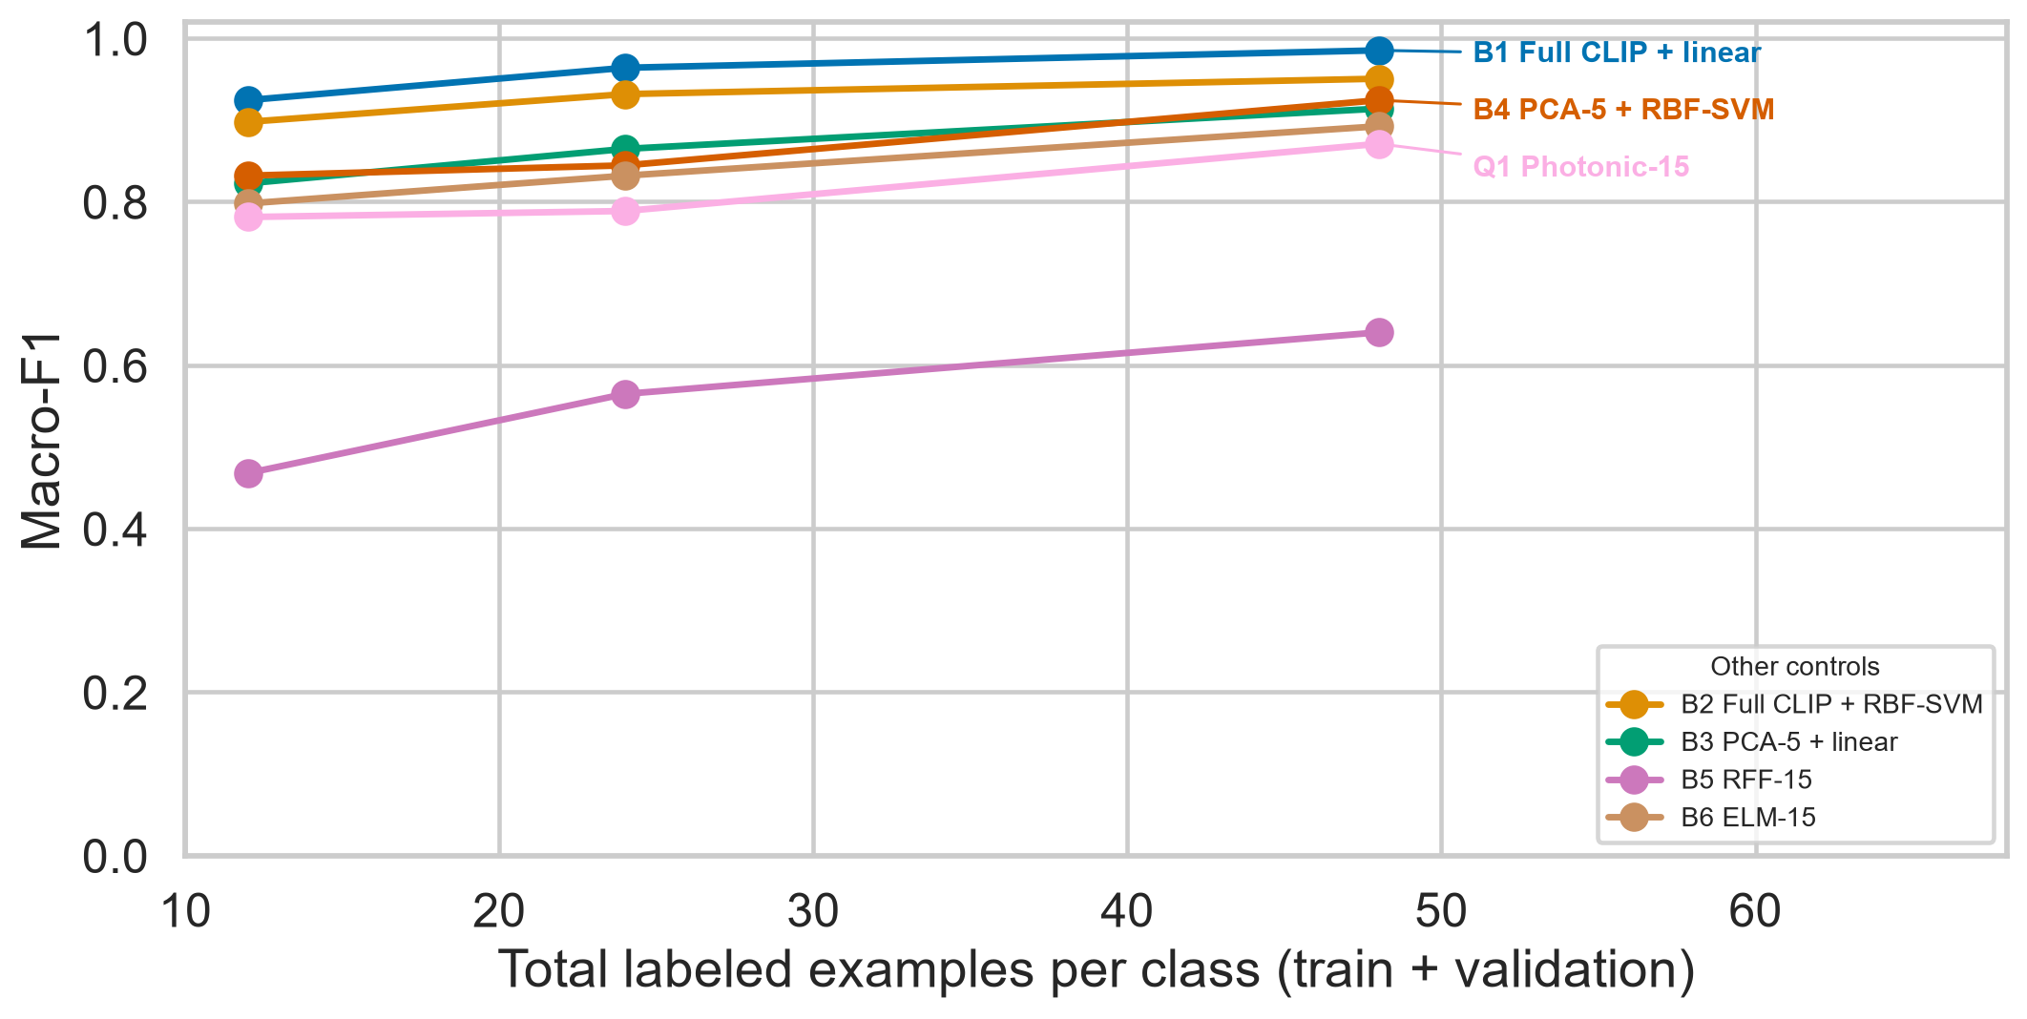
COMPLETED PILOT · PRIMARY EVIDENCE
The pilot shows useful signal—not competitive advantage
Q1 · PHOTONIC-15
0.7812 → 0.7886
→ 0.8708
12 · 24 · 48 labels per class
B1 · FULL CLIP + LINEAR
0.9242 → 0.9638
→ 0.9852
PILOT VERDICT
Learns signal;
not competitive yet.
Mean ± sample SD across three subset seeds · one outer fold · source: main_results.csv
06 / 10
Notes:
Q1 rises from 0.7812 to 0.7886 and then 0.8708 as the label budget grows. The full OpenCLIP linear baseline starts at 0.9242 and reaches 0.9852. Each point averages three subset seeds, but every point reuses one outer test fold. The correct conclusion is limited: Q1 contains useful class information in this simulation pilot, while the current map is not competitive with the full representation. The controlled comparison shows where that gap comes from.

Slide 7
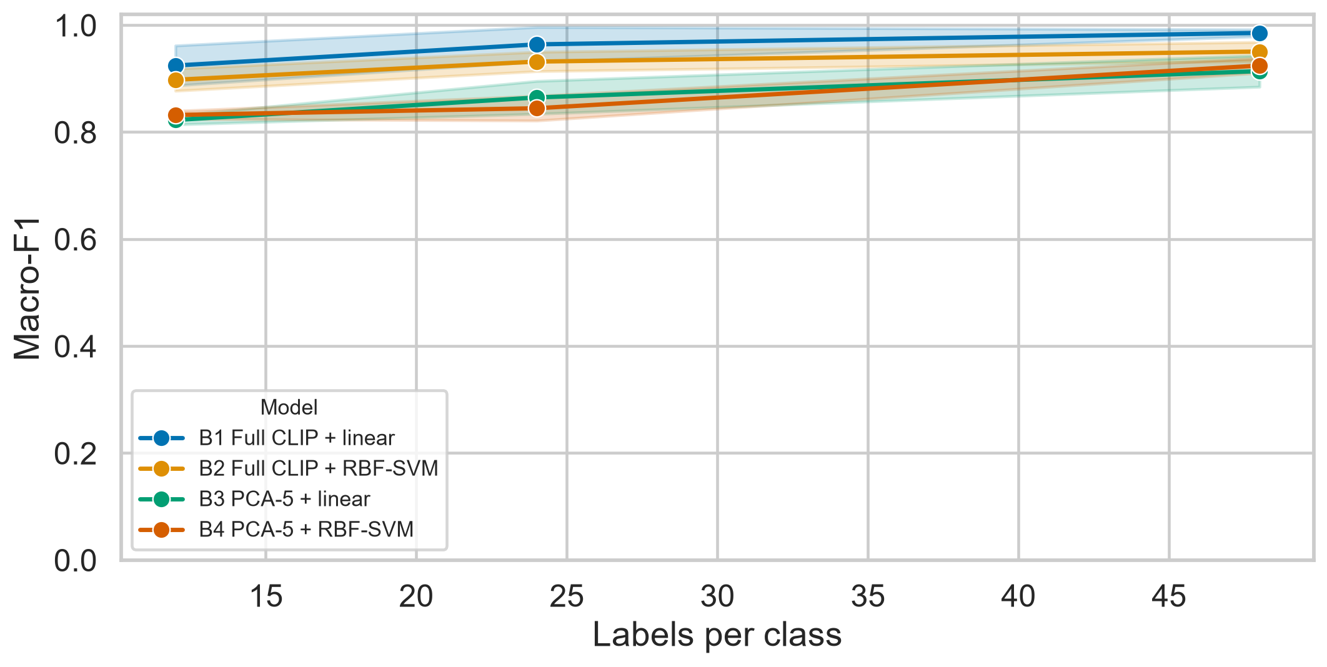
DIAGNOSIS · REPRESENTATION AND CONTROLS
PCA-5 explains most of the gap; the map explains the rest
FULL → PCA-5 PENALTY · B1 − B3
+.1018 · +.0993 · +.0713
budgets 12 · 24 · 48
Q1 − RFF
+.3133 · +.2238 · +.2307
Q1 − ELM
−.0166 · −.0432 · −.0215
Q1 − PCA-5 RBF-SVM
−.0507 · −.0558 · −.0534
Only win: locked matched RFF-15 comparator.
Separate information lost in PCA-5 from the value added by the photonic circuit.
Source: compression.csv · paired_differences.csv · subset-paired descriptive differences
07 / 10
Notes:
PCA-five costs the linear baseline about 0.07 to 0.10 macro-F1, accounting for most of the gap to the full representation. Within the compressed setting, Q1 beats the locked RFF-15 comparator by 0.22 to 0.31. It still trails ELM by about 0.02 to 0.04 and PCA-five RBF-SVM by about 0.05 to 0.06, so map choice explains the remaining shortfall. I would therefore vary representation size and circuit design separately. Before proposing hardware, I also tested whether sampling is stable.

Slide 8
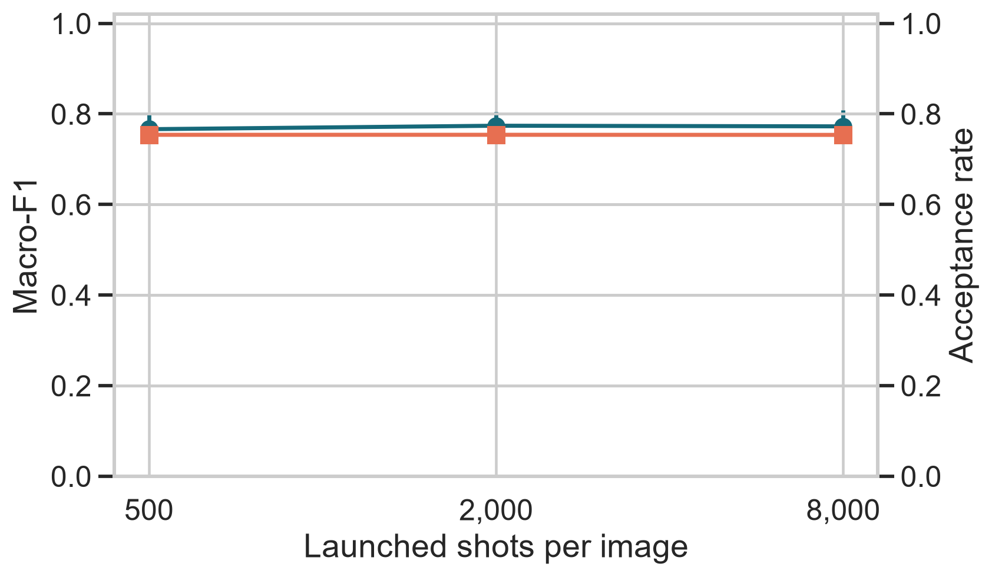
STRESS TEST · FINITE-SHOT FEASIBILITY
Finite-shot sampling is stable; accuracy does not recover
MACRO-F1 · 15 EVALUATIONS EACH
Q1 · 24 LABELS / CLASS · OUTER FOLD 0
500
0.7662 ± .0322
MACRO-F1
ACCEPTANCE RATE
2,000
0.7739 ± .0308
8,000
0.7725 ± .0363
acceptance ≈ 0.754
0 zero-acceptance failures
TESTED
NOT YET TESTED
Shot sampling
Acceptance
Ideal-trained readout
Loss · phase drift
Distinguishability
Detectors · noise training
45 evaluations = 3 map seeds × 5 sampling seeds × 3 shot levels · same outer test fold · source: finite_shot.csv
08 / 10
Notes:
At twenty-four labels per class on outer fold zero, Q1 stays near 0.77 from five hundred to eight thousand shots. Each level has three map seeds by five sampling seeds; all forty-five evaluations share that fold. Acceptance is near 0.754 with no failures. Increasing shots does not recover accuracy, so sampling noise is not the main limitation in this range. Loss, drift, distinguishability, detector effects, and noise-aware training remain untested. These results define the evidence boundary.

Slide 9
CURRENT VERDICT · EVIDENCE BOUNDARY
Simulation pipeline demonstrated; hardware feasibility untested
DEMONSTRATED
PARTIALLY ANSWERED
UNANSWERED
Simulation pipeline
Application signal
Practical utility
Executable pipeline
Simulator consistency
Reproducible artifacts
Learning with labels
Paired one-fold ranking
Finite-shot sampling
Five-fold generalization
Realistic photonic noise
Remote hardware execution
OPENCLIP EMBEDDINGS · CPU
PILOT MODEL GRID · CPU
DECISION CONSTRAINT
96.57 s
≈59.9 s
Scientific validity
One outer fold · small validation cells
ideal optics · B1 near ceiling
One cached feature pass
Broader validation is tractable
Reused across every model family.
Five folds fit the project window.
RUNTIME IS NOT THE BOTTLENECK
Local CPU profile · no loss, phase drift, detector noise, or QPU queue
09 / 10
Notes:
The demonstrated result is simulation-pipeline feasibility: the code executes, two implementation paths agree, and the artifacts are reproducible. Application signal is only partly answered because the ranking comes from one outer fold. Hardware feasibility remains untested because realistic noise and remote execution are unfinished. Local computation is not the bottleneck: embedding extraction took 96.57 seconds and the pilot model grid about 59.9 seconds. The bottleneck is scientific validity across folds, noise, and calibrated hardware. That boundary leads to a conditional recommendation.

Slide 10
RECOMMENDATION · ANSWER TO THE RESEARCH TEAM
Continue only through a decision-changing test
WHICH APPLICATION?
CONTINUE ONLY IF · B4 = PCA-5 RBF-SVM
Few-label industrial defect inspection
PASS A · Q1@48 ≥ B4@48 − 0.02
with a fixed photonic reservoir
↳ on ≥4 / 5 folds
PASS B · Q1@24 ≥ B4@48 − 0.02
WHY THIS IDEA?
↳ on ≥4 / 5 folds · ≤2,000 shots / image
↳ acceptance ≥ 0.70
Real label scarcity · compact phase encoding
Quandela simulator → hardware path · 12-week evidence
STOP CONDITION
Neither pass holds
CURRENT VERDICT
Feasible in simulation and
scientifically interesting
or Q1 loses to RFF-15 and ELM-15 on ≥4 / 5 folds.
HARDWARE FEASIBILITY REMAINS UNTESTED
Evidence first · hardware only after gates pass
Repository · github.com/MonsieurNam/Quanova_Photonic_Defect_QML
10 / 10
Notes:
My recommendation is conditional. Few-label defect inspection fits a useful Quandela simulator-to-hardware study, and the pilot shows that the simulation workflow is executable. It has not demonstrated practical or hardware advantage. B4 is the PCA-five RBF-SVM reference. I continue only if Pass A at forty-eight labels or Pass B for twofold label efficiency holds. The shot and acceptance constraints belong only to Pass B. If neither passes, or Q1 loses to RFF-15 and ELM-15 on at least four folds, I report simulation feasibility without utility and stop before spending QPU time. Thank you.

