Slide 1
QUANDELA · APPLICATION CASE STUDY
I would investigate few-label industrial
defect inspection with a photonic reservoir
A measurable 12-week path from public data to a conditional hardware test
NGUYEN NGO NHAT NAM · R&D QUANTUM OPTICS ENGINEER CANDIDATE · 15 SEP 2026 · 15:30 GMT+7
REAL INDUSTRIAL NEED
PHOTONIC FIT
12-WEEK TEST
Scarce expert labels
Fixed nonlinear map
Decision-ready result
Quality inspection needs useful
accuracy from small labelled sets.
Interference transforms compact
phase-encoded image features.
Public data · matched controls
simulator → conditional QPU run
COMPLETED DE-RISKING PILOT
Useful signal; no advantage yet
Q1 0.8708
macro-F1 · 48 labels per class
Evidence informs the next test; it does not support
a quantum-advantage claim.
01 / 10
Notes:
Good afternoon. I am Nguyen Ngo Nhat Nam, and I would investigate few-label industrial defect inspection using a fixed photonic reservoir. I chose it for three reasons: expert defect labels are costly, photonic interference offers a compact nonlinear feature map, and the idea can be evaluated rigorously within twelve weeks using public data, matched controls, and a staged path from simulation to hardware. I have already completed a de-risking pilot. Q1 reached 0.8708 macro-F1 at forty-eight labels per class. That is useful signal, but it is not evidence of practical or quantum advantage.

Slide 2
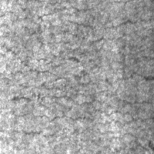
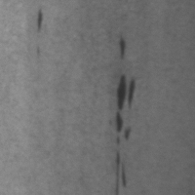
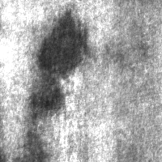
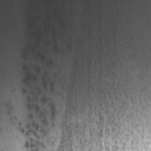
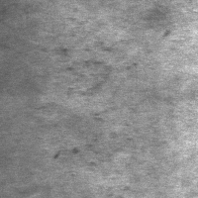
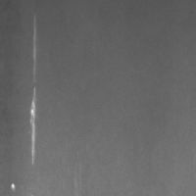
WHY THIS APPLICATION · REAL NEED, MEASURABLE TEST
Why this is a good 12-week feasibility study
Crazing
Inclusion
Patches
Pitted surface
Rolled-in scale
Scratches
REAL NEED
TRACTABLE BENCHMARK
LEAKAGE-SAFE EVIDENCE
Labels are expensive
1,800 images
One duplicate group
The target is useful accuracy from
12 · 24 · 48 labels per class.
Sample efficiency is measurable.
Six balanced defect classes
300 images per class
Public data · macro-F1 target
Pa_101 · Pa_105 never cross splits.
Fold 0: 60 test images per class.
Real need · data · decision metric
Source: dataset_audit.csv · frozen experiment protocol
02 / 10
Notes:
The operational constraint is label scarcity. Inspection images may be plentiful, but reliable defect labels consume expert time. Performance at twelve, twenty-four, and forty-eight labels per class is therefore a meaningful target. NEU-CLS gives 1,800 audited images across six balanced steel-surface defect classes, so the study can start without waiting for proprietary data. The evaluation also has a clear failure mode: the exact duplicate pair Pa_101 and Pa_105 remains in one group, and the pilot test fold contains sixty images per class with no sample or duplicate-group overlap. This gives a real need, accessible evidence, and a quantitative decision.

Slide 3
WHY QUANDELA · SIMULATOR-TO-HARDWARE PATH
A small reservoir fits Quandela’s path to hardware
6 MODES · 2 PHOTONS
FROZEN
TRAIN ONLY
POSTSELECT
CLASSICAL READOUT
U · D(x) · U
21 → 15
OpenCLIP
PCA-5
Linear model
ViT-B/32 · L2
phases [−π, π]
occupation [1,0,1,0,0,0]
conditional P(n|x)
macro-F1
fixed U · image-dependent phases
$$U\left(x\right)=UD\left(x\right)U, ϕ_{Q}\left(x\right)=\operatorname{Normalize}\left({\left\{P\left(n∣x\right)\right\}}_{n∈C}\right)$$
1 · PERCEVAL · QUANDELA
2 · SECOND IMPLEMENTATION
3 · REMOTE QPU SUBSET
Simulation complete
MerLin cross-check
Proposed next gate
max error 4.16 × 10⁻¹⁷
SEPARATE CODE PATH
NOT YET EXECUTED
NOT EXTERNAL REPLICATION
max error 8.33 × 10⁻¹⁷
Official docs: perceval.quandela.net/docs/v1.2 · merlinquantum.ai/0.4 · local verification.json
03 / 10
Notes:
The architecture is deliberately hybrid and small. A frozen OpenCLIP encoder produces an image embedding. Principal component analysis is fitted on training data only and reduces it to five values scaled from minus pi to pi. Those phases enter a fixed six-mode, two-photon circuit. Postselection turns twenty-one possible outcomes into fifteen conditional probabilities for a linear readout. Only the readout is trained, which isolates the feature map and avoids a costly variational loop. Perceval is the primary simulation layer. A second implementation in MerLin reproduces the probabilities to machine precision. That is a separate code path inside the same ecosystem, not external replication. Both checks are complete. Remote QPU execution remains a proposed final gate, subject to access.

Slide 4
FEASIBILITY QUESTION · PREDEFINED DECISION
The feasibility question is deliberately falsifiable
AT THE SAME PCA-5 INPUT
Can Q1’s 15-D photonic features beat matched 15-D controls
and approach PCA-5 RBF-SVM?
PAIRED PROTOCOL
7 FAMILIES · EQUAL-WIDTH SCHEMATIC
PASS A · ACCURACY PARITY
12 · 24 · 48
B1 Full CLIP + linear
Q1 ≥ RBF-SVM − 0.02
on at least 4 / 5 outer folds
labels per class
B2 Full CLIP + RBF-SVM
Subset seeds 11 · 22 · 33
Map seeds 101 · 202 · 303
Validation macro-F1 only
One test evaluation per
selected fitted pipeline
B3 PCA-5 + linear
PASS B · 2× LABEL EFFICIENCY
B4 PCA-5 + RBF-SVM
Q1@24 ≥ RBF-SVM@48 − 0.02
B5 RFF-15
≥4 / 5 folds · ≤2,000 shots / image
acceptance rate ≥ 0.70
B6 ELM-15
STOP IF NEITHER PASS HOLDS
MAP SEEDS AVERAGED · NEVER PICKED
Q1 Photonic-15
or Q1 fails both matched controls on ≥4 / 5 folds
Matched 15-D controls: Random Fourier Features (RFF) and Extreme Learning Machine (ELM).
RBF-SVM = radial-basis-function support vector machine. Resource value is pre-specified as label efficiency under shot and acceptance constraints.
04 / 10
Notes:
The question is specific: from the same PCA-five input, can Q1’s fifteen-dimensional photonic features beat matched fifteen-dimensional controls and approach PCA-five RBF-SVM? RFF means random Fourier features; ELM means extreme learning machine; and RBF-SVM means radial-basis-function support vector machine. The protocol uses nested label budgets, validation-only selection, averaged map seeds, and one test evaluation per selected fitted pipeline. I would preregister two pass routes. Accuracy passes if Q1 is within 0.02 macro-F1 of PCA-five RBF-SVM on at least four of five outer folds. Resource value passes if Q1 with twenty-four labels per class reaches the forty-eight-label RBF-SVM within 0.02 on at least four folds, using at most two thousand launched shots per image and an acceptance rate of at least 0.70. If neither route passes, or Q1 fails both matched controls on at least four folds, I stop.

Slide 5
APPROACH · COMPLETED PILOT → PROPOSED PROJECT
The 12-week project starts after the completed pilot
PRE-STUDY · COMPLETED PILOT
Data audit · frozen protocol · simulator verification · fold-0 result
1–2
3–4
5–6
7–8
9–10
11–12
REPLICATE
ABLATE
NOISE
FREEZE
QPU GATE
DECIDE
Five-fold
replication
PCA · circuit
Loss · drift
detectors
Hardware
candidate
Remote subset
raw counts
Harder data
replication
measurement
DELIVERABLE
DELIVERABLE
DELIVERABLE
DELIVERABLE
DELIVERABLE
DELIVERABLE
Fold-level table
Ablation matrix
Robustness curves
Frozen run spec
Calibrated result
Decision memo
EXIT
EXIT
EXIT
EXIT
EXIT
EXIT
Ranking stable
across folds
Candidate beats
matched controls
No collapse under
credible noise
Shots · calibration
metadata locked
Run only after
prior gates pass
Utility evidence
or disciplined stop
The 12-week clock begins with five-fold replication—not work already completed.
05 / 10
Notes:
The pilot is pre-study evidence; it does not consume the twelve-week project. The dataset audit, frozen protocol, simulator checks, finite-shot test, and fold-zero result are complete. Weeks one and two replicate all five outer folds. Weeks three and four ablate PCA dimension, circuit design, and measurement choices. Weeks five and six add loss, phase drift, partial distinguishability, detector effects, and noise-aware training. Weeks seven and eight select and freeze one hardware candidate, including preprocessing, shot definition, and calibration fields. Weeks nine and ten run a remote QPU subset only if the earlier gates pass. Weeks eleven and twelve use harder data or an independent evaluation, account for resources, and produce a go-or-stop memo.

Slide 6
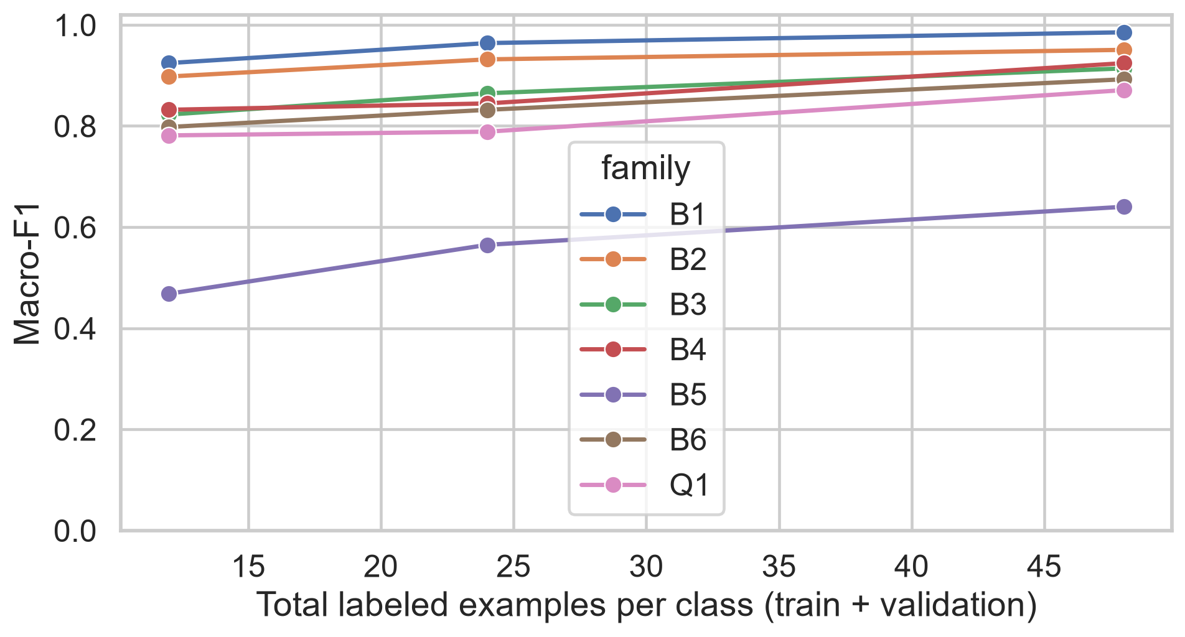
COMPLETED PILOT · PRIMARY EVIDENCE
The pilot shows useful signal—not competitive advantage
Q1 · PHOTONIC-15
0.7812 → 0.7886
→ 0.8708
12 · 24 · 48 labels per class
B1 · FULL CLIP + LINEAR
0.9242 → 0.9638
→ 0.9852
PILOT VERDICT
Learns signal;
not competitive yet.
Mean ± sample SD across three subset seeds · one outer fold · source: main_results.csv
06 / 10
Notes:
Here is the primary pilot evidence. Q1 rises from 0.7812 at twelve labels per class to 0.7886 at twenty-four and 0.8708 at forty-eight. The upward trend shows that the photonic features contain class information. The full OpenCLIP linear baseline, however, starts at 0.9242 and reaches 0.9852. Each point averages three subset seeds, with sample-standard-deviation error bars, but all points reuse one outer test fold. The correct conclusion is that Q1 learns useful structure on this pilot while the current configuration does not justify replacing the full embedding or claiming an advantage.

Slide 7
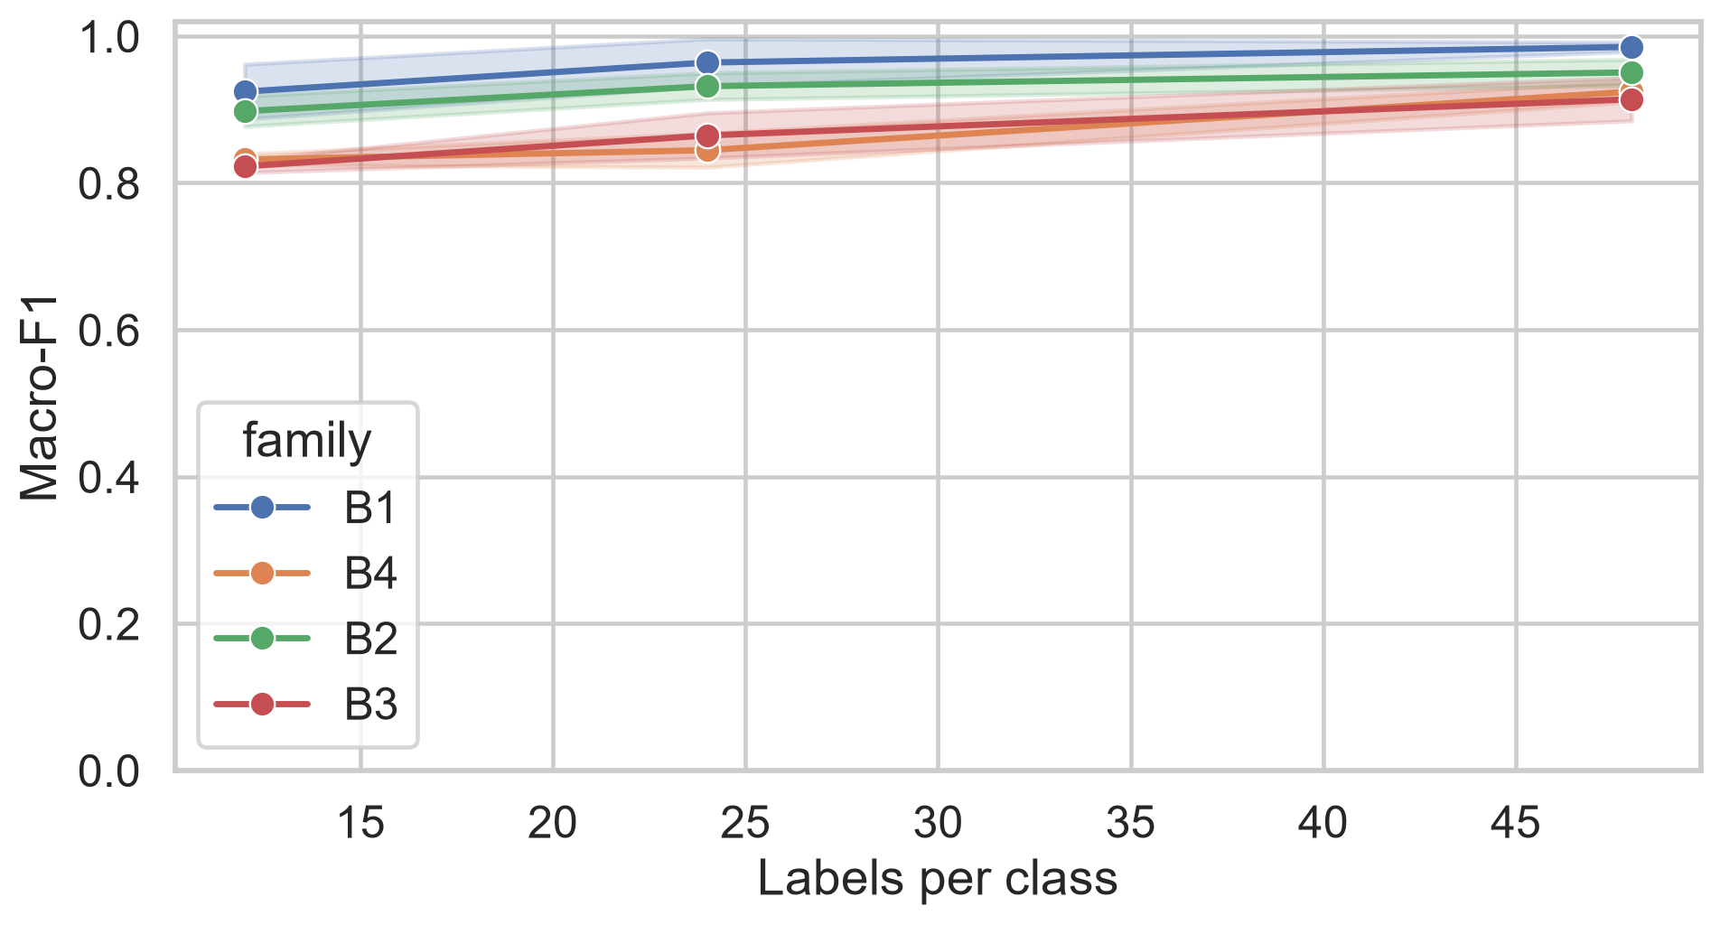
DIAGNOSIS · REPRESENTATION AND CONTROLS
Compression—not photonics alone—explains the shortfall
FULL → PCA-5 PENALTY · B1 − B3
+.1018 · +.0993 · +.0713
budgets 12 · 24 · 48
Q1 − RFF
+.3133 · +.2238 · +.2307
Q1 − ELM
−.0166 · −.0432 · −.0215
Q1 − PCA-5 RBF-SVM
−.0507 · −.0558 · −.0534
Only win: locked matched RFF-15 comparator.
Separate information lost in PCA-5 from the value added by the photonic circuit.
Source: compression.csv · paired_differences.csv · subset-paired descriptive differences
07 / 10
Notes:
The diagnosis changes the next experiment. Compressing the full embedding to five principal components costs the linear baseline about 0.07 to 0.10 macro-F1, so information is lost before the nonlinear map is tested. Within the compressed comparison, Q1 beats the locked RFF-fifteen comparator by about 0.22 to 0.31. It still trails ELM by roughly 0.02 to 0.04 and PCA-five RBF-SVM by about 0.05 to 0.06. The surviving claim is narrow: this photonic map is better than one matched random-feature control, but not the stronger nonlinear controls. I would therefore vary representation size and circuit design separately.

Slide 8
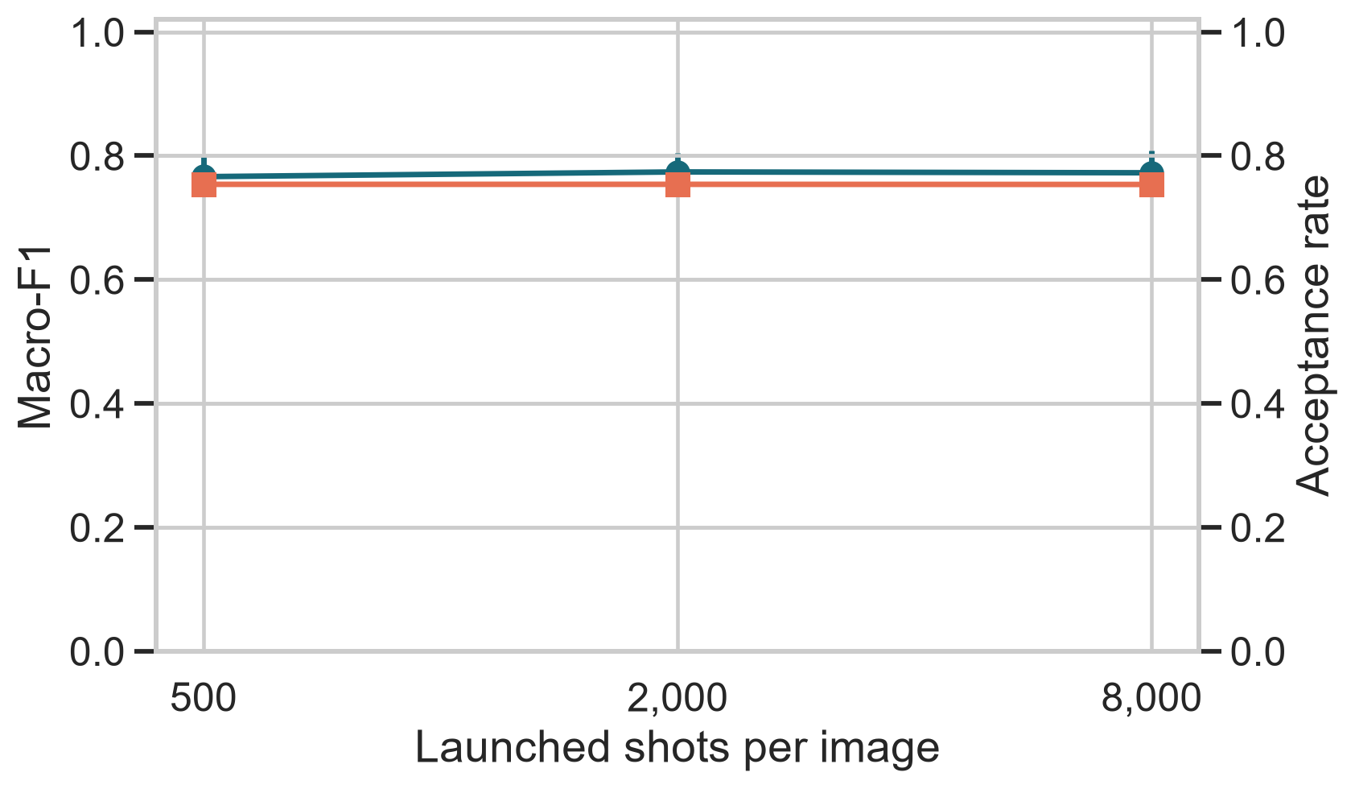
STRESS TEST · FINITE-SHOT FEASIBILITY
Finite-shot sampling is stable; accuracy does not recover
MACRO-F1 · 15 EVALUATIONS EACH
500
0.7662 ± .0322
MACRO-F1
ACCEPTANCE RATE
2,000
0.7739 ± .0308
8,000
0.7725 ± .0363
acceptance ≈ 0.754
0 zero-acceptance failures
TESTED
NOT YET TESTED
Shot sampling
Acceptance
Ideal-trained readout
Loss · phase drift
Distinguishability
Detectors · noise training
45 evaluations = 3 map seeds × 5 sampling seeds × 3 shot levels · same outer test fold · source: finite_shot.csv
08 / 10
Notes:
The finite-shot test asks whether sampled probabilities are stable enough for a later hardware comparison. Macro-F1 is 0.7662 at five hundred launched shots, 0.7739 at two thousand, and 0.7725 at eight thousand. Each shot level contains fifteen evaluations: three map seeds times five sampling seeds. Across all three levels, that is forty-five evaluations on the same outer test fold. Acceptance stays near 0.754, with no zero-acceptance failure. More shots do not recover accuracy monotonically, so shot count alone does not close the gap. This tests sampling around an ideal-trained readout; loss, drift, distinguishability, detectors, and noise-aware training remain future work.

Slide 9
CURRENT VERDICT · EVIDENCE BOUNDARY
Technically feasible; practical utility remains open
PROVEN
PARTIALLY ANSWERED
UNANSWERED
Technical feasibility
Application signal
Practical utility
Executable pipeline
Simulator semantics
Reproducible artifacts
Learning with labels
Paired one-fold ranking
Finite-shot sampling
Five-fold generalization
Realistic photonic noise
Remote hardware execution
OPENCLIP EMBEDDINGS · CPU
PILOT MODEL GRID · CPU
DECISION CONSTRAINT
96.57 s
≈59.9 s
Scientific validity
One outer fold · small validation cells
ideal optics · B1 near ceiling
One cached feature pass
Broader validation is tractable
Reused across every model family.
Five folds fit the project window.
RUNTIME IS NOT THE BOTTLENECK
Local CPU profile · no loss, phase drift, detector noise, or QPU queue
09 / 10
Notes:
The evidence supports a three-level verdict. Technical feasibility is proven: the pipeline executes, two implementations agree, and the artifacts are reproducible. Application signal is partly answered: Q1 improves with labels, the paired one-fold ranking is known, and finite-shot sampling is stable in the tested range. Practical utility remains open because five-fold generalization, realistic noise, and remote hardware are unfinished. Local runtime is not the constraint: cached OpenCLIP extraction took 96.57 seconds, and the pilot model grid took about 59.9 seconds on CPU. The bottleneck is scientific validity under more folds, stronger controls, realistic noise, and calibrated hardware.

Slide 10
RECOMMENDATION · ANSWER TO THE RESEARCH TEAM
Continue only through a decision-changing test
WHICH APPLICATION?
CONTINUE ONLY IF
Few-label industrial defect inspection
Pass A · gap ≤ 0.02 on ≥4 / 5 folds
with a fixed photonic reservoir
or Pass B · 2× label efficiency
WHY THIS IDEA?
≤2,000 shots / image · acceptance ≥ 0.70
Real label scarcity · compact phase encoding
measurable evidence within 12 weeks
STOP CONDITION
Neither pass holds
CURRENT VERDICT
Technically feasible and
scientifically interesting
or matched controls win on ≥4 / 5 folds.
NO DEMONSTRATED PRACTICAL ADVANTAGE YET
Evidence first · hardware only after gates pass
Repository · github.com/MonsieurNam/Quanova_Photonic_Defect_QML
10 / 10
Notes:
My recommendation is to continue this application only through a decision-changing test. The case is worth testing because label scarcity is real, the compact circuit fits Quandela’s simulator-to-hardware path, and the pilot proves that the workflow can be executed. It has not yet demonstrated practical advantage. I would continue only if the preregistered accuracy-parity or label-efficiency gate passes. If Q1 still beats only RFF while ELM and RBF-SVM remain stronger, I would report technical feasibility without utility and stop. The repository link contains the protocol, implementation, results, and presentation artifacts needed to audit that decision. Thank you.

