Slide 1

Project presentation on
Crop disease detection using ML and IoT
Department of Electronics & Communication Engineering SDM Institute of Technology, Ujire

Slide 2
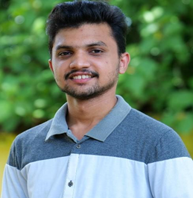
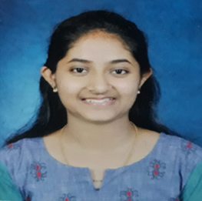
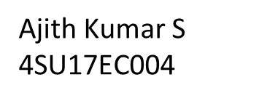
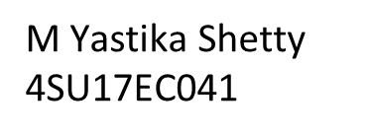
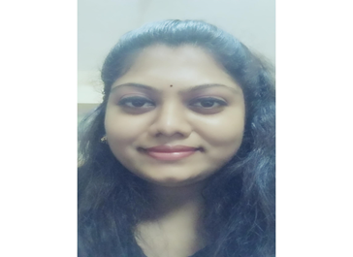

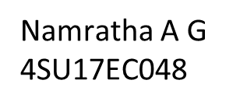
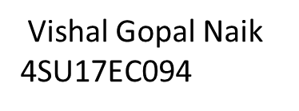
Project Guide Mr. Amith K Jain
Team Members

Slide 3
Contents
Problem statement
Objectives
Proposed Methodology
Proposed timeline
Approximation expenditure
Expected outcome
Conclusion
Literature review

Slide 4
Problem statement
Loss of crops affects livelihood
Presently, there isn’t any scientific proven way to accurately detect a
crop disease
Detection is purely based on past experience
Reaching everyone physically seems very complex
Lack of knowledge and expertise in the field of farming
Problem for knowledge transfer to younger generation
Crop disease detection using ML and IoT has been taken up as problem statement

Slide 5
Rationale behind Problem statement
Problem is prevalent, happening and as of now there isn’t a viable solution
Farmer must wait for days to know the kind of disease and possible solution

Slide 6
Objectives
To develop a viable product which accurately detects crop disease
Potato Early Blight
Tomato yellow leaf
Pepper bell Bacterial spot
To integrate ML and IoT in arriving at a viable solution for the existing problem
To design a model which assists in early detection of crop diseases such as

Slide 7

Literature Review(Background work)
1
Early detection of crop using Histogram & Edge detection
Use of ML technique for proper decision regarding disease in crop
2
Designed a system for early & accurate disease detection
Reduce manual efforts for detecting diseased crops
(1)Anuradha Badage, International Research Journal of Engineering and Technology (IRJET) https://www.irjet.net/archives/V5/i9/IRJET-V5I9158.pdf
(2)Suyash S. Patil and Sandeep A. Thorat , Second International Conference on Cognitive Computing and Information Processing (CCIP) https://ieeexplore.ieee.org/abstract/document/7802887

Slide 8

Proposed methodology Proposed methodology
Use Raspberry Pi and Pi-cam to get the image of the plant
Circuit design to set the parameters
ML algorithm will be defined to identify whether the plant is infected by disease or not
Python programming language will be used
Image captured by Raspberry Pi will be analyzed by trained ML algorithm being deployed at cloud
Result by the ML algorithm will be sent back to Raspberry pi from the cloud
Result will be displayed on the screen by which the end user will be able to know whether the crop is healthy or not

Slide 9
ML works in 2 Phases
Second phase deals with self evaluation comprising of identifying the disease
First phase deals with training of data sets - training data sets for both healthy and diseased crops, using a convolutional neural network

Slide 10
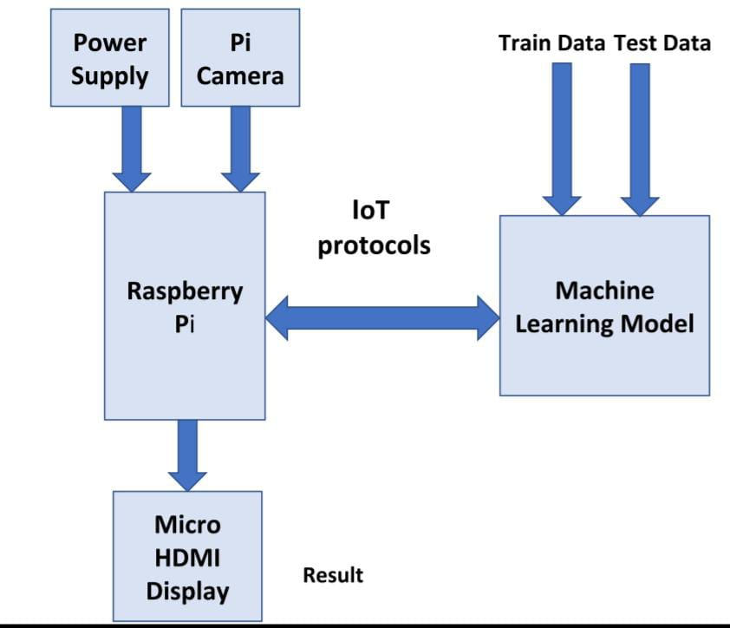
Proposed block diagram

Slide 11
Power supply
Pi camera
Raspberry-pi
Recommended input voltage is 5V, and the recommended input current is 2A
Camera module of raspberry pi clicks an image by pressing the button
It acts as a gateway between the user and Machine learning model
Proposed power supply design is 5.1 V and 2.5 A
Image will be sent to the cloud storage where the Machine Learning model is being deployed
It takes the image as an input from the user and sends it to the cloud, where the proposed ML model performs crop disease detection and gives result

Slide 12
Machine Learning Model
Micro HDMI Display
This includes training both healthy as well as diseased data sets
It assists in displaying the result of the crop image captured and to display the result / disease
It monitors the crop identifying the disease using a convolutional neural network algorithm from the image sent by the user

Slide 13
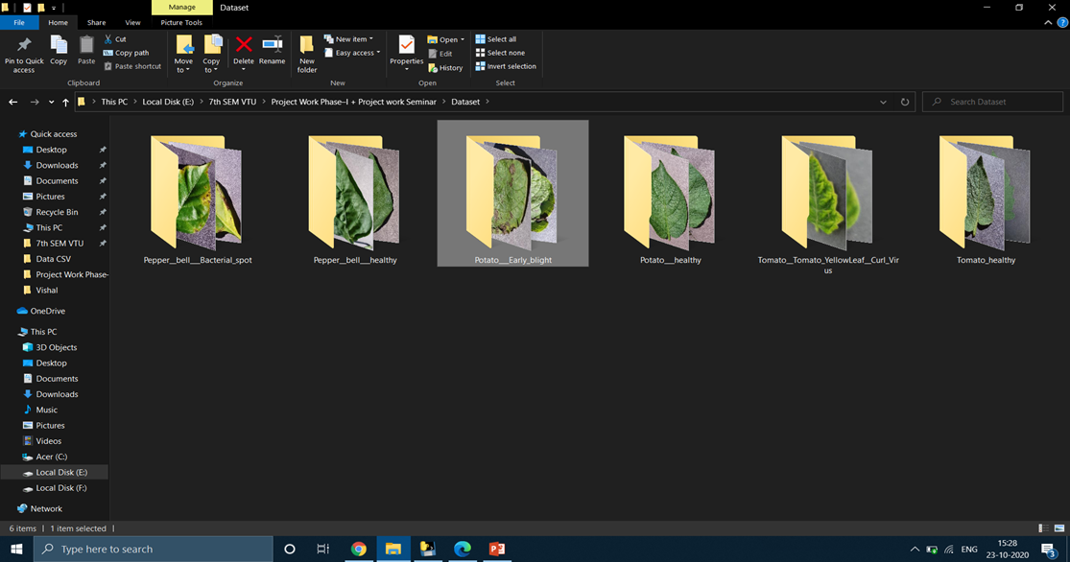
Data sets collected so far

Slide 14
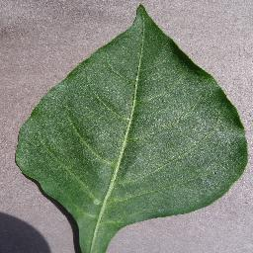
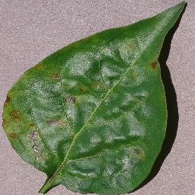
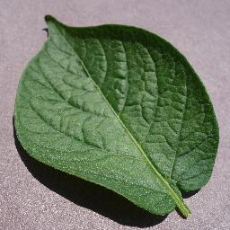
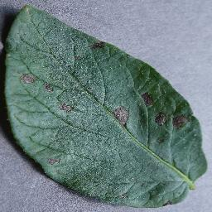
Sample Images from Datasets
Pepper Bell Healthy
Pepper bell Bacterial spot
Potato Healthy
Potato Early Blight

Slide 15
Discussions carried out
17th sept 2020
13th Oct 2020
9th Oct 2020
Discussed on the algorithm/s to be used in ML
Discussion about the necessary requirements for project
Discussion on synopsis and the data sets

Slide 16
Expenditure
Sl.No. | Item | Cost(INR)
1 | Raspberry pi and Camera Module | 3000
2 | Display | 300
3 | Miscellaneous | 3000
4 | Total approximated cost | 6300

Slide 17
Expected outcome
Early and accurate detection of healthy and diseased crop
Integration of ML and IoT to arrive at a better solution than what is existing

Slide 18
Conclusion
Proposed project model aims at early and accurate detection of the crop disease; same to be displayed on the Micro HDMI display
Information transfer to next generation as part of integrating technology and farming
Time required to detect a disease and arrive at a possible solution will be less; Geographical disadvantage will be eliminated

Slide 19
Thank you

