Slide 1



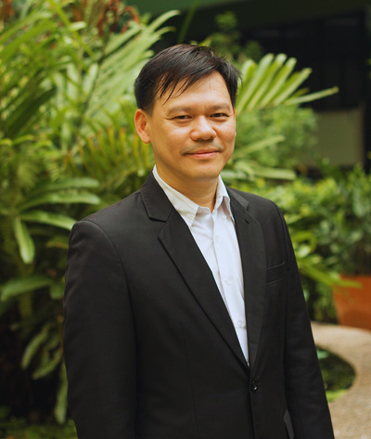
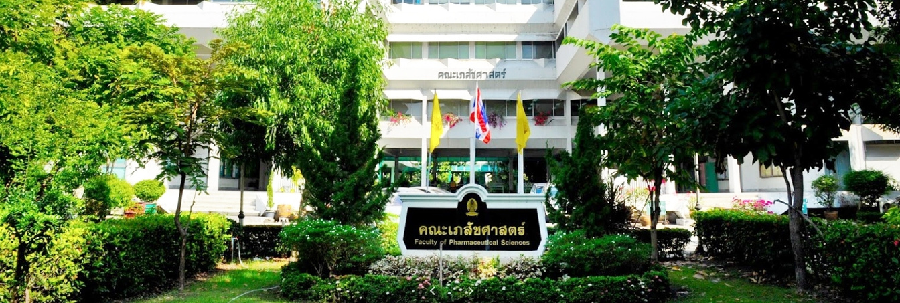
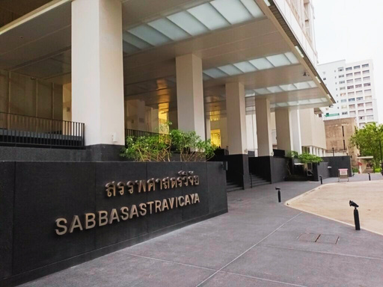
CENTER OF EXCELLENCE IN NATURAL PRODUCTS FOR AGEING AND CHRONIC DISEASES
International Collaboration Between CE-NPACD and
Shenyang Pharmaceutical University
Prof. Pornchai Rojsitthisak, Ph.D.
Director, CE-NPACD
Faculty of Pharmaceutical Sciences,
Chulalongkorn University

Slide 2
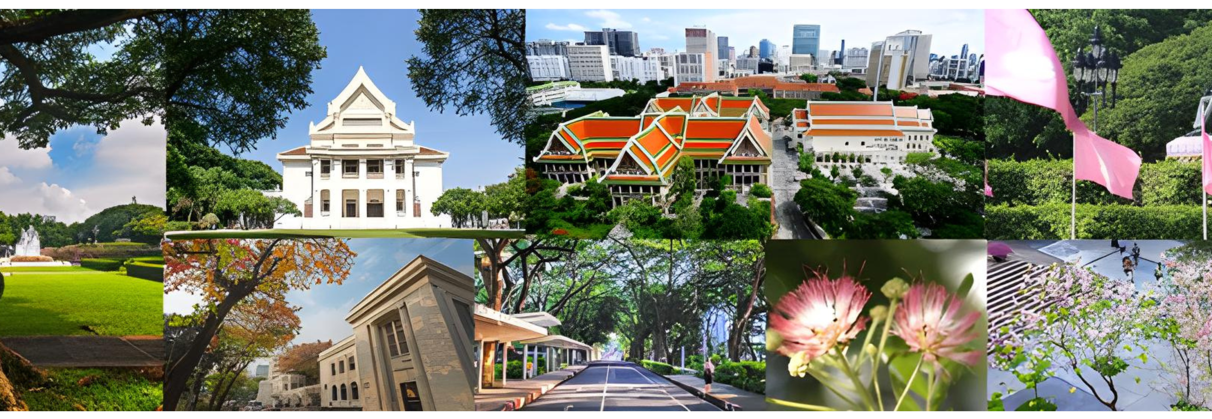
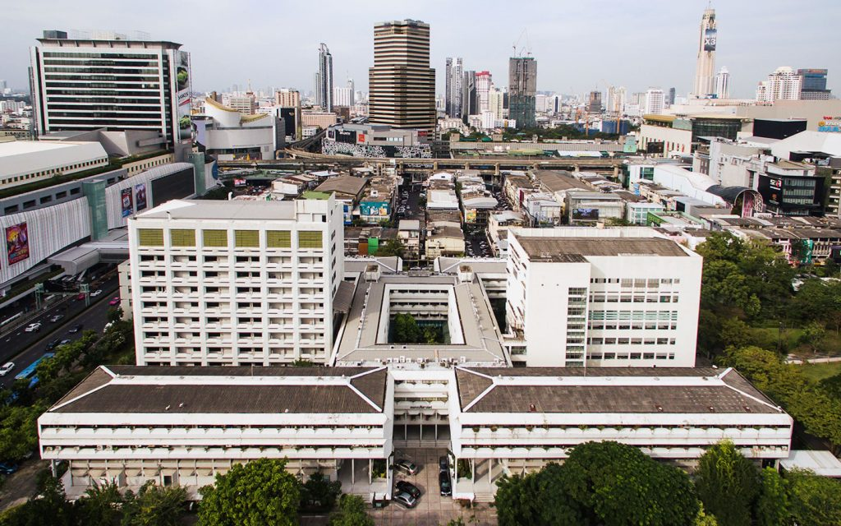
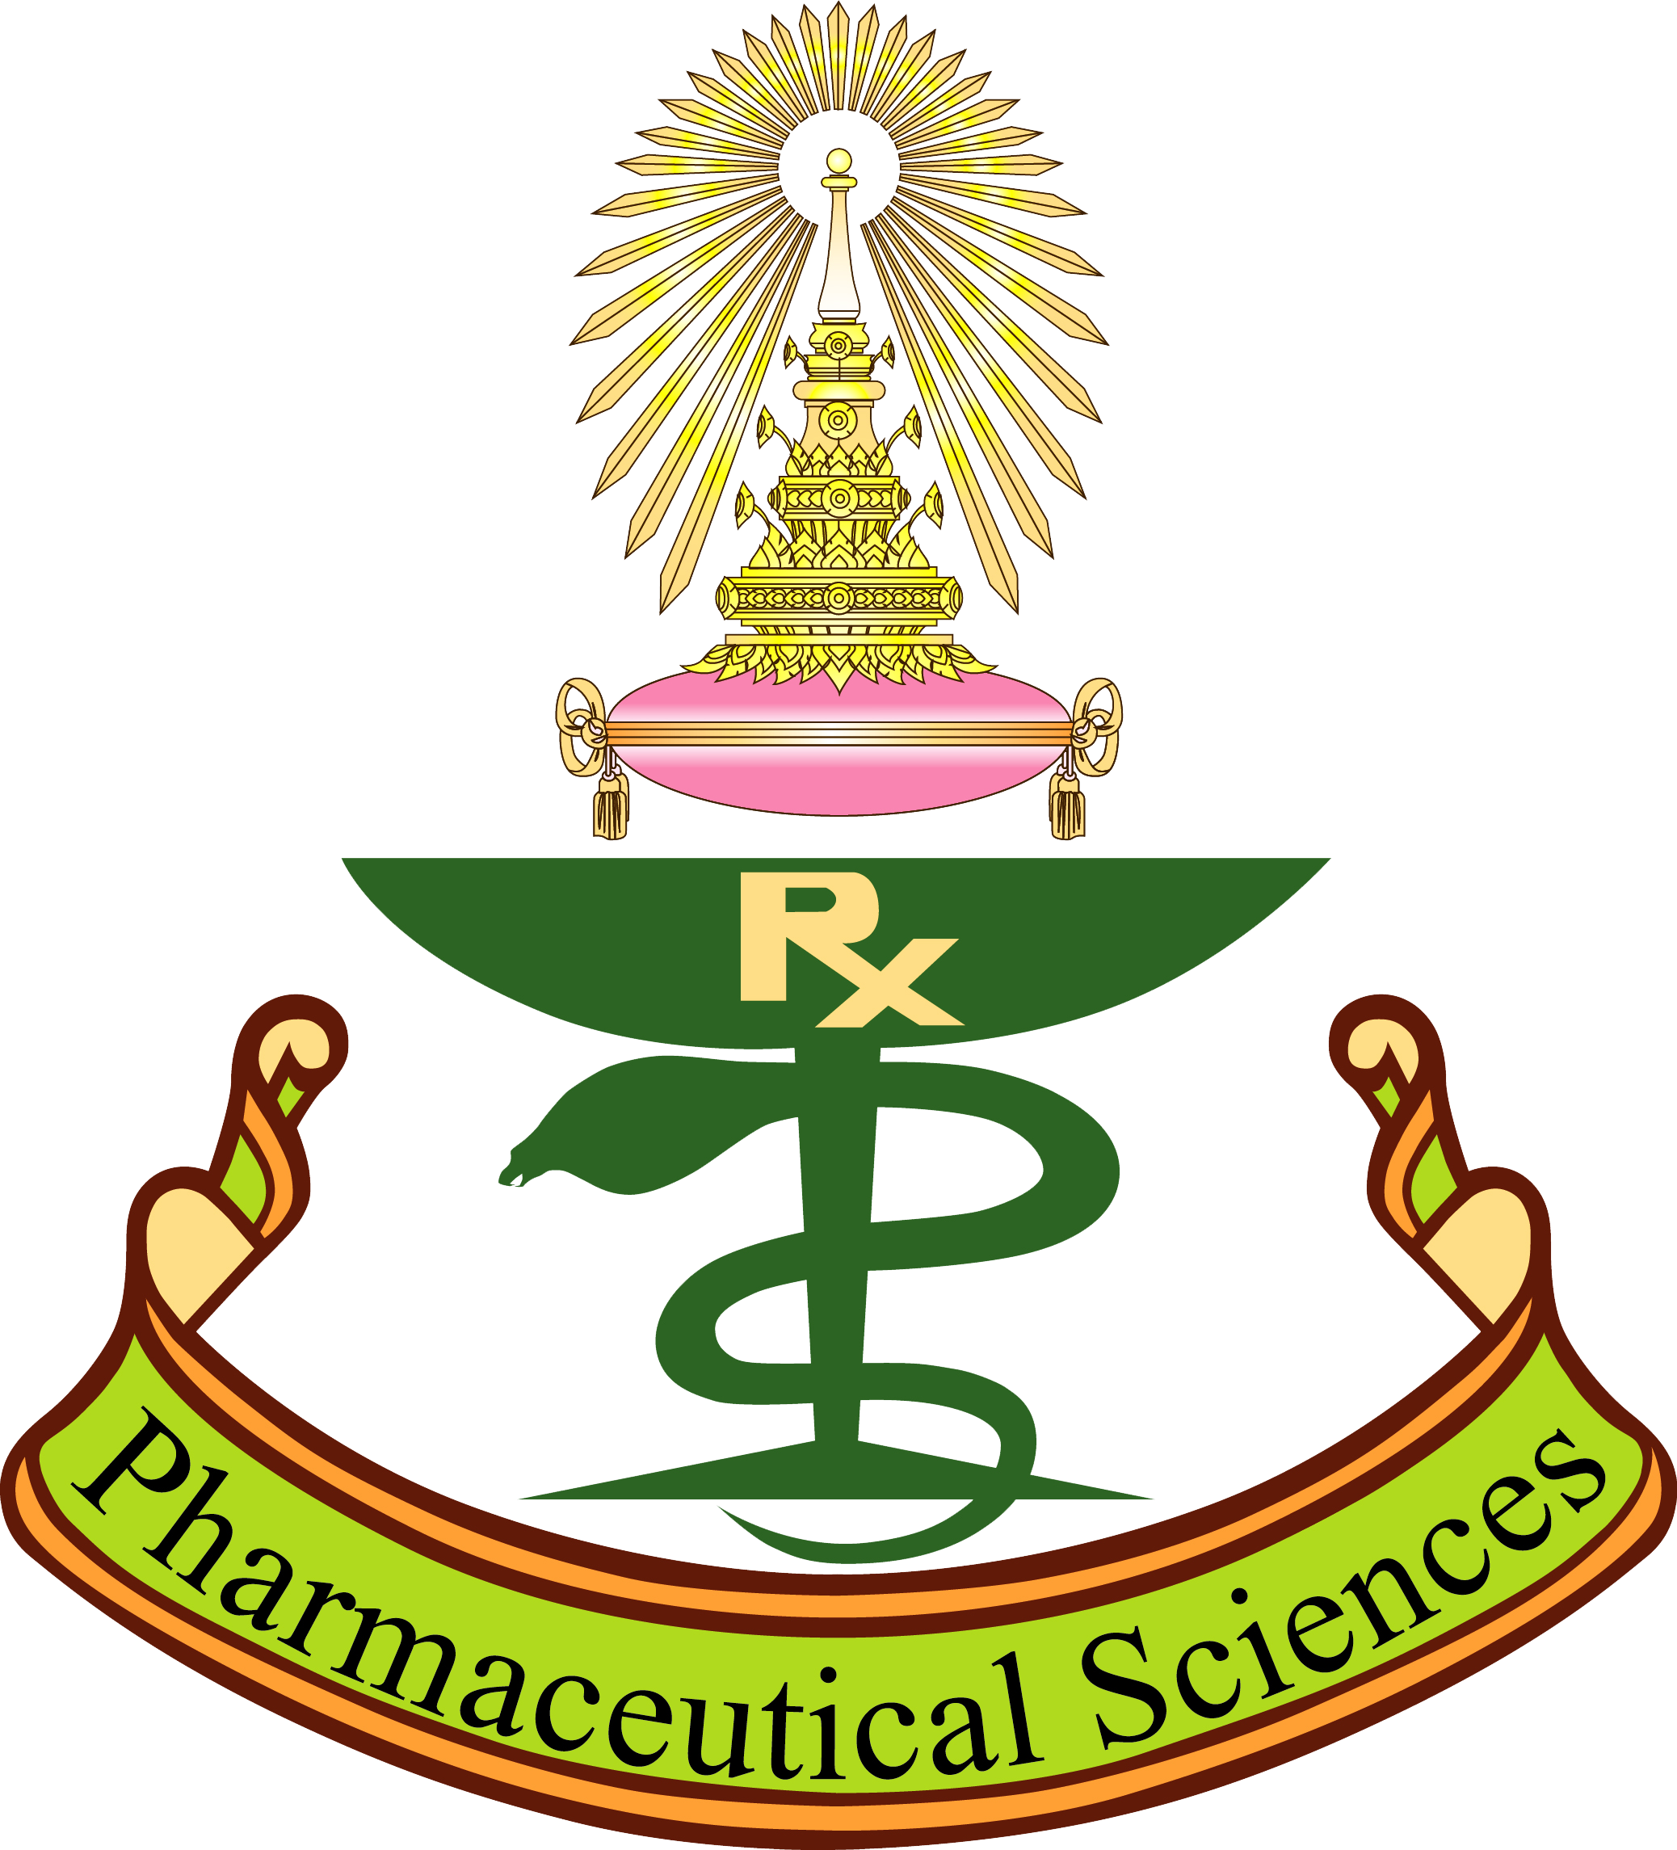

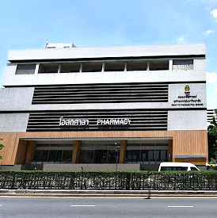
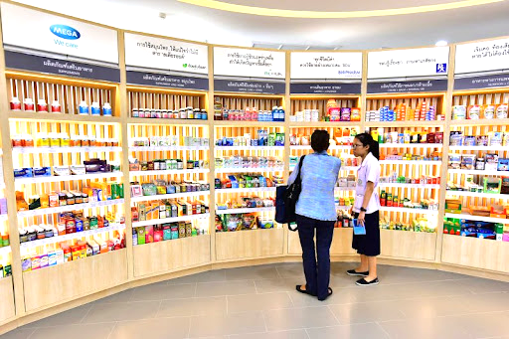





Faculty of Pharmaceutical Sciences
Thailand's first pharmacy school (111 Years)
Pharmaceutical
Innovation Bldg.
Undergraduate Program (Pharm.D.)
Doctor of Pharmacy: Pharmaceutical Sciences
Pharmaceutical Care
  Pathum Wan, Bangkok
Graduate Programs (M.Sc. and Ph.D.)
Pharmaceutical Sciences and Technology Industrial Pharmacy
Social and Administrative Pharmacy Pharmaceutical Care
Pharmacology and Toxicology Cosmetic Science
Osotsala Pharmacy
No. 1 University in Thailand | Asia and World Top-Tier Rankings

Slide 3

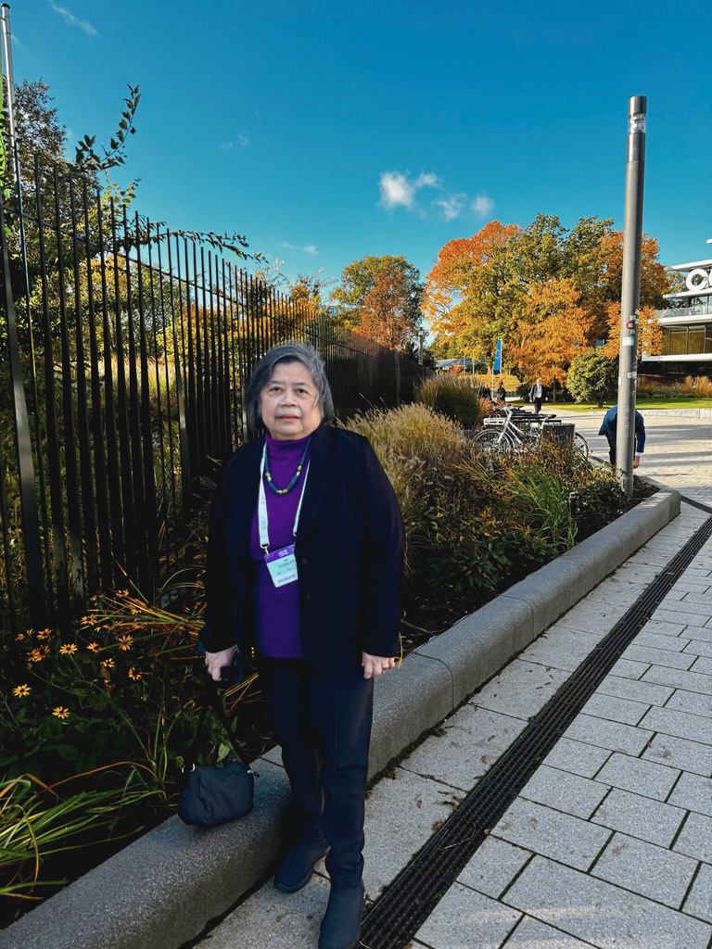
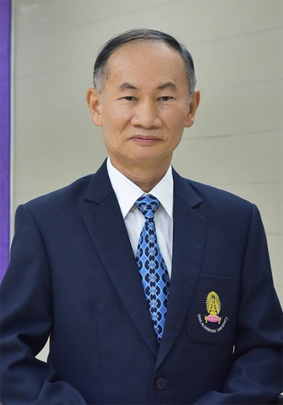
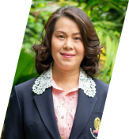
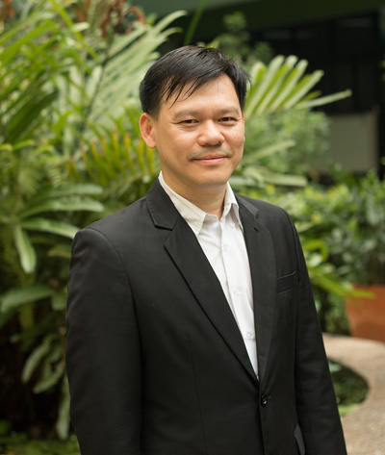
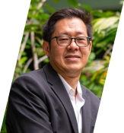
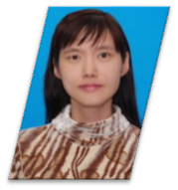
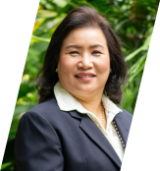
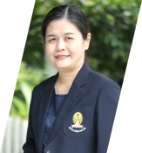
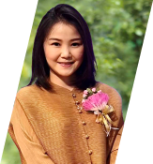
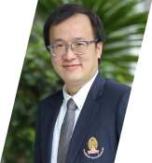

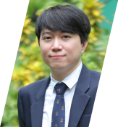
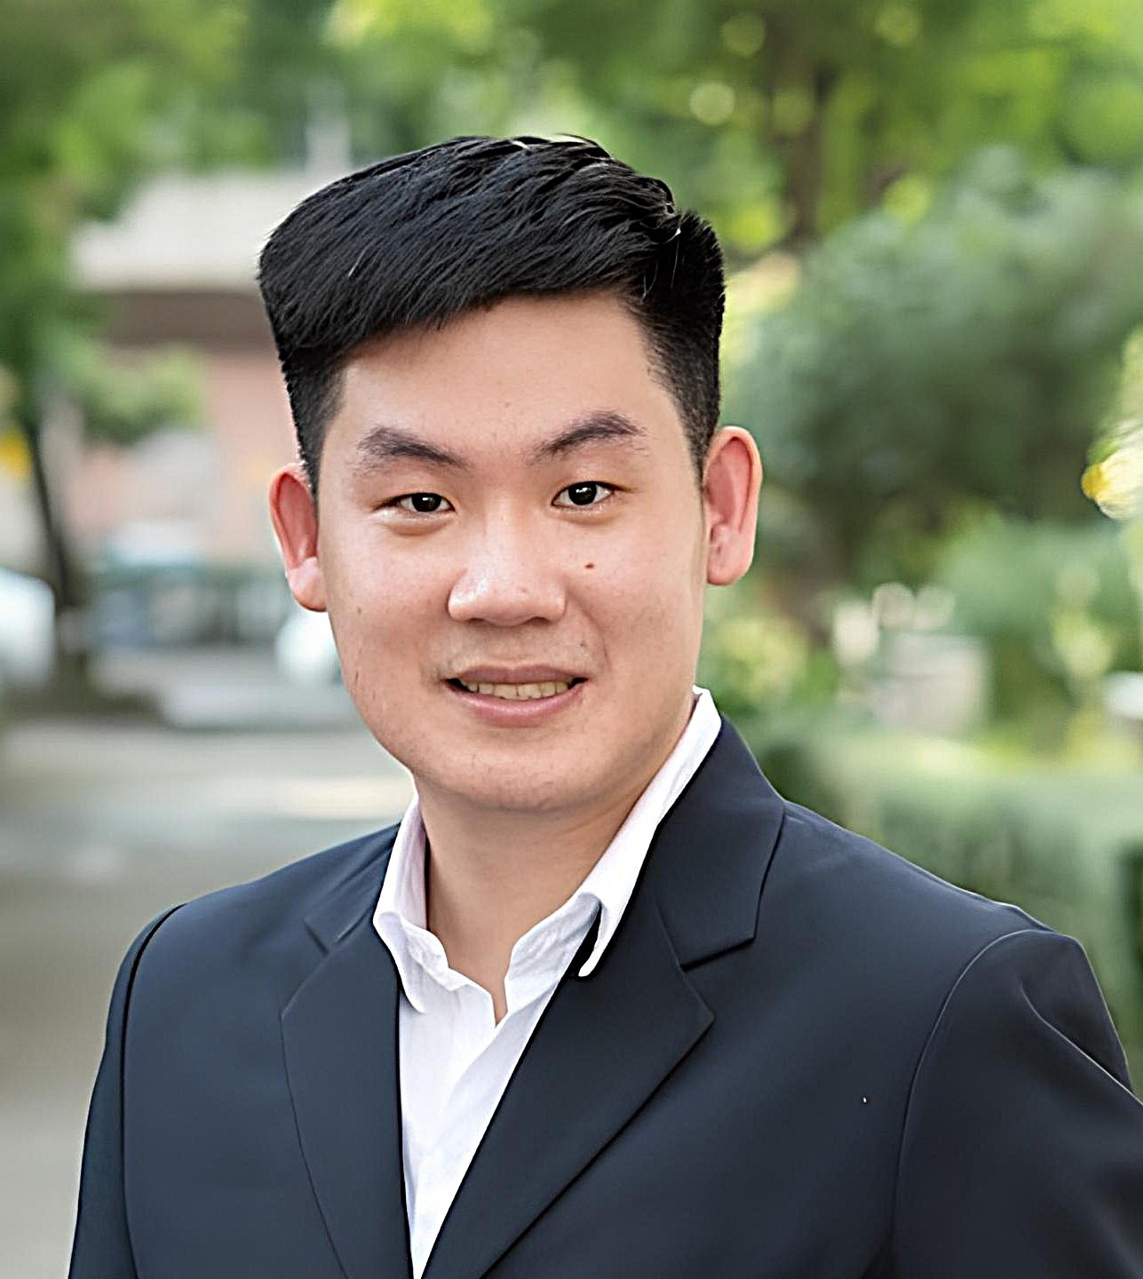
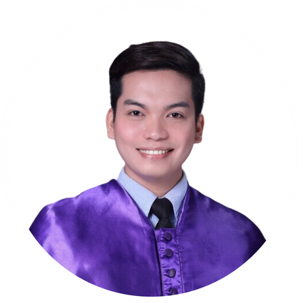
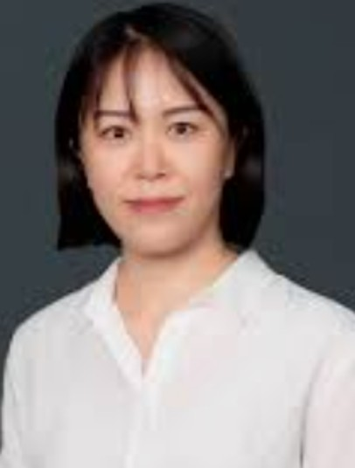
Our CE
Advisory Members
Prof. Pornchai Rojsitthisak
Director
Prof. Opa Vajragupta
Prof. Somboon Tanasuppawat
Assoc. Prof. Rataya
Luechapudiporn
Prof. Boonchoo
Sritularak
Prof.
Pranee
Rojsitthisak
Assoc. Prof. Pasarapa
Towiwat
Asst. Prof. Dusadee
Charnvanich
Assoc. Prof. Jittima
Luckanagul
Dr. Ning
Li
Assoc. Prof. Visarut
Buranasudja
Asst. Prof.
Worathat
Thitikornpong
Asst. Prof.
Nonthaneth
Nalinratana
Dr. Virunh
Kongkatitham
Dr. Khent Primo
Alcantara

Slide 4
CENTER OF EXCELLENCE IN
NATURAL PRODUCTS FOR AGEING AND CHRONIC DISEASES
Chemistry & Biopharmaceutics
Nanoformulation
Pharmacology
AI Platform
Natural product chemistry
Nanodelivery
Biological activities
Drug Discovery
Isolation
Chemical modification
Polymeric nanoparticles
Self-assembly nanoparticles
Magnetic nanoparticles
Antioxidative
Anti-inflammatory
Anticancer
Anti-atherosclerosis
Antinociceptive
Antipsoriasis
Virtual screening and molecular docking
Deep learning–based prediction (GNINA, DeepChem)
Automated workflow integration (KNIME, Rush)
Physicochemical properties
Polymer-drug conjugates
Solubility
log P, log D
Stability
PEGylation
Poloxamer conjugates
In vitro metabolism
Biopharmaceutics
Biomacromolecular-drug conjugates
(Initiated projects)
Gut metabolism
Hepatic metabolism
Plasma metabolism
Enzyme induction/inhibition
Product Development
Cellular uptake
Drug transport
In vitro absorption across the
Caco-2 monolayers
Protein/peptide-drug conjugates
Antibody-drug conjugates
ADMET and pharmacokinetic modeling (ADMETlaB, SwissADME)
Formulation optimization (KNIME)
In vivo pharmacokinetics
Bioanalytical development & validation
PK in Rodents
4

Slide 5

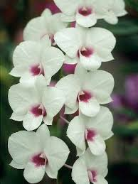



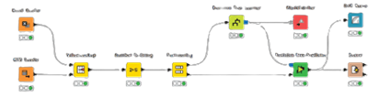
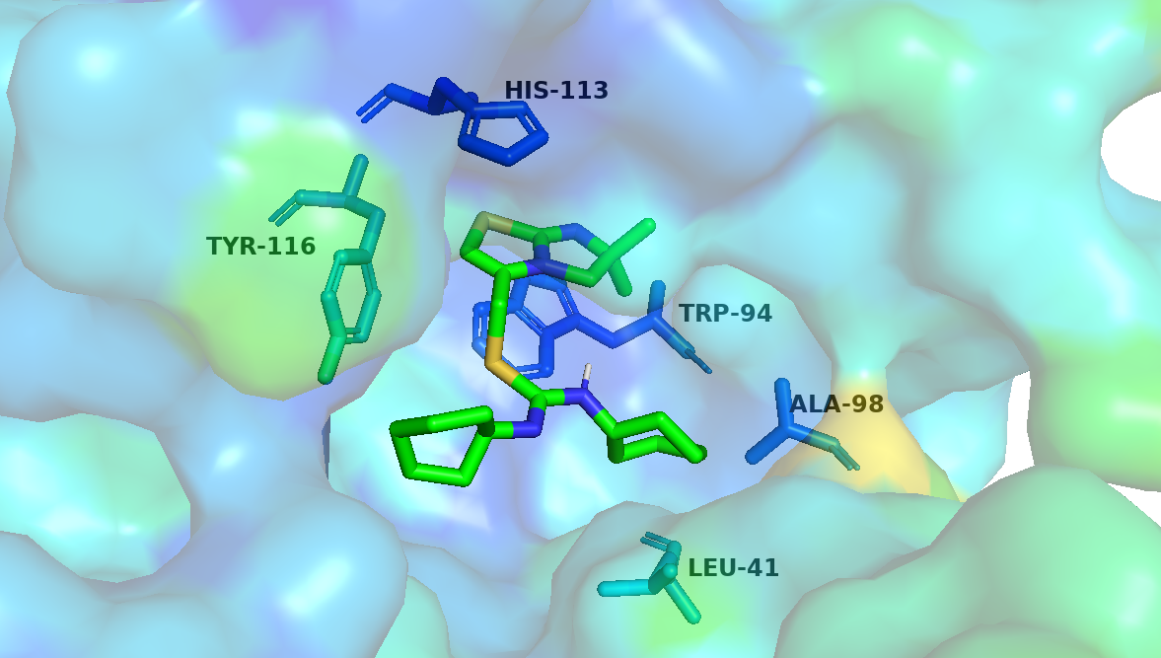
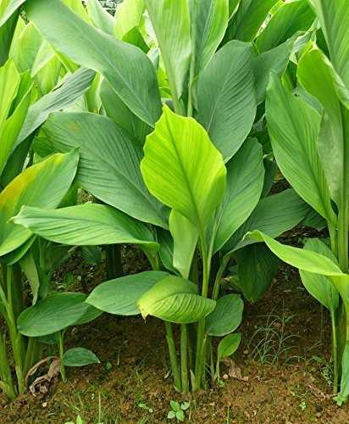
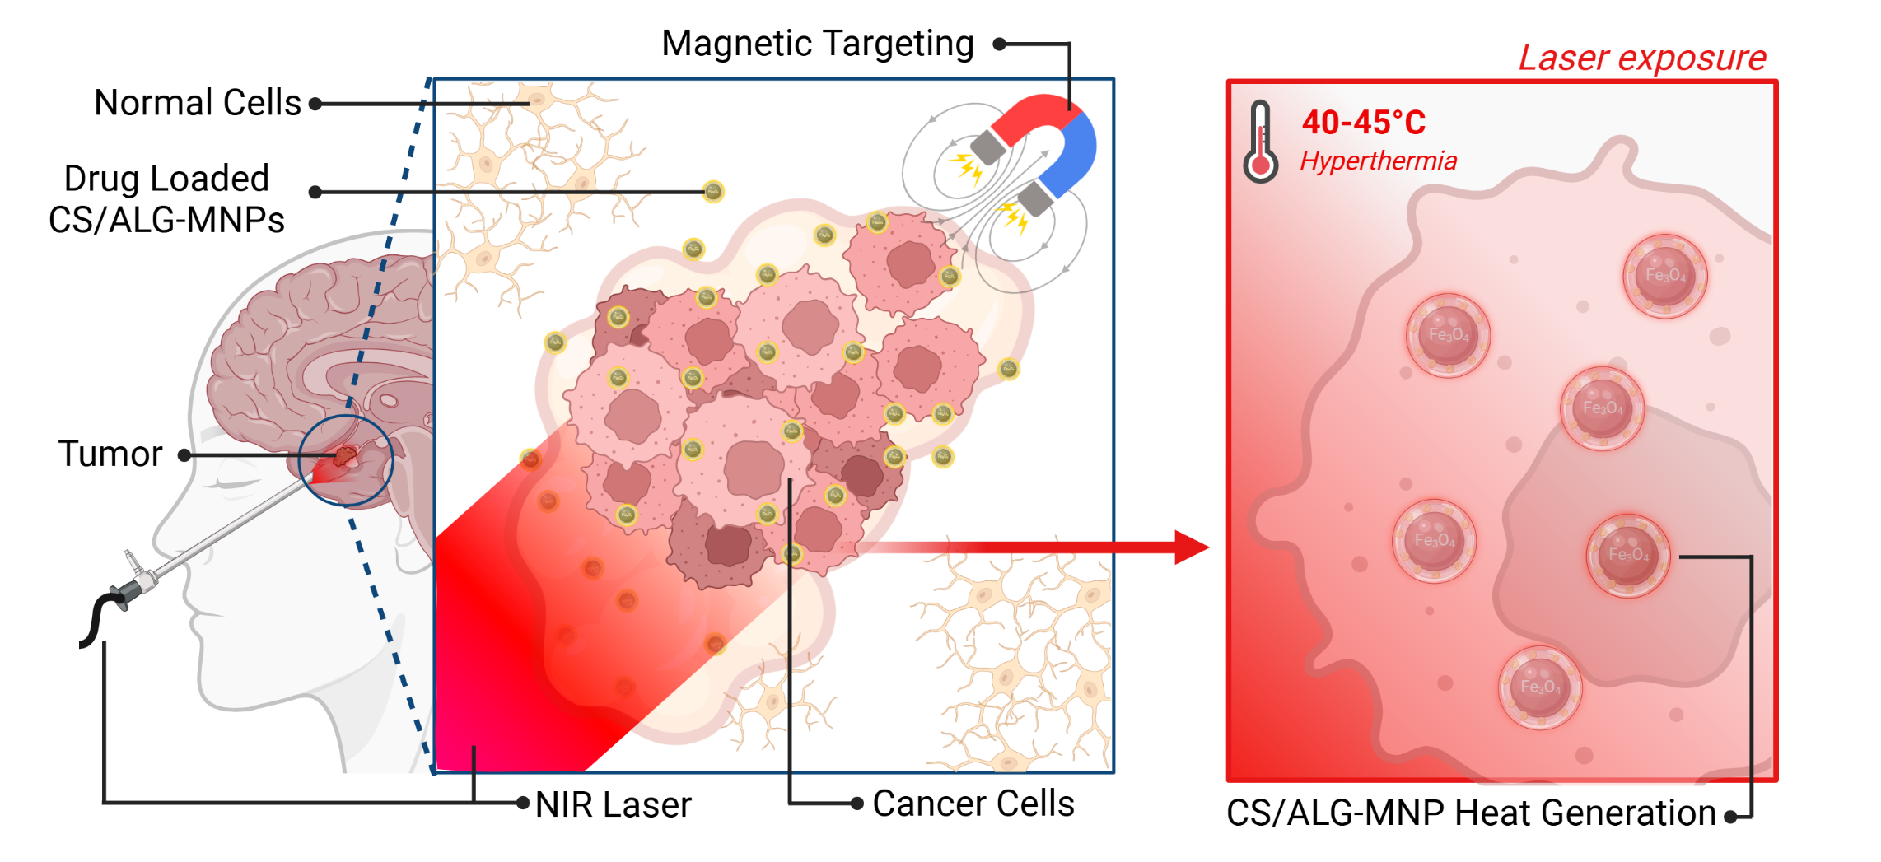


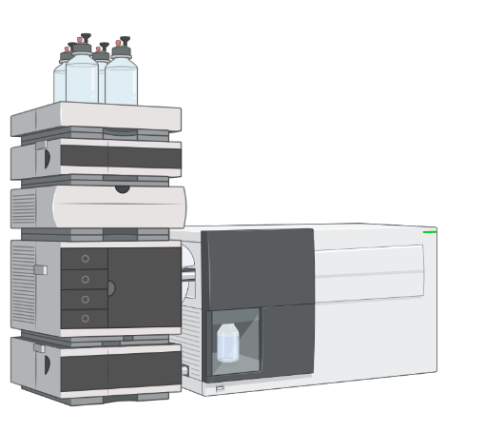
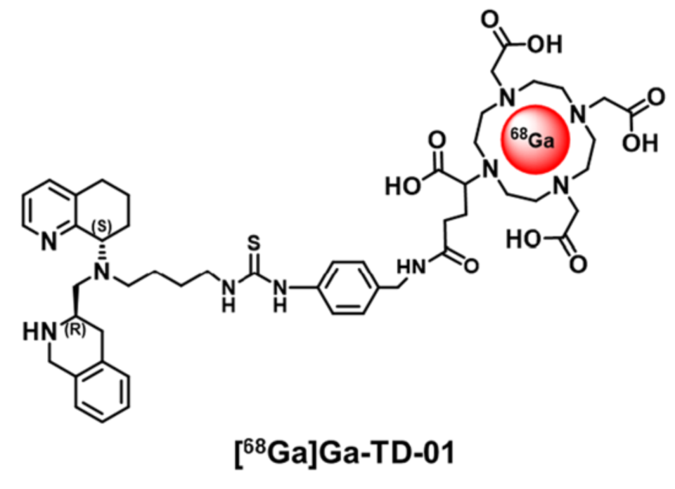
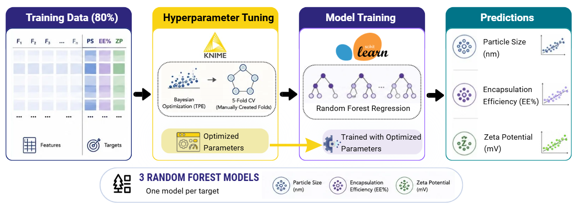
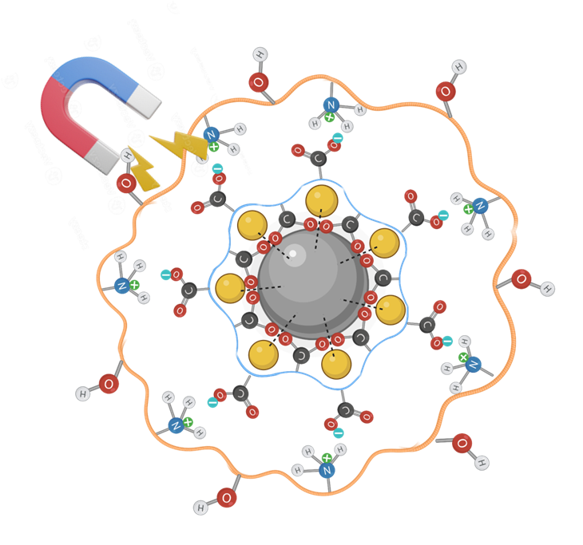
Center of Excellence in Natural Products for Ageing and
Chronic Diseases (CE-NPACD), Chulalongkorn University
Traditional Natural Product Discovery
Nanomedicine-Enabled Theranostics
AI-driven Drug Discovery and Formulation
Nanoformulations
AI-Assisted Drug Discovery
ORCHID
(Dendrobium spp.)
Polymeric
Lipid
Magnetic
TURMERIC
(Curcuma longa L.)
Delivery system
Analytical AI platform
Molecular docking
Precision Theranostics for Glioblastoma
AI-Assisted Drug Formulation
Chemical modification
Isolation
Liquid chromatography
Present Focus

Slide 6
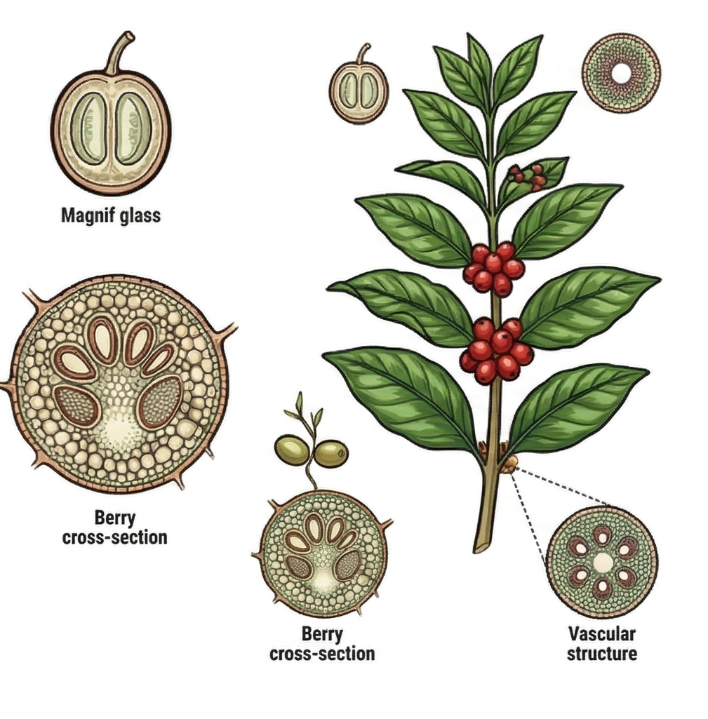
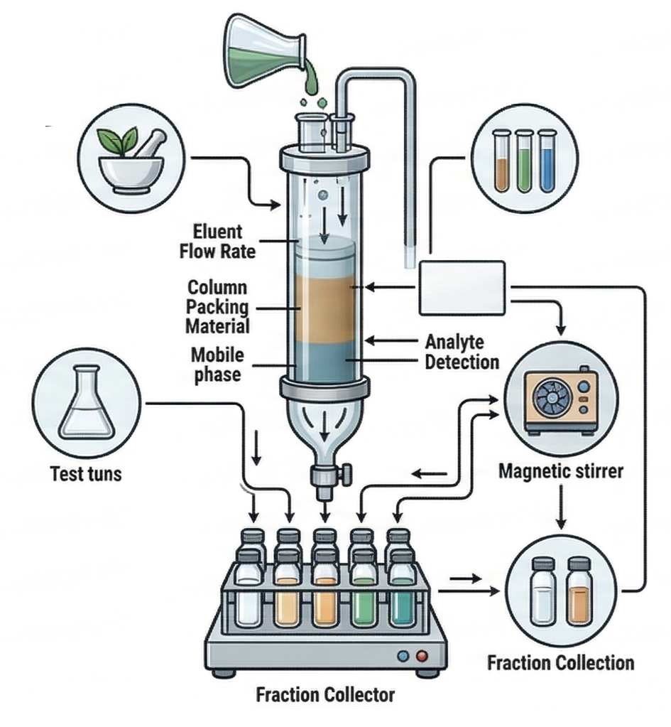
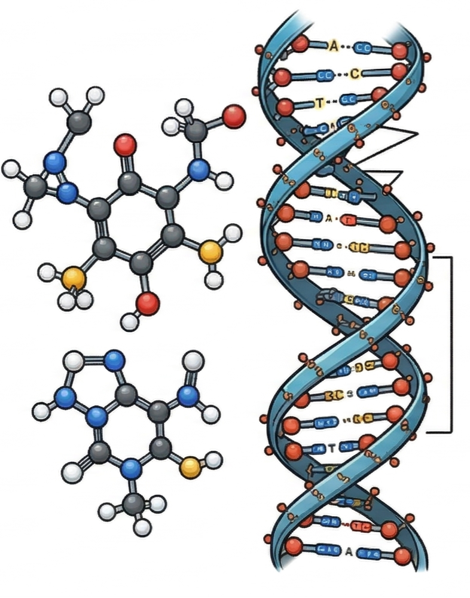
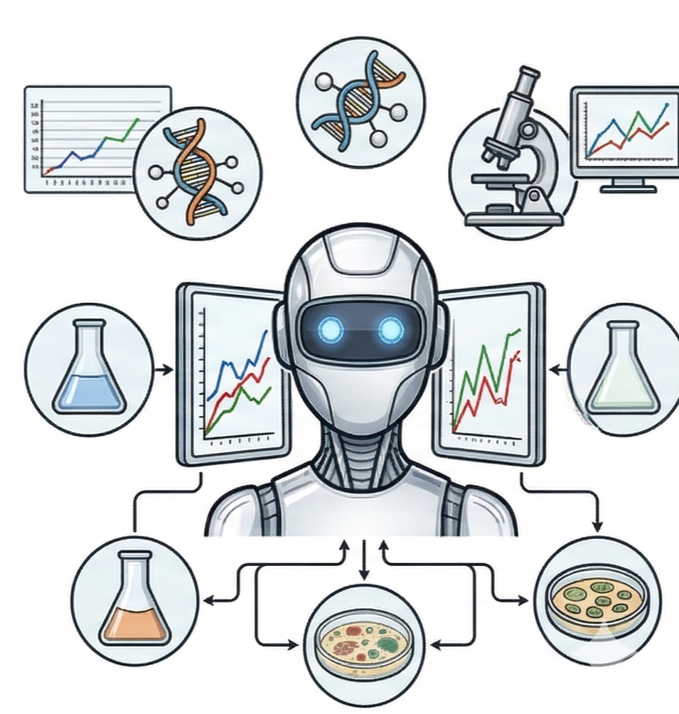
Evolution of Natural Product Drug Discovery
Before 1900
Traditional empirical era
1900–1970s – Bioactivity-oriented discovery
1980–2000 – Target-based drug discovery
2010–Present – AI-driven and data-integrated discovery
Empirical and experience-based model
Isolation and activity-guided fractionation
Mechanism-driven discovery
Data-driven and
AI-assisted discovery
Use of crude extracts and herbal mixtures based on observation, traditional knowledge, empirical use, and ethnopharmacology
Extraction, purification, and chemical modification
Bioassay-guided isolation
Focus on specific molecular targets
Target screening, Mechanistic studies, Combinatorial chemistry, High-throughput screening
Use of large datasets and multi-omics technologies
Predictive AI/ML modeling and virtual screening
Wang Y. et al. (2024). New drug discovery and development from natural products. Current Opinion in Green and Sustainable Chemistry 45, 100172.
Chaachouay N. et al. (2024). Plant-derived natural products: a source for drug discovery and development.Biomolecules 3, 11.

Slide 7
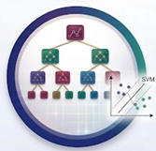
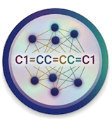



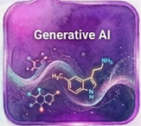
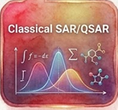
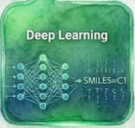
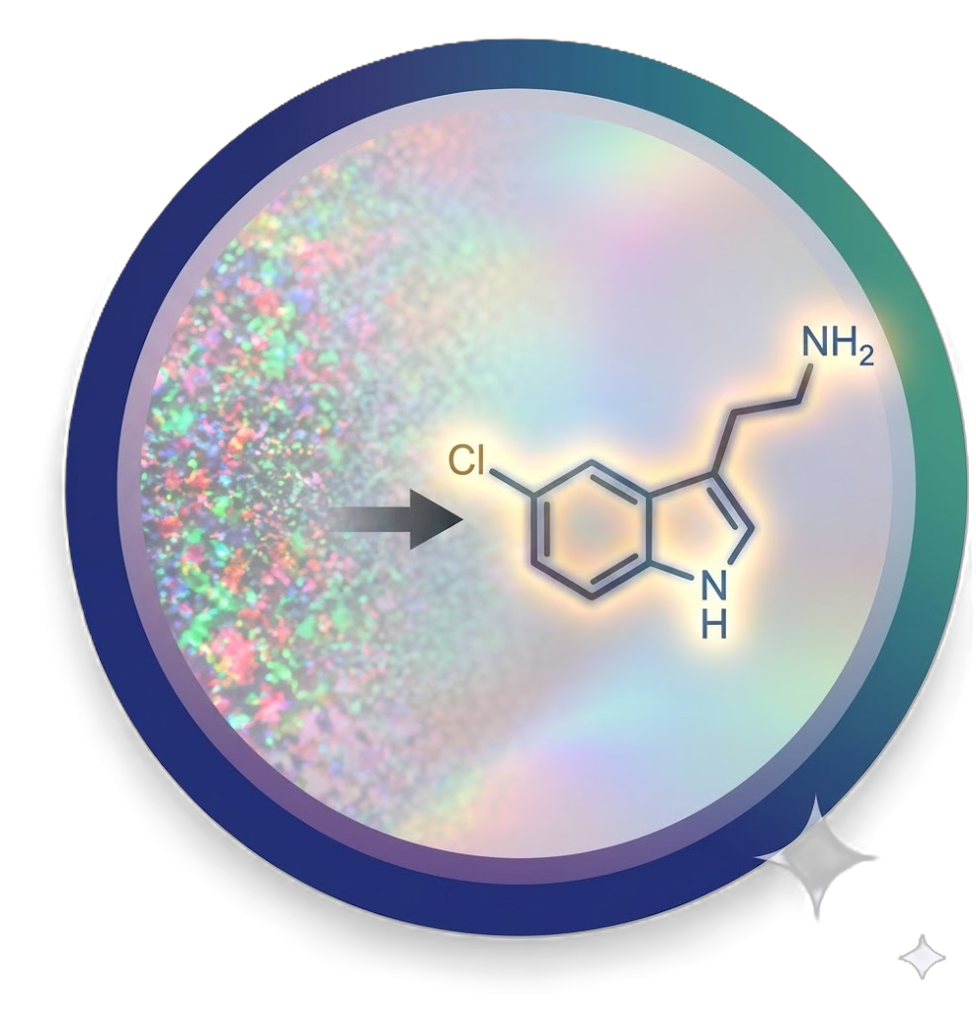

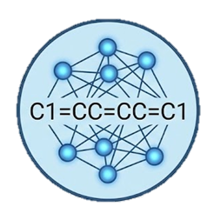
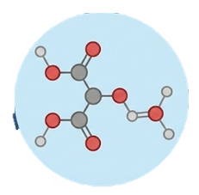
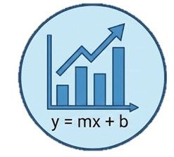
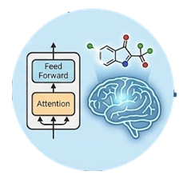
Evolution of Drug Discovery Platforms: From QSAR to Generative AI
1
2
3
4
5
Classical SAR/QSAR
Hand-picked molecular properties
Linear statistical equations
Chemist-driven design
Machine Learning
Learns patterns from data
Decision-tree ensembles & support-vector machines
Higher predictive accuracy
Deep Learning
Multi-layer neural networks
Reads molecules as text sequences
Large-scale pretraining
Graph Neural Networks
Molecules as graphs
(atoms + bonds)
Message passing between atoms
Topology-aware learning
Generative AI
Designs brand-new molecules
Self-attention backbone
Diffusion-based generation
7

Slide 8
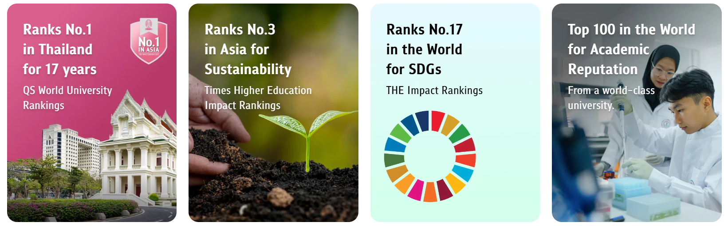
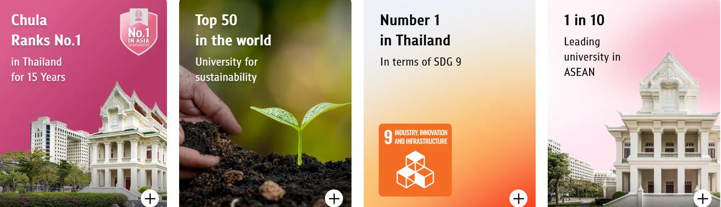
CHULALONGKORN UNIVERSITY
Academic Year 2025
Significant Rankings
Curriculum | New Students | Total Students | Graduates (Year 2024)
Bachelor's Degree | 8006 | 30262 | 6222
Graduate Studies (All) | 3939 | 11349 | 3658
Graduate Diploma | 79 | 82 | 83
Master's Degree | 3079 | 7874 | 2851
Higher Graduate Diploma | 269 | 784 | 263
Doctor's Degree | 512 | 2609 | 461
Total | 11945 | 41611 | 9880
No. 1 University in Thailand | Asia and World Top-Tier Rankings
8

Slide 9
Faculty of Pharmaceutical Sciences
Thailand's first pharmacy school (113 Years)
  Pathum Wan, Bangkok
Undergraduate Program (Pharm.D.)
Doctor of Pharmacy: Pharmaceutical Sciences
Pharmaceutical Care
Pharmaceutical Innovation Bldg.
Osotsala Pharmacy
Graduate Programs (M.Sc. and Ph.D.)
Pharmaceutical Sciences and Technology Industrial Pharmacy
Social and Administrative Pharmacy Pharmaceutical Care
Pharmacology and Toxicology Cosmetic Science

Slide 10
Center of Excellence in Natural Products for Ageing and
Chronic Diseases (CE-NPACD)
Chemistry & Biopharmaceutics
Nanoformulation
Pharmacology
AI Platform
Natural product chemistry
Nanodelivery
Biological activities
Drug Discovery
Isolation
Chemical modification
Polymeric nanoparticles
Self-assembly nanoparticles
Magnetic nanoparticles
Antioxidative
Anti-inflammatory
Anticancer
Anti-atherosclerosis
Antinociceptive
Antipsoriasis
Virtual screening and molecular docking
Deep learning–based prediction (GNINA, DeepChem)
Automated workflow integration (KNIME, Rush)
Physicochemical properties
Polymer-drug conjugates
Solubility
log P, log D
Stability
PEGylation
Poloxamer conjugates
In vitro metabolism
Biopharmaceutics
Biomacromolecular-drug conjugates
(Initiated projects)
Gut metabolism
Hepatic metabolism
Plasma metabolism
Enzyme induction/inhibition
Product Development
Cellular uptake
Drug transport
In vitro absorption across the
Caco-2 monolayers
Protein/peptide-drug conjugates
Antibody-drug conjugates
ADMET and pharmacokinetic modeling (KNIME, JMP)
Formulation optimization (FormulationAI, JMP)
In vivo pharmacokinetics
Bioanalytical development & validation
PK in Rodents

Slide 11
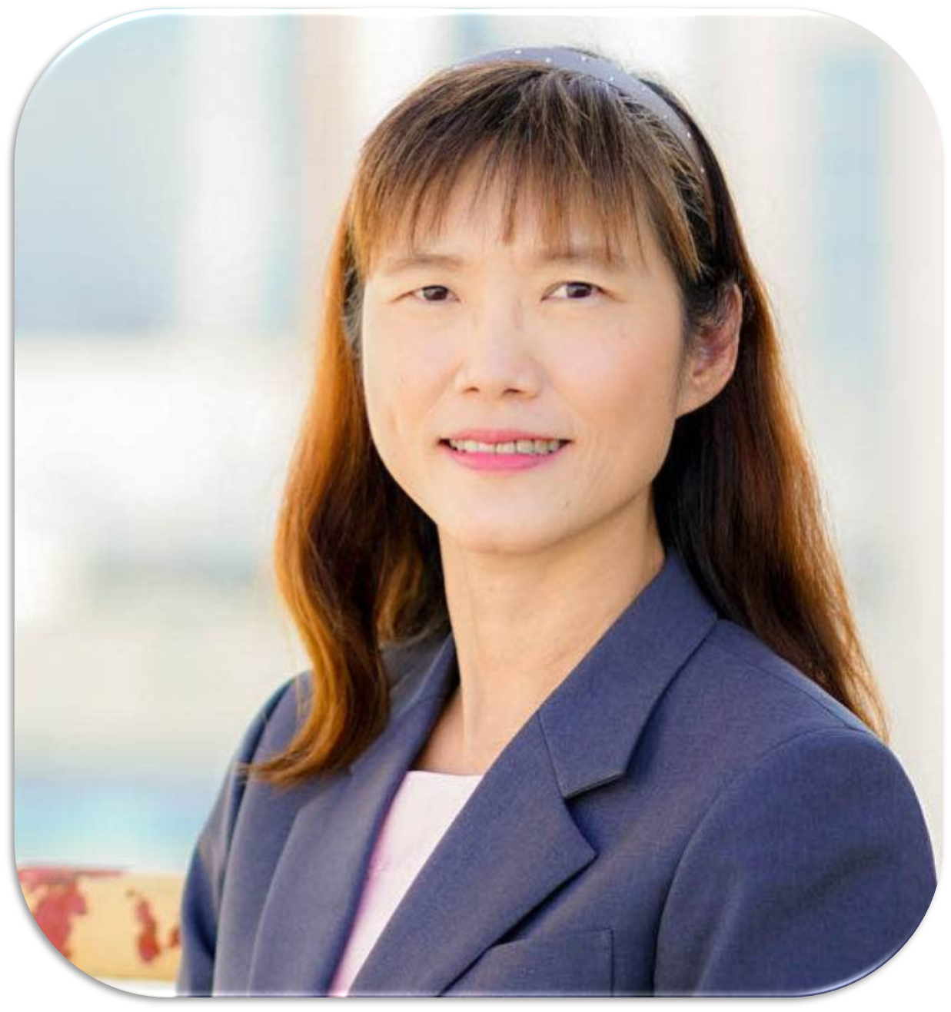
Center of Excellence in Natural Products for Ageing and Chronic Diseases (CE-NPACD)
Prof. Pornchai Rojsitthisak
Director
Prof. Opa Vajragupta
Prof. Somboon Tanasuppawat
Assoc. Prof. Rataya
Luechapudiporn
Advisory Members
Prof.Boonchoo
Sritularak
Prof.Pranee
Rojsitthisak
Prof. Pasarapa
Towiwat
Asst. Prof. Dusadee
Charnvanich
Assoc. Prof. Jittima
Luckanagul
Dr. Ning
Li
Dr. Khent Primo
Alcantara
11
Assoc. Prof. Visarut
Buranasudja
Asst. Prof.
Worathat Thitikornpong
Asst. Prof.
Nonthaneth Nalinratana
Dr. Virunh
Kongkatitham

Slide 12












International Collaborators
China
Peking University, Prof. Hua Zhu
Shenyang Pharmaceutical University, Prof. Yilin Song
Taizhou University, Prof. Jie Wu, Prof. Kai Zhao, Assoc. Prof. Bin Bin
Southwest Forestry University Prof. Lianpeng Zhang
Jiaxing University Prof. Guanyinsheng Qiu
Zhejiang University Prof. Ming Chen
Germany
Universitätsmedizin Berlin Prof. Chotima Böttcher.
United Kingdom
University of Liverpool
Prof. Luminita Paraoan
Qatar
The University of Doha for
Science and Technology
Dr. Asma El-Magboub
Japan
Chiba University Prof. Kunikazu Moribe
Kyushu University Prof. Kenji Hamase; Assoc. Prof. Seiichi Sakamoto
USA
University of Southern California
Assoc. Prof. Ian S. Haworth.
Philippines
University of the Philippines (UP)
Assoc. Prof. Bryan Paul Bulatao
University of Santo Tomas (UST)
Prof. Agnes Llamasares-Castillo
Prof. Ross D. Vasquez.
Mariano Marcos State University (MMSU)
Sri Lanka
University of Ruhuna
Dr. Peththa Wadu Dasuni Wasana
Singapore
National University of Singapore (NUS)
Assoc. Prof. Chan Lai Wah
Malaysia
Faculty of Pharmacy, Universiti Teknologi MARA (UiTM), Prof. Wong Tin Wui, Assoc. Prof. Hasseri Halim

Slide 13


