Slide 1
MANAGEMENT REVIEW · 28 OCTOBER 2026
Complaints and FIRs:
the backlog is concentrated,
aging, and uneven
Across ACC, AHTC, AMLC, CBC, and CCC.
9,302
8,011
78%
48%
Complaints disposed
Complaints pending
Share in AHTC
Pending over six months
14,699 complaints and 3,350 FIRs.
50% of 18,774 registered since January.
43% of the total; 4,860 at enquiry stage.
1,437 of 3,003 cases; 781 of 937 proclaimed offenders not arrested.
Notes:
Set the frame: the backlog is not evenly distributed. The review covers complaints and FIRs across five circles as of 28 October 2026.
Summary: 9,302 complaints are disposed and 8,011 remain pending. AHTC carries 78% of complaints. Pending work is ageing, especially enquiries and cases over six months. The rest of the deck explains each point.

Slide 2
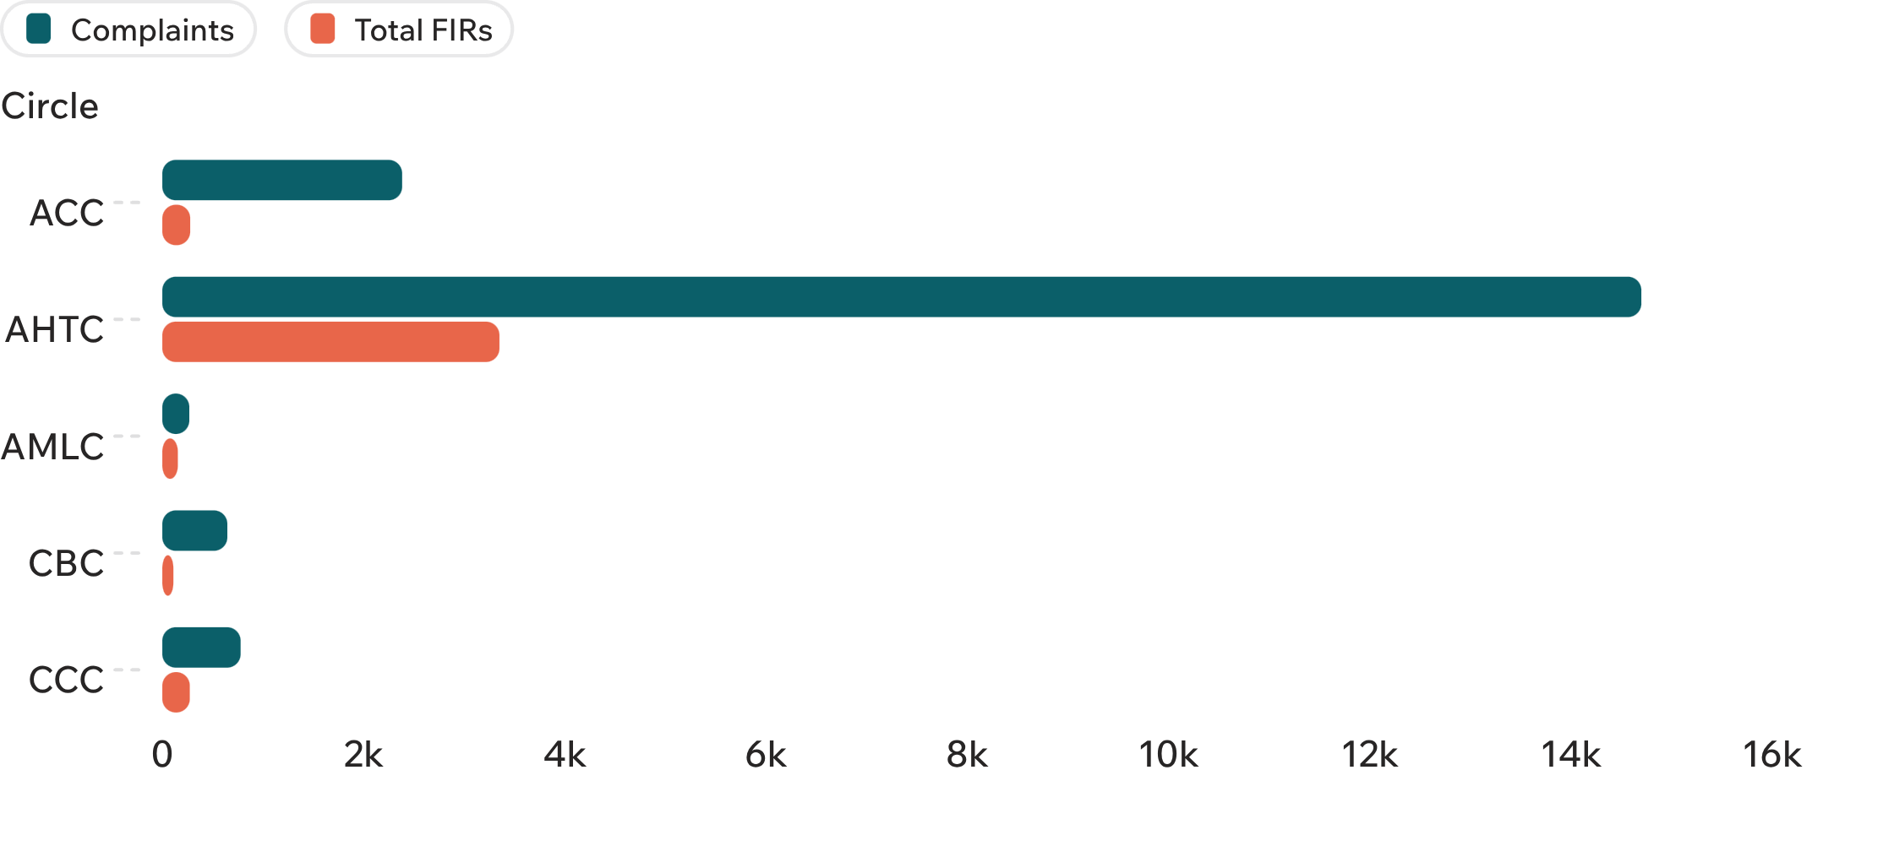
WORKLOAD BY CIRCLE · 28 OCTOBER 2026
AHTC carries most of the workload
AHTC SHARE
78%
14,699 of 18,774 complaints.
80% of FIRs also sit in AHTC: 3,350 of 4,164.
Source: Management review data, 28 October 2026.
02
Notes:
AHTC dominates both workload measures: 78% of complaints and 80% of FIRs sit in one circle.

Slide 3
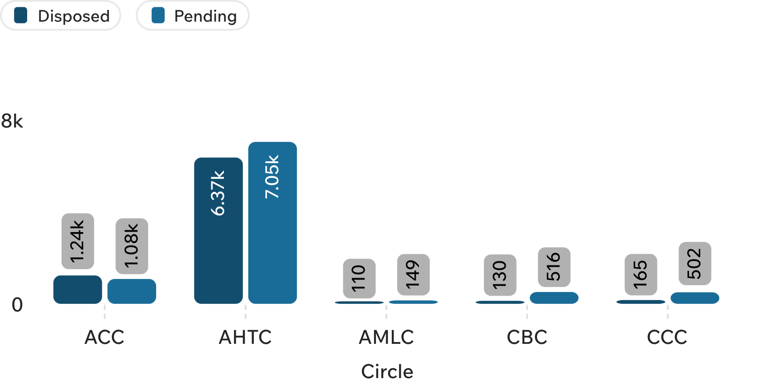
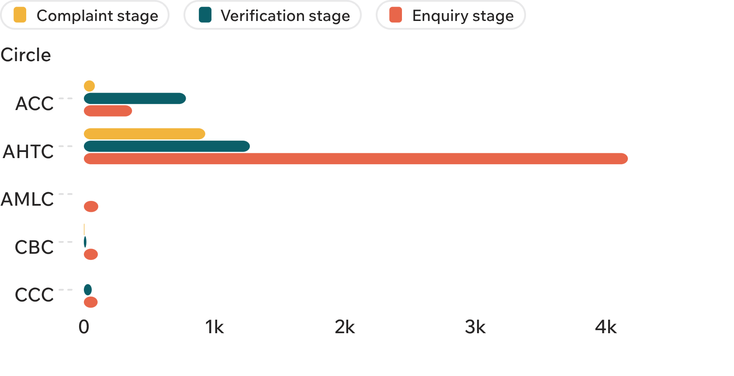
PIPELINE · 28 OCTOBER 2026
Half of complaints are disposed; enquiry holds 61% of the pending book
9,302
4,860
Complaints disposed
Pending at enquiry stage
50% of the total; 8,011 remain pending.
61% of 8,011 pending; verification holds 27%, complaint stage 13%.
Source: Management review data, 28 October 2026.
03
Notes:
Overall, the book is balanced between disposed and pending. Operational pressure is concentrated in AHTC, with 6,371 pending complaints.
The pending book is primarily an enquiry-management problem. AMLC is the clearest example: all 110 pending complaints are at enquiry stage.

Slide 4
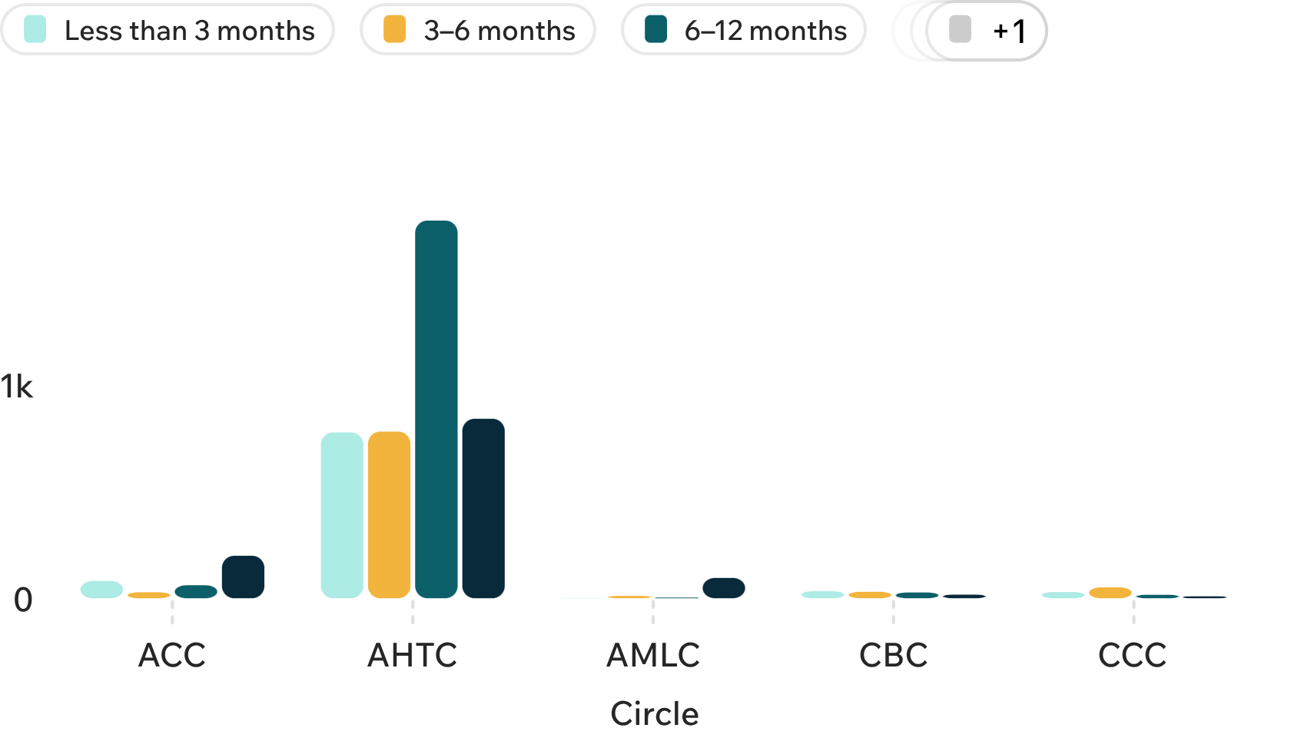
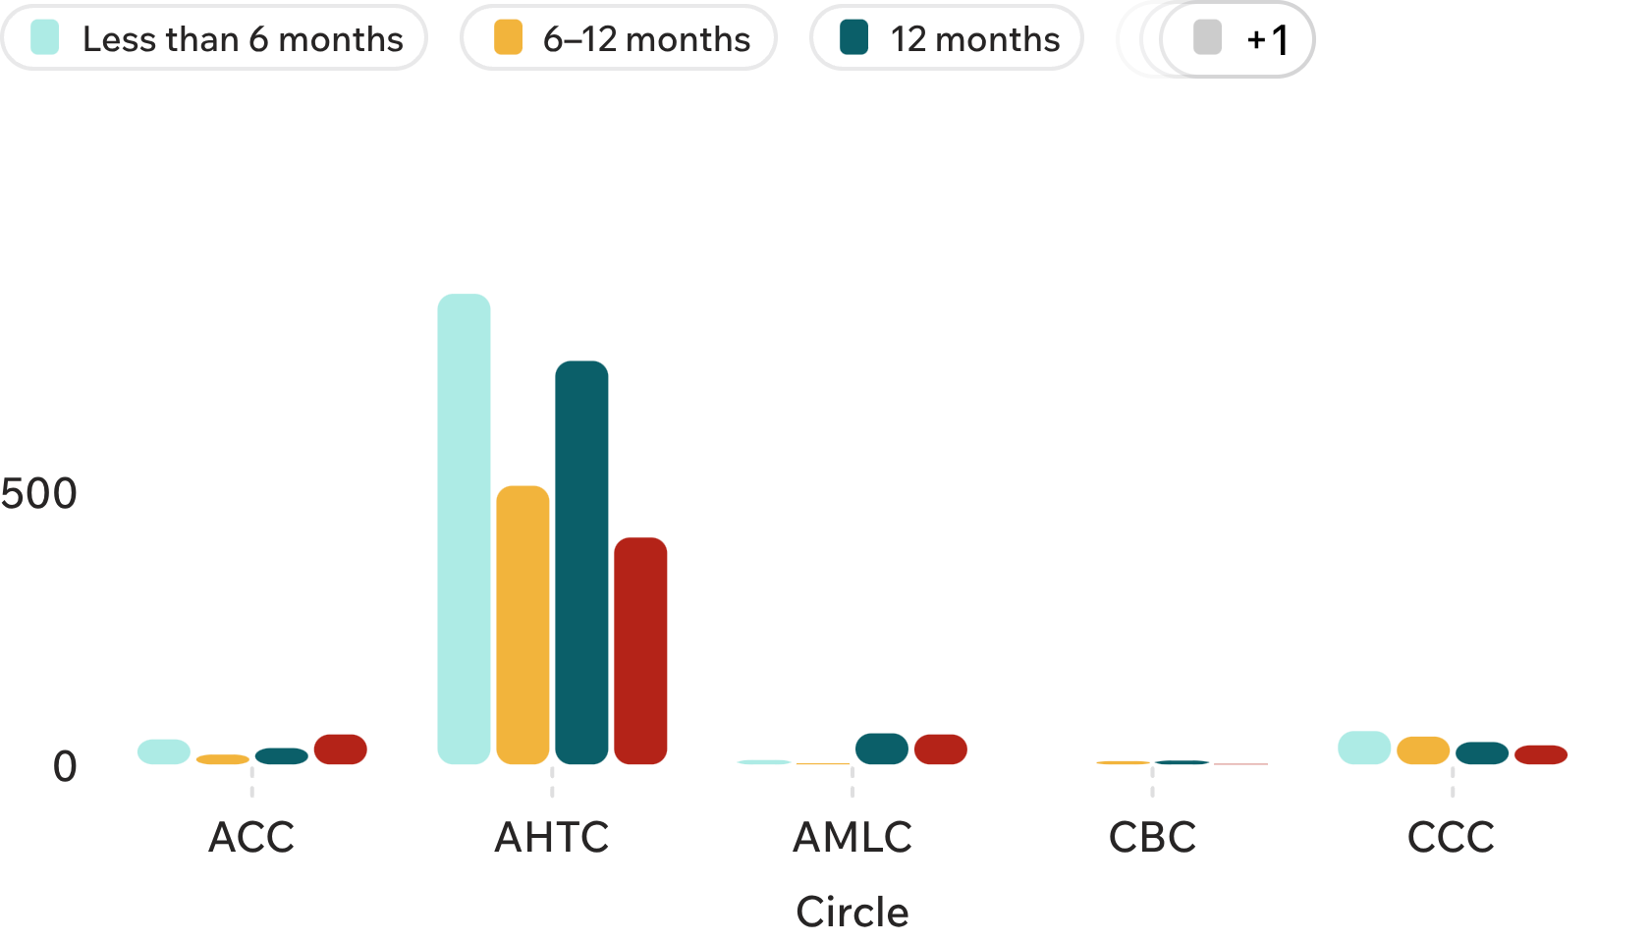
AGING · 28 OCTOBER 2026
Older enquiries sit in ACC and AMLC; 48% of cases pass six months
1,161
48%
Enquiries over 12 months
Cases pending over six months
24% of all enquiries; 54% of ACC's and 87% of AMLC's enquiry backlog.
1,437 of 3,003 cases; AMLC is highest, with 102 of 122 at least six months old.
Source: Management review data, 28 October 2026.
04
Notes:
AHTC has the largest absolute aged volume. ACC and AMLC carry the sharper aging exposure within their own enquiry books.
Nearly half of the total pending case book is already six months old or more. AMLC has the highest aging exposure, while AHTC carries the largest volume.

Slide 5
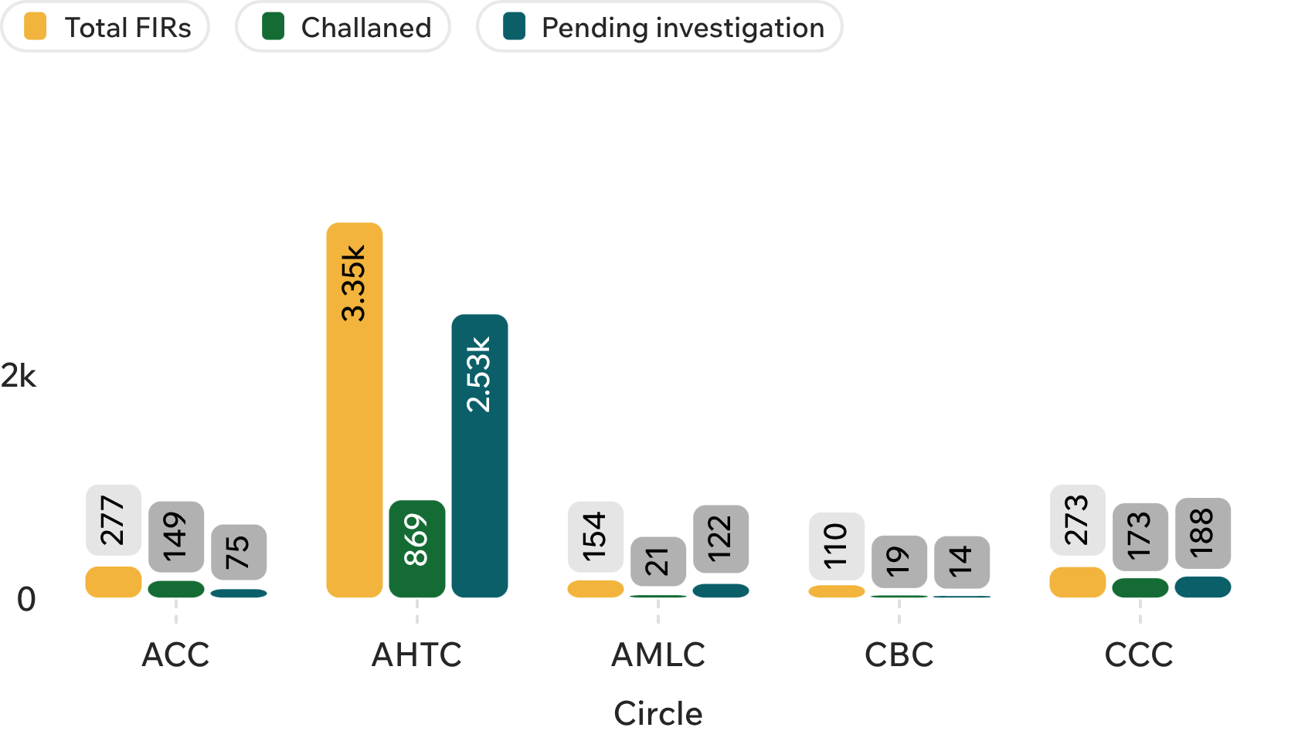
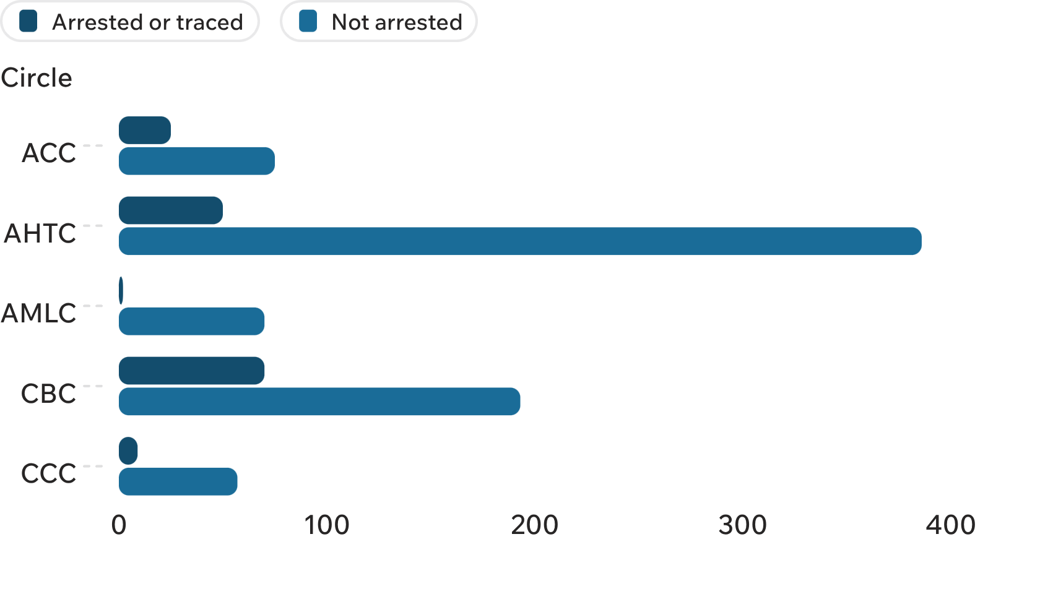
FIRS AND PROCLAIMED OFFENDERS · 28 OCTOBER 2026
FIR progress is uneven, and 83% of proclaimed offenders are not arrested
3,003
83%
FIRs pending investigation
Proclaimed offenders not arrested
72% of 4,164 FIRs; CCC has the highest challan rate at 63%.
781 of 937; 156 arrested or traced. AHTC has the largest total at 436.
Source: Management review data, 28 October 2026.
05
Notes:
Progress is uneven. CCC leads on challan rate, but AHTC remains the main management issue because of its absolute pending-investigation load.
The gap is consistent across every circle: 83% of proclaimed offenders remain not arrested. AHTC has the largest total population and 386 not arrested.

Slide 6
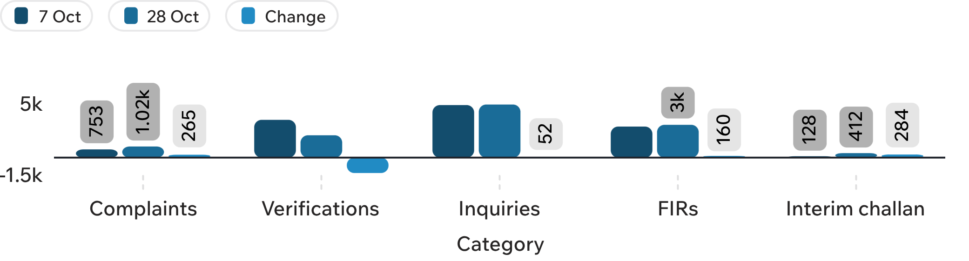
OCTOBER MOVEMENT · 7 TO 28 OCTOBER 2026
October movement: verification fell, while complaints and FIRs rose
28 OCTOBER SNAPSHOT
−1,409
pending verifications
+265 complaints · +52 enquiries · +160 FIRs · +284 interim challans
01
Clear aged enquiries
02
Protect verification progress
03
Separate volume and aging targets
Use an aging-based plan for ACC, AMLC, and AHTC.
Prevent new complaints from rolling forward.
AHTC needs throughput; ACC and AMLC need aged-case clearance.
Source: Management review data, 7 October and 28 October 2026.
Notes:
Verification improved sharply over October. That improvement did not translate into lower overall pendency: complaints, FIRs, and interim challans all increased.
Close on the management response: clear enquiry by age and circle, preserve the verification gain, and separate the throughput problem in AHTC from the aged-case problem in ACC and AMLC.

