Slide 1

Bangladesh University of engineering and technology EEE-312 Digital signal processing laboratory–I
traffic sign classification
Submitted to:
Dr. S. M. Mahbubur Rahman
Professor, Dept. of EEE, BUET.
Shafayeth Jamil
Lecturer, Dept. of EEE, BUET.
Prepared by
ID:1906135, 1906140,
1906153, 1906154, 1906155

Slide 2
Table of Content
1
Introduction
Working Procedure
Objective of this project
Work Flow
Code Explanation
Accuracy and Losses
Sample Outputs
Limitations

Slide 3
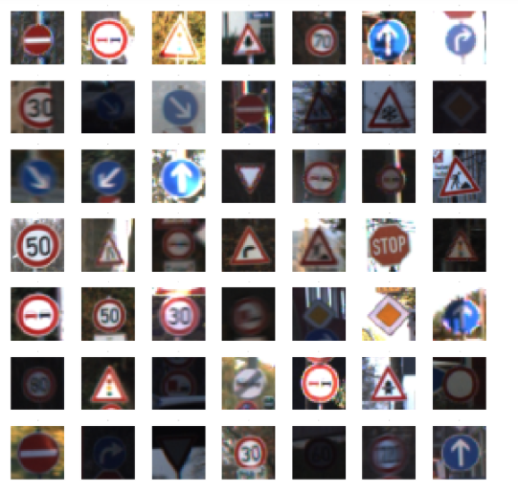
Introduction to our Project
2
Python project
Deep Neural Network model
Classification of traffic signs
According Traffic Decisions

Slide 4
Objective of this project
3
Detect and classify traffic signs
Advanced driver-assistance systems (ADAS)
A robust and efficient machine learning algorithm
Fine-tuning hyperparameters
Deploy the traffic sign classification model
Reduce the frequency of accidents

Slide 5
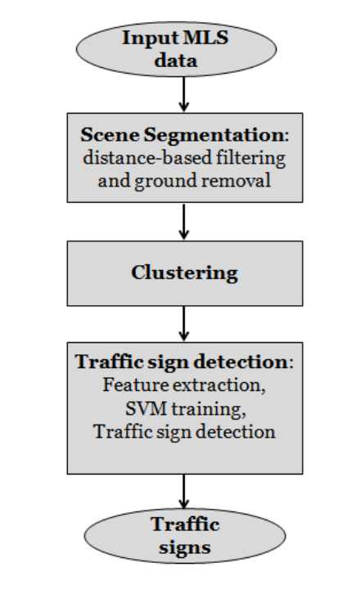
Work Flow
4
Building a deep neural network model
Establishing the dataset.
48 Classes of traffic sign.
A train folder
A test folder

Slide 6
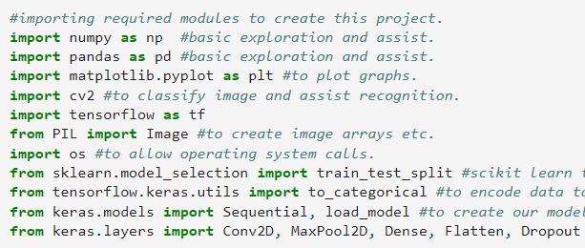
Modules and Libraries
5
NumPy and Pandas
Matplotlib
CV2.
TensorFlow
PIL
OS
scikit-learn
Keras

Slide 7
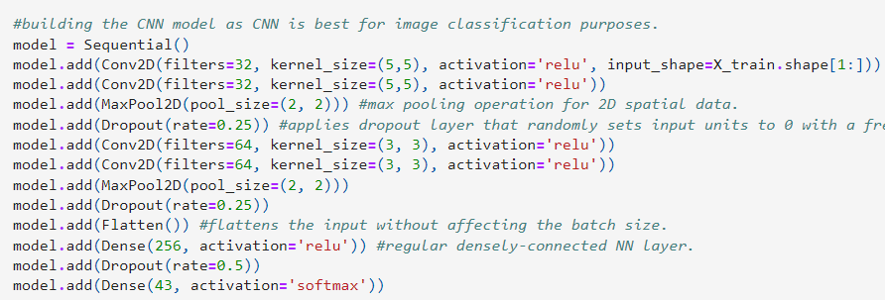
Convolution Neural Network
6
Two 2D convolutional layers
A max pooling layer.
A dropout layer
A flattening layer
A dense layer

Slide 8
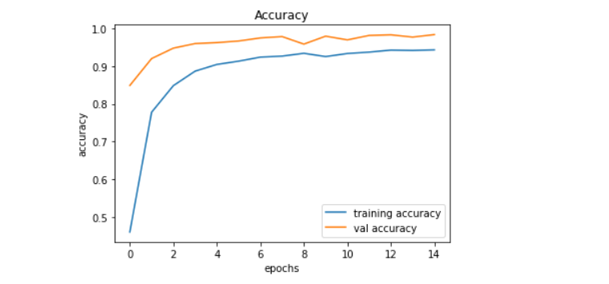
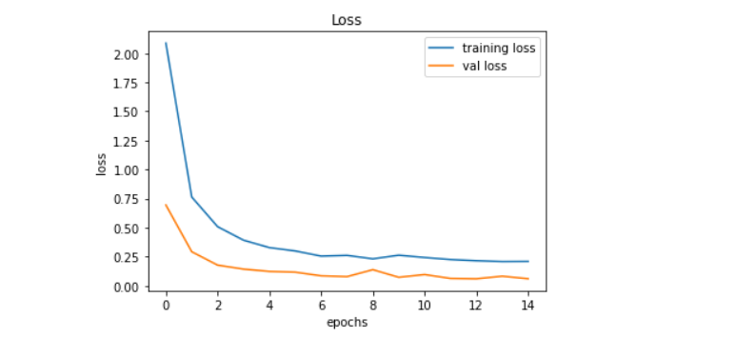
Accuracy and Losses
7

Slide 9
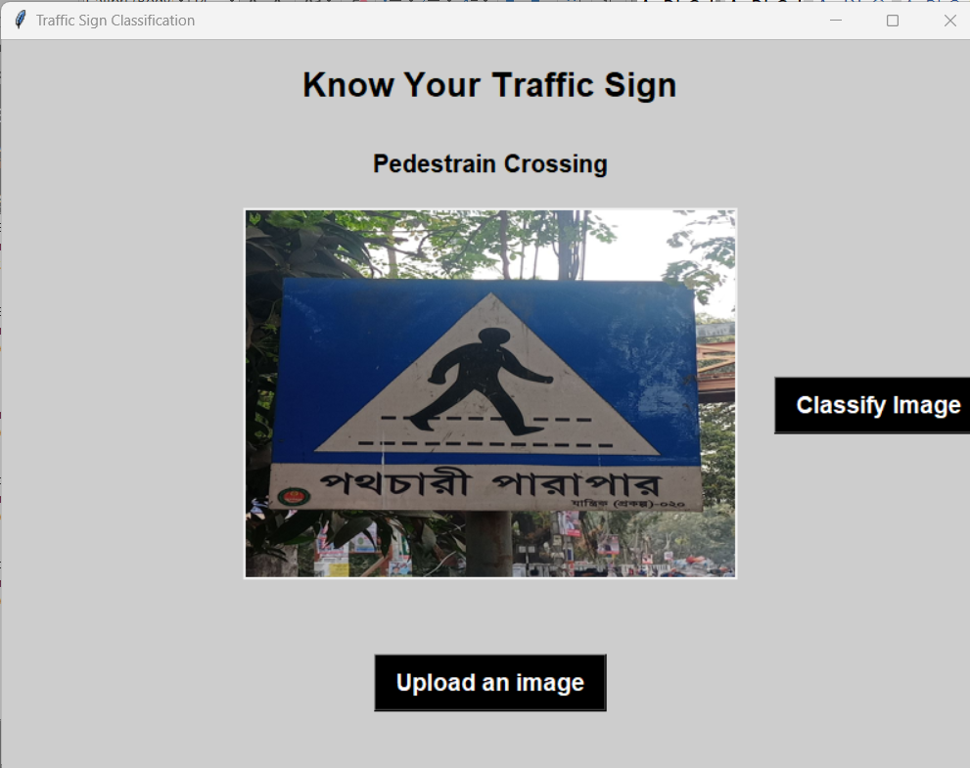
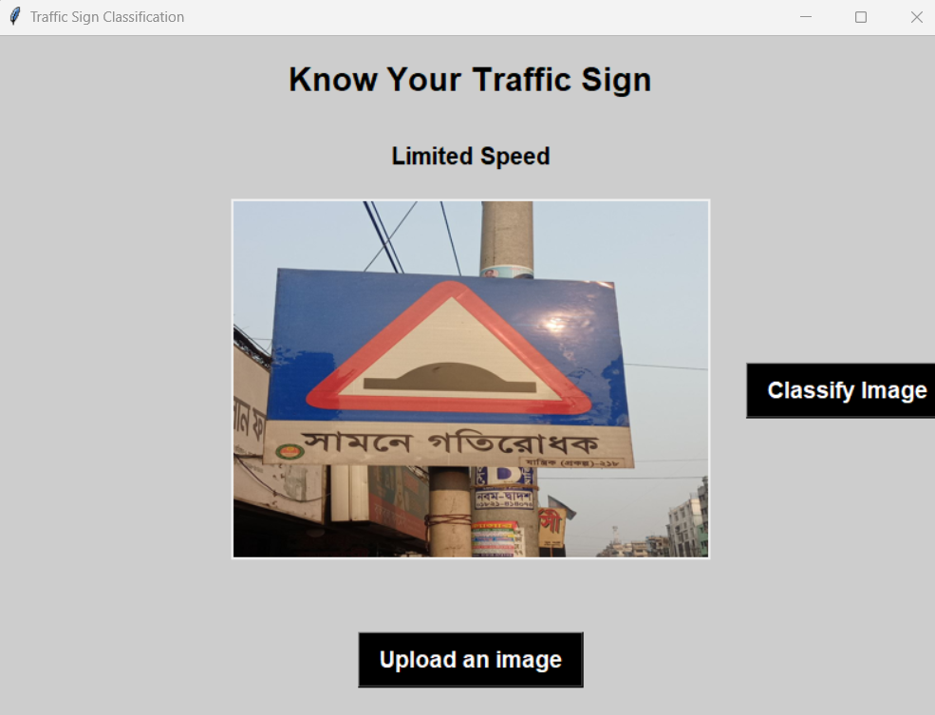
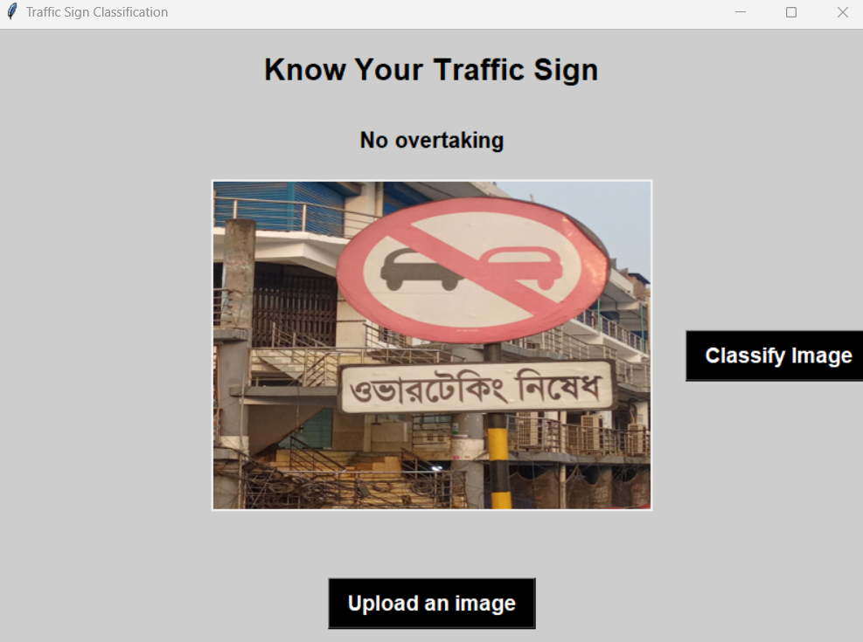
Sample Outputs
8

Slide 10
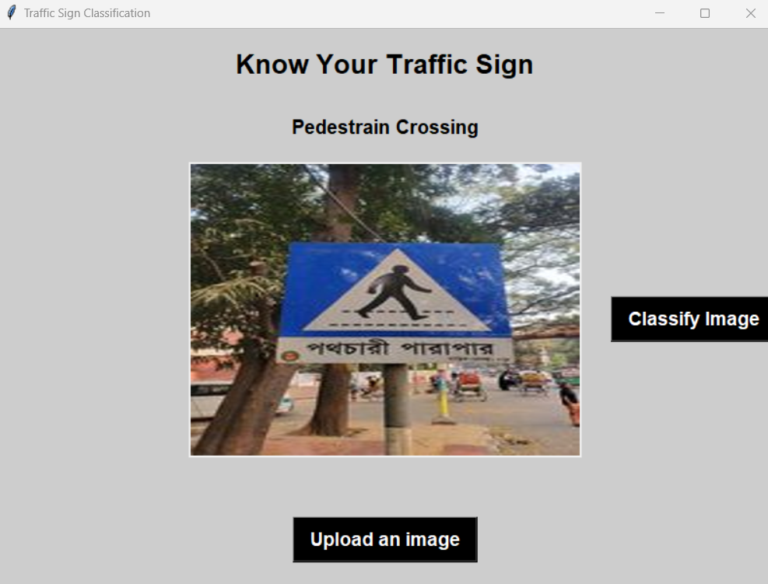
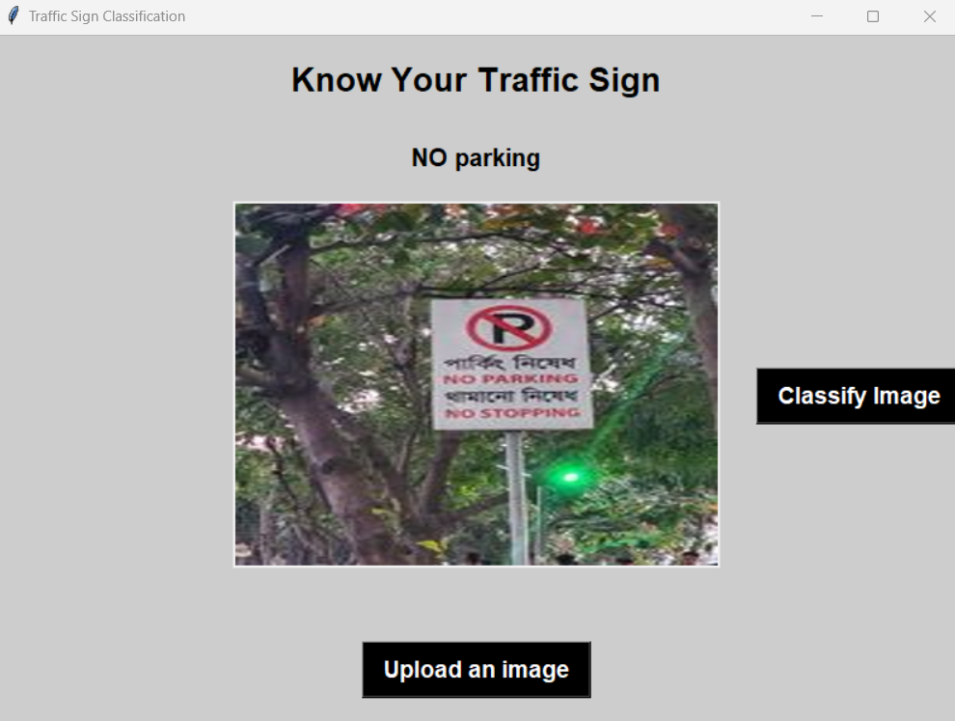
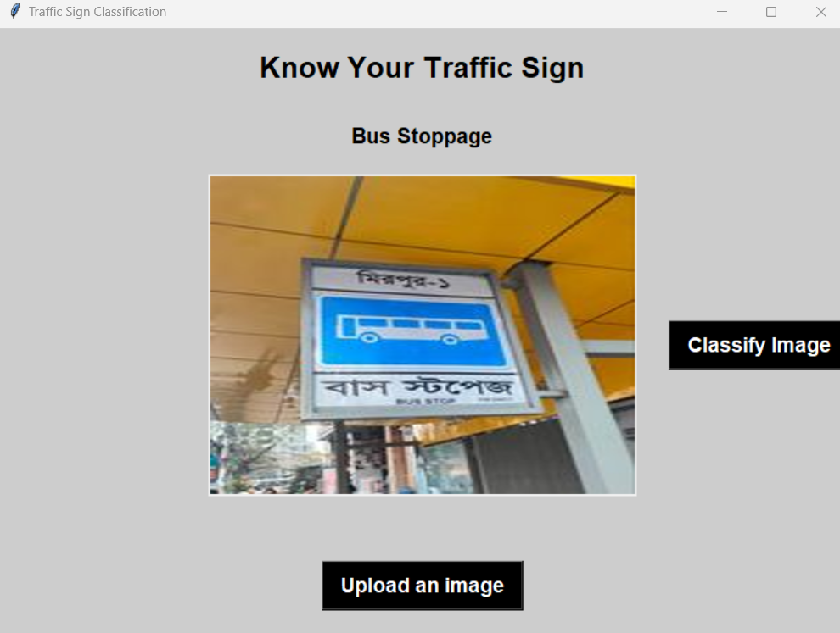
Sample Outputs
9

Slide 11
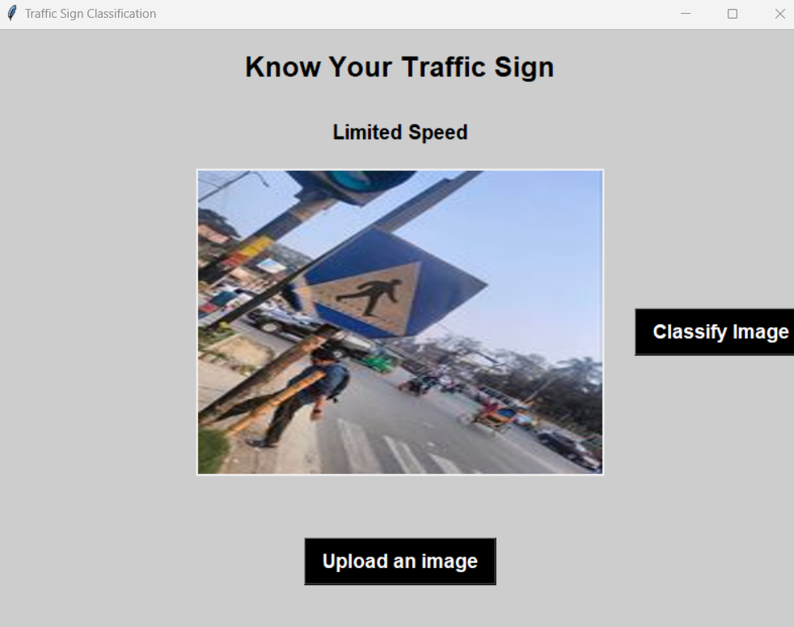
Limitations
10

Slide 12
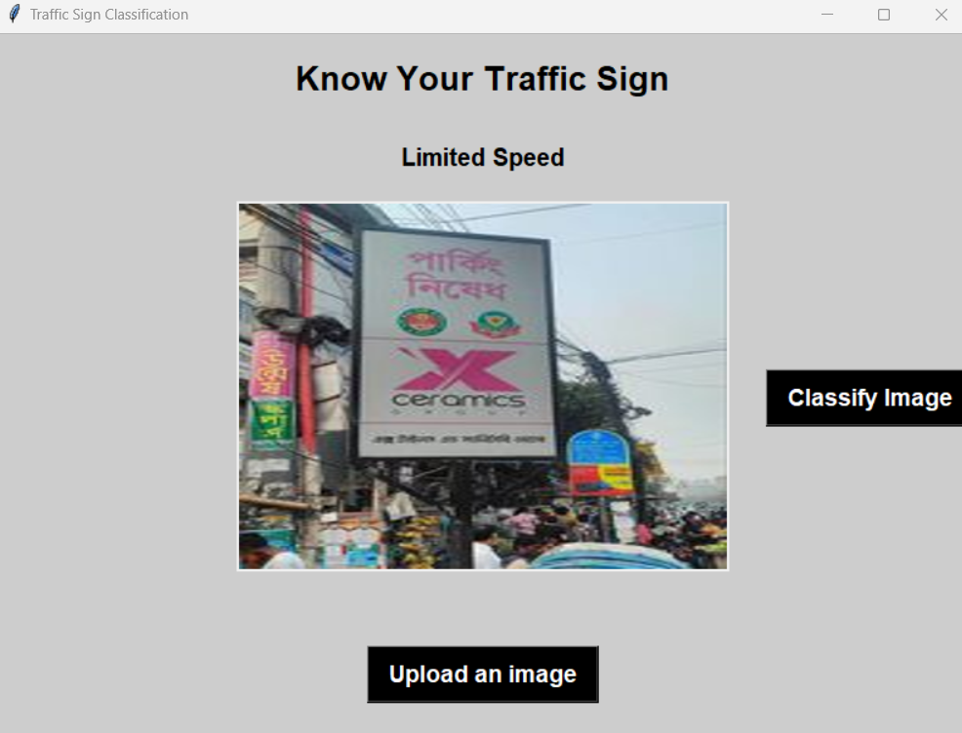
Limitations
11

Slide 13
THANK YOU FOR YOUR ATTENTION
Group Members:
1906135- Md. Hasan Newaz
1906140- Rokon Uddin Mahmud
1906153- Md. Asif Kabir
1906154- Tamim Hasan Bhuiyan
1906155- Shipon Hossain

