Slide 1
Vue.js
Alexandra Beldean

Slide 2
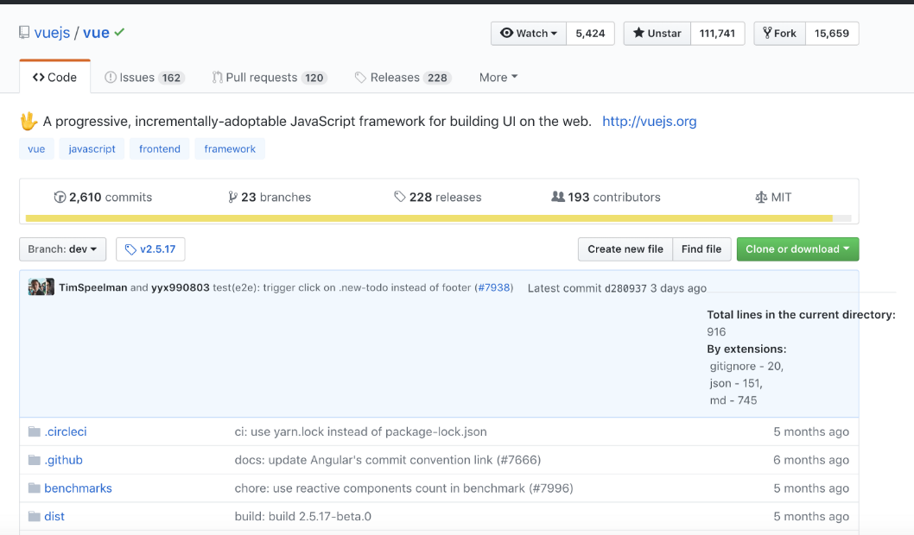
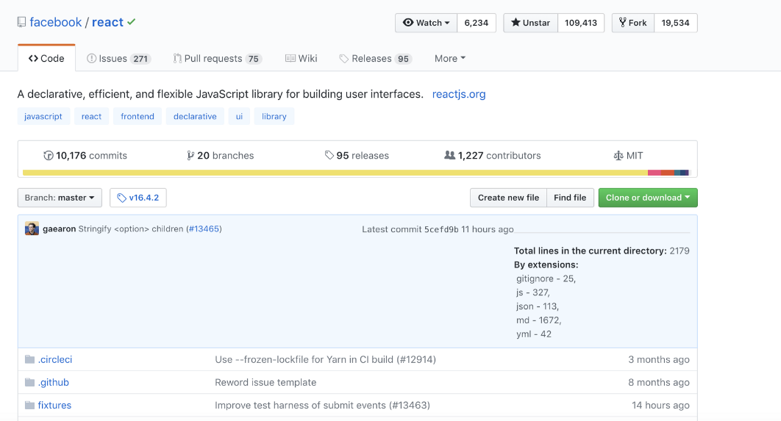
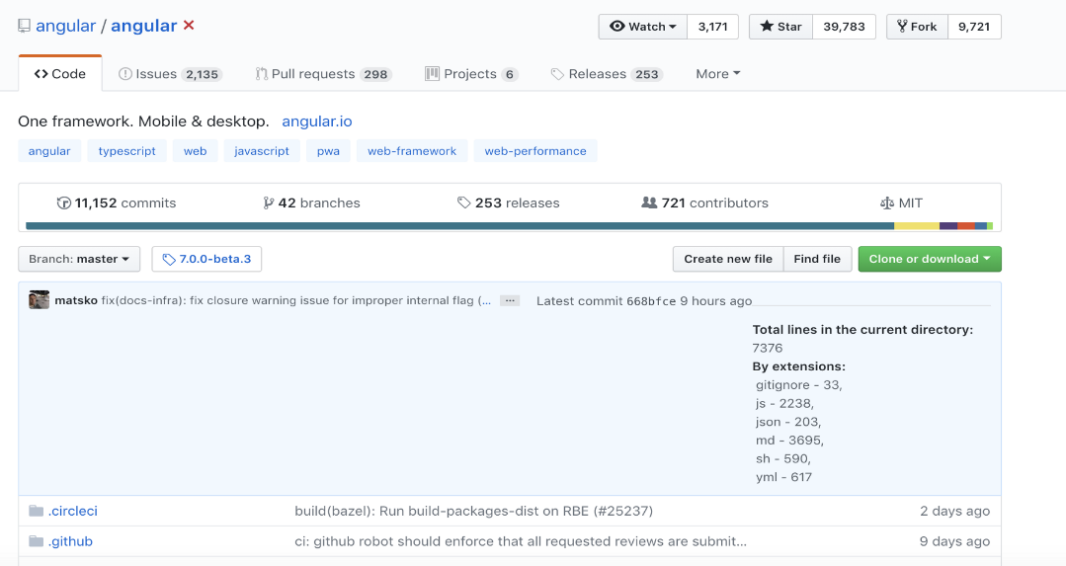
The most popular framework

Slide 3
What’s Vue?
Progressive framework for building user interfaces
Designed to be incrementally adoptable
Easy to integrate with other libraries or existing projects
Perfect for Single-Page application

Slide 4
Why Vue?
Easy to get it up and running
Strong open source community
Slowly migration from a huge application to a SPA
Gets along well with SSR applications like Rails, Laravel or Node

Slide 5
Vue & React
Vue
React
Knows precisely which component has to re-render
Uses templates
Wide variety of templates for various purposes
Unnecessarily re-render of child components
All the components are using JSX within the render function
Offers a single template assuming you develop a SPA
Both use a virtual DOM
Reactive and composable components
Maintain focus in the core library

Slide 6
Vue & Angular2
Vue
Angular2
Full-features Vue app ~30 kb gzipped
Official support with freedom on structuring your own app
Requires only basic skills background of HTML and plain JavaScript
Requires using TypeScript
Out-of-the-box app generated by angular-cli ~ 65 kb gzipped
Targets only complex applications

Slide 7
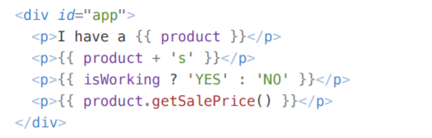
Vue essentials
Expressions

Slide 8
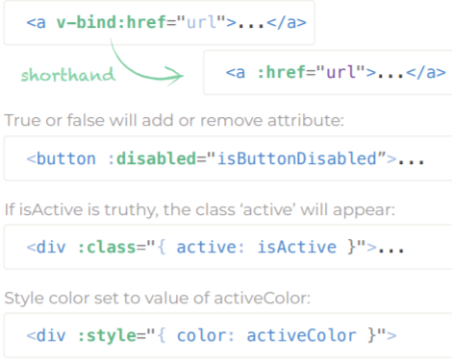
Vue essentials
Binding

Slide 9
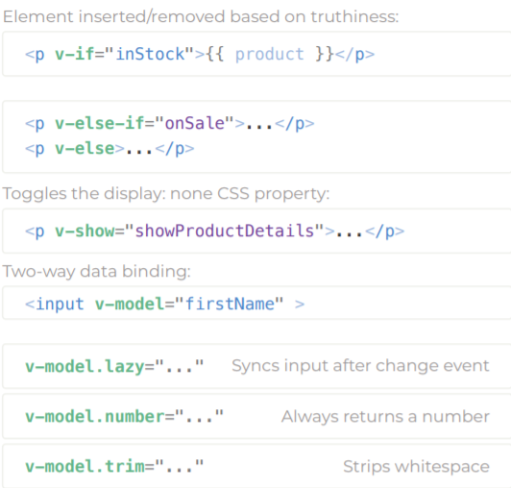
Vue essentials
Directives

Slide 10
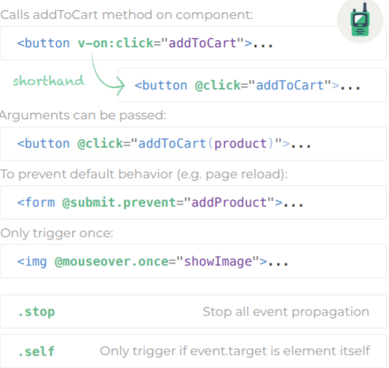
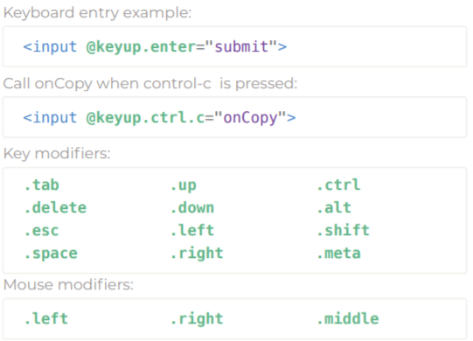
Vue essentials
Actions & events

Slide 11
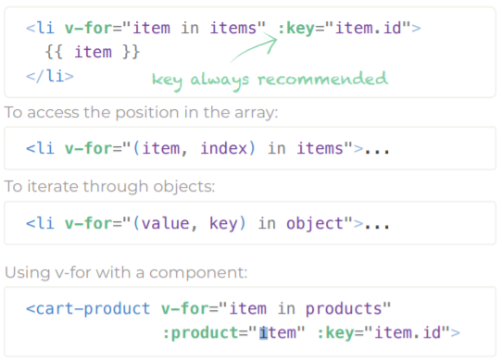
Vue essentials
List rendering

Slide 12
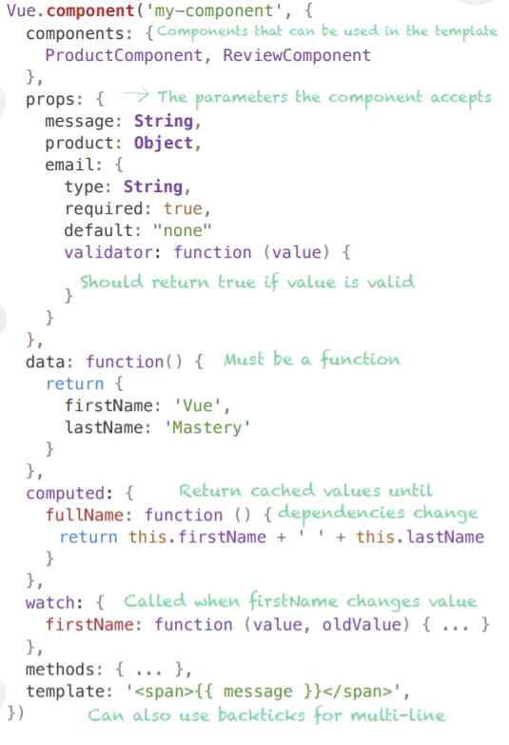
Vue essentials
Component anatomy

Slide 13
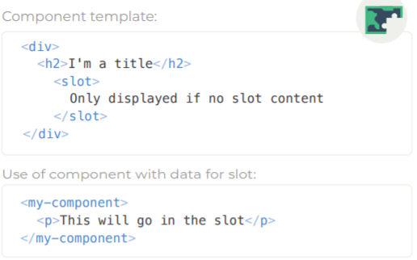
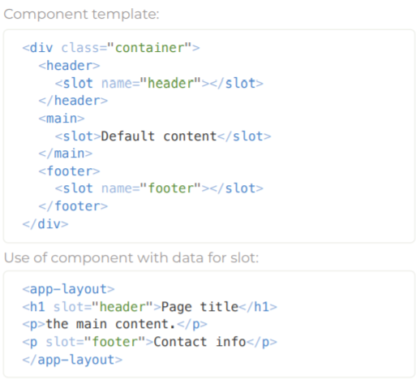
Vue essentials
Single slot
Multiple slots

Slide 14
Lifecycle hooks
beforeCreate
created
beforeMount
mounted
beforeUpdate
updated
beforeDestroy
destroyed

Slide 15
Useful libraries
Vue CLI - Command line interface for rapid Vue development.
Vue Router - Navigation for a Single-Page Application.
Vue DevTools - Browser extension for debugging Vue applications.
Nuxt.js - Library for server side rendering, code-splitting, hot-reloading, static generation and more.

