Slide 1
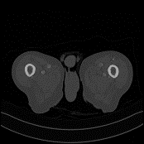

MAResDiff
reverse
…
…
LDCT
forward
NDCT
Conv
Conv
GN
ResBlock
ResBlock
MRBlock
Skip Connections
MRBlock
Timestep embedding
$$\frac{H}{8}×\frac{W}{8}$$
AP
$$\frac{H}{4}×\frac{W}{4}$$
AP
$$\frac{H}{2}×\frac{W}{2}$$
AP
SiLU
x2
ResBlock
ResBlock
(b)ResBlock
MAA
MAA
MAA
MRBlock
MRBlock
$$H×W$$
UP
$$H×W$$
UP
$$H×W$$
UP
ResBlock
ResBlock
MRBlock
MRBlock
Conv
Conv
Conv
MBA
ResBlock
ResBlock
x2
Conv
MRBlock
MRBlock
(d)MBA
ResBlock
MRBlock
ResBlock
(b)MRBlock
Downsample
Upsample
Addition
(a)MR-Net
AP
Average Pooling
UP
Upsample
GN
GroupNorm

Slide 2
Conv
GN
Scale
Timestep embedding
MLP
t
SiLU
Shift
x2

Slide 3


AP
Global Average Pooling
GAB
CAB
Addition
Convolution
(a)MAA
AP
AP
Dilated
Dilated
Conv
Conv
WA
Tanh
FM
Tanh
FM
Tanh
FM
Conv
WA
Dilated
AP
WA
(b)GAB
(c)CAB

Slide 4
AP
AP
AP
Dilated
Dilated
Conv
GAB
CAB
Conv
WA
Tanh
FM
Tanh
FM
Tanh
FM
UP
Conv
WA
Dilated
AP
WA
(a)MAA
UP
Upsample
AP
Global Average Pooling
Addition
(b)GAB
Convolution
(c)CAB

Slide 5
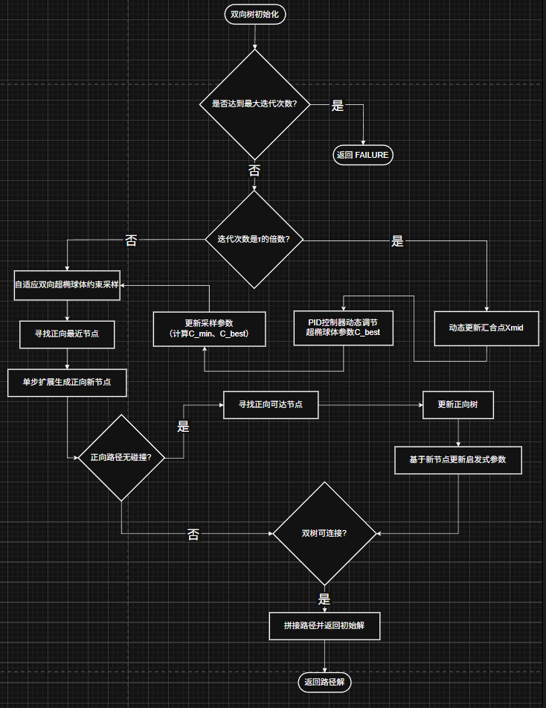

Slide 6
Iter % N == 0?
AP
Dilated
Yes
No
UpdateMeet
return false
Dilated
GAB
CAB
PIDController
PID
Update SSR
UP
ValidateSample
CheckConnect？
PathFound
Yes
Collision?
FM
Downsample
Upsample
Addition
Tanh
CS
Find nearest forward node.
GNN
Generate New Node
EFT
Extend Forward Tree
SSR
Superellipsoid Sampling Region
Conv
FNFN
Find nearest forward node.
GNN
Generate New Node
EFT
Extend Forward Tree
SSR
Superellipsoid Sampling Region
AP
Iter % N == 0?
Iter % N == 0?
Yes
No
Yes
No
UpdateMeet
return false
update_X_{mid}
Bi-SSR-Sampling
PIDController
PIDController
FNFN
Update SSR
Update SSR
GNN
ValidateSample
CheckConnect？
Bi-SSR-Sampling
Collision?
PathFound
Yes
Collision?
No
No
TreeA/B
Connect?

Slide 7
PIDController
Iter % N == 0?
Kp*e(t)
Yes
No
UpdateMeet
return false
K_{i}*∫e(τ)dτ
PIDController
Kd*de(t)/dt
Feedback
Update SSR
Out(PID)
ValidateSample
CheckConnect？
No
Yes
PathFound
Yes
Collision?
No
(b)PID工作流程图
(a)自适应双向超椭球体工作流程图

Slide 8
Iter % N == 0?
Kp*e(t)
SP
Yes
No
K_{i}*∫e(τ)dτ
UpdateMeet
return false
Kd*de(t)/dt
PID
ADCS
PIDController
Feedback
PF
Update SSR
Out(PID)
ValidateSample
Check
Connect？
No
Connect
Yes
(B)SC-RRT
No
Yes
Collision?
(A)PID
(C)ADCS
ADCS
Adaptive Dual-Ellipsoid Constrained Sampling
SP
Start Path Planing
PF
Path Founded
Addition
Judgement

Slide 9
Iter % N == 0?
PE
SP
Yes
No
FR
UpdateMeet
return false
IS
SSFOR
ADCS
Update SSR
Feedback
ValidateSample
Greedy Connect
PF
Out(x)
No
Yes
No
Path
Collision?
Check Connect
(B)SC-RRT
Yes
(A)SSFOR
ADCS
Adaptive Dual-Ellipsoid Constrained Sampling
(C)ADCS
SSFOR
Search State Feedback-based Online Regulation
PE
Parameter Estimation
FR
Feedback Regulation
IS
Informed Sampling
SP
Start Path Planing
PF
Path Founded
Addition
Judgement

Slide 10
PE
FR
IS
Feedback
Out(x)
(A)SSFOR
PE
Parameter Estimation
FR
Feedback Regulation
IS
Informed Sampling
SSFOR
Search State Feedback-based Online Regulation

Slide 11
Iter % N == 0?
Yes
No
UpdateMeet
return false
Update SSR
ValidateSample
Greedy Connect
No
Yes
No
Path
Collision?
Check Connect
Yes
SSR
Superellipsoid Sampling Region
ADCS
Adaptive Dual-Ellipsoid Constrained Sampling

Slide 12
穴位识别

Slide 13
输入RGB图+部位码
全身姿态+脐点
部位路由
No
输入
姿态合格？
输出
2D穴位像素列表
全身姿态+
膝模
背部
膝部
脐部
提取肩/髋/颈/脐
Yes
输出
Yes
算寸:像素/寸
寸*1.28
全身姿态+颈点
No
裤腰 遮挡？
按JSON骨度分寸规则算穴位
（a）部位路由
（b）总流程

Slide 14
Iter % N == 0?
Kp*e(t)
SP
Yes
No
K_{i}*∫e(τ)dτ
UpdateMeet
return false
Kd*de(t)/dt
PID
ADCS
PIDController
Feedback
PF
Update SSR
Out(PID)
ValidateSample
Check
Connect？
No
Connect
Yes
(B)SC-RRT
No
Yes
Collision?
(A)PID
(C)ADCS
ADCS
Adaptive Dual-Ellipsoid Constrained Sampling
SP
Start Path Planing
PF
Path Founded
Addition
Judgement

Slide 15
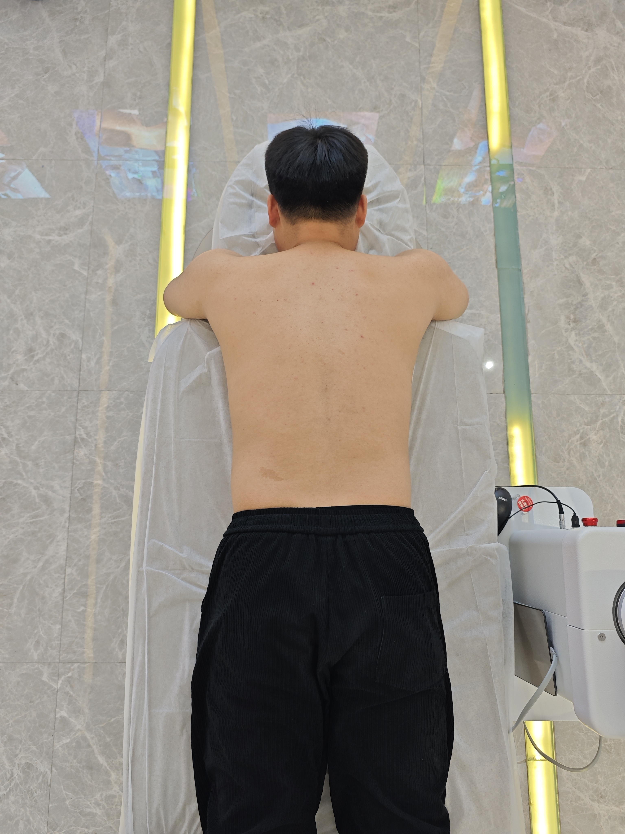
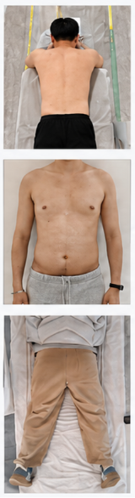
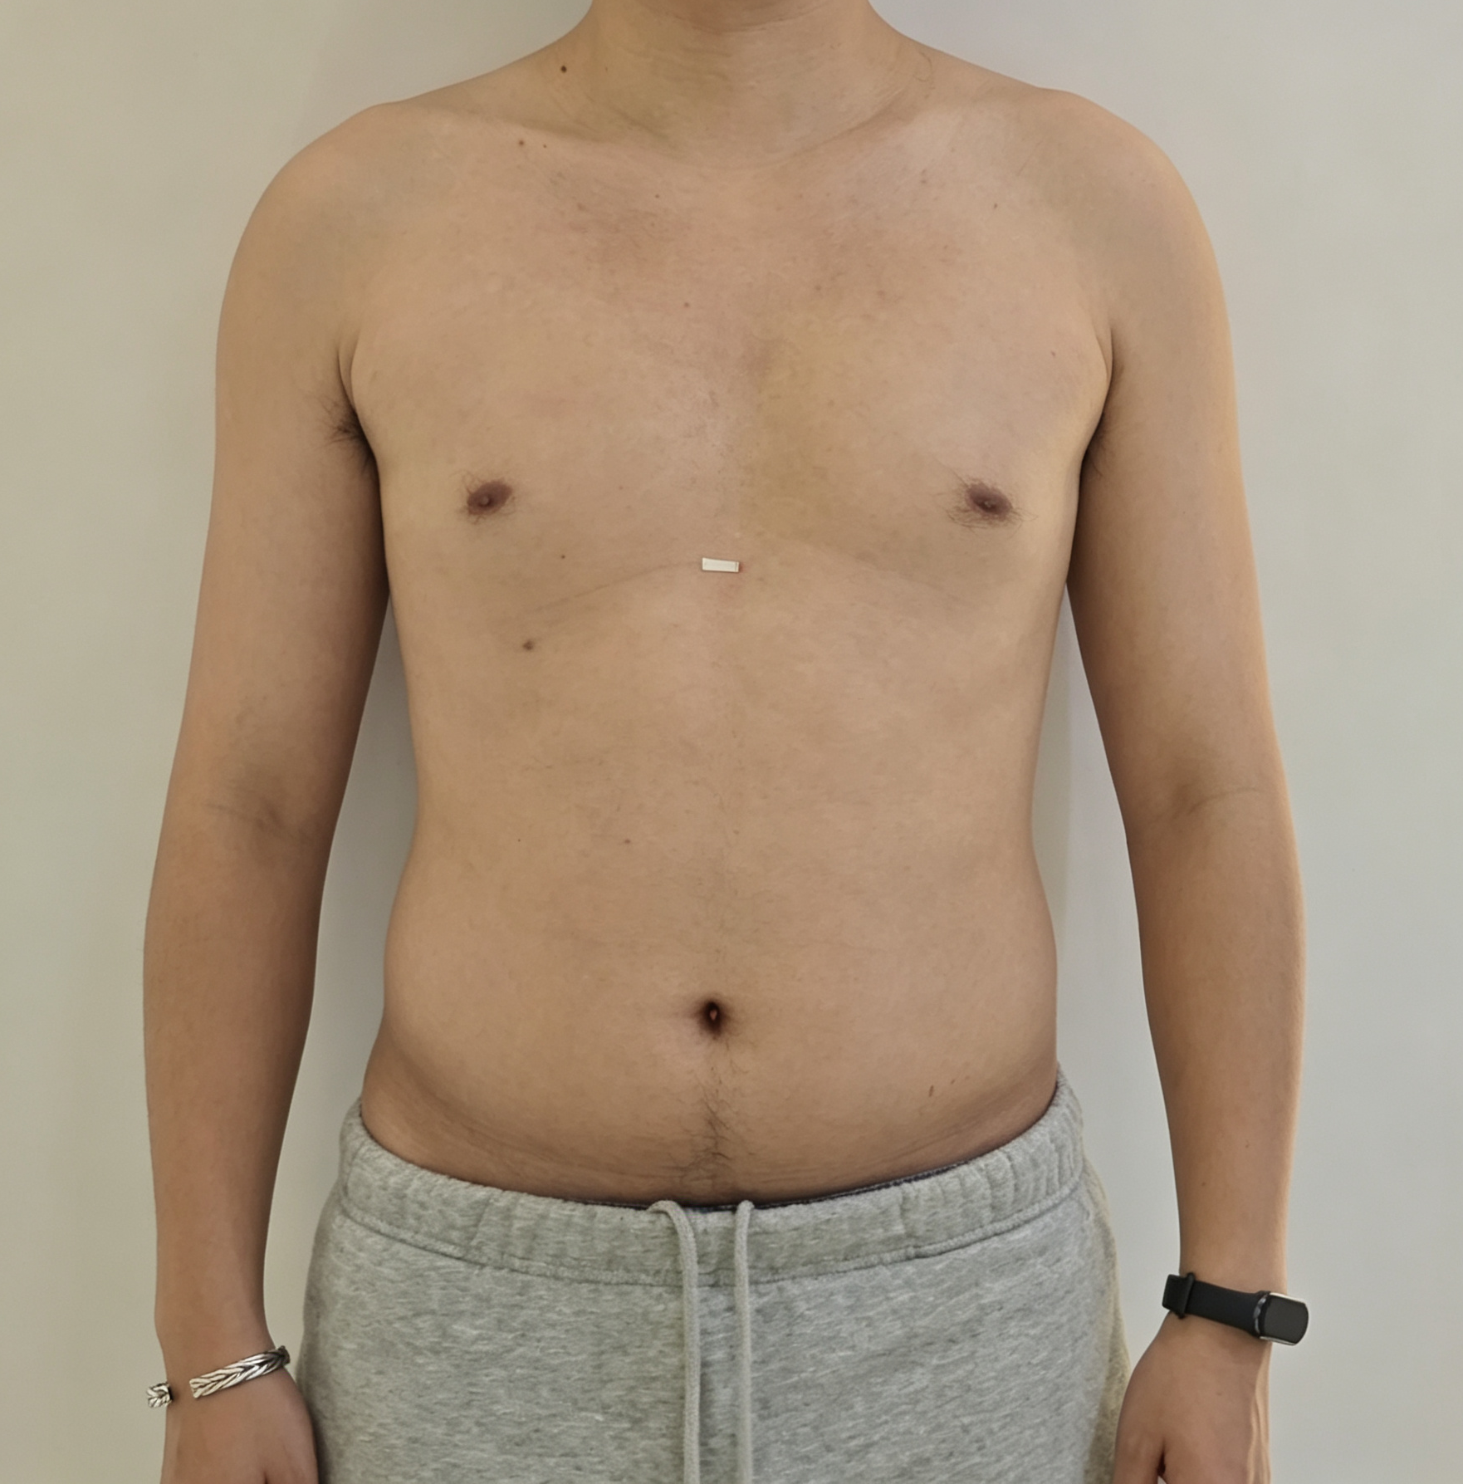
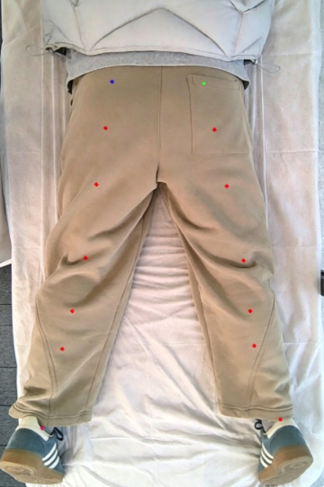
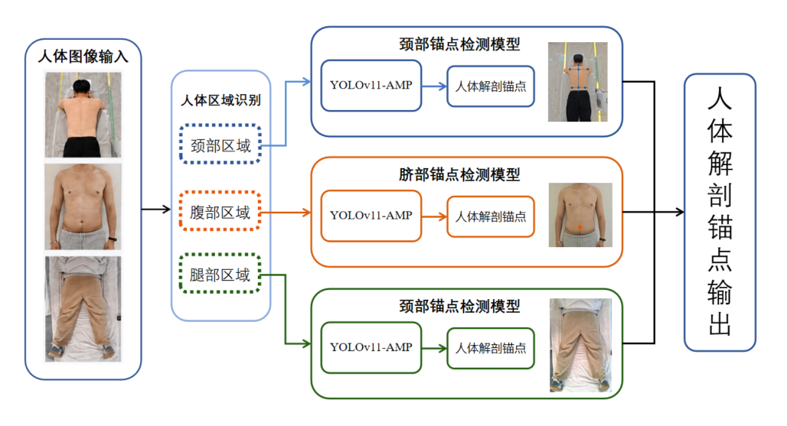
专用锚点检测模型
（Landmark Detectors）
输入
输出
人体图像
Neck
YOLOv11-AMP
人体解剖锚点
人
体
解
剖
锚
点
输
出
Body Region Routing
颈部区域
脐部锚点检测模型
YOLOv11-AMP
人体解剖锚点
腹部区域
腿部区域
腿部锚点检测模型
YOLOv11-AMP
人体解剖锚点
...

Slide 16
输入
YOLOv11-AMP
输出
人体图像
Body Region Routing
颈部区域
锚点输出
腹部区域
腿部区域
...

Slide 17
专用锚点检测模型
（Landmark Detectors）
输入
输出
Neck
人体图像
人
体
解
剖
锚
点
输
出
Body Region Routing
颈部区域
Abdomen
腹部区域
腿部区域
Leg
...

