Slide 1


Face recognition system
Realized by:
Eya CHAIBNI & Montaha REBHI
Evaluated by the jury:
Mr. Kacem CHAMMALI President
Mr. Moez BALTI Member
Mrs. Héla CHAIEB Member
Supervised by :
Dr. Afef GUEIDI
Mr. Rabii MALLEK

Slide 2


A face recognition system integrating mobile and web applications, enhancing suspect identification
Notes:
Polisee is a face recognition system designed to assist policemen in efficiently identifying and capturing suspects. The system detects and recognizes faces.
When a match occurs, policemen receive immediate notifications. Polisee also has a website where they can keep all the information organized.

Slide 3
Conclusion
Introduction
Implementation
Proposed system
Presentation plan

Slide 4






Rapid results
Identify suspects
Efficiency
Safety
Introduction
Notes:
advg : Polisee is designed to make it easier for policemen to identify suspects faster, work efficiently, and keep our communities safe.

Slide 5



Limited information
Crowded places
Suspect mobility
Introduction
Notes:
Limited information/ resources: Police officers may have limited or incomplete information about the suspect's appearance or identity. This lack of information can make locating and identifying the suspect in a crowded public place difficult.
Crowded places/crowd management difficulties: It can be difficult to spot a suspect in densely populated areas because of chaos and crowding. When there are many people gathered together in one place, it can make it difficult for a police officer to see clearly, move around easily, and it can also help suspects hide or run away without being noticed.
Suspect mobility: Suspects can move quickly in public areas, especially if they know the police are after them. They might run which makes it difficult for officers to catch them.

Slide 6
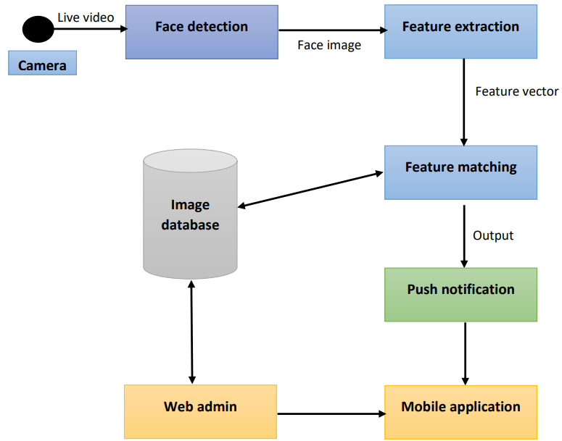
Solution
Notes:
Our solution is to develop a face recognition system using AI technology implemented with a mobile application.
1. The camera: The system starts with a body camera worn by a police officer. The camera captures live video feeds and images of individuals.
2. Face Detection: The captured video feed is processed using AI-based face detection algorithms. These algorithms analyze video frames and identify faces.
3. Face Recognition: Once faces are detected, the system applies AI-powered face recognition models to compare the captured faces with a pre-existing database of suspects.
4. Suspect Match: If a face in the captured footage matches a suspect in the database, it is considered a positive match.
5. Alert Generation: The system generates an alert in real-time, containing relevant details about the identified suspect. This alert is sent as a notification to the mobile application.

Slide 7




Database
Implementation
Face Recognition
Mobile/ Web applications

Slide 8


Data Base
Resizing the face size
Face processing
Design
Implementation
Convert the color format
Notes:
Resizing the face regions to a fixed size required by the face recognition model, such as 160x160 pixels. • Converting the color format of the face regions from BGR (Blue-Green-Red) to RGB (Red-Green-Blue) format, as FaceNet typically expects RGB images.

Slide 9



Face Recognition
Face Detection
DNN pre-trained model
Face Processing
Feature Extraction
FaceNet pre-trained model
Design
Implementation
Euclidean Similarity
Face Matching
Feature Vectors
Database
Notes:
Indexing starts from a multimedia database which is composed of various types of media which are text, image and video. When it comes to natural language text it goes directly to textual indexing. Image, on the other hand, has to go through Image Recognition, There, it gets turned into text and from there it goes to textual indexing. Videos get turned into text with Speech Recognition methods in order for it to be textually indexed. Finally we should mention that unnatural text such as script gets transformed into text in preprocessing in order for it to get to the text indexing stage.

Slide 10
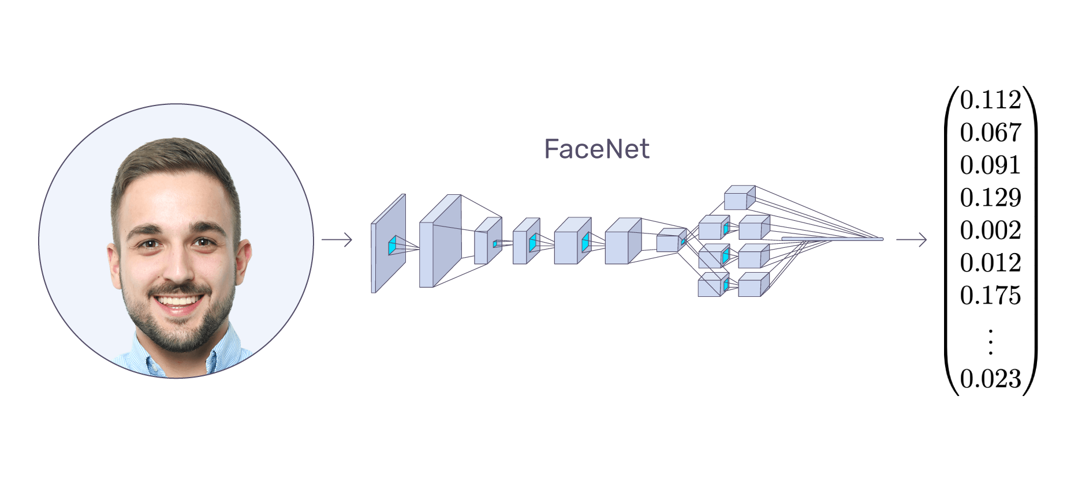

Face Recognition
FaceNet pre-trained model is used for Feature extraction
Design
Implementation
Input Face
128 embeddings
Notes:
Extracting the most important features from an image of the face. FaceNet is a deep neural network used for extracting features from an image of a person’s face. It was published in 2015 by Google researchers Schroff et al. FaceNet takes an image of the person’s face as input and outputs a vector of 128 numbers which represent the most important features of a face. In machine learning, this vector is called embedding. Why embedding? Because all the important information from an image is embedded into this vector. Basically, FaceNet takes a person’s face and compresses it into a vector of 128 numbers. Ideally, embeddings of similar faces are also similar.

Slide 11
Face Recognition
Euclidean distance Similarity
Measure of similarity between
A detected face vector and every face vector in the data base
Design
d<0.6
Implementation
Suspect name
Unknown
Notes:
Euclidean distance is used to compare between two vectors . The minimum distance index is determined to find the closest match. If the minimum distance is below a threshold (0.6 in this case), the recognized face is assigned the corresponding name from the suspect-face-names list. Otherwise, it is labeled as ”Unknown”

Slide 12




User
Implementation
Frontend
Backend
Database
Flutter Framework
Angular Framework
Node.js
MongoDB
GUI
Storage Facility

Slide 13
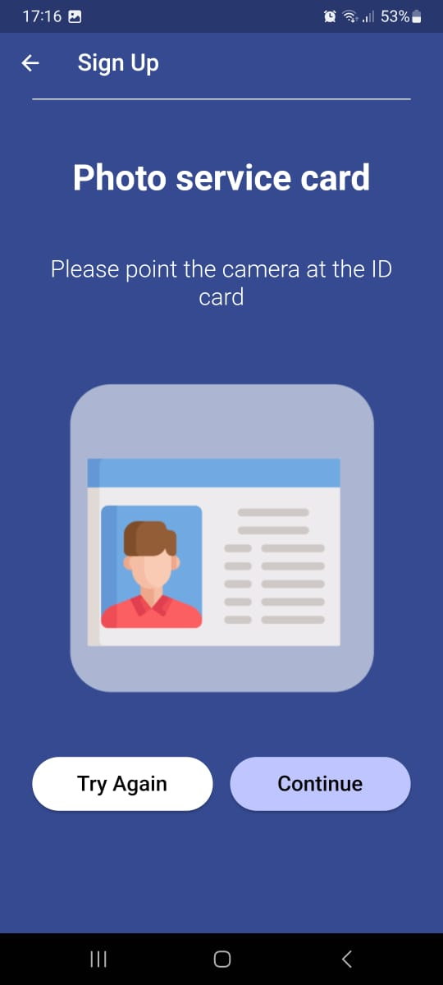
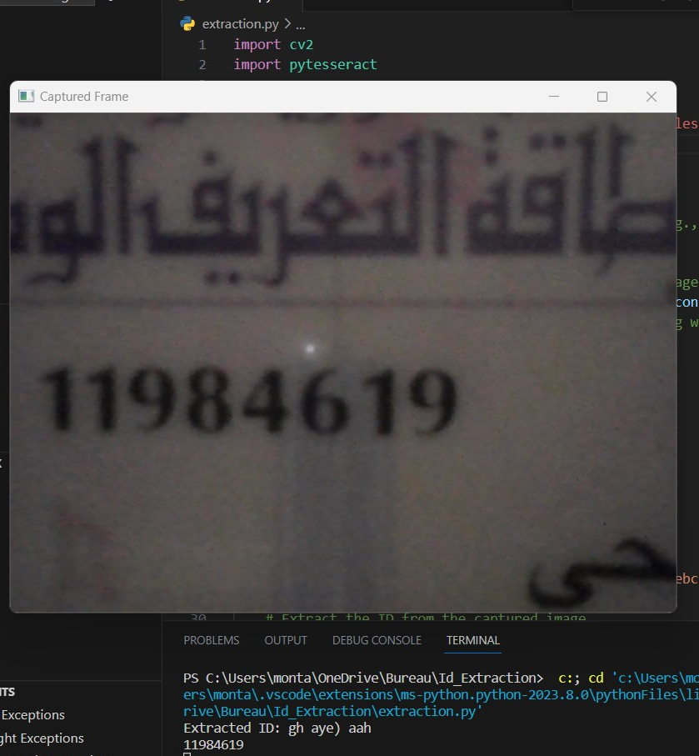
Design
Implementation

Slide 14
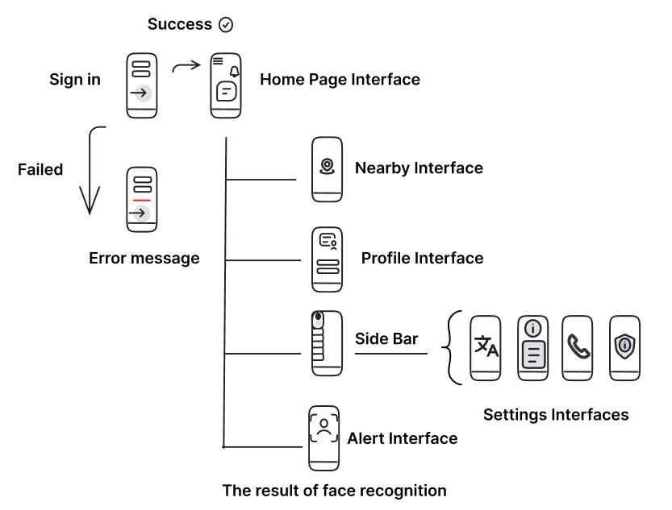
Design
Implementation

Slide 15
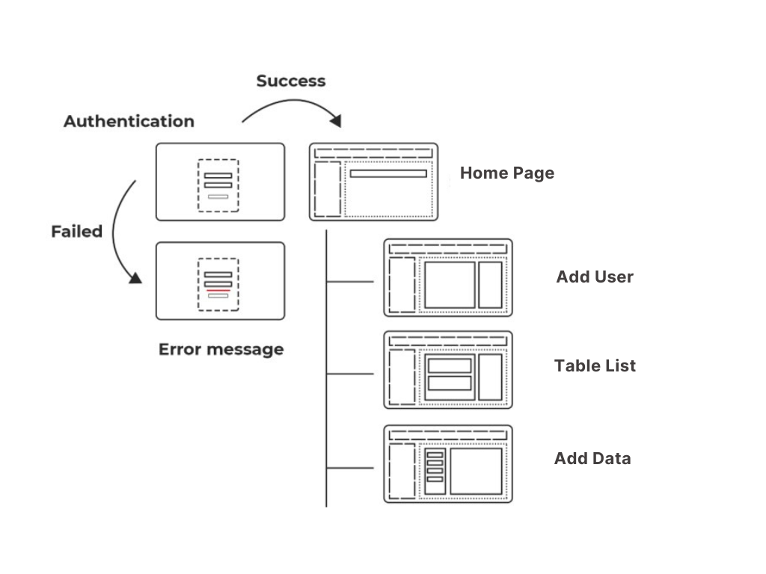
Design
Implementation

Slide 16




Larger Dataset
.
Body Camera
Conclusion
Long Disatances
.
Alert generation
.
Notes:
To conclude,

Slide 17
THANK YOU FOR YOUR ATTENTION

