Slide 1
PhD Progress Review
Summer, 2022
Michael F. Marchini
Electrical and Computer Engineering Department
Villanova University
Villanova, Pennsylvania, USA, 19085
ORCID: 0000-0001-5594-9756
https://github.com/lmco/ChaordicLedger

Slide 2






Recap of the Problem Space
Development of large-scale systems.
Numerous dependencies, multiple disparate organizations.
Multiple constraints.
Contractual stipulations, customer requirements.
Stakeholder expectations.
Compliance / regulatory issues.
Contract Awarding
Development
Operations
Maintenance

Slide 3
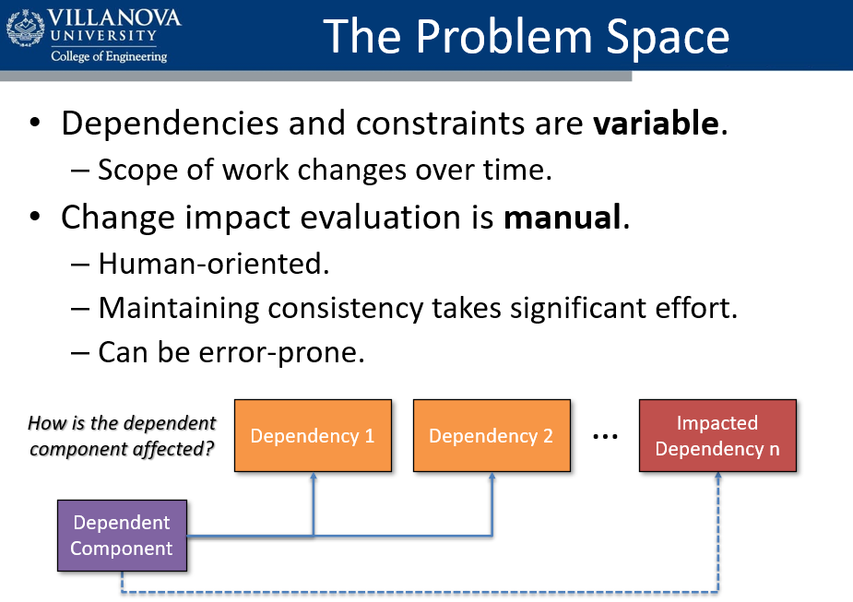
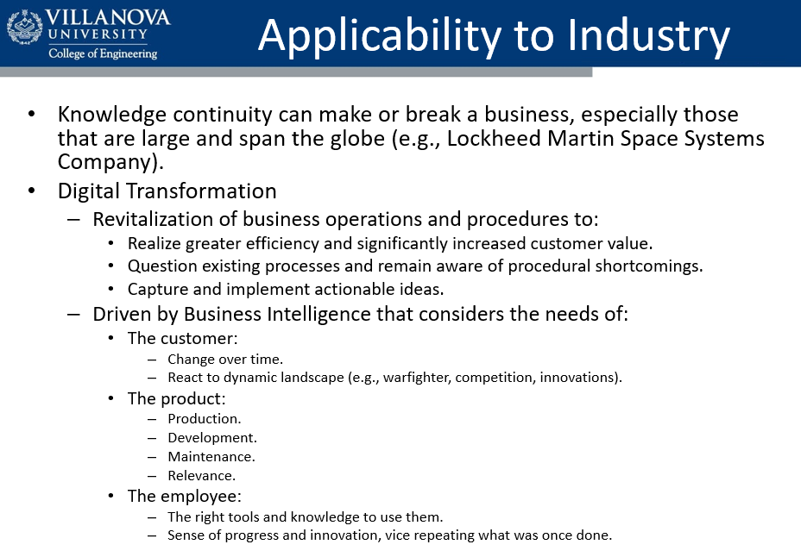
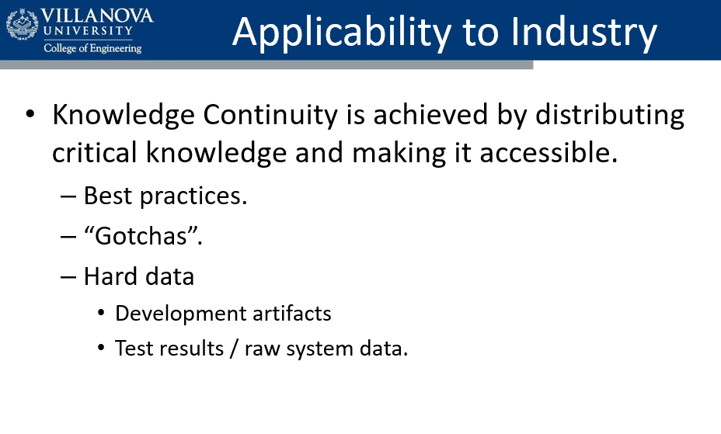
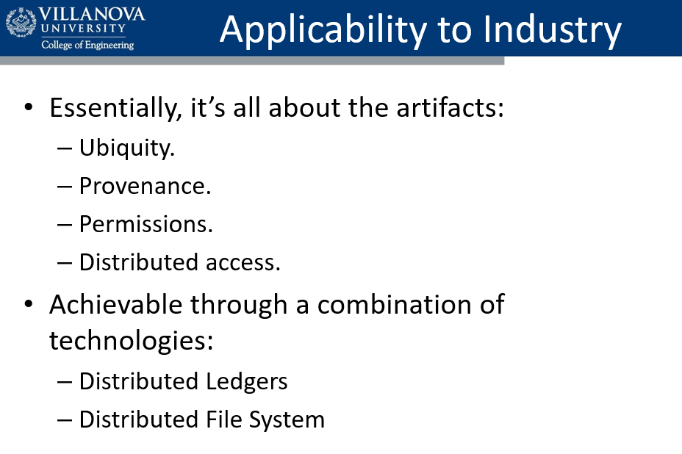
Recap of the Problem Space

Slide 4
Literature Review – Knowledge Transfer
S. Saito, Y. Iimura, A. Massey, A. Antón, “How Much Undocumented Knowledge is there in Agile Software Development?: Case Study on Industrial Project Using Issue Tracking System and Version Control System”, 2017 IEEE 25th International Requirements Engineering Conference
Discusses the importance of knowledge connectivity between software users, requirements engineers, and software engineers.
“When an agile team tries to introduce and apply knowledge management, overcoming cultural and psychological barriers is important.”
Discipline is required for useful results (garbage in, garbage out).
Indicates visualization in an approachable form is useful for all participants (e.g. 3-D City metaphor).
Analysis:
As with other cases of systems engineering, the system will fail at its interfaces, which in this case is how changes relate to requirements.
Undocumented knowledge is costly, often requiring subjective ‘guesstimates’ or arduous, manual traceability review.
Industry Need: Requirement to Artifact Traceability
https://ieeexplore-ieee-org.ezp1.villanova.edu/stamp/stamp.jsp?tp=&arnumber=8048905

Slide 5
Literature Review – Knowledge Transfer
P. Chantamit-O-Pas, “Knowledge Acquisition, Representation and Transfer in the Metamodel for Software Development Methodologies”, 2019 11th International Conference on Information Technology and Electrical Engineering (ICITEE), Pattaya, Thailand
Discusses the importance of knowledge management for organizations.
“Knowledge is a fluid mix of framed experience, values, contextual information, and expert insight that provides a framework for evaluating and incorporating new experiences and information.”
Indicates existing process models may not represent all knowledge.
Discusses how development can be hindered by ambiguity, misunderstanding, and differing domain skills.
Analysis:
A maintained knowledgebase of consistent interrelationships enables knowledge transfer throughout the organization.
Industry Need: Approachable self-governed knowledgebase.
https://ieeexplore-ieee-org.ezp1.villanova.edu/stamp/stamp.jsp?tp=&arnumber=8929942

Slide 6
Literature Review – Reuse and Traceability
C. Tinnes, A. Biesdorf, U. Hohenstein, F. Matthes, “Ideas on Improving Software Artifact Reuse via Traceability and Self-Awareness”, 2019 IEEE/ACM 10th International Symposium on Software and Systems Traceability (SST)
Discusses the need for and barriers to reuse and traceability.
Indicates traceability tools like TraceLab are
“rarely capable of being integrated into existing day-to-day activities”
“most tools are provided for research purposes and not for industrial application”
Discusses a gap in natural language processing and lexicon differences between domain.
Analysis:
A platform that puts artifact relationships first allows for both the fact-of a relationship but its ontological dynamics.
Can mitigate lexical and language processing issues.
Industry Need: Traceability with Context
https://dl-acm-org.ezp1.villanova.edu/doi/pdf/10.1109/SST.2019.00013

Slide 7
Research Contributions
It is indeed possible to combine the features of DLT and IPFS into a cohesive platform, though significant effort was necessary.
The Proof-of-Concept demonstrates:
Use of open standards and FOSS.
Flexibility in API capability and regenerative extensibility.
Sub-second execution of API operations.
Ability to handle large batches of information.
Low resource usage.
Approachability in creating new chaincode.
Meets industrial needs for knowledge transfer, traceability, and context.

Slide 8
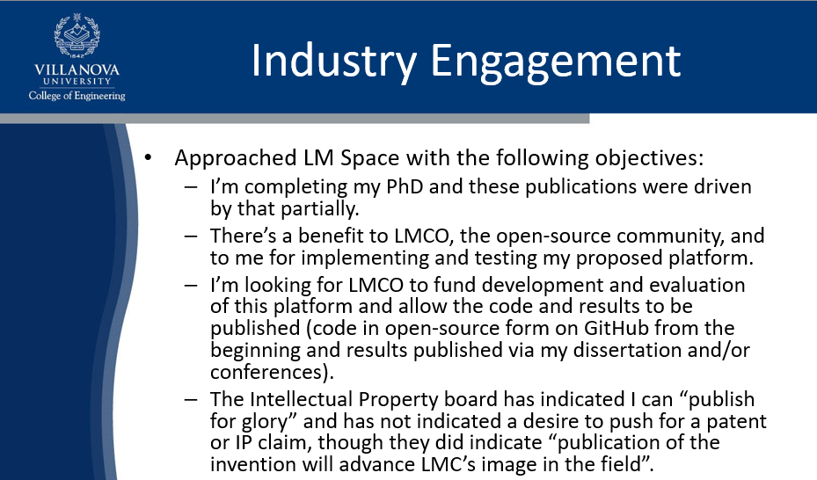
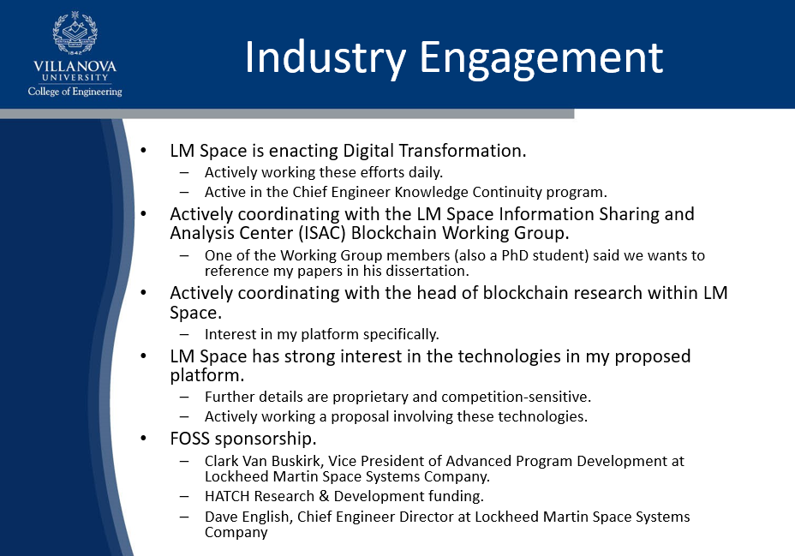
Recap of Industry Engagement
Many thanks to Lockheed Martin for sponsoring the implementation of this Proof-of-Concept!

Slide 9
Publications
“Distributed Ledgers in Developing Large-Scale Integrated Systems”
Presented at 2021 IEEE SysCon
https://ieeexplore.ieee.org/document/9447136
“ChaordicLedger: Digital Transformation and Business Intelligence via Data Provenance and Ubiquity”
Presented at 2022 IEEE SysCon
https://ieeexplore.ieee.org/document/9773812

Slide 10
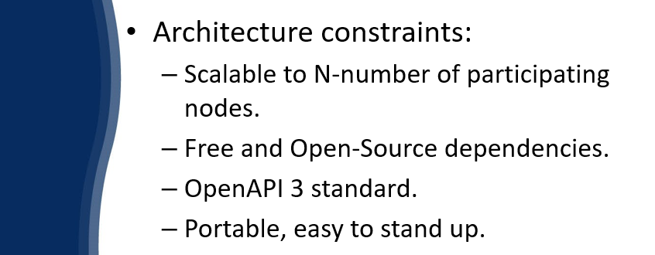
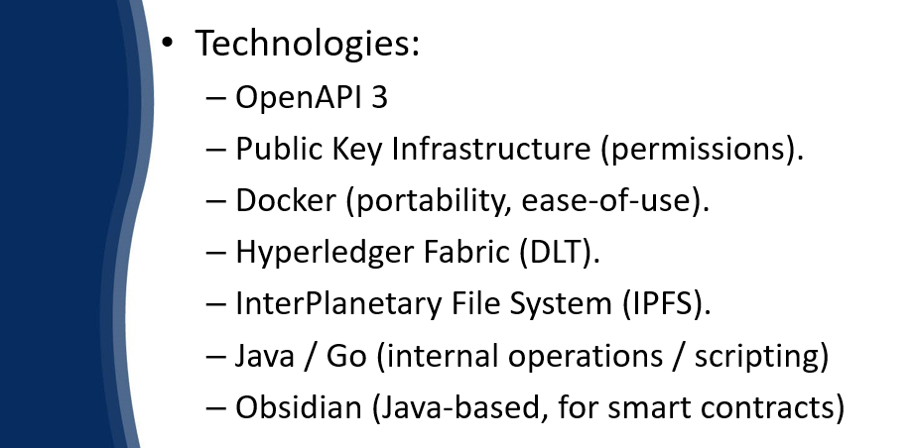
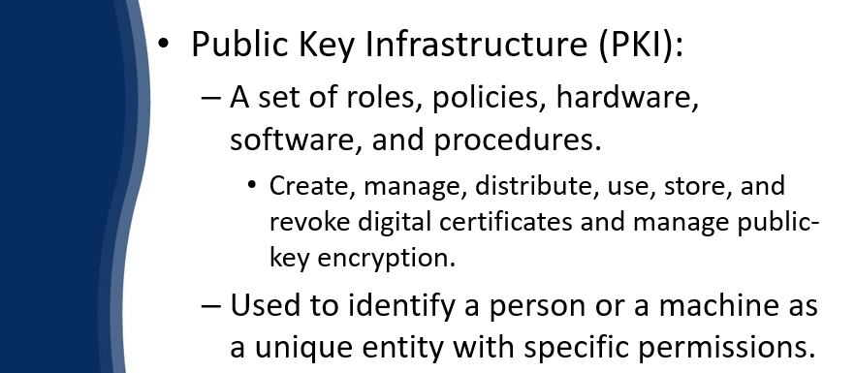
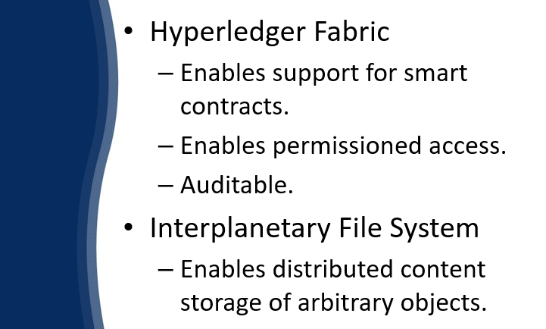






Recap of Implementation

Slide 11
Recap of Design
Read requests are handled by IPFS.
Write requests are handled by HLF’s smart contracts.
Ledger world state is kept synchronized.
File system state is kept synchronized.
API / HMI
Network
Physical Host 1
Physical Host 2
Docker Container on Peer
Docker Container on Peer
…
Other
Hosts
Hyperledger Fabric
Hyperledger Fabric
IPFS
IPFS
Legend
Read/Write
Read
Write

Slide 12
Proof-of-Concept
Read requests are handled by IPFS.
Write requests are handled by HLF’s smart contracts.
Ledger world state is kept synchronized.
File system state is kept synchronized.
Chaincode handles the introduction of files and their relationships.
API returns provide execution duration for operations.
Dashboards provide a view into system behavior over time and resource utilization.
Log aggregation enables behavioral verification and validation.
Metrics Dashboard
REST API
System Dashboard
Physical Host
Docker Container on Peer
Hyperledger Fabric
IPFS
Legend
Read/Write
Read
Write

Slide 13
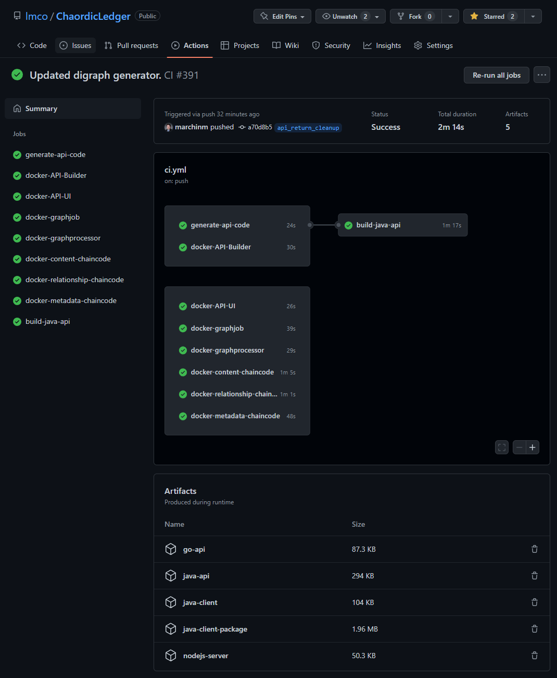
Build Pipeline
The build pipeline is executed on every code push to GitHub, generating Docker images and supporting packages.
Captured from https://github.com/lmco/ChaordicLedger/actions/runs/2589837045

Slide 14
Original Plan for Simulations
Consistent sets of artifacts
Small / Medium / Large batches
Documents
Text data
Binary Data
Scenarios:
Small team (3 participants).
Medium team (25 participants).
Large team (50 participants).
Analysis:
Time to store/retrieve/replace artifact.
CPU, RAM, and disk usage per node.

Slide 15
Developed Simulations
Note: 1 KiB = 1024 Bytes
# | Scenario | Artifact Count | Size | Contents
1 | Create Artifact | 1 | Small | Generated a 1 KiB binary file
2 | Create and Relate Artifacts | 10 | Small | Generated binary files (1 KiB each)
3 | Create and Relate Artifacts | 20 | Small | Generated binary files (1 KiB each)
4 | Create and Relate Artifacts | 200 | Small | ASCII Text and Binary files (varying sizes <= 25 KiB)
5 | Industrial – GPS | 8 | Small | ASCII Text and Binary files (varying sizes <= 25 KiB)

Slide 16
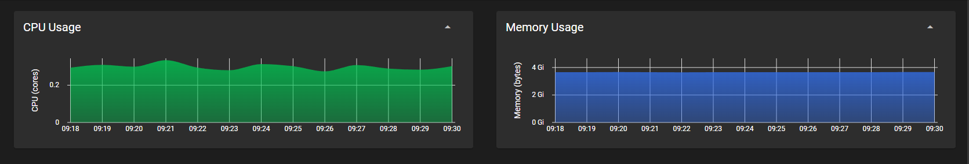
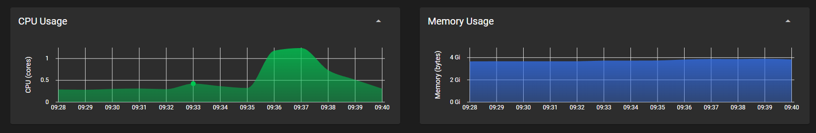
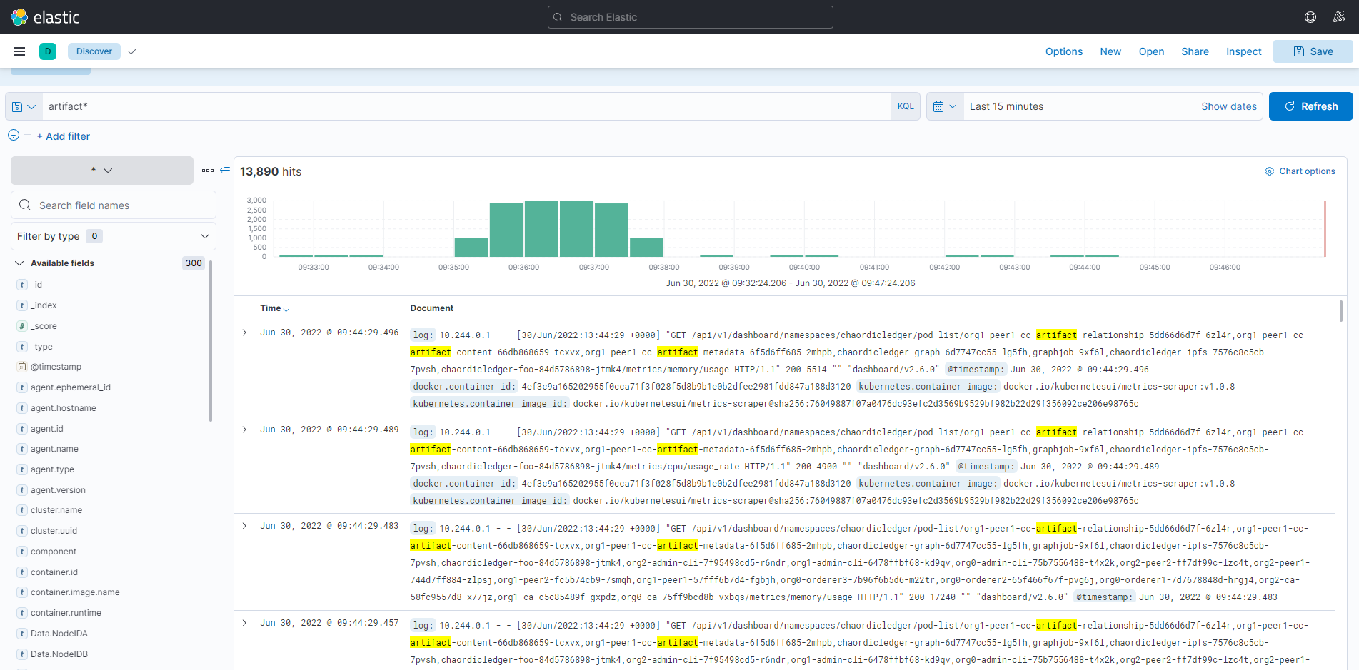
Scenario 3 – Twenty Related Artifacts
Initial
Steady-State
Post-Execution
Steady-State
Memory use across the cluster remained flat.
CPU usage increased to 1.3 cores during test execution, and settled back to nominal.
Aggregated Logs show operations across the cluster.

Slide 17
Research Contribution
Provides TRL 4 proof-of-concept to meet industry needs.
Demonstrates a fusion of Distributed Ledgers and Distributed File Systems in a zero-trust context.
Demonstrates the foundation of contextual knowledge transfer and objective impact analysis.
Demonstrates 100% use of Free and Open Source Software (FOSS).
No vendor-lock and no vendor-exclusion.
Portable, flexible.
Provides code that is freely accessible to the software community.
Demo: cl_demo_annotated.mp4

Slide 18
Academic Status
PhD Candidacy form submitted.
Prospective Graduate form to be submitted at the start of Fall 2022.
48 of 48 credits complete.
Dissertation outline written.
Seeking approval to proceed.

Slide 19
Dissertation Plan
Working Title: “Applicability of Distributed Ledgers and Historical Transparency in Digital Transformation of Modern Industrial Software Development Processes”
1. Introduction
1.1. Motivation
1.2. Literature Review of Distributed Ledger Technology
1.3. Literature Review of Business Intelligence and Software Cost Estimation
1.4. Literature Review of Digital Transformation
1.5. Literature Review of Modern Software Development as Driven by the U.S. Department of Defense
2. Platform Design
2.1. Use Cases
2.2. Functional Requirements
2.3. Non-Functional Requirements
2.4. Features
2.5. Methodology
2.5.1. Containerization
2.5.2. Packaging and Installation
2.5.3. Certificate Authority
3. Platform Implementation
3.1. Core Dependencies
3.2. Trades and Justifications
3.3. Open-Source Contribution
4. Platform Evaluation
4.1. Criteria
4.2. Methodology
4.2.1. Simulations
4.2.2. Subjective Use
4.3. Results
4.4. Analysis
5. Conclusions and Recommendations

Slide 20
Next Steps
Write dissertation.
Final defense.

Slide 21
PhD Progress Review
Summer, 2022
Michael F. Marchini
Electrical and Computer Engineering Department
Villanova University
Villanova, Pennsylvania, USA, 19085
ORCID: 0000-0001-5594-9756
https://github.com/lmco/ChaordicLedger

