Slide 1
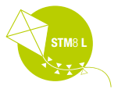


STM8 8-bit MCU Family

Slide 2

STM8 series
More than one million units delivered worldwide every day! We plan for longevity with a sustainable growth
STM8 MCU LONGEVITY COMMITMENT
STMicroelectronics provides a minimum longevity of 10 years for its STM8 microcontrollers!
STM8AF series of multi‑purpose 8‑bit microcontrollers for automotive applications
STM8AL series of ultra‑low‑power 8‑bit microcontrollers for automotive applications
STM8L series of ultra‑low‑power 8‑bit microcontrollers
STM8S series of mainstream 8‑bit microcontrollers
STM8

Slide 3
STM8 series
STM8 CORE
ST’s 8‑bit microcontroller platform is implemented around a high‑performance 8‑bit core and a state‑of‑the‑art set of peripherals. This platform is manufactured using an ST‑proprietary 130 nm embedded non‑volatile memory technology. It is able to reach 1.6 cycles per instruction and up to 24 MHz clock frequency, allowing customers to run their applications at low speed with high performance.
The lexibility of the architecture minimizes switching noise, resulting in improved system robustness and lower power consumption.
An innovative clock implementation provides strong beneits such as fast wake‑ups in only 4 μs.
It enables immediate clock switching on the ly to allow clock accelerations for PWM or calculation routines.
The 32‑bit robust NVM memory addressed through a 3‑stage pipeline interface, the 16‑bit index registers and stack pointers and the advanced instruction set with hardware
multiplication/division are key elements that signiicantly improve the eficiency of this 8‑bit device family.
Complete instructions
The STM8 allows fast and safe development through enhanced stack pointer operations, advanced addressing modes and new instructions.
B4 | B3 | B2 | B1
32-bit memory
Data memory
3-stage
pipeline
Fetch
Decode
Execute
STM8 core

Slide 4
STM8 series
STM8S
Mainstream
STM8 S
Data EEPROM,
3 and 5 V families, precise RC
STM8A
Automotive
STM8 A
Data EEPROM,
3 and 5 V families, precise RC, LIN, CAN, grade 0
STM8L
Ultra‑low‑power
STM8 L
Data EEPROM,
1.65 and 3 V families, strong analog, LCD drivers, low-leakage technology
Ideal combination of low‑power performance and features
Best market value
Long‑term guarantee
Robust and reliable Up to 125 ° C www.st.com/stm8s
AEC-Q100
Up to 150 °C www.st.com/stm8af www.st.com/stm8al
High-end analog IPs Active Halt < 1 μA www.st.com/stm8l

Slide 5
STM8 series
PORTFOLIO OVERVIEW
A large product portfolio to meet all your needs
Standard
Ultra‑low‑power
STM8S208
STM8AL3LE
STM8L162
Performance
STM8S207
STM8AL3L
STM8AF62
STM8L152
STM8S105
STM8AF52
STM8L151
General purpose
STM8S103
STM8AL31E
STM8AL31
STM8L101
STM8S007
STM8L052
Value
STM8S005
STM8L051
STM8S003
Speci c
STM8S903
4- to 128-Kbyte,
20- to 80-pin
4- to 128-Kbyte,
20- to 80-pin
2- to 64-Kbyte,
20- to 80-pin
LCD AES
Mainstream
Automotive
Ultra-low-power
CAN
LIN

Slide 6
STM8 series
STM8S DESCRIPTION
Upgrade to a higher or downgrade to a lower memory size, or use a different package across lines without changing the initial layout or software.
STM8 24 MHz CPU
4 to 128 Kbytes of embedded Flash memory, up to 6 Kbytes of SRAM
Supply voltage: 2.95 to 5.5 V
Up to four low‑power modes: down to 4 µA with complete context retention
State‑of‑the‑art digital and analog peripherals
Speciic interfaces such as IrDA and smartcard for support of consumer applications
‑40 to +85 °C, or up to 125 °C temperature range
Free class B self‑diagnostic library for IEC 60335/IEC 60730 compliant applications
Many software libraries and examples are available for download
STM8S APPLICATIONS
Appliances, power tools
HVAC
Power management
Lighting
Factory automation
Devices with rechargeable batteries
Motor control
e‑vehicles
Toys and games
Sensors
Power supplies
User interfaces

Slide 7
STM8 series
STM8S BLOCK DIAGRAM
System Power supply
STM8 CPU
Up to 24 MHz
Nested vector interrupt controller (NVIC)
SWIM debug module
4- to 128-Kbyte Flash memory
2.95 to 5.5 V
(1.8 V internal regulator) POR / BOR
Up to 6-Kbyte SRAM
Up to 2-Kbyte EEPROM
Xtal oscillator
Boot ROM
1-24 MHz
Internal RC oscillators 128 kHz and 16 MHz
Connectivity
Clock control
CAN 2.0 B
Clock detector
2xU(S)ART LIN
Smartcard / IrDA
AWU
2x watchdogs (independent and window)
SPI
Up to 68 I/Os
I²C
Control
Analog
10-bit ADC 16 channels
16-bit timer, 4 CAPCOM + 3 comparator outputs
2x16-bit timer 2/3 CAPCOM
8-bit timer
Beeper 1/2/4 kHz

Slide 8
STM8 series
STM8S PRODUCT LINES
The STM8S series consists of four lines with differentiated features with full compatibility and upgradability to simplify design changes.
The STM8S003/005/007 Value line is the entry‑level series with a basic features set.
The STM8S103/105 Access line offers more features and a larger variety of packages.
The STM8S207/208 Performance line features a full set of peripherals and provides performance for medium to higher‑end applications.
The STM8S Application‑speciic line provides more analog features and dedicated irmware solutions.
Product line | ^{F}CPU (MHz) | Flash _{RAM} ^{memory} (Kbytes) (Kbytes) |  | Data EEPROM (bytes) | CAN 2.0B | ₂nd UART | Additional analog channels | LNB irmware
STM8S003/005/007 Value line | 16 | 8 to 64 | 1 to 6 | 128
STM8S103/105 | 16 | 4 to 32 | 1 to 2 | 640 to 1024
STM8S207/208 | 24 | 32 to 128 | 6 | 1024 to 2048 | • | • | •
STM8S Application‑speciic line | 16 | 8 | 1 | 640 |  |  | • | •
STM8 core ‑ Up to 24 MHz
10-bit ADC
USART, SPI, I²C
8- and 16-bit timers
16 MHz crystal oscillator and 128 kHz internal RC oscillators
SWIM debug module

Slide 9
STM8 series
STM8S PORTFOLIO
Flash size (bytes)
128 K
STM8S208SB
STM8S208CB
STM8S208RB
STM8S208MB
STM8S207SB
STM8S207CB
STM8S207RB
STM8S207MB
STM8S208S8
STM8S208C8
STM8S208R8
STM8S208M8
64 K
STM8S207K8
STM8S207S8
STM8S207C8
STM8S207R8
STM8S207M8
STM8S007C8
STM8S208S6
STM8S208C6
STM8S208R6
32 K
STM8S207K6
STM8S207S6
STM8S207C6 STM8S207R6
STM8S105K6 STM8S105S6 STM8S105C6
STM8S005K6 STM8S005C6
16 K STM8S105K4 STM8S105S4 STM8S105C4
8 K
STM8S903F3 STM8S903K3 STM8S103F3 STM8S103K3
STM8S003F3 STM8S00KF3
4 K | STM8S103F2
 | 20 pins | 32 pins | 44 pins | 48 pins | 64 pins | 80 pins
 | TSSOP/QFN/SO | LQFP/QFN/SDIP | LQFP | LQFP | LQFP | LQFP
Pin count
Legend:
Performance line
Access line
Application specific line
Value line

Slide 10
STM8 series
STM8L DESCRIPTION
Upgrade or downgrade to a different memory size, or package across lines without changing your initial design or software.
STM8 16 MHz CPU
2 to 64 Kbytes of embedded Flash memory, up to 4 Kbytes of SRAM and up to 2 Kbytes of EEPROM
Four lines: pin‑to‑pin, software and peripheral compatibility
Supply voltage: 1.65 to 3.6 V
Up to four ultra‑low‑power modes: down to 350 nA with SRAM and context retention
Run mode dynamic consumption down to 150 µA/MHz
State‑of‑the‑art digital and analog peripherals
‑40 to +85 °C, or up to 125 °C operating temperature range
Free touch‑sensing library
LCD driver
AES‑128 encryption

Slide 11
STM8 series
STM8L BLOCK DIAGRAM
System Power supply
2- to 64-Kbyte
STM8L APPLICATIONS
Medical equipment
Glucose meters and insulin pumps
Blood pressure and colesterol monitors
Patient monitoring
Metering (electricity/gas/water/ heat meters, and scales)
Alarm systems (central units, sensors, door locks, and ire alarms)
GP portable devices
Mobile phones, and accessories
Gaming and remote controls
GPS watches and sports equipment
Flash memory
1.8 V regulator POR/PDR/PVD/BOR
1.5- to 4-Kbyte SRAM
1- to 2-Kbyte EEPROM*
Xtal oscillator
32
STM8 CPU
Up to 16 MHz
Boot ROM*
kHz + 1~16 MHz
Internal RC oscillators
Connectivity
38 kHz + 16 MHz
1 to 3x USART
Clock control
RTC*/AWU
1 to 2x SPI
2x watchdogs
I²C
(independent and window)
18/26/30/41/54/68 I/Os
Nested vector
Touch sensing Charge-transfer driver
up to 16 channels
interrupt controller (NVIC)
Control
1x 16-bit PWM
SWIM debug
module
Synchronized AC timer
Analog
2 to 3x 16-bit timers
4-channel DMA
1 to 2x 12-bit DAC
1x 8-bit timer
12-bit ADC
Encryption AES (128 bits)
Display
25 channels
LCD driver
(4 x 28 or 8 x 40)
2x comparators
Temperature sensor
Note: * STM8L15x/STM8L16x only

Slide 12
STM8 series
STM8L PRODUCT LINES
Product line | Flash memory (Kbytes) | RAM (Kbytes) | Data EEPROM (bytes) | Four DMA channels | LCD interface | AES 128‑bit crypto
STM8L051/052 Value line | 8 to 64 | 1 to 4 | 256 | • | •
STM8L101 | 2 to 8 | 1.5
STM8L151/152 | 4 to 64 | 1 to 4 | 256 to 2048 | • | •
STM8L162 | 64 | 2 | 2048 | • | • | •
12-bit ADC
12-bit DAC
USART, SPI, I²C
RTC with 32 kHz oscillator
8- and 16-bit timers
Temperature sensor
Comparators
SWIM debug module
STM8 core – Up to 16 MHz

Slide 13
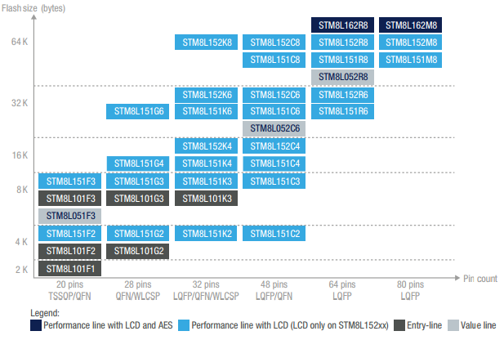
STM8 series
STM8L PORTFOLIO

Slide 14
STM8 series
STM8L ULTRA LOW POWER MODES
Typical current
@ 25 °C
192 µA/MHz
90 µA/MHz
5.1 µA
3.0 µA
1.2 µA
0.3 µA
Dynamic Run from Flash
Dynamic Run from RAM
Low-power Run
@ 32 kHz
Low-power Wait
@ 32 kHz
Active Halt with RTC
Halt
Notes:
POR/PDR on
RAM content preserved
BOR option at 2.4 µA
Startup time from Active Halt 5 µs

Slide 15
STM8 series
STM8L ULTRA LOW POWER MODES – BY FAMILY
The STM8L series is available in four different lines making the STM8L an optimal series to support many applications requiring special care on power savings.
STM8L101 line
Lowest power mode: 0.30 µA
Dynamic run mode: 150 µA/MHz
STM8L151/152 line
Lowest power mode: 0.35 µA
Dynamic run mode: 180 µA/MHz
STM8L162 line
Lowest power mode: 0.35 µA
Dynamic run mode: 180 µA/MHz
STM8L051/052 Value line
Lowest power mode: 0.35 µA
Dynamic run mode: 180 µA/MHz
STM8 L

Slide 16
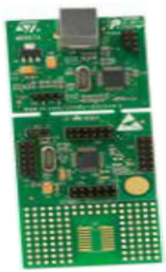
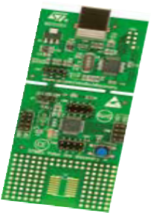
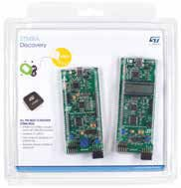
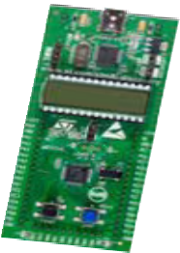
STM8 series
STM8 TOOLS
STM8 S
STM8 A
STM8 L
STM8S‑DISCOVERY STM8SVLDISCOVERY
STM8A‑DISCOVERY
STM8L‑DISCOVERY
ORDERING INFORMATION
Order number Description
STM8S‑DISCOVERY | Discovery kit for STM8S series with STM8S105C6 MCU
STM8SVLDISCOVERY | Discovery kit for STM8S Value Line with STM8S105C6 MCU
STM8L‑DISCOVERY | Discovery kit for STM8L series with STM8L152C6 MCU
STM8A‑DISCOVERY | Discovery kit for STM8A Automotive series with STM8AF52C6 and STM8AL3L68 MCUs

Slide 17
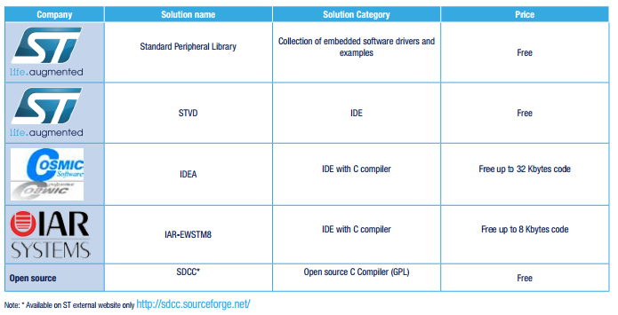
STM8 series
FREE TOOLS, SOFTWARE LIBRARIES AND EXAMPLES

Slide 18
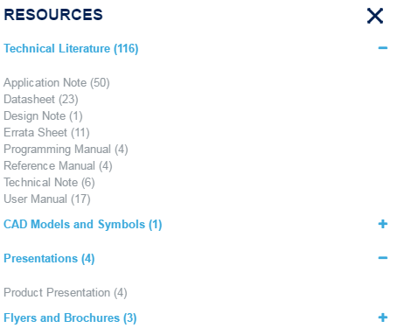
STM8 series
WEB TRAINING AND MATERIAL
Aside from all the available material from st.com/stm8
There is also some different Hands On trainings under our FAE’s repository here

Slide 19

Thank You

