Slide 1

STM32
Micro102

Slide 2

CONTENT
GPIO lab
EXTI lab
SLEEP lab
STOP lab
STANDBY lab
DMA Pool lab
DMA Interrupt lab
RTC Alarm lab

Slide 3
GPIO Lab 1

Slide 4
Configure GPIO for LED toggling
1
Objective
Learn how to setup pin and GPIO port in Cube MX
How to generate project in Cube MX and use HAL functions
Goal
Configure GPIO pin in Cube MX and generate project
Add in to project HAL_Delay function and HAL_GPIO_Toggle function
Verify the correct functionality on toggling LED

Slide 5
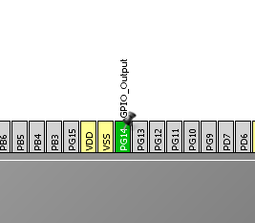
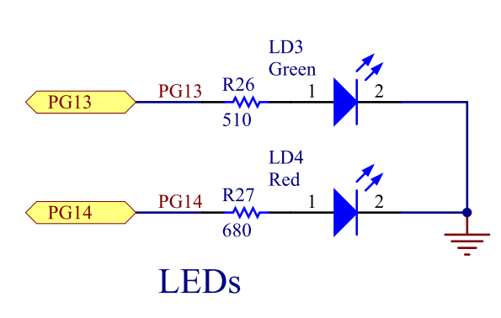
Configure GPIO for LED toggling
1
Create project in Cube MX
Menu > File > New Project
Select STM32F4 > STM32F429/439 > LQFP144 > STM32F439ZITx
Configure LED pin as GPIO_Output

Slide 6
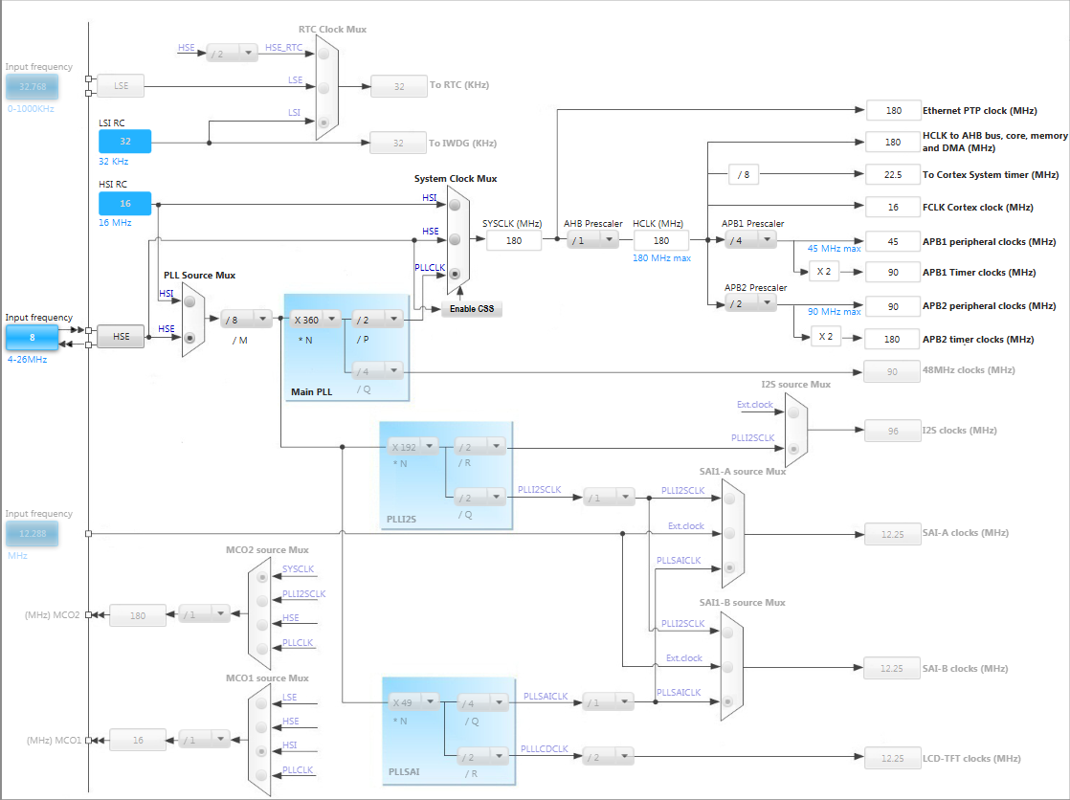
Configure GPIO for LED toggling
1
Clock Configuration
TAB->Clock Configuration
We can easily setup STM32 clocks

Slide 7
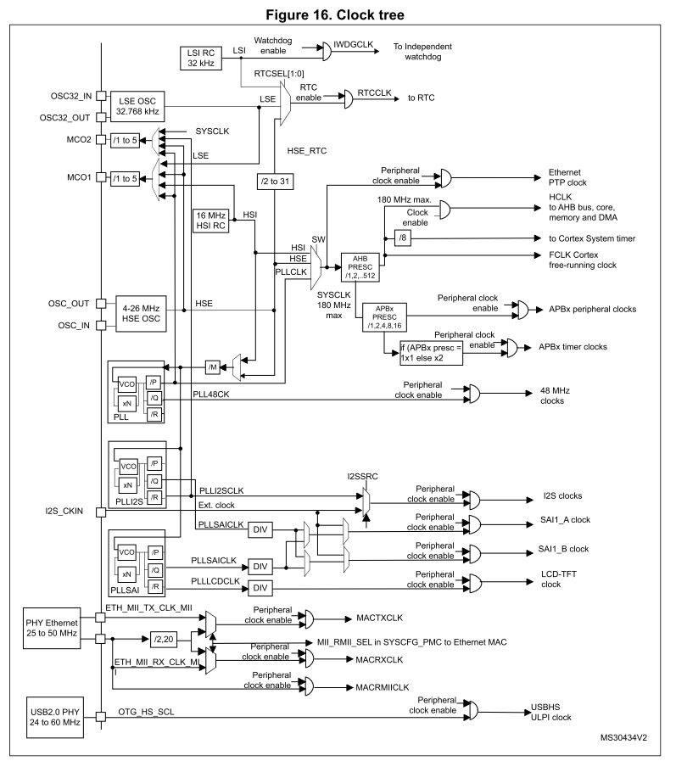
Configure GPIO for LED toggling
1
The clock Configuration thee is interactive version of tree from RM
RM0090 Chapter 6 Reset and clock control Page 151

Slide 8
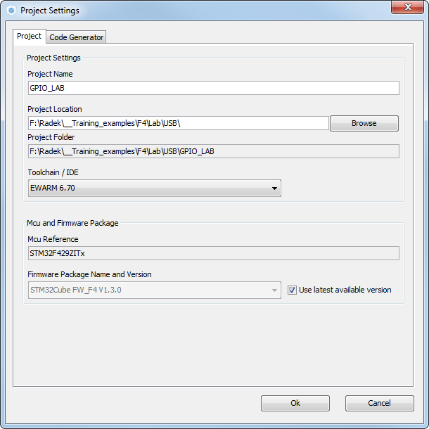
Configure GPIO for LED toggling
1
Now we set the project details for generation
Menu > Project > Project Settings
Set the project name
Project location
Type of toolchain
Now we can generate project
Menu > Project > Generate Project

Slide 9
Configure GPIO for LED toggling
1
Now we open the project in our IDE
The functions we want to put into main.c
Between /* USER CODE BEGIN 3 */ and /* USER CODE END 3 */ tags
Into infinite loop while(1){ }
For toggling we need to use this functions
HAL_HAL_Delay which create specific delay
HAL_GPIO_WritePin or HAL_GPIO_TogglePin

Slide 10
Configure GPIO for LED toggling
1
Now we open the project in our IDE
The functions we want to put into main.c
Between /* USER CODE BEGIN 3 */ and /* USER CODE END 3 */ tags
Into infinit loop while(1){ }
For toggling we need to use this functions
HAL_HAL_Delay which create specific delay
HAL_GPIO_WritePin or HAL_GPIO_TogglePin
/* USER CODE BEGIN 3 */
/* Infinite loop */
while (1)
{
HAL_GPIO_WritePin(GPIOG, GPIO_PIN_13, GPIO_PIN_SET);
HAL_Delay(500);
HAL_GPIO_WritePin(GPIOG, GPIO_PIN_13, GPIO_PIN_RESET);
HAL_Delay(500);
}
/* USER CODE END 3 */

Slide 11
EXTI lab 2

Slide 12
Configure EXTI which turns on LED
2
Objective
Learn how to setup input pin with EXTI in Cube MX
How to generate project in Cube MX and use HAL functions
Goal
Configure GPIO and EXTI pin in Cube MX and generate project
Add into project Callback function and function which turn on led
Verify the correct functionality by pressing button which turns on LED

Slide 13
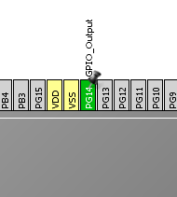
Configure EXTI which turns on LED
2
Create project in Cube MX
Menu > File > New Project
Select STM32F4 > STM32F429/439 > LQFP144 > STM32F439ZITx
Configure LED pin as GPIO_Output
Configure Button pin as GPIO_EXTIX

Slide 14
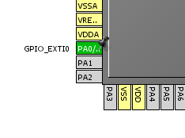
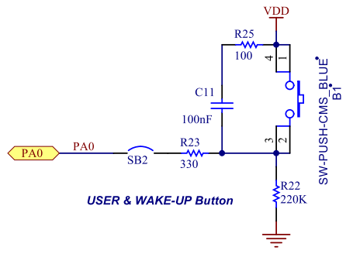
Configure EXTI which turns on LED
2
Create project in Cube MX
Menu > File > New Project
Select STM32F4 > STM32F429/439 > LQFP144 > STM32F439ZITx
Configure LED pin as GPIO_Output
Configure Button pin as GPIO_EXTIX

Slide 15
Configure EXTI which turns on LED
2
In order to make HAL_Delay to work correctly we need to setup clock system
Details in lab 0

Slide 16
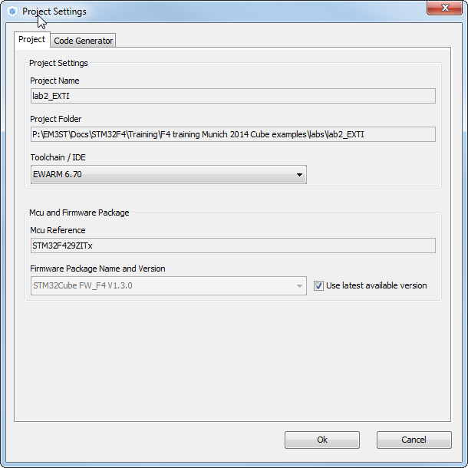
Configure EXTI which turns on LED
2
Now we set the project details for generation
Menu > Project > Project Settings
Set the project name
Project location
Type of toolchain
Now we can generate project
Menu > Project > Generate Project

Slide 17
Configure EXTI which turns on LED
2
HAL Library work flow 1
Peripheral Initializations
including peripheral interrupt NVIC initializations
Generated by CubeMX
Configure the GPIO to generate interrupt on rising or falling edge
HAL_EXTI0_IRQHandler
EXTI0_IRQHandler
Edge detection callback
HAL_GPIO_EXTI_Callback

Slide 18
Configure EXTI which turns on LED
2
HAL Library work flow 2
Peripheral Initializations
including peripheral interrupt NVIC initializations
MX_GPIO_Init
inside main.c
Configure the GPIO to generate interrupt on rising or falling edge
HAL_EXTI0_IRQHandler
EXTI0_IRQHandler
Edge detection callback
HAL_GPIO_EXTI_Callback

Slide 19
Configure EXTI which turns on LED
2
HAL Library working flow 3
Peripheral Initializations
including peripheral interrupt NVIC initializations
inside stm32f4xx_it.c
Configure the GPIO to generate interrupt on rising or falling edge
HAL_EXTI0_IRQHandler
EXTI0_IRQHandler
Edge detection callback
HAL_GPIO_EXTI_Callback

Slide 20
Configure EXTI which turns on LED
2
HAL Library work flow 4
Peripheral Initializations
including peripheral interrupt NVIC initializations
Configure the GPIO to generate interrupt on rising or falling edge
HAL_EXTI0_IRQHandler
EXTI0_IRQHandler
Edge detection callback
HAL_GPIO_EXTI_Callback
User must define Callback it is declared by default as empty weak

Slide 21
Configure EXTI which turns on LED
2
HAL Library work flow 5
Peripheral Initializations
including peripheral interrupt NVIC initializations
Configure the GPIO to generate interrupt on rising or falling edge
HAL_EXTI0_IRQHandler
EXTI0_IRQHandler
Edge detection callback
HAL_GPIO_EXTI_Callback
Usually in main.c between /* USER CODE BEGIN */
tags

Slide 22
Configure EXTI which turns on LED
2
HAL Library work flow summary
3. create edge
1. init NVIC
Peripheral Initializations
including peripheral interrupt NVIC initializations
2. init GPIO
Configure the GPIO to generate interrupt on rising or falling edge
5. HAL EXTI interrupt handler
4. EXTI interrupt handler
HAL_EXTI0_IRQHandler
EXTI0_IRQHandler
Edge detection callback
HAL_GPIO_EXTI_Callback
HAL files clearing flags, check errors, …
6. HAL EXTI callback

Slide 23
Configure EXTI which turns on LED
2
Now we open the project in our IDE
The functions we want to put into main.c
Between /* USER CODE BEGIN 4 */ and /* USER CODE END 4 */ tags
We create function which will handle the EXTI interrupts
The HAL callback function for EXTI
void HAL_GPIO_EXTI_Callback(uint16_t GPIO_Pin)
For LED turn on we need to use this functions
HAL_GPIO_WritePin

Slide 24
Configure EXTI which turns on LED
2
Now we open the project in our IDE
The functions we want to put into main.c
Between /* USER CODE BEGIN 4 */ and /* USER CODE END 4 */ tags
We create function which will handle the EXTI interrupts
The HAL callback function for EXTI
void HAL_GPIO_EXTI_Callback(uint16_t GPIO_Pin)
For LED turn on we need to use this functions
HAL_GPIO_WritePin
/* USER CODE BEGIN 4 */
void HAL_GPIO_EXTI_Callback(uint16_t GPIO_Pin)
{
if(GPIO_Pin == GPIO_PIN_0) {
HAL_GPIO_WritePin(GPIOG, GPIO_PIN_14, GPIO_PIN_SET);
} else {
__NOP();
}
}
/* USER CODE END 4 */

Slide 25
Low Power mode SLEEP lab 3

Slide 26
Use SLEEP mode with EXTI
3
Objective
We use the EXTI setup from lab 1
Learn how to setup SLEEP in HAL
Create simple project with SLEEP mode with wake up on pin press
Goal
Use project from EXTI lab
Learn how to setup the SLEEP in HAL, which events can wake up you
Verify the correct functionality by measuring consumption

Slide 27


SLEEP Mode
GPIO’s
Core
CM4
FLASH
Core is stopped
Peripherals are running
RTC/backup reg.
RAM
IWDG
DMA
Clock
GP timers
HSI
SPI
HSE
USB
LSI
USART
DAC
LSE
I2C
Reset
ADC
Power regulator

Slide 28
Use SLEEP mode with EXTI
3
HAL Library work flow summary
4. create edge
1. init NVIC
Peripheral Initializations
including peripheral interrupt NVIC initializations
2. init GPIO
Configure the GPIO to generate interrupt on rising or falling edge
5. EXTI interrupt handler
3. Use WFI
HAL_EXTI0_IRQHandler
EXTI0_IRQHandler
Enter into SLEEP mode(WFI)
6. HAL EXTI interrupt handler
Edge detection callback
HAL_GPIO_EXTI_Callback
HAL files clearing flags, check errors, …
7. HAL EXTI callback

Slide 29
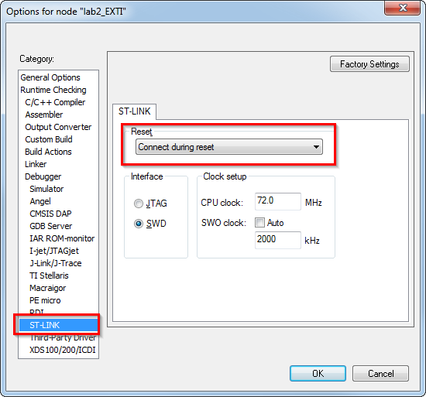
Use SLEEP mode with EXTI
3
Now we open the project in our IDE
The functions we want to put into main.c
Between /* USER CODE BEGIN 3 */ and /* USER CODE END 3 */ tags
Function to enter SLEEP
HAL_PWR_EnterSLEEPMode(uint32_t Regulator, uint8_t SLEEPEntry)
We can measure consumption
To be able reprogram the STM32 which is in LP mode we must use connection under reset option

Slide 30
Use SLEEP mode with EXTI
3
Now we open the project in our IDE
The functions we want to put into main.c
Between /* USER CODE BEGIN 3 */ and /* USER CODE END 3 */ tags
Function to enter SLEEP
HAL_PWR_EnterSLEEPMode(uint32_t Regulator, uint8_t SLEEPEntry)
We can measure consumption

Slide 31
Use SLEEP mode with EXTI
3
Now we open the project in our IDE
The functions we want to put into main.c
Between /* USER CODE BEGIN 3 */ and /* USER CODE END 3 */ tags
Function to enter SLEEP
HAL_PWR_EnterSLEEPMode(uint32_t Regulator, uint8_t SLEEPEntry)
We can measure consumption
/* USER CODE BEGIN 3 */
/* Infinite loop */
while (1)
{
HAL_Delay(1000);
HAL_PWR_EnterSLEEPMode(PWR_LOWPOWERREGULATOR_ON,PWR_SLEEPENTRY_WFI);
}
/* USER CODE END 3 */

Slide 32
Use SLEEP mode with EXTI
3
Consumption still to high?
Is STM32 really in SLEEP?
Is the Systick disabled?
Is this better?
Notes:
In run approx. 53mA
Consumption on STM32F429disco approx. 24.2mA in sleep
You ma test the difference with pins ins floating in and analog

Slide 33
Use SLEEP mode with EXTI
3
Consumption still to high?
Is STM32 really in SLEEP?
Is the Systick disabled?
Is this better?
/* USER CODE BEGIN 3 */
/* Infinite loop */
while (1)
{
HAL_Delay(1000);
HAL_SuspendTick();
HAL_PWR_EnterSLEEPMode(PWR_LOWPOWERREGULATOR_ON,PWR_SLEEPENTRY_WFI);
HAL_ResumeTick();
}
/* USER CODE END 3 */
Notes:
In run approx. 53mA
Consumption on STM32F429disco approx. 24.2mA in sleep
You ma test the difference with pins ins floating in and analog

Slide 34
Low Power mode STOP lab 4

Slide 35
Use STOP mode with EXTI
4
Objective
We use the EXTI setup from lab 1
Learn how to setup STOP in HAL
Create simple project with STOP mode with wake up on pin press
Goal
Use project from EXTI lab
Learn how to setup the STOP in HAL, which events can wake up you
Verify the correct functionality by measuring consumption

Slide 36



STOP Mode
Core is stopped
HSE, MSI clocks are OFF
SRAM and registers content is preserved
Peripherals with HSI, LSI, LSE clock option can be ON
GPIO’s keep their setup
GPIO’s
Core
CM4
FLASH
RTC/backup reg.
RAM
IWDG
DMA
Clock
GP timers
HSE
SPI
HSI
USB
LSI
USART
DAC
LSE
I2C
ADC
Reset
Power regulator
Notes:
The Stop mode is based on the Cortex™-M0+ deepsleep mode combined with peripheral clock gating.
HSI ON/OFF is optional

Slide 37
Use STOP mode with EXTI
4
HAL Library work flow summary
4. create edge
1. init NVIC
Peripheral Initializations
including peripheral interrupt NVIC initializations
2. init GPIO
Configure the GPIO to generate interrupt on rising or falling edge
5. EXTI interrupt handler
3. Use WFI
Enter into STOP mode(WFI)
HAL_EXTI0_IRQHandler
EXTI0_IRQHandler
8. Reconfigure clock after wakeup
6. HAL EXTI interrupt handler
Clock reconfigure
Edge detection callback
HAL_GPIO_EXTI_Callback
HAL files clearing flags, check errors, …
7. HAL EXTI callback

Slide 38
Use STOP mode with EXTI
4
Now we open the project in our IDE
The functions we want to put into main.c
Between /* USER CODE BEGIN 3 */ and /* USER CODE END 3 */ tags
Function to enter SLEEP
HAL_PWR_EnterSTOPMode(uint32_t Regulator, uint8_t STOPEntry)
HAL_PWREx_EnterUnderDriveSTOPMode(uint32_t Regulator, uint8_t STOPEntry)
We can measure consumption
To be able reprogram the STM32 which is in LP mode we must use connection under reset option

Slide 39
Use STOP mode with EXTI
4
Now we open the project in our IDE
The functions we want to put into main.c
Between /* USER CODE BEGIN 3 */ and /* USER CODE END 3 */ tags
Function to enter SLEEP
HAL_PWR_EnterSTOPMode(uint32_t Regulator, uint8_t STOPEntry)
HAL_PWREx_EnterUnderDriveSTOPMode(uint32_t Regulator, uint8_t STOPEntry)
We can measure consumption

Slide 40
Use STOP mode with EXTI
4
Now we open the project in our IDE
The functions we want to put into main.c
Between /* USER CODE BEGIN 3 */ and /* USER CODE END 3 */ tags
Function to enter SLEEP
HAL_PWR_EnterSTOPMode(uint32_t Regulator, uint8_t STOPEntry)
HAL_PWREx_EnterUnderDriveSTOPMode(uint32_t Regulator, uint8_t STOPEntry)
We can measure consumption
/* USER CODE BEGIN 3 */
/* Infinite loop */
while (1)
{
HAL_Delay(1000);
HAL_PWR_EnterSTOPMode(PWR_LOWPOWERREGULATOR_ON,PWR_STOPENTRY_WFI);
SystemClock_Config();
}
/* USER CODE END 3 */

Slide 41
Use STOP mode with EXTI
4
Or different function
/* USER CODE BEGIN 3 */
/* Infinite loop */
while (1)
{
HAL_Delay(1000);
HAL_PWREx_EnterUnderDriveSTOPMode(PWR_LOWPOWERREGULATOR_UNDERDRIVE_ON,PWR_STOPENTRY_WFI);
SystemClock_Config();
}
/* USER CODE END 3 */
Notes:
In run approx. 53mA
Consumption on STM32F429disco approx. 5mA in stop(not optimized)
You ma test the difference with pins ins floating in and analog

Slide 42
Low Power mode STANDBY lab 5

Slide 43
Use STANDBY mode
5
Objective
Learn how to setup STANDBY in HAL
Create simple project with STANDBY mode with wake up on pin press
Goal
Use project from EXTI lab
Learn how to setup the STANDBY in HAL, which events can wake up you
Verify the correct functionality by measuring consumption

Slide 44

STANDBY Mode
Core and all peripherals are OFF, except RTC and IWDG if enabled
HSE, MSI, HSI clocks are OFF, LSI LSE can be ON
SRAM and registers content is lost, except RTC, and standby circuitry
GPIO’s are in high Z, except Reset, RTC OUT and WKUP 1,2,3
GPIO’s
Core
CM4
FLASH
RTC/backup reg.
RAM
IWDG
DMA
Clock
GP timers
HSE
SPI
HSI
USB
LSI
USART
DAC
LSE
I2C
ADC
Reset
Power regulator
Reset
RTC OUT
WKUP 1,2,3
Notes:
The Standby mode allows to achieve the lowest power consumption. It is based on the
Cortex™-M0+ deepsleep mode, with the voltage regulator disabled. The VCORE domain is
consequently powered off. The PLL, the MSI, the HSI16 oscillator and the HSE oscillator
are also switched off. SRAM and register contents are lost except for the RTC registers,
RTC backup registers and Standby circuitry

Slide 45
Use STANDBY mode
5
HAL Library work flow summary
1. init NVIC
Peripheral Initializations
including peripheral interrupt NVIC initializations
2. Standby
Enable Wake-up pin
3. Use WFI
4. create edge
Enter into STANDBY mode(WFI)
5. Wake up STM with reset
Reset

Slide 46
Use STANDBY mode
5
Now we open the project in our IDE
The functions we want to put into main.c
Between /* USER CODE BEGIN 3 */ and /* USER CODE END 3 */ tags
Function to enter STANDBY
HAL_PWR_EnableWakeUpPin(uint32_t WakeUpPinx)
HAL_PWR_EnterSTANDBYMode();
We can measure consumption
To be able reprogram the STM32 which is in LP mode we must use connection under reset option

Slide 47
Use STANDBY mode
5
Now we open the project in our IDE
The functions we want to put into main.c
Between /* USER CODE BEGIN 3 */ and /* USER CODE END 3 */ tags
Function to enter SLEEP
HAL_PWR_EnterSTOPMode(uint32_t Regulator, uint8_t STOPEntry)
HAL_PWREx_EnterUnderDriveSTOPMode(uint32_t Regulator, uint8_t STOPEntry)
We can measure consumption
/* USER CODE BEGIN 3 */
/* Infinite loop */
while (1)
{
HAL_GPIO_TogglePin(GPIOG, GPIO_PIN_14);
HAL_Delay(2000);
HAL_PWR_EnableWakeUpPin(PWR_WAKEUP_PIN1);
HAL_PWR_EnterSTANDBYMode();
}
/* USER CODE END 3 */

Slide 48
Use STANDBY mode
5
We cannot go into STANDBY again?
Try to clear wake up flag
__HAL_PWR_CLEAR_FLAG(PWR_FLAG_WU);
/* USER CODE BEGIN 2 */
__HAL_PWR_CLEAR_FLAG(PWR_FLAG_WU);
/* USER CODE END 2 */

Slide 49
Data transfer over DMA lab 6

Slide 50
Use DMA in M2M transfer
6
Objective
Learn how to setup DMA transfer in CubeMX
Create simple DMA memory to memory transfer from RAM to RAM
Goal
Use CubeMX and generate project with DMA
Learn how to setup the DMA in HAL
Verify the correct functionality by comparing transferred buffers

Slide 51
Use DMA in M2M transfer
6
CCM data RAM
64KB
CORTEX-M4
168MHz
w/ FPU & MPU
Master 1
Ethernet
10/100
Master 5
High Speed
USB2.0
Master 4
Dual Port
DMA1
Master 2
Dual Port
DMA2
Master 3
FIFO/DMA
FIFO/DMA
FIFO/8 Streams
FIFO/8 Streams
Dual Port
AHB1-APB2
D-Bus
I-Bus
S-Bus
AHB1
Dual Port
AHB1-APB1
AHB2
SRAM1
112KB
SRAM2
16KB
FSMC
FLASH
1Mbytes
I-Code
ART
Accelerator
D-Code
Multi-AHB Bus Matrix

Slide 52
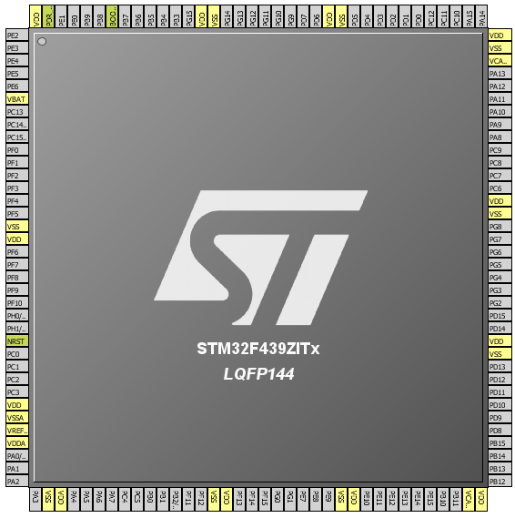
Use DMA in M2M transfer
6
Create project in Cube MX
Menu > File > New Project
Select STM32F4 > STM32F429/439 > LQFP144 > STM32F439ZITx
For DMA we don’t need to configure any pins

Slide 53
Use DMA in M2M transfer
6
In order to make HAL_Delay to work correctly we need to setup clock system
Details in lab 0

Slide 54
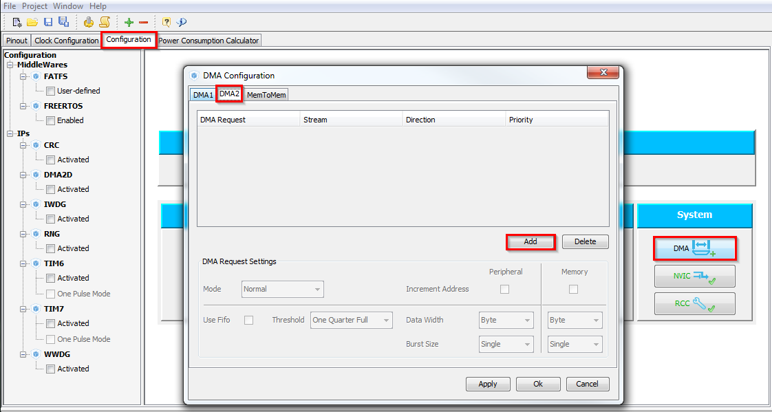
Use DMA in M2M transfer
6
DMA configuration
TAB->Configuration
System->DMA
TAB->DMA2
Button ADD
1. TAB -> Configuration
2. System DMA
3. TAB->DMA 2
4. Add DMA channel

Slide 55
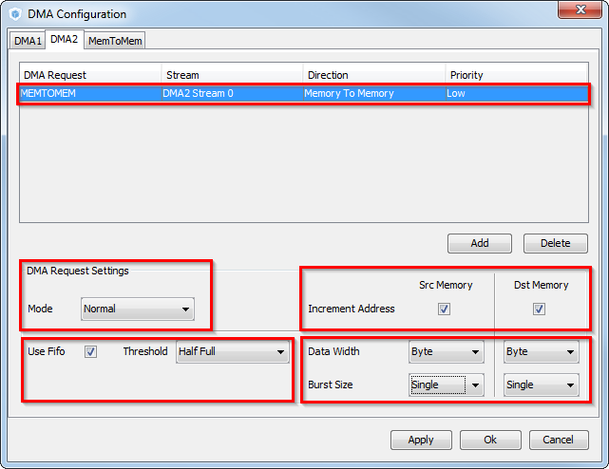
Use DMA in M2M transfer
6
DMA configuration
Select MEMTOMEM DMA request
Normal mode
Increment source and destination address
FIFO setup
Byte data width
Burst size
Button OK
1. MEMTOMEM
3. Increment addresses
5. Data width and Burst
2. Normal mode
4. FIFO setup
6. OK

Slide 56
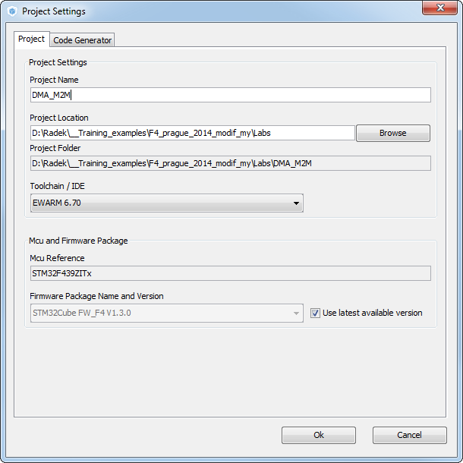
Use DMA in M2M transfer
6
Now we set the project details for generation
Menu > Project > Project Settings
Set the project name
Project location
Type of toolchain
Now we can generate project
Menu > Project > Generate Project

Slide 57
Use DMA in M2M transfer
6
Start process DMA (same for TIM, ADC)
Non blocking start process
The end of the process must be checked by pooling
1. init DMA
Peripheral Initializations
2. Start DMA
Start Process
(HAL_DMA_Start)
3. DMA transfer data
Poll for process complete
(PollForTransfer)
4. Check if transfer is complete

Slide 58
Use DMA in M2M transfer
6
Now we open the project in our IDE
The functions we want to put into main.c
Between /* USER CODE BEGIN 2 */ and /* USER CODE END 2 */ tags
HAL functions for DMA
HAL_DMA_Start(DMA_HandleTypeDef *hdma, uint32_t SrcAddress, uint32_t DstAddress, uint32_t DataLength)
HAL_DMA_PollForTransfer(DMA_HandleTypeDef *hdma, uint32_t CompleteLevel, uint32_t Timeout)

Slide 59
Use DMA in M2M transfer
6
We create tow buffers
One with source data
Second as destination buffer
/* USER CODE BEGIN 0 */
uint8_t Buffer_Src[]={0,1,2,3,4,5,6,7,8,9};
uint8_t Buffer_Dest[10];
/* USER CODE END 0 */

Slide 60
Use DMA in M2M transfer
6
HAL_DMA_Start start the M2M data transfer
HAL_DMA_PollForTransfer check if the transfer ends successfuly
/* USER CODE BEGIN 2 */
HAL_DMA_Start(&hdma_memtomem_dma2_stream0, (uint32_t) (Buffer_Src), (uint32_t) (Buffer_Dest), 10);
while(HAL_DMA_PollForTransfer(&hdma_memtomem_dma2_stream0, HAL_DMA_FULL_TRANSFER, 100) != HAL_OK)
{
__NOP();
}
/* USER CODE END 2 */

Slide 61
Data transfer over DMA with interrupt lab 7

Slide 62
Use DMA M2M transfer with interrupt
7
Objective
Learn how to setup DMA transfer with interrupt in CubeMX
Create simple DMA memory to memory transfer from RAM to RAM
Goal
Use CubeMX and generate project with DMA
Learn how to setup the DMA in HAL
Verify the correct functionality by comparing transferred buffers

Slide 63
Use DMA M2M transfer with interrupt
7
Create project in Cube MX
Menu > File > New Project
Select STM32F4 > STM32F429/439 > LQFP144 > STM32F439ZITx
For DMA we don’t need to configure any pins

Slide 64
Use DMA M2M transfer with interrupt
7
In order to make HAL_Delay to work correctly we need to setup clock system
Details in lab 0

Slide 65
Use DMA M2M transfer with interrupt
7
DMA configuration
TAB->Configuration
System->DMA
TAB->DMA2
Button ADD
1. TAB -> Configuration
2. System DMA
3. TAB->DMA 2
4. Add DMA channel

Slide 66
Use DMA M2M transfer with interrupt
7
DMA configuration
Select MEMTOMEM DMA request
Normal mode
Increment source and destination address
FIFO setup
Byte data width
Burst size
Button OK
1. MEMTOMEM
3. Increment addresses
5. Data width and Burst
2. Normal mode
4. FIFO setup
6. OK

Slide 67
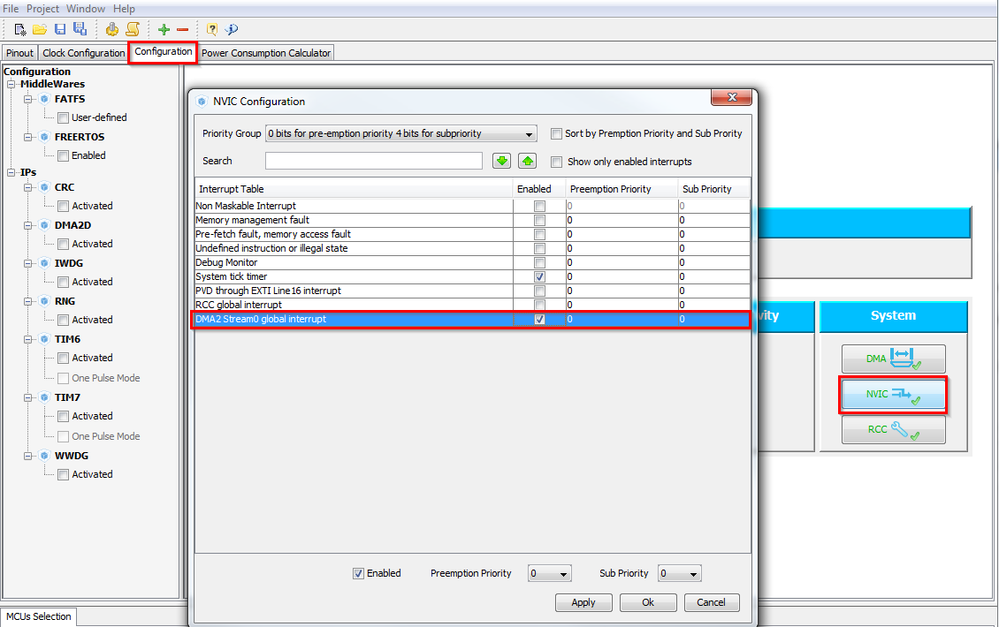
Use DMA M2M transfer with interrupt
7
DMA configuration
System -> NVIC
Enable DMA2 Stream interrupt
Button OK
1. TAB -> Configuration
2. System -> NVIC
3. Enable DMA2 interrupts
4. OK

Slide 68
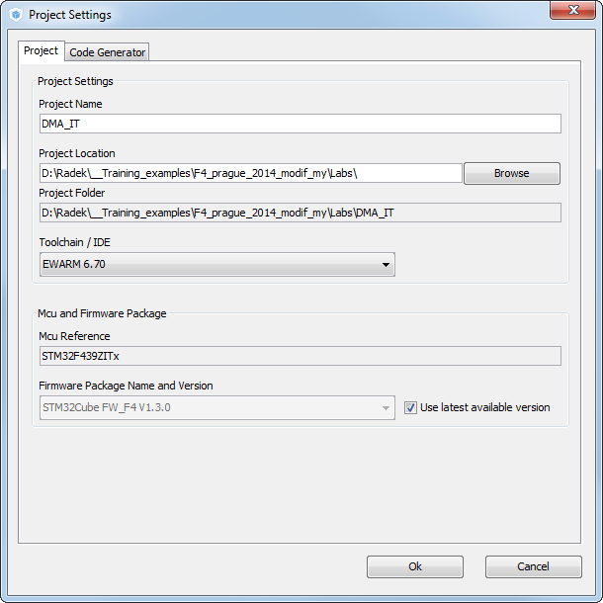
Use DMA M2M transfer with interrupt
7
Now we set the project details for generation
Menu > Project > Project Settings
Set the project name
Project location
Type of toolchain
Now we can generate project
Menu > Project > Generate Project

Slide 69
Use DMA M2M transfer with interrupt
7
HAL Library DMA with IT flow
1. DMA init
DMA Initializations
including peripheral interrupt NVIC initializations
Start process with interrupt generation at end of process
HAL_DMA_Start_IT
2. DMA transfer start
HAL_OK
HAL_ERROR
HAL_DMA_IRQHandler
DMA2_Stream0_IRQHandler
HAL_BUSY
4. HAL DMA management
3. DMA transfer complete or error
end of process callback
DMA_XferCpltCallback
5. DMA transfer was correct
process Error callback
DMA_XferErrorCallback
5. Error in DMA transfer

Slide 70
Use DMA M2M transfer with interrupt
7
Now we open the project in our IDE
The functions we want to put into main.c
Between /* USER CODE BEGIN 2 */ and /* USER CODE END 2 */ tags
DMA callback function
We need to add the name of callback function into DMA structure
HAL functions for DMA
HAL_DMA_Start_IT(DMA_HandleTypeDef *hdma, uint32_t SrcAddress, uint32_t DstAddress, uint32_t DataLength)

Slide 71
Use DMA M2M transfer with interrupt
7
We create tow buffers
One with source data
Second as destination buffer
/* USER CODE BEGIN 0 */
uint8_t Buffer_Src[]={0,1,2,3,4,5,6,7,8,9};
uint8_t Buffer_Dest[10];
/* USER CODE END 0 */

Slide 72
Use DMA M2M transfer with interrupt
7
DMA callback creation function prototype
DMA complete callback with nop where we can put breakpoint
/* USER CODE BEGIN 0 */
uint8_t Buffer_Src[]={0,1,2,3,4,5,6,7,8,9};
uint8_t Buffer_Dest[10];
void XferCpltCallback(DMA_HandleTypeDef *hdma);
/* USER CODE END 0 */
/* USER CODE BEGIN 4 */
void XferCpltCallback(DMA_HandleTypeDef *hdma)
{
__NOP();//we reach this only if DMA transfer was correct
}
/* USER CODE END 4 */

Slide 73
Use DMA M2M transfer with interrupt
7
DMA Start
Before we start the DMA with interrupt we need to set the callback into DMA structure
Then is possible use the HAL_DMA_Start_IT to begin DMA transfer
/* USER CODE BEGIN 2 */
hdma_memtomem_dma2_stream0.XferCpltCallback=&XferCpltCallback;
HAL_DMA_Start_IT(&hdma_memtomem_dma2_stream0,(uint32_t)Buffer_Src,(uint32_t)Buffer_Dest,10);
/* USER CODE END 2 */

Slide 74
Use RTC Alarm lab 8

Slide 75
Use RTC and Alarm with interrupt
8
Objective
Learn how to setup RTC with interrupt in CubeMX
Create simple RTC project with periodic alarm interrupt
Goal
Use CubeMX and generate project with RTC
Learn how to setup the RTC in HAL
Verify the correct functionality by periodic RTC alarm interrupts

Slide 76
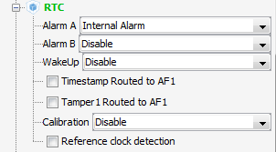
Use RTC and Alarm with interrupt
8
Create project in Cube MX
Menu > File > New Project
Select STM32F4 > STM32F429/439 > LQFP144 > STM32F439ZITx
Set Internal Alarm on Alarm A or Alarm B
Set GPIO to toggle with LED as alarm indication

Slide 77
Use RTC and Alarm with interrupt
8
In order to make HAL_Delay to work correctly we need to setup clock system
Details in the next slide

Slide 78
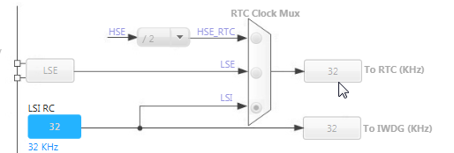
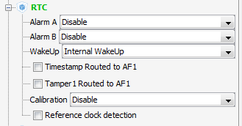
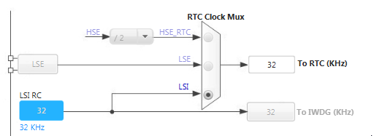
Use RTC and Alarm with interrupt
8
1. RTC disabled
Clock Configuration overview 26
RTC
TAB>Pinout
RCC>RTC set RTC feature
TAB>Clock Configuration
Now the RTC can be set
2. RTC set
3. Set RTC

Slide 79
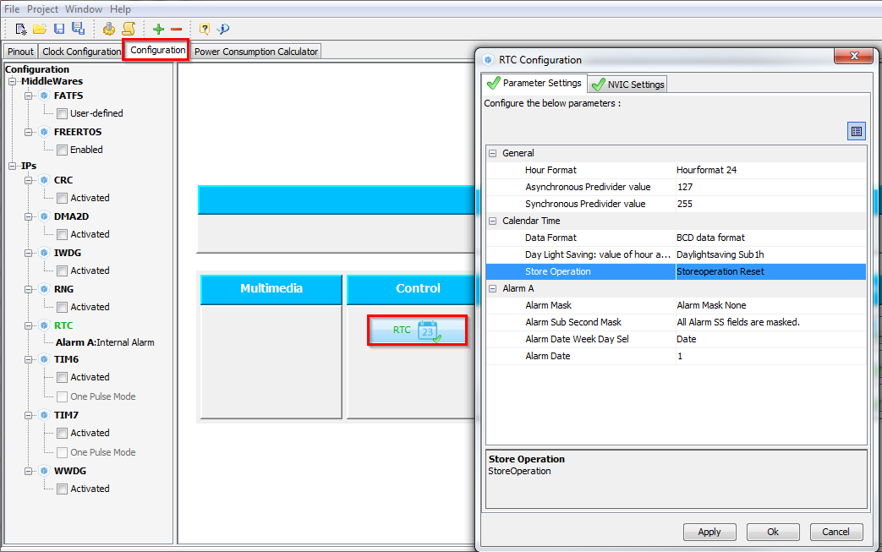
Use RTC and Alarm with interrupt
8
RTC Configuration
TAB->Configuration
Control -> RTC
Set parameters which you want
1. TAB -> Configuration
2. RTC
3. Check configuration

Slide 80
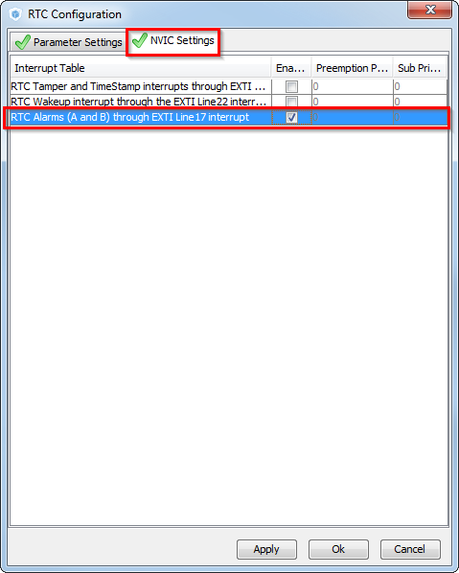
Use RTC and Alarm with interrupt
8
RTC Configuration NVIC
TAB->NVIC Setup
Enable Alarm interrupt
Button OK
1. TAB -> NVIC
2. Enable RTC Alarm
3. Button OK

Slide 81
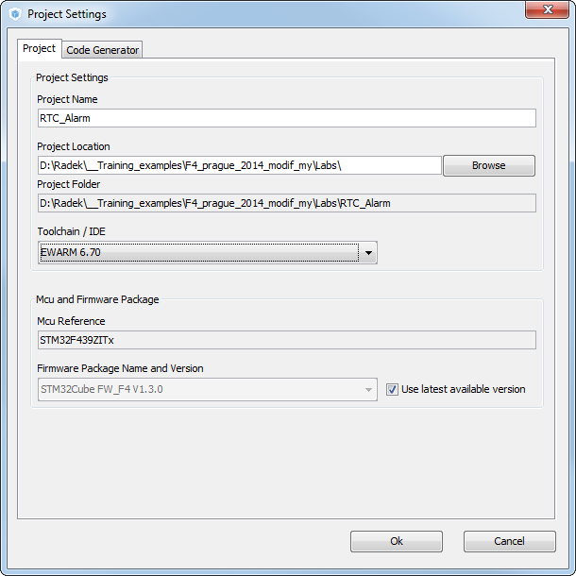
Use RTC and Alarm with interrupt
8
Now we set the project details for generation
Menu > Project > Project Settings
Set the project name
Project location
Type of toolchain
Now we can generate project
Menu > Project > Generate Project

Slide 82
Use RTC and Alarm with interrupt
8
The RTC can be preserved during RESET(ok LP modes)
CubeMX not enable the RTC by default
We need to add HAL_PWR_EnableBkUpAccess() and __HAL_RCC_RTC_ENABLE() before we call MX_RTC_Init()
Set the first alarm to 1s
In MX_RTC_Init
We create the RTC interrupt handler and we reconfigure the Alarm A time
HAL_RTC_AlarmAEventCallback(RTC_HandleTypeDef *hrtc)
HAL_RTC_GetAlarm(RTC_HandleTypeDef *hrtc, RTC_AlarmTypeDef *sAlarm, uint32_t Alarm, uint32_t Format)
HAL_RTC_SetAlarm_IT(RTC_HandleTypeDef *hrtc, RTC_AlarmTypeDef *sAlarm, uint32_t Format)
RTC alarm indication will be done by LED
HAL_GPIO_TogglePin(GPIO_TypeDef* GPIOx, uint16_t GPIO_Pin)

Slide 83
Use RTC and Alarm with interrupt
8
RTC enable
In MX_RTC_Init we set first Alarm to 1s
/* Initialize all configured peripherals */
HAL_PWR_EnableBkUpAccess();//enable PWR backup domain access (RTC,BKReg)
__HAL_RCC_RTC_ENABLE();//Enable RTC. not created by cube because the RTC can run.
MX_GPIO_Init();
MX_RTC_Init();
/**Enable the Alarm A
*/
sAlarm.AlarmTime.Hours = 0;
sAlarm.AlarmTime.Minutes = 0;
sAlarm.AlarmTime.Seconds = 1;
sAlarm.AlarmTime.SubSeconds = 0;

Slide 84
Use RTC and Alarm with interrupt
8
RTC enable
/* USER CODE BEGIN 4 */
void HAL_RTC_AlarmAEventCallback(RTC_HandleTypeDef *hrtc){
RTC_AlarmTypeDef sAlarm;
HAL_RTC_GetAlarm(hrtc,&sAlarm,RTC_ALARM_A,FORMAT_BIN);
if(sAlarm.AlarmTime.Seconds>58){
sAlarm.AlarmTime.Seconds=0;
}else{
sAlarm.AlarmTime.Seconds=sAlarm.AlarmTime.Seconds+1;
}
while(HAL_RTC_SetAlarm_IT(hrtc, &sAlarm, FORMAT_BIN)!=HAL_OK){}
HAL_GPIO_TogglePin(GPIOG,GPIO_PIN_14);
}
/* USER CODE END 4 */

Slide 85
Use RTC and Alarm with interrupt
8
Advanced task
The counting stops after 1minute
Modify the project to create alarm every 1s for infinite time
We only need to modify the Alarm mask to ignore Days, Hours and Minutes
/**Enable the Alarm A
*/
sAlarm.AlarmTime.Hours = 0;
sAlarm.AlarmTime.Minutes = 0;
sAlarm.AlarmTime.Seconds = 1;
sAlarm.AlarmTime.SubSeconds = 0;
sAlarm.AlarmTime.TimeFormat = RTC_HOURFORMAT12_AM;
sAlarm.AlarmTime.DayLightSaving = RTC_DAYLIGHTSAVING_NONE;
sAlarm.AlarmTime.StoreOperation = RTC_STOREOPERATION_RESET;
sAlarm.AlarmMask = RTC_ALARMMASK_DATEWEEKDAY|RTC_ALARMMASK_HOURS|RTC_ALARMMASK_MINUTES;
sAlarm.AlarmSubSecondMask = RTC_ALARMSUBSECONDMASK_ALL;
sAlarm.AlarmDateWeekDaySel = RTC_ALARMDATEWEEKDAYSEL_DATE;
sAlarm.AlarmDateWeekDay = 1;
sAlarm.Alarm = RTC_ALARM_A;
HAL_RTC_SetAlarm_IT(&hrtc, &sAlarm, FORMAT_BCD);

Slide 86

Thank You

