Slide 1

STM32 Dist
Micro105

Slide 2

Timing peripherals
3
WDGs (3.3)
WWDG lab (3.3.1)
IWDG lab (3.3.2)

Slide 3
5. BSP package
5
FMC SDRAM BSP lab (5.1)
LCD BSP Print text lab (5.2)

Slide 4
3.3.1 WWDG lab

Slide 5
Use WWDG
3.3.1
Objective
Learn how to setup WWDG in CubeMX
How to Generate Code in CubeMX and use HAL functions
Create simple application to test WWDG
Goal
Configure WDGin in CubeMX and Generate Code
Learn how to start WWDG
WWDG indication via LED

Slide 6
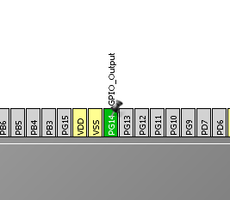

Use WWDG
3.3.1
Create project in CubeMX
Menu > File > New Project
Select STM32F4 > STM32F429/439 > LQFP144 > STM32F439ZITx
CubeMX WWDG selection
Select WWDG
Configure PG14 for LED indication

Slide 7
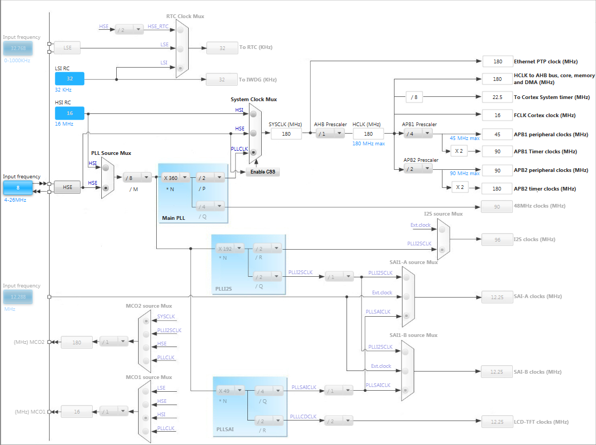
Use WWDG
3.3.1
In order to run on maximum frequency, setup clock system
Details in lab 0

Slide 8
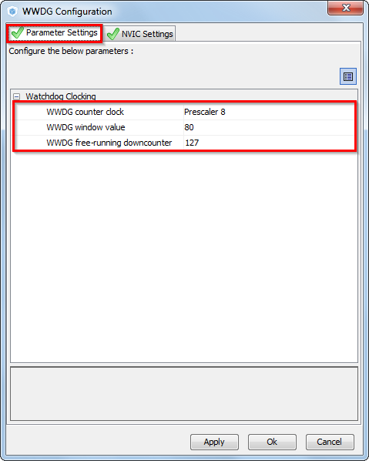
Use WWDG
3.3.1
CubeMX ADC configuration
TAB>Configuration>System> >WWDG>Parameter Settings
Set prescaller to 8
WWDG window to 80
And free running counter to 127
Button OK

Slide 9
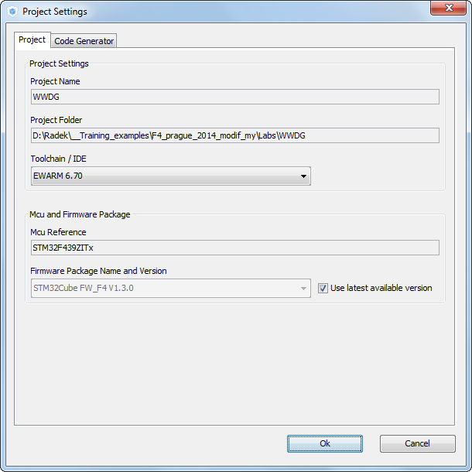
Use WWDG
3.3.1
Now we set the project details for generation
Menu > Project > Project Settings
Set the project name
Project location
Type of toolchain
Now we can Generate Code
Menu > Project > Generate Code

Slide 10
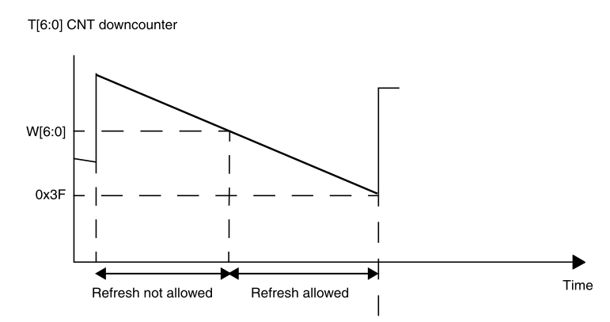
Use WWDG
3.3.1
How calculate the window APB1_{freq}=45MHz, prescaller 8
We refresh the WWDG to 127
In our case 80
Fixed 63

Slide 11
Use WWDG
3.3.1
Solution
WWDG Start
WWDG refresh
/* USER CODE BEGIN 2 */
HAL_WWDG_Start(&hwwdg);
/* USER CODE END 2 */
/* USER CODE BEGIN 3 */
/* Infinite loop */
while (1)
{
//30ms or 50ms is outside the WWDG window, 40ms fits inside the window
HAL_Delay(40);
HAL_GPIO_WritePin(GPIOG, GPIO_PIN_14, GPIO_PIN_SET);
HAL_WWDG_Refresh(&hwwdg, 127);
}
/* USER CODE END 3 */

Slide 12
3.3.2 IWDG lab

Slide 13
Use IWDG
3.3.2
Objective
Learn how to setup IWDG in CubeMX
How to Generate Code in CubeMX and use HAL functions
Create simple application to test IWDG
Goal
Configure IWDG in CubeMX and Generate Code
Learn how to start IWDG
IWDG indication via LED

Slide 14

Use IWDG
3.3.2
Create project in CubeMX
Menu > File > New Project
Select STM32F4 > STM32F429/439 > LQFP144 > STM32F439ZITx
CubeMX IWDG selection
Select IWDG
Configure PG14 for LED indication

Slide 15
Use IWDG
3.3.2
In order to run on maximum frequency, setup clock system
Details in lab 0

Slide 16
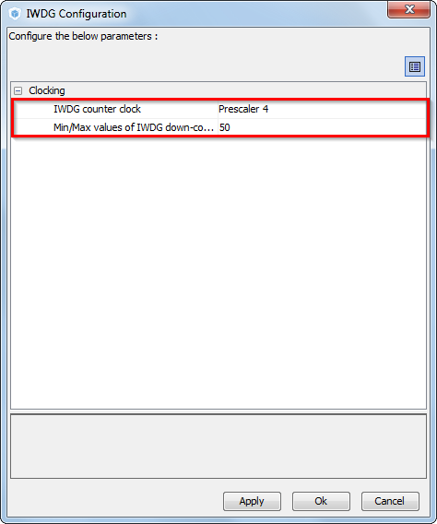
Use IWDG
3.3.2
CubeMX ADC configuration
TAB>Configuration>System> >IWDG>Parameter Settings
Set prescaller to 4
Max value to 50
Button OK

Slide 17
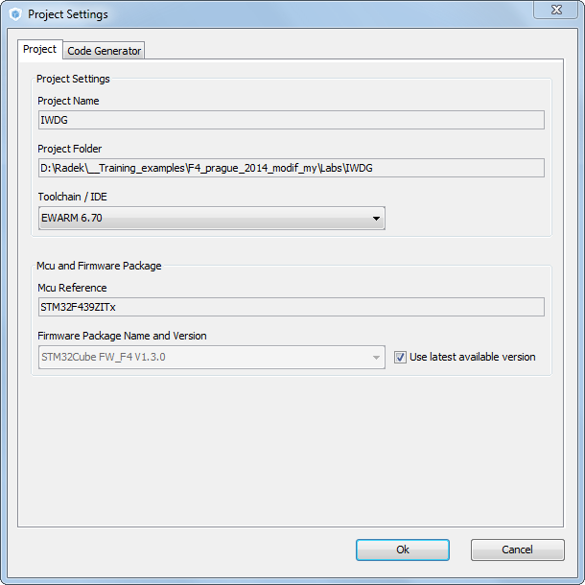
Use IWDG
3.3.2
Now we set the project details for generation
Menu > Project > Project Settings
Set the project name
Project location
Type of toolchain
Now we can Generate Code
Menu > Project > Generate Code

Slide 18
Use IWDG
3.3.2
IWDG refresh interval

Slide 19
Use IWDG
3.3.2
Solution
IWDG Start
IWDG refresh
/* USER CODE BEGIN 2 */
HAL_IWDG_Start(&hiwdg);
/* USER CODE END 2 */
/* USER CODE BEGIN 3 */
/* Infinite loop */
while (1)
{
HAL_Delay(7);//try delay 6ms and 7ms
HAL_GPIO_WritePin(GPIOG,GPIO_PIN_14,GPIO_PIN_SET);
HAL_IWDG_Refresh(&hiwdg);
}
/* USER CODE END 3 */

Slide 20
Use IWDG
3.3.2
Hardware IWDG
Remove IWDG start from project
Use ST-Link utility and enable IWDG Hardware start
/* USER CODE BEGIN 2 */
/* USER CODE END 2 */

Slide 21
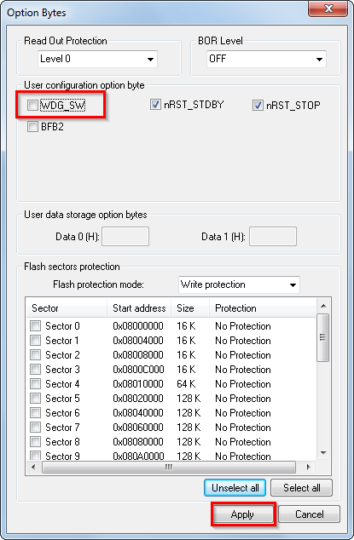
Use IWDG
3.3.2
Hardware IWDG
Start ST-Link utility
Menu>Target>Option bytes or CTRL+B
Uncheck the WDG_WS
Button APPLY
Now the IWDG is automatically started after reset
!!! DO NOT FORGET disable IWDG automatic start after you end this example
Notes:
Check if it is functional

Slide 22
5.1 BSP SDRAM lab

Slide 23
Use BSP for SDRAM initialization
5.1
Objective
Learn how import BSP into project
Which part need to by configured in GUI
Try to write data into SDRAM and read it
Goal
Successfully import BSP into your project
Learn which part you need to import
How to setup the project

Slide 24

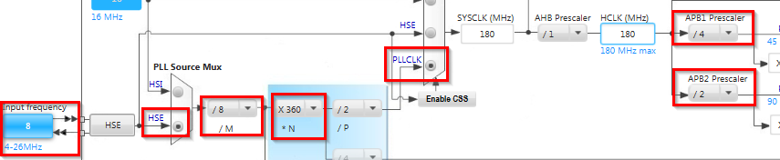
Use BSP for SDRAM initialization
5.1
Create project in CubeMX
Menu > File > New Project
Select STM32F4 > STM32F429/439 > LQFP144 > STM32F439ZITx
We need only blank project with clock initialization
We only set the RCC and configure the core to maximum speed

Slide 25
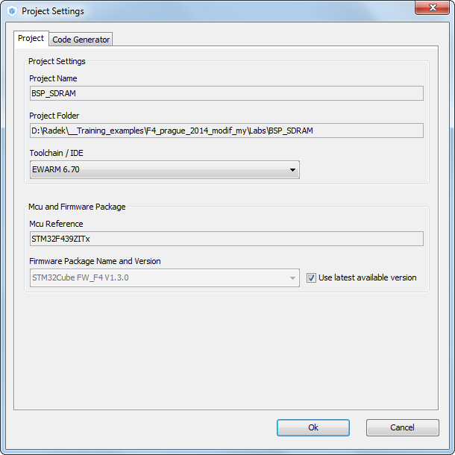
Use BSP for SDRAM initialization
5.1
Now we set the project details for generation
Menu > Project > Project Settings
Set the project name
Project location
Type of toolchain
Now we can Generate Code
Menu > Project > Generate Code

Slide 26
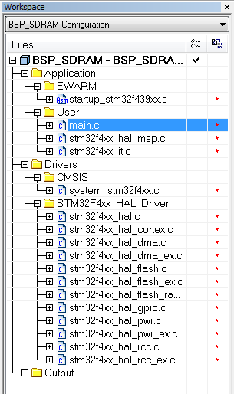
Use BSP for SDRAM initialization
5.1
Now we have bank project
For SDRAM we need to include more parts
Our project
BSP package
Discovery drivers
stm32f4xx_discovery.c
stm32f4xx_discovery_sdram.c
stm32f4xx_discovery_io.c
Components
ili9341.c
lis3dsh.c
stmpe811.c
HAL API
stm32f4xx_II_fmc.c
stm32f4xx_hal_sdram.c
stm32f4xx_hal.c
stm32f4xx_hal_spi.c
stm32f4xx_hal_i2c.c

Slide 27
Use BSP for SDRAM initialization
5.1
BSP SDRAM organization
Our project
BSP package
Discovery drivers
stm32f4xx_discovery.c
stm32f4xx_discovery_sdram.c
stm32f4xx_discovery_io.c
Components
ili9341.c
lis3dsh.c
stmpe811.c
HAL API
stm32f4xx_II_fmc.c
stm32f4xx_hal_sdram.c
stm32f4xx_hal.c
stm32f4xx_hal_spi.c
stm32f4xx_hal_i2c.c

Slide 28
Use BSP for SDRAM initialization
5.1
BSP SDRAM organization
1. include stm32f4xx_discovery_sdram.h
Our project
BSP package
Discovery drivers
stm32f4xx_discovery.c
stm32f4xx_discovery_sdram.c
stm32f4xx_discovery_io.c
Components
2. include stm32f4xx_discovery.h
ili9341.c
lis3dsh.c
stmpe811.c
HAL API
stm32f4xx_II_fmc.c
stm32f4xx_hal_sdram.c
stm32f4xx_hal.c
stm32f4xx_hal_spi.c
stm32f4xx_hal_i2c.c

Slide 29
Use BSP for SDRAM initialization
5.1
BSP SDRAM organization
Our project
3. include stm32f4xx_hal.h
BSP package
Discovery drivers
stm32f4xx_discovery.c
stm32f4xx_discovery_sdram.c
stm32f4xx_discovery_io.c
4. stm32f4xx_hal.h include all peripherals which are used in stm32f4xx_discovery.c
Components
ili9341.c
lis3dsh.c
stmpe811.c
HAL API
stm32f4xx_II_fmc.c
stm32f4xx_hal_sdram.c
stm32f4xx_hal.c
stm32f4xx_hal_spi.c
stm32f4xx_hal_i2c.c

Slide 30
Use BSP for SDRAM initialization
5.1
BSP SDRAM organization
Our project
BSP package
Discovery drivers
stm32f4xx_discovery.c
stm32f4xx_discovery_sdram.c
stm32f4xx_discovery_io.c
5. stm32f4xx_hal.h include all peripherals which are used in stm32f4xx_discovery_sdram.c
Components
ili9341.c
lis3dsh.c
stmpe811.c
HAL API
stm32f4xx_II_fmc.c
stm32f4xx_hal_sdram.c
stm32f4xx_hal.c
stm32f4xx_hal_spi.c
stm32f4xx_hal_i2c.c

Slide 31
Use BSP for SDRAM initialization
5.1
BSP SDRAM organization
6. HAL_SDRAM_Init is function from stm32f4xx_discovery_sdram.c
Our project
7. HAL_SDRAM_Init
call functions from stm32f4xx_II_fmc.c
BSP package
Discovery drivers
stm32f4xx_discovery.c
stm32f4xx_discovery_sdram.c
stm32f4xx_discovery_io.c
Components
8. stm32f4xx_II_fmc.c use functions from stm32f4xx_hal_sdram.c
ili9341.c
lis3dsh.c
stmpe811.c
HAL API
stm32f4xx_II_fmc.c
stm32f4xx_hal_sdram.c
stm32f4xx_hal.c
stm32f4xx_hal_spi.c
stm32f4xx_hal_i2c.c

Slide 32
Use BSP for SDRAM initialization
5.1
Source files
Include files
user_code.c
user_code.h
User Code
stm32f4xx_it.c
stm32f4xx_it.h
Stm32f4xx_discovery.c
Stm32ffxx_discovery_sdram.c
Stm32f4xx_discovery.h
Stm32ffxx_discovery_sdram.h
BSP Drivers
stm32f4xx_hal_ppp.c
stm32f4xx_hal_ppp_ex.c
stm32f4xx_hal.h
HAL Drivers
stm32f4xx_hal_conf.h
stm32f4xx_hal.c
stm32f4xx_hal_ppp.h
stm32f4xx_hal_ppp_ex.h
stm32f4xx_hal_def.h

Slide 33
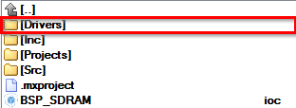

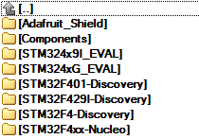

Use BSP for SDRAM initialization
5.1
The copy part
In our project in Drivers folder create folder BSP
Now go into CubeMX repository …\STM32Cube_FW_F4_V1.3.0\Drivers\BSP\
And copy Components and STM32F429I-Discovery into BSP folder
Copy folders into BSP

Slide 34
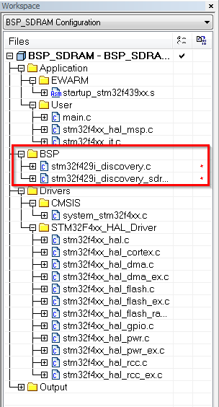
Use BSP for SDRAM initialization
5.1
Now we need to add this files also in project
Create BSP folder in project
Right click on project in Workplace>ADD>Group
Name it BSP
Now right click on BSP>ADD>Files
From Drivers\BSP\STM32F429I-Discovery\ add stm32f429i_discovery.c and stm32f429i_discovery_sdram.c

Slide 35
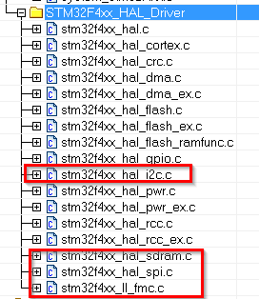
Use BSP for SDRAM initialization
5.1
The stm32f429i_discovery.c contains functions for all components on discovery kit (LCD, GYRO,…)
Then we also need add into project HAL library which handle their interface (I2C, SPI, … )
Right click on STM32F4xx_HAL_Drive>ADD from \Drivers\STM32F4xx_HAL_Driver\Src
stm32f4xx_hal_i2c.c
stm32f4xx_hal_spi.c
stm32f4xx_hal_sdram.c
stm32f4xx_II_fmc.c

Slide 36

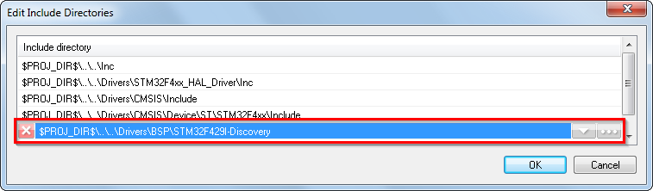
Use BSP for SDRAM initialization
5.1
Now add the include paths for this new files
Right click on project>Options>Category C/C++Compiler>Preprocesor
Into Defined symbols add USE_STM32F429I_DISCO
This allow use BSP functions
Into additional includes add $PROJ_DIR$\..\..\Drivers\BSP\STM32F429I-Discovery
Button OK
Button OK close project options

Slide 37
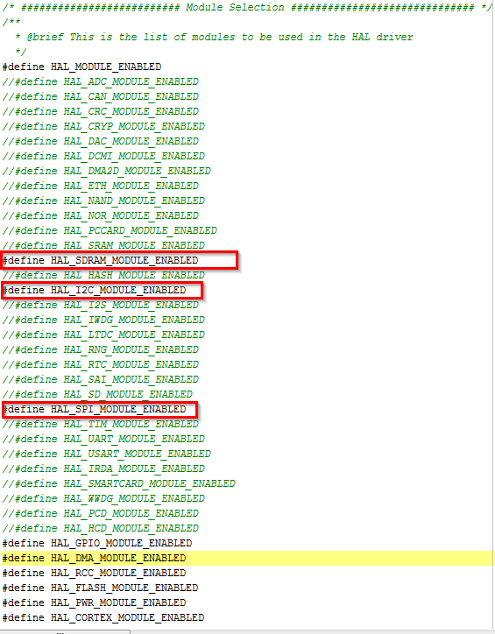
Use BSP for SDRAM initialization
5.1
Now last thing is allow to include new HAL files which we added
Open stm32f4xx_hal_conf.h in ..\Inc\
Uncomment files which we added
HAL_SDRAM_MODULE_ENABLED
HAL_I2C_MODULE_ENABLED
HAL_SPI_MODULE_ENABLED

Slide 38
Use BSP for SDRAM initialization
5.1
Into main.c now we add include of stm32f429i_discovery_sdram.h
Now we can use the SDRAM init functions from BSP
Now you can try to write into SDRAM area In stm32f429i_discovery_sdram.h you can find where is the SDRAM memory and how is their size
SDRAM_DEVICE_ADDR ((uint32_t)0xD0000000)
SDRAM_DEVICE_SIZE ((uint32_t)0x800000) /* SDRAM device size in MBytes */
/* USER CODE BEGIN Includes */
#include "stm32f429i_discovery_sdram.h"
/* USER CODE END Includes */
/* USER CODE BEGIN 2 */
BSP_SDRAM_Init();
/* USER CODE END 2 */

Slide 39
Use BSP for SDRAM initialization
5.1
SDRAM test
/* USER CODE BEGIN PV */
volatile uint32_t value;
/* USER CODE END PV */
/* USER CODE BEGIN 2 */
BSP_SDRAM_Init();
*((uint32_t*)SDRAM_DEVICE_ADDR)=0x12345678;
value=*((uint32_t*)SDRAM_DEVICE_ADDR);
/* USER CODE END 2 */

Slide 40
5.2 BSP LCD lab

Slide 41
Use BSP for LCD init and writing
5.2
Objective
Learn how import BSP LCD into project
Because the LCD use the SDRAM we use project from lab 25
Which part need to by configured in GUI
Try to write text on LCD
Goal
Successfully import BSP LCD into your project
Learn which part you need to import
How to setup the project

Slide 42
Use BSP for LCD init and writing
5.2
BSP LCD organization
Our project
BSP package
Discovery drivers
stm32f4xx_discovery.c
stm32f4xx_discovery_lcd.c
stm32f4xx_discovery_sdram.c
Components
Utilities
ili9341.c
lis3dsh.c
stmpe811.c
Fonts
HAL API
stm32f4xx_hal_sdram.c
stm32f4xx_hal_ltdc.c
stm32f4xx_hal.c
stm32f4xx_hal_spi.c
stm32f4xx_II_fmc.c
stm32f4xx_hal_i2c.c

Slide 43
Use BSP for LCD init and writing
5.2
BSP LCD organization
1. include stm32f4xx_discovery_lcd.h
Our project
BSP package
Discovery drivers
stm32f4xx_discovery.c
stm32f4xx_discovery_lcd.c
stm32f4xx_discovery_sdram.c
2. stm32f4xx_discovery_lcd.h use the discovery BSP and SDRAM
Components
Utilities
ili9341.c
lis3dsh.c
stmpe811.c
Fonts
HAL API
stm32f4xx_hal_sdram.c
stm32f4xx_hal_ltdc.c
stm32f4xx_hal.c
stm32f4xx_hal_spi.c
stm32f4xx_II_fmc.c
stm32f4xx_hal_i2c.c

Slide 44
Use BSP for LCD init and writing
5.2
BSP LCD organization
Our project
3. stm32f4xx_discovery_lcd.h use driver ili9341.c which is TFT LCD controller
BSP package
Discovery drivers
stm32f4xx_discovery.c
stm32f4xx_discovery_lcd.c
stm32f4xx_discovery_sdram.c
Components
Utilities
4. stm32f4xx_discovery_lcd.h use LCTD controller from HAL
ili9341.c
lis3dsh.c
stmpe811.c
Fonts
HAL API
stm32f4xx_hal_sdram.c
stm32f4xx_hal_ltdc.c
stm32f4xx_hal.c
stm32f4xx_hal_spi.c
stm32f4xx_II_fmc.c
stm32f4xx_hal_i2c.c

Slide 45
Use BSP for LCD init and writing
5.2
BSP LCD organization
Our project
BSP package
Discovery drivers
stm32f4xx_discovery.c
stm32f4xx_discovery_lcd.c
stm32f4xx_discovery_sdram.c
Components
Utilities
2. stm32f4xx_discovery_lcd.h use fonts from utility folder
ili9341.c
lis3dsh.c
stmpe811.c
Fonts
HAL API
stm32f4xx_hal_sdram.c
stm32f4xx_hal_ltdc.c
stm32f4xx_hal.c
stm32f4xx_hal_spi.c
stm32f4xx_II_fmc.c
stm32f4xx_hal_i2c.c

Slide 46
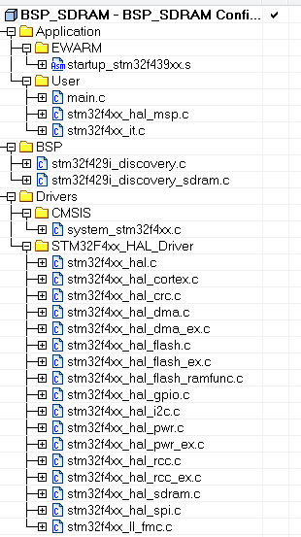
Use BSP for LCD init and writing
5.2
We use the project from BSP SDRAM because the LCD also use the SDRAM
We need copy the Fonts from Utilities folder in CubeMX repository

Slide 47
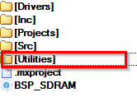
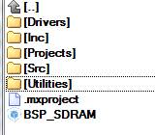
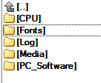
Use BSP for LCD init and writing
5.2
The copy part
In our project in Drivers folder create folder Utilities
Now go into CubeMX repository …\STM32Cube_FW_F4_V1.3.0\Utilities\
And copy Fonts into Utilities folder
Copy folders into Utilities

Slide 48
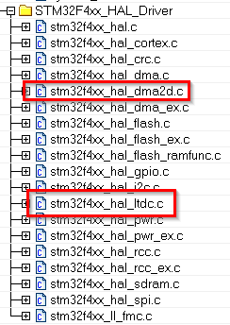
Use BSP for LCD init and writing
5.2
We add the driver for LCD from HAL
Right click on STM32F4xx_HAL_Drive>ADD from \Drivers\STM32F4xx_HAL_Driver\Src
stm32f4xx_hal_ltdc.c
Stm32f4xx_hal_dma2d.c

Slide 49

Use BSP for LCD init and writing
5.2
We add the driver for BSP LDC
Right click on BSP>ADD from \Drivers\BSP\STM32F429I-Discovery\
stm32f429i_discovery_lcd.c
Right click on BSP>ADD from \Drivers\BSP\Components\ili9341\
ili9341.c

Slide 50
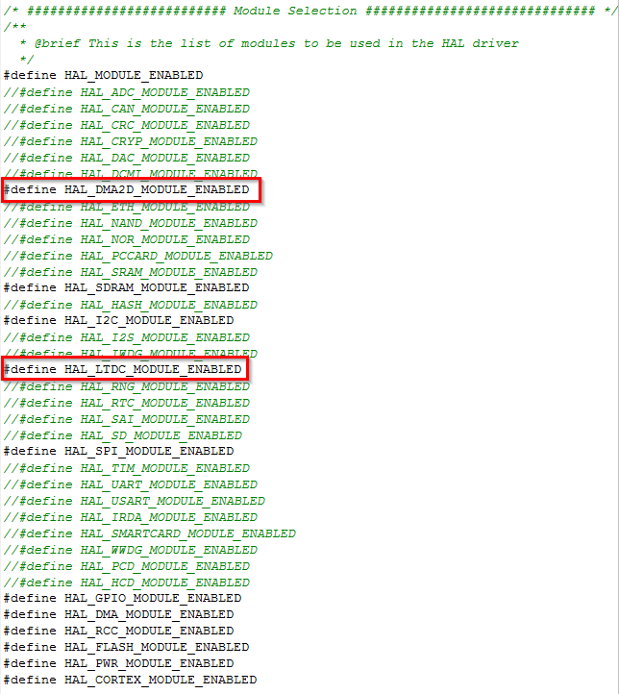
Use BSP for LCD init and writing
5.2
Now last thing is allow to include new HAL files which we added
Open stm32f4xx_hal_conf.h in ..\Inc\
Uncomment files which we added
HAL_DMA2D_MODULE_ENABLED
HAL_LTDC_MODULE_ENABLED

Slide 51
Use BSP for LCD init and writing
5.2
Into main.c now we modify include from stm32f429i_discovery_sdram.h to stm32f429i_discovery_lcd.h
And remove the BSP_SDRAM_Init()
/* USER CODE BEGIN Includes */
#include "stm32f429i_discovery_lcd.h"
/* USER CODE END Includes */
/* USER CODE BEGIN 2 */
/* USER CODE END 2 */

Slide 52
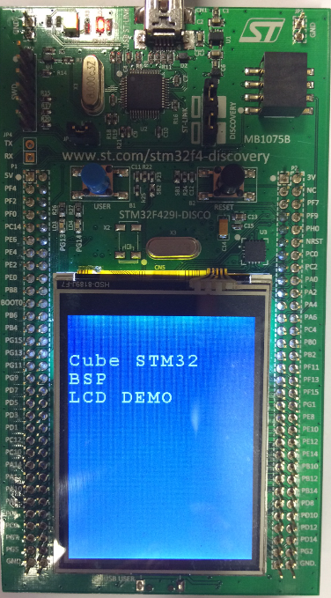
Use BSP for LCD init and writing
5.2
Simple LCD demonstration
/* USER CODE BEGIN 2 */
BSP_LCD_Init();//init LCD
//set the layer buffer address into SDRAM
BSP_LCD_LayerDefaultInit(1, SDRAM_DEVICE_ADDR);
BSP_LCD_SelectLayer(1);//select on which layer we write
BSP_LCD_DisplayOn();//turn on LCD
BSP_LCD_Clear(LCD_COLOR_BLUE);//clear the LCD on blue color
BSP_LCD_SetBackColor(LCD_COLOR_BLUE);//set text background color
BSP_LCD_SetTextColor(LCD_COLOR_WHITE);//set text color
//write text
BSP_LCD_DisplayStringAtLine(2,"Cube STM32");
BSP_LCD_DisplayStringAtLine(3,"BSP");
BSP_LCD_DisplayStringAtLine(4,"LCD DEMO");
/* USER CODE END 2 */

Slide 53
www.st.com/stm32

