Slide 1



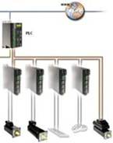
bxCAN – STM32F0xx
Atollic - TrueStudio
06/2018 – Bruno Montanari – v0a

Slide 2
Agenda
Presentation
Time
    Overview
    Download and First Steps
    Debug Features
      Basics
    bxCAN
      Introduction
      Features
      General Description
      Operating Modes
      Test Mode
      Functional description
      Filters
    Hands On
14:00 – 17:00

Slide 3
Overview

Slide 4

TrueStudio
A powerful eclipse based C/C++ IDE
TrueSTUDIO® is based on open standards (ECLIPSE and GNU) and extended with professional features for code management and advanced system analysis. This gives a unique insight into the structure and the dynamic behavior of the system.
In particular, TrueSTUDIO® provides STM32 developers with a wide selection of system analysis functions, helping them to assess the design soundness from a variety of angles (including static analysis on memory and stack usage, as well as visualizing the dynamic behavior of the running system).

Slide 5
TrueStudio – Key Features
Built on Eclipse, CDT, GCC and GDB
Project Management
  Project wizards
  Importers
  Configuration tools
  CMSIS-PACK
Editor
  Advanced code editing
  Navigation, refactoring, styling and structure visualization
Compiler and Build tools
  Highly optimized C/C++ compiler
  Assembler, linker and utilities
Memory and stack analyzers to find bugs that cannot be identified studying the source code
RTOS-aware debugger with advanced trace, visualization and analysis capabilities
ST-LINK and J-LINK support
Client for bug and issue tracking systems such as Bugzilla, Trac, Mantis
Version Control system clients for Subversion (SVN), Git and CVS
Source code review
Technical support

Slide 6
Download and Installation

Slide 7
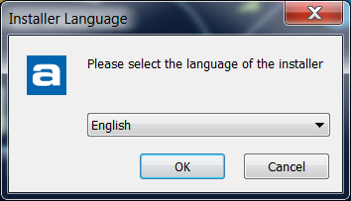
Download and Installation
Windows
First thing, Atollic TrueStudio installer can be downloaded from www.atollic.com
If we do a Seminar using this tool, it’s recommended not to install it directly from a USB memory
The installation itself is straight forward: run the executable, choose the language:

Slide 8
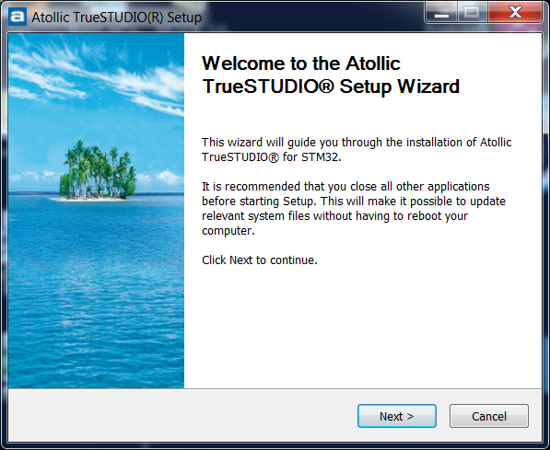
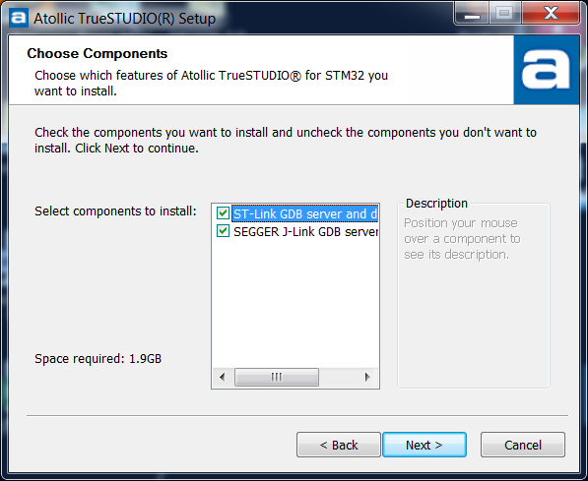
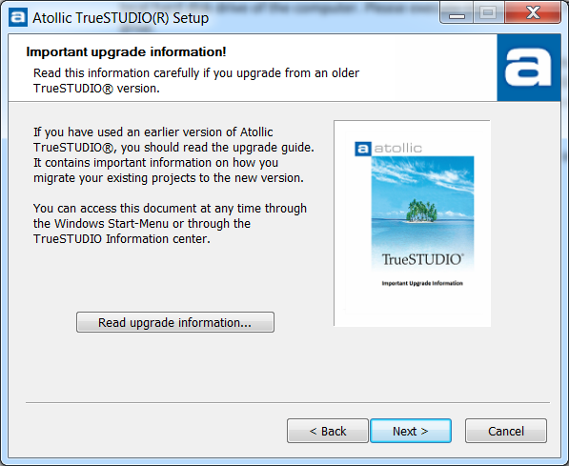
Download and Installation
Windows
Click Next in all Tabs

Slide 9
Download and Installation
Linux
Install and start Atollic TrueSTUDIO on Linux using the following three steps:
  Extract the downloaded archive, command example:
  $ tar -xvf ~/Downloads/Atollic_TrueSTUDIO_for_STM32_linux_x86_64_9.0.0_yyyymmdd-hhmm.tar.gz
  Run install.sh to install the product
  $ cd Atollic_TrueSTUDIO_for_ARM_9.0.0_installer && sudo ./install.sh
  Start Atollic TrueSTUDIO from the Applications menu, or alternatively start from the command line:
  $ cd /opt/Atollic_TrueSTUDIO_for_STM32_9.0.0/ide && ./TrueSTUDIO

Slide 10
Debug Features

Slide 11
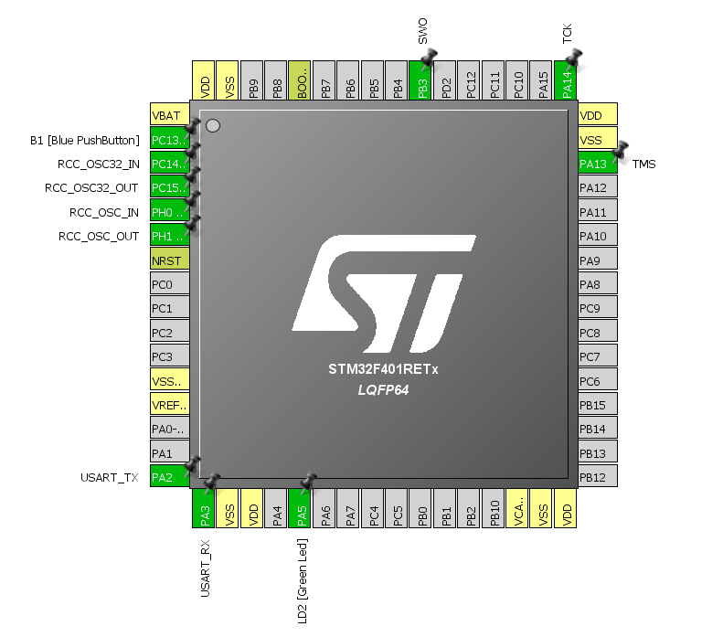

STM32CubeMX Project
For the video that demonstrated the debug basics, the board used is: NUCLEO-F401RE
The configuration used was:

Slide 12





Debug - Basics
Understanding the basics
Tool bar for building:
  Build Project
  Rebuild the Project, which means it will clean and build
  This is the Clean, it will only clean the build
  Access the build settings
  Select the build configuration to be used

Slide 13
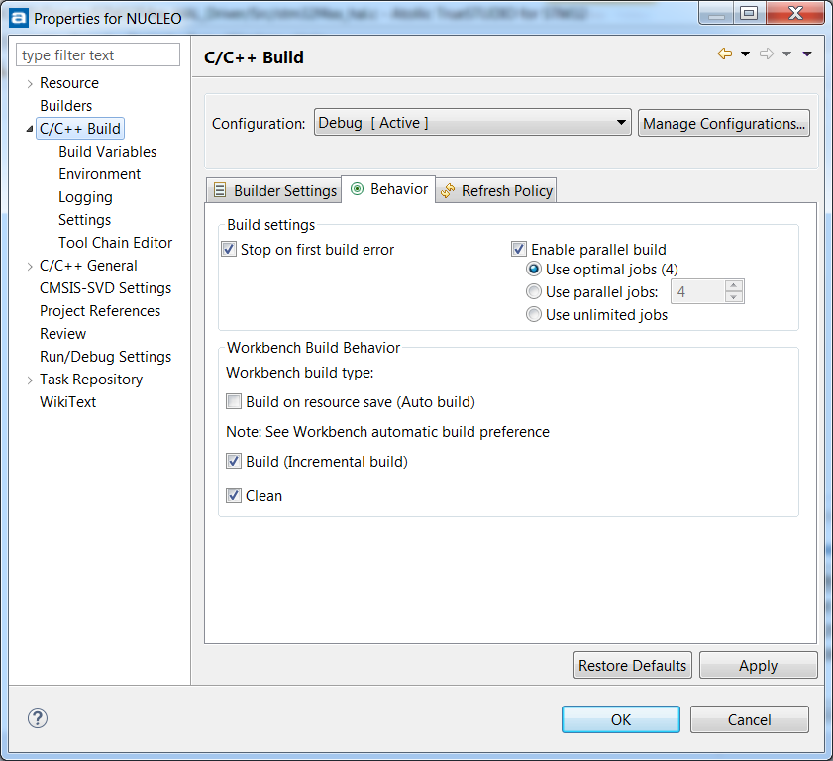
Debug - Basics
Building Settings:
  The first thing we may want to change is to enable the parallel build, to speed up the overall time of building/re-build
    It will go from 20sec to 13sec in the blink LED demo example

Slide 14
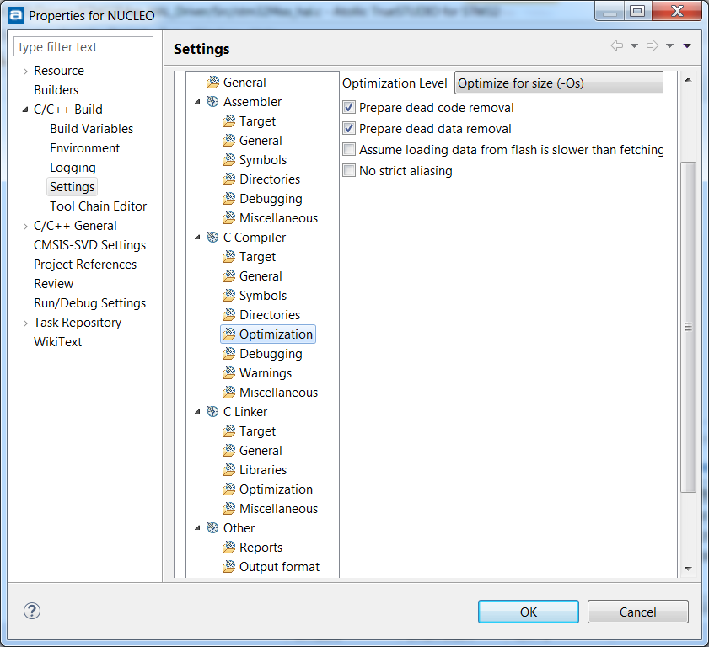
Debug - Basics
Building Settings:
  The code optimization can be changed here:

Slide 15
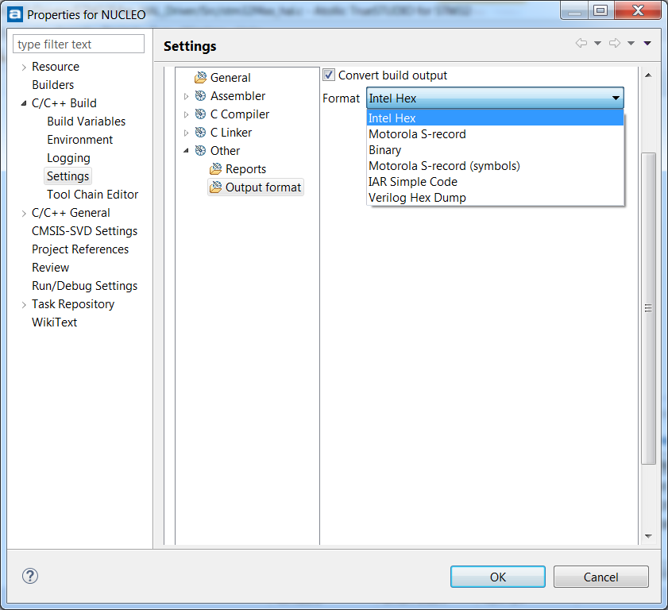
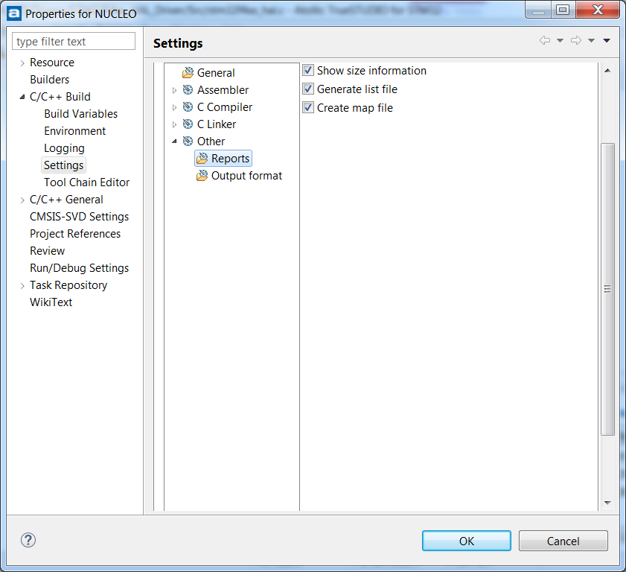
Debug - Basics
Using the building settings to:
  Change the output Add the map and list files

Slide 16
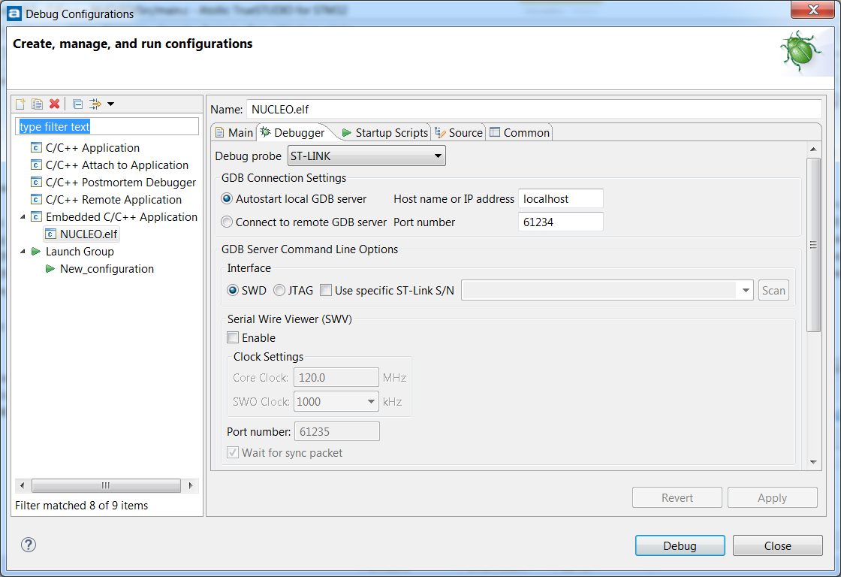
Debug – Basics
Starting the debug session
To enter in Debug Mode, just click in the icon:
If the project was not created by STM32CubeMX or if it was migrated from a different workspace, it’ll request to configure the debug session first:

Slide 17
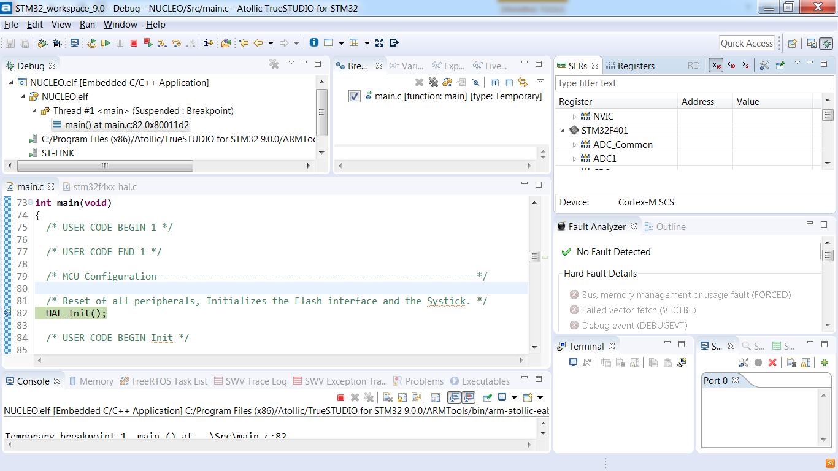
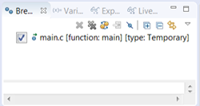
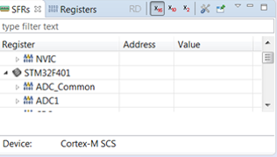
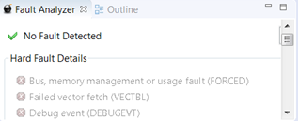
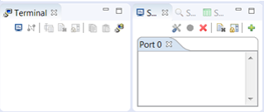

Debug - Basics
Default Perspective

Slide 18
How to turn STLINK into JLINK

Slide 19
Debug with Jlink
The most important feature that can be added to the basic debug functionalities is the live expression
Since this feature is not support using STLINK with TrueStudio, it’s possible to change the programmer firmware, so it can become a Jlink
The tutorial is public at Segger’s webpage: https://www.segger.com/products/debug-probes/j-link/models/other-j-links/st-link-on-board/

Slide 20
Debug with Jlink
In order to get started with STLINK onboard and upgrade it to Jlink, follow these steps:
  Make sure that the ST-LINK USB drivers are installed: Download
  Make sure that the J-Link software package V5.12b or later is installed: Download
  Download the SEGGER STLinkReflash utility: Download
  Start the STLinkReflash utility
  Agree to the license terms

Slide 21
bxCAN - Intro

Slide 22
bxCAN - Intro
Basic Extended Controller Area Network Interface or for us, bxCAN ;)
  CAN is an asynchronous serial communication protocol
  Multi-master concept
    CSMA/CA (Carrier Sense Multiple Access / Collision Avoidance)
    Message priority
  Object-oriented communication
    No node addressing, but content identification
  Real-time capability
    Low message transfer latency
  System wide message consistency
    Error detection & management mechanism

Slide 23
bxCAN - Intro
Overview:
  The controller area network (CAN) is a standard serial differential bus broadcast interface, allowing the microcontroller to communicate with external devices connected to the same network bus.
  The CAN interface is highly configurable, allowing nodes to easily connect using two wires.
  Applications benefit from the low-cost, robust, and direct asynchronous serial asynchronous interface.

Slide 24
bxCAN - Intro
Provides simple communication interface with external devices via two pins
  Highly configurable
  Supports standard asynchronous serial protocols
Node 1
Node N
. . .
CAN high
120Ω
120Ω
  Low cost: Only two pins needed
High-speed, real-time communication.
Robust in electromagnetically noisy environments
CAN low
Application benefits
CAN Bus Line
Notes:
1 Mbit/s 40 m
500 kbit/s 110 m
250 kbit/s 240 m
125 kbit/s 500 m
50 kbit/s 1.3 km
20 kbit/s 3.3 km
10 kbit/s 6.6 km
5 kbit/s 130 km

Slide 25
bxCAN - Features
Supports CAN protocol versions 2.0 A and B Active
Bit rates up to 1Mbit/s
  Three transmit mailboxes with configurable transmit priority option
Two receive FIFOs with three stages with 14 scalable filter banks
4 dedicated interrupt vectors: transmit interrupt, FIFO0 interrupt, FIFO1 interrupt and status change error interrupt
Supports the Time Triggered Communication option
Notes:
The STM32 CAN peripheral supports the Basic Extended CAN protocol versions 2.0 A and B Active with a maximum bit rate of 1 Mbit/s. The BxCAN includes 3 transmit mailboxes with a configurable transmit priority option and 2 receive FIFOs with three stages with 14 scalable filter banks. This allows the CAN to efficiently manage a high number of incoming and outgoing messages with a minimum CPU load.
The BxCAN peripheral also manages four dedicated interrupt vectors.

Slide 26
bxCAN - Features
Transmission:
  3 transmit mailboxes
  Configurable transmit priority
  Time Stamp on SOF transmission
Reception:
  Two receive FIFOs with three stages
  Scalable filter banks: – 14 filter banks
  Identifier list feature
  Configurable FIFO overrun
  Time Stamp on SOF reception
  Software-efficient mailbox mapping at a unique address space

Slide 27
bxCAN – General Description
In addition to the application messages, Network Management and Diagnostic messages have been introduced.
  An enhanced filtering mechanism is required to handle each type of message.
Application tasks require more CPU time, therefore real-time constraints caused by message reception have to be reduced.
  A receive FIFO scheme allows the CPU to be dedicated to application tasks for a long time period without losing messages.
The standard HLP (Higher Layer Protocol) based on standard CAN drivers requires an efficient interface to the CAN controller

Slide 28
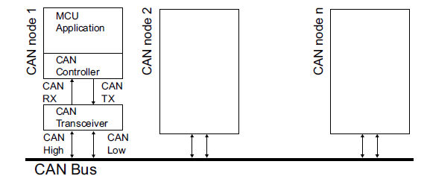
bxCAN – General Description
From this macro block, the topology is expandated like this:
Node 1
Node N
. . .
CAN high
120Ω
120Ω
CAN low
CAN Bus Line

Slide 29
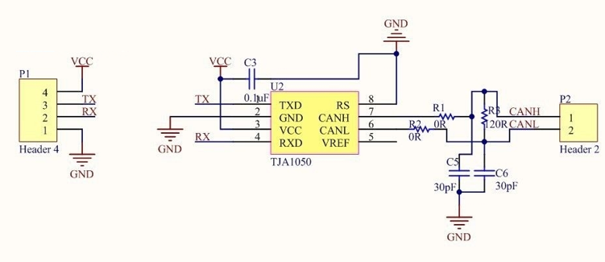
bxCAN – General Description
In terms of hardware, here are couple of possible tranceiver options, the hardware used in this tranning will be this:

Slide 30
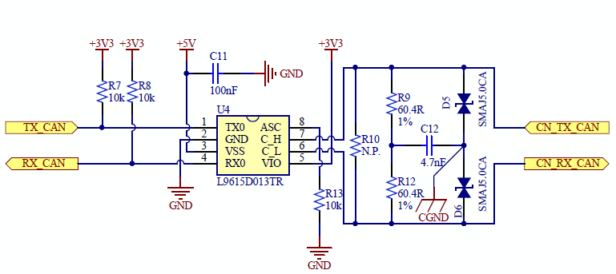
bxCAN – General Description
A professional hardware option, with given protections would be like this:

Slide 31
bxCAN – General Description
CAN 2.0B active core
  The bxCAN module handles the transmission and the reception of CAN messages fully autonomously. Standard identifiers (11-bit) and extended identifiers (29-bit) are fully supported by hardware.
Control, status and configuration registers
  The application uses these registers to:
    Configure CAN parameters, e.g. baud rate
    Request transmissions
    Handle receptions
    Manage interrupts
    Get diagnostic information

Slide 32
bxCAN – General Description
Tx mailboxes
  Three transmit mailboxes are provided to the software for setting up messages. The transmission Scheduler decides which mailbox has to be transmitted first.
Acceptance filters
  The bxCAN provides up 28 scalable/configurable identifier filter banks for selecting the incoming messages the software needs and discarding the others.
    CAN1 has the filters from 0..13 and CAN2, when available has the 14..27 filters position
Receive FIFO
  Two receive FIFOs are used by hardware to store the incoming messages. Three complete messages can be stored in each FIFO. The FIFOs are managed completely by hardware.

Slide 33
bxCAN – Operating Modes
The bxCAN has three main operating modes:
  Initialization
  Normal
  Sleep.
After a hardware reset, the bxCAN is in Sleep mode which operates at a lower power.
The bxCAN enters Initialization mode via software to allow the configuration of the peripheral.

Slide 34
bxCAN - Operating Modes
Reset
Sleep mode
Normal mode
Initialization mode
Operation mode
Test mode
Notes:
The BxCAN has three main operating modes: Initialization, Normal and Sleep. After a hardware reset, the BxCAN is in Sleep mode which operates at a lower power (Note: In Sleep mode, the internal pull-up is active on pin CANTX). The BxCAN enters Initialization mode via software to allow the configuration of the peripheral. Before entering Normal mode, the BxCAN must synchronize with the CAN bus, so it waits until the bus is idle (this means 11 consecutive recessive bits have been monitored on pin CANRX).
When the CAN is in Normal mode, the user can select whether to run in Operation or Test mode.

Slide 35
bxCAN - Test Modes
Silent
Loopback
Combined Loopback and Silent
CAN TX
CAN RX
CAN TX
CAN RX
CAN TX
CAN RX
=1
=1
TX
RX
TX
RX
TX
RX
CAN Core
CAN Core
CAN Core
Transmission is internally looped to RX
Reception remains possible
CAN TX is held recessive
Transmission is internally looped to RX
Transmission remains possible
CAN RX is ignored
Transmission is internally looped to RX
Allows host self-test
Node is disconnected from the CAN bus
Notes:
The BxCAN supports three test modes:
In Silent mode, the BxCAN is able to receive valid frames, but it sends only recessive bits on the CAN bus and it cannot start a transmission. Silent mode can be used to analyze traffic on a CAN bus without affecting it by the transmission of dominant bits.
In Loop Back mode, the BxCAN treats its own transmitted messages as received messages and stores them (if they pass acceptance filtering) in a Receive mailbox. Loop Back mode is provided for self-test functions.
Combined Loop Back and Silent mode. In this mode, the BxCAN can be tested in Loop Back mode but without affecting the running CAN system connected to the CANTX and CANRX pins.

Slide 36
bxCAN – Functional Description
Transmission handling:
  In order to transmit a message, the application must:
    select one empty transmit mailbox
    set up the identifier
    the data length code (DLC)
    the data
  All this before requesting the transmission
  Transmit priority by identifier
    When more than one transmit mailbox is pending, the transmission order is given by the identifier of the message stored in the mailbox. The message with the lowest identifier value has the highest priority. If the identifier values are equal, the lower mailbox number will be scheduled first.
  Transmit priority by transmit request order
    In this mode the priority order is given by the transmit request order. This mode is very useful for segmented transmission.

Slide 37
bxCAN – Functional Description
Reception handling
  For the reception of CAN messages, three mailboxes organized as a FIFO are provided.
  In order to save CPU load, simplify the software and guarantee data consistency, the FIFO is managed completely by hardware.
  The application accesses the messages stored in the FIFO through the FIFO output mailbox.
Valid Message
  A received message is considered as valid when it has been received correctly according to the CAN protocol (no error until the last but one bit of the EOF field) and It passed through the identifier filtering successfully,

Slide 38
bxCAN – Functional Description
FIFO management
  Starting from the empty state, the first valid message received is stored in the FIFO which becomes pending_1. The hardware signals the event setting the FMP[1:0] bits in the CAN_RFR register to the value 01b.
  The message is available in the FIFO output mailbox. The software reads out the mailbox content and releases it by setting the RFOM bit in the CAN_RFR register.
  The FIFO becomes empty again. If a new valid message has been received in the meantime, the FIFO stays in pending_1 state and the new message is available in the output mailbox.
  If the application does not release the mailbox, the next valid message will be stored in the FIFO which enters pending_2 state (FMP[1:0] = 10b). The storage process is repeated for the next valid message putting the FIFO into pending_3 state (FMP[1:0] = 11b). At this point, the software must release the output mailbox by setting the RFOM bit, so that a mailbox is free to store the next valid message. Otherwise the next valid message received will cause a loss of message.

Slide 39
bxCAN – Functional Description
Reception related interrupts
  Once a message has been stored in the FIFO, the FMP[1:0] bits are updated and an interrupt request is generated if the FMPIE bit in the CAN_IER register is set.
  When the FIFO becomes full (i.e. a third message is stored) the FULL bit in the CAN_RFR register is set and an interrupt is generated if the FFIE bit in the CAN_IER register is set.
  On overrun condition, the FOVR bit is set and an interrupt is generated if the FOVIE bit in the CAN_IER register is set

Slide 40
bxCAN - Filters
Identifier filtering
  In the CAN protocol the identifier of a message is not associated with the address of a node but related to the content of the message.
  On message reception a receiver node decides - depending on the identifier value - whether the software needs the message or not.
  The bxCAN Controller provides scalable filter banks to the application in order to receive only the messages the software needs.
  This hardware filtering saves CPU resources which would be otherwise needed to perform filtering by software.
Notes:
Consequently a transmitter broadcasts its message to all receivers.
If the message is needed, it is copied into the SRAM. If not, the message must be discarded without intervention by the software.

Slide 41
bxCAN - Filters
Scalable width
  To optimize and adapt the filters to the application needs, each filter bank can be scaled independently.
  Depending on the filter scale a filter bank provides:
    One 32-bit filter
    Two 16-bit filters
  The filters can be configured in mask mode or in identifier list mode
    Mask Mode
    Identifier List Mode

Slide 42
bxCAN - Filters
Mask mode
  The identifier registers are associated with mask registers specifying which bits of the identifier are handled as “must match” or as “don’t care”.
  Use this mode to filter a group of identifiers
Identifier list mode
  The mask registers are used as identifier registers.
  Instead of defining an identifier and a mask, two identifiers are specified, doubling the number of single identifiers.
  All bits of the incoming identifier must match the bits specified in the filter registers.
  Use this mode to select single identifiers

Slide 43
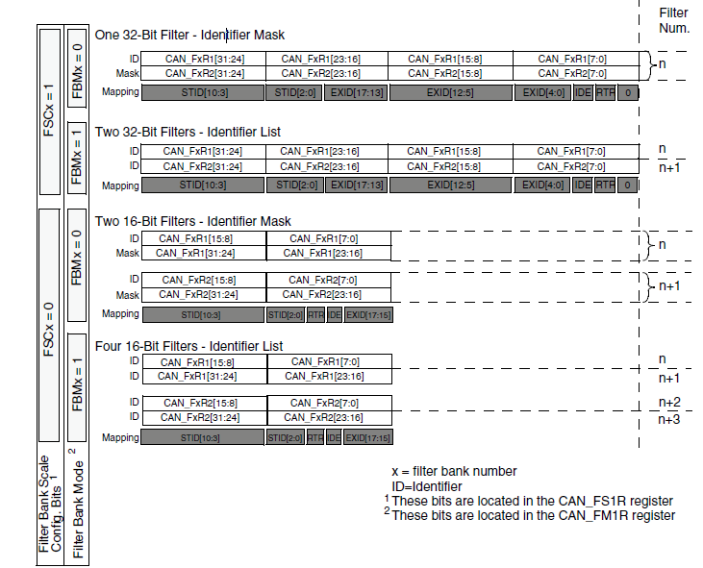
bxCAN - Filters
Filter Bank Scale Configuration:

Slide 44
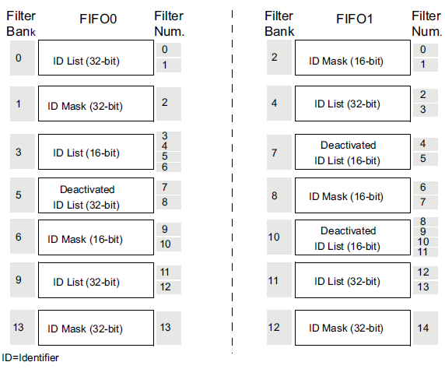
bxCAN - Filters
Once a message has been received in the FIFO it is available to the application. An example of filter numbering:

Slide 45
bxCAN - Filters
Filter priority rules
  Depending on the filter combination it may occur that an identifier passes successfully through several filters.
  In this case the filter match value stored in the receive mailbox is chosen according to the following priority rules:
    A 32-bit filter takes priority over a 16-bit filter.
    For filters of equal scale, priority is given to the Identifier List mode over the Identifier Mask mode
    For filters of equal scale and mode, priority is given by the filter number (the lower the number, the higher the priority).

Slide 46
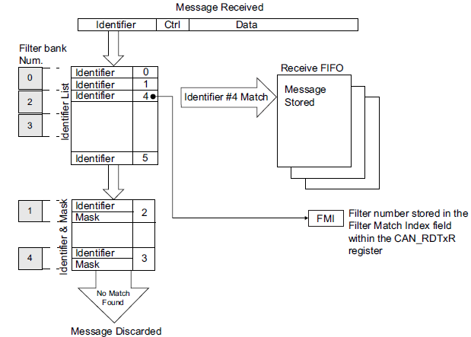
bxCAN - Filters
Filtering mechanism example:

Slide 47
Block diagram – bxCAN
Tx mailboxes
Receive FIFO 0
Receive FIFO 1
Control configuration registers
Mailbox 2
Master Control
Interrupt Enable
Mailbox 2
Mailbox 2
Mailbox 1
Mailbox 1
Mailbox 1
Bit Timing
Mailbox 0
Mailbox 0
Mailbox 0
Filter configuration registers
Transmission
Scheduler
Filter Master
Filter Scale
Filter Mode
CAN 2.0B Active Core
Filter Bank x[13:0]
Acceptance filters
Filter Activation
Filter FIFO Assignment
Filter 0
Memory Access Controller
1
..
Status registers
n
..
Transmit Status
Master Status
13
Receive FIFO1 Status
Error Status
Receive FIFO0 Status
Filter range: 0 .. 13
Notes:
This simplified block diagram of the CAN shows its basic functional and control features.
- Three types of registers: Control configuration registers, filter configuration registers and status registers.
- Three transmit mailboxes are provided to the software for setting up messages. The Transmission Scheduler decides which mailbox has priority to be transmitted first.
- The BxCAN provides 14 scalable and configurable identifier filters for selecting the incoming messages the application needs and discarding the others.
- Two receive FIFOs: FIFO0 and FIFO1 are used by hardware to store incoming messages. Each FIFO can store three complete messages. The FIFOs are managed completely by hardware.

Slide 48
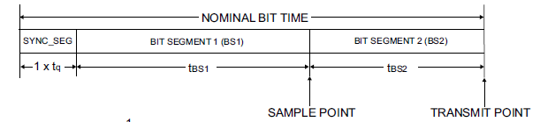
bxCAN - BaudRate
Below is the math behind the Baud Rate
BaudRate = 1/NominalBitTime
  NominalBitTime = 1*tq+tBS1+tBS2
  tBS1 = tq*(TS1[3:0]+1)
  tBS2 = tq*(TS2[2:0]+1)
  tq (this is given by STM32CubeMX)

Slide 49
bxCAN - Hands On
3 Hands On examples will be shown:
  A simple CAN implementation with no filter
  Identifier CAN filter with 2 FIFOs and 2 filters
  Mask CAN filter with 1 FIFO
All examples will use the concept:
  TX will be made by polling
  RX will be made by interrupt
  3 Nodes in all demos
Hardware
  NUCLEO-F091RC

Slide 50
bxCAN – Hands On
Let’s cover the common ground for all the demos
  STM32CubeMX MCU
  Peripheral configuration
  Functions
  Pointers and Buffers
There are ifdefs in the code to facilitate the demo selection
#define CAN_NODE1 1
//#define CAN_NODE2 2
//#define CAN_NODE3 3
#define NO_CAN_FILTER 1
//#define IDENTIFIER_CAN_FILTER 2
//#define MASK_CAN_FILTER 3

Slide 51
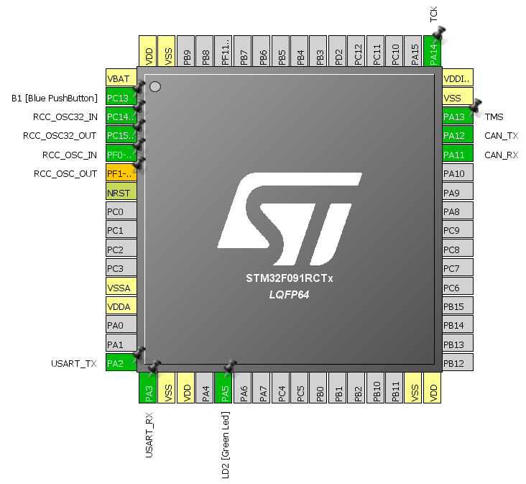
bxCAN – Hands On
In STM32CubeMX, create a new project with the NUCLEO-F091RC
  Configure the CAN peripheral and start all peripherals by default:

Slide 52
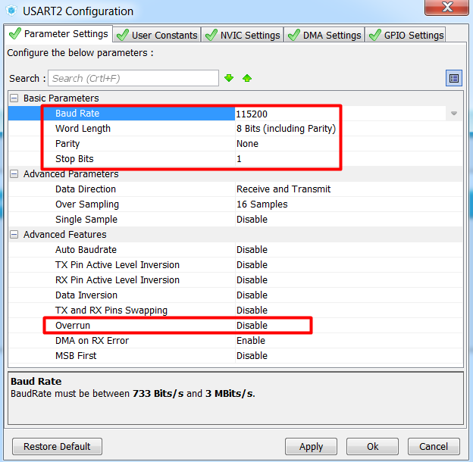
bxCAN – Hands On
The clock will be automaticall set to use HSI with PLL to get 48MHz
In the Configuration Tab
  USART2:

Slide 53
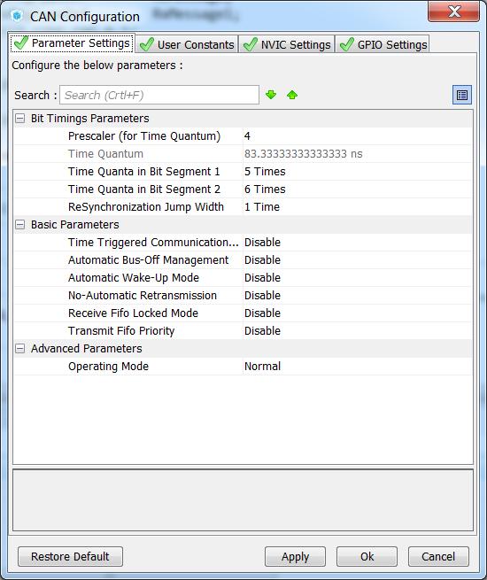
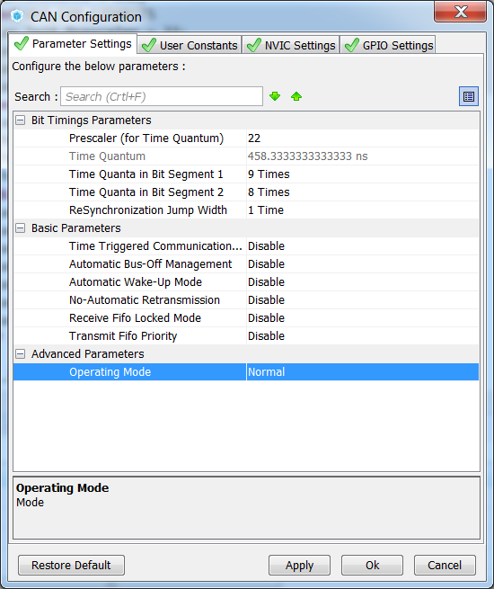
bxCAN – Hands On
CAN for 1Mbit/s: for 125Kbit/s:

Slide 54
bxCAN – Hands On
Let’s get to the code!
Remember to add the CAN interrupt!
It’s currently available in my github page> https://github.com/Montanari9/CAN_training
The overall for all the demos:
  There is a LED_Display function that will change the LED blinking time every time the key button is pressed
  This function is also called whenever a valid CAN package is received, so the blinking frequency of the sender will be the same of the receiver

Slide 55
bxCAN – Hands On
void LED_Display(uint8_t LedStatus)
{
/* Turn OFF the LED */
HAL_GPIO_WritePin(LD2_GPIO_Port,LD2_Pin,GPIO_PIN_RESET);
switch(LedStatus)
{
case (1):
/* Blink LED every 100ms */
ubLedBlinkTime = 1;
break;
case (2):
/* Blink LED every 200ms */
ubLedBlinkTime = 2;
break;
case (3):
/* Blink LED every 300ms */
ubLedBlinkTime = 3;
break;
case (4):
/* Blink LED every 400ms */
ubLedBlinkTime = 4;
break;
default:
break;
}
}
LED handling:

Slide 56
bxCAN – Hands On
1ms periodic call
/* USER CODE BEGIN 4 */
void HAL_SYSTICK_Callback(void){
static uint16_t u16LedBlinkCounter = 0;
if(u16LedBlinkCounter){
u16LedBlinkCounter--;
}
else{
u16LedBlinkCounter = 100*ubLedBlinkTime;//delay based in the received value
HAL_GPIO_TogglePin(LD2_GPIO_Port,LD2_Pin);
}
}

Slide 57
bxCAN – Hands On
Main LOOP:
while (1){
/* USER CODE END WHILE */
/* USER CODE BEGIN 3 */
while (HAL_GPIO_ReadPin(B1_GPIO_Port,B1_Pin) == GPIO_PIN_RESET) //key pressed
{
if (ubKeyNumber == 0x4) ubKeyNumber = 0x00;
else{
LED_Display(++ubKeyNumber);
/* Set the data to be transmitted */
hcan.pTxMsg->Data[0] = ubKeyNumber;
hcan.pTxMsg->Data[1] = 0xAD;
/*##-3- Start the Transmission process ###############################*/
HAL_CAN_Transmit(&hcan, 10);
HAL_Delay(10);
while (HAL_GPIO_ReadPin(B1_GPIO_Port,B1_Pin) != GPIO_PIN_SET) {}
}
}
}
/* USER CODE END 3 */

Slide 58
bxCAN – Hands On
Another thing needed in all applications is to address the receiver buffers and transmitter
/* USER CODE BEGIN 0 */
CanTxMsgTypeDef TxMessage;
CanRxMsgTypeDef RxMessage;
CanRxMsgTypeDef RxMessage1;
/* USER CODE END 0 */
/* USER CODE BEGIN SysInit */
/*##-1- Configure the CAN peripheral #######################################*/
hcan.pTxMsg = &TxMessage; //Tx
hcan.pRxMsg = &RxMessage; //Rx FIFO0
hcan.pRx1Msg = &RxMessage1; //Rx FIFO1
/* USER CODE END SysInit */

Slide 59
A simple CAN implementation with no filter
Filter configuration:
/* USER CODE BEGIN 2 */
sFilterConfig.FilterNumber = 0;
sFilterConfig.FilterMode = CAN_FILTERMODE_IDMASK;
sFilterConfig.FilterScale = CAN_FILTERSCALE_32BIT;
sFilterConfig.FilterIdHigh = 0x0000;
sFilterConfig.FilterIdLow = 0x0000;
sFilterConfig.FilterMaskIdHigh = 0x0000;
sFilterConfig.FilterMaskIdLow = 0x0000;
sFilterConfig.FilterFIFOAssignment = CAN_FILTER_FIFO0;
sFilterConfig.FilterActivation = ENABLE;
sFilterConfig.BankNumber = 14;
HAL_CAN_ConfigFilter(&hcan, &sFilterConfig);

Slide 60
A simple CAN implementation with no filter
Transmission process
hcan.pTxMsg->StdId = 0x321;
hcan.pTxMsg->ExtId = 0x00;
hcan.pTxMsg->RTR = CAN_RTR_DATA;
#ifdef ID_EXTENDED
hcan.pTxMsg->IDE = CAN_ID_EXT; //set extended (29-bit)
#elif ID_STANDARD
hcan.pTxMsg->IDE = CAN_ID_STD; //set standard (11-bit)
hcan.pTxMsg->DLC = 2;
/* USER CODE END 2 */
/* Infinite loop */
/* USER CODE BEGIN WHILE */
HAL_CAN_Receive_IT(&hcan, CAN_FIFO0);

Slide 61
A simple CAN implementation with no filter
Reception Process
void HAL_CAN_RxCpltCallback(CAN_HandleTypeDef *hcan)
{
{//In NO_CAN_FILTER example, check if any NODE has sent the message in FIFO0
if ((hcan->pRxMsg->StdId == 0x321) && (hcan->pRxMsg->IDE == CAN_ID_STD) && (hcan->pRxMsg->DLC == 2))
{
LED_Display(hcan->pRxMsg->Data[0]);
ubKeyNumber = hcan->pRxMsg->Data[0];
}
}
/* Receive */
HAL_CAN_Receive_IT(hcan, CAN_FIFO0);
}

Slide 62
Pause to see the demo running

Slide 63
Identifier CAN filter with 2 FIFOs and 2 filters
In this demo, the will be able to receive from both other nodes
All the other nodes will only receive messages from
This demo requires to program the boards with different codes, so first uncomment the flash 1 board, comment it and uncomment the next node, rebuild and flash the other kits, to the same for the third node
Enable both receptions (FIFO0 and FIFO1)
CAN_NODE1
CAN_NODE1
#define CAN_NODE1 1
/* USER CODE BEGIN WHILE */
HAL_CAN_Receive_IT(&hcan, CAN_FIFO0);
HAL_CAN_Receive_IT(&hcan, CAN_FIFO1);

Slide 64
Identifier CAN filter with 2 FIFOs and 2 filters
Filters for NODE1
sFilterConfig.FilterNumber = 0;//CAN1 =0..13] CAN2[14..27]
sFilterConfig.FilterMode = CAN_FILTERMODE_IDLIST;
sFilterConfig.FilterScale = CAN_FILTERSCALE_32BIT;
//will enable IDLIST in FIFO0 for 0x321 and 0x123 in FIFO1
sFilterConfig.FilterIdHigh = (0x321<<5); //filter for 0x321
sFilterConfig.FilterIdLow = 0x0000;
sFilterConfig.FilterMaskIdHigh = 0x0000; //in IDLIST, there is no MASK to fill
sFilterConfig.FilterMaskIdLow = 0x0000; //in IDLIST, there is no MASK to fill
sFilterConfig.FilterFIFOAssignment = CAN_FILTER_FIFO0;
sFilterConfig.FilterActivation = ENABLE;
sFilterConfig.BankNumber = 0;
HAL_CAN_ConfigFilter(&hcan, &sFilterConfig);
sFilterConfig.FilterNumber = 1;//CAN1 =0..13] CAN2[14..27]
sFilterConfig.FilterIdHigh = (0x123<<5); //filter for 0x123
sFilterConfig.FilterIdLow = 0x0000;
sFilterConfig.FilterMaskIdHigh = 0x0000; //in IDLIST, there is no MASK to fill
sFilterConfig.FilterMaskIdLow = 0x0000; //in IDLIST, there is no MASK to fill
sFilterConfig.FilterFIFOAssignment = CAN_FILTER_FIFO1;
sFilterConfig.FilterActivation = ENABLE;
sFilterConfig.BankNumber = 0;
HAL_CAN_ConfigFilter(&hcan, &sFilterConfig);

Slide 65
Identifier CAN filter with 2 FIFOs and 2 filters
Filters for the other NODEs
sFilterConfig.FilterNumber = 0;//CAN1 =0..13] CAN2[14..27]
sFilterConfig.FilterMode = CAN_FILTERMODE_IDLIST;
sFilterConfig.FilterScale = CAN_FILTERSCALE_32BIT;
sFilterConfig.FilterIdHigh = (0x100<<5); //filter for 0x100
sFilterConfig.FilterIdLow = 0x0000;
sFilterConfig.FilterMaskIdHigh = 0x0000; //in IDLIST, there is no MASK to fill
sFilterConfig.FilterMaskIdLow = 0x0000; //in IDLIST, there is no MASK to fill
sFilterConfig.FilterFIFOAssignment = CAN_FILTER_FIFO0;
sFilterConfig.FilterActivation = ENABLE;
sFilterConfig.BankNumber = 0;
HAL_CAN_ConfigFilter(&hcan, &sFilterConfig);

Slide 66
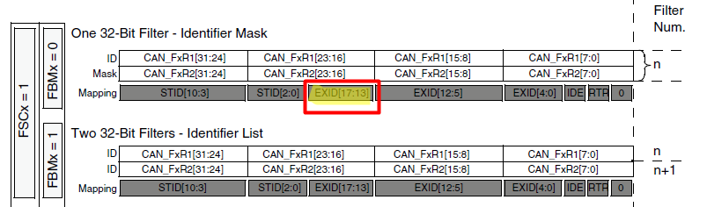
Identifier CAN filter with 2 FIFOs and 2 filters
Why the << 5???
Since the demo uses the STID (Standard ID) those 5 Extended bits needs to be shifted to ensure that the mask and ID matchs the Mapping

Slide 67
Identifier CAN filter with 2 FIFOs and 2 filters
Transmitter Nodes
#elif IDENTIFIER_CAN_FILTER
#ifdef CAN_NODE1
hcan.pTxMsg->StdId = 0x100;
hcan.pTxMsg->ExtId = 0x00;
#elif CAN_NODE2
hcan.pTxMsg->StdId = 0x123;
hcan.pTxMsg->ExtId = 0x00;
#elif CAN_NODE3
hcan.pTxMsg->StdId = 0x321;
hcan.pTxMsg->ExtId = 0x00;
#endif
hcan.pTxMsg->RTR = CAN_RTR_DATA;
#ifdef ID_EXTENDED
hcan.pTxMsg->IDE = CAN_ID_EXT; //set extended (29-bit)
#elif ID_STANDARD
hcan.pTxMsg->IDE = CAN_ID_STD; //set standard (11-bit)
#endif
#endif
hcan.pTxMsg->DLC = 2;

Slide 68
Identifier CAN filter with 2 FIFOs and 2 filters
Reception:
void HAL_CAN_RxCpltCallback(CAN_HandleTypeDef *hcan){
#ifdef CAN_NODE1
if(hcan->State == HAL_CAN_STATE_BUSY_RX0){//check FIFO1
if((hcan->pRx1Msg->StdId == 0x123)&& (hcan->pRx1Msg->IDE == CAN_ID_STD)
&& (hcan->pRx1Msg->DLC == 2)){
LED_Display(hcan->pRx1Msg->Data[0]);
ubKeyNumber = hcan->pRx1Msg->Data[0]; } }
if(hcan->State == HAL_CAN_STATE_BUSY_RX1) //check FIFO0
#endif
{
if((hcan->pRxMsg->StdId==0x100) && (hcan->pRxMsg->IDE==CAN_ID_STD) && (hcan->pRxMsg->DLC==2)){
LED_Display(hcan->pRxMsg->Data[0]);
ubKeyNumber = hcan->pRxMsg->Data[0]; }
if((hcan->pRxMsg->StdId==0x123) && (hcan->pRxMsg->IDE==CAN_ID_STD) && (hcan->pRxMsg->DLC==2)){
LED_Display(hcan->pRxMsg->Data[0]);
ubKeyNumber = hcan->pRxMsg->Data[0]; } }
/* Receive */
HAL_CAN_Receive_IT(hcan, CAN_FIFO0);
#ifdef CAN_NODE1
HAL_CAN_Receive_IT(hcan, CAN_FIFO1);
#endif
}

Slide 69
Pause to see the demo running

Slide 70
Mask CAN filter with 1 FIFO
In this demo, the and will transmit their ID in the range of 0x100 and 0x123 and the will transmit its ID of 0x321
The filter will be set to receive anything frmo 0x100 to 0x1FF
The FIFO0 will be used
CAN_NODE1
CAN_NODE2
CAN_NODE3

Slide 71
Mask CAN filter with 1 FIFO
Filter:
sFilterConfig.FilterNumber = 0; //CAN1 =0..13] CAN2[14..27]
sFilterConfig.FilterMode = CAN_FILTERMODE_IDMASK;
sFilterConfig.FilterScale = CAN_FILTERSCALE_32BIT;
/* Filter 0x100..0x1FF */
sFilterConfig.FilterIdHigh = INIT_RANGE<<5; //11-BIT id IN TOP BITS
sFilterConfig.FilterIdLow = 0;
sFilterConfig.FilterMaskIdHigh = MASK<<5;
sFilterConfig.FilterMaskIdLow = 0;
sFilterConfig.FilterFIFOAssignment = CAN_FILTER_FIFO0;
sFilterConfig.FilterActivation = ENABLE;
sFilterConfig.BankNumber = 0;//hcan.pRxMsg->Data[1];;
HAL_CAN_ConfigFilter(&hcan, &sFilterConfig);

Slide 72
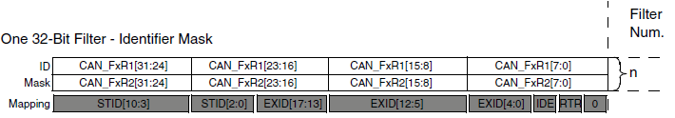
Mask CAN filter with 1 FIFO
Example: ID: 0x100 MASK: 0x700
  Mapping: 0x123
    With this value and the Mask, the result of the bitwise will be the same as the ID
  Mapping: 0x321
    With this mapping and the Mask, the result of the bitwise will not be the same as the ID, so the data is not valid

Slide 73
Mask CAN filter with 1 FIFO
To test if the INIT_RANGE and MASK have the desired range, a simple function was created and can be enable by
This function will print in the VCOM all the values in the range:
#define TEST_CAN_RANGE 1
// CAN Filtering Simulation:
int validationfilter(void)
{
int id;
for(id=0; id<0x800; id++)
if ((id & MASK) == INIT_RANGE) printf("%03X\n", id);
return(1);
}

Slide 74
Mask CAN filter with 1 FIFO
Transmitters:
#ifdef CAN_NODE1
hcan.pTxMsg->StdId = 0x100;
hcan.pTxMsg->ExtId = 0x00;
#elif CAN_NODE2
hcan.pTxMsg->StdId = 0x123;
hcan.pTxMsg->ExtId = 0x00;
#elif CAN_NODE3
hcan.pTxMsg->StdId = 0x321;
hcan.pTxMsg->ExtId = 0x00;
#endif
hcan.pTxMsg->RTR = CAN_RTR_DATA;
#ifdef ID_EXTENDED
hcan.pTxMsg->IDE = CAN_ID_EXT; //set extended (29-bit)
#elif ID_STANDARD
hcan.pTxMsg->IDE = CAN_ID_STD; //set standard (11-bit)
#endif
#endif
hcan.pTxMsg->DLC = 2;

Slide 75
Mask CAN filter with 1 FIFO
Reception:
void HAL_CAN_RxCpltCallback(CAN_HandleTypeDef *hcan){
if ((hcan->pRxMsg->StdId == 0x100) && (hcan->pRxMsg->IDE == CAN_ID_STD) && (hcan->pRxMsg->DLC == 2)) {
LED_Display(hcan->pRxMsg->Data[0]);
ubKeyNumber = hcan->pRxMsg->Data[0];
}
//In MASK_CAN_FILTER example, check if NODE2 sent the message in FIFO0
if ((hcan->pRxMsg->StdId == 0x123) && (hcan->pRxMsg->IDE == CAN_ID_STD) && (hcan->pRxMsg->DLC == 2)) {
LED_Display(hcan->pRxMsg->Data[0]);
ubKeyNumber = hcan->pRxMsg->Data[0];
}
/* Receive */
HAL_CAN_Receive_IT(hcan, CAN_FIFO0);
}

Slide 76
Pause to see the demo running

Slide 77
Support – User Forum
Notes:
Important: focus on the 10-years longevity, as minimum commitment (can be longer).

Slide 78
Support
Atollic TrueSTUDIO users have a number of support resources available.
  Atollic TrueSTUDIO User Community Forum. Here you can ask questions and receive assistance from the community. Atollic personnel monitor the forum and will participate in some of these discussions to provide assistance.
  Video Tutorials. Browse our extensive library of video tutorials on many aspects of setting up and using Atollic TrueSTUDIO.
  Applications Notes and White Papers. In the resources section of the Atollic website you can find many helpful whitepapers and application notes on various topics related to using TrueSTUDIO.
  TruePERSPECTIVES. Atollic maintains a blog that covers a variety of topics including tips and techniques for using Atollic TrueSTUDIO.

Slide 79
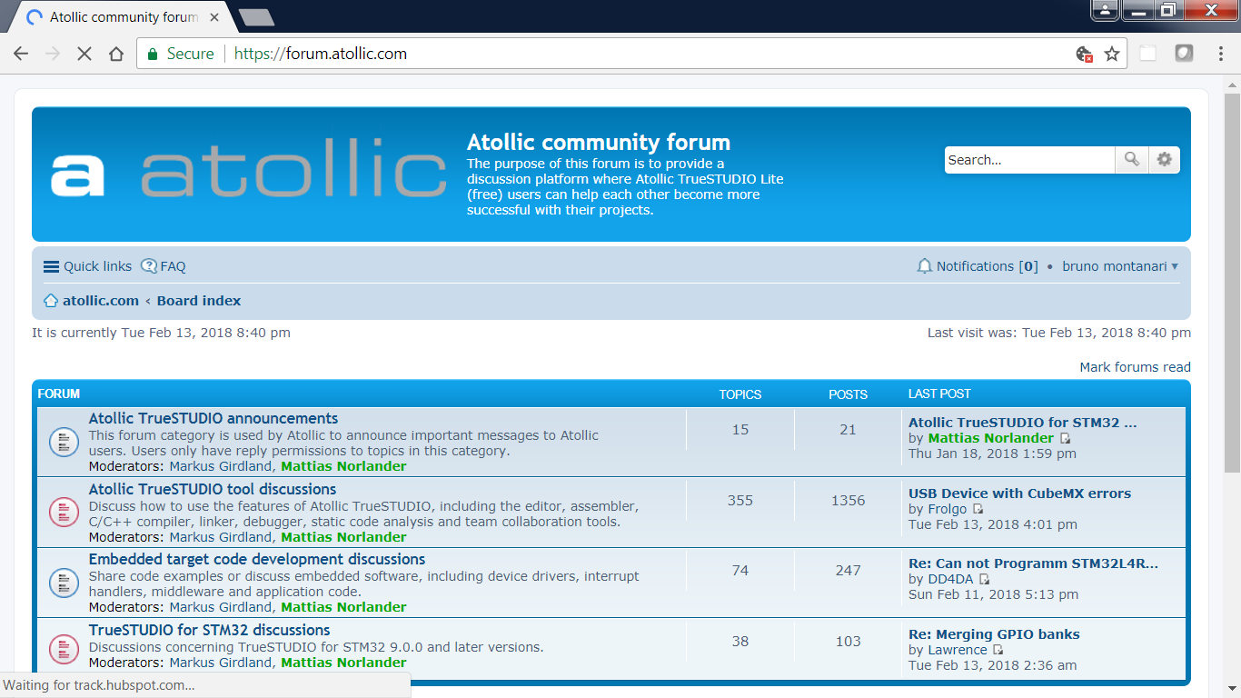
Support - Forum

Slide 80

QUESTIONS ???

Slide 81




Thank you
/STM32
@ST_World
community.st.com
www.st.com/stm32softwaretools

