Slide 1
STM32
Training Hands

Slide 2

Free MDK-ARM for ST
Free licenses for STM32 devices based on Cortex-M0/M0+ cores :
Applicable immediately to all STM32F0 and STM32L0 mcus.
PC-locked multi-year licenses.
No code size limit.
Multiple language support.
Technical support included.
Direct download from Keil website :
No limit of number of downloads by customer.
Direct access to configuration files for STM32 and associated boards.
Free access to MDK-ARM periodic updates.
How to get free MDK-ARM licenses for STM32F0 and STM32L0 ?
Go to Keil website at : www.keil.com/mdk-st
Download MDK-ARM toolchain.
Activate the free license using this Product Serial Number (PSN) : U1E21-CM9GY-L3G4L

Slide 3

STM32F0 Labs

Slide 4

System Peripherals
1
GPIO & EXTI (1.1)
GPIO lab (1.1.1)
EXTI lab (1.1.2)

Slide 5
Basic communication peripherals
2
UART (2.1)
UART printf lab (2.1.2)

Slide 6
Timing peripherals
3
TIM (3.1)
TIM Interrupt lab (3.1.1)
TIM PWM lab - BEEP (3.1.2)

Slide 7
Analog peripherals
4
ADC (4.1)
ADC Interrupt lab (4.1.2)

Slide 8
Application
6
InfraRED
Demonstration of RC5 patter

Slide 9
1.1.1 GPIO Lab

Slide 10
Configure GPIO for LED toggling
1.1.1
Objective
Learn how to setup pin and GPIO port in CubeMX
How to Generate Code in CubeMX and use HAL functions
Goal
Configure GPIO pin in CubeMX and Generate Code
Add in to project HAL_Delay function and HAL_GPIO_Toggle function
Verify the correct functionality on toggling LED

Slide 11
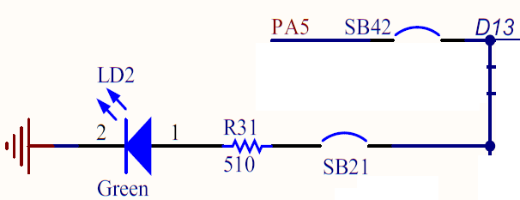
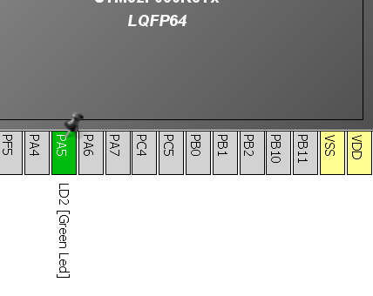
Configure GPIO for LED toggling
1.1.1
Create project in CubeMX
Menu > File > New Project
Select STM32F0 > STM32F030 > LQFP64 > STM32F030R8
Configure LED pin as GPIO_Output

Slide 12

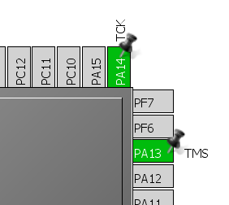

Configure GPIO for LED toggling
1.1.1
For debug purpose is recommended to select debug pins SWD or JTAG
Select can be done in TAB>Pinout>SYS
On discovery is available only SWD option
If SWD/JTAG is not selected and the Set all free pins as analog (MENU>Project>Settings>TAB>Code Generator) is selected, debug is not possible

Slide 13
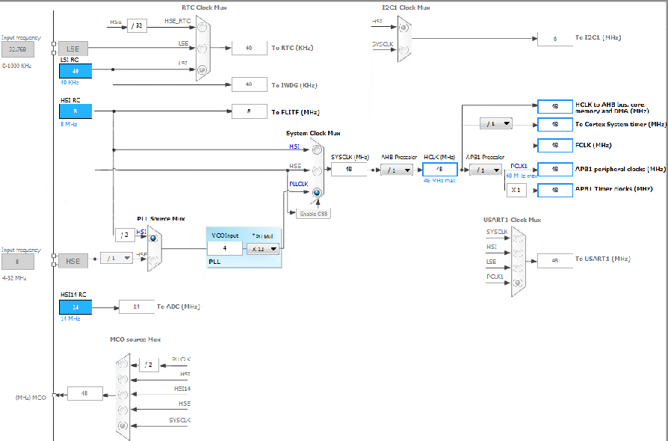
Configure GPIO for LED toggling
1.1.1
Clock Configuration
TAB>Clock Configuration
We can easily setup STM32 clocks

Slide 14
Configure GPIO for LED toggling
1.1.1
The Clock configuration tree is interactive version of tree from RM
RM0360 Chapter 7 Reset and clock control Page 80

Slide 15
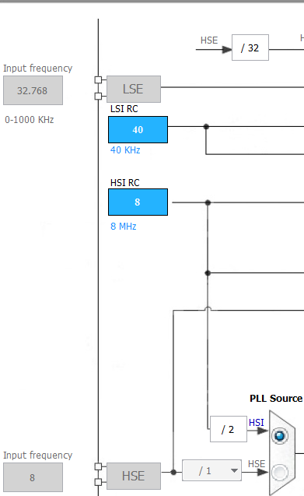
Configure GPIO for LED toggling
1.1.1
Clock Configuration overview 1
Clock sources
Internal oscillators
Internal oscillators

Slide 16
Configure GPIO for LED toggling
1.1.1
Clock Configuration overview 3
Clock sources
Internal oscillators
External clock sources
External clock sources

Slide 17
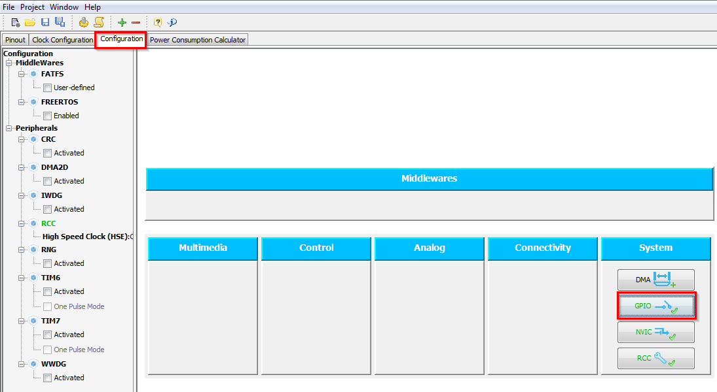
Configure GPIO for LED toggling
1.1.1
GPIO Configuration
TAB>Configuration>System>GPIO

Slide 18
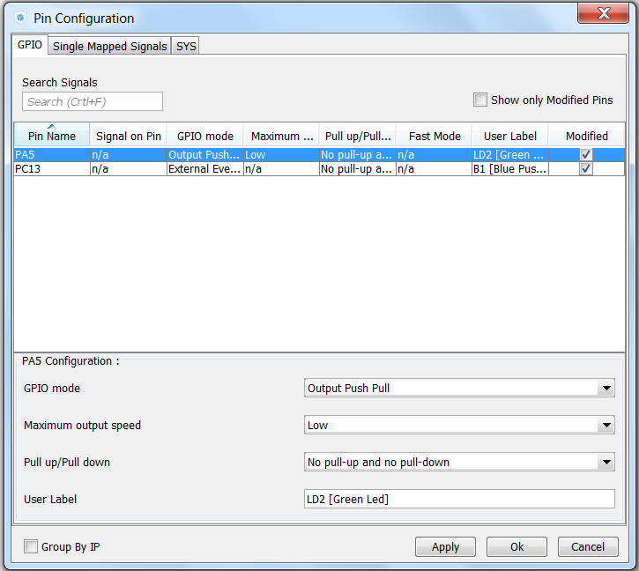
Configure GPIO for LED toggling
1.1.1
GPIO(Pin) Configuration
Select Push Pull mode
No pull-up and pull-down
Output speed to HIGH Is important for faster peripheries like SPI, USART
Button OK

Slide 19
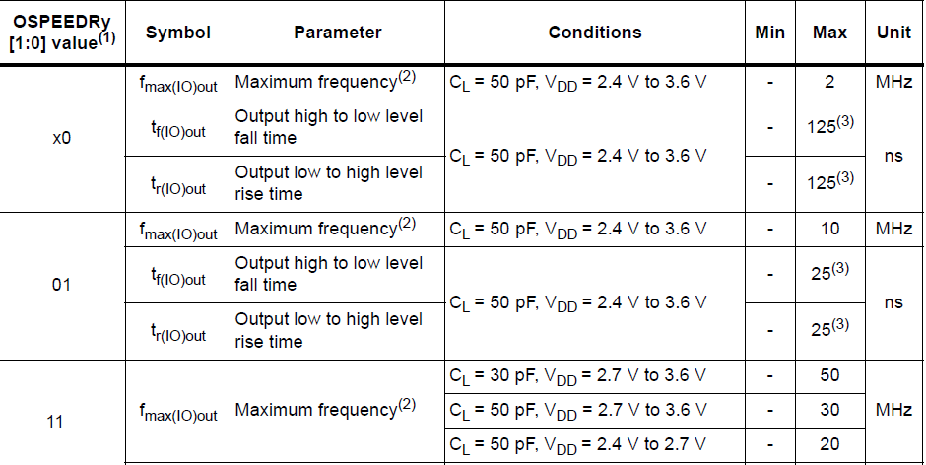
Configure GPIO for LED toggling
1.1.1
GPIO(Pin) output speed configuration
Change the rising and falling edge when pin change state from high to low or low to high
Higher GPIO speed increase EMI noise from STM32 and increase STM32 consumption
It is good to adapt GPIO speed with periphery speed. Ex.: Toggling GPIO on 1Hz is LOW optimal settings, but SPI on 45MHz the HIGH must be set
GPIO output LOW speed
GPIO output MEDIUM speed
LOW
LOW
HIGH
HIGH
GPIO output HIGH speed
LOW
HIGH

Slide 20
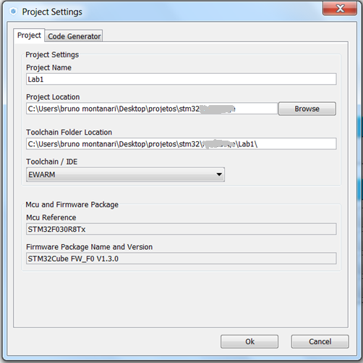
Configure GPIO for LED toggling
1.1.1
Now we set the project details for generation
Menu > Project > Project Settings
Set the project name
Project location
Type of toolchain
Now we can Generate Code
Menu > Project > Generate Code

Slide 21
Configure GPIO for LED toggling
1.1.1
Now we open the project in our IDE
The functions we want to put into main.c
Between /* USER CODE BEGIN 3 */ and /* USER CODE END 3 */ tags
Into infinite loop while(1){ }
For toggling we need to use this functions
HAL_Delay which create specific delay
HAL_GPIO_WritePin or HAL_GPIO_TogglePin

Slide 22
Configure GPIO for LED toggling
1.1.1
Now we open the project in our IDE
The functions we want to put into main.c
Between /* USER CODE BEGIN 3 */ and /* USER CODE END 3 */ tags
Into infinite loop while(1){ }
For toggling we need to use this functions
HAL_HAL_Delay which create specific delay
HAL_GPIO_WritePin or HAL_GPIO_TogglePin
/* USER CODE BEGIN 3 */
/* Infinite loop */
while (1)
{
HAL_GPIO_WritePin(GPIOA, GPIO_PIN_5, GPIO_PIN_SET);
HAL_Delay(500);
HAL_GPIO_WritePin(GPIOA, GPIO_PIN_5, GPIO_PIN_RESET);
HAL_Delay(500);
}
/* USER CODE END 3 */

Slide 23
1.1.2 EXTI lab

Slide 24
Configure EXTI to turn on LED
1.1.2
Objective
Learn how to setup input pin with EXTI in CubeMX
How to Generate Code in CubeMX and use HAL functions
Goal
Configure GPIO and EXTI pin in CubeMX and Generate Code
Add into project Callback function and function which turn on led
Verify the correct functionality by pressing button which turns on LED

Slide 25
Configure EXTI to turn on LED
1.1.2
Create project in CubeMX
Menu > File > New Project
Select STM32F0 > STM32F030 > LQFP64 > STM32F030R8
Configure LED pin as GPIO_Output

Slide 26
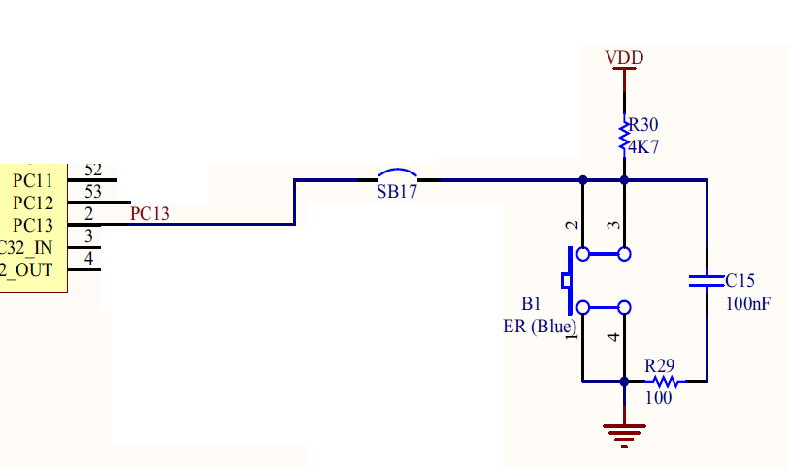
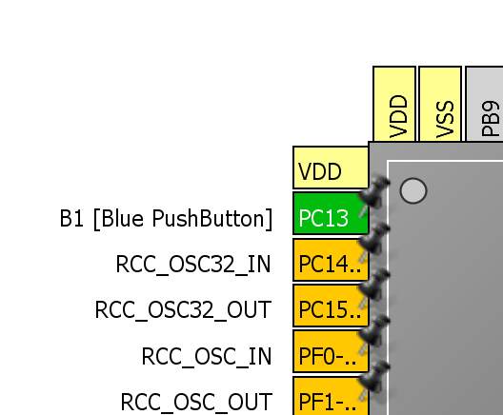
Configure EXTI to turn on LED
1.1.2
Configure Button pin as GPIO_EXTIX

Slide 27
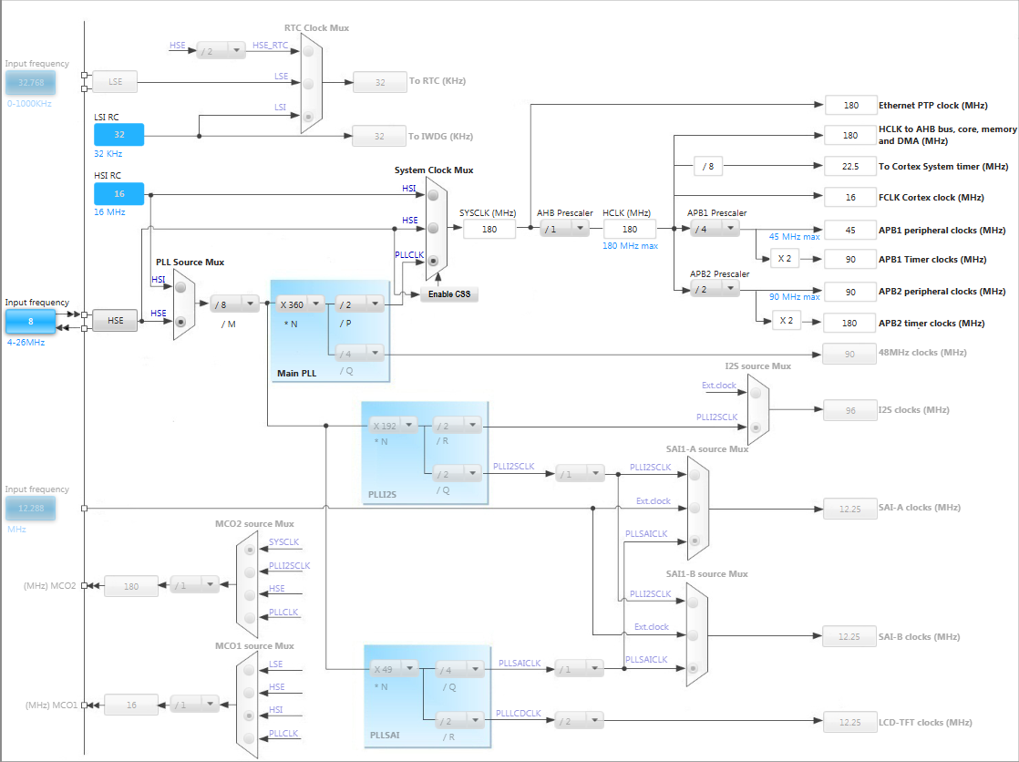
Configure EXTI to turn on LED
1.1.2
In order to run on maximum frequency, setup clock system
Details in lab 0

Slide 28
Configure EXTI to turn on LED
1.1.2
GPIO Configuration
TAB>Configuration>System>GPIO

Slide 29
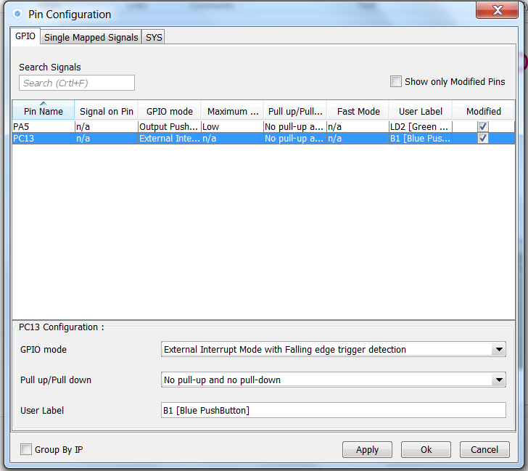
Configure EXTI to turn on LED
1.1.2
GPIO(Pin) Configuration
Select External Interrupt Mode with Faling edge trigger detection
No pull-up or pull-down
Button OK

Slide 30
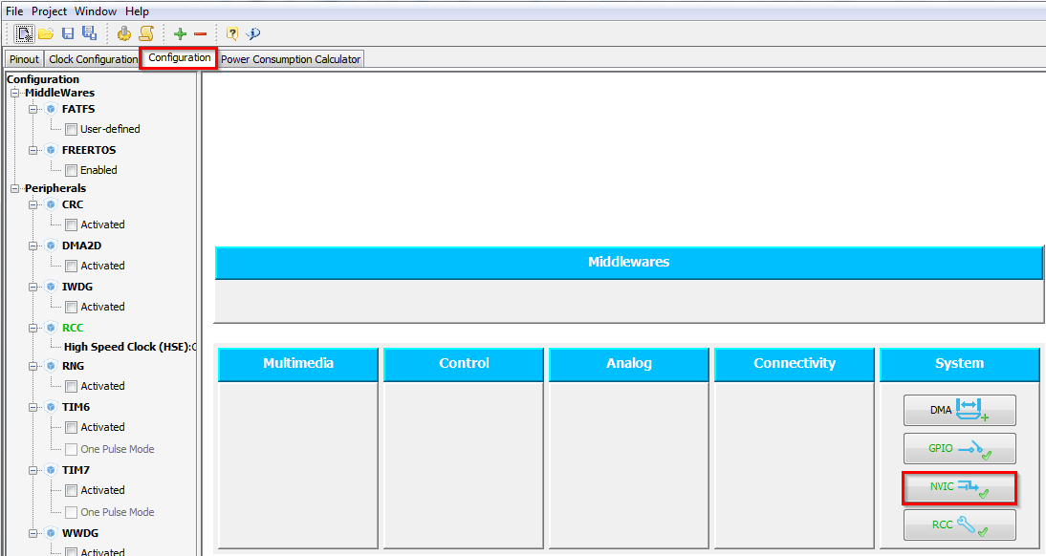
Configure EXTI to turn on LED
1.1.2
NVIC Configuration
We need to enable interrupts for EXTI
TAB>Configuration>System>NVIC

Slide 31
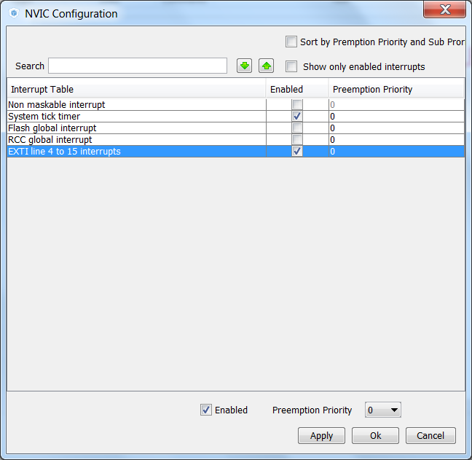
Configure EXTI to turn on LED
1.1.2
NVIC Configuration
Enable interrupt for EXTI Line4_15
Button OK

Slide 32
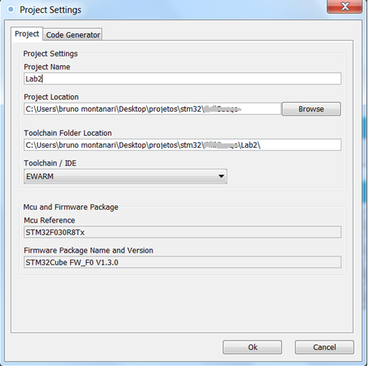
Configure EXTI to turn on LED
1.1.2
Now we set the project details for generation
Menu > Project > Project Settings
Set the project name
Project location
Type of toolchain
Now we can Generate Code
Menu > Project > Generate Code

Slide 33
Configure EXTI to turn on LED
1.1.2
HAL Library work flow summary
3. create edge
1. init NVIC
Peripheral Initializations
including peripheral interrupt NVIC initializations
2. init GPIO
Configure the GPIO to generate interrupt on rising or falling edge
5. HAL EXTI interrupt handler
4. EXTI interrupt handler
HAL_EXTI4_15_IRQHandler
EXTI4_15_IRQHandler
Edge detection callback
HAL_GPIO_EXTI_Callback
HAL files clearing flags, check errors, …
6. HAL EXTI callback

Slide 34
Configure EXTI to turn on LED
1.1.2
Now we open the project in our IDE
The functions we want to put into main.c
Between /* USER CODE BEGIN 4 */ and /* USER CODE END 4 */ tags
We create function which will handle the EXTI interrupts
The HAL callback function for EXTI
void HAL_GPIO_EXTI_Callback(uint16_t GPIO_Pin)
For LED turn on we need to use this functions
HAL_GPIO_WritePin

Slide 35
Configure EXTI to turn on LED
1.1.2
Now we open the project in our IDE
The functions we want to put into main.c
Between /* USER CODE BEGIN 4 */ and /* USER CODE END 4 */ tags
We create function which will handle the EXTI interrupts
The HAL callback function for EXTI
void HAL_GPIO_EXTI_Callback(uint16_t GPIO_Pin)
For LED turn on we need to use this functions
HAL_GPIO_WritePin
/* USER CODE BEGIN 4 */
void HAL_GPIO_EXTI_Callback(uint16_t GPIO_Pin)
{
if(GPIO_Pin == GPIO_PIN_13) {
HAL_GPIO_WritePin(GPIOA, GPIO_PIN_5, GPIO_PIN_SET);
} else {
__NOP();
}
}
/* USER CODE END 4 */

Slide 36
2.1.2 UART printf lab

Slide 37
Use UART with printf
2.1.2
Objective
Learn how to setup UART with interrupts in CubeMX
How to Generate Code in CubeMX and use HAL functions
Add the printf function
Goal
Configure UART in CubeMX and Generate Code
Learn how to send data over UART to a terminal
Verify the correct functionality

Slide 38
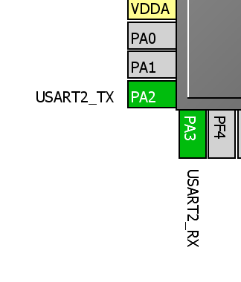

Use UART with printf
2.1.2
Create project in CubeMX
Menu > File > New Project
Select STM32F0 > STM32F030 > LQFP64 > STM32F030R8
CubeMX UART selection
Select USART2 in asynchronous mode
Select PA2 and PA3 for USART2 if weren't selected

Slide 39
Use UART with interrupt
2.1.2
In order to run on maximum frequency, setup clock system
Details in lab 0

Slide 40
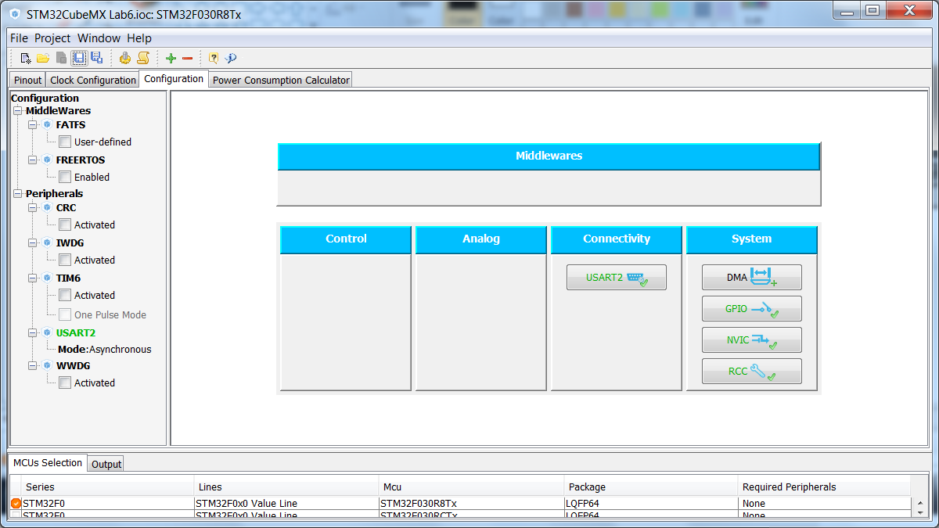
Use UART with interrupt
2.1.2
CubeMX UART configuration
Tab>Configuration>Connectivity>USART2

Slide 41
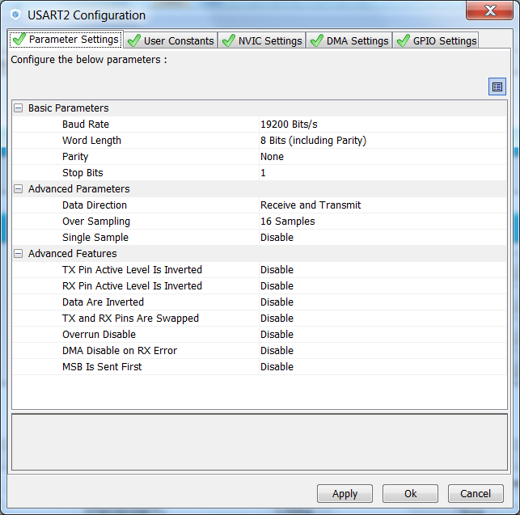
Use UART with interrupt
2.1.2
CubeMX UART configuration check:
BaudRate
World length
Parity
Stop bits
Data direction
Oversampling

Slide 42
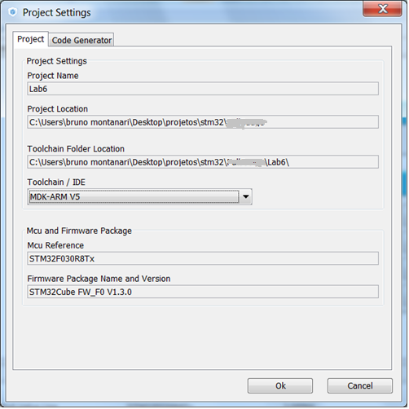
Use UART with interrupt
2.1.2
Now we set the project details for generation
Menu > Project > Project Settings
Set the project name
Project location
Type of toolchain
Now we can Generate Code
Menu > Project > Generate Code

Slide 43
Use UART with printf
2.1.2
Send
Sending method
/* USER CODE BEGIN 0 */
printf("\f\r\nHello Printf!!");
/* USER CODE END 1 */
/* USER CODE BEGIN 4 */
int fputc(int ch, FILE *f) // Retarget printf() to USART2
{
HAL_UART_Transmit(&huart2, (uint8_t*) &ch, 1, 200);
return ch;
} /* USER CODE END 4 */

Slide 44
3.2.1 TIM with interrupt lab

Slide 45
Use TIM with interrupt
3.2.1
Objective
Learn how to setup TIM with Interrupt in CubeMX
How to Generate Code in CubeMX and use HAL functions
Indicate TIM interrupt with LED toggle
Goal
Configure TIM in CubeMX and Generate Code
Learn how start timer and handle interrupt
Verify the correct functionality

Slide 46
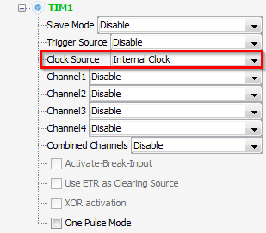
Use TIM with interrupt
3.2.1
Create project in CubeMX
Menu > File > New Project
Select STM32F0 > STM32F030 > LQFP64 > STM32F030R8
CubeMX TIM selection
Select TIM clock source Internal clock
Enable GPIO for LED PA5

Slide 47
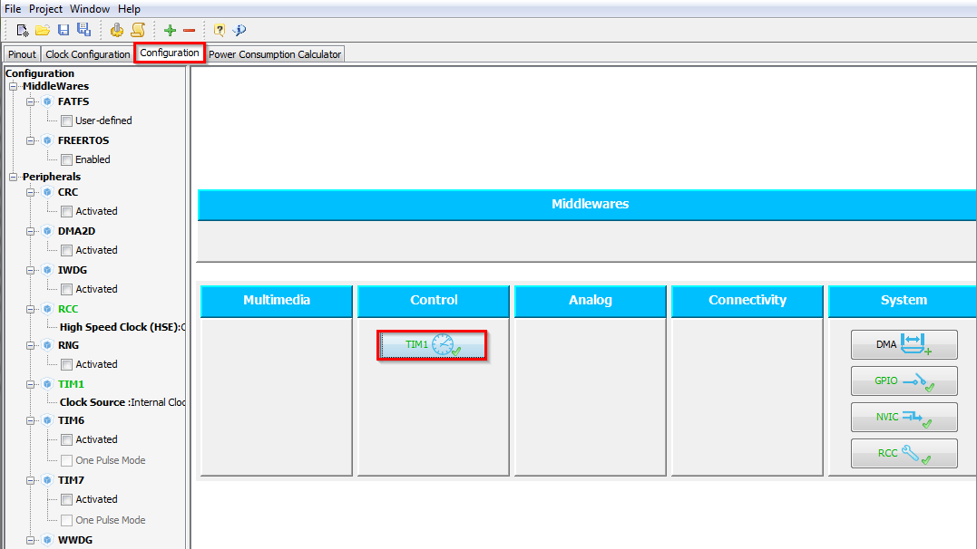
Use TIM with interrupt
3.2.1
CubeMX TIM configuration
Tab>Configuration>Control>TIM1
Check the settings

Slide 48
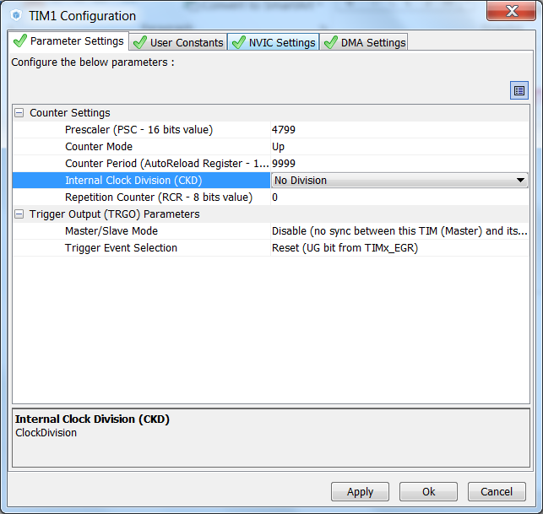
Use TIM with interrupt
3.2.1
CubeMX TIM configuration
Tab>Parameter Settings
Prescaler to 4799
Counter period to 9999
Together with 48MHz TIMER1 clock we get period 1Hz

Slide 49
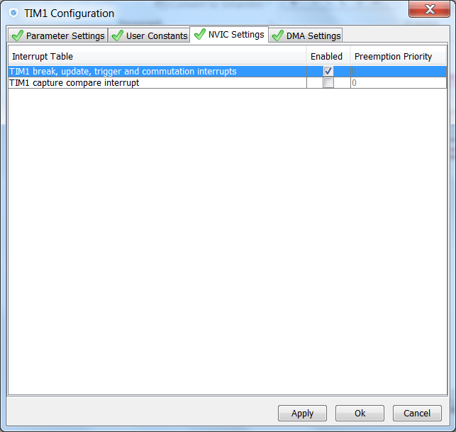
Use TIM with interrupt
3.2.1
CubeMX TIM configuration
Tab>NVIC Settings
Enable TIM1 Update interrupt
Button OK

Slide 50
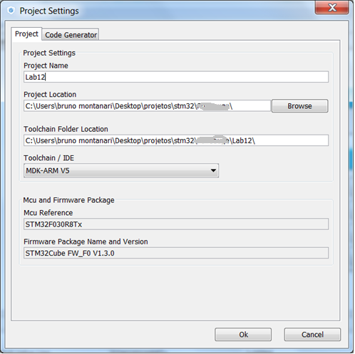
Use TIM with interrupt
3.2.1
Now we set the project details for generation
Menu > Project > Project Settings
Set the project name
Project location
Type of toolchain
Now we can Generate Code
Menu > Project > Generate Code

Slide 51
Use TIM with interrupt
3.2.1
HAL Library TIM with IT flow
TIM Initializations
including peripheral interrupt NVIC initializations
Start process with interrupt generation at end of process
HAL_TIM_Base_Start_IT
HAL_OK
HAL_ERROR
HAL_TIM_IRQHandler
TIM1_UP_TIM10_IRQHandler
HAL_BUSY
process callback
HAL_TIM_PeriodElapsedCallback
process Error callback
HAL_TIM_ErrorCallback

Slide 52
Use TIM with interrupt
3.2.1
Open the project in our IDE
The functions we want to put into main.c
Between /* USER CODE BEGIN 2 */ and /* USER CODE END 2 */ tags
For TIM start use function
HAL_TIM_Base_Start_IT(TIM_HandleTypeDef *htim)
TIM callback
void TIM1_UP_TIM10_IRQHandler(void)
GPIO LED toggle
HAL_GPIO_TogglePin(GPIO_TypeDef* GPIOx, uint16_t GPIO_Pin)

Slide 53
Use TIM with interrupt
3.2.1
Solution
TIM start
Callback handling
/* USER CODE BEGIN 2 */
HAL_TIM_Base_Start_IT(&htim1);
/* USER CODE END 2 */
/* USER CODE BEGIN 4 */
void HAL_TIM_PeriodElapsedCallback(TIM_HandleTypeDef *htim)
{
HAL_GPIO_TogglePin(GPIOA,GPIO_PIN_5);
}
/* USER CODE END 4 */

Slide 54
3.2.2 TIM in PWM Mode

Slide 55
Use TIM in PWM
3.2.2
Objective
Learn how to setup TIM in PWM under CubeMX
How to Generate Code in CubeMX and use HAL functions
Indicate TIM PWM with LED dim
Goal
Configure TIM in CubeMX and Generate Code
Verify the correct functionality

Slide 56
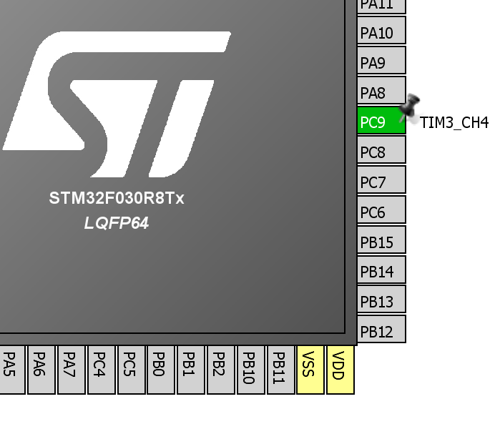
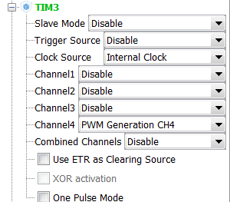
Use TIM in PWM
3.2.2
Create project in CubeMX
Menu > File > New Project
Select STM32F0 > STM32F030 > LQFP64 > STM32F030R8
CubeMX TIM selection
Select TIM clock source Internal clock
Enable PWM Mode

Slide 57
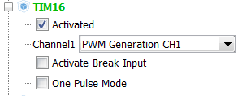
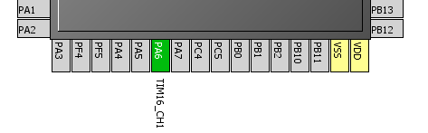
Use TIM in PWM
3.2.2
Create project in CubeMX
Menu > File > New Project
Select STM32F0 > STM32F030 > LQFP64 > STM32F030R8
CubeMX TIM selection
Select TIM clock source Internal clock
Enable PWM Mode

Slide 58
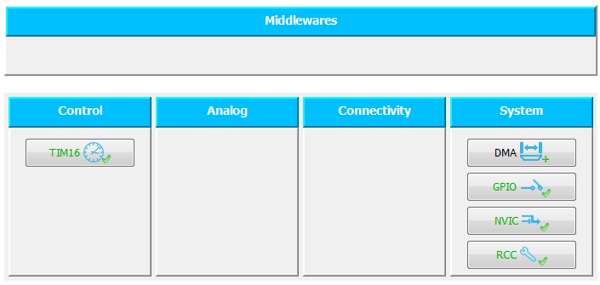
Use TIM in PWM
3.2.2
CubeMX TIM configuration
Tab>Configuration>Control>TIM16
Check the settings

Slide 59
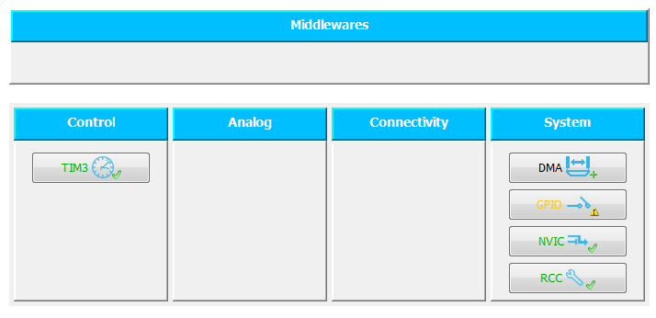
Use TIM in PWM
3.2.2
CubeMX TIM configuration
Tab>Configuration>Control>TIM3
Check the settings

Slide 60
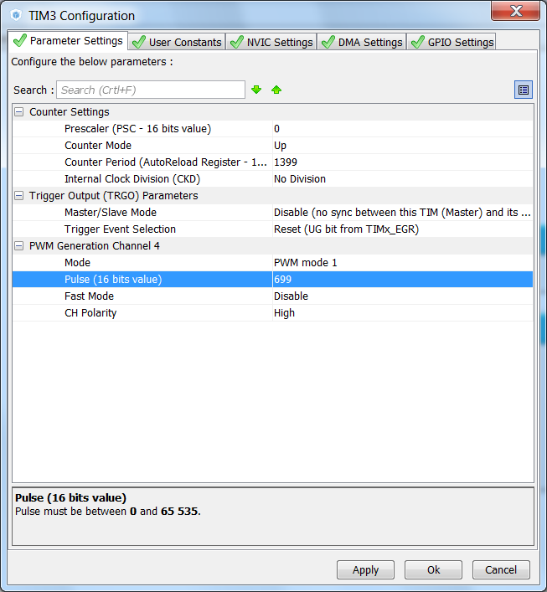
Use TIM in PWM
3.2.2
CubeMX TIM configuration
Tab>Parameter Settings
Prescaler to 0
Counter period to 1333
Together with 48MHz TIMER3 clock we get period 34.31KHz

Slide 61
Use TIM in PWM
3.2.2
Now we set the project details for generation
Menu > Project > Project Settings
Set the project name
Project location
Type of toolchain
Now we can Generate Code
Menu > Project > Generate Code

Slide 62
Use TIM in PWM
3.2.2
Open the project in our IDE
The functions we want to put into main.c
Between /* USER CODE BEGIN 2 */ and /* USER CODE END 2 */ tags
For TIM start use function
HAL_TIM_PWM_Start(&TimHandle, TIM_CHANNEL_4);

Slide 63
Use TIM in PWM
3.2.2
Solution
TIM start
Callback handling
/* USER CODE BEGIN 1 */
TIM_OC_InitTypeDef sConfigOC;
sConfigOC.Pulse = 699;
/* USER CODE END 1 */
/* USER CODE BEGIN 3 */
HAL_Delay(100);
if(sConfigOC.Pulse >= (1399)){
sConfigOC.Pulse = (000);
}else{
sConfigOC.Pulse += 100;
}
TIM3->CCR4 = sConfigOC.Pulse;
/* USER CODE END 3 */

Slide 64
4.1.2 ADC Interrupt lab

Slide 65
Use ADC with interrupt
4.1.2
Objective
Learn how to setup ADC with interrupt in CubeMX
How to Generate Code in CubeMX and use HAL functions
Goal
Configure ADC in interrupt in CubeMX and Generate Code
Learn how to start ADC
Verify the measured wave in STMStudio (http://www.st.com/web/en/catalog/tools/PF251373 require JAVA)

Slide 66
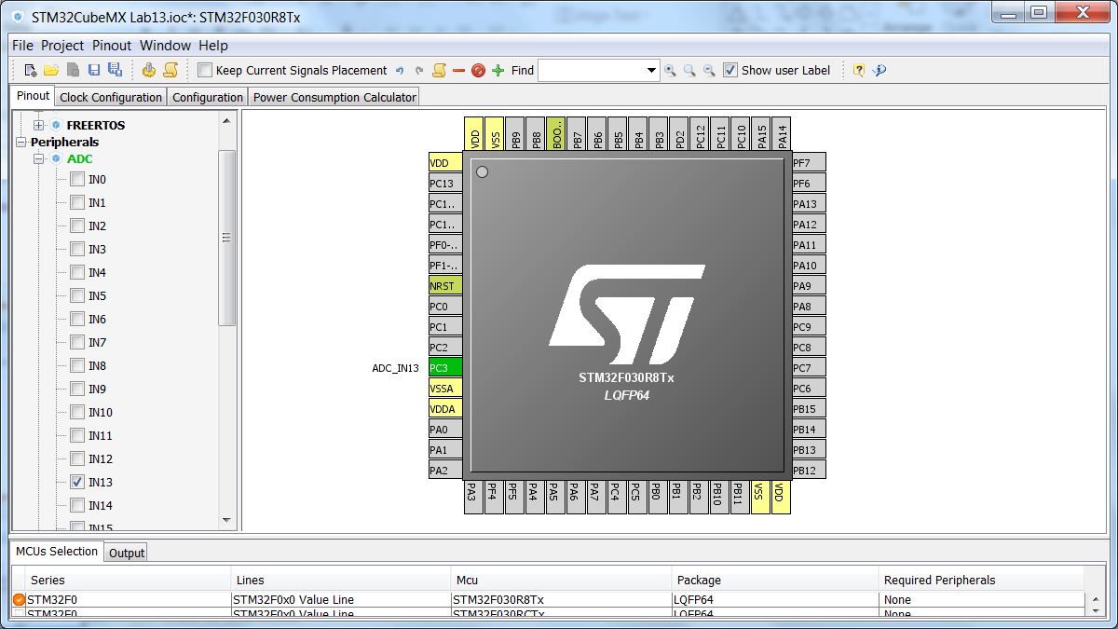
Use ADC with interrupt
4.1.2
Create project in CubeMX
Menu > File > New Project
Select STM32F0 > STM32F030 > LQFP64 > STM32F030R8

Slide 67
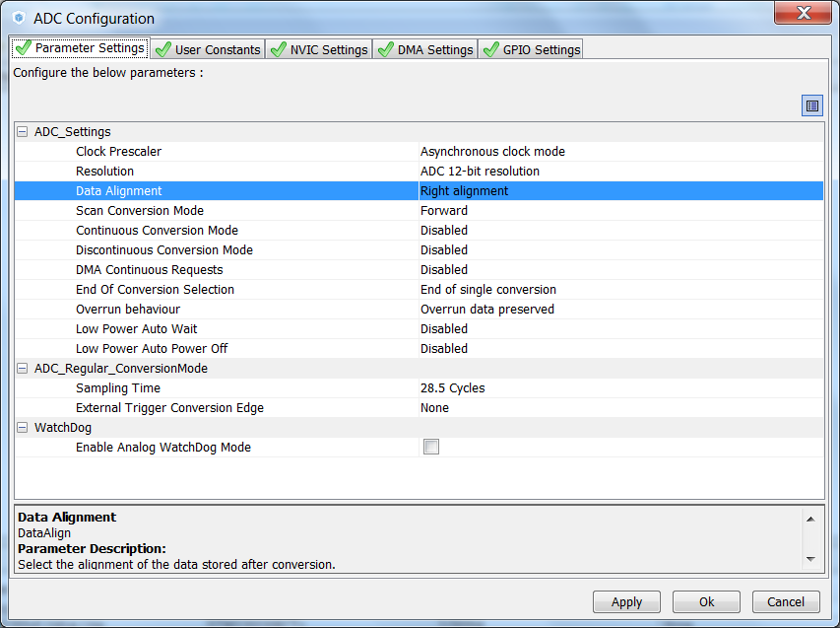
Use ADC with interrupt
4.1.2
CubeMX ADC configuration
TAB>Configuration>Analog>ADC1>Parametr Settings
Set ADC1
Set sampling time for CH13
Button OK

Slide 68
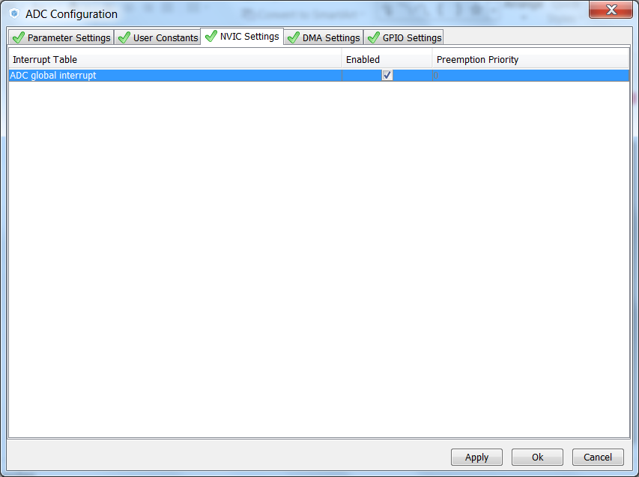
Use ADC with interrupt
4.1.2
CubeMX ADC configuration
TAB>NVIC settings
Enable ADC1 interrupt
Button OK

Slide 69
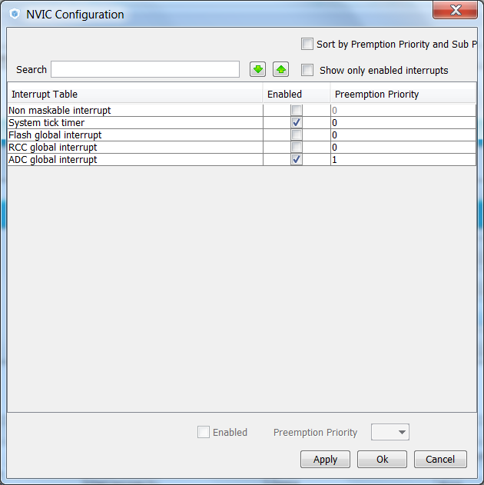
Use ADC with interrupt
4.1.2
CubeMX NVIC configuration
Because we want use the Systick for delay in interrupt The ADC interrupt priority must be changed
TAB>Configuration>System>NVIC
Change ADC1 preemption priority to 1

Slide 70
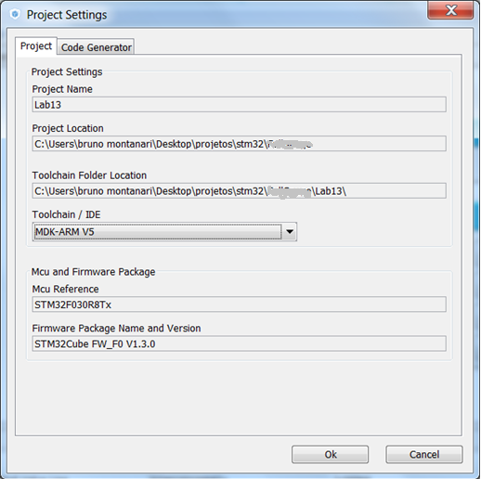
Use ADC with interrupt
4.1.2
Now we set the project details for generation
Menu > Project > Project Settings
Set the project name
Project location
Type of toolchain
Now we can Generate Code
Menu > Project > Generate Code

Slide 71
Use ADC with interrupt
4.1.2
HAL Library ADC with IT flow
ADCInitializations
including peripheral interrupt NVIC initializations
Start process with interrupt generation at end of process
HAL_ADC_Start_IT
HAL_OK
HAL_ERROR
HAL_ADC_IRQHandler
ADC_IRQHandler
HAL_BUSY
process callback
HAL_ADC_ConvCpltCallback
process Error callback
HAL_ADC_ErrorCallback

Slide 72
Use ADC with interrupt
4.1.2
Open the project in our IDE
The functions we want to put into main.c
Between /* USER CODE BEGIN 2 */ and /* USER CODE END 2 */ tags
and /* USER CODE BEGIN 4 */ and /* USER CODE END 4 */ tags
For DAC start use function
HAL_ADC_Start_IT(ADC_HandleTypeDef* hadc, uint32_t Channel)
HAL_ADC_GetValue(ADC_HandleTypeDef* hadc)
ADC complete callback function
HAL_ADC_ConvCpltCallback(ADC_HandleTypeDef* hadc)

Slide 73
Use ADC with interrupt
4.1.2
Solution
Variables
Start ADC
/* USER CODE BEGIN PV */
uint32_t value_adc;
/* USER CODE END PV */
/* USER CODE BEGIN 2 */
HAL_ADC_Start_IT(&hadc);
/* USER CODE END 2 */

Slide 74
Use ADC with interrupt
4.1.2
Solution
ADC complete callback routine
/* USER CODE BEGIN 4 */
void HAL_ADC_ConvCpltCallback(ADC_HandleTypeDef* hadc)
{
value_adc=HAL_ADC_GetValue(hadc);
HAL_Delay(1);
HAL_ADC_Start_IT(hadc);
}
/* USER CODE END 4 */

Slide 75
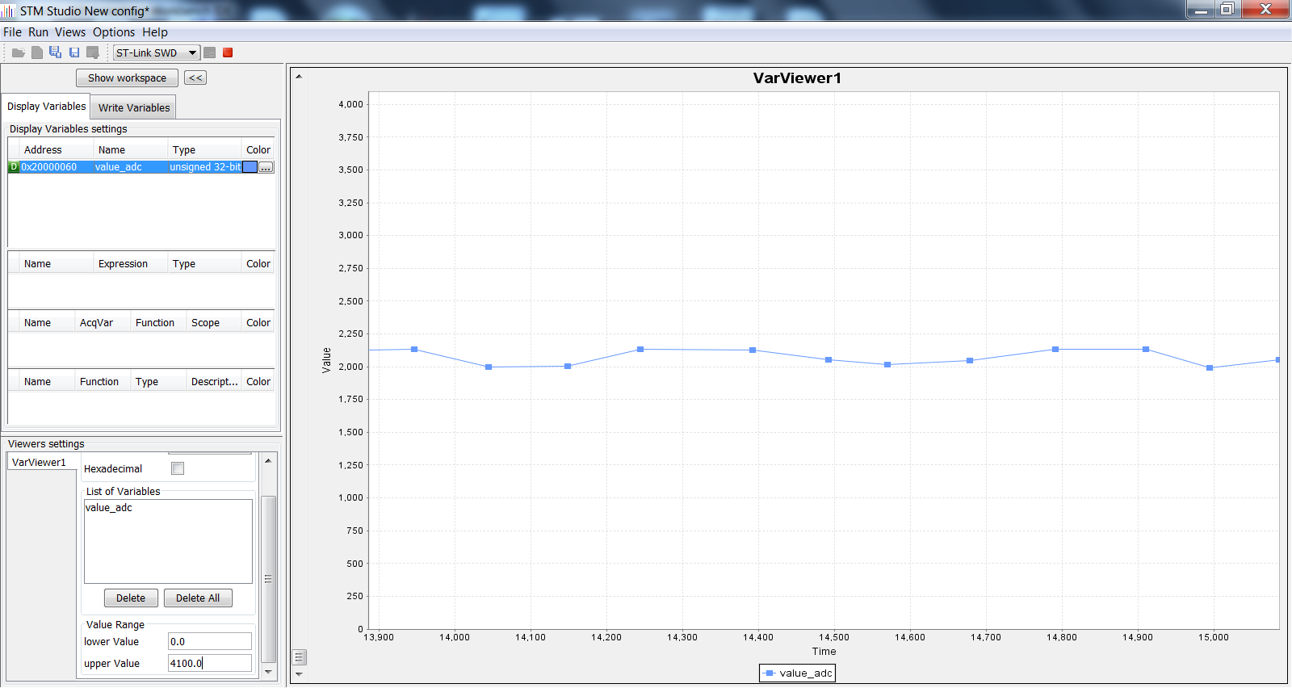
Use ADC with interrupt
4.1.2
STM studio settings
Check functionality again with STMstudio

Slide 76
6.1.1 Application InfraRED

Slide 77
Application InfraRED
6.1.1
Objective
Learn how to setup InfraRED using CubeMX
Goal
The purpose of this application note is to provide general guidelines for creating a TX and RX application on STM32 microcontrollers for IR.

Slide 78
Application InfraRED
6.1.1
Principle
This demonstration consists in transmitting IR messages displayed on the serial terminal.
Each IR message is displayed in two parts
The IR device receiver • The command to be executed
This demonstration consists in receiving IR messages and sending them to the serial terminal.
Each IR message is displayed in two parts
The device that transmitted the IR frame • The command to be executed

Slide 79
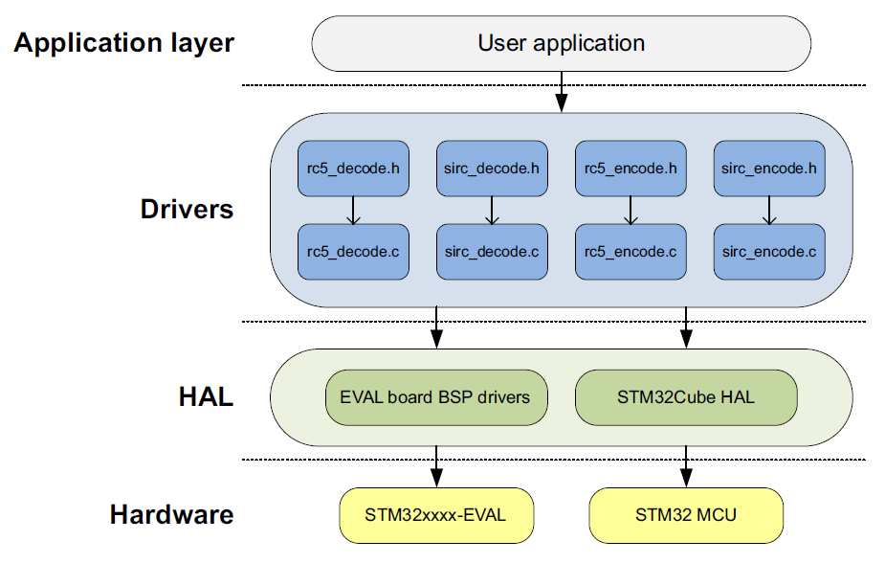
Application InfraRED
6.1.1

Slide 80
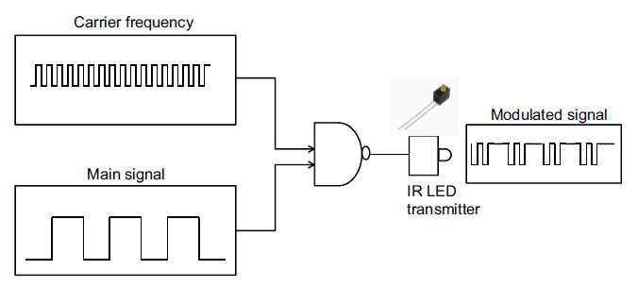
Application InfraRED
6.1.1
Hardware considerations TX
The TX-IR LED is an infrared transmitter designed for infrared serial data links and remote control applications. Data present is modulated at the selected carrier frequency of 36 kHz or 40 kHz providing a simple, single-chip solution for infrared data communications and remote control applications.
An infrared interface (IRTIM) for remote control is available on STM32F0xx, the IR interface is very easy to configure and uses two signals provided by two STM32 timers (TIM16 and TIM17 for STM32F0

Slide 81
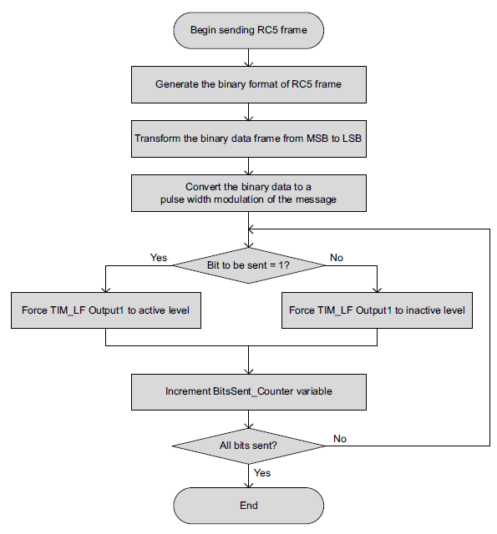
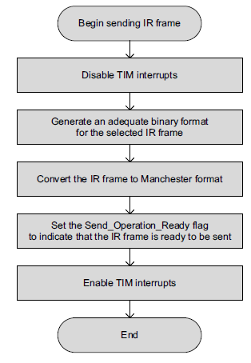
Application InfraRED
6.1.1
Flowchart for code

Slide 82
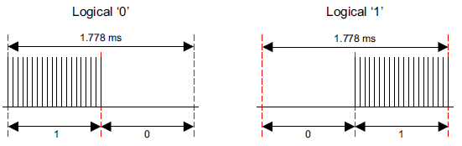
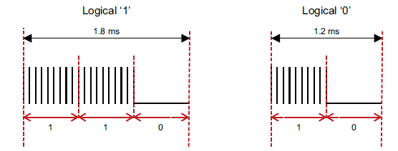
Application InfraRED
6.1.1
Patern bit - Econder:
RC5
SIRC

Slide 83
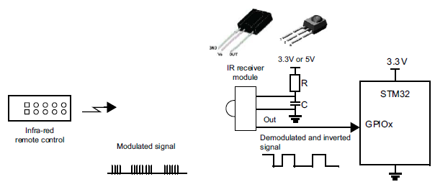
Application InfraRED
6.1.1
Hardware considerations RX
To improve noise rejection, the IR pulses are modulated at around 36 kHz, 38 kHz or 40 kHz. The easiest way to receive these pulses is to use an integrated IR receiver/demodulator module like the TSOP1736 (5 V supply version), the TSOP34836 (3.3 V supply version), or other equivalent part numbers
These are 3-pin devices that receive the infrared burst and output the demodulated bit stream on the output pin which is connected directly to one of the STM32 microcontroller GPIO pins or GP-Timers Input Capture channels. If TSOP1736 is used, the selected GPIO must be Five volt Tolerant (FT). The output of the IR module is inverted compared to the transmitted data (the data is idle high and logic "0" becomes logic "1" and vice versa).

Slide 84
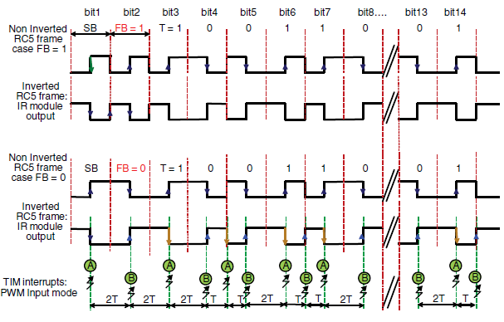
Application InfraRED
6.1.1
Patern bit - Deconder:
RC5

Slide 85
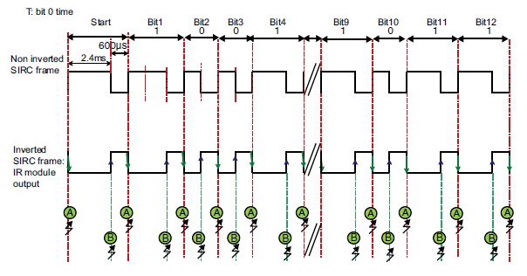
Application InfraRED
6.1.1
Patern bit - Deconder:
SIRC

Slide 86
Application InfraRED
6.1.1
IR Transmitter drivers:
.Add the header file of the appropriate IR protocol to the project
Example: rc5_encode.h
2. Add the file.c corresponding to the IR protocol to the project
Example: rc5_encode.c
3. Call the protocol initiation function in the main()
Example: RC5_Encode_Init();
4. Add the TIMx interrupt functions to stm32f0xx_it.c
Example:
void TIM16_IRQHandler(void) {
HAL_TIM_IRQHandler(&TimHandleLF);
}
5. Call the encoding function in main()
Example:
void main(void) { ...
RC5_Encode_Init();
while(1) {
RC5_Encode_SendFrame(Address, Instruction, Control);
}
}

Slide 87
Application InfraRED
6.1.1
IR receiver drivers:
.Add the header file of the appropriate IR protocol to the project
Example: rc5_decode.h
2. Add the file.c corresponding to the IR protocol to the project
Example: rc5_decode.c
3. Call the protocol initiation function in the main()
Example: RC5_Init();
4. Add the TIMx interrupt functions to stm32f0xx_it.c
Example:
void TIM2_IRQHandler(void) {
HAL_TIM_IRQHandler(&TimHandleDEC);
}
5. Call the encoding function in main()
RC5_Frame_TypeDef IR_FRAME;
void main(void) { ...
RC5_Init();
while(1) {
RC5_Decode(&IR_Frame);
}
}

Slide 88
Appendix A CubeMX install

Slide 89
CubeMX install
A
CubeMX tool
http://www.st.com/web/catalog/tools/FM147/CL1794/SC961/SS1533/PF259242?s_searchtype=partnumber
The CubeMX tool need the java
Please check if you have actual java on your pc, for sure 32bit and 64bit version
Optionally you can download the Cube packages for STM32 device if you don’t want to download them throe CubeMX
STM32CubeL0
STM32CubeL1
STM32CubeF0
STM32CubeF2
STM32CubeF3
STM32CubeF4

Slide 90
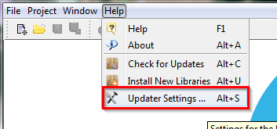

CubeMX install
A
Install the CubeMX
After installation run CubeMX
In case you download the package from web we need to find the place where they need to be stored
MENU>Help>Updater Settings…
You will see where is the repository folder
Default is C:/User/Acc_name/STM32Cube/Repository/
You need to download STM32 packages into this folder
Or CubeMX automatically download them into this folder

Slide 91
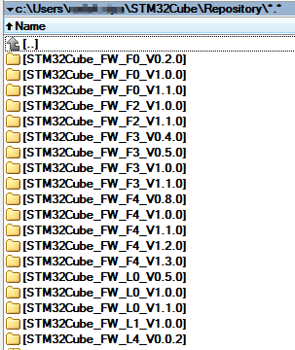
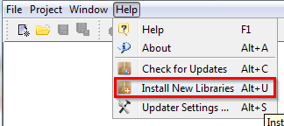
CubeMX install
A
The comparison of the CubeMX repository settings and structure in this folder
In case you want to download this files automatically use in CubeMX
MENU>Help>Install New Libraries
Select libraries which you want
Force download with button Install Now

Slide 92
CubeMX install
A
For the code generation the CubeMX use the package from the Repository folder
The CubeMX can generate the code for some GUI
Keil
IAR
Atollic
For the debugging is necessity to have the ST-Link drivers
STSW-LINK003 driver for Win XP/Vista/7
STSW-LINK006 driver for Win 8
For driver installation you will need the Admin rights on your PC

