Slide 1


STM32
Snippets

Slide 2

CONTENT
GPIO lab
EXTI lab
SLEEP lab
STOP lab
STANDBY lab
TIMER lab
ADC lab
UART lab

Slide 3
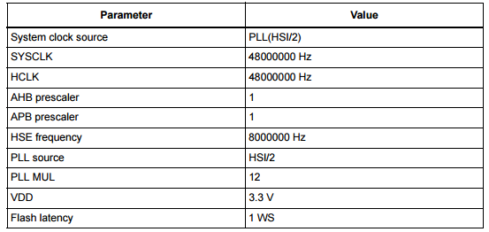
Generic setup
All examples will have the system clock configured as below:
The hardware used for all codes is the STM32F072xB device, the same one in the Discovery kit provided

Slide 4
GPIO Lab 1

Slide 5
Configure GPIO for LED toggling
1
Objective
Learn how to setup pin and GPIO port using Snippets
How to generate open the example and understand it
Goal
Configure GPIOA pin0 as input
Configure GPIOC pin8 as output
Use a simple template from Snippet

Slide 6
Configure GPIO for LED toggling
1
Now we open the project in our IDE
Check the configuration clock for 48MHz
Configure the GPIO Pins
For toggling we used a simple logic:
ConfigureGPIO();
SysTick_Config(48000); /* 1ms config */
while (1) /* Infinite loop */
{
if((GPIOA->IDR&0x01))
{
GPIOC->BSRR = (1<<8); //turn on orange led on PC8 when pressed
}
else
{
GPIOC->BRR = (1<<8); //turn off orange led on PC8 when released
}
}

Slide 7
EXTI lab 2

Slide 8
Configure EXTI which turns on LED
2
Objective
Learn how to setup input pin with EXTI in Snippets
Goal
Configure GPIO and EXTI pin
Check the interrupt vector handler
Verify the correct functionality by pressing button which turns on LED
GPIOA pin 0 is the EXTI pin
GPIOC pin 9 is the LED used

Slide 9
Configure EXTI which turns on LED
2
Simple code for main function and there is no loop
Configure the GPIO
Configure the EXTI
ConfigureGPIO();
ConfigureExternalIT();
while (1) /* Infinite loop */
{
}

Slide 10
Configure EXTI which turns on LED
2
Configure the GPIO
__INLINE void ConfigureGPIO(void)
{
/* (1) Enable the peripheral clock of GPIOC */
/* (2) Select output mode (01) on GPIOC pin 9 */
RCC->AHBENR |= RCC_AHBENR_GPIOCEN; /* (1) */
GPIOC->MODER = (GPIOC->MODER & ~(GPIO_MODER_MODER9)) \
| (GPIO_MODER_MODER9_0); /* (2) */
}

Slide 11
Configure EXTI which turns on LED
2
Configure the EXTI
__INLINE void ConfigureExternalIT(void)
{
/* (1) Enable the peripheral clock of GPIOA */
/* (3) Configure the corresponding mask bit in the EXTI_IMR register */
/* (4) Configure the Trigger Selection bits of the Interrupt line on rising edge*/
/* (5) Configure the Trigger Selection bits of the Interrupt line on falling edge*/
RCC->AHBENR |= RCC_AHBENR_GPIOAEN; /* (1) */
EXTI->IMR = 0x0001; /* (3) */
EXTI->RTSR = 0x0001; /* (4) */
EXTI->FTSR = 0x0001; /* (5) */
/* Configure NVIC for External Interrupt */
/* (6) Enable Interrupt on EXTI0_1 */
/* (7) Set priority for EXTI0_1 */
NVIC_EnableIRQ(EXTI0_1_IRQn); /* (6) */
NVIC_SetPriority(EXTI0_1_IRQn,0); /* (7) */
}

Slide 12
Configure EXTI which turns on LED
2
Interrupt Handler
void EXTI0_1_IRQHandler(void)
{
if ((EXTI->PR & 0x0001) != 0) /* Check line 0 has triggered the IT */
{
EXTI->PR |= 0x0001; /* Clear the pending bit */
GPIOC->ODR ^= (1<<9); /* Toggle green led on PC9 */
}
}

Slide 13
Low Power mode SLEEP lab 3

Slide 14


SLEEP Mode
GPIO’s
Core
CM4
FLASH
Core is stopped
Peripherals are running
Consuption: 164uA@48MHz 84uA@8MHz
RTC/backup reg.
RAM
IWDG
DMA
Clock
GP timers
HSI
SPI
HSE
USB
LSI
USART
DAC
LSE
I2C
Reset
ADC
Power regulator

Slide 15
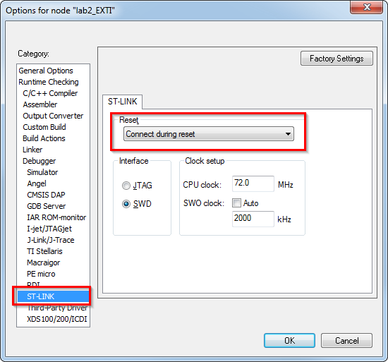
Use SLEEP mode with EXTI
3
Quick setup for the IDE to enable debug in low power mode
To be able reprogram the STM32 which is in LP mode we must use connection under reset option

Slide 16
Use SLEEP mode with EXTI
3
Simple main function to configure the EXTI and LED
ConfigureGPIO();
ConfigureExternalIT();
while (1) /* Infinite loop */
{
GPIOC->BRR = (1<<8); //turn off orange led on PC8 when released
PWR_EnterSLEEPMode();
while((GPIOA->IDR&0x01))
{
GPIOC->BSRR = (1<<8); //turn on orange led on PC8 when pressed
}
}

Slide 17
Use SLEEP mode with EXTI
3
The functions for GPIO and EXTI are the same from the previous exercices
__INLINE void ConfigureGPIO(void)
__INLINE void ConfigureExternalIT(void)
void EXTI0_1_IRQHandler(void)
New function to enable entering in sleep mode
__INLINE void PWR_EnterSLEEPMode(void)
{
/* Clear SLEEPDEEP bit of Cortex System Control Register */
SCB->SCR &= (uint32_t)~((uint32_t)1<<2);
/* Select SLEEP mode entry -------------------------------------*/
/* Request Wait For Interrupt */
__WFI();
}

Slide 18
Low Power mode STOP lab 4

Slide 19



STOP Mode
Core is stopped
HSE, MSI clocks are OFF
SRAM and registers content is preserved
Peripherals with HSI, LSI, LSE clock option can be ON
GPIO’s keep their setup
Consuption: 7uA
GPIO’s
Core
CM4
FLASH
RTC/backup reg.
RAM
IWDG
DMA
Clock
GP timers
HSE
SPI
HSI
USB
LSI
USART
DAC
LSE
I2C
ADC
Reset
Power regulator
Notes:
The Stop mode is based on the Cortex™-M0+ deepsleep mode combined with peripheral clock gating.
HSI ON/OFF is optional

Slide 20
Use STOP mode with EXTI
4
Simple main function to enter STOP mode, same logic as Sleep Mode
ConfigureGPIO();
ConfigureExternalIT();
while (1) /* Infinite loop */
{
GPIOC->BRR = (1<<8); //turn off orange led on PC8 when released
PWR_EnterSTOPMode();
while((GPIOA->IDR&0x01))
{
GPIOC->BSRR = (1<<8); //turn on orange led on PC8 when pressed
}
}

Slide 21
Use STOP mode with EXTI
4
Our different function
__INLINE void PWR_EnterSTOPMode(void)
{
uint32_t tmpreg = 0;
/* Select the regulator state in STOP mode ---------------------------------*/
tmpreg = PWR->CR;
/* Clear PDDS and LPDS bits */
tmpreg &= (uint32_t)~(0x00000002U | 0x00000001U);
/* Store the new value */
PWR->CR = tmpreg;
/* Set SLEEPDEEP bit of Cortex System Control Register */
SCB->SCR |= (1UL<<2);
/* Request Wait For Interrupt */
__WFI();
/* Reset SLEEPDEEP bit of Cortex System Control Register */
SCB->SCR &= (uint32_t)~((uint32_t)(1UL<<2));
}
Notes:
In run approx. 53mA
Consumption on STM32F429disco approx. 5mA in stop(not optimized)
You ma test the difference with pins ins floating in and analog

Slide 22
Low Power mode STANDBY lab 5

Slide 23

STANDBY Mode
Core and all peripherals are OFF, except RTC and IWDG if enabled
HSE, MSI, HSI clocks are OFF, LSI LSE can be ON
SRAM and registers content is lost, except RTC, and standby circuitry
GPIO’s are in high Z, except Reset, RTC OUT and WKUP 1,2,3
Consuption: 2uA
GPIO’s
Core
CM4
FLASH
RTC/backup reg.
RAM
IWDG
DMA
Clock
GP timers
HSE
SPI
HSI
USB
LSI
USART
DAC
LSE
I2C
ADC
Reset
Power regulator
Reset
RTC OUT
WKUP 1,2,3
Notes:
The Standby mode allows to achieve the lowest power consumption. It is based on the
Cortex™-M0+ deepsleep mode, with the voltage regulator disabled. The VCORE domain is
consequently powered off. The PLL, the MSI, the HSI16 oscillator and the HSE oscillator
are also switched off. SRAM and register contents are lost except for the RTC registers,
RTC backup registers and Standby circuitry

Slide 24
Use STANDBY mode with WKPIN
5
Simple main function to enter STANDBYmode, same logic as Sleep Mode but it’s mandatory to specify the waking up pin (PA0)
ConfigureGPIO();
ConfigureExternalIT();
/*Enables the WakeUp PINx functionality, based in the PWM->CSR EWUP1 .*/
PWR->CSR |= (0x00000100U << (uint8_t)1);
while (1) /* Infinite loop */
{
GPIOC->BRR = (1<<8); //turn off orange led on PC8 when released
PWR_EnterSTANDBYMode ();
while((GPIOA->IDR&0x01))
{
GPIOC->BSRR = (1<<8); //turn on orange led on PC8 when pressed
}
}

Slide 25
Use STANDBY mode with WKPIN
5
Our different function
__INLINE void PWR_EnterSTANDBYMode(void)
{
/* Select STANDBY mode */
PWR->CR |= (uint32_t)0x00000002U;
/* Set SLEEPDEEP bit of Cortex System Control Register */
SCB->SCR |= (1UL << 2);
/* Request Wait For Interrupt */
__WFI();
}
Notes:
In run approx. 53mA
Consumption on STM32F429disco approx. 5mA in stop(not optimized)
You ma test the difference with pins ins floating in and analog

Slide 26
TIMER lab 6

Slide 27
Configure TIMER which turns on LED
6
Objective
Learn how to setup the timer as time base
Goal
GPIOC pin 9 is the LED used
TIM15 configured as TimeBase Interrupt

Slide 28
Configure TIMER which turns on LED
6
Simple code for main function and there is no loop
Configure the GPIO
Configure the EXTI
ConfigureGPIO();
ConfigureExternalIT();
while (1) /* Infinite loop */
{
}

Slide 29
Configure TIMER which turns on LED
6
Configure the GPIO
__INLINE void ConfigureGPIO(void)
{
/* (1) Enable the peripheral clock of GPIOC */
/* (2) Select output mode (01) on GPIOC pin 9 */
RCC->AHBENR |= RCC_AHBENR_GPIOCEN; /* (1) */
GPIOC->MODER = (GPIOC->MODER & ~(GPIO_MODER_MODER9)) \
| (GPIO_MODER_MODER9_0); /* (2) */
}

Slide 30
Configure TIMER which turns on LED
6
Configure the EXTI
__INLINE void ConfigureExternalIT(void)
{
/* (1) Enable the peripheral clock of GPIOA */
/* (3) Configure the corresponding mask bit in the EXTI_IMR register */
/* (4) Configure the Trigger Selection bits of the Interrupt line on rising edge*/
/* (5) Configure the Trigger Selection bits of the Interrupt line on falling edge*/
RCC->AHBENR |= RCC_AHBENR_GPIOAEN; /* (1) */
EXTI->IMR = 0x0001; /* (3) */
EXTI->RTSR = 0x0001; /* (4) */
EXTI->FTSR = 0x0001; /* (5) */
/* Configure NVIC for External Interrupt */
/* (6) Enable Interrupt on EXTI0_1 */
/* (7) Set priority for EXTI0_1 */
NVIC_EnableIRQ(EXTI0_1_IRQn); /* (6) */
NVIC_SetPriority(EXTI0_1_IRQn,0); /* (7) */
}

Slide 31
Configure TIMER which turns on LED
6
Interrupt Handler
void EXTI0_1_IRQHandler(void)
{
if ((EXTI->PR & 0x0001) != 0) /* Check line 0 has triggered the IT */
{
EXTI->PR |= 0x0001; /* Clear the pending bit */
GPIOC->ODR ^= (1<<9); /* Toggle green led on PC9 */
}
}

Slide 32
ADC lab 7

Slide 33
Configure ADC with continuous conv.
7
Objective
Learn how to setup the ADC for continuous conversion for 4 channels
ADC on PA1, PB1, PC0 and VREFINT
Goal
Configure GPIO and EXTI pin
Check the interrupt vector handler
Show the values from ADC in the ADC_array
GPIOA pin 0 is the EXTI pin to enable / disable the ADC
GPIOC pin 9 is the LED used for OK
GPIOC pin 8 is the LED used for ON / OFF conversion indication

Slide 34
Configure ADC with continuous conv.
7
Simple code for main function and there is no loop
Configure the GPIO
Configure the EXTI
Set Clock for the ADC
Configure the ADC pins
Enable the ADC
Configure the ADC
Select the first channel
Start the conversion

Slide 35
Configure ADC with continuous conv.
7
main function
ConfigureGPIO();
ConfigureExternalIT();
SetClockForADC();
CalibrateADC();
ConfigureGPIOforADC();
EnableADC();
ConfigureADC();
CurrentChannel = 0; /* Initializes the CurrentChannel */
ADC1->CR |= ADC_CR_ADSTART; /* start the ADC conversions */
while (error == 0) /* loop till no unrecoverable error, should never be exited */
{
__WFI();
}
DisableADC();
SysTick_Config(48000); /* 1ms config */
while (1); /* Infinite loop */

Slide 36
Configure ADC with continuous conv.
7
Configure the GPIO used in the ADC
__INLINE void ConfigureGPIOforADC(void)
{
/* (1) Enable the peripheral clock of GPIOA, GPIOB and GPIOC */
/* (2) Select analog mode for PA1 */
/* (3) Select analog mode for PB1 */
/* (4) Select analog mode for PC0 */
RCC->AHBENR |= RCC_AHBENR_GPIOAEN | RCC_AHBENR_GPIOBEN | RCC_AHBENR_GPIOCEN; /* (1) */
GPIOA->MODER |= GPIO_MODER_MODER1; /* (2) */
GPIOB->MODER |= GPIO_MODER_MODER1; /* (3) */
GPIOC->MODER |= GPIO_MODER_MODER0; /* (4) */
}

Slide 37
Configure ADC with continuous conv.
7
Configure ADC clock
__INLINE void SetClockForADC(void)
{
/* (1) Enable the peripheral clock of the ADC */
/* (2) Start HSI14 RC oscillator */
/* (3) Wait HSI14 is ready */
RCC->APB2ENR |= RCC_APB2ENR_ADC1EN; /* (1) */
RCC->CR2 |= RCC_CR2_HSI14ON; /* (2) */
while ((RCC->CR2 & RCC_CR2_HSI14RDY) == 0) /* (3) */
{
/* For robust implementation, add here time-out management */
}
}

Slide 38
Configure ADC with continuous conv.
7
Configure the ADC
__INLINE void ConfigureADC(void)
{
/* (1) Select HSI14 by writing 00 in CKMODE (reset value) */
/* (2) Select the continuous mode and scanning direction */
/* (3) Select CHSEL1, CHSEL9, CHSEL10 and CHSEL17 */
/* (4) Select a sampling mode of 111 i.e. 239.5 ADC clk to be greater than 17.1us */
/* (5) Enable interrupts on EOC, EOSEQ and overrrun */
/* (6) Wake-up the VREFINT (only for VBAT, Temp sensor and VRefInt) */
//ADC1->CFGR2 &= ~ADC_CFGR2_CKMODE; /* (1) */
ADC1->CFGR1 |= ADC_CFGR1_CONT | ADC_CFGR1_SCANDIR; /* (2) */
ADC1->CHSELR = ADC_CHSELR_CHSEL1 | ADC_CHSELR_CHSEL9 \
| ADC_CHSELR_CHSEL10 | ADC_CHSELR_CHSEL17; /* (3) */
ADC1->SMPR |= ADC_SMPR_SMP_0 | ADC_SMPR_SMP_1 | ADC_SMPR_SMP_2; /* (4) */
ADC1->IER = ADC_IER_EOCIE | ADC_IER_EOSEQIE | ADC_IER_OVRIE; /* (5) */
ADC->CCR |= ADC_CCR_VREFEN; /* (6) */
/* Configure NVIC for ADC */
/* (7) Enable Interrupt on ADC */
/* (8) Set priority for ADC */
NVIC_EnableIRQ(ADC1_COMP_IRQn); /* (7) */
NVIC_SetPriority(ADC1_COMP_IRQn,0); /* (8) */
}

Slide 39
Configure ADC with continuous conv.
7
Interrupt Handler
void ADC1_COMP_IRQHandler(void)
{
if ((ADC1->ISR & ADC_ISR_EOC) != 0) /* checks EOC has triggered the IT */
{
ADC_array[CurrentChannel] = ADC1->DR; /* reads data and clears EOC flag */
CurrentChannel++; /* increments the index on ADC_array */
}
if ((ADC1->ISR & ADC_ISR_EOSEQ) != 0) /* checks EOSEQ has triggered the IT */
{
ADC1->ISR |= ADC_ISR_EOSEQ; /* clears the pending bit */
CurrentChannel = 0; /* reinitialize the CurrentChannel */
GPIOC->ODR ^= (1<<9);//toggle green led on PC9
}
}

Slide 40
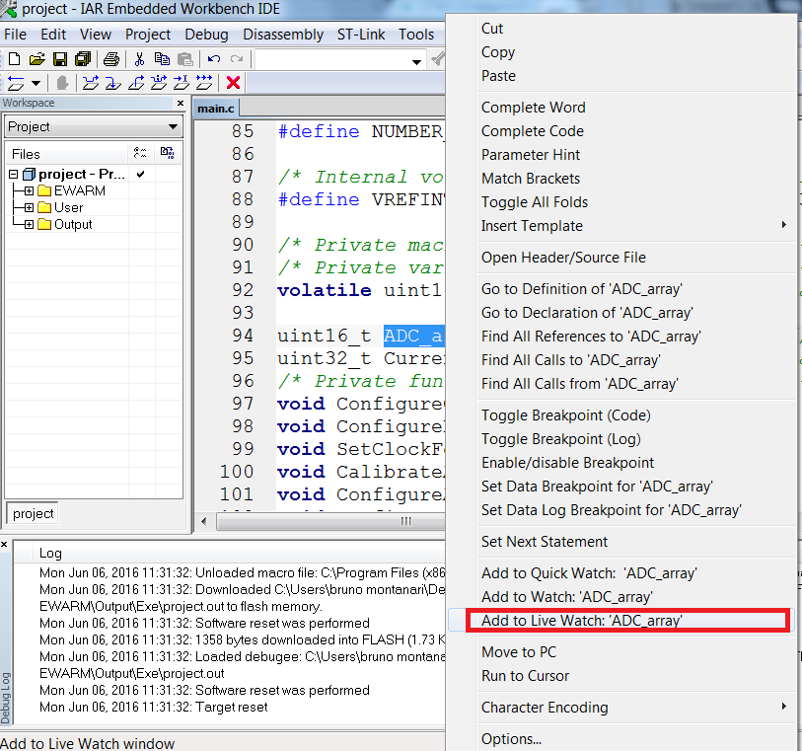
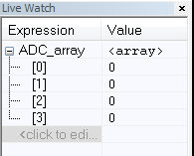
Configure ADC with continuous conv.
7
Configure the IDE to enable the “live watch”

Slide 41
UART lab 8

Slide 42
Configure USART in loopback mode
8
Objective
Learn how to setup the USART
Goal
Configure UART TX as polling
Configure UART RX as interrupt
Configure LEDs and GPIO
Connect the PA9 to the PA10 for loopbackmode

Slide 43
Configure USART in loopback mode
8
Simple code for main function and there is no loop
Configure the GPIO
Configure the EXTI
Configure the USART and USART pins
Elable USART interrupt
Configure_GPIO_LED();
Configure_GPIO_USART1();
Configure_USART1();
Configure_GPIO_Button();
Configure_EXTI();
/* Reception done in USART1 IRQ handler */
/* Infinite loop */
while (1)
{
}

Slide 44
Configure USART in loopback mode
8
Configure the GPIO used in USART
__INLINE void Configure_GPIO_USART1(void)
{
/* Enable the peripheral clock of GPIOA */
RCC->AHBENR |= RCC_AHBENR_GPIOAEN;
/* GPIO configuration for USART1 signals */
/* (1) Select AF mode (10) on PA9 and PA10 */
/* (2) AF1 for USART1 signals */
GPIOA->MODER = (GPIOA->MODER & ~(GPIO_MODER_MODER9|GPIO_MODER_MODER10))\
| (GPIO_MODER_MODER9_1 | GPIO_MODER_MODER10_1); /* (1) */
GPIOA->AFR[1] = (GPIOA->AFR[1] &~ (GPIO_AFRH_AFRH1 | GPIO_AFRH_AFRH2))\
| (1 << (1 * 4)) | (1 << (2 * 4)); /* (2) */
}

Slide 45
Configure USART in loopback mode
8
Configure the USART1
__INLINE void Configure_USART1(void)
{
/* Enable the peripheral clock USART1 */
RCC->APB2ENR |= RCC_APB2ENR_USART1EN;
/* Configure USART1 */
/* (1) oversampling by 16, 9600 baud */
/* (2) 8 data bit, 1 start bit, 1 stop bit, no parity, tranmittion and reception mode */
USART1->BRR = 480000 / 96; /* (1) */
USART1->CR1 = USART_CR1_RXNEIE | USART_CR1_RE | USART_CR1_TE| USART_CR1_UE; /* (2) */
/* polling idle frame Transmission */
while((USART1->ISR & USART_ISR_TC) != USART_ISR_TC)
{
/* add time out here for a robust application */
}
USART1->ICR |= USART_ICR_TCCF;/* clear TC flag */
/* Configure IT */
/* (3) Set priority for USART1_IRQn */
/* (4) Enable USART1_IRQn */
NVIC_SetPriority(USART1_IRQn, 0); /* (3) */
NVIC_EnableIRQ(USART1_IRQn); /* (4) */
}

Slide 46
Configure USART in loopback mode
8
Interrupt Handler for the Button pressed
void EXTI0_1_IRQHandler(void)
{
EXTI->PR |= 1;
/* start USART transmission */
USART1->TDR = stringtosend[send++]; /* Will inititiate TC if TXE */
if(send > 1)
{
send = 0;
}
}

Slide 47
Configure USART in loopback mode
8
Interrupt Handler for the USART Reception
void USART1_IRQHandler(void)
{
uint8_t chartoreceive = 0;
if((USART1->ISR & USART_ISR_RXNE) == USART_ISR_RXNE)
{
chartoreceive = (uint8_t)(USART1->RDR); /* Receive data, clear flag */
switch(chartoreceive)
{
case 'G': GPIOC->ODR ^= GPIO_ODR_9; /* toggle green LED */
break;
case 'O': GPIOC->ODR ^= GPIO_ODR_8; /* toggle orange LED */
break;
default: break;
}
}
}

Slide 48

Thank You

