Slide 1


STM32L4 MCU series Excellence in ultra-low-power with performance

Slide 2
Agenda
Presentation
Time
STM32L4 Family & Tools Overview
Hands On Session: Out-of-the-box demos
Hands On Lab#1: Getting Started with CubeMX and STM32L4
STM32L4 Overview: Architecture, Memory, Clocks, Power
Hands On Lab#2: printf() debugging via onboard ST-LINK
STM32L4 Low Power details
Hands On Lab#3: STM32CubeMX Power Consumption Calculator
STM32L4 Peripherals Details 1/2
Hands-On Lab#4: 3-axis MEMS Gyro communications
STM32L4 Peripherals Details 2/2
Hands-On Lab#5: Autonomous peripherals: ADC/TIM/DMA app
8:30 – 10:00

Slide 3




Birth of the STM32 L4
High-performance
ARM Cortex-M4 FPU, DSP
Advanced analog,
New digital peripheral set
Ultra-low-power
STM32L4 is a perfect fit in terms of ultra-low power, performances, memory size, and peripherals at a cost effective price.
Convergence between High performance and Ultra-low power series

Slide 4
Ultra-Low-Power and Flexibility
FlexPowerControl
STM32L4 is based on a new platform optimized to reduce power consumption and increase flexibility
Down to 30 nA for I/O wake-up
with additional Shutdown mode
External level shifter no longer needed
Separate V_{DD} supplies
(down to 1.08 V)
RTC available for all power modes
(from Active down to V_{BAT})
Down to 360 nA keeping 32 Kbytes of SRAM active
in Standby mode
4 nA V_{BAT} mode with charging capability
Automatic switch to maintain power for RTC and backup registers
STM32L4
Wake up MCU with any peripheral
(Communication I/Fs,
analog circuits, timers…)
USB capable with 32 kHz crystal oscillator
(Dedicated crystal oscillator is no longer needed for USB function)
I/O level kept in low power modes
Optimization of system consumption
Internal oscillator from 100 kHz to 48 MHz (+/-0.25% int. clock accuracy over voltage/temperature with LSE)
1
1
ULP leader and performance booster
Notes:
I/O level kept in low power modes
Enable using a very low power modes while optimizing system consumption
I/O level is maintained even during wake-up
Backup SRAM in Standby mode
32 kbytes can be kept
Flexible wake-up sources in Stop mode
I2C, UART, all I/Os, Low power Timers, RTC, Comparators, Reset pin, BOR, PVD, PVM, IWDG, OTG_FS, SWPMI
Shutdown mode
Down to 44nA with 5 I/O to wake-up
Separated VDD supply
14 I/Os with a dedicated supply (down to 1.08V): remove the need for external level shifter
VBAT domain with charging capability
Automatic switch to keep power on RTC and backup registers with internal charging circuitry
3 tamper pins available in this mode
MSI programmable from 100kHz to 48 MHz

Slide 5
Ultra-low-power modes
Best power consumption numbers with full flexibility
Wake-up time
VBAT 4 nA / 300 nA*
Tamper: 3 I/Os, RTC
250 µs
SHUTDOWN 30 nA / 330 nA*
Wake-up sources: reset pin, 5 I/Os,
RTC
14 µs
STANDBY 130 nA / 430 nA*
Wake-up sources: + BOR,
IWDG
14 µs
STANDBY + 32 KB RAM 360 nA / 660 nA*
Wake-up sources: + all I/Os, PVD,
LCD, COMPs, I²C, LPUART, LPTIM
5 µs
STOP 2 (full retention) 1.1 µA / 1.4 µA*
4 µs
STOP 1 (full retention) 7.3 µA / 7.6 µA*
Wake-up sources: + all I²C, UART
6 cycles
SLEEP 35 µA / MHz
Wake-up sources: any interrupt
or event
RUN at 24 MHz 100 µA / MHz
RUN at 80 MHz 112 µA / MHz
1
Note : * without RTC / with RTC
1
ULP leader and performance booster

Slide 6

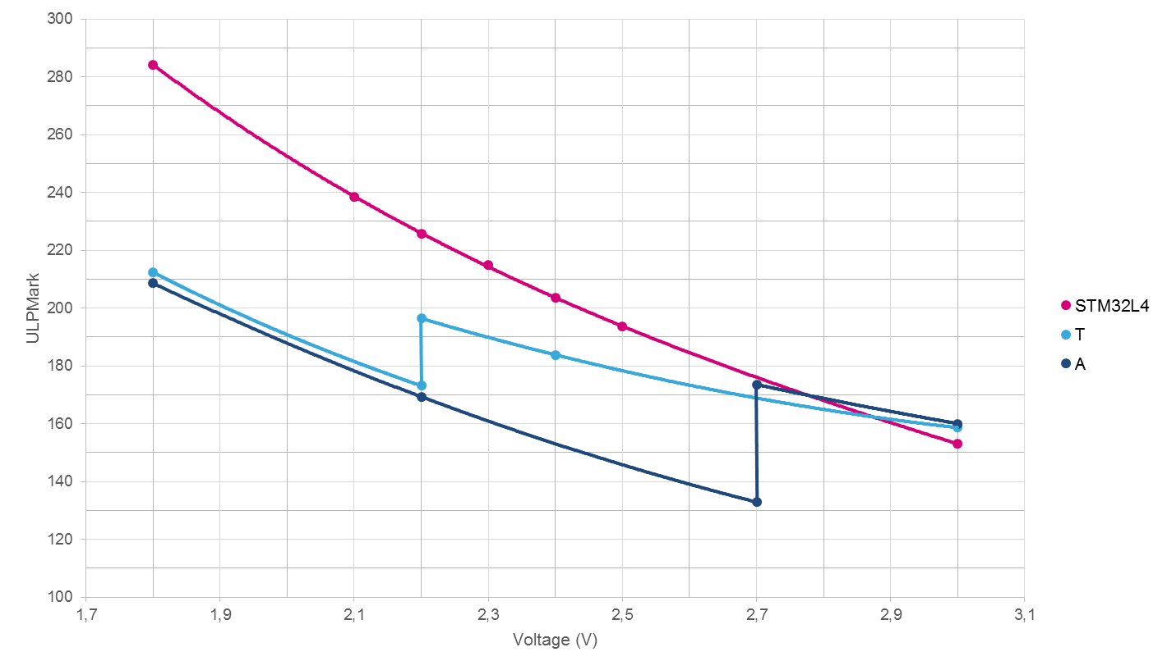



STM32L4
This ULPBench® winner takes off like a rocket
And shatters performance limits in ULP world
Dhrystone
100
MIPS
153
273
www.st.com/stm32l4
The higher the better!
From 0 to 48 MHz in less than 5 µs
From 0 to 80 MHz in less than 20 µs
Run 48 MHz
Run 80 MHz
< 5 µs!
On competition devices: discontinuity due to lack of DC/DC functionality when voltage decreases
STOP mode
No external coil and capacitor required for STM32L4
Notes:
The STM32L4 series shatters performance limits in the ultra-low-power world. It delivers 100 DMIPS (Di – Mips) based on its ARM® Cortex®-M4 core with FPU and ST’s ART Accelerator™ at 80 MHz. Once woken up from Stop mode, the internal clock is available in less than 5 µs running at 48 MHz and up to 80 MHz in less than 20 µs.
STM32L4 MCUs scored 153 in the standardized EEMBC™ ULPBench® tests that compare the efficiency of ultra-low-power microcontrollers. While competition is optimized at 3 volts, ST’s product delivers its full power efficiency at 1.8 volts. Since an external coil and capacitor are not required to reach this number, the BOM cost and the peak power consumption at start-up are reduced.

Slide 7
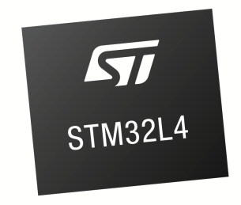
High integration
High integration with high memory size in small packages
Parallel Interface
Cortex-M4 80 MHz FPU
MPU
ETM
Connectivity
FSMC 8-/16-bit
(TFT-LCD, SRAM, NOR, NAND)
USB OTG,
1x SD/SDIO/MMC, 3 x SPI, 3 x I²C, 1x CAN, 1 x Quad SPI,
5 x USART + 1 x ULP UART,
1 x SWP
Package size down
to 4.4 x 3.8 mm
Display
LCD driver 8 x 40
DMA
Digital
Timers
ART Accelerator™
AES (256-bit), TRNG, 2 x SAI, DFSDM (8 channels)
17 timers including:
2 x 16-bit advanced motor control timers
2 x ULP timers
7 x 16-bit-timers
2 x 32-bit timers
Up to
1-Mbyte Flash with ECC
Dual Bank
Analog
3 x 16-bit ADC, 2 x DAC,
2 x comparators, 2 x op amps
1 x temperature sensor
I/Os
128-Kbyte RAM
Up to 114 I/Os
Touch-sensing controller
3
Integration and safety

Slide 8


Safety and security
Integrated safety and security features
ULP with
performance
SAFETY
SECURITY
Brown-out Reset
Clock Security System
SRAM parity check
Backup byte registers
Supply monitoring
Flash with ECC
Dual watchdog
Anti-tamper detection
Memory Protection Unit
Read and Write Protection
Unique ID
AES-256 Encryption
JTAG fuse
Random Number Generator
Software IP Protection
3
Integration and safety

Slide 9









STM32L4: continuity in STM32 portfolio
9 product series / 32 product lines
STM32L4 benefits from pin-to-pin compatibility across the family
2
7
1
High-performance
398 CoreMark
120 MHz
150 DMIPS
608 CoreMark
180 MHz
225 DMIPS
1 000 CoreMark
200 MHz
428 DMIPS
4
5
6
Mainstream
106 CoreMark
48 MHz
38 DMIPS
177 CoreMark
72 MHz
61 DMIPS
245 CoreMark*
72 MHz
90 DMIPS
(*) from CCM-SRAM
3
3
1
Ultra-low-power
75 CoreMark
32 MHz
26 DMIPS
93 CoreMark
32 MHz
33 DMIPS
273 CoreMark
80 MHz
100 DMIPS
Cortex-M0
Cortex-M0+
Cortex-M3
Cortex-M4
Cortex-M7
number of lines
4
Great investment

Slide 10
STM32L4 portfolio
Flash memory / RAM size (bytes)
STM32L486RG
STM32L486JG
STM32L486VG
STM32L486QG
STM32L486ZG
1 M / 128 K
5
5
STM32L476RG
STM32L476JG
STM32L476MG
STM32L476VG
STM32L476QG
STM32L476ZG
512 K / 128 K
STM32L476RE
STM32L476JE
STM32L476ME
STM32L476VE
STM32L476QE
STM32L476ZE
256 K / 128 K
STM32L476RC
STM32L476VC
Pin count
LQFP64
(10x10x1.4 mm)
WLCSP72
(4.4x3.8x0.585 mm)
WLCSP81
(4.4x3.8x0.585 mm)
LQFP100
(14x14x1.4 mm)
UFBGA132
(7x7x0.6 mm)
LQFP144
(20x20x1.4 mm)
Legend:
With 128/256-bit AES hardware encryption
Without encryption
4
Great investment
Notes:
The STM32L4 portfolio is available in a wide choice of packages (from LQFP64 up to LQFP144) and from 256 Kbytes up to 1 Mbyte of Flash memory size.
The AES encryption hardware accelerator is optional.

Slide 11
Hands-On Session: Out-of-the-box demos

Slide 12

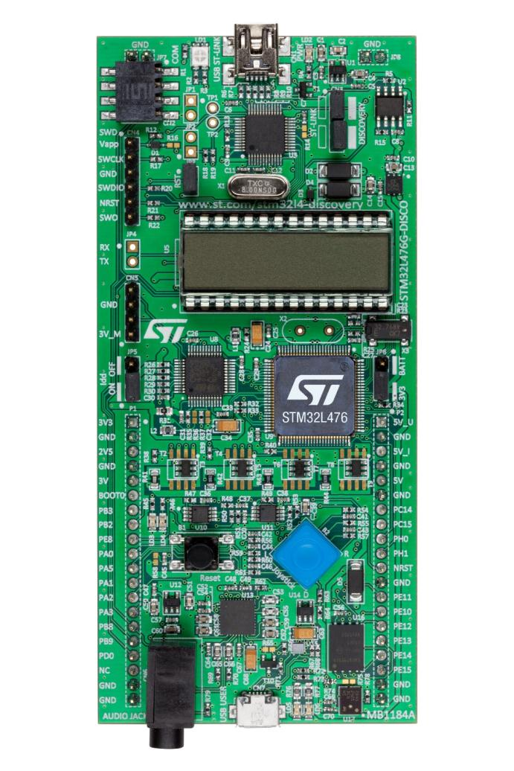
STM32L476 Discovery – HMI
Integrated ST-Link/V2-1 (for programming and debugging)
LCD 96 segments
Motion Mems (9-axis)
push buttons and joystick,
2 color LEDs
Quad SPI NOR Flash
16 MB
USB OTG connector
12

Slide 13
STM32L476 Discovery - Audio and connector
NFC / ACP connector
MFX to auto-measure power
consumption
Direct access to all MCU I/Os
Audio Codec and 3.5 mm connector
Microphone Mems
13

Slide 14
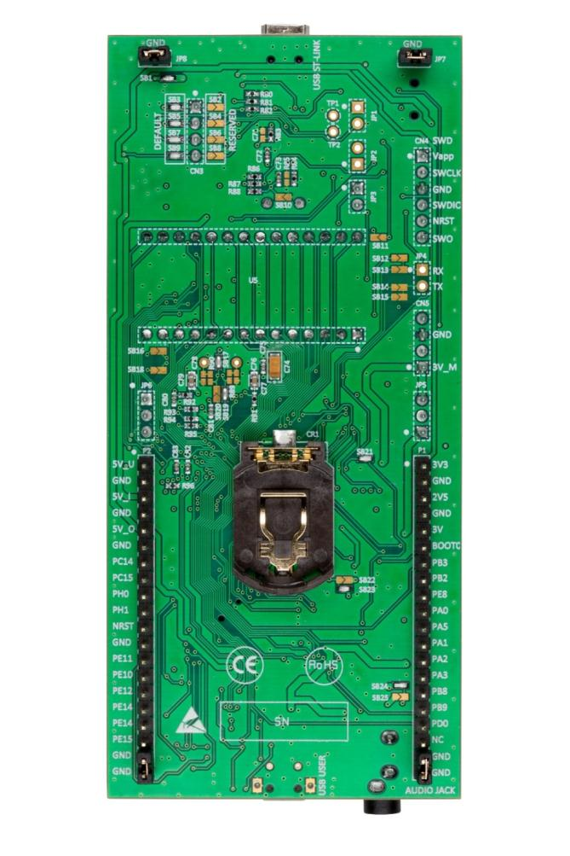
STM32L476 Discovery - back side
Flexible board power supply CR2032 battery or USB

Slide 15
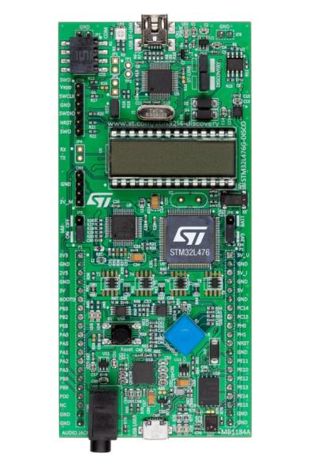
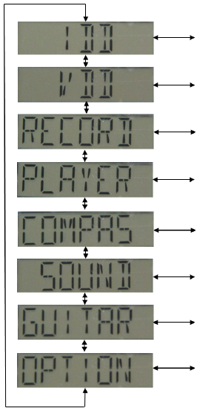
Out-of-the-Box Demos
Plug the USB cable into the top Mini-B connector of the Discovery Board
Use the blue joystick to scroll through the application menu:
IDD Measurement app
VDD Measurement app
Record / Playback app
Compass app
Sound Meter app
Guitar Tuner app
Options
The project is in the CubeL4 library, Discovery Demonstrations folder:
C:\Users\xxxx\STM32Cube\Repository\STM32Cube_FW_L4_V1.0.0\Projects\STM32L476G-Discovery\Demonstrations\EWARM
Notes:
The RECORD application uses the MP34DT01 MEMS digital microphone to provide 16-bit audio samples at 48 KHz. The recorded audio file is stored into the QuadSPI Flash. Note that recording a new audio file will erase the previous one.
The PLAYER application plays back in loops any WAV file programmed in the internal Flash at address 8020000hex or stored in the QuadSPI Flash after a record; if both files are available, you can select from a sub-menu which one you want to play. It uses the CS43L22 on-board audio digital to analog converter to output the audio data on the 3.5 mm jack. Earphone volume can be adjusted during playback.

Slide 16
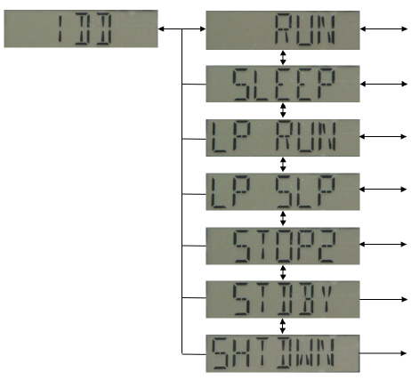

IDD / VDD Measurement apps
Mode | Description
Run | Run 24Mhz, voltage range 2, PLL off, RTC/LSE off, Flash ART on
Sleep | Sleep 24Mhz, voltage range 2, PLL off, RTC/LSE off, Flash ART on
Low-power run | Low Power Run 2Mhz, PLL off, RTC/LSE off, Flash ART on
Low-power sleep | Low Power Sleep 2Mhz, PLL off, RTC/LSE off, Flash ART on
Stop 2 | RTC/LSE off, Flash ART off
Standby | RTC/LSE off, Flash ART off, RAM retention off
Shutdown | RTC/LSE off, Flash ART off
The “IDD Measure” app uses the “MFX” onboard STM32L151 as a non-intrusive auto-ranging current measurement probe.
The target L4 will enter a low power state, the MFX will measure the current, wake the L4 up and report the measurement back over I2C.
Notes:
This menu allows to measure the current consumption in a subset of the STM32L4 low power capabilities.
First, select with the joystick the power mode (Run, Sleep, Low-power run, Low-power sleep, Stop 2, Standby or Shutdown) and the measurement will be displayed on the LCD.
Typically, you will observe that the STM32L476 consumes in the range of 1.3µA in Stop2 and 70nA in Shutdown under 3V at 25 degrees Celsius.
You may want to reuse the demonstration firmware to design your own low-power application.

Slide 17

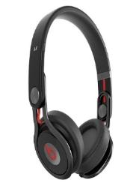
Audio demonstrations
RECORD application
Uses MP34DT01 MEMS microphone (LED5 toggling during record)
16-bit audio samples @ 48 kHz stored in N25Q128A13 QuadSPI Flash
LEFT key to exit
PLAYER application
Uses CS43L22 audio DAC and 3.5mm jack output
Audio playback either from internal or QuadSPI Flash after a RECORD. Sub-menus :
“FLASH” : Audio playback of any WAV binary file loaded @ 0x08020000
“QSPI” : Audio playback from QuadSPI Flash
Options :
SEL key to pause/resume playback
UP/DOWN keys to control volume
Audio is played back in loops until LEFT key is pressed
Notes:
The RECORD application uses the MP34DT01 MEMS digital microphone to provide 16-bit audio samples at 48 KHz. The recorded audio file is stored into the QuadSPI Flash. Note that recording a new audio file will erase the previous one.
The PLAYER application plays back in loops any WAV file programmed in the internal Flash at address 8020000hex or stored in the QuadSPI Flash after a record; if both files are available, you can select from a sub-menu which one you want to play. It uses the CS43L22 on-board audio digital to analog converter to output the audio data on the 3.5 mm jack. Earphone volume can be adjusted during playback.

Slide 18
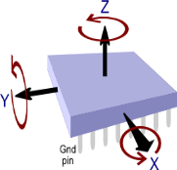
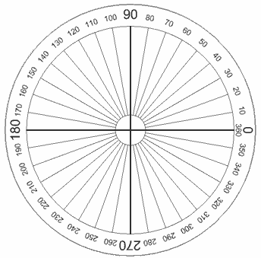
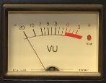
Compass and sound meter demonstrations
COMPASS application
Uses LSM303C eCompass MEMS device
3D accelerometer and 3D magnetometer
Sub-Menu
“CALIB”: rotate board (360° on all axis's) after scrolling message invitation
“RUN”: displays angle in degrees
LEFT key to exit
SOUND meter application
Uses MP34DT01 audio sensor to measure ambient noise
Displays measurement value in dB on LCD screen
LEFT key to exit
Notes:
The COMPASS application uses the on-board LSM303C eCOMPASS MEMS device to sense the earth magnetic field. The user needs to quickly rotate the board by 360 degrees on all 3 axis to perform the calibration step. The user can then enter the RUN sub-menu and observe the board angle in degrees.
The SOUND Meter application uses the on-board MP34DT01 digital microphone and displays the ambient noise in decibels.

Slide 19

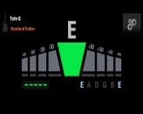
Guitar tuner demonstration
Select guitar string
“STR1”: “E” (low E, thickest string, closest to the ceiling)
“STR2”: “A
“STR3”: “D”
“STR4”: “G”
“STR5”: “B”
“STR6”: “e” (high E, thinnest string, closest to the floor)
RIGHT/SEL to start recording
Output:
“ ++ “ when string needs to be tightened
“ + “ when string needs to be slightly tightened (close to correct tune)
“ OK “ when string is correctly tuned
“ - “ when string needs to be slightly loosened (close to correct tune)
“ -- ” when string needs to be loosened
LEFT key to exit
Notes:
The GUITAR tuning application helps the user to tune his acoustic guitar. First select the string you want to tune and place the discovery board close to the sound hole. The sound is continuously recorded until valid samples are detected; the MCU then displays on the LCD screen whether the tune is correct or the string needs to be strained or loosen.

Slide 20
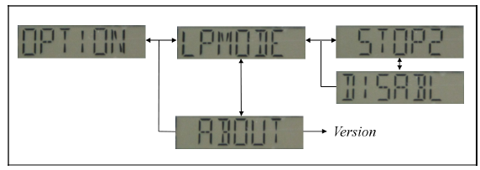
Option app
Select whether to enter STOP2 mode after few seconds of inactivity
Display Firmware version #
1
1
ULP leader and performance booster

Slide 21
Hands-On Lab #1: Getting Started with CubeMX LED Blinky in Five Easy Steps!

Slide 22
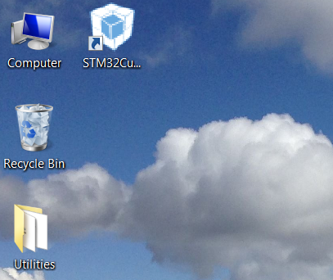
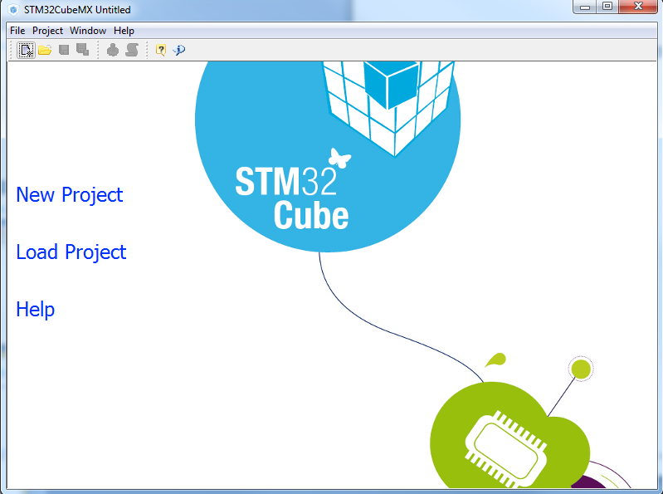
Run STM32CubeMX

Slide 23
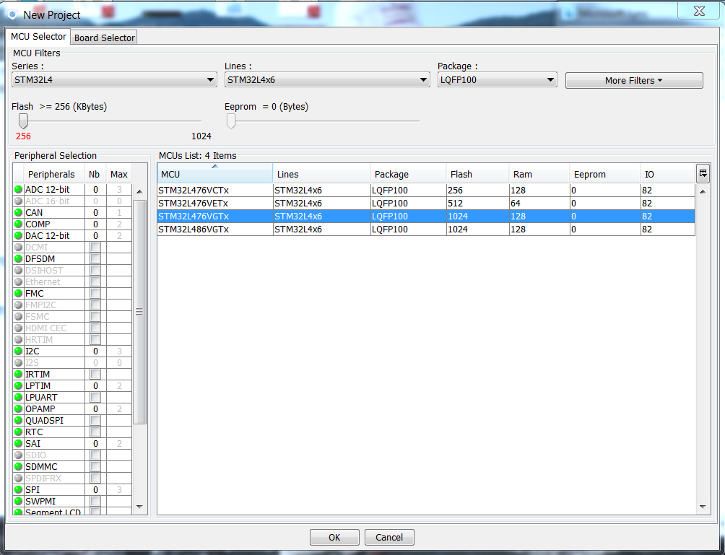
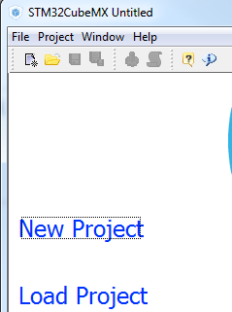
Step 1: Create New Project
Create New Project
Select STM32L476VGTx
LQFP100, 1024KB Flash
Click “OK”

Slide 24
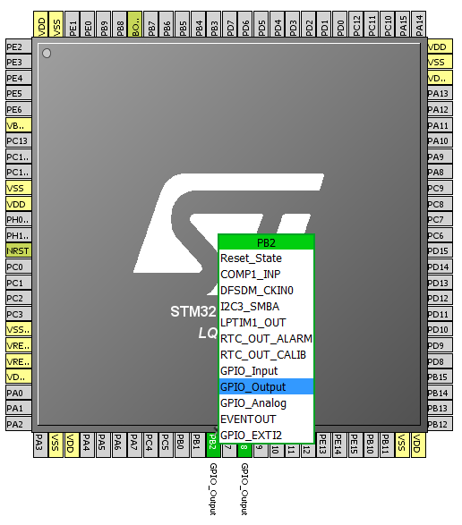
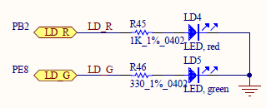
Step 2: Pin Configuration
In this example we are going to use the LED’s present on the STM32L476 Discovery board.
Left-click PB2 & PE8 and set to GPIO_Output mode

Slide 25
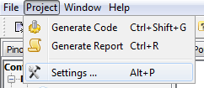
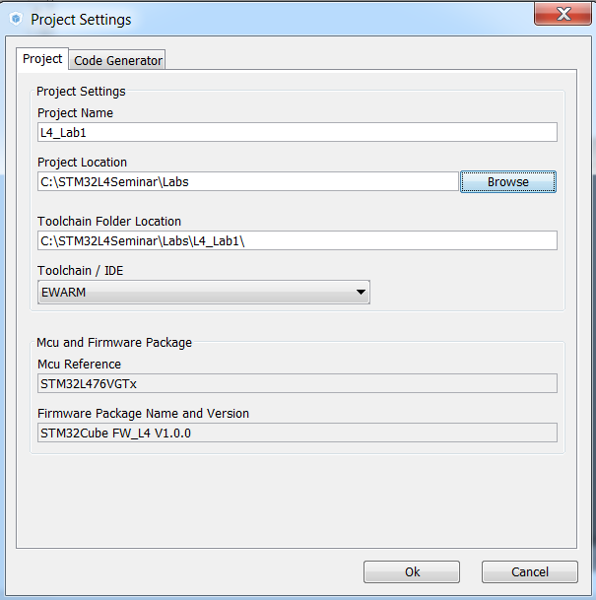
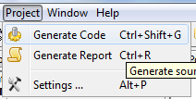
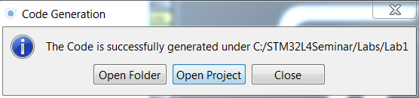
Step 3: Generate Source Code
Open Project > Settings (Alt + P)
Set the project name (Lab1) and the project location (C:\STM32L4Seminar\Labs)
Set the IDE Toolchain to EWARM
Click OK
Generate Code (Ctrl + Shift + G)
Click Open Project

Slide 26
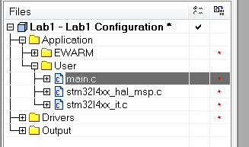
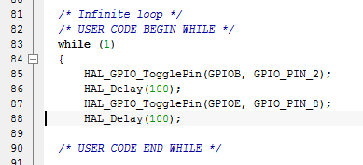
Step 4: Toggle The LED
The IAR EWARM IDE should now be open.
Expand the file tree and open the main.c file
Add the following code inside the while(1) loop
Line 85 in “main.c”
Add within “USER CODE BEGIN WHILE” / “USER CODE END WHILE” section (this will preserve your code after regeneration)
HAL_GPIO_TogglePin(GPIOB, GPIO_PIN_2);
HAL_Delay(100);
HAL_GPIO_TogglePin(GPIOE, GPIO_PIN_8);
HAL_Delay(100);

Slide 27
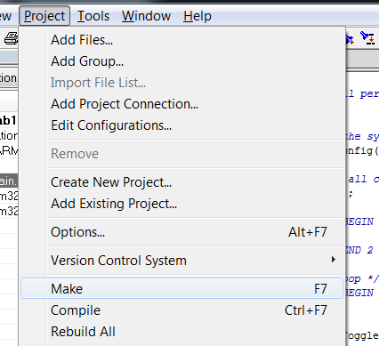



Step 5: Build the Project
Click “F7” or the “Make” button or use menu Project > Make.
Click the “Download and Debug” Green Arrow button (CTRL + D)
Click the “Go” button (F5)
Enjoy the flashing LED’s!

Slide 28
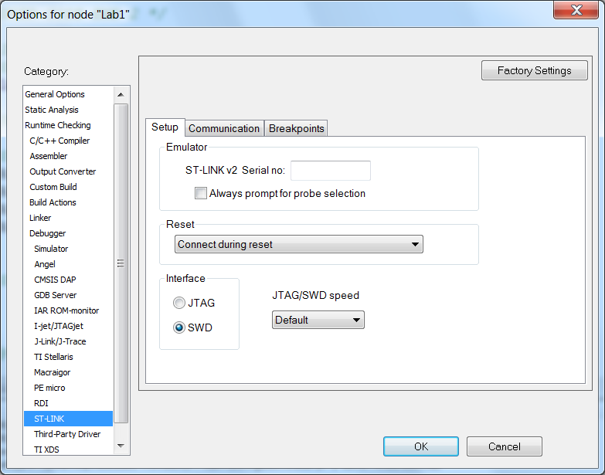
In case it fails

Slide 29
STM32L4 Overview Architecture, Memory, Clocks, Power

Slide 30
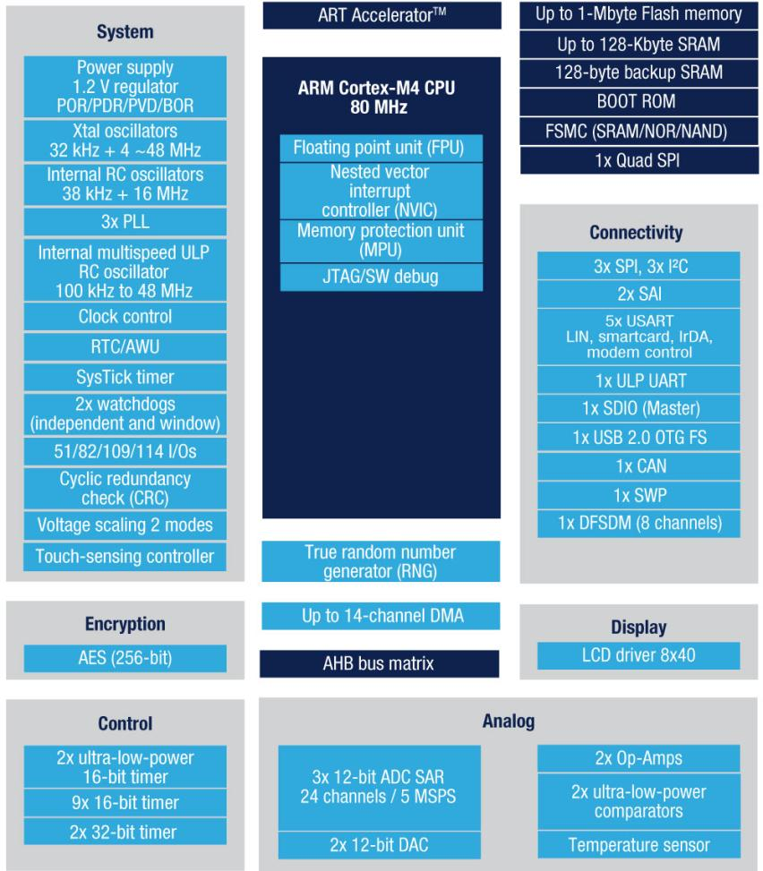
STM32L476 block diagram
Notes:
26-Apr-16
30
All buses (AHB and APB) can operate up to 80MHz

Slide 31
Flash organization
Two 512KB User Flash banks:
Each bank is 256 pages of 2KB
Information block:
System memory boot loader
1 KB (128 double word) OTP for user data
Option bytes for user configuration
Flash area |  | Flash memory address | Size | Name
Main memory | Bank 1 | 0x0800 0000 – 0x0800 07FF | 2K | Page 0
 |  | … |  | …
 |  | 0x0807 F800 – 0x0807 FFFF | 2K | Page 255
 | Bank 2 | 0x0808 0000 – 0x0808 07FF | 2K | Page 256
 |  | … |  | …
 |  | 0x080F F800 – 0x080F FFFF | 2K | Page 511
Information block | Bank 1 | 0x1FFF 0000 – 0x1FFF 6FFF | 28K | System memory
 | Bank 2 | 0x1FFF 8000 – 0x1FFF EFFF | 28K
 | Bank 1 | 0x1FFF 7000 – 0x1FFF 73FF | 1K | OTP area
 | Bank 1 | 0x1FFF 7800 – 0x1FFF 780F | 16 | Option bytes
 | Bank 2 | 0x1FFF F800 – 0x1FFF F80F | 16

Slide 32
Program / Erase
ECC (Error Code Correction) : 8-bit for 64-bit word
Single error correction:
Failure address and bank saved in FLASH_ECCR register, optional interrupt
Double error detection : NMI!
Programming granularity is 64-bit
Page granularity for erase is 2 Kbytes
Parameter | Typ
64-bit programming time | 82 µs
Page (2 KB) erase time | 22 ms
One row (32 double-word) programming time | Normal : 2.6 ms Fast : 1.9 ms
One page (2 KB) programming time | Normal : 20.9 ms Fast : 15.3 ms
One bank (512 KB) programming time | Normal : 5.35 s Fast : 3.9 s
Mass erase time (1 or 2 banks) | 22 ms
Notes:
Comparison with F4:
Double word programming : 16 µs
Sector (16 KB) erase : 230 ms
Sector (64 KB) erase : 490ms
Sector (128 KB) erase : 875ms
Mass erase : 6.9s

Slide 33
Flash protections
Flexible Protections configurable with option bytes :
Readout protection (RDP)
Forbids access to Flash/SRAM2/Backup registers by:
Debug interface (JTAG/SWD)
Boot from SRAM1
Bootloader
Proprietary Code Protection (PCROP) with 64-bit granularity
Used to protect specific code area from any read or write access
The code can only be executed.
Write Protection (WRP) with 2-KByte granularity
Used to protect specific code area from unwanted write/erase

Slide 34
Readout Protections
Readout protection Level 0 : No read protection
All operations are possible in all boot configurations.
Readout protection Level 1
User mode: Code executing in user mode can access main Flash memory, option bytes, RTC backup registers and SRAM2 with all operations.
Debug, boot RAM and boot loader modes: The main Flash memory, backup registers and SRAM2 are totally inaccessible in these modes, a simple read access generates a bus error and a Hard Fault interrupt.
Un-protection, Level 1 to Level 0:
Flash memory is mass-erased, RTC backup registers and SRAM2 are cleared
If Option bit PCROP_RDP is set, the PCROP-protected area is not erased
Readout protection Level 2 (No debug)
All protections provided by Level 1 are active.
RAM boot, System memory boot and all debug features are disabled
Option bytes can no longer be changed in user mode.
Un-protection is not possible. It is an irreversible operation

Slide 35

Proprietary Code (PCROP) / Write Protections
When enabled, PCROP area is protected against all D-code bus accesses
The PCROP regions are execute-only
1 area per bank, 64-bit granularity.
PCROP area can be increased but never decreased
Only way to deactivate PCROP is to change RDP from Level 1 to Level 0
Option bit PCROP_RDP
When DISABLED: PCROP content is erased when RDP is changed from Level 1 to Level 0. PCROP_RDP is locked in this state.
When ENABLED: PCROP content is preserved when RDP is changed from Level 1 to Level 0.
Flash Write Protection:
Write-protected area is protected against erasing and programming.
2 areas per bank, 2-KByte granularity.

Slide 36
STM32 Firewall (FW)
The FIREWALL is made to protect parts of code/data (volatile and non volatile) from access from the rest of the code executed outside of the protected area.
Code Segment (NVM Code)
31
24
23
8
7
1
Start Address
FW_CSSA
31
22
21
8
7
1
GP-DMA
Length
FW_CSL
Cortex-M4
Protection : Code fetch
Bus Matrix
Non-Volatile Data Segment (NVM Data)
31
24
23
8
7
1
Start Address
FW_NVDSSA
SRAM1
AHB/APB
FLASH
31
22
21
8
7
1
Length
FW_NVDSL
Volatile Data
NVM code
NVM data
Protection : Data
FIREWALL
Reset event
Volatile Data Segment (SRAM1 Data)
31
17
8
7
1
16
Start Address
FW_VDSSA
31
22
21
8
7
1
3 Segments may be protected
by the Firewall
Length
FW_VDSL
Protection: - Code fetch if SRAM1 is executable (not shared)
- Data
31
1
VDE
VDS
FPA
FW_CR
FPA : Pre-alarm bit to control the exit point of the protected code
VDS : SRAM1 protected segment is sharable with non protected code
VDE : SRAM1 is executable into the protected volatile data segment

Slide 37
Clocks: MSI (Multi-Speed Internal)
MSI = clock at startup from Reset, Standby or Shutdown modes.
12 Programmable frequency ranges:
100 kHz, 200 kHz, 400 kHz, 800 kHz, 1 MHz, 2 MHz, 4 MHz (reset value), 8 MHz, 16 MHz, 24 MHz, 32 MHz, 48 MHz.
After Standby: Frequency selected from 1, 2, 4 or 8 MHz with MSISRANGE in RCC_CSR register.
Normal mode and PLL-mode (=auto-calibration with LSE)
PLL-mode : allows USB FS device functionality (0.25% accuracy)
Factory and user trimmed

Slide 38
HSI vs. MSI (design spec)
 | MSI |  | HSI
 | Normal mode | PLL-mode
Accuracy (max) | Over temperature: ±6% | Better than 0.25% | 0.3% after trim
 | Over voltage: From 100 to 800 kHz : ±1% From 1 to 8 MHz : ±2% From 16 to 48 MHz : ±4%
Consumption (typ) | 100 kHz : 0.5 µA |  | 130 µA
 | 800 kHz : 2µA
 | 1 MHz : 5µA
 | 8 MHz : 20 µA
 | 16 MHz : 60 µA
 | 48 MHz : 160 µA
Startup time (typ) | 100 kHz : 10 µs 48 MHz : 2.5 µs | 1.25 ms for 5% of final freq. | 0.9 µs

Slide 39
Clocks: LSE (Low-Speed External)
LSE: programmable amplifier driving capability (4 modes)
Available in all low-power modes + VBAT
Mode | Crystal (max) | Consumption (typ)
Ultra low power | 50kOhm/6pF | 200 nA
Medium low driving | 80kOhm/6pF | 260 nA
Medium high driving | 50kOhm/12.5pF | 410 nA
High driving | 80kOhm/12.5pF | 540 nA

Slide 40
Clocks: LSI (Low-Speed Internal)
LSI 32kHz
Available in all low-power modes except Shutdown and VBAT
Parameters | STM32L15x | STM32L4x
Accuracy over parts | 26..56KHz | ~8%
Accuracy over temperature | -10% / +4% (0..85°C)
 |  | 2% (-40 125°C)
Consumption (typ) | 400nA | 110nA

Slide 41
Power schemes (1/3)
USB transceivers
VDDUSB
2 OPAMP
VDDA
2 COMP
3 ADC
2 DAC
CPU
VREF+
VREF buffer
SRAM1
SRAM2
LCD
Digital peripherals
VLCD
LCD booster
Flash
V_{CORE}
Reset block
Temp. sensor
Voltage Regulator
3 PLL, HSI, MSI
Standby circuitry (wakeup, IWDG)
VDD
I/O ring
VDDIO1
VDDIO2
Backup domain
LSE, RTC, backup registers
VBAT
I/O ring
VDDIO2

Slide 42
Peripheral Voltage Monitor
By default independent powers are electrically isolated and the features powered by them are not available
The power isolation must be removed by SW
Peripheral Voltage Monitor for VDDA, VDDUSB, VDDIO2:
PVM | Power supply | PVM threshold | EXTI line
PVM1 | V_{DDUSB} | VPVM1 = 1.2 V | 35
PVM2 | V_{DDIO2} | VPVM2 = 0,9 V | 36
PVM3 | V_{DDA} | VPVM3 = 1.65 V | 37
PVM4 | V_{DDA} | VPVM4 = 1.82 V | 38

Slide 43
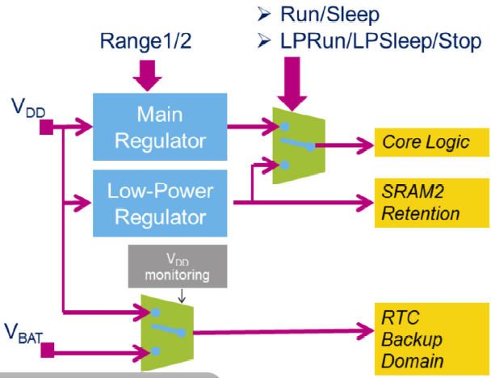
V_{CORE} Voltage Regulator
Dynamic Voltage Scaling optimizes performance vs power
V_{CORE} Voltage Range 1 = 1.2V (Up to 80MHz)
V_{CORE} Voltage Range 2 = 1.0V (Up to 26MHz)
V_{CORE} powered by main regulator (MR) or low-power regulator (LPR)
MVR for Run and Sleep modes.
LPR for LP run, LP sleep and STOP1/STOP2 modes.
Regulators OFF in Standby and Shutdown mode.
However LPR remains ON to preserve SRAM2 content in Shutdown mode, if required.
Notes:
In Run mode, both MR and LPR are enable. Nevertheless the LPR startup time is longer than MR startup time, and when starting from BOR reset, Standby mode or Shutdown mode, the MCU starts before the LPR is woken up.
REGLPS flag shows when the LPR is ready

Slide 44
Hands-On Lab #2: printf() debugging

Slide 45

Hands-On Lab #2 – printf() debugging
Adding to the existing CubeMX project, we will add USART2 debug via the ST-LINK Virtual-COM port
Set up additional GPIO / Clocks:
PD5 – USART2, “VirtualCOM-TX” – Alt. Fn. Push/Pull
PD6 – USART2, “VirtualCOM-RX” – Alt. Fn. Push/Pull
PA0 – GPIO_EXTI0: External Interrupt on Rising Edge Input
USART2 Clock = PCLK1 (80MHz)
USART2 settings:
Asynchronous Mode - 9600 N/8/1, No HW Flow control
Tx/Rx, 16-sample oversampling
No advanced features
User Code HAL function calls required:
See lab2_printf_debug.c in Lab2_Printf directory
Also Need Terminal emulator (Hyperterm, etc)
USART2 is routed to the ST-LINK’s USART, and brought via the USB Virtual-COM port class
(SB13/16 have been soldered)
45

Slide 46
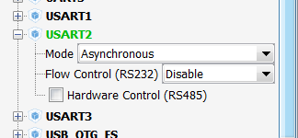
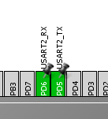

GPIO Configuration additions
Expand the USART2 dialog, and select Asynchronous mode:
Use PD5 & PD6 for Tx / Rx pins:
These are the alternate mapping pins (PA2/3 are default)
Use PA0 in External Interrupt Mode, Rising edge trigger:

Slide 47
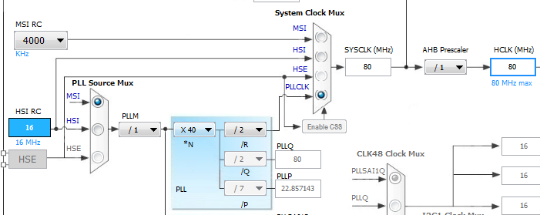
Clock Configuration
We will run the STM32L4 at 80MHz for this lab
Click on the Clock Configuration tab
Set the PLL Source Mux to MSI
Set the System Clock Mux to PLLCLK
Use PLLM=/1, *N = x40, /R=/2
AHB Prescaler = /1
HCLK should equal 80MHz
80MHz

Slide 48

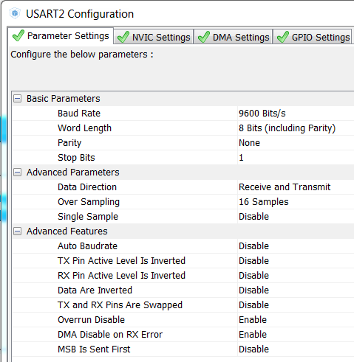
USART2 Configuration
Click on the Configuration tab, and select USART2:
Parameter Settings tab:
9600Bits/s
8-bit word length
No parity bit
1 Stop bit
Rx & Tx data
16-clock oversampling
No advanced feature settings needed
No NVIC or DMA settings used

Slide 49
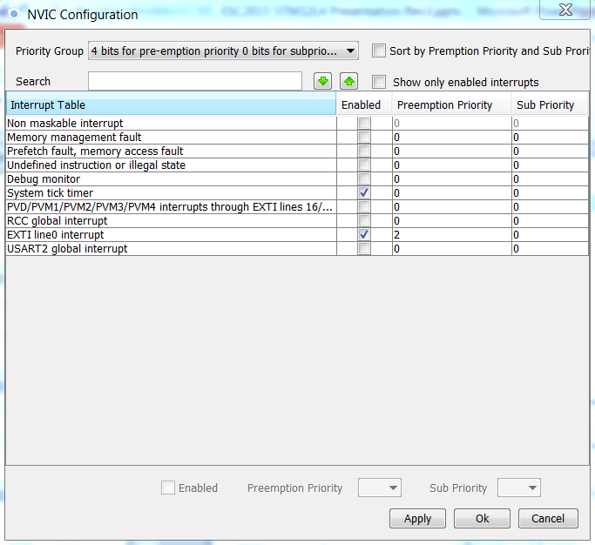

NVIC Configuration
Click on the Configuration tab, and select NVIC:
Enable EXTI line0
Set Preemption Priority to 2
Click ‘OK’

Slide 50
Regenerate Source Code for Lab1
Generate Code (Ctrl + Shift + G)
Open Project
Copy/Paste needed code bits for Hands-On Lab #2 into main.c:
C:\STM32L4Seminar\Labs\lab2_printf_debug.c
Add code bits between: /* USER CODE BEGIN PV */ /* USER CODE END PV */
Add code bits between: /* USER CODE BEGIN 2 */ /* USER CODE END 2 */
Add code bits between: /* USER CODE BEGIN WHILE */ /* USER CODE END WHILE */
Add code bits between: /* USER CODE BEGIN 4 */ /* USER CODE END 4 */
Open a terminal emulator, using USART2 settings, Virtual COM port xx
Rebuild, Program/Debug, Run!

Slide 51
STM32L4 Low Power details

Slide 52
STM32L4 Power Mode Run mode
Available
Peripheral
GPIO
DMA
FSMC
QUADSPI
BOR
PVD, PVM
Run Mode Range 1
Ex: execution from Flash
LCD
USB OTG
USART
LP UART
I2C 1 / I2C 2
I2C 3
SPI
CAN
Cortex M4
Main regulator (MR)
SDMMC
Range 1
131uA/MHz at 80 MHz
(10.2mA)
SWPMI
SAI
Range 1 (up to 80MHZ)
DFSDM
Flash
(1MB)
SRAM 1 (96KB)
ADC
Range 2 (up to 26MHZ)
Range 2
112uA/MHz at 26 MHz
(2.9 mA)
DAC
OPAMP
Low Power regulator (LPR)
up to 2MHz
COMP
SRAM 2 (32KB)
Temp Sensor
Timers
LPTIM 1
LPTIM 2
Available
Clock
IWDG
WWDG
Systick Timer
HSI
Touch Sens
HSE
Cell in power-down
RNG
LSI
Active cell
Frozen cell
Available
Periph and clock
AES
LSE
CRC
MSI

Slide 53
STM32L4 Power Mode Low-power run mode
Available
Peripheral
GPIO
DMA
DMA
FSMC
FSMC
QUADSPI
QUADSPI
BOR
PVD, PVM
LCD
Low-power run mode
Ex: execution from Flash
USB OTG
USART
LP UART
I2C 1 / I2C 2
I2C 3
SPI
CAN
Cortex M4
Main regulator (MR)
SDMMC
from Flash
135 µA/MHz at 2 MHz
(269 µA)
SWPMI
SAI
Range 1 (up to 80MHZ)
DFSDM
Flash
(1MB)
SRAM 1 (96KB)
ADC
Range 2 (up to 26MHZ)
From SRAM1
112 µA/MHz at 2 MHz
(225 µA)
DAC
OPAMP
Low Power regulator (LPR)
up to 2MHz
COMP
SRAM 2 (32KB)
Temp Sensor
Timers
LPTIM 1
LPTIM 2
Available
Clock
IWDG
WWDG
Systick Timer
HSI
Touch Sens
HSE
Cell in power-down
RNG
LSI
Active cell
Frozen cell
Available
Periph and clock
AES
LSE
CRC
MSI

Slide 54
STM32L4 Power Mode Sleep mode
Available
Peripheral
GPIO
DMA
FSMC
DMA
FSMC
QUADSPI
QUADSPI
BOR
PVD, PVM
LCD
Sleep Mode Range 1
Ex: Flash ON, SRAMs ON (default)
USB OTG
USART
LP UART
Zzz
I2C 1 / I2C 2
I2C 3
SPI
CAN
Cortex M4
Main regulator (MR)
SDMMC
Range 1
37 µA/MHz at 80 MHz
(2.96 mA)
SWPMI
SAI
Range 1 (up to 80MHZ)
DFSDM
Flash
(1MB)
SRAM 1 (96KB)
ADC
Range 2 (up to 26MHZ)
Range 2
35 µA/MHz at 26 MHz
(0.92 mA)
DAC
OPAMP
Low Power regulator (LPR)
up to 2MHz
COMP
SRAM 2 (32KB)
Temp Sensor
Timers
LPTIM 1
LPTIM 2
Available
Clock
IWDG
WWDG
Systick Timer
HSI
Touch Sens
HSE
Cell in power-down
RNG
LSI
Active cell
Frozen cell
Available
Periph and clock
AES
LSE
CRC
MSI

Slide 55
STM32L4 Power Mode Low-power sleep mode
Available
Peripheral
GPIO
DMA
DMA
FSMC
FSMC
QUADSPI
QUADSPI
BOR
PVD, PVM
Low-power sleep mode
Ex: Flash OFF, SRAM1 OFF
LCD
USB OTG
USART
LP UART
Zzz
I2C 1 / I2C 2
I2C 3
SPI
CAN
Cortex M4
Main regulator (MR)
SDMMC
Flash ON, SRAMs OFF
48 µA/MHz at 2 MHz
(96 µA)
SWPMI
SAI
Range 1 (up to 80MHZ)
DFSDM
Flash
(1MB)
SRAM 1 (96KB)
ADC
Range 2 (up to 26MHZ)
Flash OFF, SRAMs OFF
40,5 µA/MHz at 2 MHz
(81 µA)
DAC
OPAMP
Low Power regulator (LPR)
up to 2MHz
COMP
SRAM 2 (32KB)
Temp Sensor
Timers
LPTIM 1
LPTIM 2
Available
Clock
IWDG
WWDG
Systick Timer
HSI
Touch Sens
HSE
Cell in power-down
RNG
LSI
Active cell
Frozen cell
Available
Periph and clock
AES
LSE
CRC
MSI

Slide 56
STM32L4 Power Mode Stop 1 Mode
Available
Peripheral
GPIO
I/Os kept, and configurable
DMA
FSMC
QSPI
BOR
PVD, PVM
Stop 1 w/ RTC on LSE quartz
7.1 µA @3.0V
6.9 µA @1.8V
LCD
USB OTG
USART
LP UART
Wake-up
event
I2C 1 / I2C 2
Zzz
I2C 3
SPI
CAN
Cortex M4
Main regulator (MR)
NRST
SDMMC
BOR
SWPMI
PVD
SAI
PVM
DFSDM
Flash
(1MB)
SRAM 1 (96KB)
RTC + Tamper
ADC
LCD
DAC
USB OTG
OPAMP
Low Power regulator (LPR)
USART
COMP
SRAM 2 (32KB)
LP UART
Temp Sensor
I2C 1 / I2C 2
Timers
I2C 3
LPTIM 1
SWPMI
LPTIM 2
Available
Clock
Backup domain
COMP
IWDG
LPTIM 1
WWDG
Backup Register
(32x32-bits)
LPTIM 2
Systick Timer
HSI
IWDG
Touch Sens
HSE
RTC
GPIOs
RNG
LSI
AES
LSE
6us wake-up from Flash
4us wake-up from RAM
CRC
MSI

Slide 57
STM32L4 Power Mode Stop 2 Mode
Available
Peripheral
GPIO
I/Os kept, and configurable
DMA
FSMC
QSPI
BOR
PVD, PVM
Stop 2 w/ RTC on LSE quartz
1.67 µA @3.0V
1.43 µA @1.8V
LCD
USB OTG
USART
LP UART
Wake-up
event
I2C 1 / I2C 2
Zzz
I2C 3
SPI
CAN
Cortex M4
Main regulator (MR)
NRST
SDMMC
BOR
SWPMI
PVD
SAI
PVM
DFSDM
Flash
(1MB)
SRAM 1 (96KB)
RTC + Tamper
ADC
LCD
DAC
OPAMP
Low Power regulator (LPR)
COMP
SRAM 2 (32KB)
LP UART
Temp Sensor
Timers
I2C 3
LPTIM 1
Available
Clock
LPTIM 2
Backup domain
COMP
IWDG
LPTIM 1
WWDG
Backup Register
(32x32-bits)
Systick Timer
HSI
IWDG
Touch Sens
HSE
RTC
GPIOs
RNG
LSI
AES
LSE
7us wake-up from Flash
5us wake-up from RAM
CRC
MSI

Slide 58
STM32L4 Power Mode Standby Mode
Available
Peripheral
GPIO
I/Os can be configured
w/ or w/o pull-up
w/ or w/o pull-down
DMA
FSMC
QSPI
BOR
PVD, PVM
Standby
w/ SRAM2
w/o RTC
LCD
405 nA @ 3.0V
363 nA @1.8V
USB OTG
USART
LP UART
I2C 1 / I2C 2
Zzz
I2C 3
SPI
CAN
Cortex M4
Main regulator (MR)
SDMMC
SWPMI
SAI
DFSDM
Flash
(1MB)
SRAM 1 (96KB)
ADC
Wake-up
event
DAC
OPAMP
Low Power regulator (LPR)
COMP
SRAM 2 (32KB)
Temp Sensor
NRST
Timers
BOR
LPTIM 1
Available
Clock
RTC + Tamper
LPTIM 2
Backup domain
IWDG
IWDG
5 WKUP pins
WWDG
Backup Register
(32x32-bits)
Systick Timer
HSI
14 us wake-up
Touch Sens
HSE
RTC
RNG
LSI
AES
LSE
CRC
MSI

Slide 59
STM32L4 Power Mode Standby Mode
Available
Peripheral
GPIO
I/Os can be configured
w/ or w/o pull-up
w/ or w/o pull-down
DMA
FSMC
QSPI
BOR
PVD, PVM
Standby w/ RTC
on LSE quartz
650 nA @ 3.0V
433 nA@ 1.8V
LCD
USB OTG
USART
LP UART
I2C 1 / I2C 2
Zzz
I2C 3
SPI
CAN
Cortex M4
Main regulator (MR)
SDMMC
SWPMI
SAI
DFSDM
Flash
(1MB)
SRAM 1 (96KB)
ADC
Wake-up
event
DAC
OPAMP
Low Power regulator (LPR)
COMP
SRAM 2 (32KB)
Temp Sensor
NRST
Timers
BOR
LPTIM 1
RTC + Tamper
LPTIM 2
Available
Clock
Backup domain
IWDG
IWDG
5 WKUP pins
WWDG
Backup Register
(32x32-bits)
Systick Timer
HSI
14 us wake-up
Touch Sens
HSE
RTC
RNG
LSI
AES
LSE
CRC
MSI

Slide 60
STM32L4 Power Mode Standby Mode
Available
Peripheral
GPIO
I/Os can be configured
w/ or w/o pull-up
w/ or w/o pull-down
DMA
FSMC
QSPI
BOR
PVD, PVM
Standby
150 nA @ 3.0V
114 nA @ 1.8V
LCD
USB OTG
USART
LP UART
I2C 1 / I2C 2
Zzz
I2C 3
SPI
CAN
Cortex M4
Main regulator (MR)
SDMMC
SWPMI
SAI
DFSDM
Flash
(1MB)
SRAM 1 (96KB)
ADC
Wake-up
event
DAC
OPAMP
Low Power regulator (LPR)
COMP
SRAM 2 (32KB)
Temp Sensor
NRST
Timers
BOR
LPTIM 1
RTC + Tamper
LPTIM 2
Available
Clock
Backup domain
IWDG
IWDG
5 WKUP pins
WWDG
Backup Register
(32x32-bits)
Systick Timer
HSI
14 us wake-up
Touch Sens
HSE
RTC
RNG
LSI
AES
LSE
CRC
MSI

Slide 61
STM32L4 Power Mode Shutdown Mode
Available
Peripheral
GPIO
I/Os can be configured
w/ or w/o pull-up
w/ or w/o pull-down
But floating when exit from Shutdown
DMA
FSMC
QSPI
BOR
PVD, PVM
Shutdown w/ RTC
on LSE quartz
550 nA @ 3.0V
329 nA @ 1.8V
LCD
USB OTG
USART
LP UART
I2C 1 / I2C 2
Zzz
I2C 3
SPI
CAN
Cortex M4
Main regulator (MR)
SDMMC
SWPMI
SAI
DFSDM
Flash
(1MB)
SRAM 1 (96KB)
ADC
Wake-up
event
DAC
OPAMP
Low Power regulator (LPR)
COMP
SRAM 2 (32KB)
Temp Sensor
NRST
Timers
LPTIM 1
RTC + Tamper
LPTIM 2
Available
Clock
Backup domain
IWDG
5 WKUP pins
WWDG
Backup Register
(32x32-bits)
Systick Timer
HSI
250 us wake-up
Touch Sens
HSE
RTC
RNG
LSI
AES
LSE
CRC
MSI

Slide 62
STM32L4 Power Mode Shutdown Mode
Available
Peripheral
GPIO
I/Os can be configured
w/ or w/o pull-up
w/ or w/o pull-down
But floating when exit from Shutdown
DMA
FSMC
QSPI
BOR
PVD, PVM
LCD
Shutdown
64 nA @ 3.0V
30 nA @ 1.8V
USB OTG
USART
LP UART
I2C 1 / I2C 2
Zzz
I2C 3
SPI
CAN
Cortex M4
Main regulator (MR)
SDMMC
SWPMI
SAI
DFSDM
Flash
(1MB)
SRAM 1 (96KB)
ADC
Wake-up
event
DAC
OPAMP
Low Power regulator (LPR)
COMP
SRAM 2 (32KB)
Temp Sensor
NRST
Timers
LPTIM 1
RTC + Tamper
LPTIM 2
Available
Clock
Backup domain
IWDG
5 WKUP pins
WWDG
Backup Register
(32x32-bits)
Systick Timer
HSI
256 us wake-up
Touch Sens
HSE
RTC
RNG
LSI
AES
LSE
CRC
MSI

Slide 63
Low-power modes summary
Mode | Regulator | CPU | Flash | SRAM | Clocks | Peripherals In Bold : wakeup source | Consumption @ 1.8V | Wakeup time
Run | R1 | Yes | ON⁽¹) | ON | Any | All | 131 µA/MHz | N/A
 | R2 |  |  |  |  | All except OTG, SDMMC, RNG | 112 µA/MHz
LPRun | LPR | Yes | ON⁽¹) | ON | Any except PLL | All except OTG, SDMMC, RNG | 135 µA/MHz | TBD
Sleep | R1 | No | ON⁽¹) | ON⁽²) | Any | All Any IT or event | 37 µA/MHz | 6 cycles
 | R2
 |  |  |  |  |  |  | 35 µA/MHz
LPSleep | LPR | No | ON⁽¹) | ON⁽²) | Any except PLL | All except OTG, SDMMC, RNG Any IT or event | 40 µA/MHz | 6 cycles
Stop 1 | LPR | No | OFF | ON | LSE/LSI | Reset pin, all I/Os BOR,PVD,PVM,RTC,LCD,IWDG, COMPx,DACx,OPAMPx,USARTx, LPUART,I2Cx,LPTIMx,OTG_FS, SWPMI | 6.6µA w/o RTC 6.9 µA w/RTC | 4 µs RAM 6 µs Flash
Stop 2 | LPR | No | OFF | ON | LSE/LSI | Reset pin, all I/Os BOR,PVD,PVM,RTC,LCD,IWDG, COMPx,LPUART,I2C3,LPTIM1 | 1.2 µA w/o RTC 1.4 µA w/RTC | 5 µs RAM 7 µs Flash
Standby | LPR | DOWN | OFF | SRAM2 ON | LSE/LSI | Reset pin, 5 WKUPx pins BOR, RTC, IWDG | + 235 nA | 14 µs
 | OFF |  |  | DOWN |  |  | 128 nA w/o RTC 433 nA w/RTC
Shutdown | OFF | DOWN | OFF | DOWN | LSE | Reset pin, 5 WKUPx pins RTC | 30 nA w/o RTC 329 nA w/RTC | 256 µs
Can be put in power-down and clock can be gated off
SRAM1 and SRAM2 can be gated off independently

Slide 64
Low-power modes transitions
LPSleep
Sleep
LPRun
Shutdown
Run
Stop1
Standby
Stop2

Slide 65
Hands-On Lab #3: Power Consumption Calculator

Slide 66
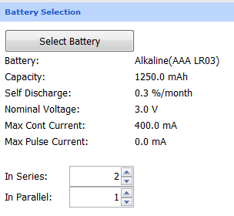
Power Consumption Calculator Lab
Click on the Power Consumption Calculator tab in CubeMX
Select two AAA Alkaline batteries (in series) as our power source:

Slide 67

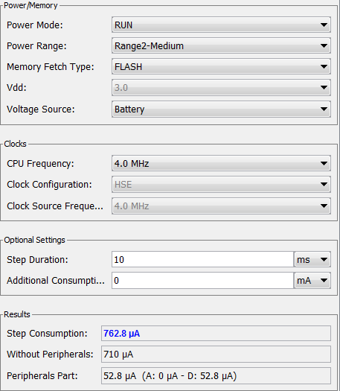
Power Consumption Calculator Lab
Add a step to our power sequence: Click: Step.. Add
Configure a 10ms step:
4.0MHz Range2 RUN mode
GPIOB, GPIOE and USART2 peripherals enabled
Click “Add”
Resulting step consumption should be 762.8uA

Slide 68
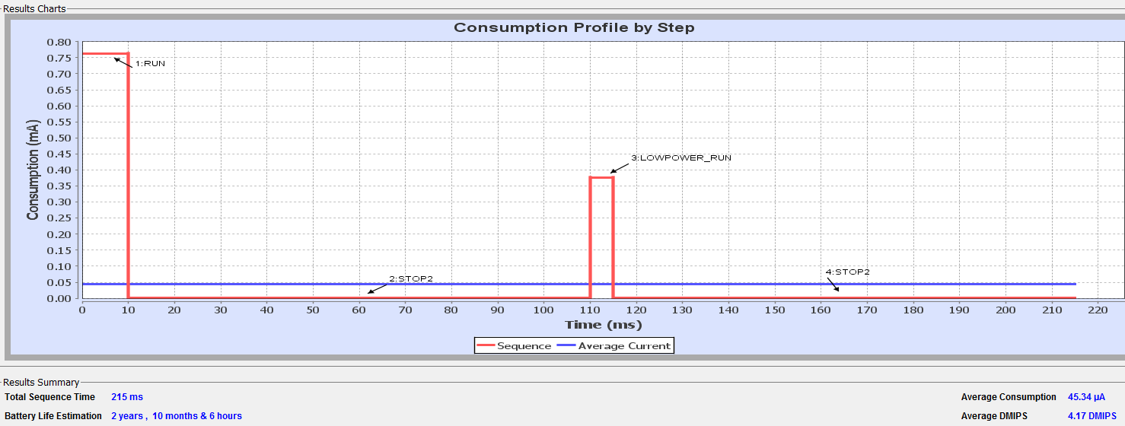
Power Consumption Calculator Lab
Add three more additional power steps:
STOP2 mode, Battery power source, ALL Clocks OFF, 100ms duration
LPRUN mode, FLASH fetch type, Battery power source, 2.0MHz freq, 5ms duration, GPIOB, GPIOE active
Duplicate Step #2 (STOP2 mode) using the DUPLICATE button
Check the result:

Slide 69
VBAT backup domain
VBAT charging : allows charging a super-cap on VBAT through internal resistor when VDD is present
Battery charging is enabled by setting VBE bit in the PWR_CR4 register.
VBRS bit value in the PWR_CR4 register selects the resistor value
Backup domain
VDD
VBAT
VDD domain
1.5 kΩ
VBE
VBRS
5 kΩ
Battery charging

Slide 70
STM32L4 Peripheral details 1/2

Slide 71
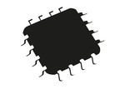







Smart peripherals Δ Metering
Digital Filter for Sigma
Delta Modulators
8 x parallel inputs
with up to 24-bit data output resolution
ADC
ΣΔ 24-bit
88×40 or 4×44
with step-up converter
LCD Display
V_{BAT} with RTC
for battery backup 240 nA in V_{BAT} mode for RTC and
32x 32-bit backup registers
STM32L4
Anti Tamper pin
3 x tamper pins
for battery domain
TRNG & AES for Security
128-/256-bit AES
key encryption hardware accelerator
Electricity/Gas
/Water
Smart Meter
SPI / UART/ SDIO for Wireless
3x SPIs (4x SPIs with the Quad SPI)
6x USARTs (ISO 7816, LIN, IrDA, modem)
1 x SDIO
FSMC
External memory interface for static memories supporting SRAM, PSRAM, NOR and NAND
I/Os Up to 114 fast I/Os for buttons & relays
2
Innovation
Notes:
Pour FSMC remplacer l’image. On voit ecrit le nom d’un competitor dessus ;) « Spansion »

Slide 72





Smart Peripherals Industrial Sensors
Motor Control :
2x 16-bit advanced motor-control timers
3x 12-bit ADCs: 5 MSPS,
with up to 16-bit with hardware
oversampling, 200 μA/MSPS
8×40 or 4×44
with step-up converter
LCD Display
STM32L4
CAN Bus
(2.0B Active)
High temperature
from -40°C
up to + 125°C
TRNG & AES for Security
128/256-bit AES
key encryption hardware accelerator
SPI / UART
3x SPIs (4x SPIs with the
Quad SPI)
6x USARTs (ISO 7816, LIN,
IrDA, modem)
FSMC
External memory interface
for static memories supporting
SRAM, PSRAM, NOR and NAND
I²C
3x I²C FM+(1 Mbit/s), SMBus/PMBus
I/Os
Up to 114 GPIOs
2
Innovation

Slide 73




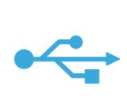




Smart peripherals Fitness tracker application
Digital Filter for Sigma
Delta Modulators
with PDM microphone input support
TFT Display
STM32L4
FSMC
Parallel interface to TFT
SPI
Up to 40 MHz speed
Sensors
I²C
3x I²C FM+
Batch Acquisition Mode (BAM)
USB
USB OTG 2.0 full-speed,
LPM and BCD
SPI / UART
3x SPIs
Quad SPI
6x USARTs
OPAMP
2x with built-in PGA
DAC
Low-power sample and hold
ADC
3× 12-bit ADC 5 MSPS,
SAI
2x serial audio interfaces
SWP
Single wire protocol master interface (SWPMI)
2
Innovation

Slide 74
Smart peripherals - SPI
STM32L4
SPI
Programmable frame from 4 to 16bit (bit granularity)
32-bit FIFO to optimize bus bandwidth (performance & power consumption)
BUSY status bit IP fix
Up to 40 Mbits/s in master mode
I²S functionality no longer supported in SPI. Now in SAI peripheral
2
Innovation

Slide 75
Hands-On Lab #4: SPI communications to MEMS Gyro

Slide 76
Hands-On Lab #4 – SPI communications to 3-axis Gyro
Adding to the existing CubeMX project, we will add SPI communications to the L3GD20 MEMS gyroscope:
Set up additional GPIO / Clocks:
PD1 – SPI2 SCK – Alt. Fn. Push/Pull
PD3 – SPI2 MISO – Alt. Fn. Push/Pull
PD4 – SPI2 MOSI – Alt. Fn. Push/Pull
PD7 – nCS – GPIO Output, Push/Pull mode
SPI2 settings:
Full-Duplex Master
Motorola, 8-bit MSB-first
Prescaler /16
CPOL = Low, CPHA = 1-Edge
No CRC
Software NSS
User Code HAL function calls required to be added to main.c:
C:\STM32L4Seminar\Labs\lab4_spi_gyro.c
Gyro (under LCD) data is routed to SPI2
76

Slide 77
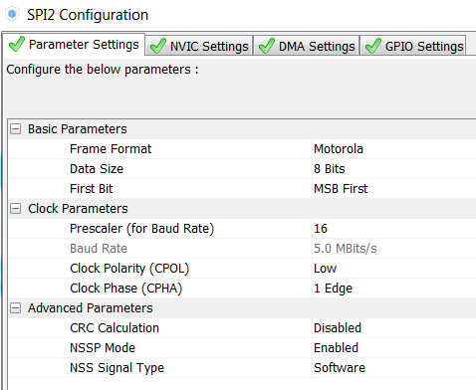
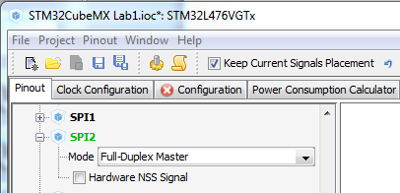
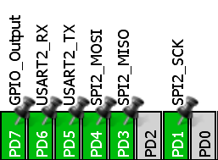
Regenerate Source Code for Lab1
Needed code bits from C:\STM32L4Seminar\Labs\lab4_spi_gyro.c into main.c:
Add code bits between: /* USER CODE BEGIN PV */ /* USER CODE END PV */
Add code bits between: /* USER CODE BEGIN PFP */ /* USER CODE END PFP */
Add code bits between: /* USER CODE BEGIN 2 */ /* USER CODE END 2 */
Add code bits between: /* USER CODE BEGIN WHILE */ /* USER CODE END WHILE */
Add code bits between: /* USER CODE BEGIN 4 */ /* USER CODE END 4 */
Open a terminal emulator, using USART2 settings, Virtual COM port xx
Rebuild, Program/Debug, Run!

Slide 78
STM32L4 Peripherals details 2/2

Slide 79

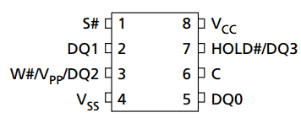
Smart peripherals - QuadSPI
STM32L4
QuadSPI
Communication interface for single/dual/quad SPI flash memories
2
Innovation

Slide 80

Smart peripherals Sensor Hub scenario
Sensors
I²C
STM32L4
I²C
Wakeup from STOP
Host
App.
Processor
SPI / UART
3x SPI
6x USART
Batch Acquisition Mode (BAM)
Optimized mode for transferring data while the system is in low power mode
Only the needed communication peripheral + 1 DMA + 1 SRAM (SRAM1 or SRAM2) are configured with clock enable in Sleep mode
Flash is in power-down mode
Enter either Sleep or Low-power sleep mode
I2C clock can be at 16 MHz, allowing FM+ support
2
Innovation

Slide 81
Smart peripherals – USB OTG FS 2.0
USB 2.0 / OTG 2.0 compliant
VDDUSB: Dedicated 3.3V supply input
6 bidirectional endpoints
MSI in PLL mode (auto-trimmed with LSE) to reach 48MHz & < 0.25% accuracy
HSE not needed
Link power management (LPM) support
New power-save state, L1 (Sleep), with fast entry/exit compared to traditional L2 state (Suspend): 50uS vs 10mS
Battery charging detection (BCD) support
Detect and identify the port type (standard or charging)
Attach Detection Protocol (ADP) support
Allows an OTG device, embedded host or USB device to determine attachment status in the absence of bus power
Suspend/resume support
Wakeup from STOP
STM32L4
USB
USB OTG 2.0 full-speed,
LPM and BCD
2
Innovation

Slide 82
Smart peripherals
Analog Peripherals
OPAMP’s:
Rail-to-rail inputs, 1mV offset after calibration
Outputs: 500µA (sink/source), 100µA (low-power mode)
1MHz GBW (normal mode), 500kHz (low-power mode)
0.7V/µs slew rate (normal), 0.3V/µs (low-power Mode)
Comparators:
2 Comparators
Window mode
Available in low-power modes
DAC’s:
8/12-bit mode
Lots of conversion triggers
Programmable output buffer to drive more current
Supply: VDDA = 1.8 V to 3.6 V
NEW! Sample and hold low-power mode
ADC’s:
ADC1/ADC2 are tightly coupled, ADC3 is standalone
Consumption linear vs. conversion rate : 200 µA / MSPS
Dual-clock architecture
Up to 5.3Ms/s with 12-bit resolution in single mode
Single-ended or differential inputs
Internal channels: Temp sensor, VREF, VBAT/3, DAC
NEW! Hardware Oversampling
STM32L4
OPAMP
2x with built-in PGA
COMP
2x Low-power
DAC
2x Low-power sample and hold
ADC
3× 12-bit ADC 5 MSPS
2
Innovation

Slide 83

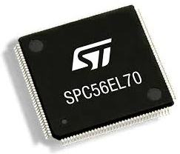

Sample & Hold feature
NEW!
Maintains DAC output voltage when the MCU is in a low power mode, such as STOP1 mode
In Sample & Hold mode the DAC is able to hold its’ output voltage while all related analog and digital blocks are shut off
Up to 15x power savings in some configurations!
STM32L4
Vout

Slide 84
Oversampler
Oversampler performs data pre-processing to offload the CPU. Handles up to 256 conversions and averages them
For : Averaging, Data rate reduction, SNR improvement, Basic filtering
Programmable oversampling ratio
x2, x4, x8, x16, x32, x64, x128, x256
Programmable data shifting / truncating
Right shift 0 to 8 bits
12bit data
20 bit register
0 to 8 bit right shift
16 bit register
ADC
+
Accumulation data register
DATA SHIFTER, TRUNCATER
ADCx_DR
Example: Oversampling ratio x2
CH1(0)
CH1(1)
CH1(0)
CH1(1)
Sampling
Conversion
Trigger for oversampling channel
EOC
Trigger
End of conversion for oversampling channel

Slide 85
COMP low power features
Power consumption -vs- propagation delay can be adjusted:
PWRMODE | Max propagation delay | Consumption (Typ)
00 | 80 ns | 70 µA
01 or 10 | 1 µs | 5 µA
11 | 12 µs | 350 nA
LP mode | Feature / limitation
Run, LPRun | no limitation, state polling or interrupt thru EXTI
Sleep, LPSleep | wakeup capability thru EXTI
Stop 1, Stop 2 | wakeup capability thru EXTI
Standby | not available
Shutdown | not available

Slide 86

LPTIM Features Summary
Asynchronous running capability
Ultra low power-consumption
LPTIM: 00032
Timeout function for wakeup from Stop 1 mode (LPTIM1 & LPTIM2) and Stop 2 mode (LPTIM1 only)

Slide 87
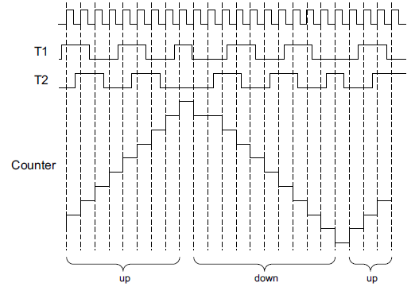
LPTIM Features
Up to 5 clock sources to achieve lowest power consumption
APB clock, LSE, LSI, HSI, External clock
Internal / External hardware triggers, with digital glitch filter:
Rising / Falling or Both edges
GPIO, RTC events, COMP1/2
Up to 2 operation modes
Continuous mode: free running mode; many counter overruns are possible
One Shot mode: Counter stops counting when the overrun value is reached
Encoder mode (LPTIM1 only)
6 interrupt sources

Slide 88
LPTIM Features
Up to 3 configurable waveforms with configurable polarity
PWM waveform
One Pulse waveform
Set Once waveform
POL = 0
LPTIMx_ARR
LPTIMx_CMP
PWM
OnePulse
SetOnce

Slide 89
Hands-On Lab #5: Autonomous peripherals: ADC/TIM/DMA

Slide 90

Hands-On Lab #5: ADC-TIM-DMA functionality
Set up additional GPIO / Clocks:
PA7 – ADC1_IN12 – Analog Input, Single-Ended
ADC Clock = SYSCLK/4 (20MHz)
PD15 – TIM4CH4 Alt Fn output – PWM Generation CH4
ADC1 settings:
Clock Prescaler = Synch /4
12-bit, Right aligned, No Scan, Scan/Continuous modes disabled
x16 oversampling, 4-bit shift, continued mode
Trigger on TIM4CC4, Rising edge
Enable DMA, 1 conversion
Channel 12: Rank1, 6.5 cycle sampling, no offset
DMA settings:
DMA1CH1, Circular mode, Increment memory address, Word data width
DMA1CH1 interrupt enabled, preempt priority = 3
TIM4 settings:
Counting UP, Prescaler=79, Counter Period = 1000, No CKD
PWM Mode 1, Pulse = 200, Fast Mode enabled, Polarity High
User Code HAL function calls required:
C:\STM32L4Seminar\Labs\lab5_adc_tim_dma.c
Internal L4 ADC / TIM / DMA peripherals
90

Slide 91
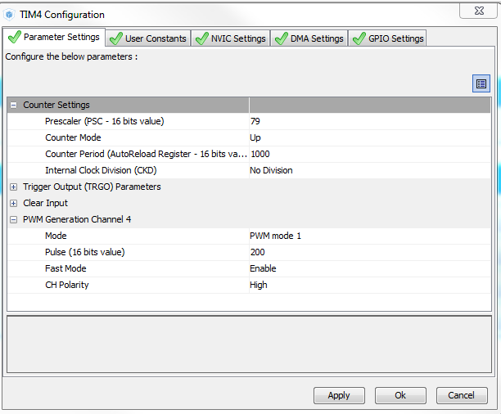
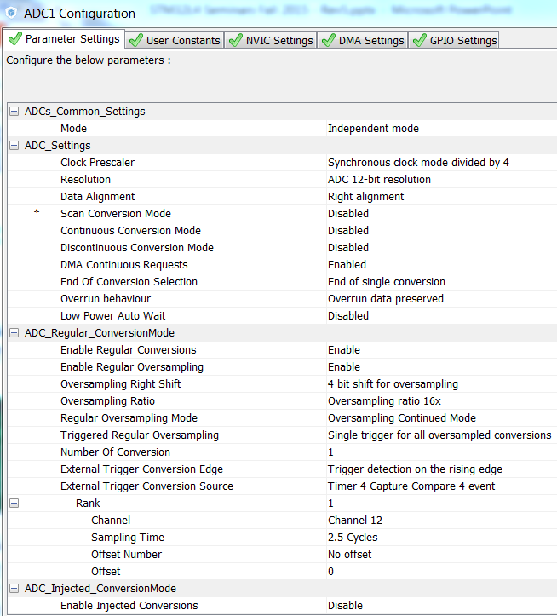
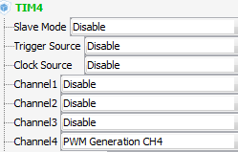
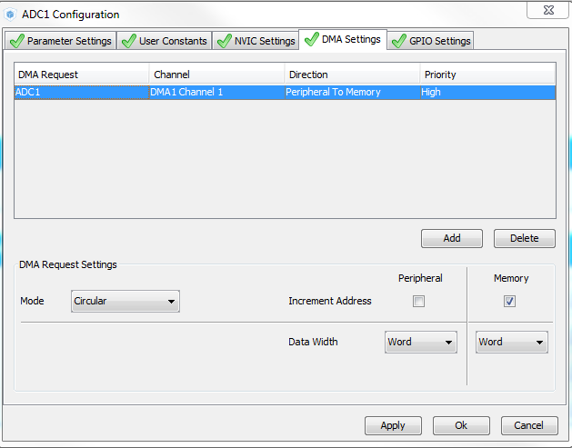
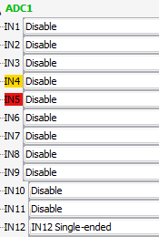

TIM / ADC / DMA setup:

Slide 92
Autonomous Peripherals
Needed code bits from C:\STM32L4Seminar\Labs\lab5_adc_tim_dma.c into main.c:
Add code bits between: /* USER CODE BEGIN PV */ /* USER CODE END PV */
Add code bits between: /* USER CODE BEGIN 2 */ /* USER CODE END 2 */
Add code bits between: /* USER CODE BEGIN WHILE */ /* USER CODE END WHILE */
Add code bits between: /* USER CODE BEGIN 4 */ /* USER CODE END 4 */
Open a terminal emulator, using USART2 settings, Virtual COM port xx
Rebuild, Program/Debug, Run!
On the rising edge of each TIM4 PWM cycle, the ADC is triggered.
The ADC input is oversampled 16 times
The summed result is shifted right 4 places, performing a hardware averaging
A DMA transfer moves this result into a data array and the array pointer is incremented
10 data elements are transferred and then the cycle repeats
Add the array ADC_Result to the Live Watch debug window to see updates!

Slide 93





STM32 apps & social media
Find more about STM32 products and solutions:
ST MCU Finder mobile application
Social media
ST Forums on microcontrollers
facebook.com/stm32
youtube.com/STonlineMedia
twitter.com/@ST_World
Mbed.org
www.st.com/stmcufinder
STM32 @ ARM connected community
Notes:
It has never been so easy to select, download, watch tutorials or get the [CLICK1] latest news about STM32 products and solutions on a computer, tablet or smartphone.
[CLICK2] The ST MCU Finder app lets you quickly and easily select the devices of your choice on a tablet or smartphone. Then, visit www.st.com/stm32. [CLICK3] The ST forums on microcontrollers allow the STM32 developer community to discuss and share experiences.
If you would like to know more about STM32 products and solutions in real-time, join the growing STM32 community on Facebook!

Slide 94




Thank you
/STM32
@ST_World
st.com/e2e
www.st.com/stm32l4

