Slide 1
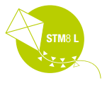


STM8 8-bit MCU Family

Slide 2

STM8 series
More than one million units delivered worldwide every day! We plan for longevity with a sustainable growth
STM8 MCU LONGEVITY COMMITMENT
STMicroelectronics provides a minimum longevity of 10 years for its STM8 microcontrollers!
STM8AF series of multi‑purpose 8‑bit microcontrollers for automotive applications
STM8AL series of ultra‑low‑power 8‑bit microcontrollers for automotive applications
STM8L series of ultra‑low‑power 8‑bit microcontrollers
STM8S series of mainstream 8‑bit microcontrollers
STM8

Slide 3
STM8 series
STM8 CORE
ST’s 8‑bit microcontroller platform is implemented around a high‑performance 8‑bit core and a state‑of‑the‑art set of peripherals. This platform is manufactured using an ST‑proprietary 130 nm embedded non‑volatile memory technology. It is able to reach 1.6 cycles per instruction and up to 24 MHz clock frequency, allowing customers to run their applications at low speed with high performance.
The lexibility of the architecture minimizes switching noise, resulting in improved system robustness and lower power consumption.
An innovative clock implementation provides strong beneits such as fast wake‑ups in only 4 μs.
It enables immediate clock switching on the ly to allow clock accelerations for PWM or calculation routines.
The 32‑bit robust NVM memory addressed through a 3‑stage pipeline interface, the 16‑bit index registers and stack pointers and the advanced instruction set with hardware
multiplication/division are key elements that signiicantly improve the eficiency of this 8‑bit device family.
Complete instructions
The STM8 allows fast and safe development through enhanced stack pointer operations, advanced addressing modes and new instructions.
B4 | B3 | B2 | B1
32-bit memory
Data memory
3-stage
pipeline
Fetch
Decode
Execute
STM8 core

Slide 4
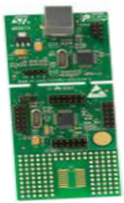
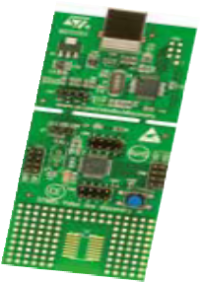
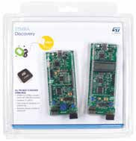
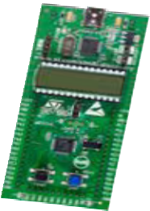
STM8 series
STM8 TOOLS
STM8 S
STM8 A
STM8 L
STM8S‑DISCOVERY STM8SVLDISCOVERY
STM8A‑DISCOVERY
STM8L‑DISCOVERY
ORDERING INFORMATION
Order number Description
STM8S‑DISCOVERY | Discovery kit for STM8S series with STM8S105C6 MCU
STM8SVLDISCOVERY | Discovery kit for STM8S Value Line with STM8S105C6 MCU
STM8L‑DISCOVERY | Discovery kit for STM8L series with STM8L152C6 MCU
STM8A‑DISCOVERY | Discovery kit for STM8A Automotive series with STM8AF52C6 and STM8AL3L68 MCUs

Slide 5
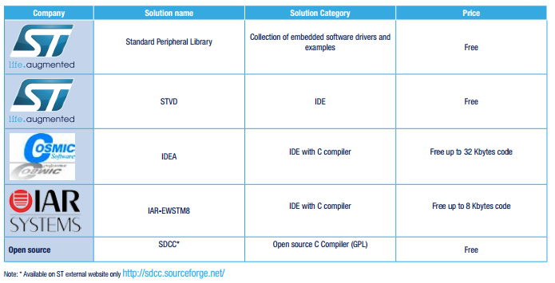
STM8 series
FREE TOOLS, SOFTWARE LIBRARIES AND EXAMPLES

Slide 6
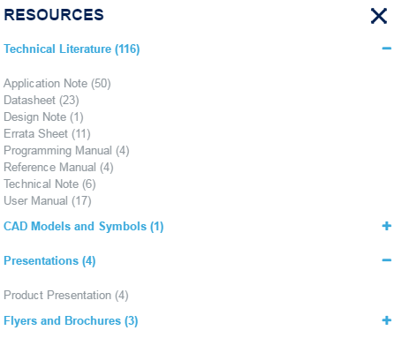
STM8 series
WEB TRAINING AND MATERIAL
Aside from all the available material from st.com/stm8
There is also some different Hands On trainings under our FAE’s repository here

Slide 7
Suggested MCUs for TX & RX application

Slide 8

STM8L101FX
Ultra-low-power 8-bit MCU with up to 8 Kbytes Flash, 16 MHz CPU, up to 2-Kbyte of EEPROMKey Features
Main microcontroller features
Supply voltage range 1.65 V to 3.6 V
Low power consumption (Halt: 0.3 μA, Active-halt: 0.8 μA, Dynamic Run: 150 μA/MHz)
STM8 Core with up to 16 CISC MIPS throughput
Temp. range: -40 to 85 °C and 125 °C
Memories
Up to 8 Kbytes of Flash program including up to 2 Kbytes of data EEPROM
Flexible write and read protection modes
1.5 Kbytes of static RAM
Clock management
Internal 16 MHz RC with fast wakeup time (typ. 4 μs)
Internal low consumption 38 kHz RC driving both the IWDG and the AWU
Reset and supply management
Ultra-low power POR/PDR with three low-power modes: Wait, Active-halt, Halt
I/Os
18 I/Os, all mappable on external interrupt vectors
I/Os with programmable input pull-ups, high sink/source capability and one LED driver infrared output
Peripherals
Two 16-bit general purpose timers (TIM2 and TIM3) with up and down counter and 2 channels (used as IC, OC, PWM)
One 8-bit timer (TIM4) with 7-bit prescaler
Infrared remote control (IR)
Independent watchdog
Auto-wakeup unit
Beeper timer with 1, 2 or 4 kHz frequencies
SPI synchronous serial interface
Fast I2C Multimaster/slave 400 kHz
USART with fractional baud rate generator
2 comparators with 4 inputs each
96-bit unique ID

Slide 9
STM8S003F3
Mainstream Value line 8-bit MCU with 8 Kbytes Flash, 16 MHz CPU, integrated EEPROM
Main microcontroller features
Supply voltage range 2.95 V to 5.5 V
16 MHz advanced STM8 core with Harvard architecture and 3-stage pipeline
Memories
Up to 8 Kbytes of Flash program including up to 128 bytes of data EEPROM
1 Kbyte of static RAM
Clock management
4 master clock sourcesLow-power crystal resonator oscillatorExternal clock inputInternal, user-trimmable 16 MHz RCInternal low-power 128 kHz RC
Reset and supply management
Power managementLow-power modes (wait, active-halt, halt)Switch-off peripheral clocks individuallyPermanently active, low-consumption power-on and power-down reset
I/Os
16 I/Os, all mappable on external interrupt vectors
Highly robust I/O design, immune against current injection
Peripherals
10-bit ADC, ± 1 LSB ADC with up to 5 multiplexed channels, scan mode and analog watchdog
Advanced control timer: 16-bit, 4 CAPCOM channels, 3 complementary outputs, dead-time insertion and flexible synchronization
16-bit general purpose timers, with 3 CAPCOM channels (IC, OC or PWM)
8-bit basic timer with 8-bit prescaler
Auto wakeup timer
Window and independent watchdog timers
UART with clock output for synchronous operation, SmartCard, IrDA, LIN master mode
SPI interface up to 8 Mbit/s
I2 C interface up to 400 Kbit/s

Slide 10
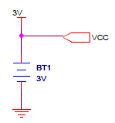
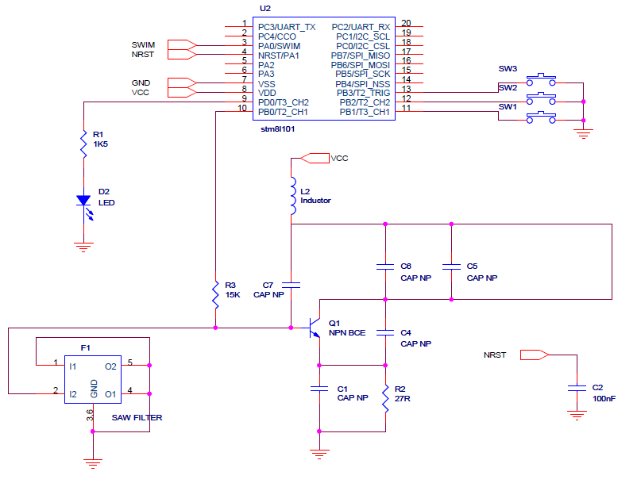
HW & FW Example
Upon request, ST can share the 6p20 emulation code for transmittion and reception
Usual hardware example with STM8L101 with a 3V battery

Slide 11
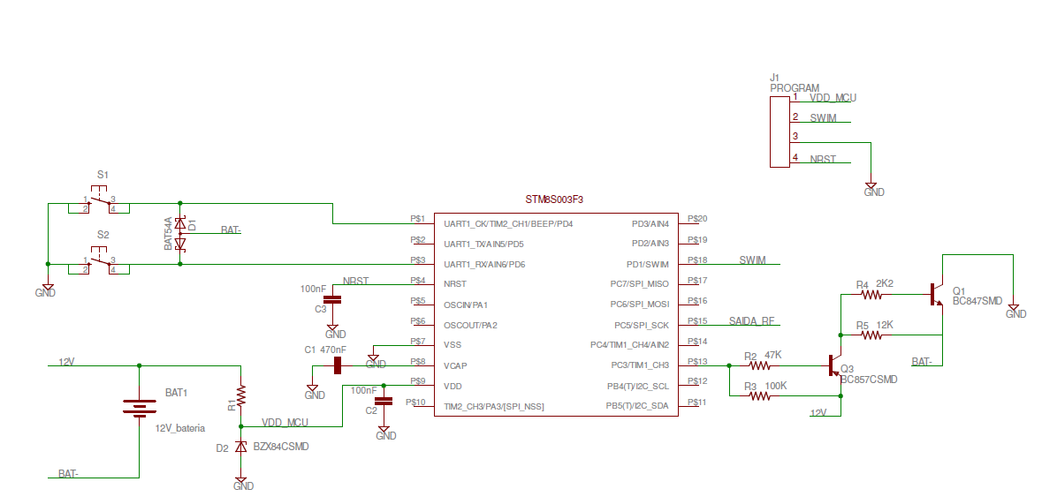
HW & FW example
HW example with STM8S003 + seal feature with a 12V battery

Slide 12

Thank You

