Slide 1
STM8L Training

Slide 2
Agenda
STM8 Basics & Portifolio
Available Peripherals
Getting Started with the Software and Firmware
Compiler and IDE
Library
Eval Board
Hands-On

Slide 3
STM8L Training
STM8 Basics & Portifolio

Slide 4
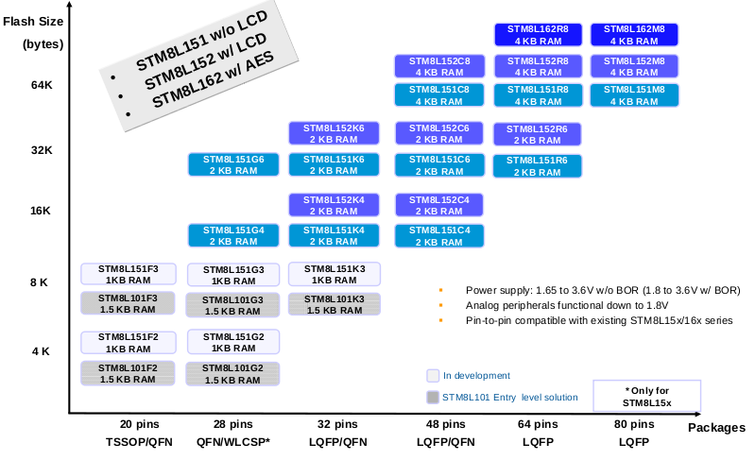
Portfolio

Slide 5
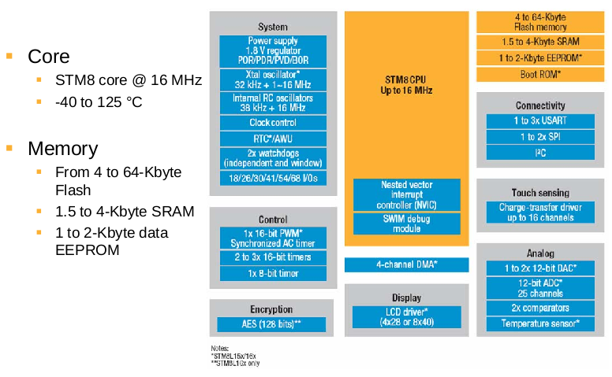
Internal block Diagram

Slide 6
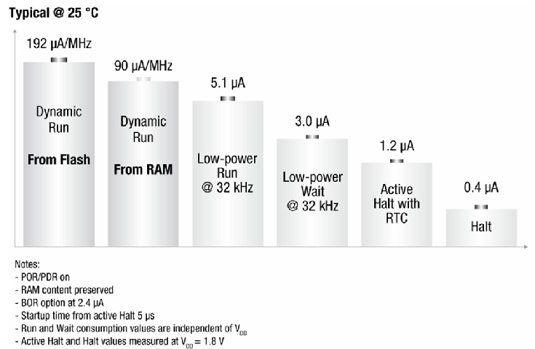
Highlight – Consumption!!

Slide 7
Consumption per family and how to calculate it
Formulas for calculate consumption for STM8L15x family
The RUN from RAM consumption can be approximated with the linear formula: IDD(run_from_RAM) = Freq. * 95 μA/MHz + 250 μA
The run from FLASH consumption can be approximated with the linear formula: IDD(run_from_Flash) = Freq. * 200 μA/MHz + 330 μA
Formulas for calculate consumption for STM8L10x family
An approximate value of IDD(run_from_Flash) can be given by the following formula: IDD(run_from_Flash) = Freq. * 150 μA/MHz + 215 μA.
STM8L101 line:
Lowest power mode: 0.30 µA / Dynamic run mode: 150 µA/MHz
STM8L151/152 line:
Lowest power mode: 0.35 µA / Dynamic run mode: 180 µA/MHz
STM8L162 line:
Lowest power mode: 0.35 µA Dynamic run mode: 180 µA/MHz
STM8L051/052 Value line
Lowest power mode: 0.35 µA Dynamic run mode: 180 µA/MHz

Slide 8
STM8L Training
Getting Started

Slide 9
Where can I find the library and SW?
The libraries are available here:
The STVD (our IDE!) is available here
The compiler is a 3rd part and has no limitation and it’s free!!
http://cosmicsoftware.com/download_stm8_free.php
STSW-STM8016 |  | STM8L15x/16x/05x/AL3Lx/AL31x standard peripheral library
STSW-STM8012 |  | STM8L10x standard peripheral library
STVD | ST Visual develop IDE for developing ST7 and STM8 applications

Slide 10
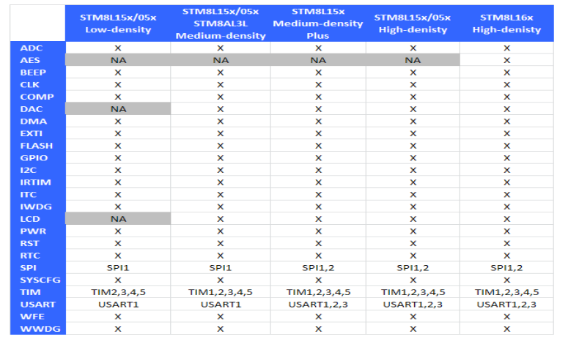
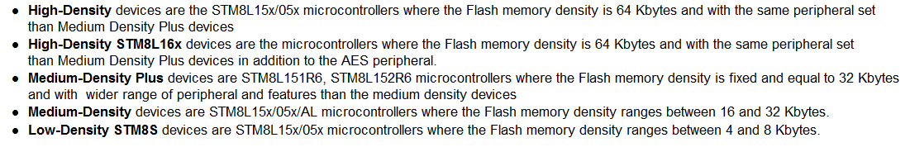
Library’s Supported Features

Slide 11
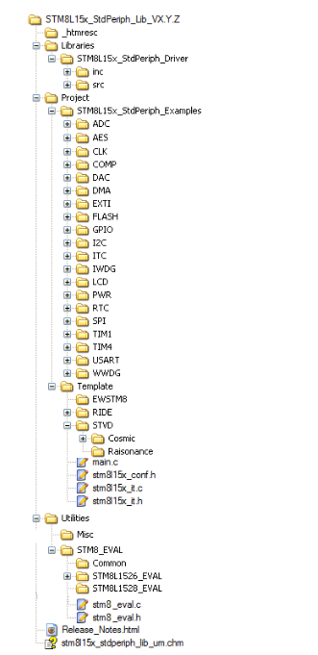
File Structure

Slide 12
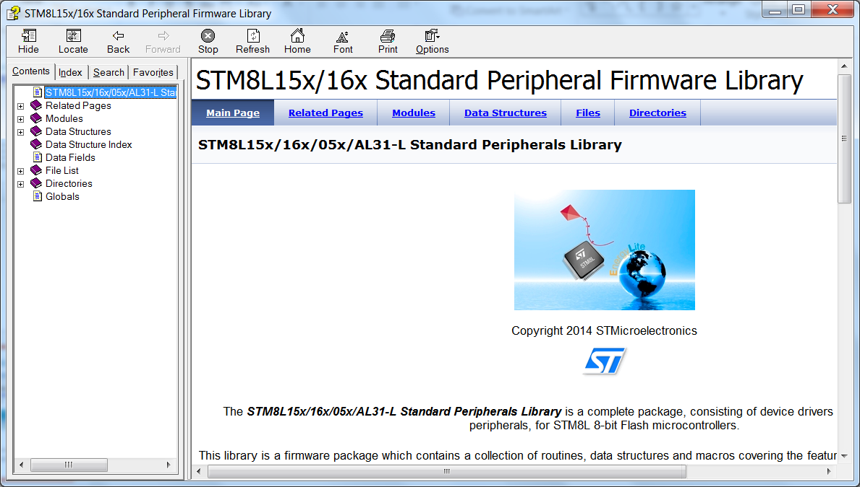
Library’s Help/User Manual

Slide 13
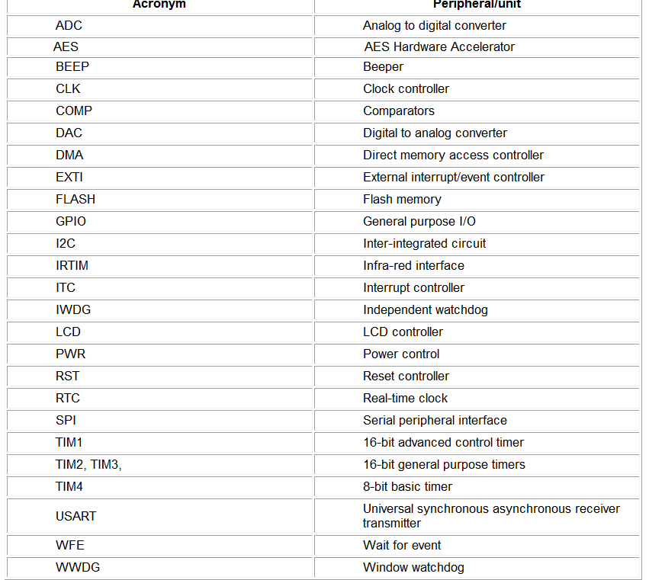
Conventions 1/3 ☺

Slide 14
Conventions 2/3 ☺
The library uses the following naming patern:
PPP refers to any peripheral acronym, for example TIM2 and TIM3
System and source/header file names are preceded by the prefix ‘STM8L_’.
Names of peripheral functions are preceded by the corresponding peripheral acronym in upper case followed by an underscore, for example SPI_SendData.
Functions used to initialize the PPP peripheral according to parameters specified in the header file are named PPP_Init, for example TIM2_Init
Functions used to reset the PPP peripheral registers to their default values are named PPP_DeInit, for example TIM2_DeInit
Functions used to enable or disable the specified PPP peripheral are named PPP_Cmd, for example SPI_Cmd
Functions used to enable or disable an interrupt source of the specified PPP peripheral are named PPP_ITConfig, for example SPI_ITConfig
Functions used to check whether the specified PPP flag is set or reset are named PPP_GetFlagStatus, for example I2C_GetFlagStatus
Functions used to clear a PPP flag are named PPP_ClearFlag, for example I2C_ClearFlag
Functions used to check whether the specified PPP interrupt has occurred or not are named PPP_GetITStatus, for example TIM2_GetITStatus
Functions used to clear a PPP interrupt pending bit are named PPP_ClearITPendingBit, for example TIM2_ClearITPendingBit

Slide 15
Conventions 3/3 ☺
Variable types:
#define __I volatile const /*!< defines 'read only' permissions */
#define __O volatile /*!< defines 'write only' permissions */
#define __IO volatile /*!< defines 'read / write' permissions */
/*!< Signed integer types */
typedef signed char int8_t;
typedef signed short int16_t;
typedef signed long int32_t;
/*!< Unsigned integer types */
typedef unsigned char uint8_t;
typedef unsigned short uint16_t;
typedef unsigned long uint32_t;
typedef enum {FALSE = 0, TRUE = !FALSE} bool;
typedef enum {RESET = 0, SET = !RESET} FlagStatus, ITStatus, BitStatus, BitAction;
typedef enum {DISABLE = 0, ENABLE = !DISABLE} FunctionalState;

Slide 16
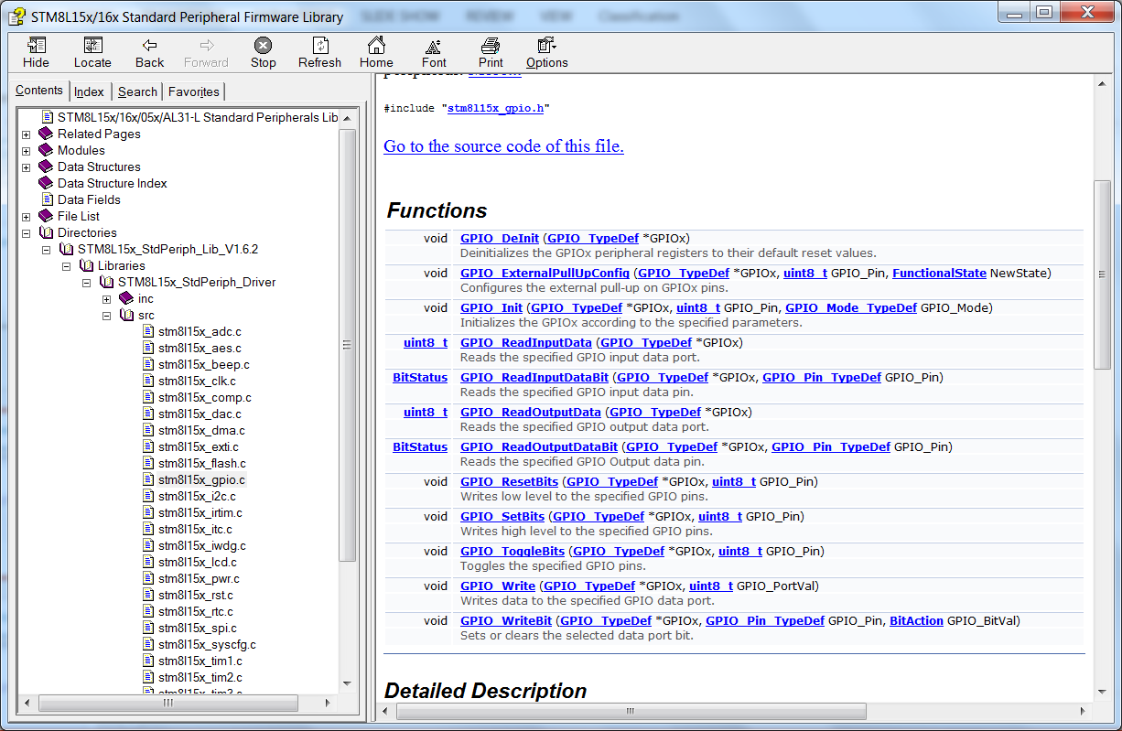
How to find the available functions

Slide 17
How to get more info?

Slide 18
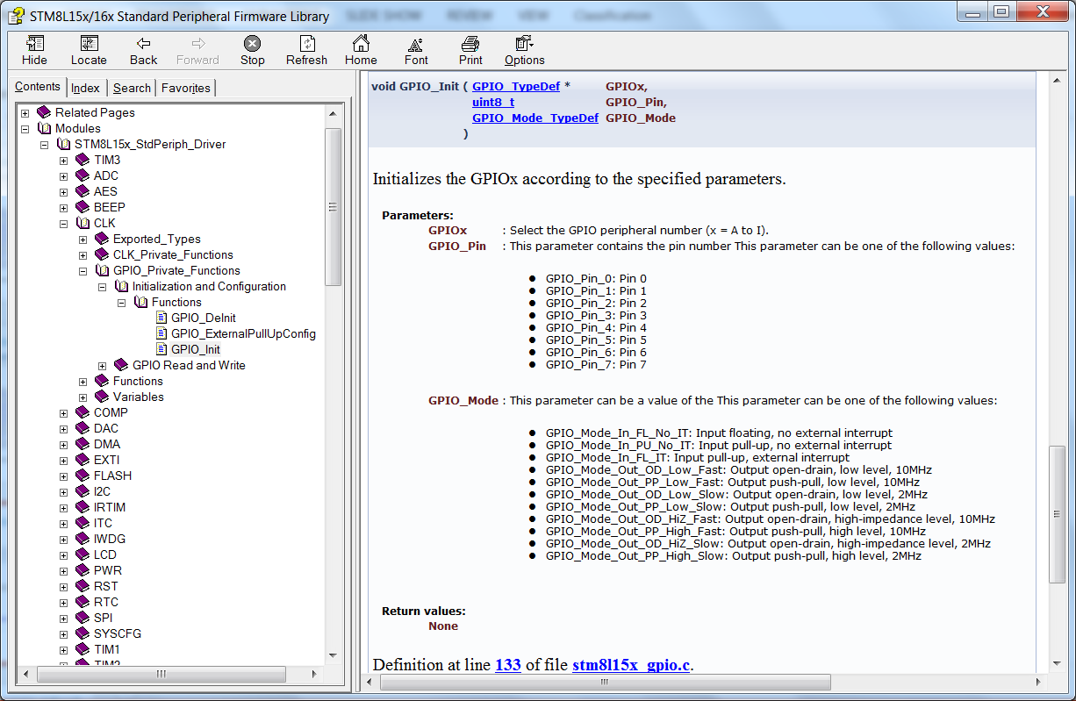
How to get more info?

Slide 19
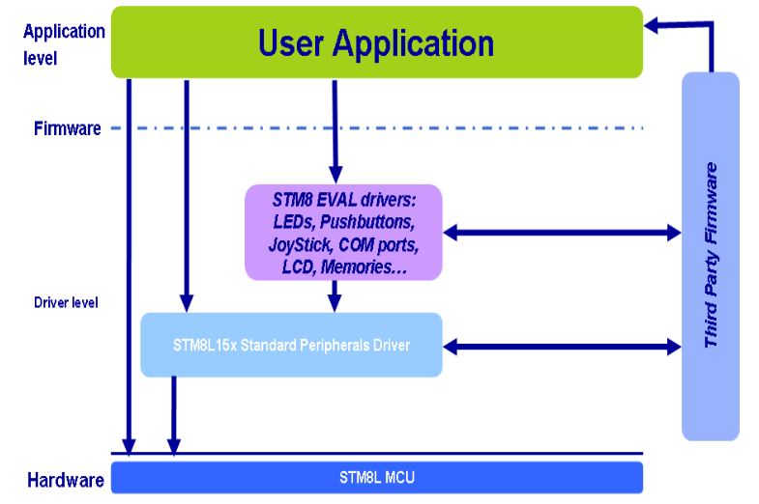
Library’s Architecture

Slide 20
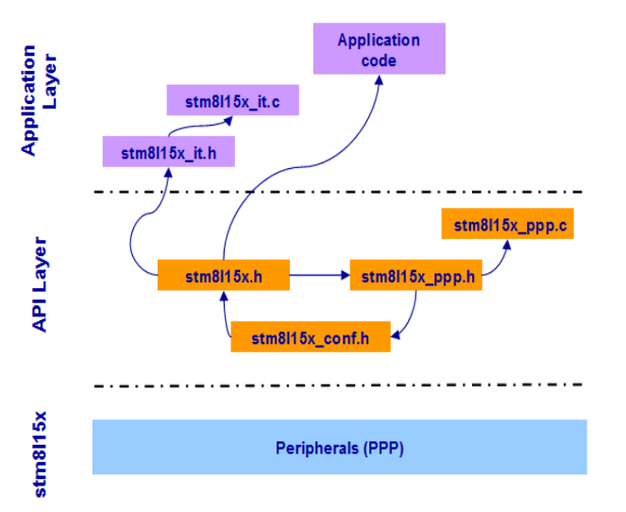
Library’s Architecture in files

Slide 21
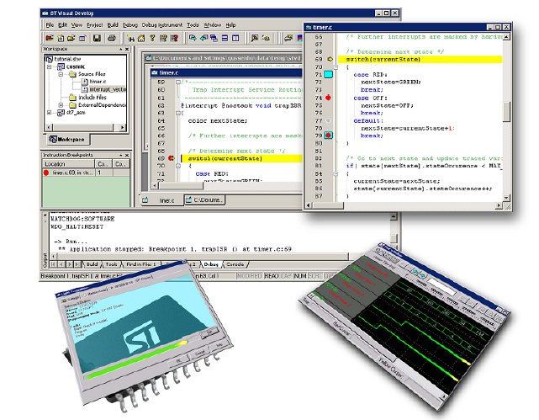
Getting Started from scratch!

Slide 22
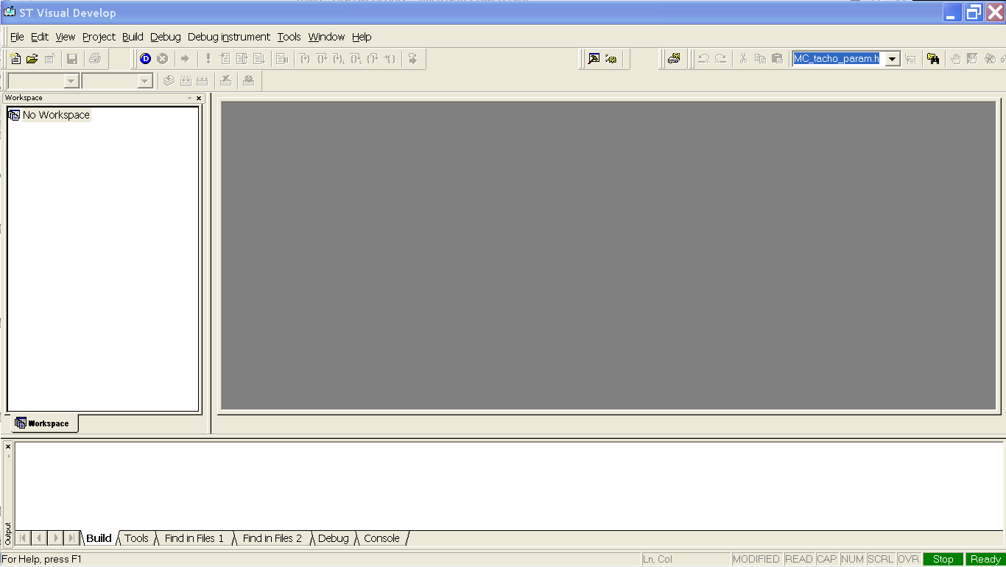
Open the STVD

Slide 23
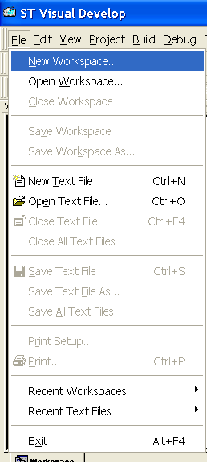
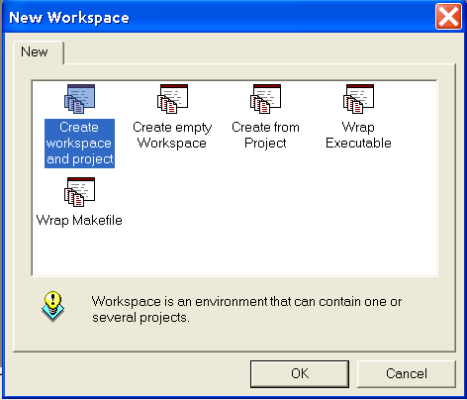
Choose to create a New Workspace
And then, to create workspace and project

Slide 24
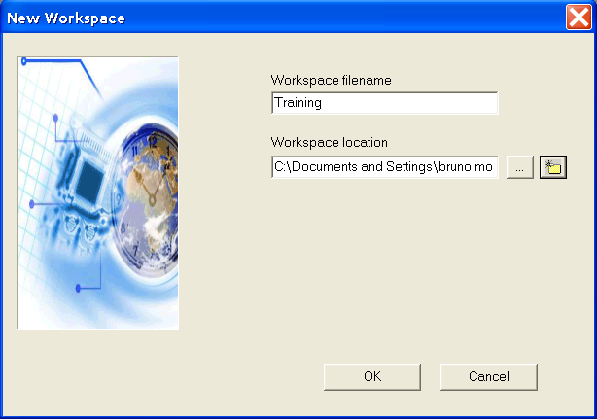
Name the workspace and set it’s location

Slide 25
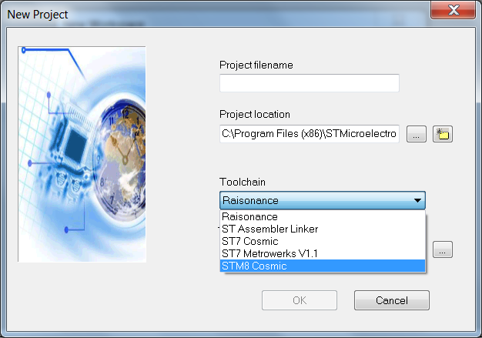
Select the proper Toolchain

Slide 26
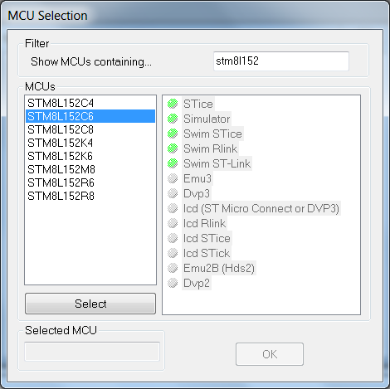
Select the STM8L152C6

Slide 27
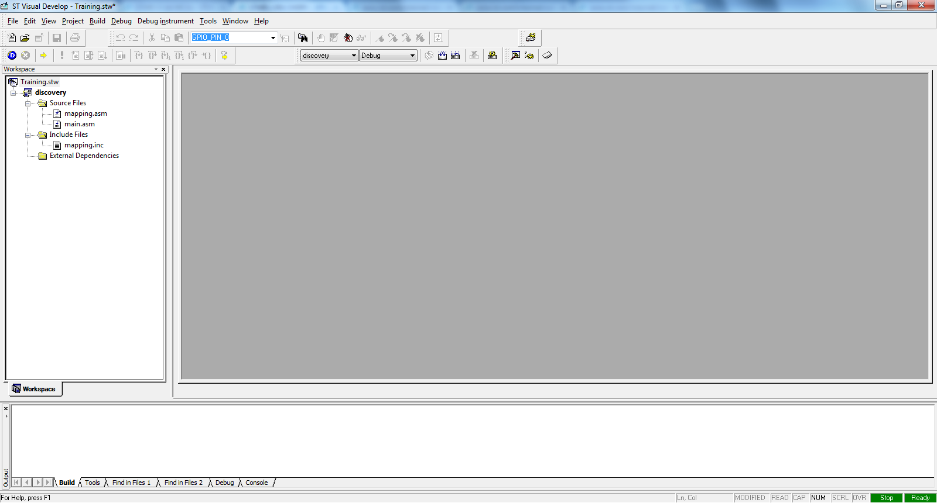
Your workspace should look like this

Slide 28
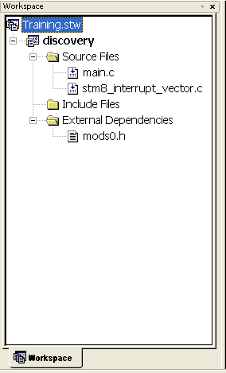
Giving a closer look

Slide 29
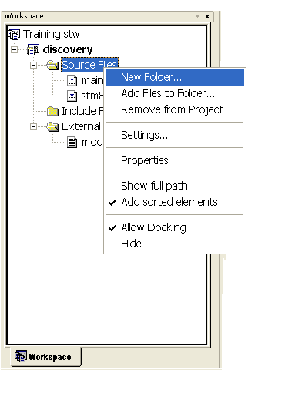
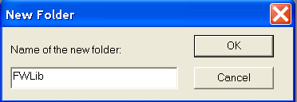
Now, let’s add the library

Slide 30
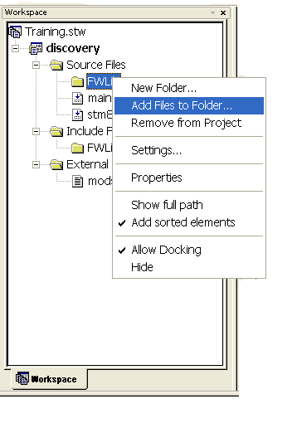
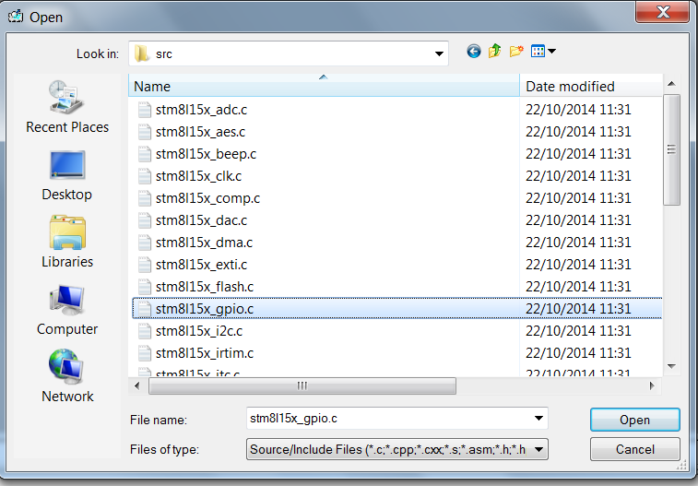
Now, let’s add the library

Slide 31
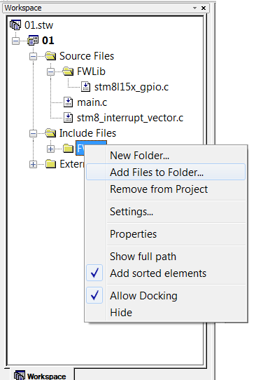
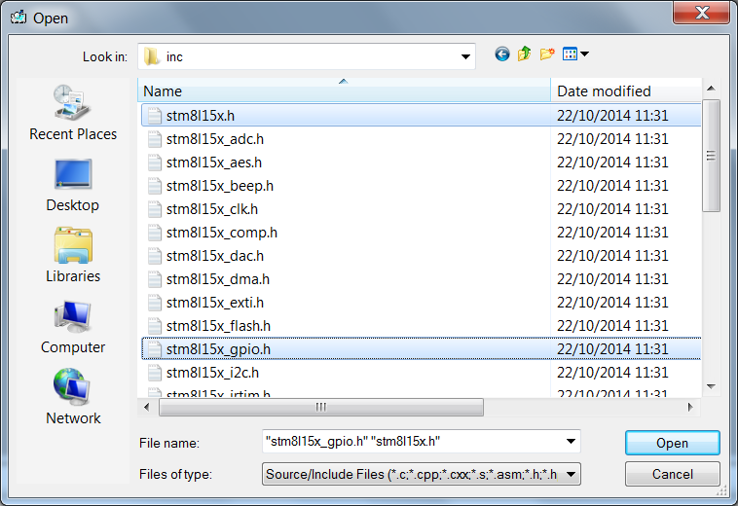
Now, let’s add the library

Slide 32
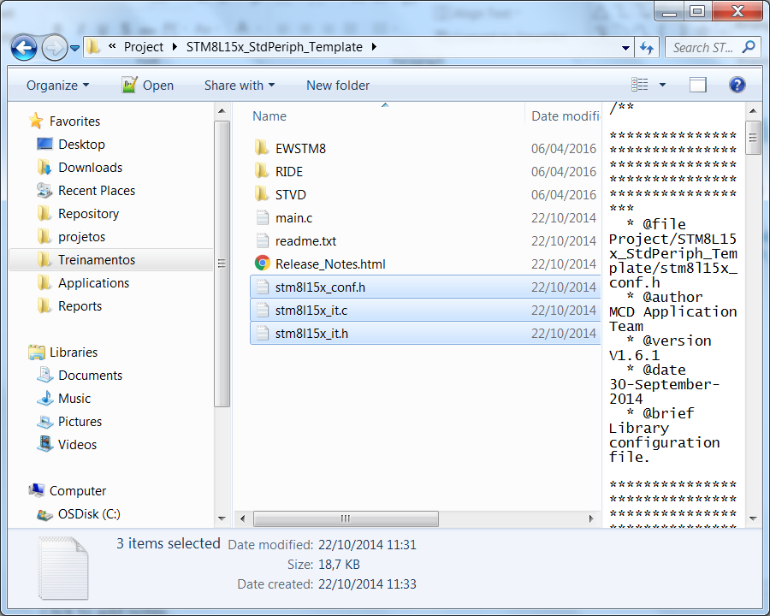
Now, let’s add the library
Once the basic files are imported, we need to add the files responsibles to manage the interrupt vector
Copy the 3 highlighted files to our project folder, these files are available under the unzip library folder: STM8L15x-16x-05x-AL31-L_StdPeriph_Lib\Project\STM8L15x_StdPeriph_Template

Slide 33
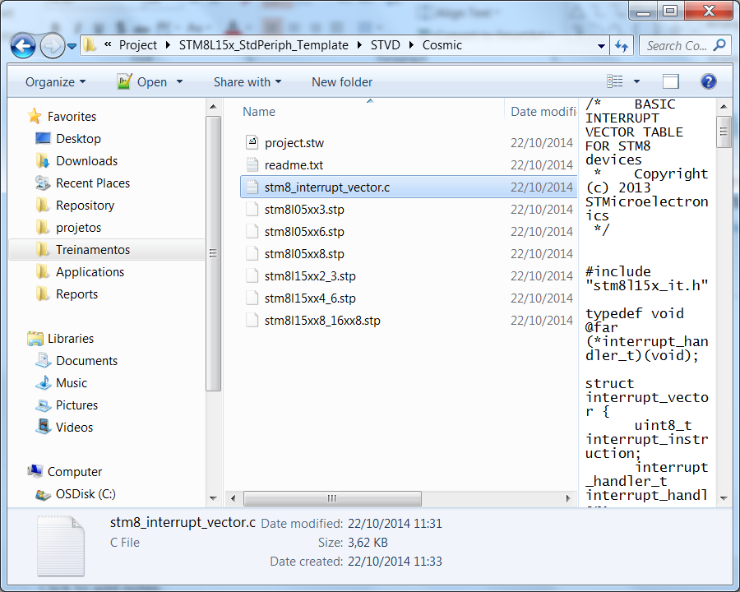
Now, let’s add the library
Since the interrupt vector file that is automatically generated is not asserted with the library’s names, we need to replace the file
Copy the highlighted file to our project folder, this file is available under the unzip library folder: STM8L15x-16x-05x-AL31-L_StdPeriph_Lib\Project\STM8L15x_StdPeriph_Template\STVD\Cosmic

Slide 34
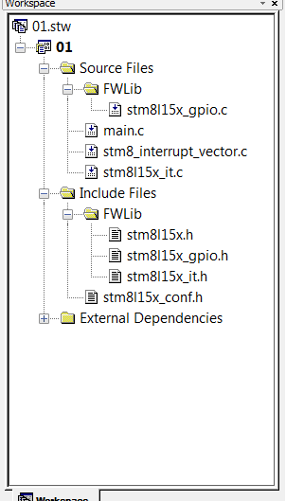
Now, let’s add the library
With all the preparations done, we just need to add the following files within our project:
STM8L15x_it.c
STM8L15x_it.h
STM8L15x_conf.h
The final result should be like this:

Slide 35
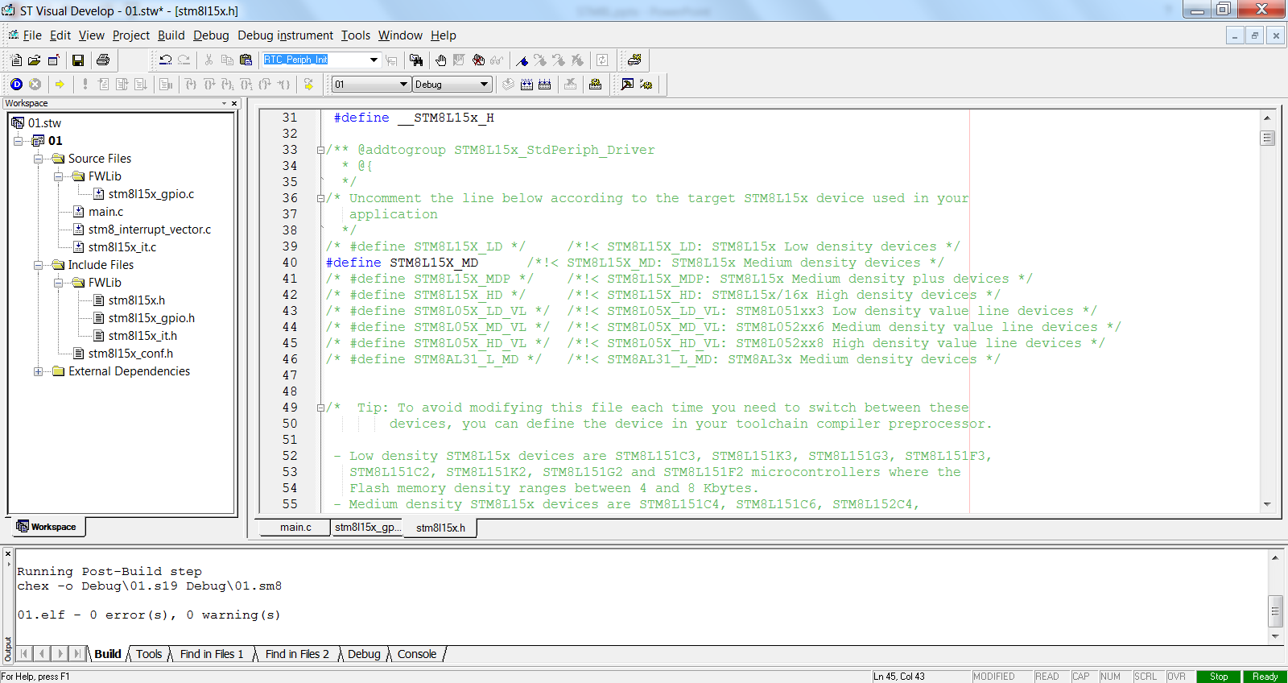
Configuring the library – STM8L15x.h

Slide 36
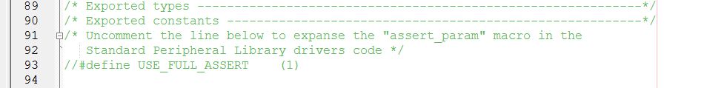
Configuring the library – STM8L_conf.h
The Standard Peripherals Library implements run-time failure detection by checking the input values of all library functions. The run-time checking is achieved by using an assert_param macro. This macro is used in all library functions which have at least an input parameter. It allows the user to check that the input value lies within the defined parameter values
For the purpouse of this training, we won’t use this feature, so it’s mandatory to comment the assert define:

Slide 37
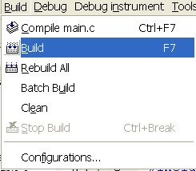
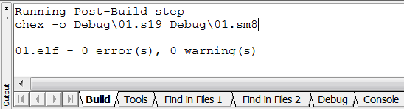
Compile the project (F7 as short key)
Once all is done, just compile and get the so desired 0 erros and 0 warnings

Slide 38
STM8L Training
Eval Board

Slide 39
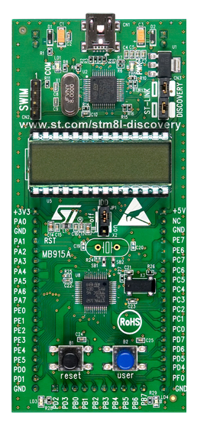
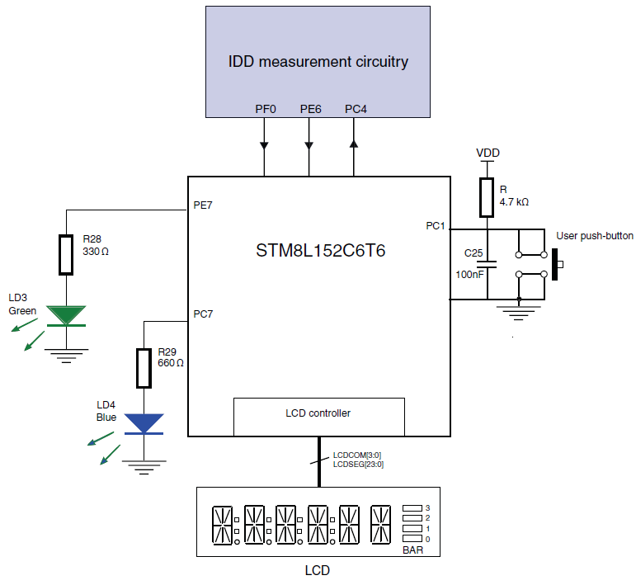
Eval Board

Slide 40
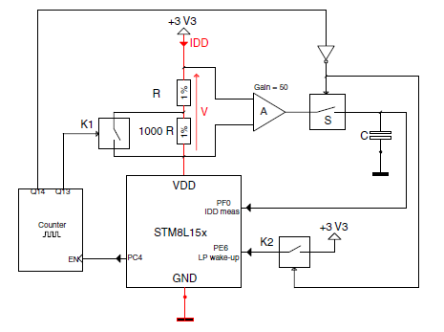
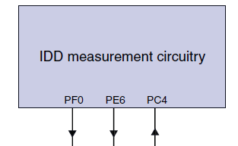
Idd measurement circuitry

Slide 41
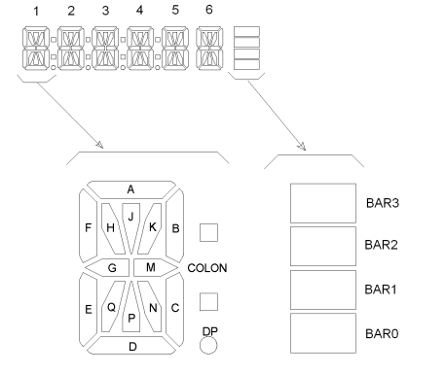
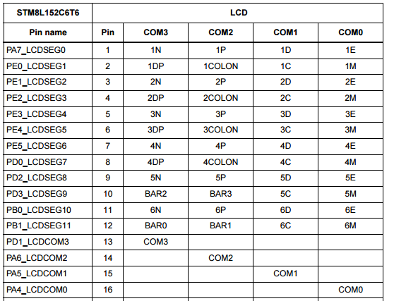
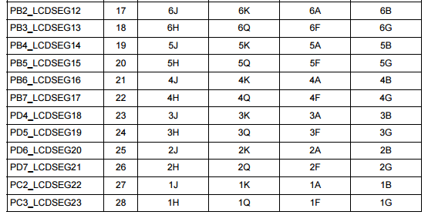
LCD segment mapping

Slide 42
STM8L Training
Hands-On

Slide 43
Hands On
GPIO
LCD
ADC to measure VDD
Run / Low Power Modes measurement
Run Mode IDD
Low Power with LCD IDD
Powe Power without LCD IDD
Halt mode IDD

Slide 44
Hands On
GPIO
LCD
ADC to measure VDD
Run / Low Power Modes measurement
Run Mode IDD
Low Power with LCD IDD
Powe Power without LCD IDD
Halt mode IDD

Slide 45
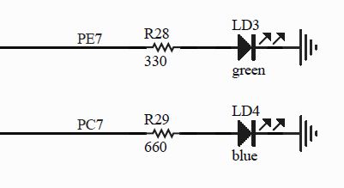
GPIO
Turn on and off a simple LED
#include "STM8L15x.h"
void Delay(u16 nCount)
{
/* Decrement nCount value */
while (nCount != 0)
{
nCount--;
}
}
main()
{
GPIO_Init(GPIOC,GPIO_Pin_7,GPIO_Mode_Out_PP_Low_Fast);
while (1){
GPIO_ToggleBits(GPIOC,GPIO_Pin_7);
Delay(20000);
}
}

Slide 46
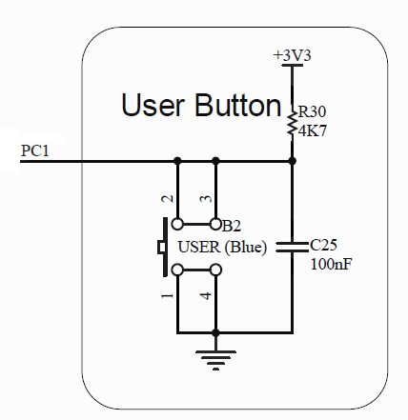
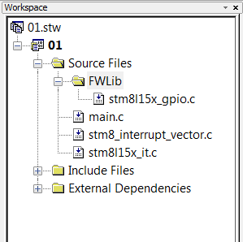
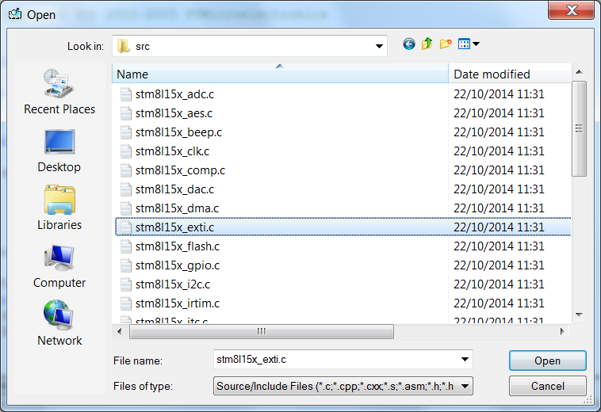
GPIO
Blink a simple LED, depending on the key status, using external interrupt
To accomplish this task, we’ll need to add the STM8L_exti.c/h in the project

Slide 47
GPIO
main.c
STM8L15x_it.c
#include "STM8L15x.h"
main()
{
GPIO_Init(GPIOC,GPIO_Pin_7,GPIO_Mode_Out_PP_Low_Fast);
GPIO_Init(GPIOC,GPIO_Pin_1,GPIO_Mode_In_PU_IT);
EXTI_SetPinSensitivity(EXTI_Pin_1,EXTI_Trigger_Falling);
enableInterrupts();
while (1)
{
}
}
INTERRUPT_HANDLER(EXTI1_IRQHandler,9)
{
/* In order to detect unexpected events during development,
it is recommended to set a breakpoint on the following instruction.
*/
EXTI_ClearITPendingBit(EXTI_IT_Pin1);
GPIO_ToggleBits(GPIOC,GPIO_Pin_7);
}

Slide 48
Hands On
GPIO
LCD
ADC to measure VDD
Run / Low Power Modes measurement
Run Mode IDD
Low Power with LCD IDD
Powe Power without LCD IDD
Halt mode IDD

Slide 49
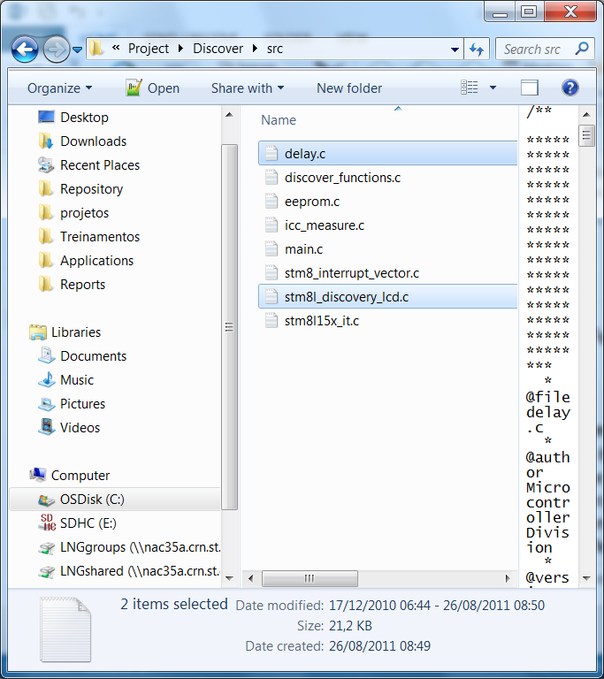
LCD
First we’ll add the necessary drivers and BSP files
Download this package:
Unzip the package and copy the following files from the: STM8L-Discovery_dev\Project\Discover\src
STSW-STM8008 | 2.0.1 | Active | Download

Slide 50
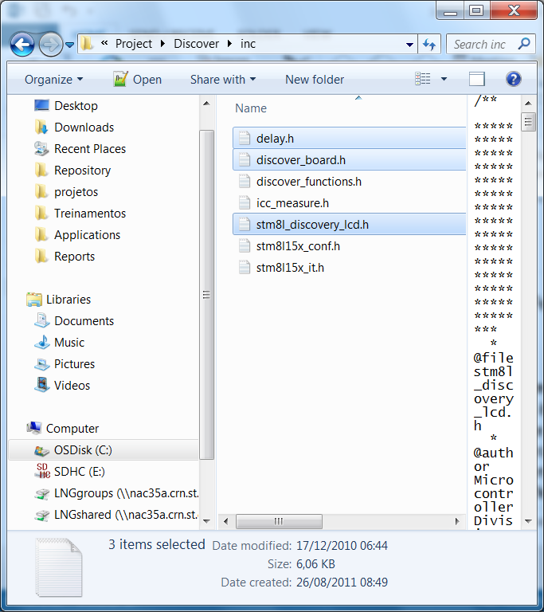
LCD
Get the BSP files from the unziped file:
STM8L-Discovery_dev\Project\Discover\inc
These BSP files use the following driver files:
stm8l15x_clk.c
stm8l15x_tim4.c
stm8l15x_lcd.c

Slide 51
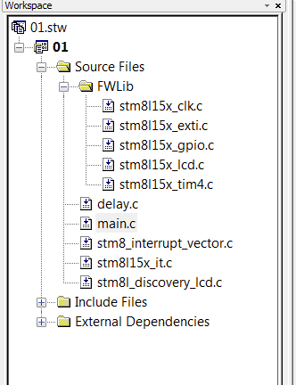
LCD
Your workspace should be like this:

Slide 52
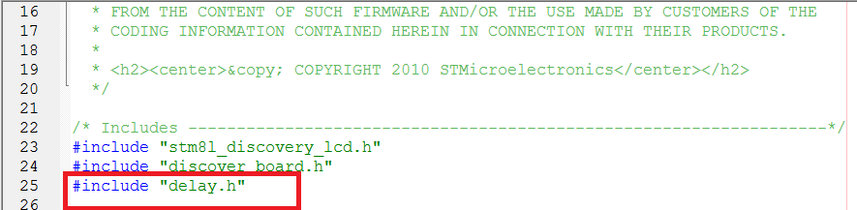

LCD
Little adjustment:
Under the BSP stm8l_discovery_lcd.c we need to add a include file
To use the BSP in our app we need to add these headers:

Slide 53
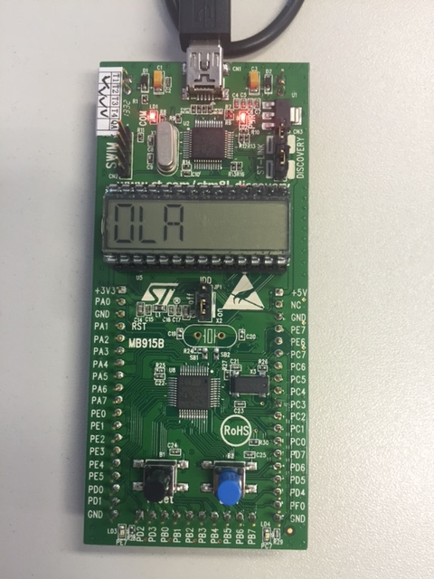

LCD
Now our code to write “OLA” in the display
Please use capital letters only, since the driver was made this way
main()
{
LCD_GLASS_Init();
LCD_GLASS_DisplayString("OLA");
while (1){
}
}

Slide 54
LCD
Just to add some effects ☺
main()
{
LCD_GLASS_Init();
while (1){
LCD_GLASS_ScrollSentence(" ** OLA **",1,SCROLL_SPEED);
}
}

Slide 55
Hands On
GPIO
LCD
ADC to measure VDD
Run / Low Power Modes measurement
Run Mode IDD
Low Power with LCD IDD
Powe Power without LCD IDD
Halt mode IDD

Slide 56
ADC – internal reference
First, we need to add the ADC file driver:
stm8l15x_adc.c
Now, since this a low power micro, we need to provide clock to the ADC, so we’ll also need to add the CLK driver:
stm8l15x_clk.c
For this hands on, we’ll also use these global variables:
main()
{
/* Enable ADC clock */
CLK_PeripheralClockConfig(CLK_Peripheral_ADC1, ENABLE);
uint8_t i;
uint16_t res;
float f_Vdd_appli ;

Slide 57
ADC – internal Reference
Now that the ADC has it’s clock enable, we can configure it
main()
{
/* Enable ADC clock */
CLK_PeripheralClockConfig(CLK_Peripheral_ADC1, ENABLE);
/*ADC configuration
ADC configured as follow: - Channel VREF - Mode = Single ConversionMode(ContinuousConvMode disabled) - Resolution = 12Bit - Prescaler = /1
- sampling time 9 */
ADC_VrefintCmd(ENABLE);
delay_10us(3);
ADC_Cmd(ADC1, ENABLE);
ADC_Init(ADC1, ADC_ConversionMode_Single,
ADC_Resolution_12Bit, ADC_Prescaler_1);
ADC_SamplingTimeConfig(ADC1, ADC_Group_FastChannels, ADC_SamplingTime_9Cycles);
ADC_ChannelCmd(ADC1, ADC_Channel_Vrefint, ENABLE);
delay_10us(3);

Slide 58
ADC - Internal Reference
In the main loop:
while (1){
/* initialize result */
res = 0;
for(i=8; i>0; i--)
{
/* start ADC convertion by software */
ADC_SoftwareStartConv(ADC1);
/* wait until end-of-covertion */
while( ADC_GetFlagStatus(ADC1, ADC_FLAG_EOC) == 0 );
/* read ADC convertion result */
res += ADC_GetConversionValue(ADC1);
}
res = res>>3;
/* The theorical value 1.224 volt */
f_Vdd_appli = (1.224/res) * 4096;
/* Vdd_appli in mV */
f_Vdd_appli *= 1000L;
}

Slide 59

ADC – Internal Reference
Let’s check the correct VDD, assuming the internal reference fixed at 1.224V under the debug!

Slide 60
ADC – Internal Reference
Let’s add this number in the display!
We’ll need to add the following drivers:
stm8l15x_exti.c
stm8l15x_flash.c
We’ll add the following BSP
Discover_functions.c
Icc_measure.c

Slide 61

ADC – Internal Reference
The BSP uses specific linker pragmas, so we’ll have to add them:

Slide 62
ADC – Internal Reference
Let’s add the necessary header file in our main.c:
#include "discover_functions.h“
Add the function that will plot the value readed
void Vref_show(float vdd)
{
uint16_t tab[6];
uint16_t Vdd_mV ;
Vdd_mV = (uint16_t)vdd;
convert_into_char (Vdd_mV, tab);
/* To add unit and decimal point */
tab[5] = 'V';
tab[4] = ' ';
tab[1] |= DOT; /* To add decimal point for display in volt */
tab[0] = ' ';
LCD_GLASS_DisplayStrDeci(tab);
}

Slide 63
ADC – Internal Reference
Under the BSP file discovery_functions.c:
#include "delay.h"
#include "icc_measure.h“
In our main loop, add these 2 linse in the end:
Vref_show(f_Vdd_appli);
/* Tempo for display values*/
delay_ms(100);

Slide 64
Hands On
GPIO
LCD
ADC to measure VDD
Run / Low Power Modes measurement
Run Mode IDD
Low Power with LCD IDD
Powe Power without LCD IDD
Halt mode IDD

Slide 65

Low Power Modes
Use the available demo that were downloaded previously
Open the project> STM8L-Discovery_dev\Project\Discover\STVD\Cosmic
This is how the demo works:

Slide 66

Low Power Modes
The demo will show the bar in the display depending on the mode it’s running:

Slide 67

Low Power Modes
Every time the key is pressed, it changes it’s state and uses the ICC hardware to check the power consumption

Slide 68
Low Power Modes
Check the power consumption of each mode!
The code example demonstrate how to enter and exit each low power mode available
RUN
Icc_measure_RUN();
LOW POWER WITH LCD
Icc_measure_LPR_LCD();
LOW POWER WITHOUT LCD
Icc_measure_LPR();
HALT WITHOUT LCD
Icc_measure_HALT();

Slide 69

Thank You

