Slide 1
STM8L Training

Slide 2
Agenda
STM8 Basics
Available Peripherals
Getting Started with the Software and Firmware
Compiler and IDE
Library
Eval Board
Hands-On

Slide 3
STM8L Training
STM8 Basics & Portifolio

Slide 4
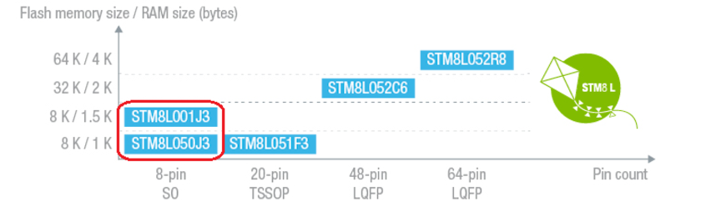
Newer MCUs!

Slide 5
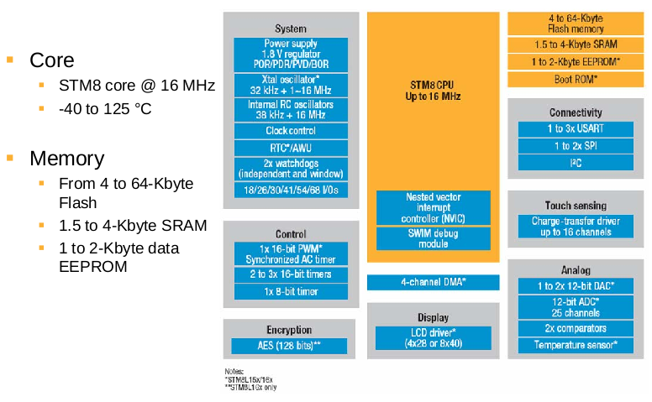
Internal block Diagram

Slide 6
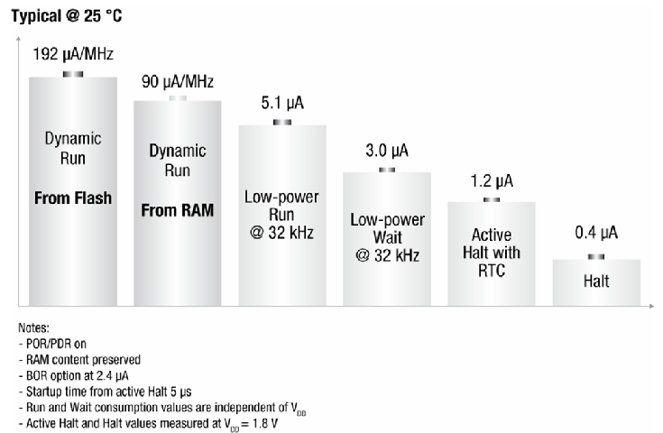
Highlight – Consumption!!

Slide 7
Consumption per family and how to calculate it
Formulas for calculate consumption for STM8L15x family
The RUN from RAM consumption can be approximated with the linear formula: IDD(run_from_RAM) = Freq. * 95 μA/MHz + 250 μA
The run from FLASH consumption can be approximated with the linear formula: IDD(run_from_Flash) = Freq. * 200 μA/MHz + 330 μA
Formulas for calculate consumption for STM8L10x family
An approximate value of IDD(run_from_Flash) can be given by the following formula: IDD(run_from_Flash) = Freq. * 150 μA/MHz + 215 μA.
STM8Lx01 line:
Lowest power mode: 0.30 µA / Dynamic run mode: 150 µA/MHz
STM8Lx5x line:
Lowest power mode: 0.35 µA / Dynamic run mode: 180 µA/MHz
STM8L162 line:
Lowest power mode: 0.35 µA Dynamic run mode: 180 µA/MHz

Slide 8
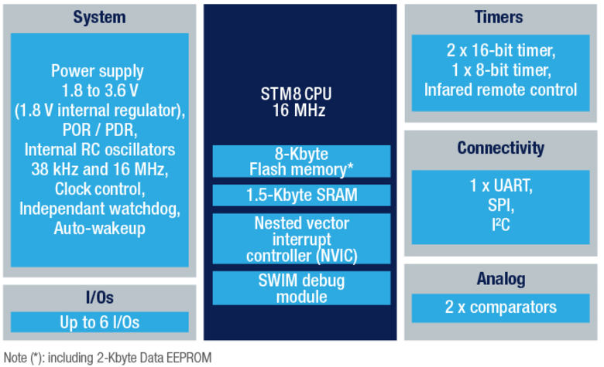
STM8L001J3
Some of important features of STM8L001J3:
Core and system
2 internal clock sources (HSI 16MHz, LSI 38kHz)
Suply voltage range: from 1.8V to 3.6V
6 I/Os
Timing peripherals
8- and 16-bit general purpose timers
Auto-wakeup unit
Watchdog
Memories
8k Flash
1.5k RAM
2k EEPROM
Conenctivity and debug
UART
SPI
I2C
Single Wire Interface Module (SWIM)
Analog
2 comparators

Slide 9
STM8L Training
Getting Started

Slide 10
Where can I find the library and SW?
The libraries are available here:
The STVD (our IDE!) is available here
The compiler is a 3rd part and has no limitation and it’s free!!
http://cosmicsoftware.com/download_stm8_free.php
STSW-STM8016 |  | STM8L15x/16x/05x/AL3Lx/AL31x standard peripheral library
STSW-STM8012 |  | STM8L10x standard peripheral library
STVD | ST Visual develop IDE for developing ST7 and STM8 applications

Slide 11
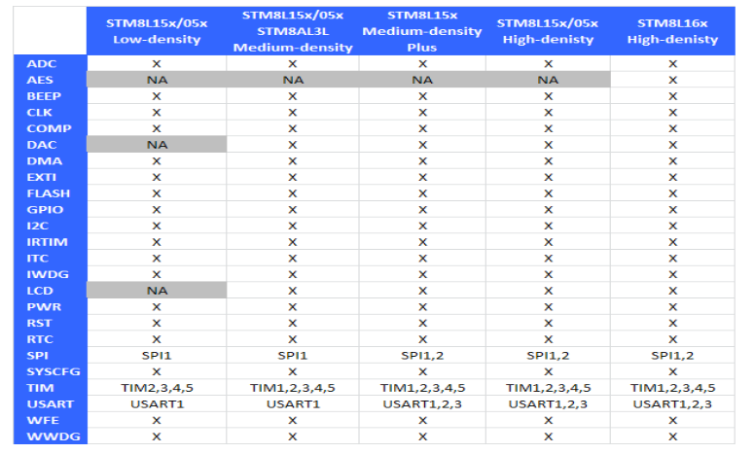
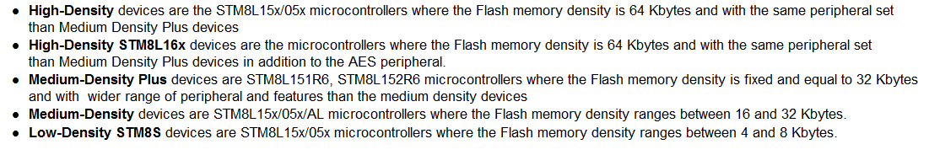
Library’s Supported Features

Slide 12
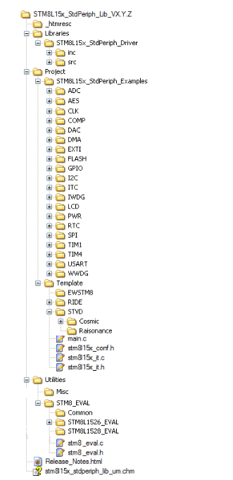
File Structure

Slide 13
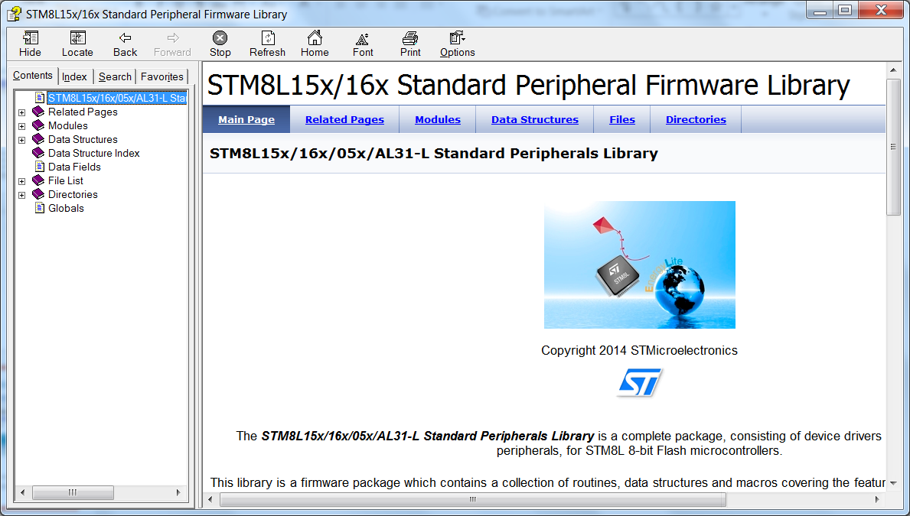
Library’s Help/User Manual

Slide 14
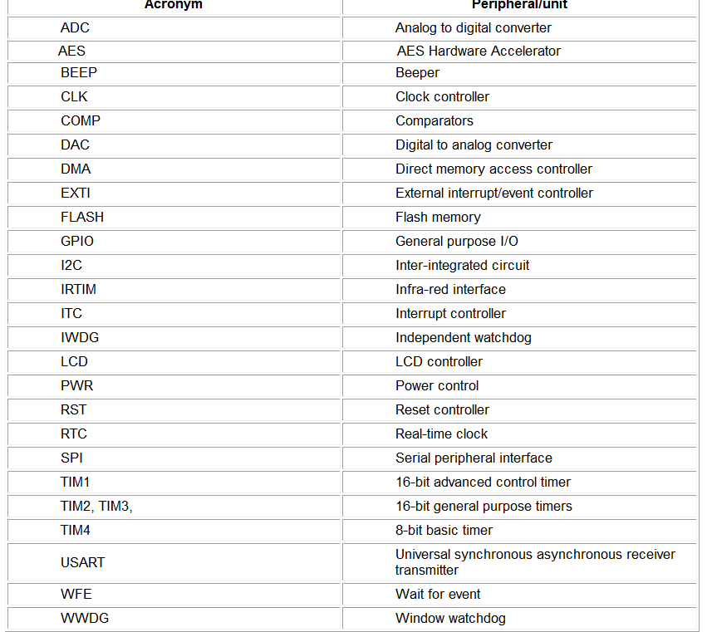
Conventions 1/3 ☺

Slide 15
Conventions 2/3 ☺
The library uses the following naming patern:
PPP refers to any peripheral acronym, for example TIM2 and TIM3
System and source/header file names are preceded by the prefix ‘STM8L_’.
Names of peripheral functions are preceded by the corresponding peripheral acronym in upper case followed by an underscore, for example SPI_SendData.
Functions used to initialize the PPP peripheral according to parameters specified in the header file are named PPP_Init, for example TIM2_Init
Functions used to reset the PPP peripheral registers to their default values are named PPP_DeInit, for example TIM2_DeInit
Functions used to enable or disable the specified PPP peripheral are named PPP_Cmd, for example SPI_Cmd
Functions used to enable or disable an interrupt source of the specified PPP peripheral are named PPP_ITConfig, for example SPI_ITConfig
Functions used to check whether the specified PPP flag is set or reset are named PPP_GetFlagStatus, for example I2C_GetFlagStatus
Functions used to clear a PPP flag are named PPP_ClearFlag, for example I2C_ClearFlag
Functions used to check whether the specified PPP interrupt has occurred or not are named PPP_GetITStatus, for example TIM2_GetITStatus
Functions used to clear a PPP interrupt pending bit are named PPP_ClearITPendingBit, for example TIM2_ClearITPendingBit

Slide 16
Conventions 3/3 ☺
Variable types:
#define __I volatile const /*!< defines 'read only' permissions */
#define __O volatile /*!< defines 'write only' permissions */
#define __IO volatile /*!< defines 'read / write' permissions */
/*!< Signed integer types */
typedef signed char int8_t;
typedef signed short int16_t;
typedef signed long int32_t;
/*!< Unsigned integer types */
typedef unsigned char uint8_t;
typedef unsigned short uint16_t;
typedef unsigned long uint32_t;
typedef enum {FALSE = 0, TRUE = !FALSE} bool;
typedef enum {RESET = 0, SET = !RESET} FlagStatus, ITStatus, BitStatus, BitAction;
typedef enum {DISABLE = 0, ENABLE = !DISABLE} FunctionalState;

Slide 17
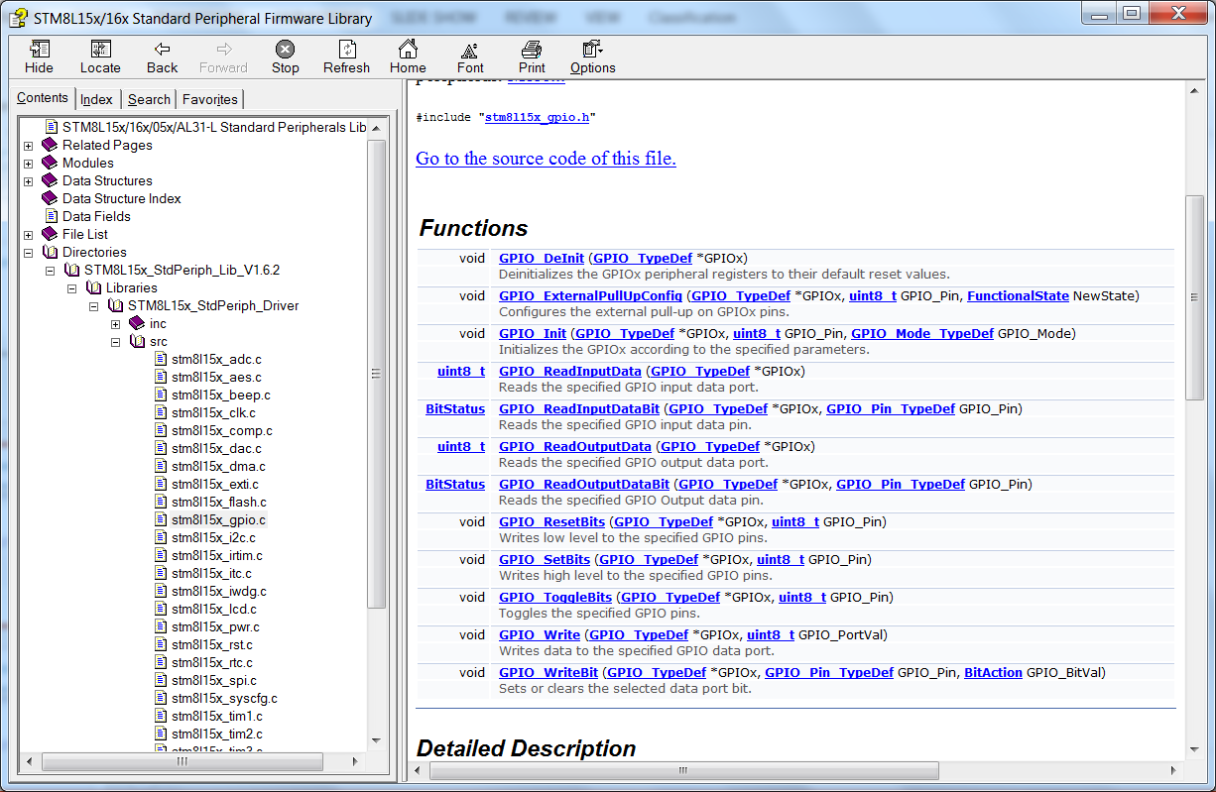
How to find the available functions

Slide 18
How to get more info?

Slide 19
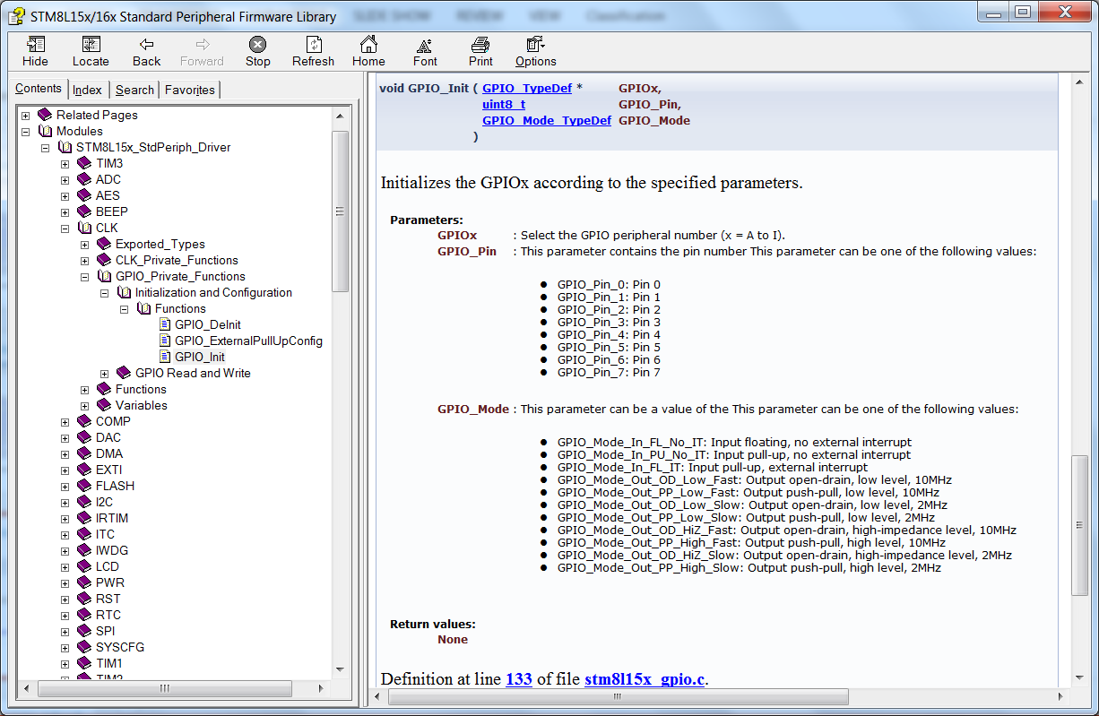
How to get more info?

Slide 20
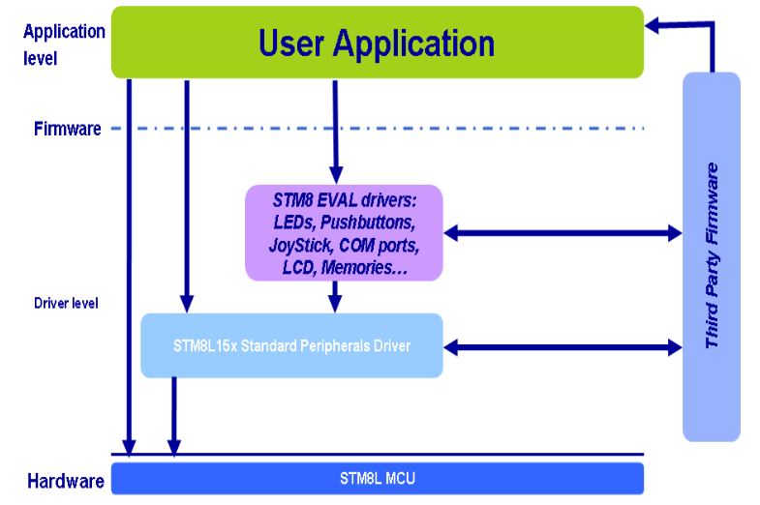
Library’s Architecture

Slide 21
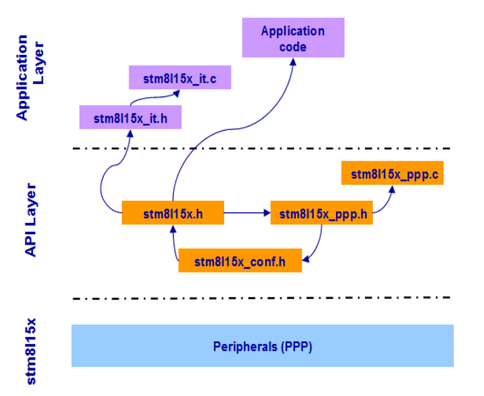
Library’s Architecture in files

Slide 22
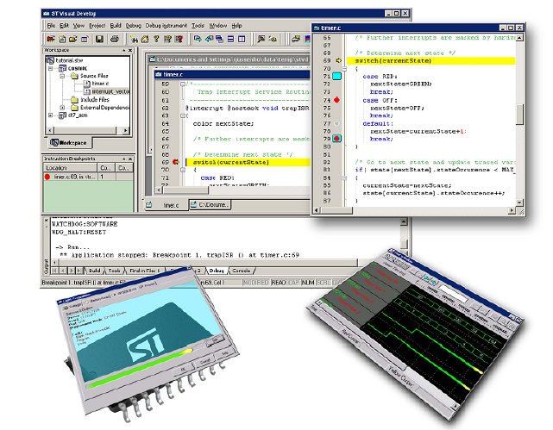
Getting Started from scratch!

Slide 23
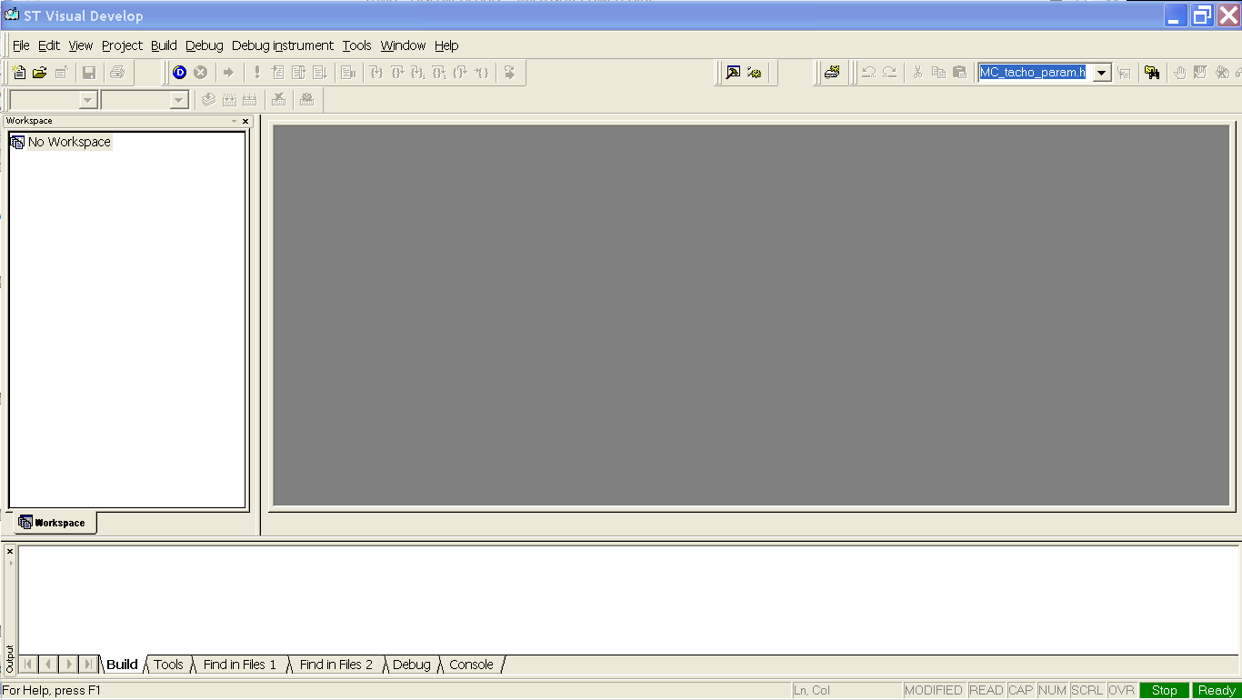
Open the STVD

Slide 24
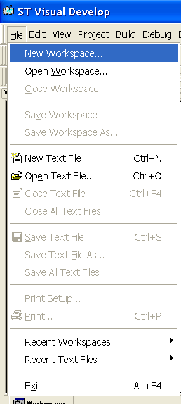
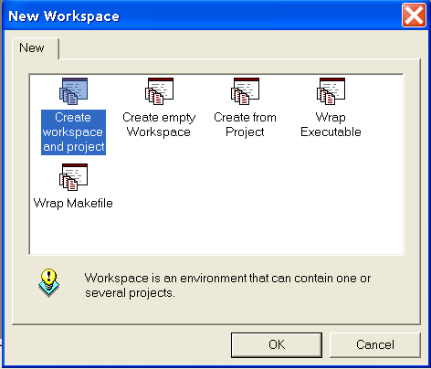
Choose to create a New Workspace
And then, to create workspace and project

Slide 25
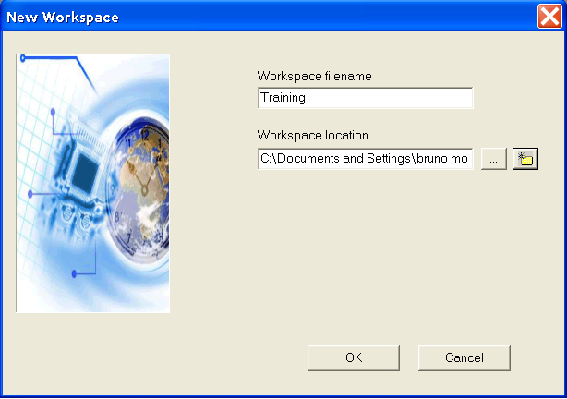
Name the workspace and set it’s location

Slide 26
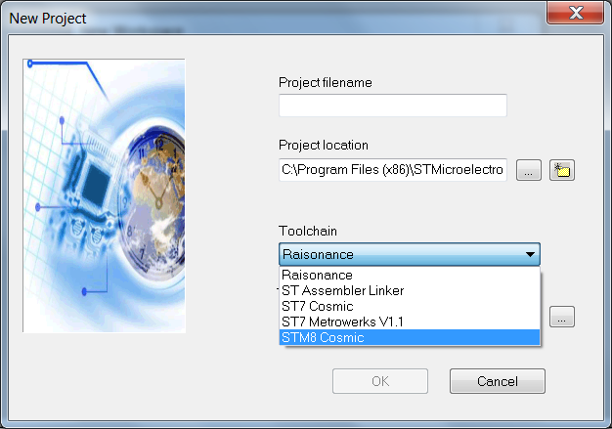
Select the proper Toolchain

Slide 27
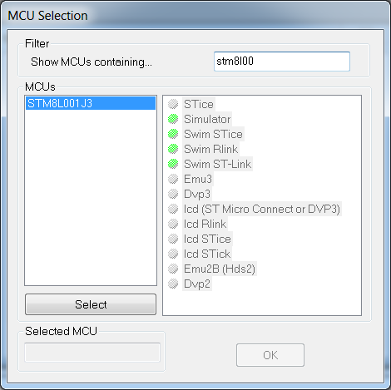
Select the STM8L152C6

Slide 28
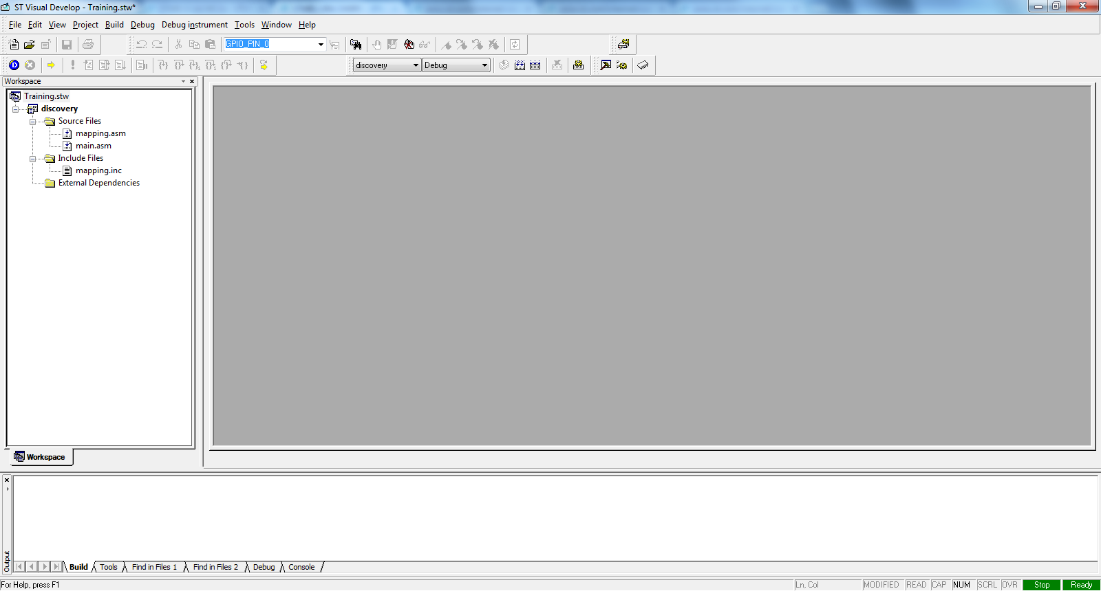
Your workspace should look like this

Slide 29
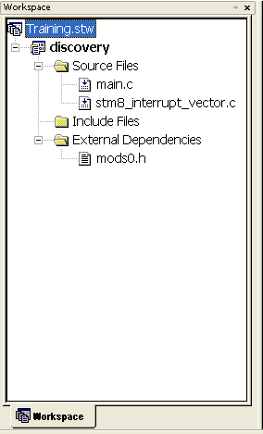
Giving a closer look

Slide 30
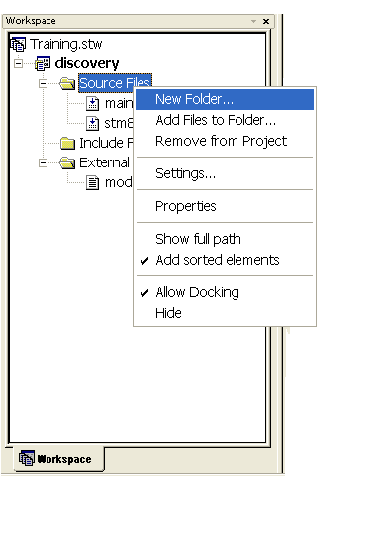
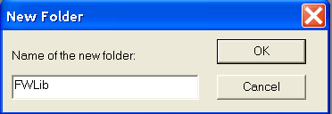
Now, let’s add the library

Slide 31
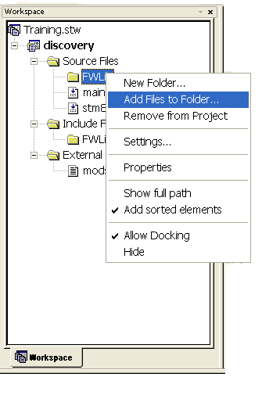
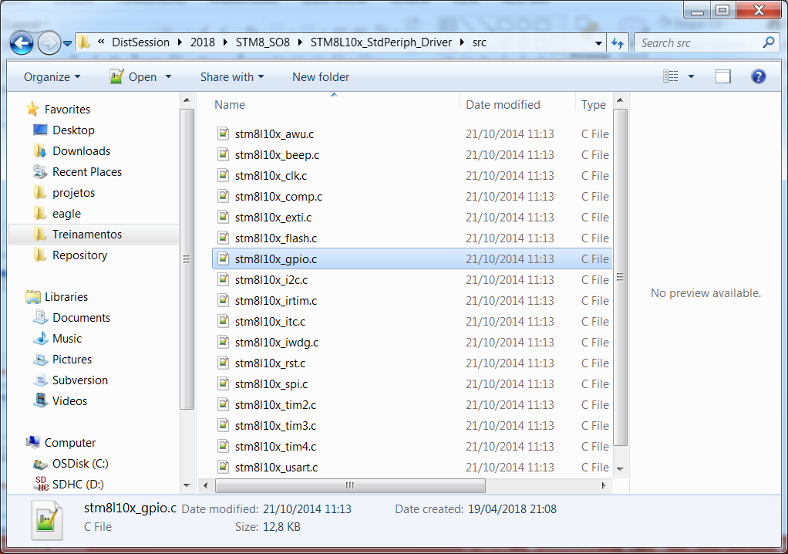
Now, let’s add the library

Slide 32
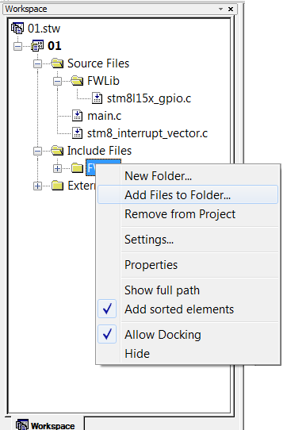
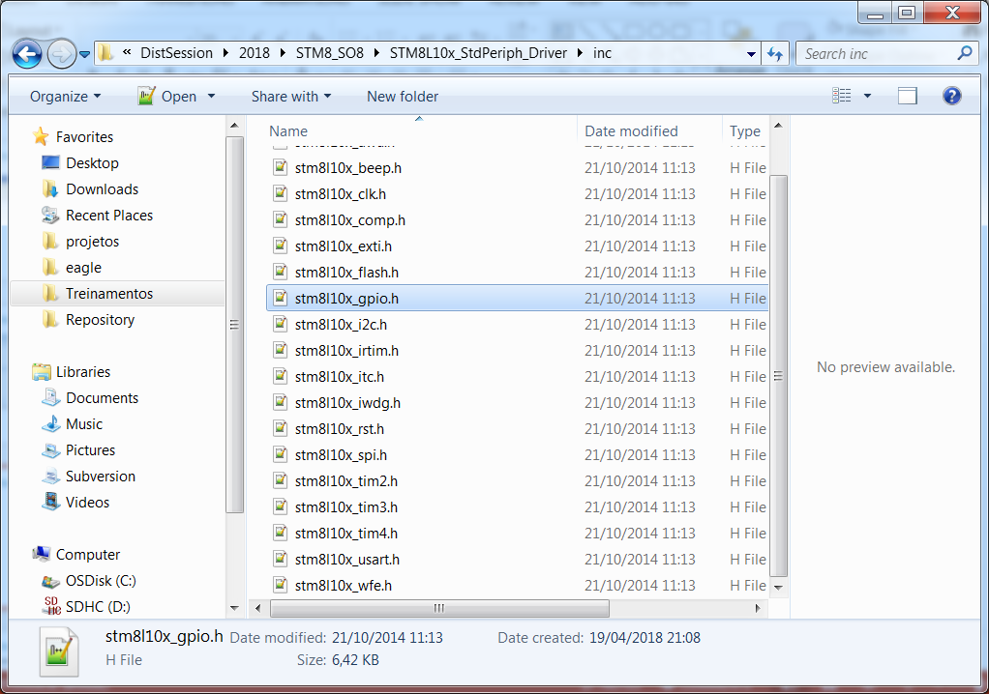
Now, let’s add the library

Slide 33
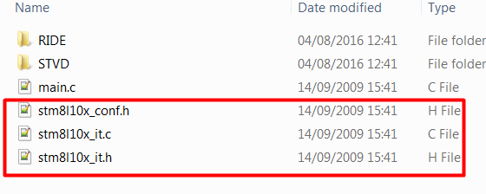
Now, let’s add the library
Once the basic files are imported, we need to add the files responsibles to manage the interrupt vector
Copy the 3 highlighted files to our project folder, these files are available under the unzip library folder: stm8l10x_stdperiph_lib\STM8L10x_StdPeriph_Lib_V1.1.0\Project\Template

Slide 34
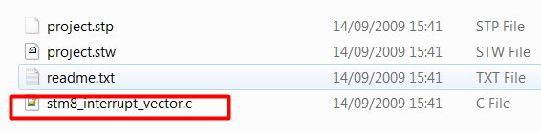
Now, let’s add the library
Since the interrupt vector file that is automatically generated is not asserted with the library’s names, we need to replace the file
Copy the highlighted file to our project folder, this file is available under the unzip library folder: stm8l10x_stdperiph_lib\STM8L10x_StdPeriph_Lib_V1.1.0\Project\Template\STVD\Cosmic

Slide 35
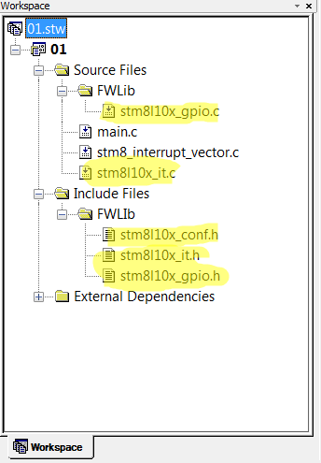
Now, let’s add the library
With all the preparations done, we just need to add the following files within our project:
STM8L10x_it.c
STM8L10x_it.h
STM8L10x_conf.h
The final result should be like this:

Slide 36
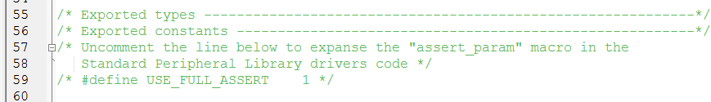
Configuring the library – stm8l10x_conf.h
The Standard Peripherals Library implements run-time failure detection by checking the input values of all library functions. The run-time checking is achieved by using an assert_param macro. This macro is used in all library functions which have at least an input parameter. It allows the user to check that the input value lies within the defined parameter values
For the purpouse of this training, we won’t use this feature, so it’s mandatory to comment the assert define:

Slide 37
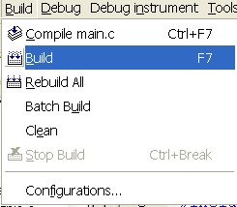
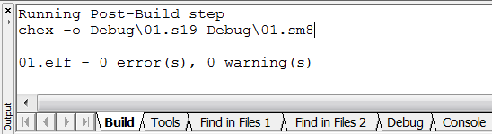
Compile the project (F7 as short key)
Once all is done, just compile and get the so desired 0 erros and 0 warnings

Slide 38
Tips and Tricks
Recommendation for STM8L001J3 and STM8L050J3 firmware
In order to successfully configure the startup code for STM8L001J3 and STM8L050J3 devices the user must:
Set unbonded GPIOS to safe state
Apply a delay before reconfiguring the SWIM pin
Set the proper modes for GPIOs
The next slides describes in detail the recommendations listed above and presents an startup code example for reference.

Slide 39
Tips and Tricks
Setting unbonded GPIOS to safe state
On STM8L001J3: GPIOs PA1, PA3, PA5, PB0, PB1, PB2, PB4, PC5, PC6, PD1, PD2, PD3, PD4, PD5, PD6 and PD7 are only present internally; they are not bonded to pins.
On STM8L050J3: GPIOs PA1, PB0, PB1, PB2 and PB4 are only present internally; they are not bonded to pins.
After the device reset, those GPIOs are configured by hardware into input-floating mode. It is recommended to set them into output-mode/low-output-level state in order to improve the EMC immunity (as GPIOs are grounded) and to lower the device's power consumption (as there are no input GPIOs with undefined logic level).

Slide 40
Tips and Tricks
Applying a delay before the SWIM pin reconfiguration
It is recommended to add a delay of around 5 seconds in the firmware startup code in order to be able to debug the device through the SWIM interface. This delay can be removed in final/locked code (see an example of delay code in the next slide)
The SWIM pin functionality is kept during this delay. The user can connect to the device though the SWIM interface and reprogram the device.
If the firmware does not implement this delay and immediately reconfigures some GPIOs on the pin 1 into output mode, it is then not possible to connect to the device through the SWIM interface (because this pin is now an output). The device is locked permanently (because firmware cannot be changed).

Slide 41
Example of recommended startup code for STM8L001J3
Example of recommended startup code for STM8L001J3
/* MAIN.C file */
#define ASM _asm //define for COSMIC
#define STARTUP_SWIM_DELAY_5S \
{ \
ASM(" PUSHW X \n" \
" PUSH A \n" \
" LDW X, #0xFFFF \n" \
"loop1: LD A, #50 \n" \
\
"loop2: DEC A \n" \
" JRNE loop2 \n" \
\
" DECW X \n" \
" JRNE loop1 \n" \
\
" POP A \n" \
" POPW X " );\
}

Slide 42
Example of recommended startup code for STM8L001J3
/* not connected pins as output low state (the best EMC immunity)
(PA1, PA3, PA5, PB0, PB1, PB2, PB4, PC5, PC6, PD1, PD2, PD3, PD4, PD5,
PD6, PD7)*/
#define CONFIG_UNUSED_PINS_STM8L001 \
{ \
GPIOA->DDR |= GPIO_Pin_1 | GPIO_Pin_3 | GPIO_Pin_5; \
GPIOB->DDR |= GPIO_Pin_0 | GPIO_Pin_1 | GPIO_Pin_2 | GPIO_Pin_4; \
GPIOC->DDR |= GPIO_Pin_5 | GPIO_Pin_6; \
GPIOD->DDR |= GPIO_Pin_1 | GPIO_Pin_2 | GPIO_Pin_3 | GPIO_Pin_4 |\
GPIO_Pin_5 | GPIO_Pin_6 | GPIO_Pin_7; \
}

Slide 43
Example of recommended startup code for STM8L001J3
/* Example of firmware for STM8L001: recommended startup + test of pins
functionality */
main()
{
uint16_t i;
/* -------------STM8L001 startup-------------- */
/* configure unbonded pins */
CONFIG_UNUSED_PINS_STM8L001;
/* delay for SWIM connection: ~5seconds */
STARTUP_SWIM_DELAY_5S;
/* ------------------------------------------- */
/* Infinite loop */

Slide 44
STM8L Training
Eval Board

Slide 45
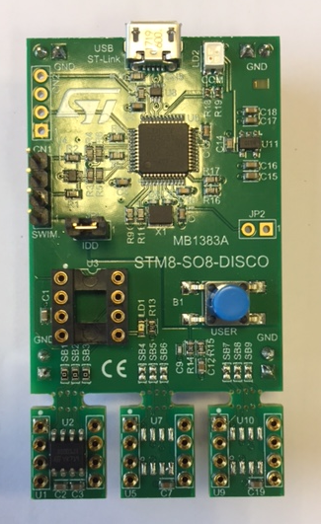
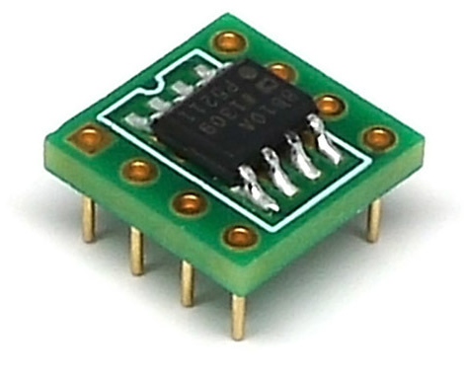

Eval Board
 | # | RPN: STM8-SO8-Disco | Delivery (To/By)
Content | 2.1.1 | Light Discoveries Contain: A DIP 8 pin socket STLink portion, conneced to DIP8 1 button, 1 led, connected to DIP8 3 breakable small boards, each with one different STM8 8-pin, with DIP connector: they can be put in uppder DIP8 connector | Web
Deliverables | 2.1.2 | Databrief | Web
 | 2.1.3 | Getting Started | Web
 | 2.1.4 | Gerber/BOM/Schematic | Web
STLink (SWIM)
DIP8
DIP8
DIP8
DIP8

Slide 46
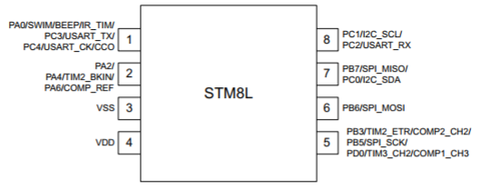
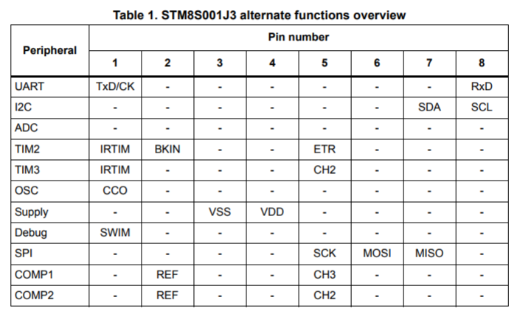
Pinout functionality overview

Slide 47
STM8L Training
Hands-On

Slide 48
Hands On
GPIO
EXTI
TIM4
UART
Run / Low Power Modes measurement
Run Mode IDD
AWU Halt mode IDD

Slide 49
Hands On
GPIO
EXTI
TIM4
UART
Run / Low Power Modes measurement
Run Mode IDD
AWU Halt mode IDD

Slide 50
GPIO
Turn on and off a simple LED
/* pin for testing */
#define TEST_PORT GPIOA
#define TEST_PIN GPIO_Pin_2
main()
{
uint16_t i;
/* -------------STM8L001 startup-------------- */
CONFIG_UNUSED_PINS_STM8L001; /* configure unbonded pins */
/* delay for SWIM connection: ~5seconds */
STARTUP_SWIM_DELAY_5S;
/* initialize tested pin */
GPIO_Init(TEST_PORT, TEST_PIN, GPIO_Mode_Out_PP_Low_Fast);
/* Infinite loop */
while (1)
{
/* toggle with tested pin */
GPIO_ToggleBits(TEST_PORT, TEST_PIN);
/* delay */
for(i=0; i<10000; i++);
}
}

Slide 51
Hands On
GPIO
EXTI
UART
Run / Low Power Modes measurement
Run Mode IDD
AWU Halt mode IDD

Slide 52
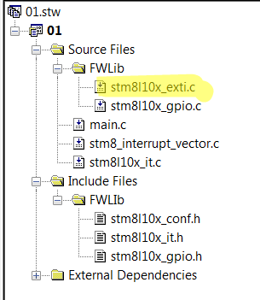
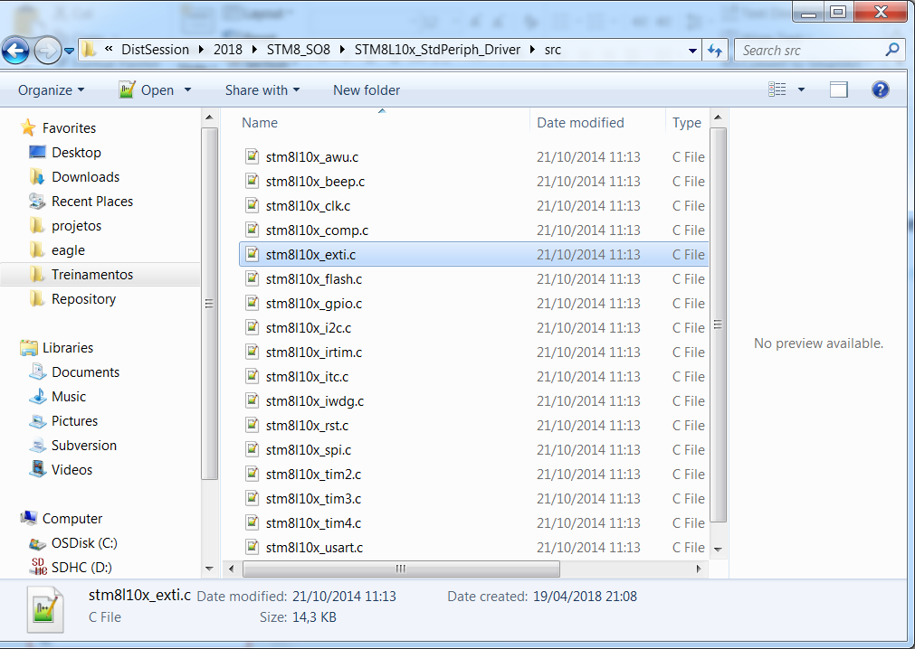
EXTI
Blink a simple LED, depending on the key status, using external interrupt
To accomplish this task, we’ll need to add the STM8L_exti.c/h in the project

Slide 53
EXTI
main.c
STM8L10x_it.c
#include "STM8L10x.h"
main()
{
CONFIG_UNUSED_PINS_STM8L001;
STARTUP_SWIM_DELAY_5S;
GPIO_Init(LED_PORT,LED_PIN,GPIO_Mode_Out_PP_Low_Fast);
GPIO_Init(KEY_PORT,KEY_PIN,GPIO_Mode_In_FL_IT);
EXTI_SetPinSensitivity(EXTI_Pin_7,EXTI_Trigger_Rising);
enableInterrupts();
while (1);
}
INTERRUPT_HANDLER(EXTI7_IRQHandler,9)
{
/* In order to detect unexpected events during development,
it is recommended to set a breakpoint on the following instruction.
*/
EXTI_ClearITPendingBit(EXTI_IT_Pin7);
GPIO_ToggleBits(LED_PORT,LED_PIN);
}

Slide 54
Hands On
GPIO
EXTI
TIM4
UART
Run / Low Power Modes measurement
Run Mode IDD
AWU Halt mode IDD

Slide 55
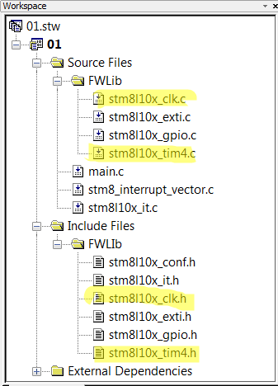
TIM4
In order to use any peripheral, it’s mandatory to turn it’s clock on, so to run the TIM4, it’s needed to add two source files and their respective header file

Slide 56
TIM4
main.c
stm8l10x._it.c
CLK_PeripheralClockConfig(CLK_Peripheral_TIM4, ENABLE); //enable TIM4 clock
TIM4_TimeBaseInit(TIM4_Prescaler_16,124); //1KHz Time base
TIM4_ITConfig(TIM4_IT_Update, ENABLE); //Enable overflow interrupt
TIM4_Cmd(ENABLE); //start timer counter
enableInterrupts(); //enable interrupts
INTERRUPT_HANDLER(TIM4_UPD_OVF_IRQHandler, 25)
{
static u16 TimerUpDate = 1000;
TIM4_ClearITPendingBit(TIM4_IT_Update);//clear interrupt request
if(!TimerUpDate){
TimerUpDate = 1000;
/* toggle with tested pin */
GPIO_ToggleBits(LED_PORT, LED_PIN);
}else{
TimerUpDate--;
}
}

Slide 57
Hands On
GPIO
EXTI
TIM4
UART
Run / Low Power Modes measurement
Run Mode IDD
AWU Halt mode IDD

Slide 58
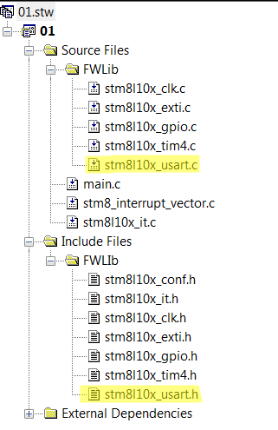
UART
Let’s Configure UART to enter in loopback mode and receive what we send! Receive using interrupt

Slide 59
UART
Let’s Configure UART to enter in loopback mode and receive what we send! Receive using interrupt
main.c
Infinite loop
stm8l10x_it.c
/* initialize UART */
GPIO_Init(GPIOC,GPIO_Pin_2,GPIO_Mode_In_PU_No_IT);//Rx: Input
GPIO_Init(GPIOC, GPIO_Pin_3, GPIO_Mode_Out_PP_High_Fast); // TxD: output
CLK_PeripheralClockConfig(CLK_Peripheral_USART, ENABLE);
USART_Init(9600, USART_WordLength_8D, USART_StopBits_1, USART_Parity_No,
(USART_Mode_TypeDef)(USART_Mode_Rx | USART_Mode_Tx));
USART_ITConfig(USART_IT_RXNE,ENABLE);
USART_Cmd(ENABLE);
USART_SendData8(0x55);
INTERRUPT_HANDLER(USART_RX_IRQHandler, 28)
{
recebe[0] = USART_ReceiveData8();
USART_ClearITPendingBit();
}

Slide 60
Hands On
GPIO
EXTI
TIM4
UART
Run / Low Power Modes measurement
Run Mode IDD
Halt mode IDD

Slide 61
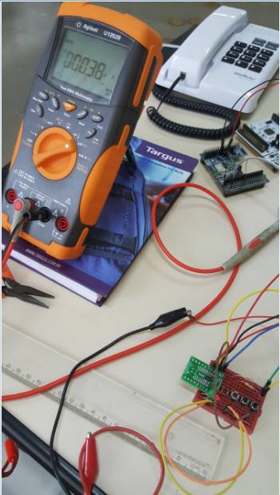
Low Power Modes
Check the power consumption of each mode!
The code example demonstrate how to enter and exit each low power mode available
RUN
Icc_measure_RUN(); @8mA in the eval board
AWU HALT
Icc_measure_HALT();
HALT MODE
Withou the AWU, waking up only from Exti: 380nA

Slide 62
Annex: Impacted ANs (1/3)
Relative to STM8S001J3
AN3259 ... RS232 communications with a terminal using the STM8S-DISCOVERY
AN1709 ... EMC design guide for ST microcontrollers
AN2822 ... STM8S and STM8A high speed internal oscillator calibration
AN3298 ... STM8S DALI slave library
AN2857 ... STM8S and STM8A family power management
AN3143 ... Audio software codec for the STM8S
AN1181 ... Electrostatic discharge sensitivity measurement
AN2860 ... EMC guidelines for STM8 microcontrollers
AN3208 ... Microstepping motor drive with STM8A and STM8S microcontrollers
AN2752 ... Getting started with the STM8S and STM8A
AN3258 ... STM8AF and STM8S series HSI oscillator calibration using LIN automatic resynchronization
AN2945 ... STM8S and STM32™ MCUs: a consistent 8/32-bit product line for painless migration

Slide 63
Annex: Impacted ANs (1/3)
Relative to STM8L001J3
AN2957 ... Implementing an RC5 infrared transmitter using the IR timer modulator of the STM8L10x microcontroller
AN3029 ... Getting started with STM8L and STM8AL
AN1181 ... Electrostatic discharge sensitivity measurement
AN1709 ... EMC design guide for ST microcontrollers
AN2860 ... EMC guidelines for STM8 microcontrollers
AN3133 ... Using the STM8L05xxx/STM8L101xx/STM8L15xxx/STM8L162xx/STM8AL31xx/STM8AL3Lxx real-time clock
AN3147 ... Power management in STM8L and STM8AL

Slide 64
Annex: Impacted ANs (1/3)
Relative to STM8L050J3
AN3133 ... Using the STM8L05xxx/STM8L101xx/STM8L15xxx/STM8L162xx/STM8AL31xx/STM8AL3Lxx real-time clock
AN3117 ... Using the STM8L05xxx/15xxx, STM8L162xx, STM8AL31xx/3Lxx DMA controller
AN2860 ... EMC guidelines for STM8 microcontrollers
AN1709 ... EMC design guide for ST microcontrollers
AN3147 ... Power management in STM8L and STM8AL
AN3101 ... STM8L05xxx/15xxx, STM8L162xx and STM8AL31xx/3Lxx internal RC oscillator calibration
AN1181 ... Electrostatic discharge sensitivity measurement
AN3029 ... Getting started with STM8L and STM8AL

Slide 65

Thank You

