Slide 1
USB MSP Host lab

Slide 2
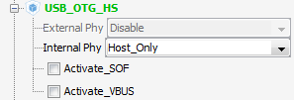
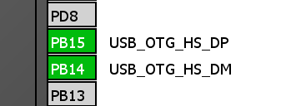
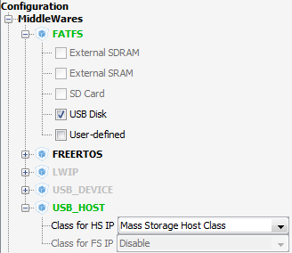
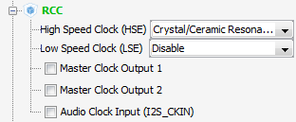
USB MSP Host lab1
Create project in CubeMX
Menu > File > New Project
Select STM32F4 > STM32F429/439 > LQFP144 > STM32F439ZITx
Select USB HS OTG internal PHY(FS)
Select HSE clock
(HSI cannot be used and STM32F4 have no clock synchronization)
Select MSP class in MiddleWares and FATFS USB Disk

Slide 3
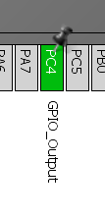
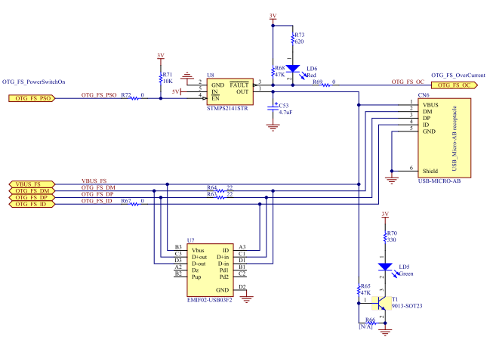
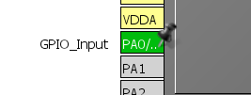
USB MSP Host lab
Because HOST must also power the device we need to enable voltage regulator connected to VBUS line
Regulator enable pin is on PC4(only select as output is enough because default state then will be LOW)
Connected to PC4

Slide 4
USB MSP Host lab
We also enable PA0 where is button only for demo purpose
USB clock set to 48MHz and core clock at maximum

Slide 5
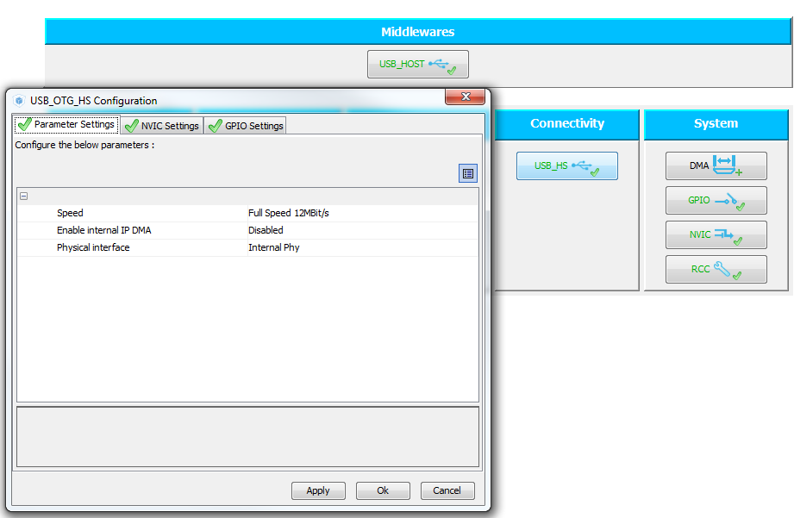
USB MSP Host lab
In Configuration tab select USB_HS in Connectivity
Disable option use internal DMA
Button OK

Slide 6
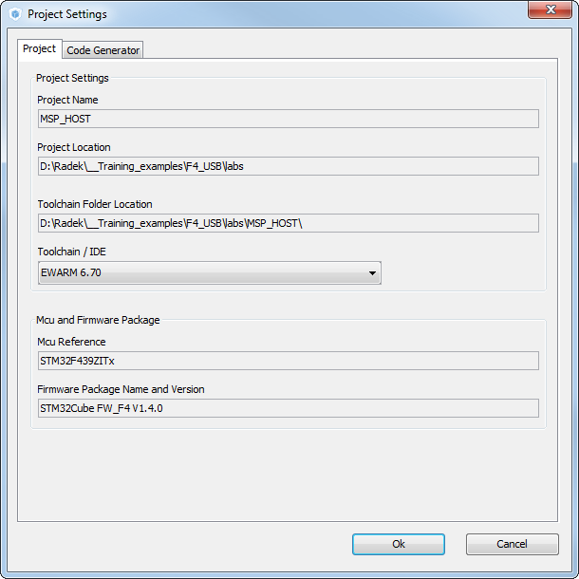
USB MSP Host lab
Now we set the project details for generation
Menu > Project > Project Settings
Set the project name
Project location
Type of toolchain
Now we can Generate Code
Menu > Project > Generate Code
If you have KEIL change HEAP size in startup file

Slide 7
USB MSP Host lab
If the Device is connected and enumerated into appli_state is stored APPLICATION_READY and we can commutate with device
For this reason we import into main.c appli_state variable
We also need FATFS variable and FIL for file operations
Other variable are for lab purposes
extern ApplicationTypeDef Appli_state;
/* USER CODE BEGIN PV */
extern ApplicationTypeDef Appli_state;
FIL fp; //file handle
FATFS fatfs; //structure with file system information
char text[]="test";//text which will be written into file
char name[]="test.txt";//name of the file
char text2[100];//buffer for data read from file
uint32_t ret;//return variable
/* USER CODE END PV */

Slide 8
USB MSP Host lab
First we need mount the USB flash disk.
Please note that FLASH disk must be formatted in FAT32 file system otherwise is not possible to mount it
/* USER CODE BEGIN 3 */
/* Initialises the File System*/
if ( f_mount( &fatfs,"" ,0) != FR_OK )
{
/* fs initialisation fails*/
while(1);
}

Slide 9
USB MSP Host lab
Basic operation with file system, reading and writing data from file “text.txt”
/* Infinite loop */
while (1)
{
MX_USB_HOST_Process();
if(Appli_state==APPLICATION_READY){
/*open or create file for writing*/
if(f_open(&fp,name,FA_CREATE_ALWAYS | FA_WRITE)!=FR_OK){
while(1);
}
/*write data into flashdisk*/
if(f_write(&fp,text,strlen(text),&ret)!=FR_OK){
while(1);
}
f_close(&fp);
/*open file for reading*/
if(f_open(&fp,name,FA_READ)!=FR_OK){
while(1);
}
/*red data from flash*/
if(f_read(&fp,text2,100,&ret)!=FR_OK){
while(1);
}
f_close(&fp);
}
}
/* USER CODE END 3 */

Slide 10
USB MSP Host lab
From the past we know that some flash sticks can have problems with out library(STD)
The USB MSP library is now only interface between flash drive and file system
The basic operation which are done with MSP USB part is calling two BULK transfer one for READ BLOCK and second WRITE BLOCK

