Slide 1









FreeRTOS with CubeMX
Technically Oriented Microcontroller Application Services
Bruno Montanari – bruno.montanari@st.com

Slide 2
Agenda
2
Cube and Keil system check
❑ What is CubeMX?
Creation and tuning of a simple project using SWO from SWD intreface
FreeRTOS Basics
FreeRTOS hands on for several features
task/priorities/timers/mutex/semaphores (not in this order) ☺

Slide 3

Cube and Keil check

Slide 4

STM32Cube Install
STM32CubeMX tool
http://www.st.com/stm32cube
The STM32CubeMX tool needs Java
Please check whether you have latest Java installed on your PC, for sure 32-bit and 64-bit version
You can either download STM32CubeF4 packages directly from STM32CubeMX or download them offline using the below links and install as local (“From loc…” button)
STM32CubeF4
12

Slide 5
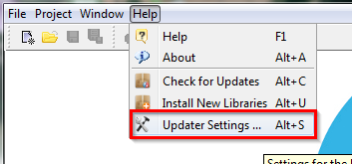

STM32Cube configuration 1/3
In case you download packages from web, you need to define place where they will be stored (repository)
MENU>Help>Updater Settings…
You will see current repository folder location
Default is C:/User/Acc_name/STM32Cube/Repository/
NOTE: In case your repository path contains diacritics, STM32CubeMX may fail to recognize them correctly. If this happens, change your repository path to contain raw Latin only (ex: C:/Repository)
You can either download STM32 packages manually and put them
into this folder or STM32CubeMX can do it for you if configured correctly

Slide 6
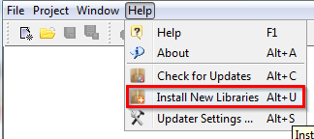
STM32Cube configuration 2/3
The comparison of the STM32CubeMX repository settings and folder structure
In case you want STM32CubeMX to download these files automatically
MENU>Help>Install New Libraries
Select required libraries
Force download with button “Install Now”
STM32CubeMX can download for you repository packages automatically

Slide 7
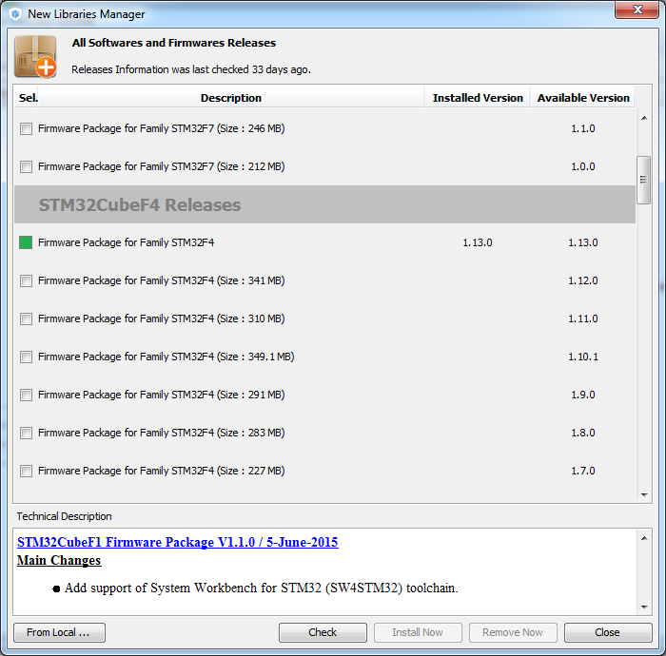
STM32Cube configuration 3/3
The comparison of the STM32CubeMX repository settings and folder structure
In case you want to install files manually
MENU>Help>Install New Libraries
15
Click “From Local…” button
Browse to select file

Slide 8
STM32CubeMX install
For code generation STM32CubeMX uses package from the Repository folder
Currently, STM32CubeMX can generate code for the following toolchains
Keil (free for F0/L0 families)
IAR
Atollic (free Lite version available)
System Workbench (SW4STM32 by AC6, free)
For debugging purposes, it is necessary to have ST-Link drivers installed.
Drivers are a part of ST-Link Utility package that can be found here
STSW-LINK004 ST-link Utility
To install drivers you will need Admin rights on your PC

Slide 9
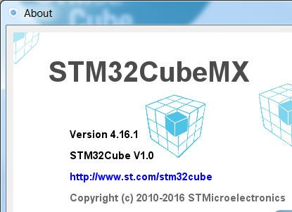



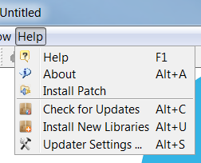

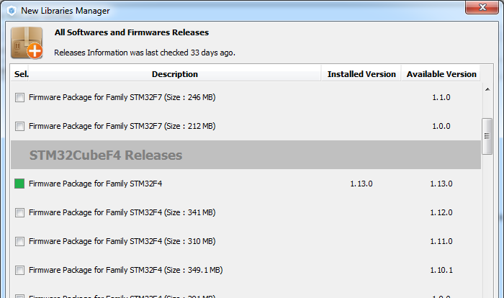



Checkpoint #1
Help->About
Help->Install New Libraries

Slide 10
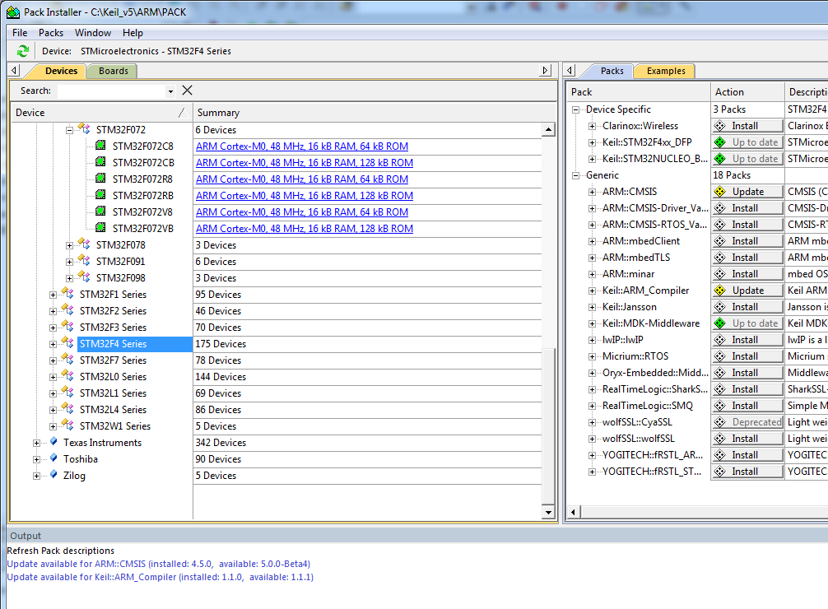





Checkpoint #2 – Keil verification
9
Open Keil v5

Slide 11
What is CubeMX?

Slide 12
STM32CubeMX applixation
5
STM32CubeMx do allow to configure peripherals using GUI, generate project framework and peripheral initialization code.
STM32CubeMx do not allow to create algorithms using GUI and generate algorithms code yet – there is still some space for programmers left ;-)

Slide 13
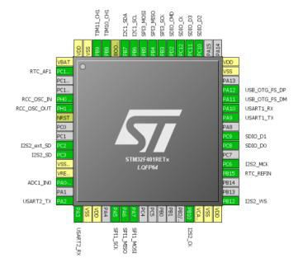
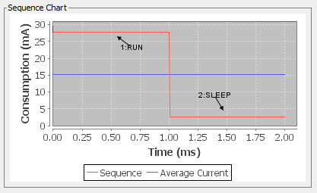
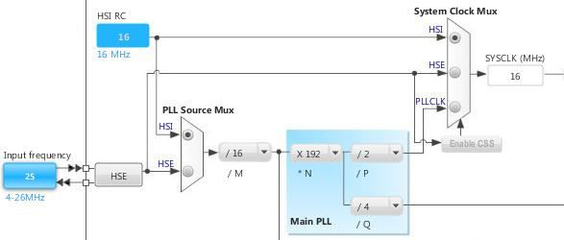
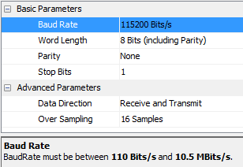





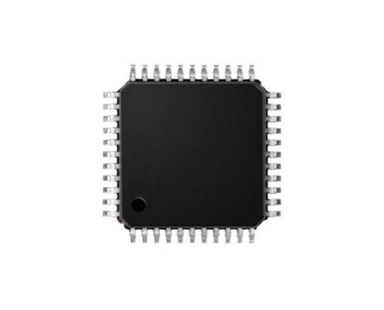


What is CubeMX?
6
Pinout Wizard
Clock Tree Wizard
Peripherals & Middleware Wizard
Power Consumption Wizard
STM32CubeMX
Generates Initialization C Code based on user choices !

Slide 14




















































What is CubeMX?
Cube F4 HAL package
Documents
Drivers
Middleware
Projects
Utilities
Advanced set of libraries
Developed/Owned by ST
Middleware
Third Party libraries
ST
Third Party
STemWin
STM32_Audio
FatFS
FreeRTOS
STM32_USB_Device_Library
STM32_USB_Host_Library
LibJPEG
LwIP
PolarSSL

Slide 15
Using SWO to print information from STM32

Slide 16
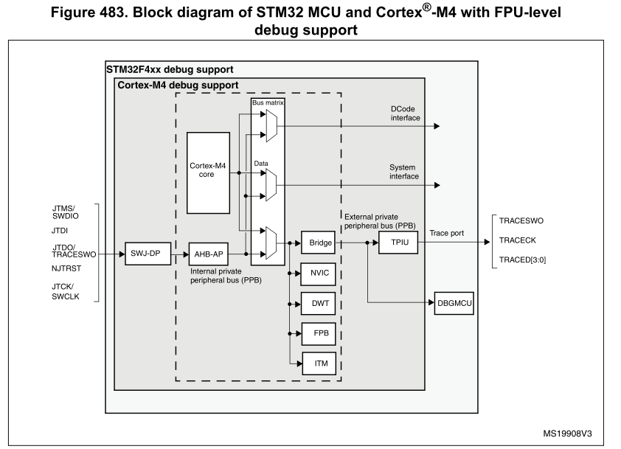
Using SWO
On some stm32 is periphery called ITM, not mix with ETM(real trace)
This periphery can be used to internal send data from MCU over SWO pin
Is possible to redirect the printf into this periphery
And also some IDEs can display this information during debug
It is similar to USART but we don’t need any additional wires and PC terminal
Video: Link

Slide 17
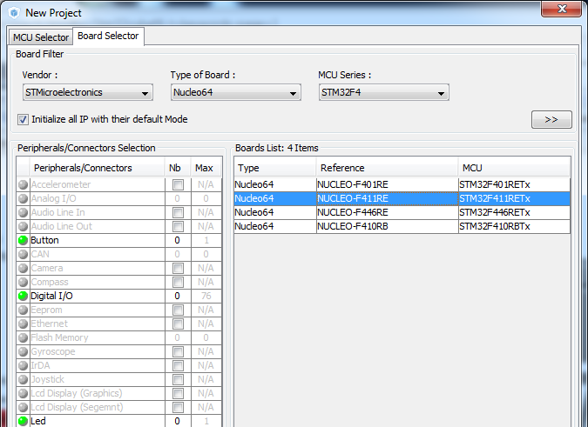
Using SWO
Create a new Cube project for our eval kit

Slide 18
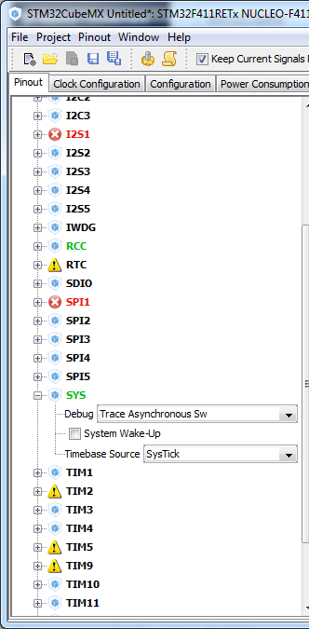
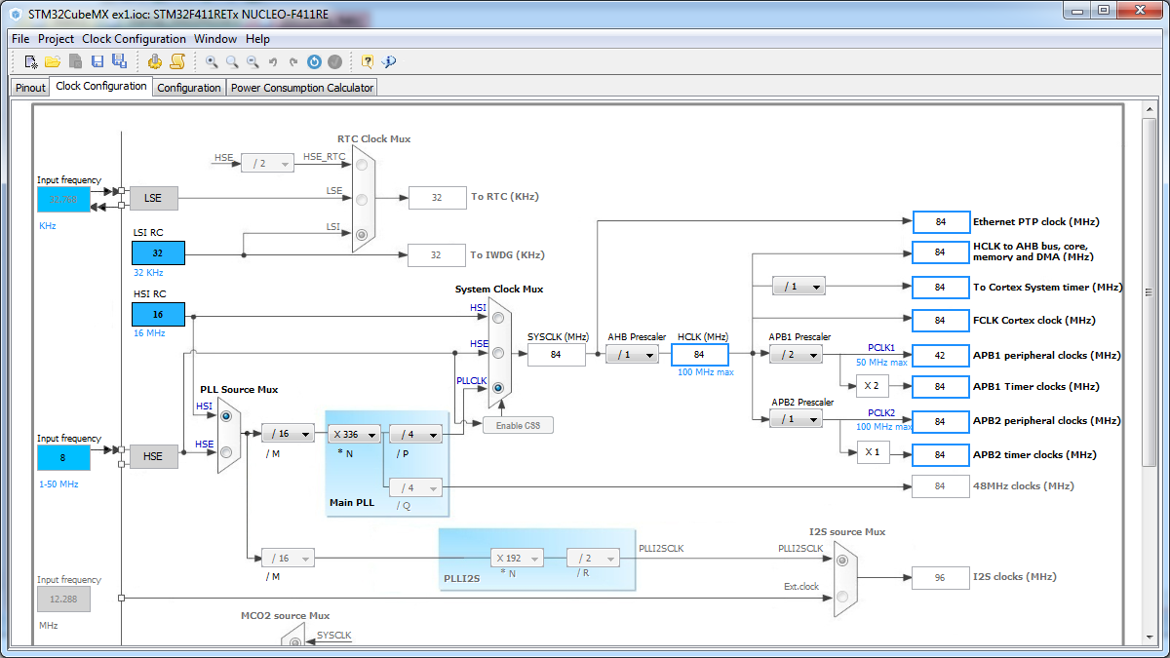
Using SWO for printf
We need only blank project with clock initialization
We set the and configure the core to maximum speed and SWD with SWO and the SYS interface to handle the Trace Asynchronous

Slide 19
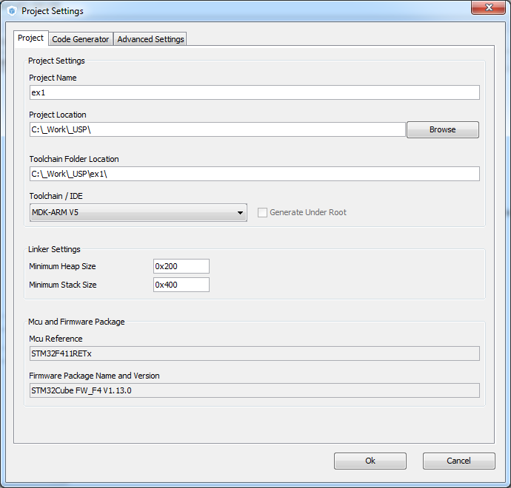
Using SWO for printf
Now we set the project details for generation
Menu > Project > Project Settings
Set the project name
Project location
Type of toolchain
Now we can Generate Code
Menu > Project > Generate Code

Slide 20
Using SWO for printf in KEIL
We need to include the stdio.h library to make printf working
And define __FILE structure
fputc function must be defined to send byte over ITM
/* USER CODE BEGIN Includes */
#include <stdio.h>
/* USER CODE END Includes */
/* USER CODE BEGIN PFP */
struct __FILE { int handle; /* Add whatever is needed */ };
/* USER CODE END PFP */
/* USER CODE BEGIN 4 */
/*send text over SWV*/
int fputc(int ch, FILE *f) {
ITM_SendChar(ch);//send method for SWV
return(ch);
}
/* USER CODE END 4 */

Slide 21
Using SWO for printf in KEIL
If the MCU run on very high frequency and you not see print f output you may try put into ITM send delay loop
/* USER CODE BEGIN 4 */
/*send text over SWV*/
int fputc(int ch, FILE *f) {
uint32_t i=0;
for(i=0;i<0xFFFF;i++);//waiting method, lower value will stop the SWV
ITM_SendChar(ch);//send method for SWV
return(ch);
}
/* USER CODE END 4 */

Slide 22
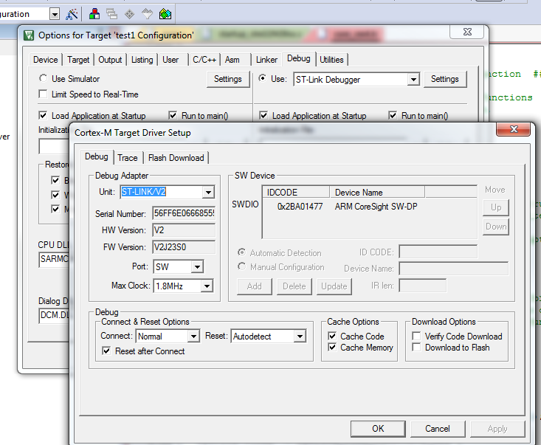
Using SWO for printf in KEIL
1. Target options
In KEIL
Open target options (ALT+F7)
Set ST-Link debugger
Button Settings
Set SW(D) in Debug TAB
Got to Trace TAB
2. Select DEBUG tab
3. Set ST-Link
4. Open Settings
6. Go to Trace tab
5. Set SW(D)

Slide 23
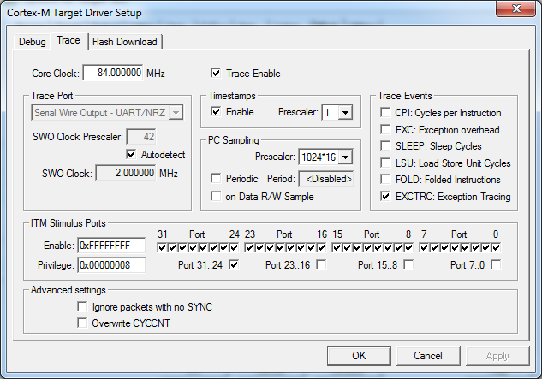
Using SWO for printf in KEIL
Check Trace Enable
Set core clock (84MHz must be same as in CubeMX clock tree)
ITM Stimulus Port 0 must be checked
Button OK
2. Set Core clock
1. Trace Enable
4. Open Settings
3. Check ITM Port 0
4. Button OK

Slide 24
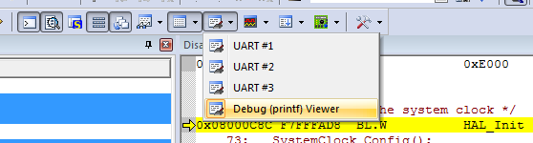
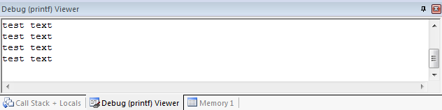
Using SWO for printf in KEIL
Testing loop printf in main
Compile and debug project
Open Debug (printf) Viewer
/* USER CODE BEGIN 3 */
/* Infinite loop */
while (1)
{
printf("test text\n");
HAL_Delay(1000);
}
/* USER CODE END 3 */

Slide 25
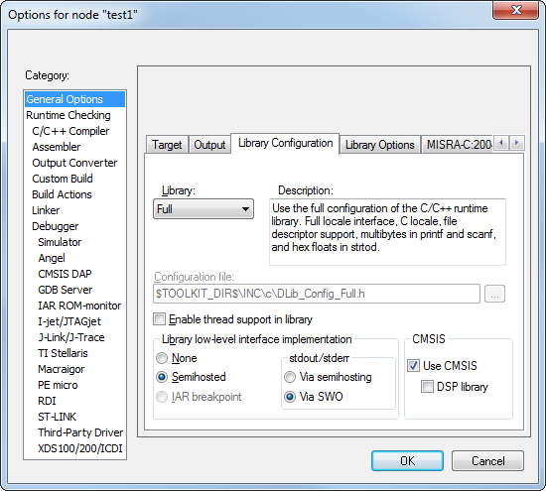
Using SWO for printf in IAR
Here is configuration more easier
Open project options
General Options
TAB library and configuration
Select stdout/stderr via SWO
Button OK
1. General options
2. Library configuration
3. Set Via SWO

Slide 26
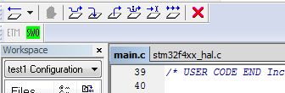
Using SWO for printf in IAR
Add testing printf into loop
Compile project and go to debug
Open SWO
/* USER CODE BEGIN 3 */
/* Infinite loop */
while (1)
{
printf("test text\n");
HAL_Delay(1000);
}
/* USER CODE END 3 */
Open SWO options

Slide 27
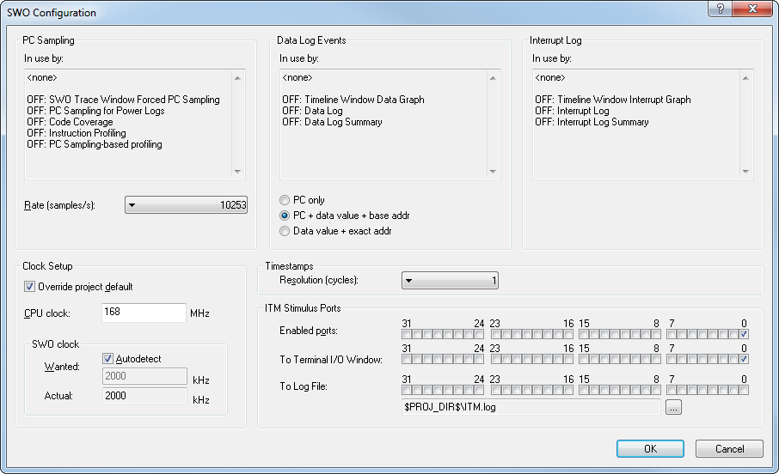
Using SWO for printf in IAR
Override project default if clocks are different from core (168MHz in out case)
Check autodetect SWO clock if possible
Enable ITM Port 0 to terminal
Button OK
Override clock and set correct value (168MHz)
Enable ITM Port 0
Check autodetect
Button OK

Slide 28
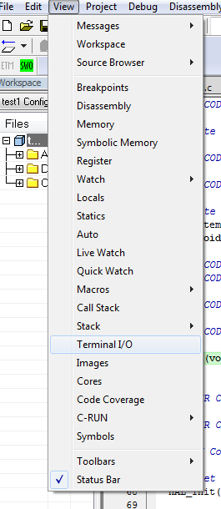
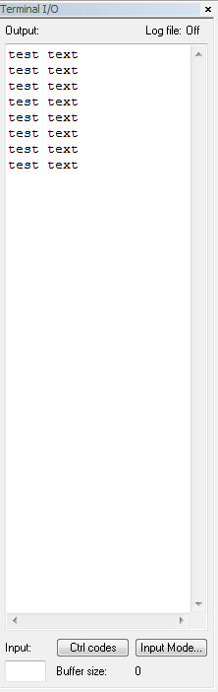
Using SWO for printf in IAR
Menu View -> Terminal I/O
Run program

Slide 29
FreeRTOS

Slide 30

FreeRTOS About FreeRTOS
Market leading RTOS by Real Time Engineers Ltd.
Professionally developed with strict quality management
Commercial versions available: OpenRTOS and SafeRTOS
Documentation available on www.freertos.org
Free support through forum (moderated by RTOS original author Richard Barry)

Slide 31
FreeRTOS Main features
Preemptive or cooperative real-time kernel
Scalable RTOS with tiny footprint (less than 10KB ROM)
Includes a tickless mode for low power applications
Synchronization and inter-task communications using
message queues
binary and counting semaphores
mutexes
group events (flags)
Software timers for tasks scheduling
Execution trace functionality
CMSIS-RTOS API port

Slide 32
FreeRTOS APIs overview (1/2)
API category
FreeRTOS
API
Description
Task
creation
xTaskCreate
Creates a new
task
vTaskDelete
Deletes a task
Task control
vTaskDelay
Task delay
vTaskPrioritySet
Set
s task priority
vTaskSuspend
Suspends
a task
vTaskResume
Resumes
a task
Kernel control
vTaskStartScheduler
Starts
kernel scheduler
vTaskSuspendAll
Suspends all tasks
xTaskResumeAll
Resumes all
tasks
taskYIELD
Forces
a context switch
taskENTER_CRITICAL
Enter
a critical section (stops
context switching)
taskEXIT_CRITICAL
Exits
from a critical section

Slide 33
FreeRTOS APIs overview (2/2)
API
FreeRTOS
API
Description
category
Message
xQueueCreate
Creates
a queue
queues
xQueueSend
Sends
data to queue
xQueueReceive
Receive
data from the queue
Semaphores
xSemaphoreCreateBinary
Creates
a binary semaphore
xSemaphoreCreateCounting
Creates
a counting semaphore
xSemaphoreCreateMutex
Creates a mutex semaphore
xSemaphoreTake
Semaphore
take
xSemaphoreGive
Semaphore give
Timers
xTimerCreate
Creates a timer
xTimerStart
Starts
a timer
xTimerStop
Stops a timer

Slide 34
FreeRTOS CMSIS-RTOS FreeRTOS implementation
Implementation in file cmsis-os.c (found in folder: “\Middlewares\Third_Party\FreeRTOS\Source\CMSIS_RTOS”)
The following table lists examples of the CMSIS-RTOS APIs and the FreeRTOS APIs used to implement them
API category | CMSIS_RTOS API | FreeRTOS API
Kernel control | osKernelStart | vTaskStartScheduler
Thread management | osThreadCreate | xTaskCreate
Semaphore | osSemaphoreCreate | vSemaphoreCreateBinary xSemaphoreCreateCounting
Mutex | osMutexWait | xSemaphoreTake
Message queue | osMessagePut | xQueueSend xQueueSendFromISR
Timer | osTimerCreate | xTimerCreate
Note: CMSIS-RTOS implements same model as FreeRTOS for task states

Slide 35
FreeRTOS CMSIS-RTOS API
CMSIS-RTOS API is a generic RTOS interface for Cortex-M processor based devices
Middleware components using the CMSIS-RTOS API are RTOS agnostic, this allows an easy linking to any third-party RTOS
The CMSIS-RTOS API defines a minimum feature set including
Thread Management
Kernel control
Semaphore management
Message queue and mail queue
Memory management
…
For detailed documentation regarding CMSIS-RTOS refer to: http://www.keil.com/pack/doc/CMSIS/RTOS/html/index.html

Slide 36
FreeRTOS Configuration options
Configuration options are declared in file FreeRTOSConfig.h
Important configuration options are:
Config option | Description
configUSE_PREEMPTION | Enables Preemption
configCPU_CLOCK_HZ | CPU clock frequency in hertz
configTICK_RATE_HZ | Tick rate in hertz
configMAX_PRIORITIES | Maximum task priority
configTOTAL_HEAP_SIZE | Total heap size for dynamic allocation
configLIBRARY_LOWEST_INTERRUPT_PRIORITY | Lowest interrupt priority (0xF when using 4 cortex preemption bits)
configLIBRARY_MAX_SYSCALL_INTERRUPT_PRIORITY | Highest thread safe interrupt priority (higher priorities are lower numeric value)

Slide 37
FreeRTOS Tickless idle mode operation
Kernel can stop system tick interrupt and place MCU in low power mode, on exit from this mode systick counter is updated
Enabled when setting configUSE_TICKLESS_IDLE as 1
The kernel will call a macro portSUPPRESS_TICKS_AND_SLEEP() when the Idle task is the only task able to run (and no other task is scheduled to exit from blocked state after n ticks)
n value is defined in FreeRTOSconf.h file
FreeRTOS implementation of portSUPRESS_TICKS_AND_SLEEP for cortexM3/M4 enters MCU in sleep low power mode
Wakeup from sleep mode can be from a system interrupt/event

Slide 38
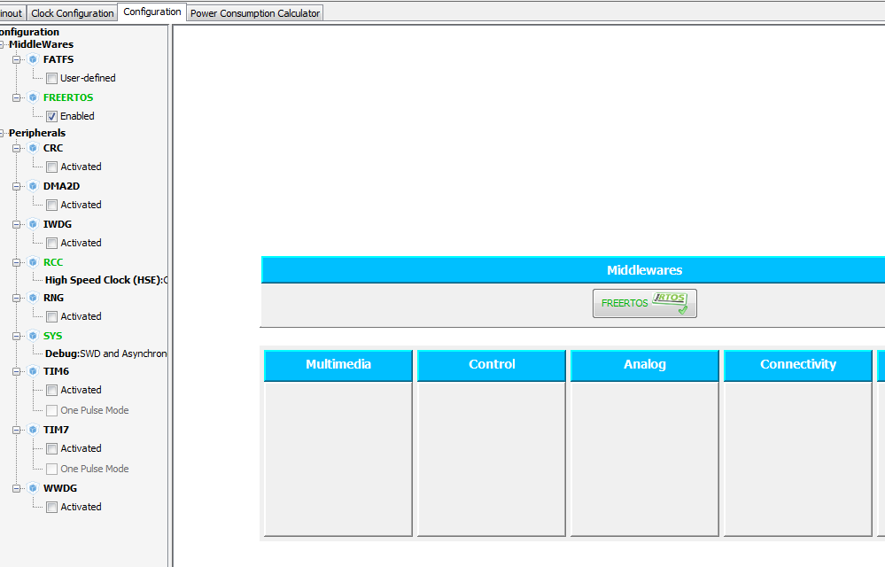
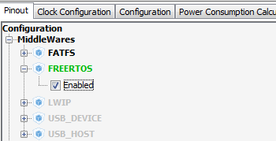
FreeRTOS in CubeMX
Use CubeMX project from printf example
In Pinout TAB select in MiddleWares FreeRTOS
In Configuration TAB is now possible to configure FreeRTOS Parameters

Slide 39
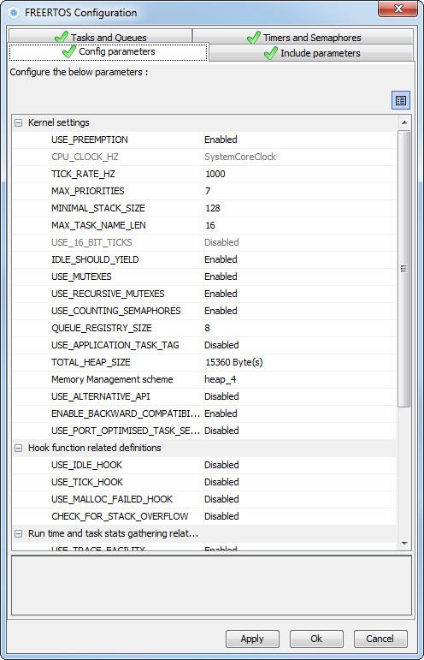
CubeMX FreeRTOS Configuration
FreeRTOS configuration supported by CubeMX
Config parameters
Set kernel
Mem setup
Include parameters
Include some additional functions, not necessary for FreeRTOS run
Tasks and Queues
We can easily create task or queue by CubeMX
Timers and semaphores
CubeMX create semaphore and timer for us

Slide 40
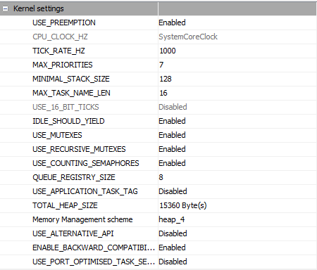
Kernel settings
Use preemption
If enabled use pre-emptive scheduling
If disabled use co-operative scheduling
Priority level
Create Task2
Task2 suspend
High priority
Task2
Low priority
Task1
Task1
time
Priority level
Create Task2
Task1 suspend
High priority
Task2
Low priority
Task1
time

Slide 41
FreeRTOS Memory allocations types

Slide 42
FreeRTOS Dynamic memory management
FreeRTOS have own heap which is use for components
Tasks
Queues
Semaphores
Mutexes
Dynamic memory allocation
Is possible to select type of memory allocation
Total heap size for FreeRTOS
How is memory allocated and dealocated

Slide 43
FreeRTOS Dynamic memory management
Heap_1.c
Simplest allocation method (deterministic), but does not allow freeing of allocated memory => could be interesting when no memory freeing is necessary
Heap
Heap
Is not possible to return memory to heap
pvPortMalloc
Allocated block 1
vPortFree
pvPortMalloc
Allocated block 2
vPortFree
pvPortMalloc
Allocated block 3
vPortFree

Slide 44
FreeRTOS Dynamic memory management
Heap_2.c
Implements a best fit algorithm for allocation
Allows memory free operation but does not combine adjacent free blocks => risk of fragmentation
Heap
Heap
Heap 1
Heap 1
Free blocks are not combined together
pvPortMalloc
Allocated block 1
Allocated block 1
vPortFree
Heap 4
pvPortMalloc
Allocated block 2
vPortFree
Heap 2
Heap 2
pvPortMalloc
Allocated block 3
vPortFree
Heap 3
Heap 3

Slide 45
FreeRTOS Dynamic memory management
Heap_3.c
Implements a simple wrapper for the standard C library malloc() and free(), the wrapper makes these functions thread safe, but makes code increase and not deterministic
Heap
Heap
Heap 1
Heap 1
Use C functions for allocation (linker must be modified)
malloc
Allocated block 1
Allocated block 1
free
Heap 4
malloc
Allocated block 2
free
Heap 2
Heap 2
malloc
Allocated block 3
free
Heap 3
Heap 3

Slide 46
FreeRTOS Dynamic memory management
Heap_4.c
First fit algorithm and able to combine adjacent free memory blocks into a single block => this model is used in STM32Cube examples
Heap
Heap
Heap 1
Heap
combine together free memory
pvPortMalloc
Allocated block 1
vPortFree
Allocated block 1
vPortFree
pvPortMalloc
Allocated block 2
vPortFree
Heap 2
pvPortMalloc
Allocated block 3
vPortFree

Slide 47
Memory allocation
Use heap_4.c
Memory Handler definition
Memory allocation
/* Private variables ---------------------------------------------------------*/
osThreadId Task1Handle;
osPoolId PoolHandle;
void StartTask1(void const * argument)
{
/* USER CODE BEGIN 5 */
osPoolDef(Memory,0x100,uint8_t);
PoolHandle = osPoolCreate(osPool(Memory));
uint8_t* buffer=osPoolAlloc(PoolHandle);
/* Infinite loop */
for(;;)
{
osDelay(5000);
}
/* USER CODE END 5 */
}
Create memory pool
Allocate memory from pool

Slide 48

FreeRTOS Tasks

Slide 49
FreeRTOS Task states
Ready
Tasks are ready to execute but are not currently executing because a different task with equal or higher priority is running
Running
when task is actually running
Blocked
Task is waiting for a either a temporal or external event
Suspended
Task not available for scheduling
Suspend
osThreadSuspend
osThreadSuspend
osThreadResume
osThreadCreate
Ready
Runing
Scheduler
osThreadSuspend
Event
Blocked API function
Blocked

Slide 50
FreeRTOS Task switch
Task switching on STM32?
Cortex cores have implemented few features which directly support os systems
Two interrupts dedicated for os
PendSV interrupt
SVC interrupt
Two stack pointers
Process stack pointer
Main stack pointer
SysTick timer
Used to periodically trigger scheduling

Slide 51
FreeRTOS OS interrupts
PendSV interrupt
In this interrupt is the scheduler
Lowest NVIC interrupt priority
Not triggered by any periphery
Pending state set from other interrupts
Or from task which want end earlier (non MPU version)
SVC interrupt
Interrupt risen by SVC instruction
Called if task want end earlier (MPU version)
In this interrupt set pending state PendSV (MPU version)
SysTick timer
Set PendSV is context switch is necessary
Priority level
High priority
osDelay
Other IRQs
SVC
PendSV
SysTick
Low priority
Task1
Task2
Task1
Task2
time

Slide 52
FreeRTOS Stack pointer
Main stack pointer
Used in interrupts
Allocated by linker during compiling
Process stack pointer
Each task have own stack pointer
During context switch the stack pointer is initialized for correct task
PendSV interrupt
Task 1
Task 2
PSP stack pointer
MSP stack pointer
PSP stack pointer
Stack – Task 1
Stack – Task 1
Stack – Task 2
Stack – Task 2
Data
Data
Data
Data
Non scratch registers
Non scratch registers

Slide 53
Tasks API
Create task
Delete task
Get task ID
Task handle definition:
Create Task
osThreadId osThreadCreate (const osThreadDef_t *thread_def, void *argument)
osStatus osThreadTerminate (osThreadId thread_id)
osThreadId osThreadGetId (void)
/* Private variables ---------------------------------------------------------*/
osThreadId Task1Handle;
/* Create the thread(s) */
/* definition and creation of Task1 */
osThreadDef(Task1, StartTask1, osPriorityNormal, 0, 128);
Task1Handle = osThreadCreate(osThread(Task1), NULL);

Slide 54
Tasks API
Check if task is suspended
Resume task
Check state of task
Suspend task
Resume all tasks
Suspend all tasks
osStatus osThreadIsSuspended(osThreadId thread_id)
osStatus osThreadResume (osThreadId thread_id)
osThreadState osThreadGetState(osThreadId thread_id)
osStatus osThreadSuspend (osThreadId thread_id)
osStatus osThreadResumeAll (void)
osStatus osThreadSuspendAll (void)

Slide 55
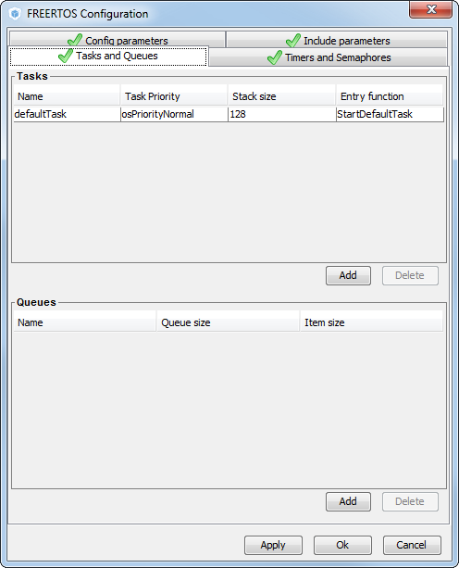
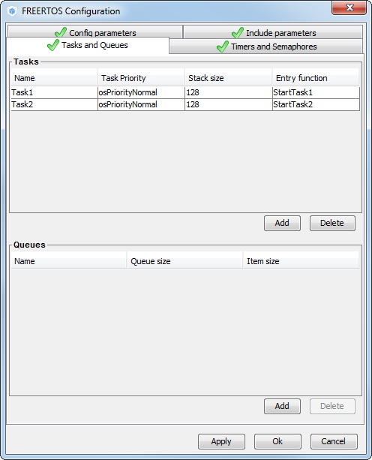
Tasks lab
By default defined one defaultTask
Task is defined by
Name
Priority
Stack size
Name of entry function
Define two tasks
Task1
Task2
With same priority

Slide 56
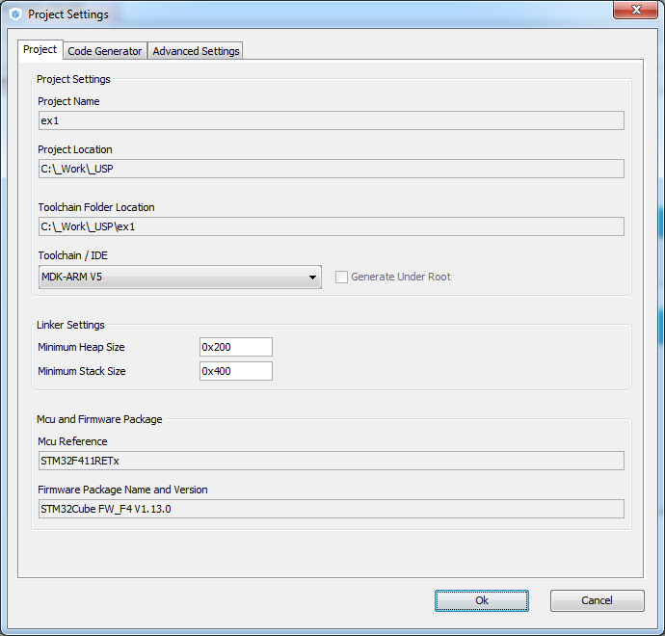
Tasks lab
Now we set the project details for generation
Menu > Project > Project Settings
Set the project name
Project location
Type of toolchain
Now we can Generate Code
Menu > Project > Generate Code

Slide 57
Tasks lab
Any component in FreeRTOS need to have handle, very similar to CubeMX
Task function prototypes, names was taken from CubeMX
Before the scheduler is start we must create tasks
/* Private variables ---------------------------------------------------------*/
osThreadId Task1Handle;
osThreadId Task2Handle;
/* Private function prototypes -----------------------------------------------*/
void SystemClock_Config(void);
static void MX_GPIO_Init(void);
void StartTask1(void const * argument);
void StartTask2(void const * argument);
Define task parameters
/* Create the thread(s) */
/* definition and creation of Task1 */
osThreadDef(Task1, StartTask1, osPriorityNormal, 0, 128);
Task1Handle = osThreadCreate(osThread(Task1), NULL);
/* definition and creation of Task2 */
osThreadDef(Task2, StartTask2, osPriorityNormal, 0, 128);
Task2Handle = osThreadCreate(osThread(Task2), NULL);
Create task, allocate memory

Slide 58
Tasks lab
Start the scheduler, the scheduler function newer ends
On first task run StartTask1 is called
Task must have inside infinity loop in case we don’t want to end the task
/* Start scheduler */
osKernelStart();
/* We should never get here as control is now taken by the scheduler */
void StartTask1(void const * argument)
{
/* USER CODE BEGIN 5 */
/* Infinite loop */
for(;;)
{
printf("Task 1\n");
osDelay(1000);
}
/* USER CODE END 5 */
}
Endless loop
osDealy will start context switch

Slide 59
Tasks lab
Second loop is same as previous
Compile and run project in debug and watch terminal window
/* StartTask2 function */
void StartTask2(void const * argument)
{
/* USER CODE BEGIN StartTask2 */
/* Infinite loop */
for(;;)
{
printf("Task 2\n");
osDelay(1000);
}
/* USER CODE END StartTask2 */
}

Slide 60
Tasks lab
If both Delays (osDelay) are processed the FreeRTOS is in idle state
Priority level
osDelay
osDelay
Delay ends
osDelay
osDelay
High priority
Low priority
Task1
Task2
Idle
Task1
Task1
Task2
time
Runing
Task1
Runing
Runing
Runing
Task1
Runing
Runing
Task2
Task2
Task1
Ready
Ready
Ready
Ready
Ready
Ready
Task2
Task2
Blocked
Blocked
Task1
Blocked
Task1
Blocked
Blocked
Blocked
Task2
Task2
Task1
Suspend
Suspend
Suspend
Suspend
Suspend
Suspend

Slide 61
Tasks lab
Without Delays the threads will be in running state or in Ready state
Use HAL_Delay
Priority level
SysTick
SysTick
SysTick
SysTick
SysTick
High priority
Low priority
Task1
Task2
Task1
Task2
Task1
time
Runing
Task1
Runing
Runing
Task1
Runing
Runing
Runing
Task2
Task2
Task1
Task1
Ready
Ready
Task1
Ready
Ready
Task1
Ready
Ready
Task2
Task2
Task2
Task2
Blocked
Blocked
Blocked
Blocked
Blocked
Blocked
Suspend
Suspend
Suspend
Suspend
Suspend
Suspend

Slide 62
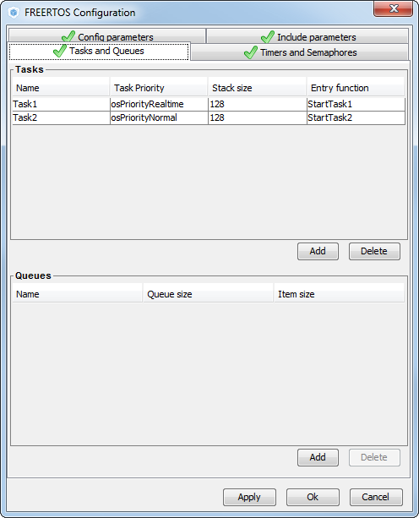
Tasks lab
Set one task Higher priority
Double click on task for change
Button OK

Slide 63
Tasks lab
After we send text for 5x times, put task to block state
Because task have high priority it allow to run lower priority task
/* USER CODE END 4 */
void StartTask1(void const * argument)
{
/* USER CODE BEGIN 5 */
uint32_t i = 0;
/* Infinite loop */
for(;;)
{
for (i = 0; i < 5; i++){
printf("Task 1\n");
HAL_Delay(50);
}
osDelay(1000);
}
/* USER CODE END 5 */
}
Helps not spam terminal
Block task

Slide 64
Tasks lab
If higher priority task is not running we can print text from this task
/* StartTask2 function */
void StartTask2(void const * argument)
{
/* USER CODE BEGIN StartTask2 */
/* Infinite loop */
for(;;)
{
printf("Task 2\n");
HAL_Delay(50);
}
/* USER CODE END StartTask2 */
}
Helps not spam terminal

Slide 65
Tasks lab
What happen when Task1 call osDelay?
Priority level
osDelay
Delay end
osDelay
Delay end
osDelay
High priority
Task1
Task1
Task1
Low priority
Task2
Task2
time
Runing
Task1
Runing
Runing
Task1
Runing
Runing
Runing
Task2
Task2
Task1
Task1
Ready
Ready
Ready
Ready
Ready
Ready
Task2
Task2
Task2
Task2
Blocked
Blocked
Task1
Blocked
Blocked
Task1
Blocked
Blocked
Suspend
Suspend
Suspend
Suspend
Suspend
Suspend

Slide 66
Tasks lab
What happen if Task1 does not call osDelay? Replace osDelay for HAL_Delay
Priority level
HAL_Delay
HAL_Delay end
HAL_Delay
HAL_Delay end
HAL_Delay
High priority
Task1
Task1
Task1
Task1
Task1
Low priority
Task2
Task2
Task2
Task2
time
Runing
Task1
Runing
Task1
Runing
Task1
Runing
Task1
Runing
Task1
Runing
Task1
Ready
Ready
Ready
Ready
Ready
Ready
Task2
Task2
Task2
Task2
Task2
Task2
Blocked
Blocked
Blocked
Blocked
Blocked
Blocked
Suspend
Suspend
Suspend
Suspend
Suspend
Suspend

Slide 67
osDelay API
Delay function
Delay function which measure time from which is delay measured
osStatus osDelay (uint32_t millisec)
osStatus osDelayUntil (uint32_t PreviousWakeTime, uint32_t millisec)

Slide 68
osDelay function
osDelay start measure time from osDelay call
Task 1 - Pri 1
Task 2 - Pri 2
Task 2
Pri 2
Task 1
Pri 1
Task 2
Pri 2
vTaskDelay
PendSV
vTaskDelay
PendSV(idle)
Task 2
Delay end
Delay time

Slide 69
osDelayUntil
osDelayUntil measure time from point which we selected
This allow us to call task in regular intervals
Task 1 - Pri 1
Task 2 - Pri 2
Task 2
Pri 2
Task 1
Pri 1
Task 2
Pri 2
vTaskDelayUntil
PendSV
vTaskDelay
PendSV(idle)
Task 2
Delay end
DelayUntil time

Slide 70
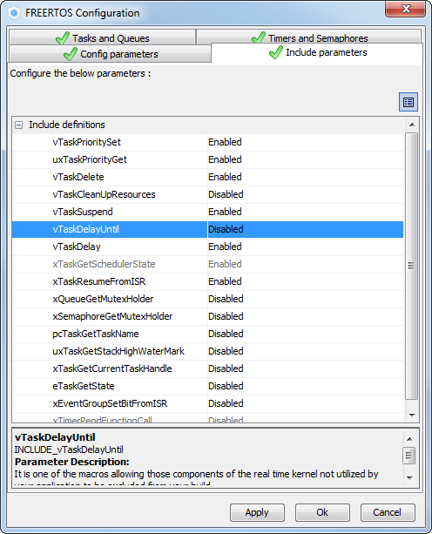
osDelay and osDelayUntil
Enable vTaskDelayUntil in Include parameters
Regenerate project, modify tasks to:
void StartTask1(void const * argument)
{
/* USER CODE BEGIN 5 */
uint32_t i = 0;
/* Infinite loop */
for(;;)
{
printf("Task 1\n");
HAL_Delay(1000);
osDelay(2000);
}
/* USER CODE END 5 */
}
Delay between two run is 2s
/* StartTask2 function */
void StartTask2(void const * argument)
{
/* USER CODE BEGIN StartTask2 */
/* Infinite loop */
for(;;)
{
printf("Task 2\n");
HAL_Delay(200);
}
/* USER CODE END StartTask2 */
}

Slide 71
osDelay and osDelayUntil
Enable vTaskDelayUntil in Include parameters
Regenerate project, modify tasks to:
void StartTask1(void const * argument)
{
/* USER CODE BEGIN 5 */
uint32_t wakeuptime;
/* Infinite loop */
for(;;)
{
wakeuptime=osKernelSysTick();
printf("Task 1\n");
HAL_Delay(1000);
osDelayUntil(wakeuptime,2000);
}
/* USER CODE END 5 */
}
For osDelayUntil function we need mark wakeup time
Function will be executed every 2s
Time from which is delay measured
Real delay time

Slide 72
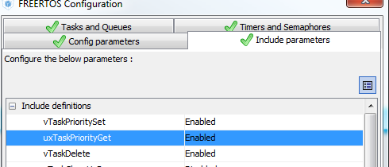
Priority change lab
Task1 have higher priority than Task2
If not enable vTaskPriorityGet and uxTaskPrioritySet in IncludeParameters

Slide 73
Priority change lab
Modify Task1 to:
void StartTask1(void const * argument)
{
/* USER CODE BEGIN 5 */
osPriority priority;
/* Infinite loop */
for(;;)
{
priority=osThreadGetPriority(Task2Handle);
printf("Task 1\n");
osThreadSetPriority(Task2Handle,priority+1);
HAL_Delay(1000);
}
/* USER CODE END 5 */
}
Reads Task2 priority
Increase Task2 priority

Slide 74
Priority change lab
Modify Task2 to:
/* StartTask2 function */
void StartTask2(void const * argument)
{
/* USER CODE BEGIN StartTask2 */
osPriority priority;
/* Infinite loop */
for(;;)
{
priority=osThreadGetPriority(NULL);
printf("Task 2\n");
osThreadSetPriority(NULL,priority-2);
}
/* USER CODE END StartTask2 */
}
Read priority of current task
Decrease task priority

Slide 75
Priority change lab
How priorities are changed?
Task 1 - Pri 6
Task 2 - Pri 4
Task 1
Pri 6
PendSV
Task 1
Pri 6
Task 2
Pri 6
Task 1
Pri 6
vTaskPrioritySet
Task 2 Pri +1
vTaskPrioritySet
Task 2 Pri +1
PendSV
vTaskPrioritySet
Task 2 Pri -2
PendSV
Task 2 - Pri 5
Task 2 - Pri 6
Task 2 - Pri 4

Slide 76
Creating and deleting tasks lab
Example how to create and delete tasks
Comment Task2 creation part in main.c
Modify Task1 to create task2
/* definition and creation of Task2 */
// osThreadDef(Task2, StartTask2, osPriorityNormal, 0, 128);
// Task2Handle = osThreadCreate(osThread(Task2), NULL);
void StartTask1(void const * argument)
{
/* USER CODE BEGIN 5 */
/* Infinite loop */
for(;;)
{
printf("Create task2\n");
osThreadDef(Task2, StartTask2, osPriorityNormal, 0, 128);
Task2Handle = osThreadCreate(osThread(Task2), NULL);
osDelay(1000);
}
/* USER CODE END 5 */
}
Task 2 creation

Slide 77
Creating and deleting tasks lab
Example how to create and delete tasks
Modift Task2 to delete him-self:
/* StartTask2 function */
void StartTask2(void const * argument)
{
/* USER CODE BEGIN StartTask2 */
/* Infinite loop */
for(;;)
{
printf("Delete Task2\n");
osThreadTerminate(Task2Handle);
}
/* USER CODE END StartTask2 */
}
Delete Task

Slide 78
Creating and deleting tasks lab
Example how to create and delete tasks
Task 1 - Pri 1
Task 1
Pri 1
Task 1
Pri 1
Task 1
Pri 1
xTaskCreate
PendSV
Task 2
Pri 2
vTaskDelay
PendSV(idle)
vTaskDelete
PendSV
Task 1
Delay end

Slide 79

FreeRTOS Queues

Slide 80
Queue
Sender Task
Receiver Task
Message 1
osMessagePut
Sender Task
Receiver Task
Message 2
Message 1
osMessagePut
Sender Task
Receiver Task
Message 2
Message 1
osMessageGet
Sender Task
Receiver Task
Message 2
osMessageGet
Sender Task
Receiver Task

Slide 81
Queue
Create Queue:
Put data into Queue
Receive data from Queue
osMessageQId osMessageCreate (const osMessageQDef_t *queue_def, osThreadId thread_id)
Queue Handle
Create Queue
osStatus osMessagePut (osMessageQId queue_id, uint32_t info, uint32_t millisec)
Queue Handle
Item to send
Send timeout
osEvent osMessageGet (osMessageQId queue_id, uint32_t millisec)
Structure with status and with received item
Queue handle
Receiving timeout

Slide 82
Queue
osEvent structure
If we want to get data from osEvent we must use:
osEventName.v if the value is 32bit message(or 8/16bit)
osEventName.p and retype on selected datatype
typedef struct {
osStatus status; ///< status code: event or error information
union {
uint32_t v; ///< message as 32-bit value
void *p; ///< message or mail as void pointer
int32_t signals; ///< signal flags
} value; ///< event value
union {
osMailQId mail_id; ///< mail id obtained by \ref osMailCreate
osMessageQId message_id; ///< message id obtained by \ref osMessageCreate
} def; ///< event definition
} osEvent;

Slide 83
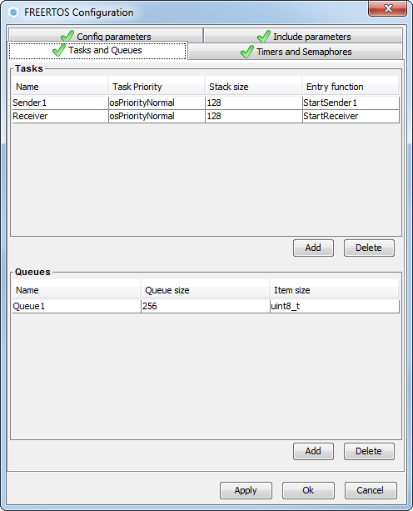
Queue lab
Set both tasks to normal priority
Queue part
Button Add
Set queue size to 256
Queue type to uint8_t
Button OK

Slide 84
Queue lab
Queue handler is now defined
Queue item type initialization, length definition and create of queue and memory allocation
/* Private variables ---------------------------------------------------------*/
osThreadId Sender1Handle;
osThreadId ReceiverHandle;
osMessageQId Queue1Handle;
Queue item definition
/* Create the queue(s) */
/* definition and creation of Queue1 */
osMessageQDef(Queue1, 256, uint8_t);
Queue1Handle = osMessageCreate(osMessageQ(Queue1), NULL);
Queue size

Slide 85
Queue lab
Sender1 task
void StartSender1(void const * argument)
{
/* USER CODE BEGIN 5 */
/* Infinite loop */
for(;;)
{
printf("Task1\n");
osMessagePut(Queue1Handle,0x1,200);
printf("Task1 delay\n");
osDelay(1000);
}
/* USER CODE END 5 */
}
Put value ‘1’ into queue
Item to send
Timeout for send
Queue handle

Slide 86
Queue lab
Receiver task
/* StartReceiver function */
void StartReceiver(void const * argument)
{
/* USER CODE BEGIN StartReceiver */
osEvent retvalue;
/* Infinite loop */
for(;;)
{
printf("Task2\n");
retvalue=osMessageGet(Queue1Handle,4000);
printf("%d \n",retvalue.value.p);
}
/* USER CODE END StartReceiver */
}
Get item from queue
How long we wait on data in queue
It will Block task
Queue handle

Slide 87
Queue Blocking
Sender Task
Receiver Task
Receiver Task
Blocked
osMessageGet
Sender Task
Receiver Task
Blocked
Message 1
osMessagePut
osMessageGet
Sender Task
Receiver Task
Blocked
Receiver Task
Message 1
osMessageGet
Sender Task
Receiver Task

Slide 88
Queue Blocking
After calling osMessageGet
If any data are not in queue the task is blocked for settable time
If the data is in queue the task will continue
Sender1- Pri 1
Receiver- Pri 1
Receiver Pri 1
Sender1 Pri 1
Receiver Pri 1
Sender1 Pri 1
xQueueReceive
PendSV
xQueueSend
PendSV
xQueueReceive
PendSV

Slide 89
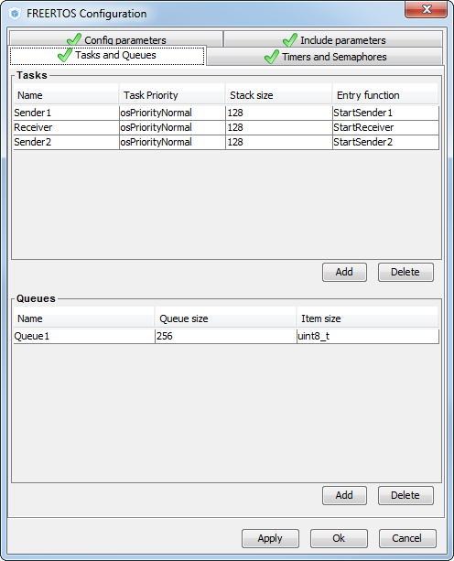
Two senders lab
Two sending tasks
One receivers tasks
Same priorities

Slide 90
Two senders lab
Two sending tasks
They are same no change necessary
void StartSender1(void const * argument)
{
/* USER CODE BEGIN 5 */
/* Infinite loop */
for(;;)
{
printf("Task1\n");
osMessagePut(Queue1Handle,0x1,200);
printf("Task1 delay\n");
osDelay(2000);
}
/* USER CODE END 5 */
}
void StartSender2(void const * argument)
{
/* USER CODE BEGIN StartSender2 */
/* Infinite loop */
for(;;)
{
printf("Task2\n");
osMessagePut(Queue1Handle,0x2,200);
printf("Task2 delay\n");
osDelay(2000);
}
/* USER CODE END StartSender2 */
}

Slide 91
Two senders lab
Simple receiver
/* StartReceiver function */
void StartReceiver(void const * argument)
{
/* USER CODE BEGIN StartReceiver */
osEvent retvalue;
/* Infinite loop */
for(;;)
{
retvalue=osMessageGet(Queue1Handle,4000);
printf("Receiver\n");
printf("%d \n",retvalue.value.p);
}
/* USER CODE END StartReceiver */
}

Slide 92
Two senders lab
What we can see in debug now?
Because tasks have same priority, receiver will get data from queue after both task put data into queue
What would happen if there were more tasks?
Sender1- Pri 1
Receiver Pri 1
Sender1 Pri 1
Sender2 Pri 1
Sender2- Pri 1
Receiver- Pri 1
xQueueReceive
PendSV
xQueueSend
PendSV
xQueueSend
Receiver Pri 1
Sender1 Pri 1
PendSV
xQueueReceive
PendSV

Slide 93
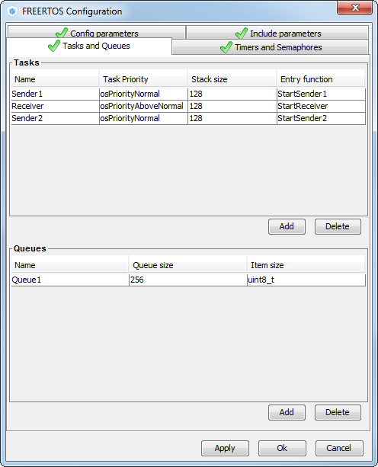
Receiver with higher priority lab
Senders have same priority
Receiver have higher priority than senders

Slide 94
Receiver with higher priority lab
Receiver is now unblocked every time when sender tasks put data into queue
Sender1- Pri 1
Sender2- Pri 1
Receiver- Pri 2
Receiver Pri 2
Sender1 Pri 1
Receiver Pri 2
Sender2 Pri 1
xQueueReceive
PendSV
xQueueSend
PendSV
xQueueReceive
PendSV
Sender1 Pri 1
Receiver Pri 2
xQueueSend
PendSV
xQueueReceive

Slide 95
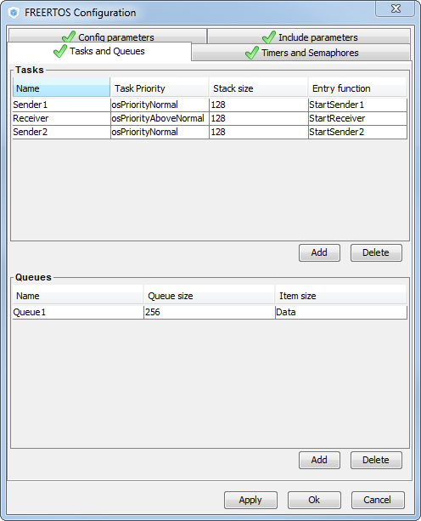
Queue items lab
Queues allow to define type (different variables or structures) which the queue use.
Regenerate project

Slide 96

Queue items lab
Item size will be structure called Data

Slide 97
Queue items lab
Create new structure type for data
Define Structures which will be sent from sender task
/* Define the structure type that will be passed on the queue. */
typedef struct
{
uint8_t Value;
uint8_t Source;
} Data;
/* Declare two variables of type Data that will be passed on the queue. */
Data DataToSend1={10,1};
Data DataToSend2={20,2};

Slide 98
Queue items lab
Sent data from Sender1 task
void StartSender1(void const * argument)
{
/* USER CODE BEGIN 5 */
/* Infinite loop */
for(;;)
{
printf("Task1\n");
osMessagePut(Queue1Handle,(uint32_t)&DataToSend1,200);
printf("Task1 delay\n");
osDelay(2000);
}
/* USER CODE END 5 */
}
Put data into queue

Slide 99
Queue items lab
Sent data from Sender2 task
void StartSender2(void const * argument)
{
/* USER CODE BEGIN 5 */
/* Infinite loop */
for(;;)
{
printf("Task2\n");
osMessagePut(Queue1Handle,(uint32_t)&DataToSend2,200);
printf("Task2 delay\n");
osDelay(2000);
}
/* USER CODE END 5 */
}
Put data into queue

Slide 100
Queue items lab
Receiver data from sender task
/* StartReceiver function */
void StartReceiver(void const * argument)
{
/* USER CODE BEGIN StartReceiver */
osEvent retvalue;
/* Infinite loop */
for(;;)
{
retvalue=osMessageGet(Queue1Handle,4000);
if(((Data*)retvalue.value.p)->Source==1){
printf("Receiver Receive message from Sender 1\n");
}else{
printf("Receiver Receive message from Sender 2\n");
}
printf("Data: %d \n",((Data*)retvalue.value.p)->Value);
}
/* USER CODE END StartReceiver */
}
Get data from queue
Decode data from osEvent structure

Slide 101

FreeRTOS Semaphores

Slide 102

Semaphores
Used for synchronization between
Tasks
Interrupt and task
Two types
Binary semaphores
Counting semaphores
Binary semaphore
Have only one ‘token’
Using to synchronize one action
Counting semaphore
Have multiple ‘tokens’
Synchronize multiple actions

Slide 103
Binary Semaphore
Task1
Task2
Task2
Blocked
osSemaphoreWait
Task1
Task2
Blocked
osSemaphoreRelease
osSemaphoreWait
Task1
Task2
Blocked
Task2
osSemaphoreWait
Task1
Task2
osSemaphoreRelease
Task1
Task2
osSemaphoreWait

Slide 104
Binary Semaphore
Semaphore creation
Wait for Semaphore release
Semaphore release
osSemaphoreId osSemaphoreCreate (const osSemaphoreDef_t *semaphore_def, int32_t count)
Semaphore handle
Semaphore definition
Semaphore ‘tokens’ For binary semaphore is 1
int32_t osSemaphoreWait (osSemaphoreId semaphore_id, uint32_t millisec)
Number of ‘tokens in semaphore’
Semaphore handle
How long wait for semaphore release
osStatus osSemaphoreRelease (osSemaphoreId semaphore_id)
Return status
Semaphore handle

Slide 105

Binary Semaphore lab
Create two tasks
With same priority
Button Add
Set parameters
Button OK

Slide 106
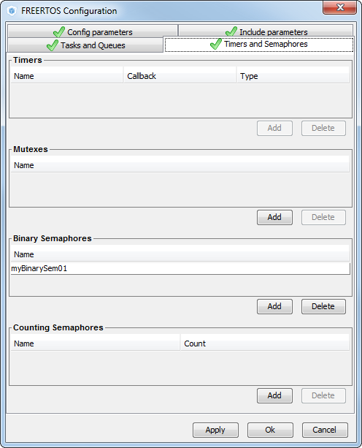
Binary Semaphore lab
Create binary binary semaphore
Button Add
Set name
Button OK

Slide 107
Binary Semaphore lab
Semaphore handle definition
Semaphore creation
/* Private variables ---------------------------------------------------------*/
osThreadId Task1Handle;
osThreadId Task2Handle;
osSemaphoreId myBinarySem01Handle;
/* Create the semaphores(s) */
/* definition and creation of myBinarySem01 */
osSemaphoreDef(myBinarySem01);
myBinarySem01Handle = osSemaphoreCreate(osSemaphore(myBinarySem01), 1);

Slide 108
Binary Semaphore lab
Semaphore use
If tasks/interrupt is done the semaphore is released
void StartTask1(void const * argument)
{
/* USER CODE BEGIN 5 */
/* Infinite loop */
for(;;)
{
osDelay(2000);
printf("Task1 Release semaphore\n");
osSemaphoreRelease(myBinarySem01Handle);
}
/* USER CODE END 5 */
}

Slide 109
Binary Semaphore lab
Semaphore Wait
Second task waits on semaphore release After releasetask is unbocked and continue in work
void StartTask2(void const * argument)
{
/* USER CODE BEGIN StartTask2 */
/* Infinite loop */
for(;;)
{
osSemaphoreWait(myBinarySem01Handle,4000);
printf("Task2 synchronized\n");
}
/* USER CODE END StartTask2 */
}

Slide 110
Binary Semaphore lab
Task1 is synchronized with Task2
Task1 - Pri 1
Task2 - Pri 1
Task1 Pri 1
Task2 Pri 1
Task1 Pri 1
Task2 Pri 1
osSemaphore Wait
PendSV
osSemaphore Release
PendSV
osSemaphore Wait
PendSV

Slide 111
Counting semaphore
Os API same as Binary semaphore
Semaphore creation
Wait for Semaphore release
Semaphore release
osSemaphoreId osSemaphoreCreate (const osSemaphoreDef_t *semaphore_def, int32_t count)
int32_t osSemaphoreWait (osSemaphoreId semaphore_id, uint32_t millisec)
osStatus osSemaphoreRelease (osSemaphoreId semaphore_id)

Slide 112
Counting Semaphore
Task1
Task2
Task3
osSemaphoreRelease
Task1
Task2
Task3
osSemaphoreRelease
Task1
Task2
Task2
Blocked
Task3
osSemaphoreWait
Task1
Task2
Task2
Blocked
Task3
osSemaphoreWait
Task1
Task2
Task3
Blocked
Task3
Task3
osSemaphoreWait

Slide 113
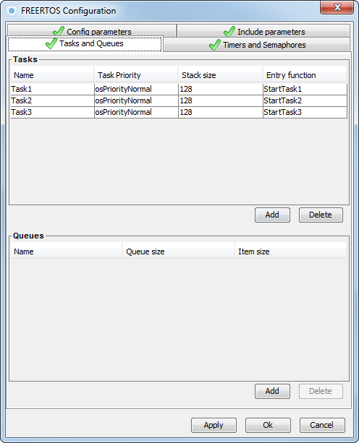
Counting Semaphore lab
Create three tasks
With same priority
Button Add
Set parameters
Button OK

Slide 114
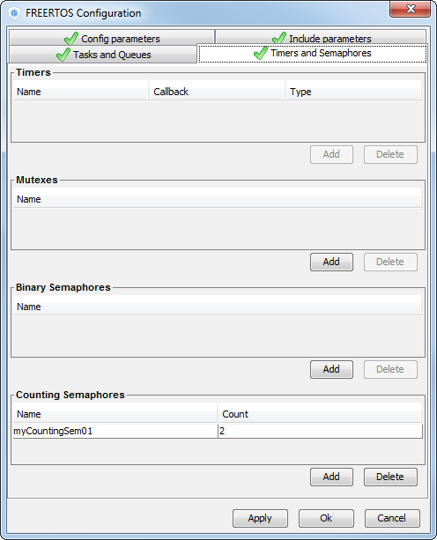
Counting Semaphore lab
Create Counting semaphore
Set count of tokens
Button Add
Set name
Button OK

Slide 115
Counting Semaphore lab
Create Counting semaphore
Task1 and Task2 will be same
/* Create the semaphores(s) */
/* definition and creation of myCountingSem01 */
osSemaphoreDef(myCountingSem01);
myCountingSem01Handle = osSemaphoreCreate(osSemaphore(myCountingSem01), 2);
void StartTask1(void const * argument)
{
/* USER CODE BEGIN 5 */
/* Infinite loop */
for(;;)
{
osDelay(2000);
printf("Task1 Release counting semaphore\n");
osSemaphoreRelease(myCountingSem01Handle);
}
/* USER CODE END 5 */
}
void StartTask2(void const * argument)
{
/* USER CODE BEGIN StartTask2 */
/* Infinite loop */
for(;;)
{
osDelay(2000);
printf("Task2 Release counting semaphore\n");
osSemaphoreRelease(myCountingSem01Handle);
}
/* USER CODE END StartTask2 */
}

Slide 116
Counting Semaphore lab
Task3 will wait until semaphore will be 2 times released
void StartTask3(void const * argument)
{
/* USER CODE BEGIN StartTask3 */
/* Infinite loop */
for(;;)
{
osSemaphoreWait(myCountingSem01Handle, 4000);
osSemaphoreWait(myCountingSem01Handle, 4000);
printf("Task3 synchronized\n");
}
/* USER CODE END StartTask3 */
}

Slide 117
Counting Semaphore lab
Task1 and Task2 release semaphore
Task 3 wait for two tokens
Task1- Pri 1
Task2- Pri 1
Task3- Pri 1
Task3
Pri 1
Task1
Pri 1
Task2 Pri 1
Task3 Pri 1
osSemaphore Wait
PendSV
osSemaphore Release
PendSV
osSemaphore Release
PendSV
Task3
Pri 1
Task1
Pri 1
osSemaphore Wait
osSemaphore Wait
PendSV
osSemaphore Release

Slide 118
FreeRTOS Mutex

Slide 119
Mutex
Used to guard access to limited resource
Work very similar as Semaphores
Task1
Task1
Resourse
Resource
Resourse
osMutexWait
Resource
Task2
Task2
Blocked
Task2 Blocked
Task2
osMutexWait
osMutexWait
Task1
Task1
Resourse
Resourse
osMutexRelease
Resource
Resource
Task2 Blocked
Task2
osMutexWait
osMutexRelease

Slide 120
Mutex
Mutex creation
Wait for Mutex release
Mutex release
osMutexId osMutexCreate (const osMutexDef_t *mutex_def)
Mutex handle
Mutex definition
osStatus osMutexWait (osMutexId mutex_id, uint32_t millisec)
Return status
Mutex handle
How long wait for mutex release
osStatus osMutexRelease (osMutexId mutex_id)
Return status
Mutex handle

Slide 121
Mutex lab
Create two tasks
With same priority
Button Add
Set parameters
Button OK

Slide 122
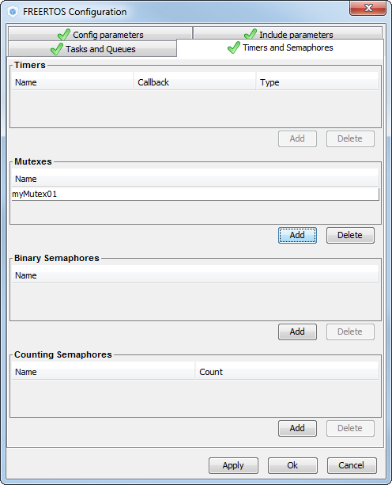
Mutex lab
Create Mutex
Button Add
Set name
Button OK

Slide 123
Mutex lab
Both tasks using printf function.
Mutex is used to avoid collisions
Task1- Pri 1
Task2- Pri 1
Task1
Pri 1
Task2
Pri 1
osMutexWait
Print
osMutexRelease
osDelay
PendSV
osMutexWait
Print
Only one task can have semaphore

Slide 124
Mutex lab
Mutex handle definition
Mutex creation
/* Private variables ---------------------------------------------------------*/
osThreadId Task1Handle;
osThreadId Task2Handle;
osMutexId myMutex01Handle;
/* Create the mutex(es) */
/* definition and creation of myMutex01 */
osMutexDef(myMutex01);
myMutex01Handle = osMutexCreate(osMutex(myMutex01));

Slide 125
Mutex lab
Task1 and Task2 using of Mutex
void StartTask1(void const * argument)
{
/* USER CODE BEGIN 5 */
/* Infinite loop */
for(;;)
{
osDelay(2000);
osMutexWait(myMutex01Handle,1000);
printf("Task1 Print\n");
osMutexRelease(myMutex01Handle);
}
/* USER CODE END 5 */
}
void StartTask2(void const * argument)
{
/* USER CODE BEGIN StartTask2 */
/* Infinite loop */
for(;;)
{
osDelay(2000);
osMutexWait(myMutex01Handle,1000);
printf("Task2 Print\n");
osMutexRelease(myMutex01Handle);
}
/* USER CODE END StartTask2 */
}

Slide 126
FreeRTOS Software Timers

Slide 127
Software Timers
Software timer is one of component in RTOS
Can extend number of Timers in STM32
Are not precise but can handle periodic actions or delay actions
Two modes
Periodic
One Pulse
Task1
Software Timer Callback
Software Timer Callback
osTimerStart
Software timer counting
Software timer counting
Software timer counting
Task1
Software Timer Callback
osTimerStart
Software timer counting

Slide 128
Software Timers
Software timer creation
Software timer start
Software timer stop
osTimerId osTimerCreate (const osTimerDef_t *timer_def, os_timer_type type, void *argument)
Timer handle
Timer definition
Repeat timing or onetime timing
osStatus osTimerStart (osTimerId timer_id, uint32_t millisec)
Return status
Timer handle
Timer period
osStatus osTimerStop (osTimerId timer_id)
Return status
Timer handle

Slide 129
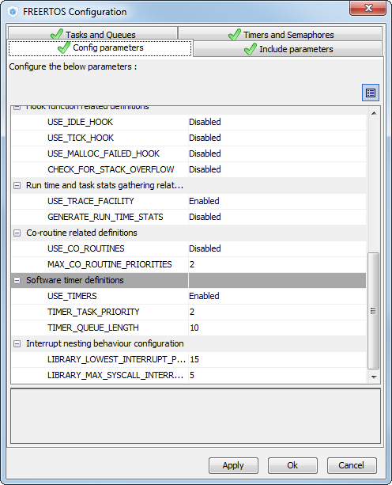
Software Timers lab
Software timers are by default disabled in CubeMX
FreeRTOS configuration
Configuration TAB
Enable Software timers

Slide 130
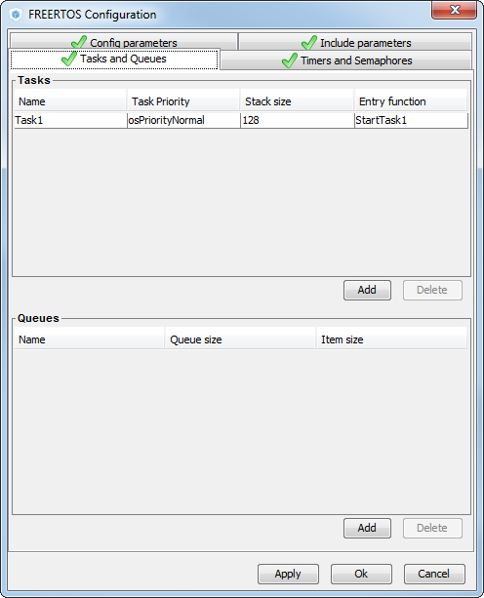
Software Timers lab
Create one task
Button Add
Set parameters
Set name
Button OK

Slide 131
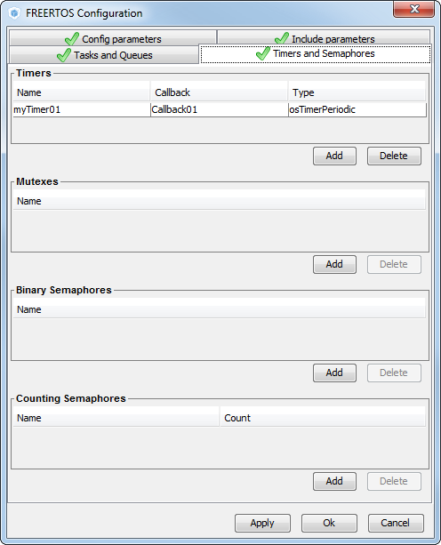
Software Timers lab
Create Timer
Button Add
Set timer name
Timer callback name
Button OK

Slide 132
Software Timers lab
Software timer handle definition
Software timer creation
Software timer start
/* Private variables ---------------------------------------------------------*/
osThreadId Task1Handle;
osTimerId myTimer01Handle;
/* Create the timer(s) */
/* definition and creation of myTimer01 */
osTimerDef(myTimer01, Callback01);
myTimer01Handle = osTimerCreate(osTimer(myTimer01), osTimerPeriodic, NULL);
void StartTask1(void const * argument)
{
/* USER CODE BEGIN 5 */
osTimerStart(myTimer01Handle,1000);
/* Infinite loop */
for(;;)
{
osDelay(2000);
printf("Task1 Print\n");
}
/* USER CODE END 5 */
}

Slide 133
Software Timers lab
Software timer callback
/* Callback01 function */
void Callback01(void const * argument)
{
/* USER CODE BEGIN Callback01 */
printf("Timer Print\n");
/* USER CODE END Callback01 */
}

Slide 134
Questions???
There are other features, as the advanced HOOK
In the web, there is an example of this feature applied
www.github.com/montanari9

Slide 135
End Thanks for your attention

