Slide 1
Travelling salesman problem
Montassar Chihi , Senior BA/IT
Tunis Business School
2021/2022

Slide 2

Problem
The salesman needs to make a tour, starting from Tunis, visiting all the governates, and going back to Tunis.
The problem is we don’t know what path they should follow in order to minimize the cost of this trip.

Slide 3
Problem
Assuming the cost of the trip is exponentially proportional to the distance covered, it is crucial to find the shortest path in order to minimize the cost ( we also assume that we can’t know if the gas price will change or if there will be traffic ).
The real question is how to actually find the shortest path ?

Slide 4

Planning
Area: Transport
Decision Variables: What path to follow
Result Variables: total cost
Uncontrollable Variables: gas price, traffic (more time equals more gas )

Slide 5
Planning
There is a lot of alternatives to find the shortest path between all cities, we will consider 3 of them:
Find all possible paths
Use greedy algorithm to find the shortest path
Use a genetic algorithm to find the shortest path

Slide 6

Analysis
We will assume steady state, meaning that we will do a static analysis. Only distance will be considered as a variable controlling our result

Slide 7

Analysis
Find all possible paths:
This is the most obvious solution to go to and unfortunately it is the unfeasible one!
There is 21! Possibilities.
Assuming 1 billion additions per second, this would take around 8,000,000,000,000,000 years.
The universe is 13,800,000,000 years old !

Slide 8
Analysis
Use greedy algorithm :
Greedy algorithms look for the best next option. It is a probable solution to this problem. However it does not guarantee the optimal solution for us as proven in the example here ➔
This example is for largest path but the same concept is applicable

Slide 9
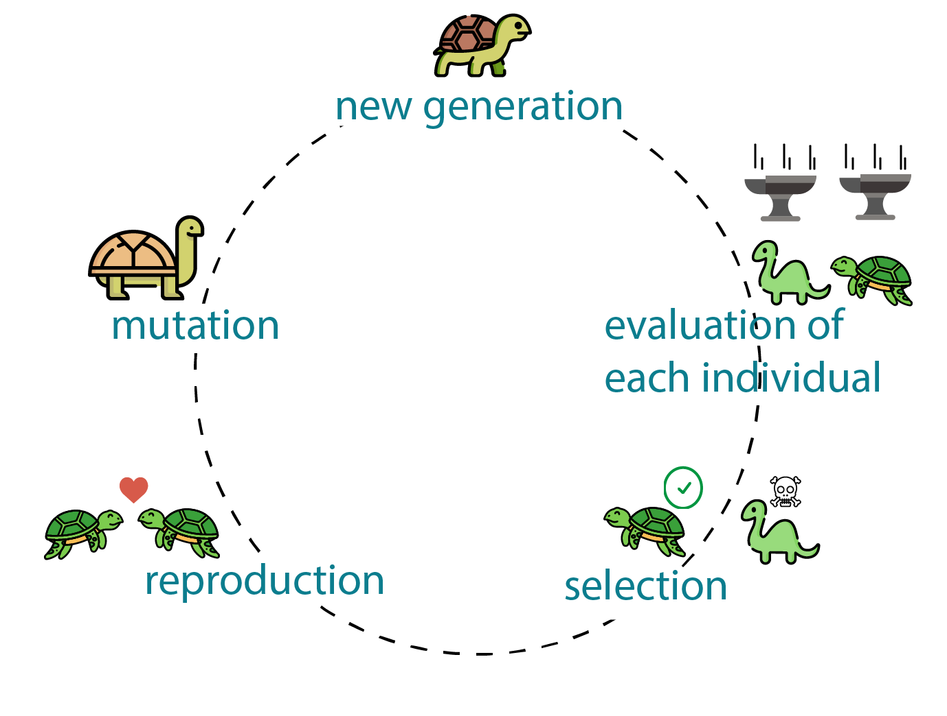
Analysis
Use a genetic algorithm :
A genetic algorithm is a search heuristic that is inspired by Charles Darwin's theory of natural evolution. This algorithm reflects the process of natural selection where the fittest individuals are selected for reproduction in order to produce offspring of the next generation.
We keep looping through the steps until we reach a satisfactory result.

Slide 10
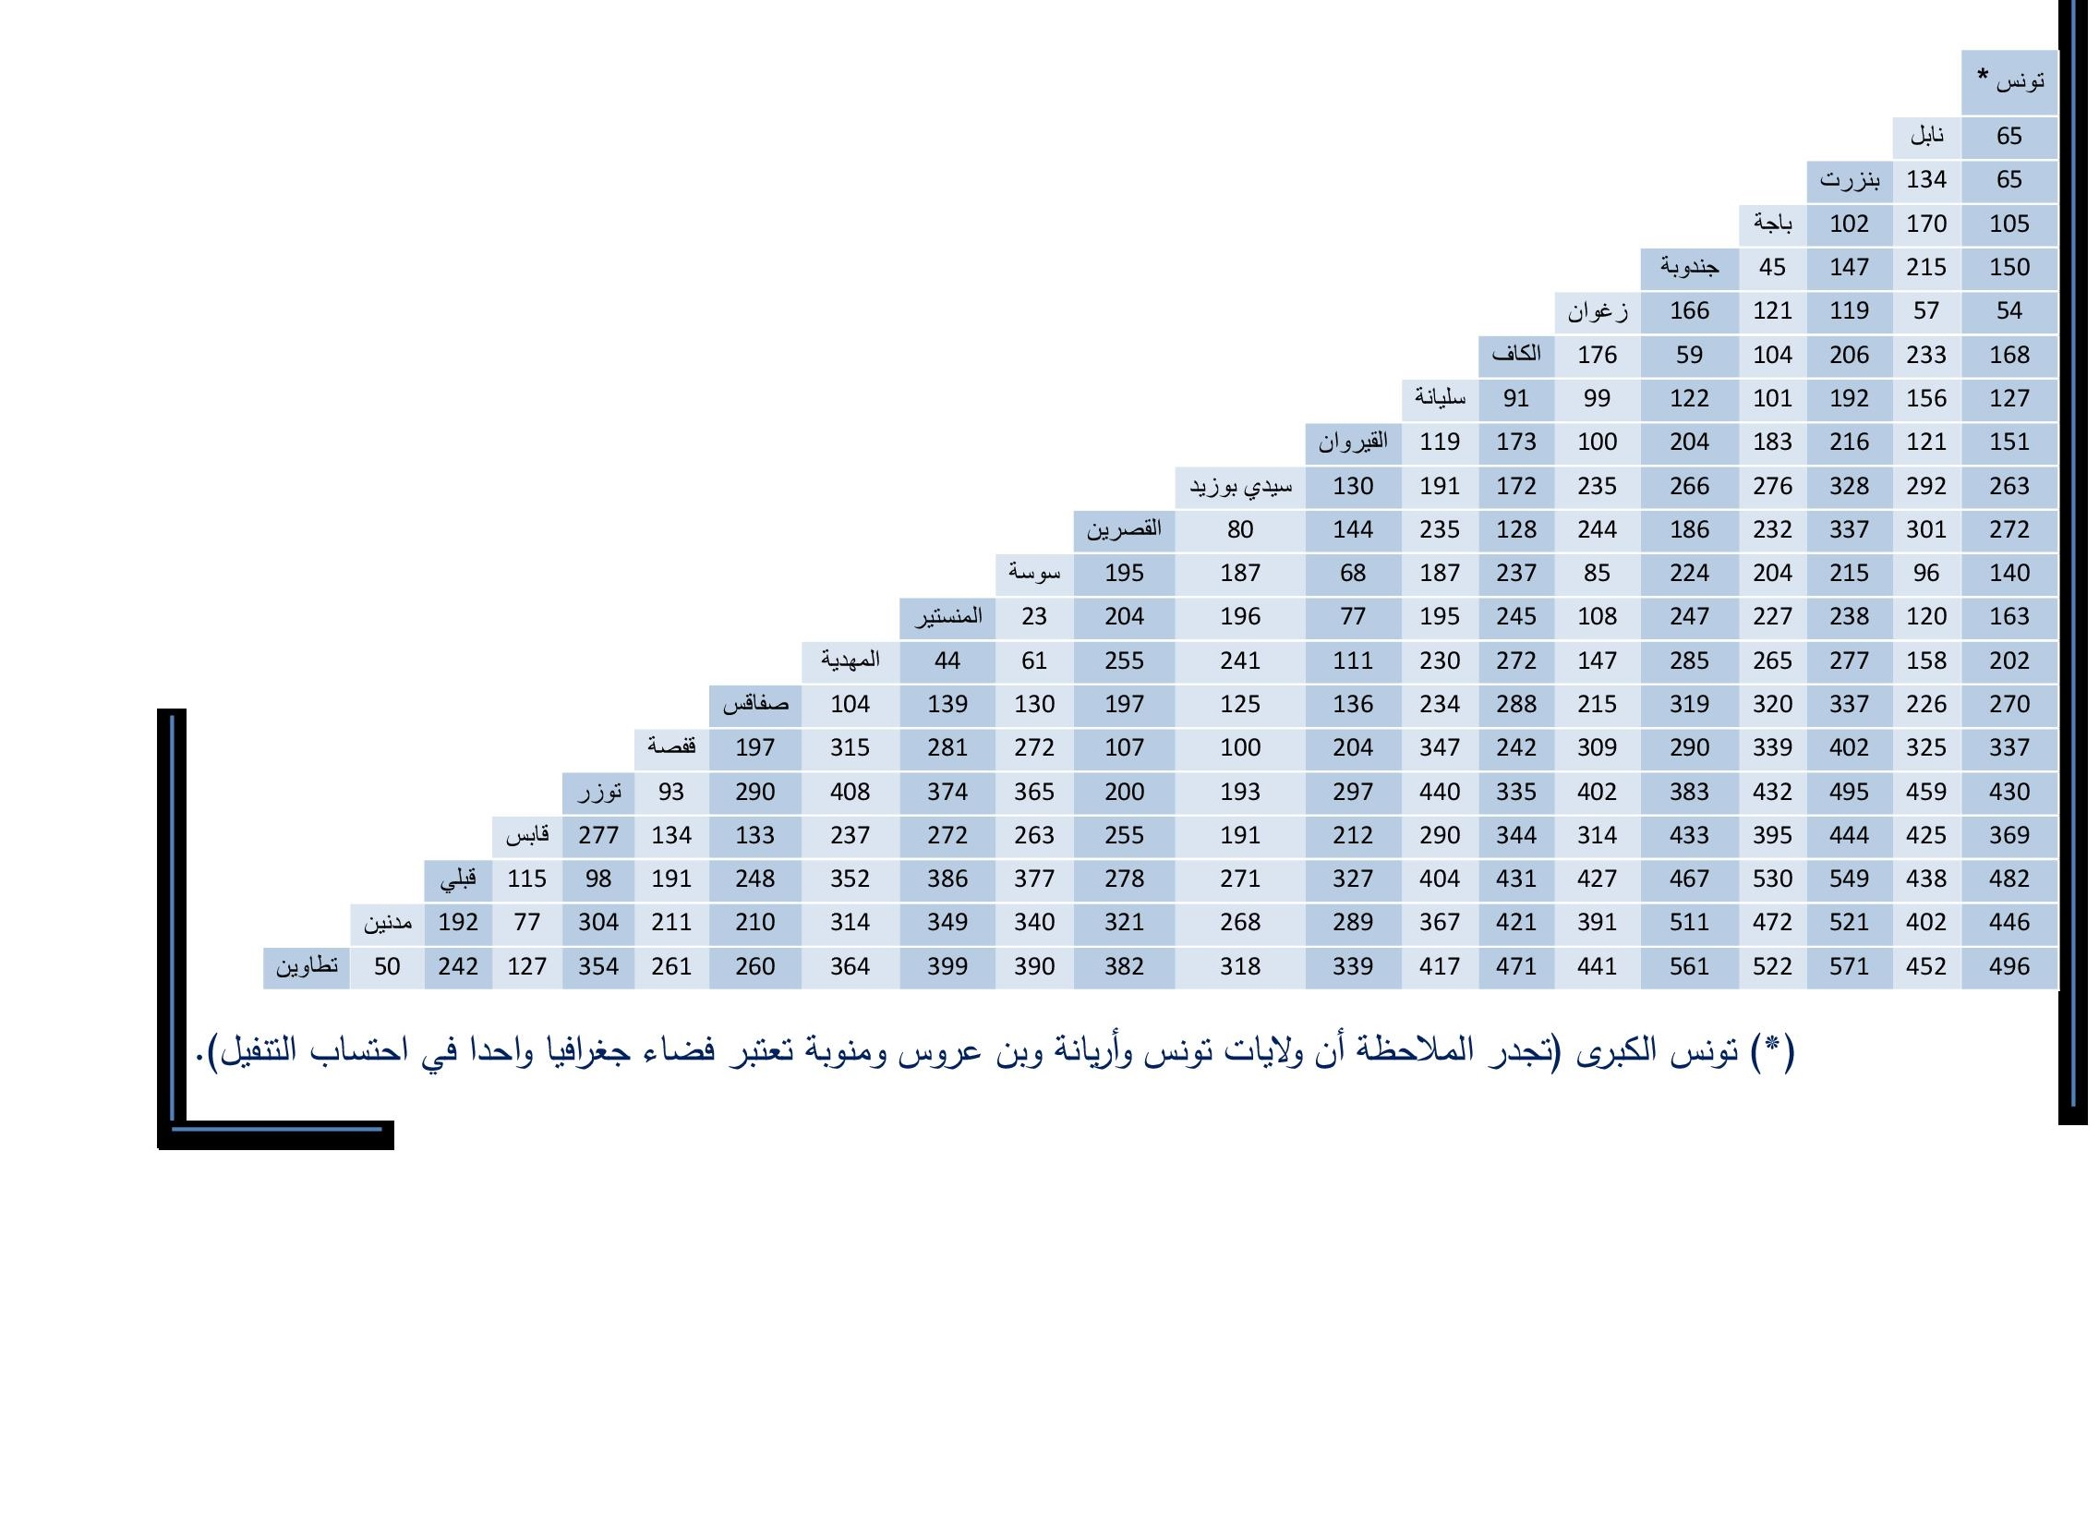
Design
Information:
We will need the distances between cities in order to find the optimal solution

Slide 11
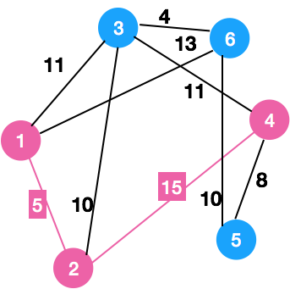
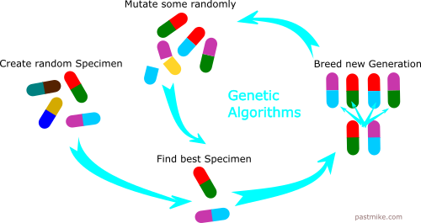
Design
Process:
We will first apply a greedy algorithm in order to find the maximum-minimum; the distance that we are not allowed to go beyond. This will serve as a benchmark to evaluate our genetic algorithm performance.

Slide 12


Design
Tools and interface:
We will use python in order to find the desired path .
Our interface will be Jupyter notebook.
Our data will be stored in our local machines.
Further details about the program will be included in the notebook,

