Slide 1

Restaurant POS
Work done by:
Montassar Chihi
Senior Student BA / IT
Tunis Business School
2021/2022

Slide 2
Description of the project
Develop a POS project using java and databases. This POS can take orders, choose the payment method, and print the customer invoice. It should also be capable of tracking sales per day, per month or year. Total sales or per item (for example “coffee Latte”. It also collects points for the loyal customers.

Slide 3
Description of the project
To better understand the project, a use case diagram was necessary.
Then, we had to make a class diagram for the conception of the database.

Slide 4
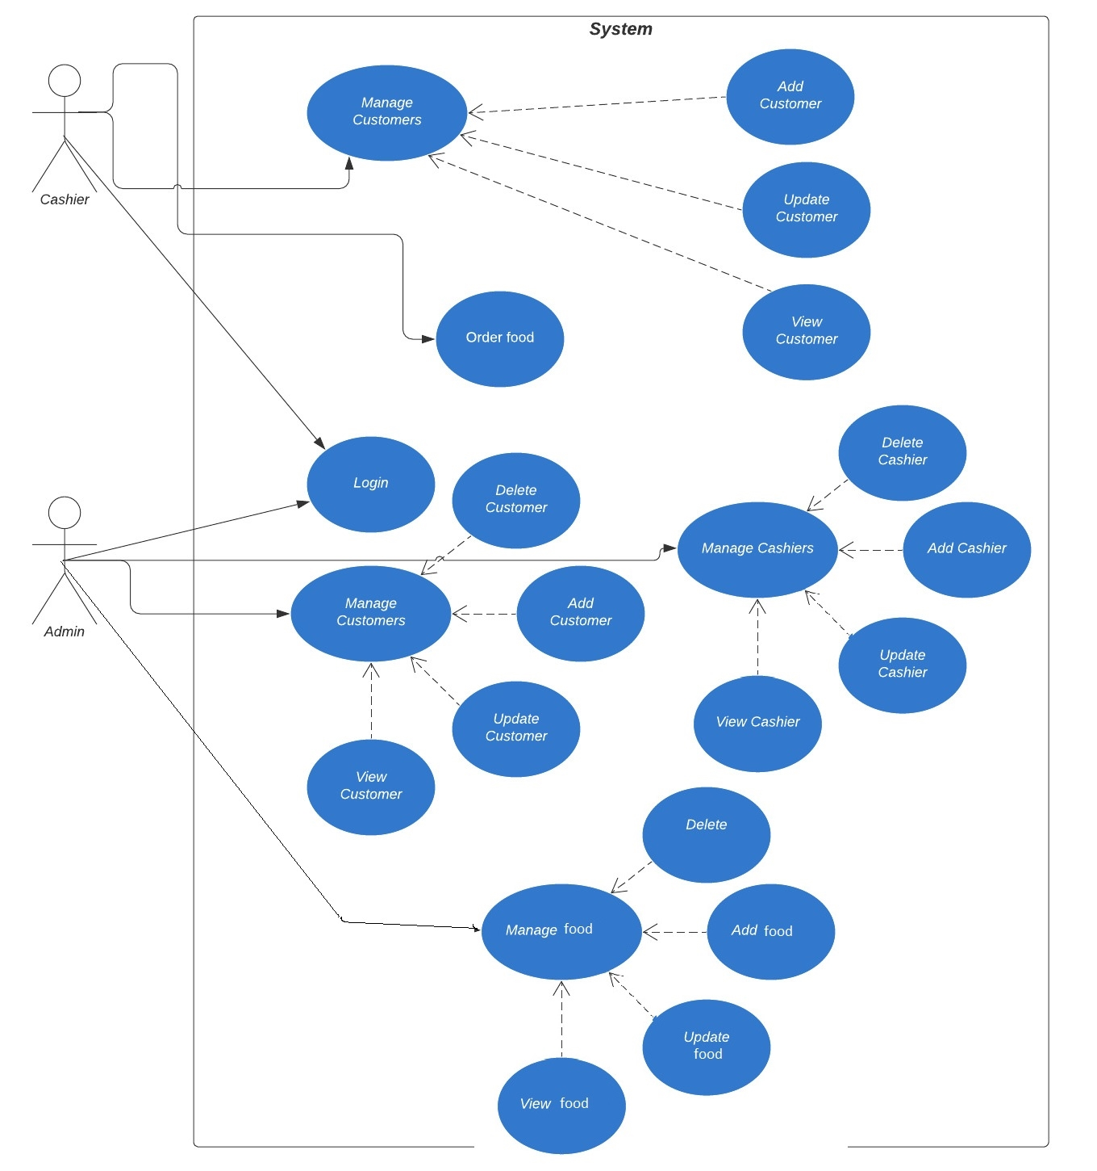
Description of the project

Slide 5
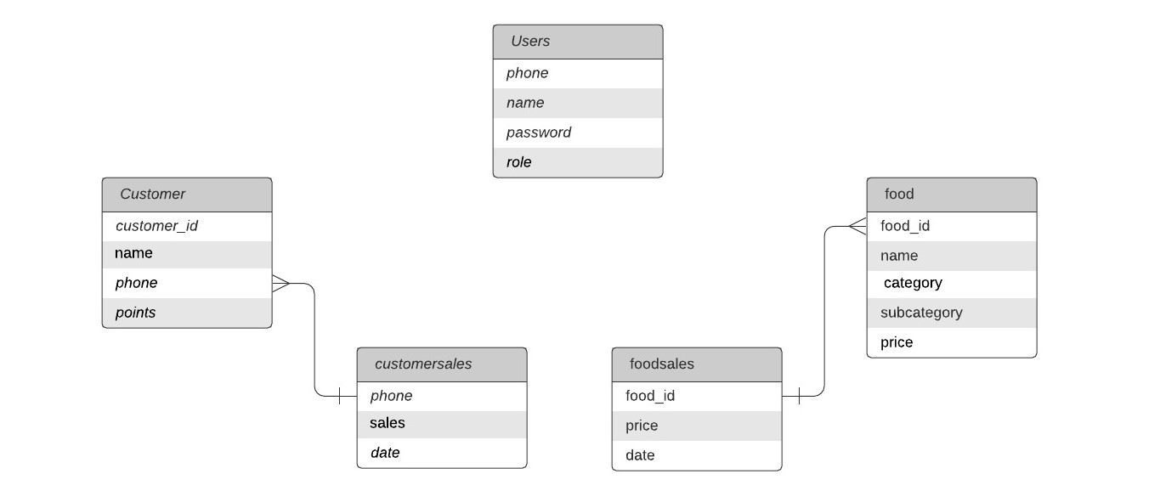
Description of the project

Slide 6
Description of the project
I used derby database , a database included in NetBeans java.
For the GUI, I used the drag and drop palette provided by NetBeans.
The “order” interface was made by coding since content is dynamically generated from database.

Slide 7
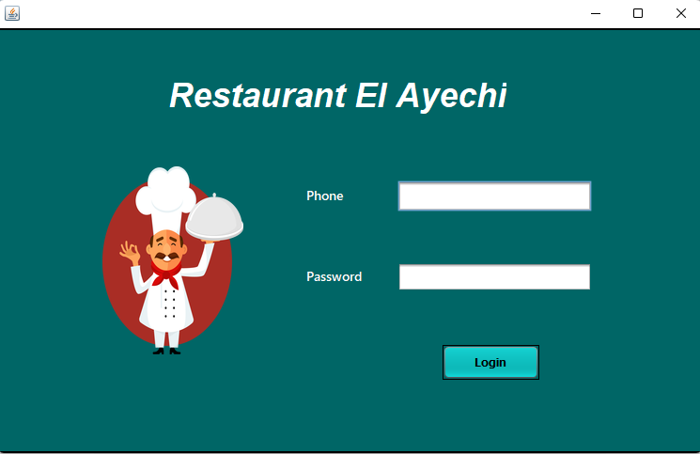
Interface
The interface connects the user to their dashboard automatically according to their role.

Slide 8
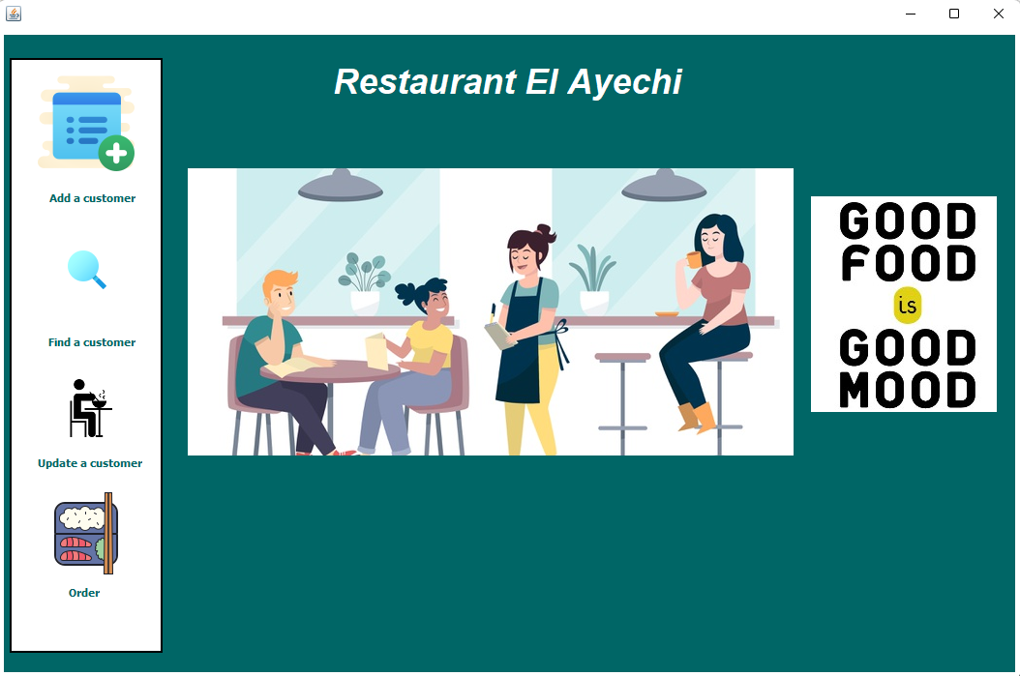
Interface: Cashier
This is the cashier dashboard. They can do 4 operations : add, find or update a customer and then order the meals for the customers.

Slide 9
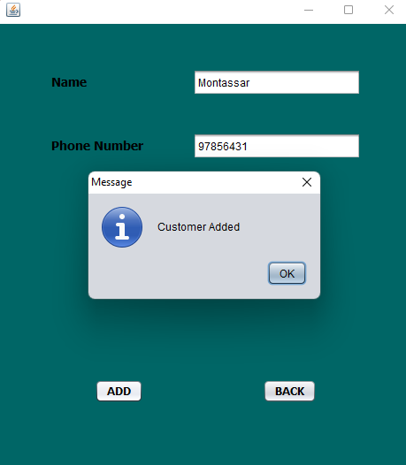
Interface: Cashier
The customer is identified by their name and their phone number.
If the phone number already exists it notifies the cashier to change it.

Slide 10
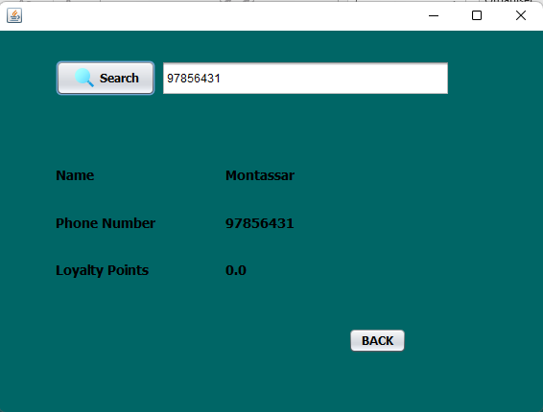
Interface: Cashier
The cashier can see a customer’s data , but can not delete them.

Slide 11
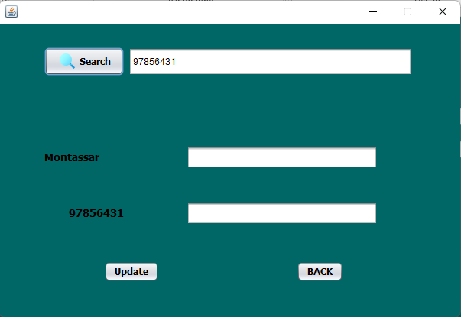
Interface: Cashier
The cashier can update a customer’s data. The application inserts the old data for the cashier to see and then change them.

Slide 12
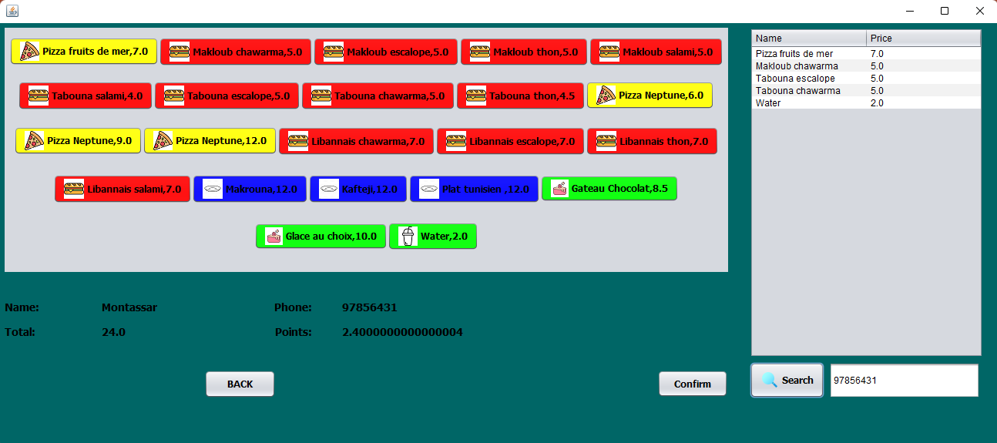
Interface: Cashier

Slide 13
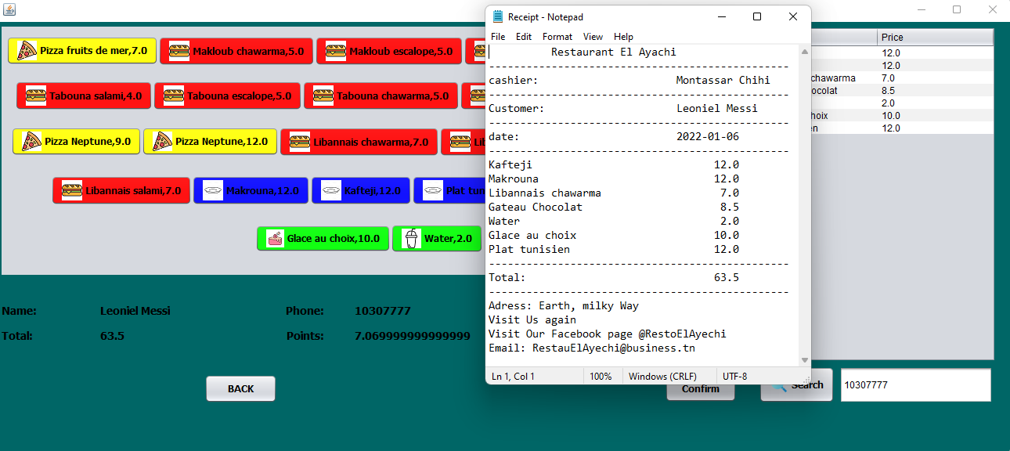
Interface: Cashier

Slide 14
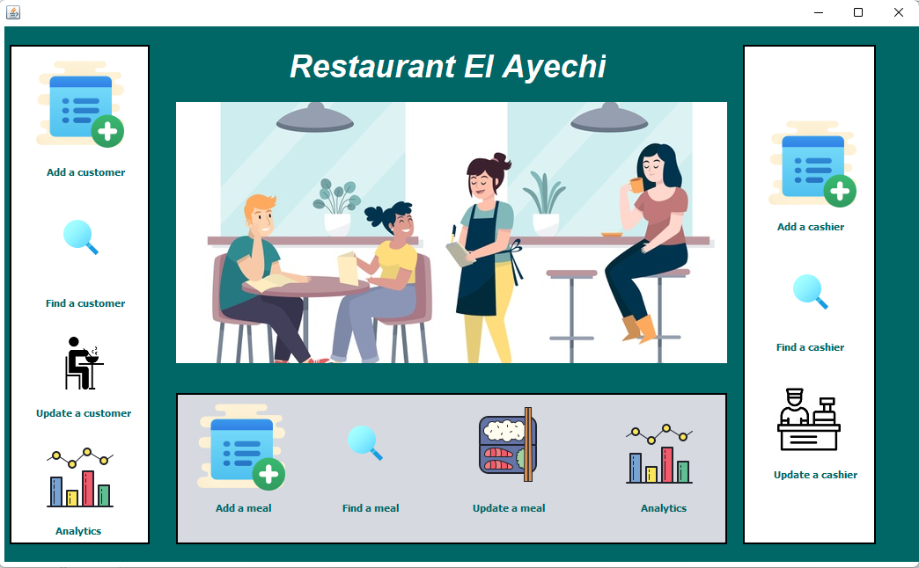
Interface: Admin
The admin has the ability to manage food, cashiers and customers ( add, delete, update and view )
The admin can get also some numbers concerning sales of each item and earnings by customers.

Slide 15
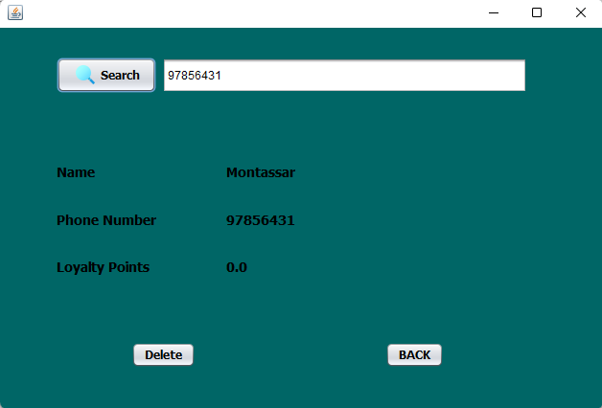
Interface: Admin

Slide 16
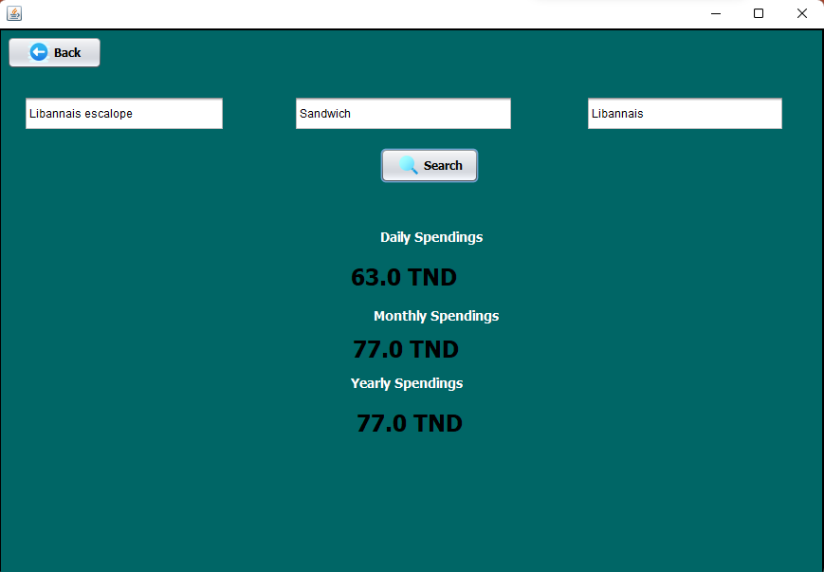
Interface: Admin

Slide 17
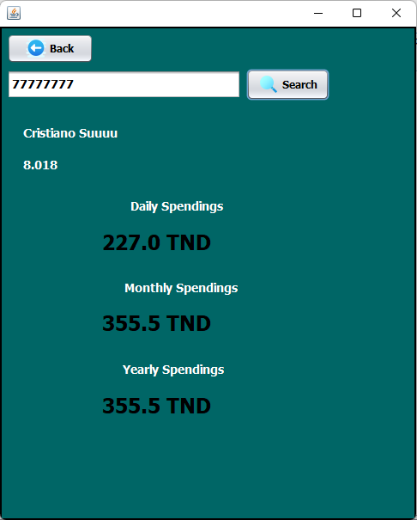
Interface: Admin

Slide 18
Bonne Appetit

