Slide 1
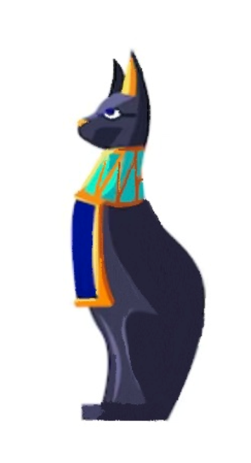

Translating Egyptian Hieroglyphics: A Neural Machine Translation Approach using the Sequence-to-Sequence Transformer and Torchtext
For the course Bachelor Project Artificial Intelligence (XB_40002)
Qi-fan Wu
2700280@student.vu.nl
Notes:
Hello, so today I’m going to present my thesis, about using a sequence to sequence transformer model that can conduct machine translation of Egyptian Hieroglyphics.

Slide 2
Study Area
Abstract
Introduction
Methods
- Training Data Preprocessing
- Model Architecture
- Overall Architecture of the Transformer
- Tokenization Strategies
- Attention Mechanism
- Train the Model
Results
- Attention Scores
- Performance
Discussion
References
This study examines the feasibility of translating Egyptian hieroglyphics into German using a sequence-to-sequence encoder-decoder transformer model. With the model architecture founded on the four layers self-attention mechanism, and the application of custom tokenizers for both languages, the project achieves noteworthy results despite the inherent complexity and richness of the hieroglyphic language. The transformer model's performance is evaluated using the BLEU score and by visualising its attention heatmaps. Various modifications on the transformer architecture, such as different decoding strategies and adjustments in model parameters are also investigated, offering insights into the model's capabilities and limitations. Although challenges about limited dataset availability, time and memory consumption persist, the work demonstrates the potential of employing machine learning for hieroglyphic translation. This research provides a valuable basis for further studies in enhancing translation performance and extending the scope to include more diverse periods and languages, thus fostering advancements in the intersection of artificial intelligence and archaeological studies.
Research Questions and Hypothesis
To reach the research goals, the research attempts to answer the following overarching research question consists of multiple aspects: “Is it possible for a sequence-to-sequence encoder-decoder transformer model to accurately convert Egyptian hieroglyphics into German, and can modifications in the transformer architecture enhance the translation performance?”
The main hypothesis is that the created transformer model, which is trained with a dataset of Egyptian hieroglyphics and German, is able to perform basic translations toward complex hieroglyphic scripts. In addition, variations on the standard transformer model can enhance the translation performance of hieroglyphic scripts slightly.
An additional hypothesis is that comprehensive investigation and visualisation about internal workings of these transformer variations might be able to provide valuable insights into the strengths and weaknesses of the model, and benefit for future improvements and applications in the translation of ancient or complex languages.
Notes:
This is the general structure of my project, at the end I hope I am able to answer my research question: Does this sequence-to sequence encoder-decoder transformer able to translate Egyptian hieroglyphics into German accurately, and whether modification in the transformer’s architecture can actually enhance its performance.

Slide 3
Introduction
Egyptian hieroglyphs, were the formal writing system used in Ancient Egypt, and they were largely carved into stone and commonly used in temples, tombs and on other monuments for nearly 3000 years
After the proliferation of Christianity by the Roman Empire in the First Century, the ability in reading ancient Egyptian script was vanished
During Renaissance, scholars initiated the study of Egyptian, while these scholars believed that hieroglyphs symbolized concepts, instead of a written language
Napoleon and the Rosetta Stone
Decipherment of the hieroglyphic and computer-encoding
- Original texts: 𓁢𓁛𓅒𓆃𓂀
- Gardiner signs: C6 C2 C2C H5 N60
- Transcriptions: dm =j rn =k ꜥšꜣ m ẖr,t-hrw
- Very limited studies about machine translation
3250–332 BC
Sacred carvings
1 AD
Egyptian religious practices being abandoned
1400-1700 AD
Interest in Egypt from Europe
1836 AD
Unlocking Egyptian Hieroglyphics
332–30 BC
Greek rule in Egypt
394 AD
The last known hieroglyphics inscription
1798-1799 AD
Napoleon invaded Egypt, found the Rosetta Stone
1984 AD
Computer-encoding of Egyptian Hieroglyphics
Source: L. Adkins and R. A. Adkins (2000)
Notes:
At the beginning, I would like to introduce a bit about the conditions of Egyptian Hieroglyphics, which is the writing system which is the writing system of Ancient Egypt, and it is no longer being used for around 18 centuries. This is a language once extinguished after the Roman Empire adapted Christian, and only after Napoleon invaded Egypt and discovered the Rosetta Stone with both hieroglyphics and Greeks on it, scholars started to decode this language and study about this linguistic system. There are three ways to display it, which is the original text with animals, gods and items that appear in temples and coffins, the Gardiner sign that represents each letter in latin characters so that they can be encoded in computer, and transcriptions which include both meaning and grammar of the word and sentence. This work will focus on translation of the transcription of Egyptian hieroglyphics. And until now, there is almost no research about this field.

Slide 4
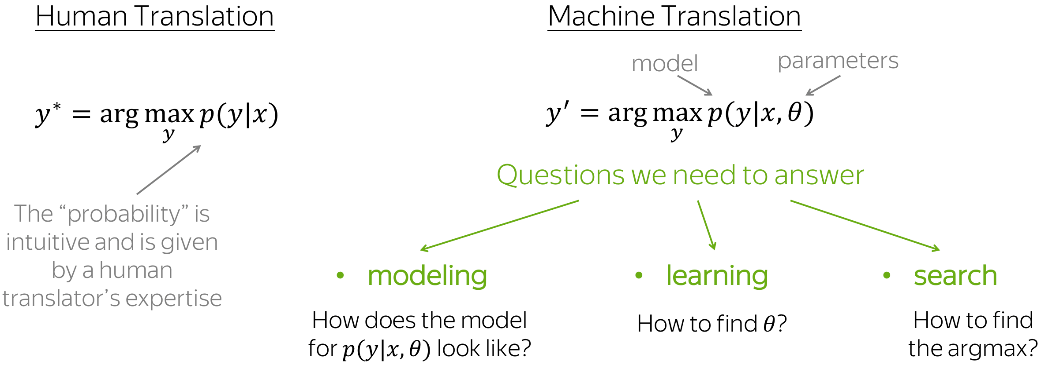
Introduction
Decipherment of the hieroglyphic and computer-encoding
- Original texts: 𓁢𓁛𓅒𓆃𓂀
- Gardiner signs: C6 C2 C2C H5 N60
- Transcriptions: dm =j rn =k ꜥšꜣ m ẖr,t-hrw
- Very limited studies about machine translation
3250–332 BC
Sacred carvings
1 AD
Egyptian religious practices being abandoned
1400-1700 AD
Interest in Egypt from Europe
1836 AD
Unlocking Egyptian Hieroglyphics
332–30 BC
Greek rule in Egypt
394 AD
The last known hieroglyphics inscription
1798-1799 AD
Napoleon invaded Egypt, found the Rosetta Stone
1984 AD
Computer-encoding of Egyptian Hieroglyphics
Source: L. Adkins and R. A. Adkins (2000)
Notes:
To apply the machine translation with input sentence x and target sentence y, so that it will able to find the target translation that is most possible, I will try to introduce the modelling, learning and inference in later sections for this specific transformer and its attention mechanisms.

Slide 5
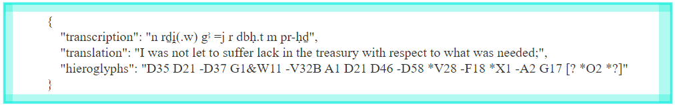
Training Data Preprocessing
The transformer model is trained on the "bbaw_egyptian" dataset which contains 100,708 translation triples
This digital corpus consists hieroglyphic texts of the Middle Kingdom of Egypt that start from 2040 BC till 1782 BC
Sources including block status, historical and biographical texts of persons, letters, literary texts, magical texts, medical texts, private stelae, and religious texts
The dataset is split into training, validation, and testing datasets, with a split ratio of 70%, 15%, and 15% respectively, the random_state parameter is set to 42
Vocabularies for source (Egyptian hieroglyphics) and target (German) texts are built using a custom function build_vocab. The vocabularies provide mapping indices for every unique token in the texts
The processed data is batched using the PyTorch's DataLoader
Sequences in each batch are padded to ensure they all have the same length, and the DataLoader shuffles the data to ensure that the model receives data in a different order for each epoch.
Two custom tokenizers are built
Source: Thesaurus Linguae Aegyptiae (2023)
Notes:
To train the model, the dataset used is called the “bbaw_egyptian” dataset contains 100,708 training triples that looks like the figure below, it consists of hieroglyphic texts from the Middle Kingdom of Egypt covering a wide range of topics. The dataset is splitted into the train, test and validation dataset with ratio 70%, 15% and 15% respectively. Vocabulary of both source and target sentences are built based on each unique token. The processed data is divided into batches, enabling the model to process a set amount of data at once. Also, each batch is padded to ensure they all have the same length. In addition, two custom tokenizers are built for both languages, to handle the unicode, split white space and exclude annotations in data.

Slide 6
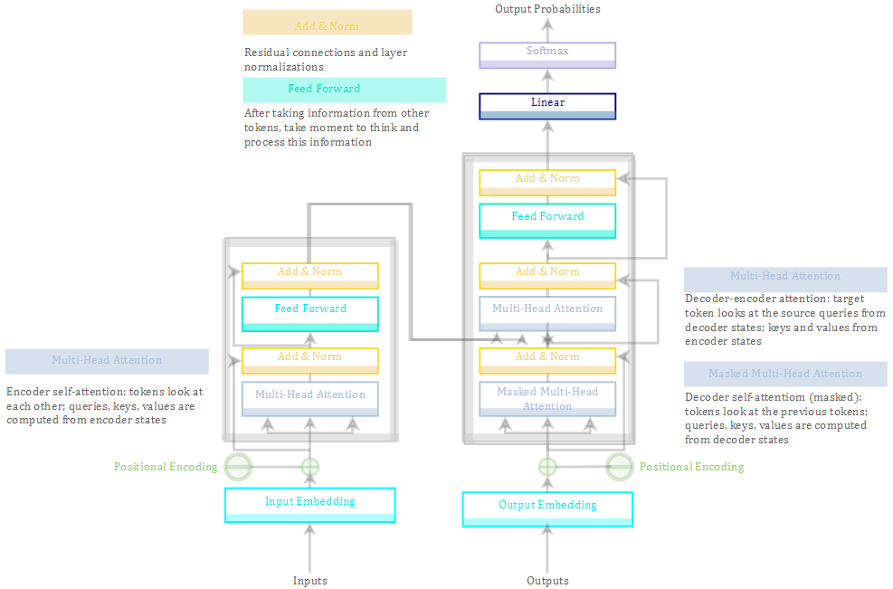
Overall Architecture of the Transformer
Feed-Forward blocks
Residual connections
Layer Normalizations
Positional Encodings
Source: Vaswani et al (2017)
Notes:
The general structure of the transformer is based on a paper called attention is all you need in 2017 For model components in addition to attention, each layer has a feed-forward network block, which is a two linear layers with ReLU nonlinearity between them, after looking at other tokens via attention mechanism, the model use this block to process new information. The Residual connection block allows stacking a lot of layers, and adds a block's input to its output. There will also be a layer normalisation to improve convergence. And finally, there is a positional embedding process for each model dimension, to let the model know the positions of the tokens.

Slide 7
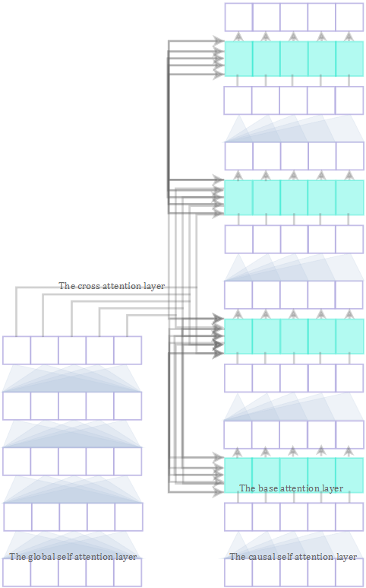
Attention Mechanism
Attention output
Attention weight
Attention scores
Attention input
(weighted sum)
(softmax)
The base attention layer
The cross attention layer
The global self attention layer
The causal self attention layer
Source: Vaswani et al (2017)
Notes:
And for the attention mechanism, there are a fixed number of four layers. Includes a base attention layer that computes a weighted sum of input values based on their relevance to keys and the current output query. The Cross attention layers cross the encoder and decoder, helping the model to focus on the relevant parts of the source sentence when generating each word in the target sentence. Also there is a global attention layer, each token in the input can attend to all tokens in the same input, no matter how far apart they are. This enables the model to incorporate context from the entire sequence when processing each token, which can be particularly useful in tasks like translation. There is also a casual self attention layer, each token attends only to preceding tokens in the input, not following ones, ensures output tokens are generated based on only the previously generated tokens, not the future ones.

Slide 8
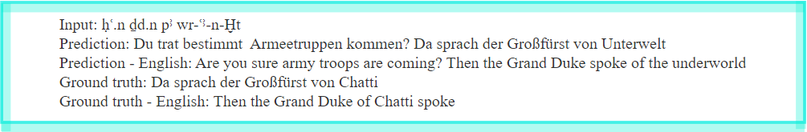
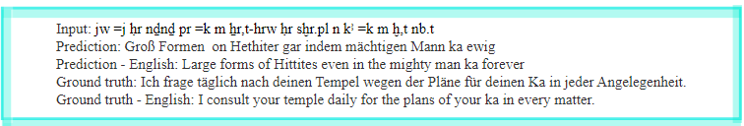
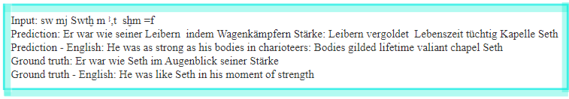
Results
Notes:
And here please see some translated results to see how it works. I will say that the model correctly translated some part of the sentence, while there are still some translated result seems unrelated, and I think might be an effect of the attention mechanism within the transformer, for example semantically plausible in the broader context of sentences that might be about military operations or political events, which can be confirmed, because in the ground truth of this sentence, the "Grand Duke of Chatti" is involved in the a War in Egyptian history history. I will try to introduce more about it in later sections.

Slide 9
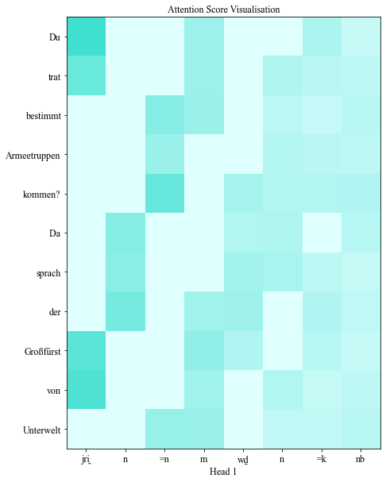
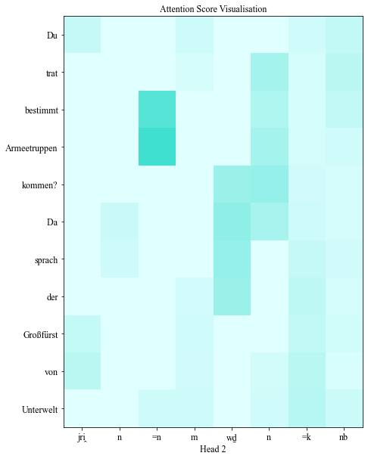
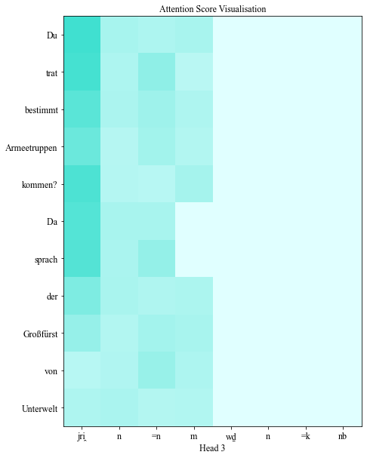
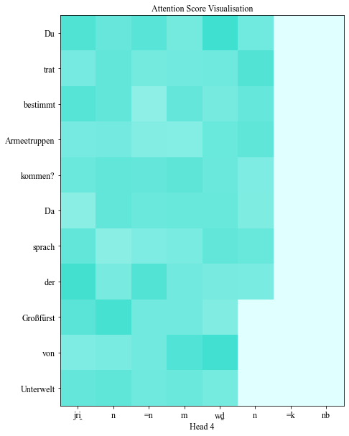
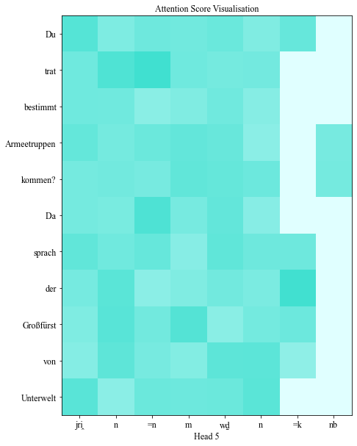
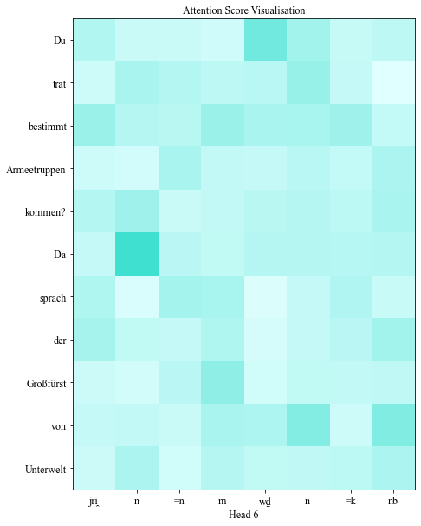
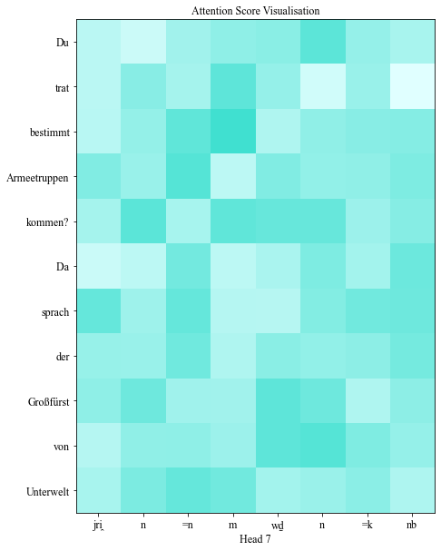
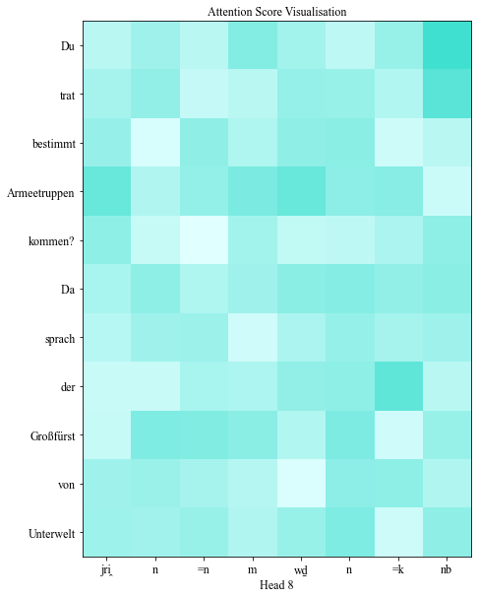
Results
Notes:
Here is a visualisation of the model’s Syntactic attention heads. It is hard to interpret if there is a general pattern for it, while it should be noticed that attention scores are concentrated on the first half of the sentence. It represents that when the model was generating the output sequence, it found the information it needed primarily in the first half of the input. Possible explanations for this attention pattern are about sentence structure of the Egyptian hieroglyphics and German. And I will also talk more about it later.

Slide 10
Results
 | Input data size | Batch size | Epochs | d_model | Training time per epoch (min) | BLEU score
Baseline | 100708 | 64 | 10 | 512 | 238.1 | 0.1726
Beam search | 100708 | 64 | 10 | 512 | 238.1 | 0.1789
Greedy search | 10070 | 64 | 10 | 512 | 108.3 | 0.1057
Beam search | 10070 | 64 | 10 | 512 | 108.3 | 0.0796
Greedy search | 10070 | 128 | 10 | 512 | 112.5 | 0.0713
Beam search | 10070 | 128 | 10 | 512 | 112.5 | 0.0506
Greedy search | 10070 | 64 | 20 | 512 | 131.8 | 0.0973
Beam search | 10070 | 64 | 20 | 512 | 131.8 | 0.0308
Greedy search | 10070 | 64 | 10 | 256 | 89.2 | 0.0121
Beam search | 10070 | 64 | 10 | 256 | 89.2 | 0.0000
Greedy search | 1007 | 64 | 10 | 512 | 4.3 | 0.0107
Beam search | 1007 | 64 | 10 | 512 | 4.3 | 0.0000
Table 1: Variations on the transformer architecture and decoding strategies and how these variations can affect the performance of the machine translation.
Source: Raffel et al (2020)
Notes:
This table shows variations on the transformer architecture and decoding strategies and how these variations can affect the performance of the machine translation, the BLEU score here can be viewed as accuracy, it measures the similarity of the machine-translated text to a set of its reference translations. Two decoding strategies for translators are used here, the greedy search algorithm and the beam search algorithm, the beam search considering multiple possibilities in the output sequence, as opposed to the greedy search which only considers the most likely next step. It can be concluded that the size of the dataset significantly affects the training result.

Slide 11
Discussion
Although the sentence has been extended with additional information, the core meaning is preserved when translated by the baseline model
Attention scores are concentrated on the first half of the sentence
Having a larger dataset contributes to superior model performance
The trade-off between speed and complexity in model architecture
Beam search yielded marginal improvement with larger datasets but appeared less beneficial or even harmful with smaller datasets
Limitations: Data availability & Requiring extensive CPU/GPU memory
Notes:
In general, results show that the core meaning of the sentence is preserved in translation, while there are always additional parts, and attention scores are concentrated on the first half of the sentence. To explain this phenomenon, one main reason might be the Egyptian hieroglyphics. The language tends to place crucial information such as the verb at the beginning of sentences, and this language structure is called the Verb-Subject-Object language structure. However, German typically follows a Subject-Verb-Object structure like English, and it uses a different structure in subordinate clauses, which means that the verb can often appear at the end of a sentence, especially in complex sentences. And for variation of model’s structure, (read slides)

Slide 12
Conclusion
Research Questions and Hypothesis
Generally, The findings suggest that this model can indeed perform basic translations of complex hieroglyphic scripts.
Customized variations of the standard architecture transformer model slightly enhanced the translation performance.
Visualizing the internal workings of the model highlighted its strengths and weaknesses, thus providing valuable insights for future improvements.
Results indicate the potential of machine translation in the realm of ancient languages such as Egyptian hieroglyphics, although further research is needed for better performance of machine translation.
To reach the research goals, the research attempts to answer the following overarching research question consists of multiple aspects: “Is it possible for a sequence-to-sequence encoder-decoder transformer model to accurately convert Egyptian hieroglyphics into German, and can modifications in the transformer architecture enhance the translation performance?”
The main hypothesis is that the created transformer model, which is trained with a dataset of Egyptian hieroglyphics and German, is able to perform basic translations toward complex hieroglyphic scripts. In addition, variations on the standard transformer model can enhance the translation performance of hieroglyphic scripts slightly.
An additional hypothesis is that comprehensive investigation and visualisation about internal workings of these transformer variations might be able to provide valuable insights into the strengths and weaknesses of the model, and benefit for future improvements and applications in the translation of ancient or complex languages.
Notes:
In conclusion, the research question can be answered. This transformer model can conduct translation tasks of Egyptian Hieroglyphics with basic meaning, while there is a lot of space to improve. Custom variations of the model's architecture can slightly enhance its performance. For further research, more periods can be included to enlarge the dataset.

