Slide 1


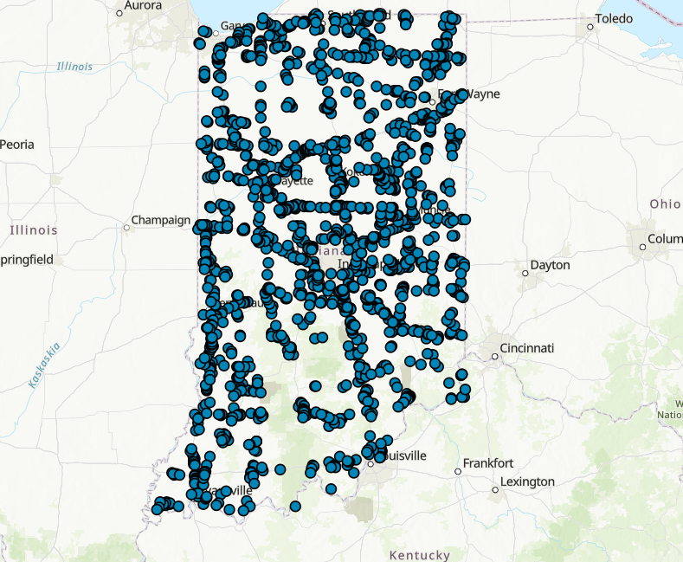
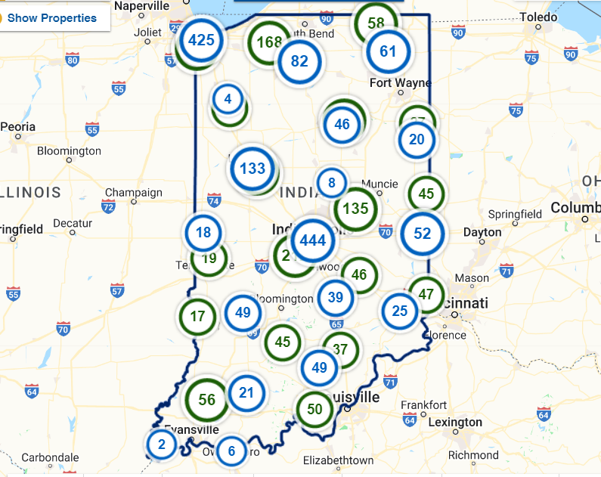




Indiana SSI / ZoomProspector
SITE COMPARISON PROJECT

Slide 2

Project Description
Conduct a site-by-site comparison to determine overlap between SSI Phase I sites and sites listed in the Indiana ZoomProspector database.
Purpose of Project
Demonstrate the volume of new potential greenfield sites produced through SSI Phase I: Site Discovery.

Slide 3
Approach
Utilize GIS-based spatial analysis to determine site boundary intersection for SSI Phase I sites and ZoomProspector sites.
Initial analysis is applied to SSI Phase I sites with a ranking of 4.0 or higher.
A grading scale for how closely intersecting boundaries match is applied.
  ZP-EM = Exact Match
  ZP-SM = Substantial Match
  ZP-PM = Partial Match (pending review)
  ZP-PR = Proximate to ZP Site
  ZP-NM = No Match
Objectives
Gain a quantitative understanding of SSI Phase I and ZoomProspector site coincidence.
Infer an indication of ZoomProspector site quality based on overlap with 4.0+ ranked SSI Phase I sites.
Derive percentage of new potential greenfield sites where SSI Phase I sites do not intersect ZoomProspector sites.
Create GIS-based site boundaries for ZoomProspector sites where property listings do not have a defined boundary.
Provide site boundaries to property listing managers to load into ZoomProspector for map display.

Slide 4
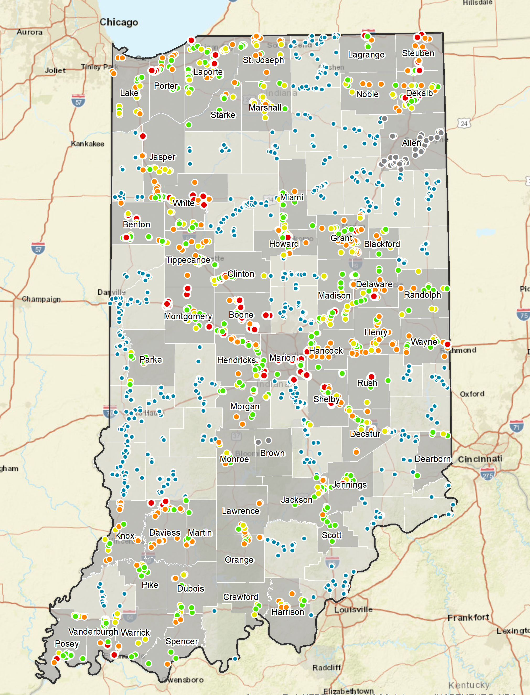
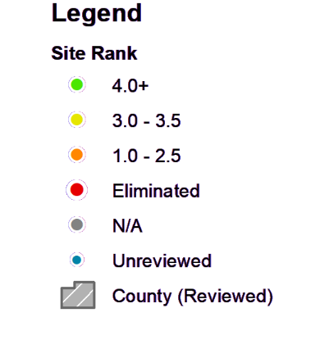
Findings Summary
SSI Sites by Ranking, Reviewed/Unreviewed
Local Site Review Workshop Stats:
53 out of 92 counties reviewed
1,097 out of 1,811 sites reviewed
407 sites with 4.0+ ranking

Slide 5
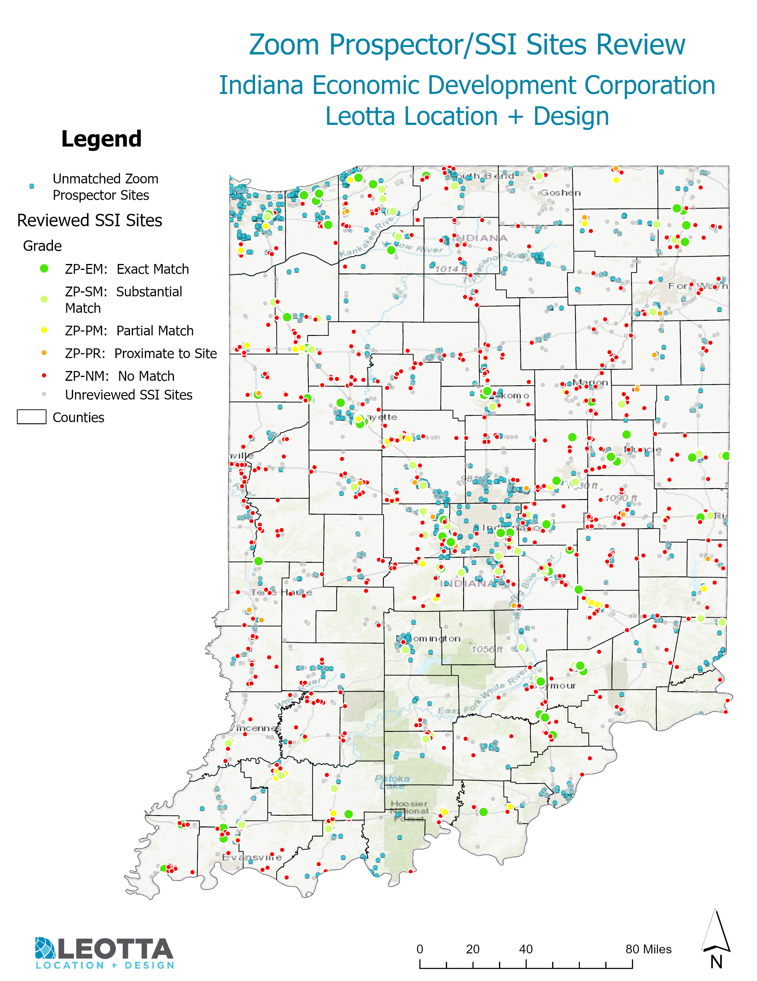
Findings Summary
ZoomProspector – SSI
Site Overlap Stats:
407 SSI PI 4.0+ sites analyzed
482 SSI PI 250+ acre sites analyzed
178 SSI sites with at least a partial ZP match
561 SSI sites not within 1,000 ft of ZP site

Slide 6
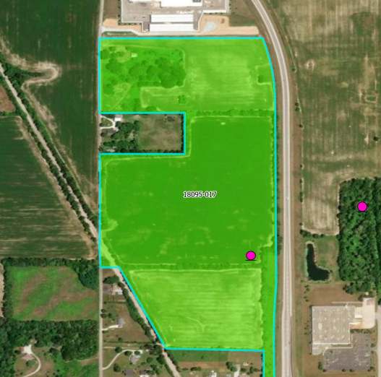
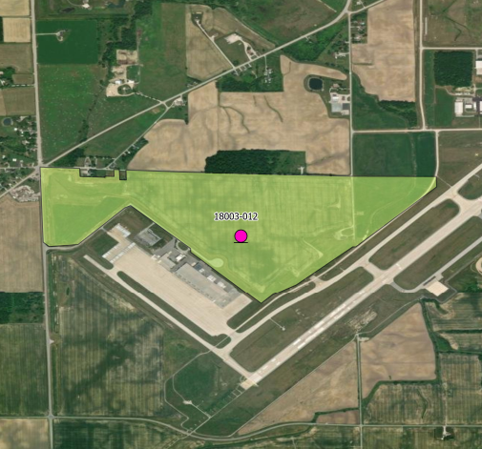
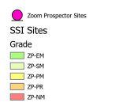
Findings Summary
SSI Phase I – ZoomProspector comparison grading scale
Grade I: SSI Site exactly matches the ZP site
Grade II: SSI Site substantially matches the ZP site

Slide 7
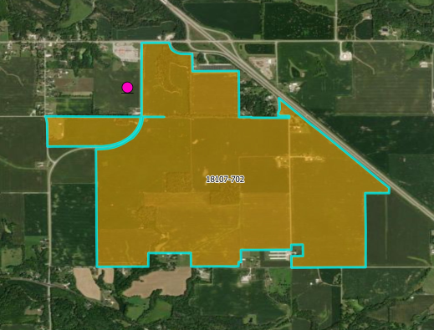
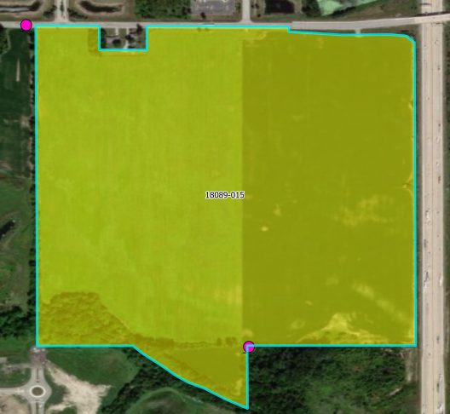
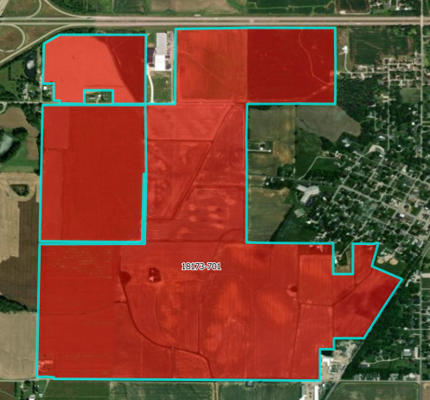
Findings Summary
Grade IV: SSI and ZP sites are within 1k feet of each other but do not overlap
Grade III: Partial match between SSI and ZP sites. Needs further review.
Grade V: SSI site is farther than 1k feet of any ZP site

Slide 8
Findings Summary
A comparison of local sites review workshop dates was performed to analyze whether each SSI-ZP site was added to the ZP database before or after the SSI county review workshop.
SSI-ZoomProspector date comparison review:
209 SSI sites were matched in someway to a ZP site
194 sites have county review dates
  Counties without review dates that have matching sites include:
  Bartholomew, Johnson, Franklin, Newton, Elkhart, Union, Vigo, Wells
31 SSI Sites were added before ZP sites, having the potential to add intrinsic value to the ZP portal.

Slide 9










Rough Order-of-Magnitude (ROM) Costs
SSI PI 4.0+ Sites
SSI PI
250+ Acre Sites
407
482
Summary Metrics
SSI Sites with Exact ZP Match
SSI Sites with Substantial ZP Match
SSI Sites with Partial
ZP Match
66
73
39
GRADE
V
SSI Sites Within 1,000 ft of ZP Site
SSI Sites Not Within 1,000 ft of ZP Site
28
561
Acreage
Range
Average
Acres
Average
Buildable Acres
8–223.3
57.4
29.8

Slide 10


How this information may be used…
Demonstrate SSI Program ROI.
Derive an understanding of general site competitiveness for current ZoomProspector sites.
Provide incentive for LEDO’s to schedule their SSI Phase I local sites review workshop.

Slide 11



Anastasi Geminden Lowe
Manager, Site Marketing
Indiana Economic Development Corporation
Phone: (463) 214-0479
Email: ageminden@iedc.in.gov
www.iedc.in.gov
Victor Leotta
Principal
Leotta Location and Design, LLC
Phone: (225) 281-4202
Email: victor@location-design.com
Contact
Tina Morgan
Site Quality Analyst
Leotta Location and Design, LLC
Phone: (225) 978-7031
Email: tina@location-design.com
www.location-design.com

