Slide 1
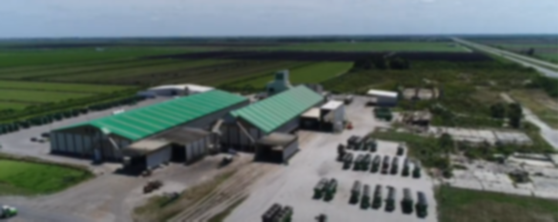


Strategic Sites Inventory

Slide 2

  Increase community competitiveness
  in economic development by strengthening the
  quality of real estate asset inventories.

Slide 3

Purpose and Value
Why was the SSI Program created?
Lack of Inventory
Inconsistent Quality Standards
Missed Opportunities
What does the SSI Program provide?
Site Identification
Validate Quality
Promote Competitiveness
SSI Program community value:
Real Estate Asset Awareness
Competitive RFI Response
Project Lead Generation

Slide 4
Program Phases
  Phase I Site Discovery
  Phase II Preliminary Due Diligence
  Phase III Site Advancement
  Phase IV Formal Due Diligence
  Phase V Branding and Marketing

Slide 5
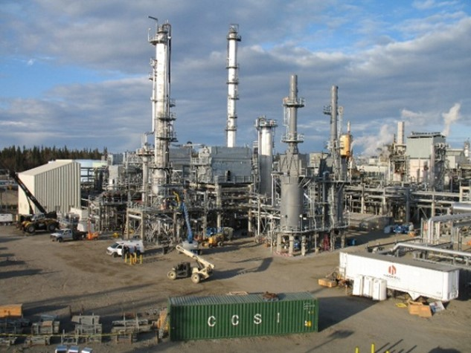
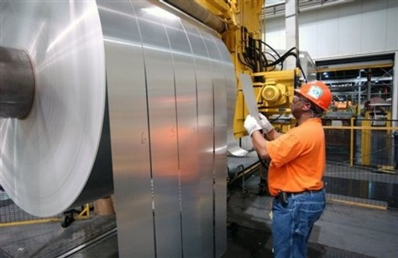
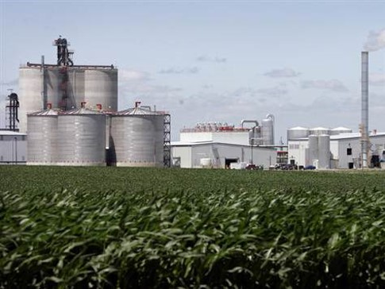
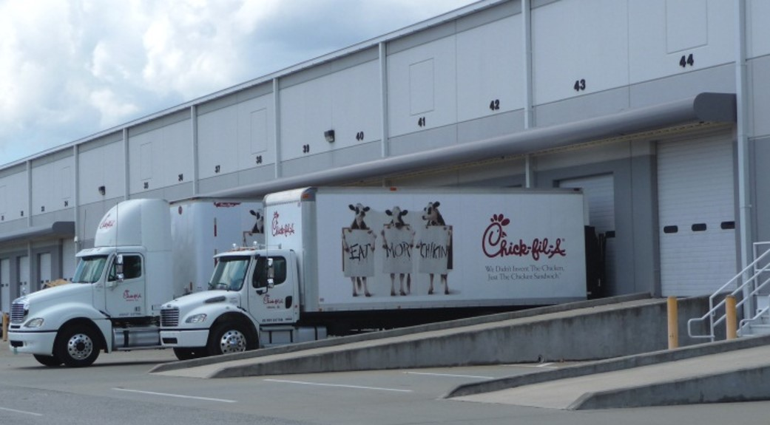

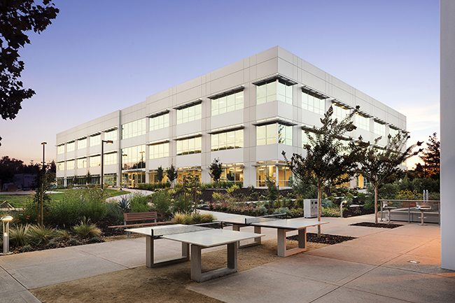
Project Land Use Intensities
  Industrial MegaSite
  Heavy Industrial
  Light Industrial
  Tech MegaPark
  General Agribusiness
  Heavy Agribusiness
  Distribution/
  Freight Logistics
  R&D/Tech
  Business Park/Medical
  Data Center
  Utility-scale Solar

Slide 6

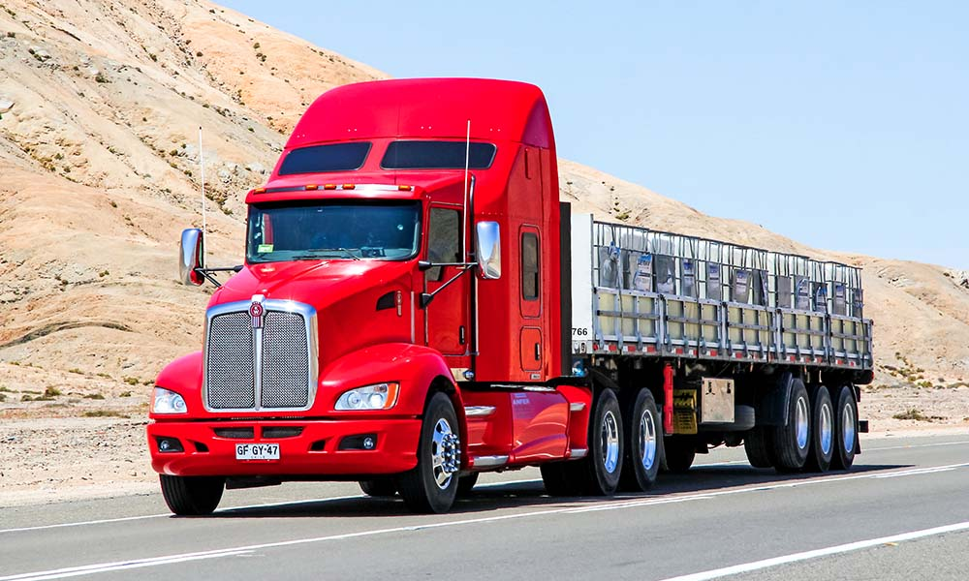
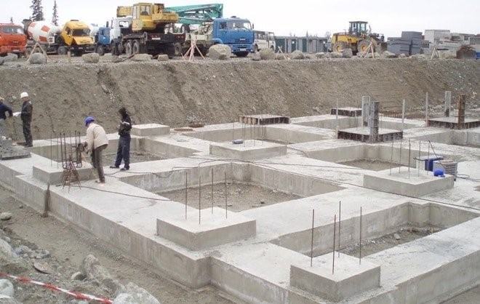
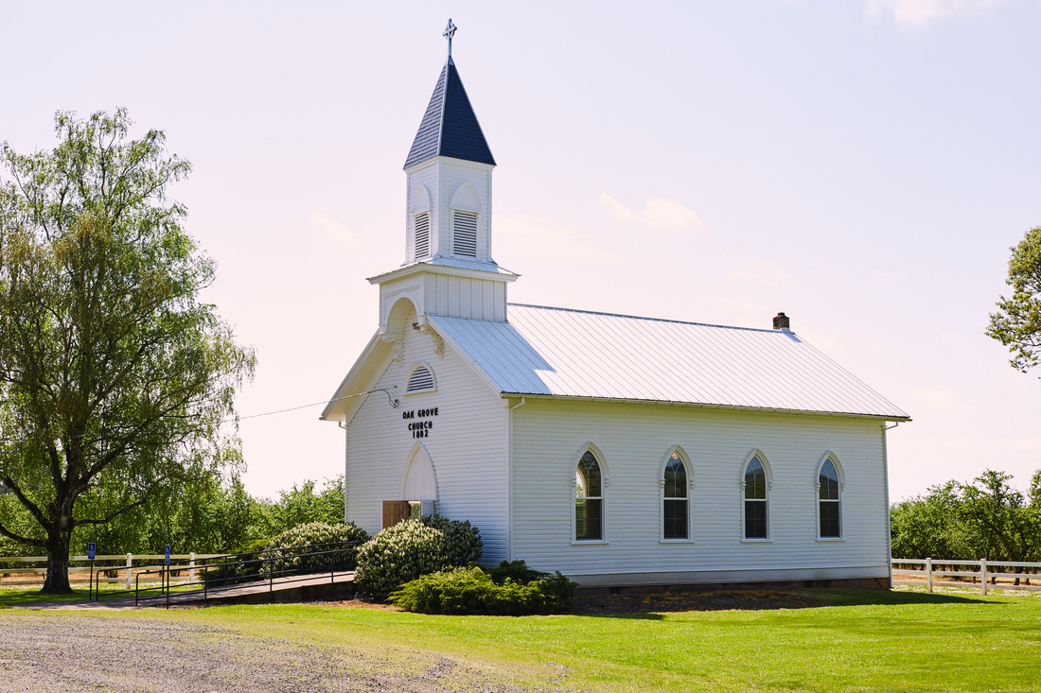
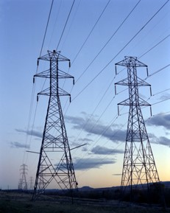


Site Quality Considerations
  Transportation
  Utilities & Telecom
  Environmental/Ecological
  Engineering
  Cultural
  Land Use/Zoning
  Workforce

Slide 7
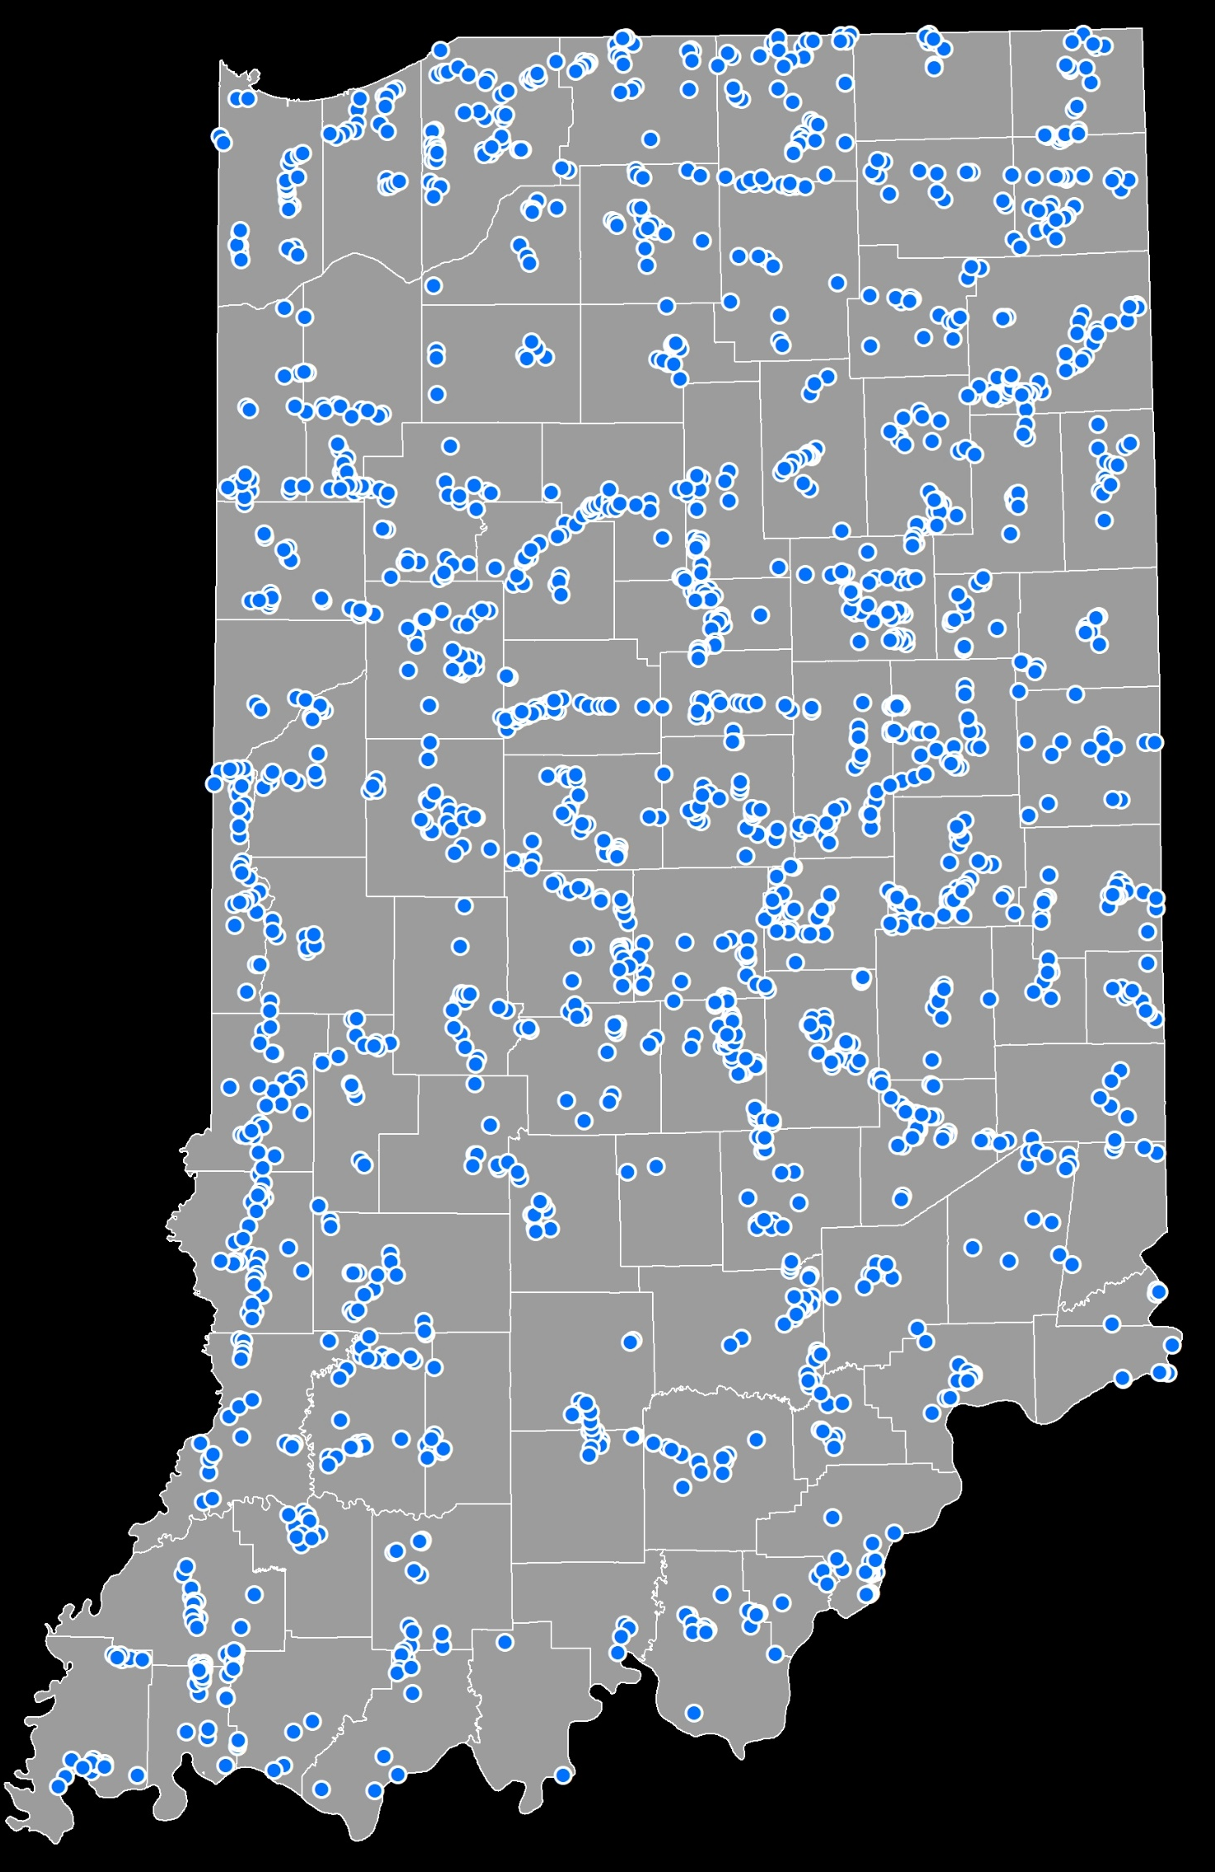
Indiana SSI Phase I Progress
as of January 2020
Total SSI Phase I Sites:
1,724

Slide 8
Indiana SSI Phase I Progress
as of January 2020
Project Land Use Intensity
Industrial MegaSite
  1,000+ acres
Heavy Industrial
  400+ acres
Tech MegaPark
  500+ acres
Light Industrial
  150+ acres
Heavy Agribusiness
  150+ acres
General Agribusiness
  50+ acres

Slide 9
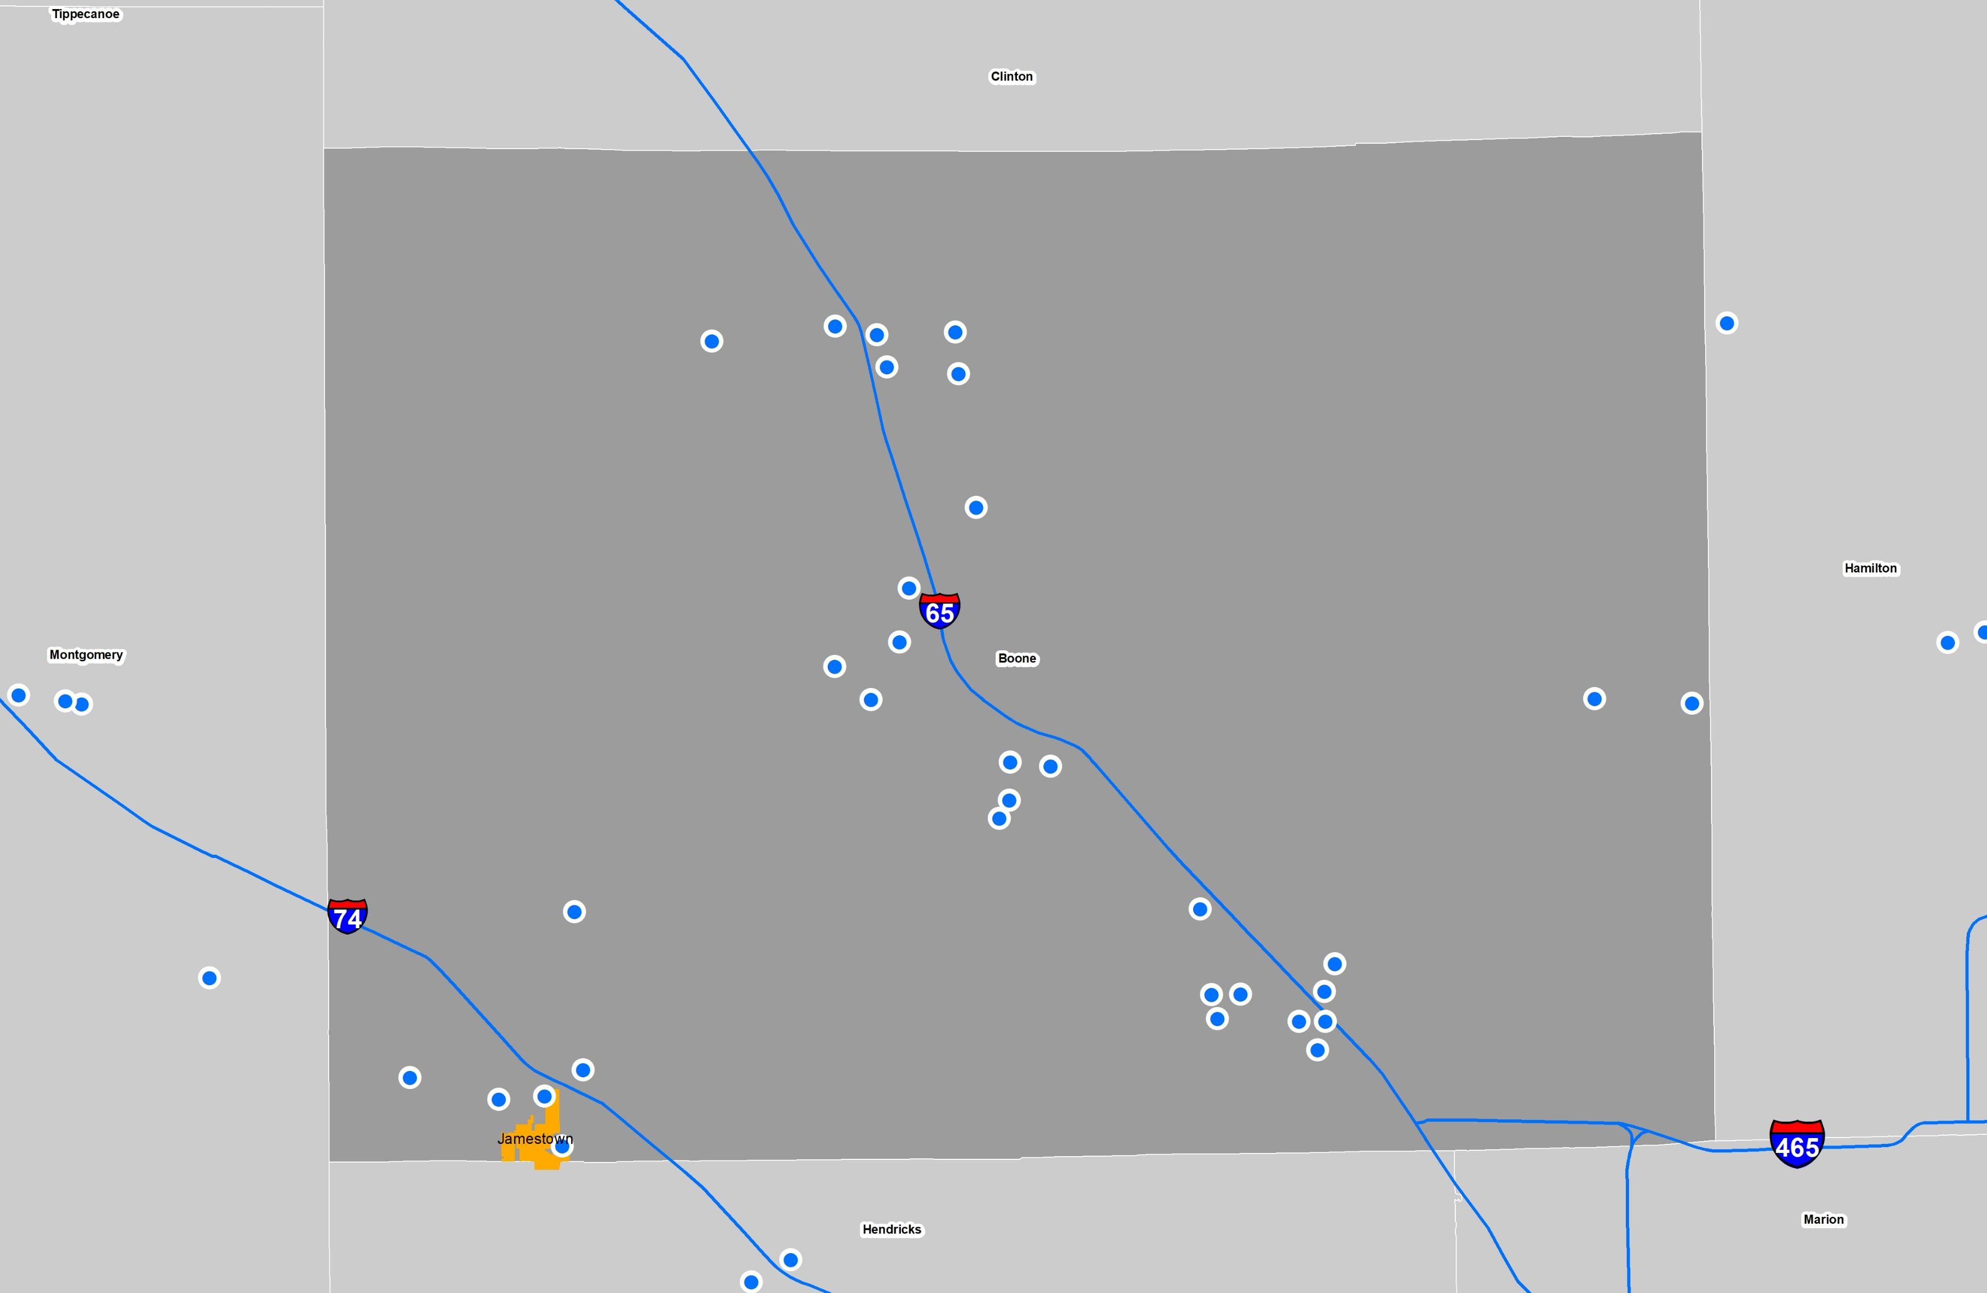
Indiana SSI Phase I Progress
as of January 2020
Boone County Phase I Sites:
31

Slide 10
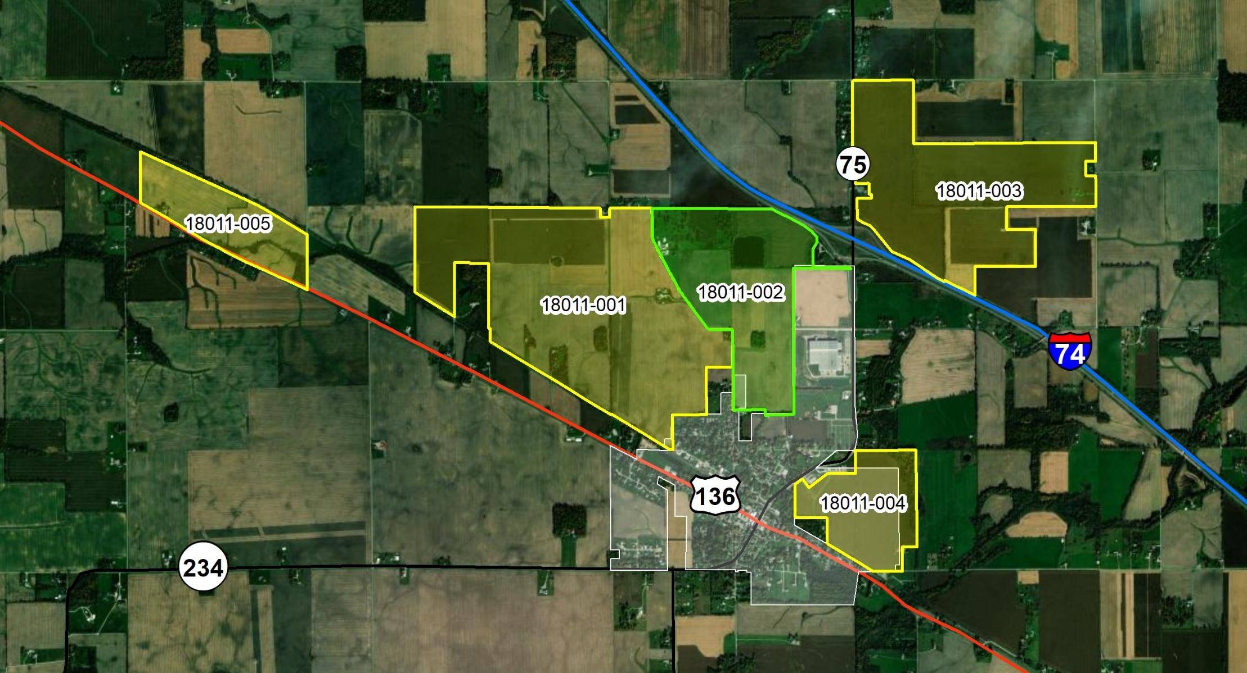
SSI Phase I/II Sites Near Jamestown

Slide 11
SSI Phase II: Preliminary Due Diligence
  SSI Site ID: 18011-002
  Site: 225.1 acres
  Buildable Area: 180.9 acres
  Current Ownership
  Charleen Purdy
  John Levinsohn/Steve Fritsch
  Highest and Best Use
  Light Industrial
  R&D Technology Park
  General Agribusiness

Slide 12
SSI Phase II: Preliminary Due Diligence
  SSI Site ID: 18011-002
  Site: 225.1 acres
  Buildable Area: 180.9 acres
  Current Ownership
  Charleen Purdy
  John Levinsohn/Steve Fritsch
  Highest and Best Use
  Light Industrial
  R&D Technology Park
  General Agribusiness

Slide 13
SSI Phase II: Preliminary Due Diligence
CONDITION
CONNECTION
COMMUNITY

Slide 14
SSI Phase II: Preliminary Due Diligence

Slide 15
SSI Phase II: Preliminary Due Diligence

Slide 16
SSI Phase II: Preliminary Due Diligence
Upon considering the factors mentioned throughout the SSI Phase II Report, it is the opinion of Leotta Location and Design that the Jamestown Industrial Site should be considered a nationally competitive site for attracting quality job-producing light industrial and general agribusiness projects to Boone County. With nearby access to all major utilities, a PAD of over 180 acres, direct interstate access, high available workforce within 60-minutes, community support and political leadership from Boone County, the property should be considered a high-quality site that is prime for development.

Slide 17
Quality Sites = Quality Projects = Quality Jobs

Slide 18

Contact
Victor Leotta
Principal
Leotta Location and Design, LLC
Baton Rouge, Louisiana
(225) 281-4202
victor@location-design.com
www.location-design.com
Notes:
18

