Slide 1


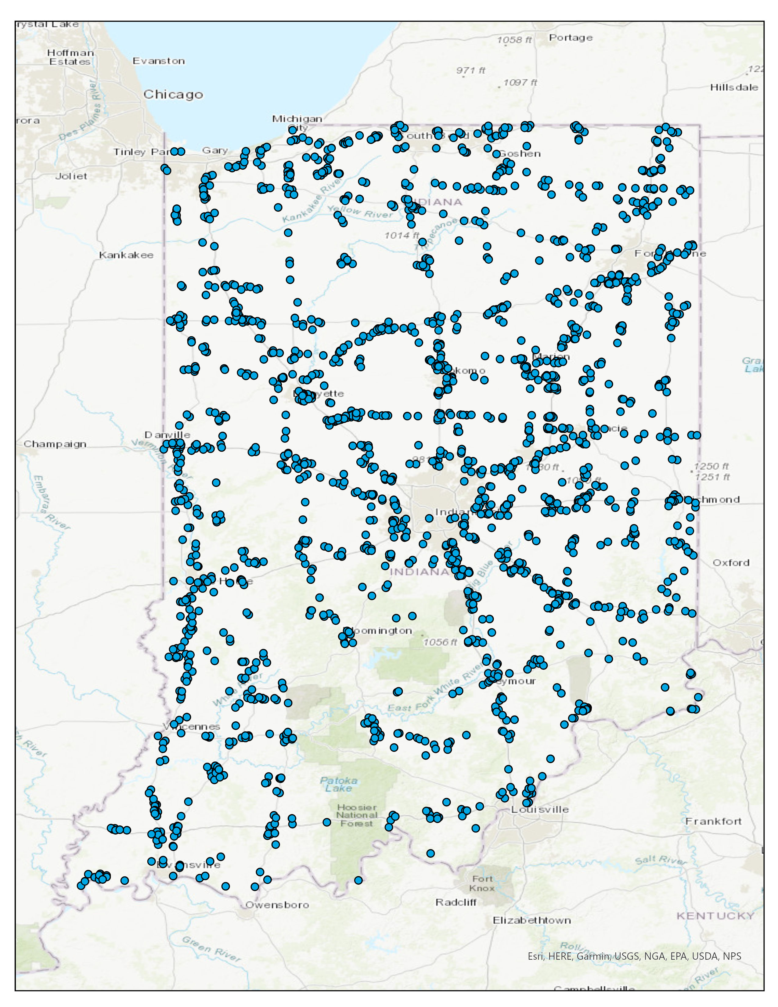
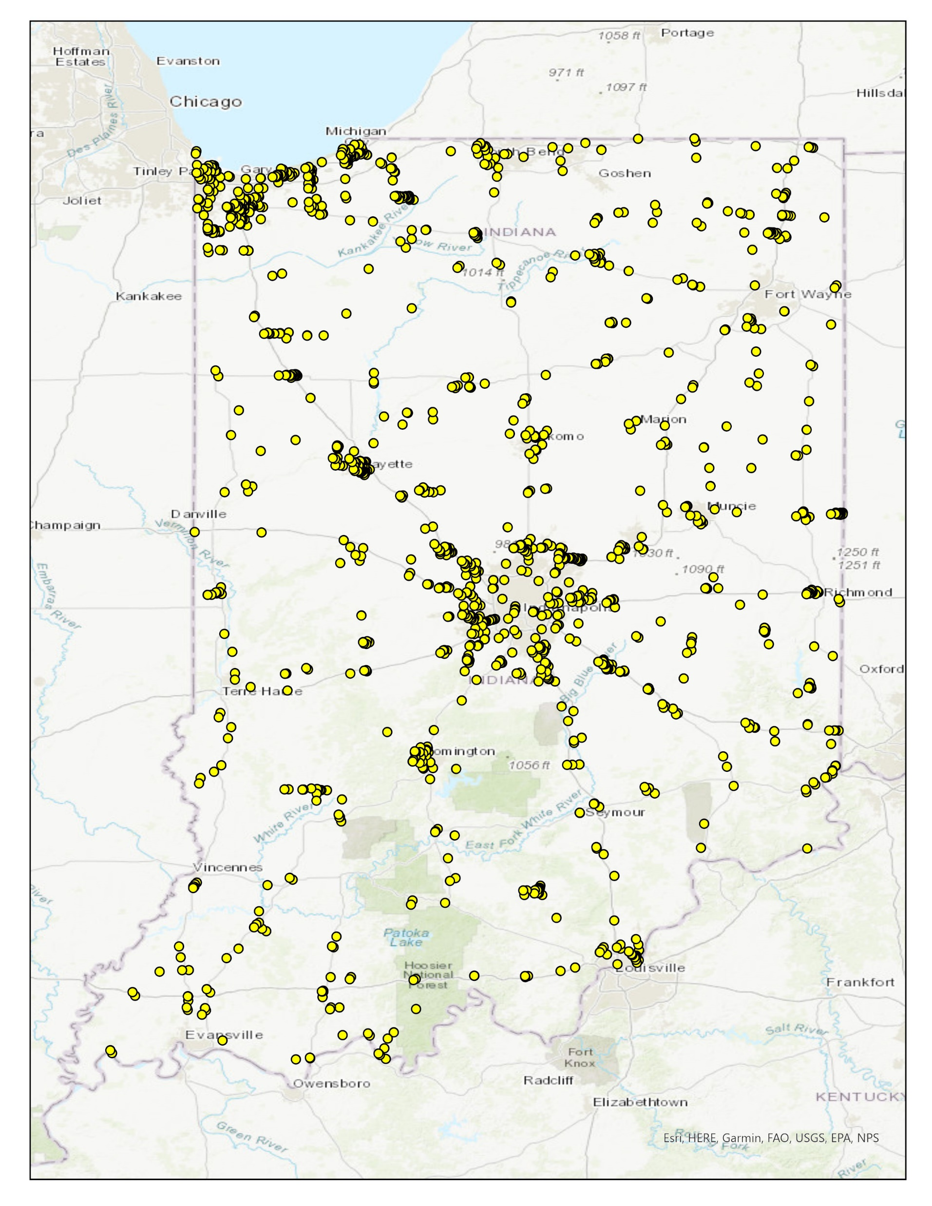




Indiana SSI / ZoomProspector
SITE COMPARISON PROJECT

Slide 2

Project Description
Conduct a site-by-site comparison to determine overlap between SSI Phase I sites and sites listed in the Indiana ZoomProspector database.
Purpose of Project
Demonstrate the volume of new potential greenfield sites produced through SSI Phase I: Site Discovery.

Slide 3
Approach
Utilize GIS-based spatial analysis to determine site boundary intersection for SSI Phase I sites and ZoomProspector sites.
Initial analysis is applied to SSI Phase I sites with a ranking of 4.0 or higher.
A grading scale for how closely intersecting boundaries match is applied.
  ZP-EM = Exact Match
  ZP-SM = Substantial Match
  ZP-PM = Partial Match (pending review)
  ZP-PR = Proximate to ZP Site
  ZP-NM = No Match
Tier levels (1-4) are formed based on SSI-ZP date added comparison.
Objectives
Gain a quantitative understanding of SSI Phase I and ZoomProspector site coincidence.
Infer an indication of ZoomProspector site quality based on overlap with 4.0+ ranked SSI Phase I sites.
Derive percentage of new potential greenfield sites where SSI Phase I sites do not intersect ZoomProspector sites.
Create GIS-based site boundaries for ZoomProspector sites where property listings do not have a defined boundary.
Provide site boundaries to property listing managers to load into ZoomProspector for map display.

Slide 4
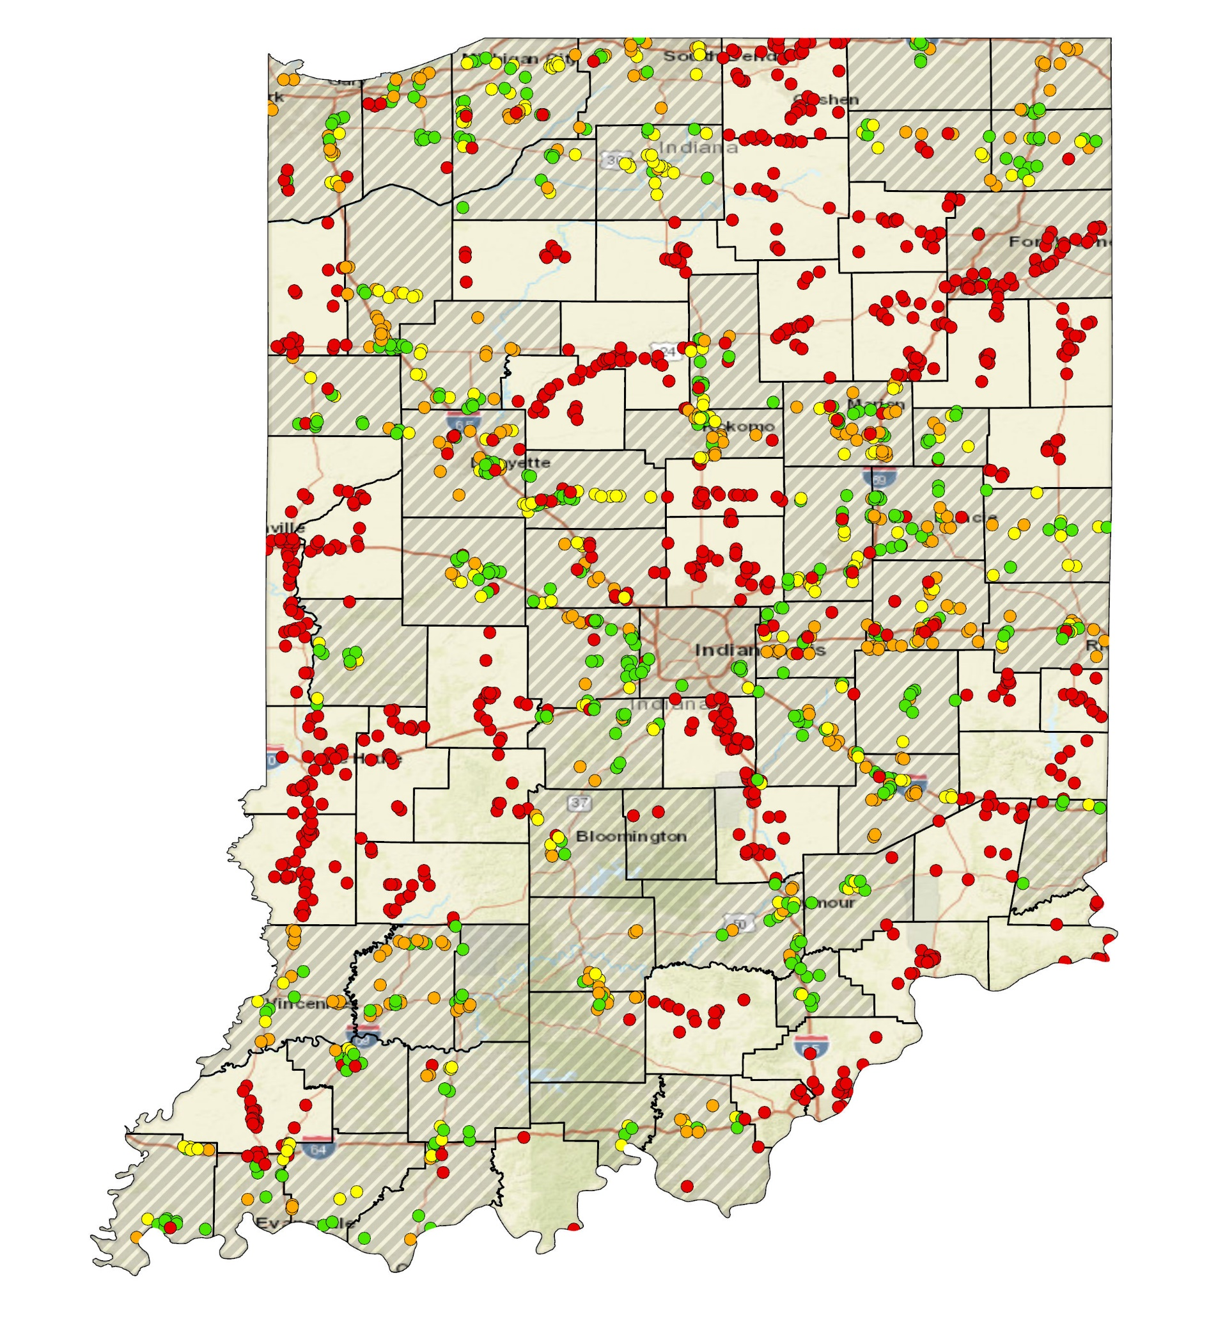
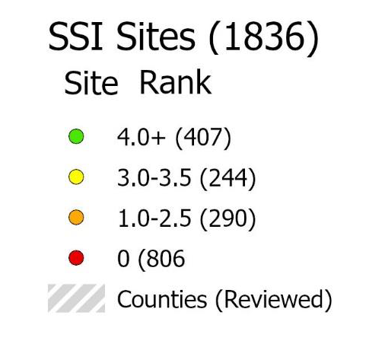
Findings Summary – Local Sites Review
SSI Sites by Ranking, Reviewed/Unreviewed
Local Site Review Workshop Stats:
54 out of 92 counties reviewed
1,823 out of 1,836 sites reviewed
407 sites with 4.0+ ranking

Slide 5
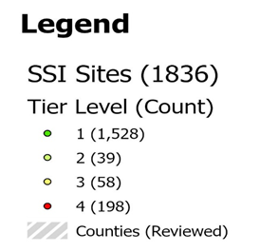
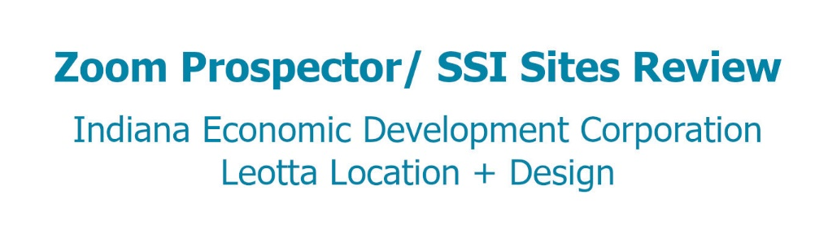
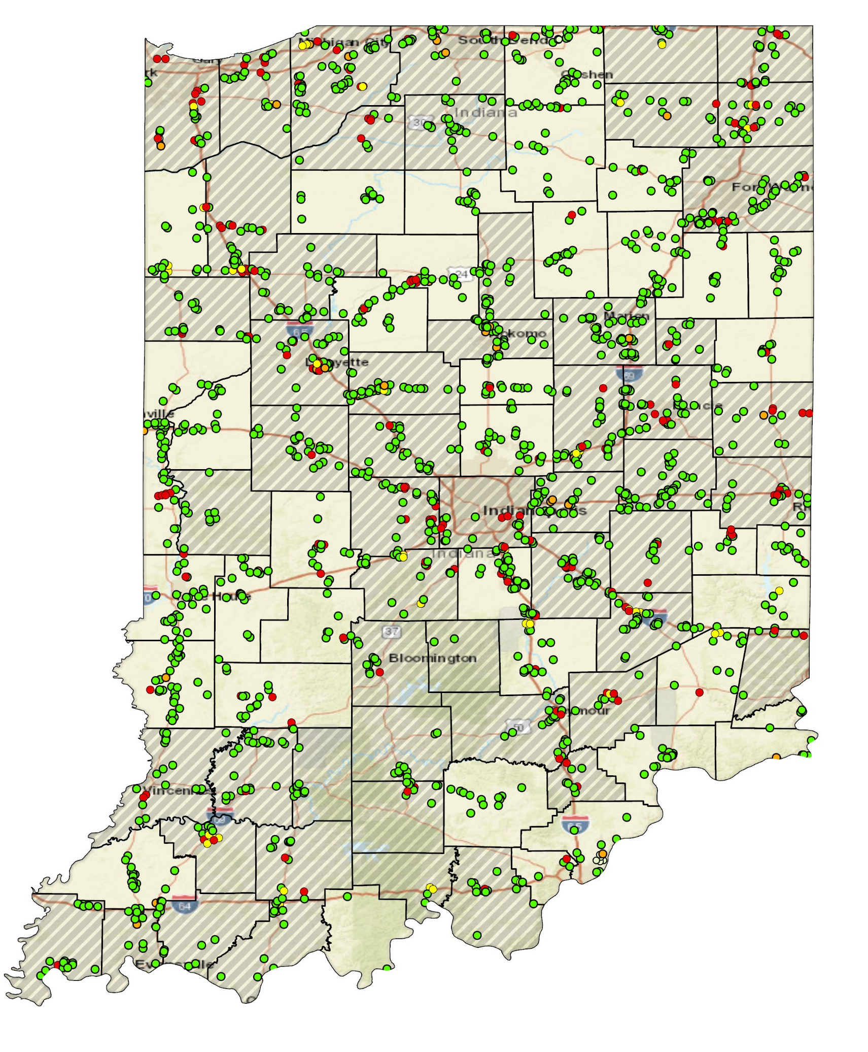
Findings Summary – Tier Levels
SSI-ZP Site Tier Descriptions:
Tier 1: ZP-NM, ZP-PR
Unique SSI sites that are not yet added to the ZP portal.
Tier 2: ZP-EM, ZP-SM
SSI sites that were reviewed during the Phase I local review workshop date and subsequently added to the ZP portal.
Tier 3: ZP-PM
SSI sites that share a boundary or some area of a current ZP site.
The ZP site could be altered based on SSI findings, or ZP site was unable to be confidently identified. Further review needed.
Tier 4: ZP-EM, ZP-SM
SSI sites that already existed in the ZP portal prior to the local review workshop.
Identification through SSI Phase I confirms ZP site validity.

Slide 6
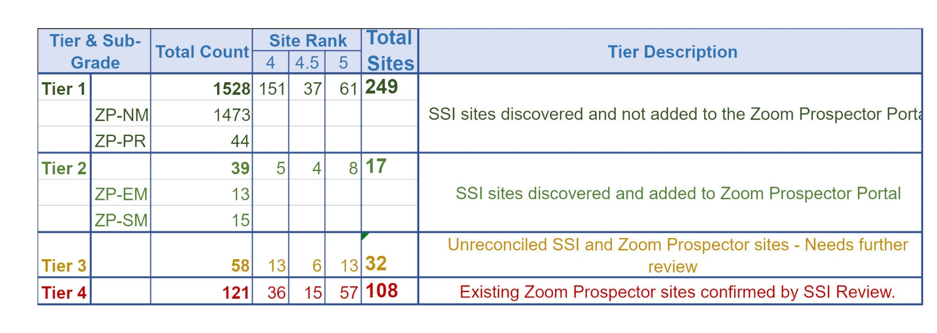
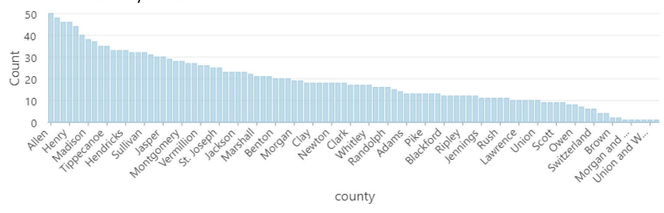
Findings Summary – Tier Levels
All SSI sites subject to further analysis received a ranking of 4.0 or greater during local county review workshops and have a total acreage of at least 250 acres.
1,065 SSI sites did not meet the above criteria and were excluded from further SSI-ZoomProspector comparison assessment.

Slide 7
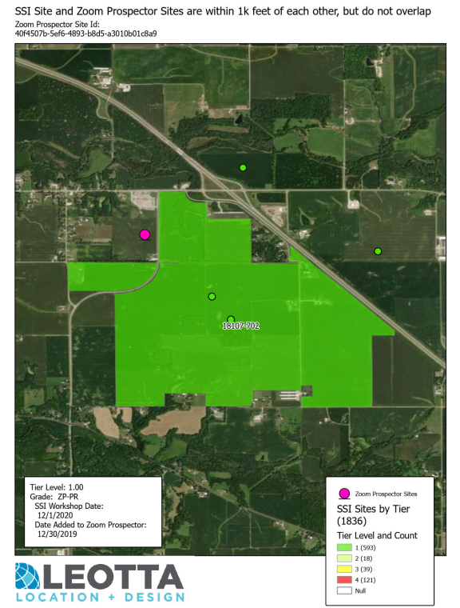
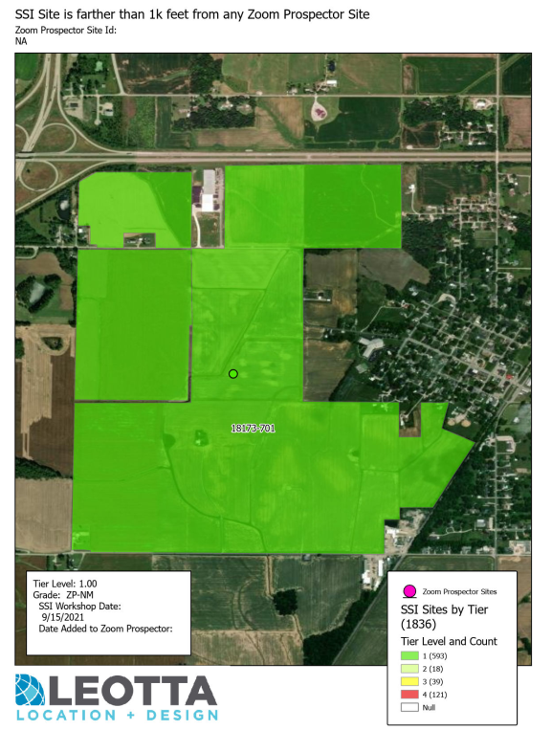
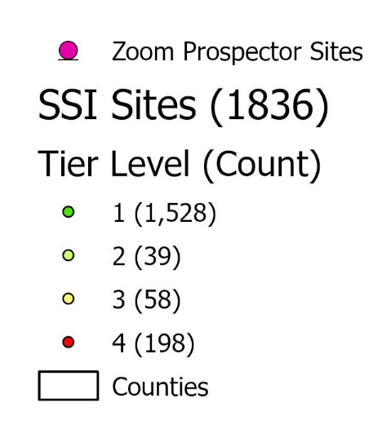
Findings Summary – Tier and Grade Samples
Tier 1
ZP-PR
(proximate
to ZP site)
Tier 1
ZP-NM
(No Match)

Slide 8
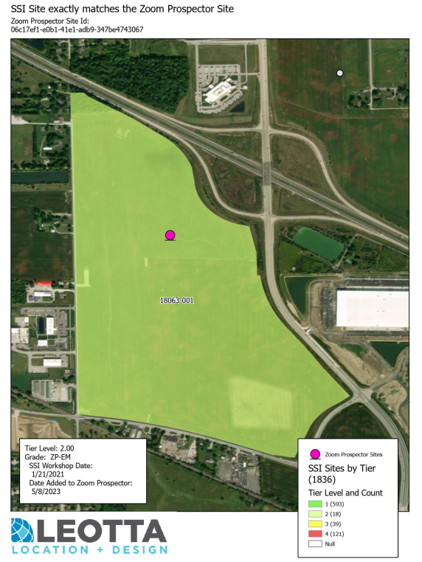
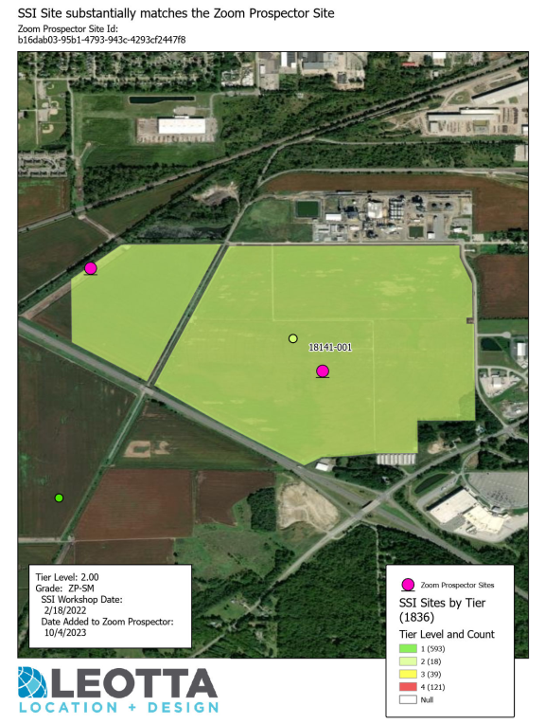
Findings Summary – Tier and Grade Samples
Tier 2
ZP-EM
(Exact Match)
Tier 2
ZP-SM
(Substantial Match)

Slide 9
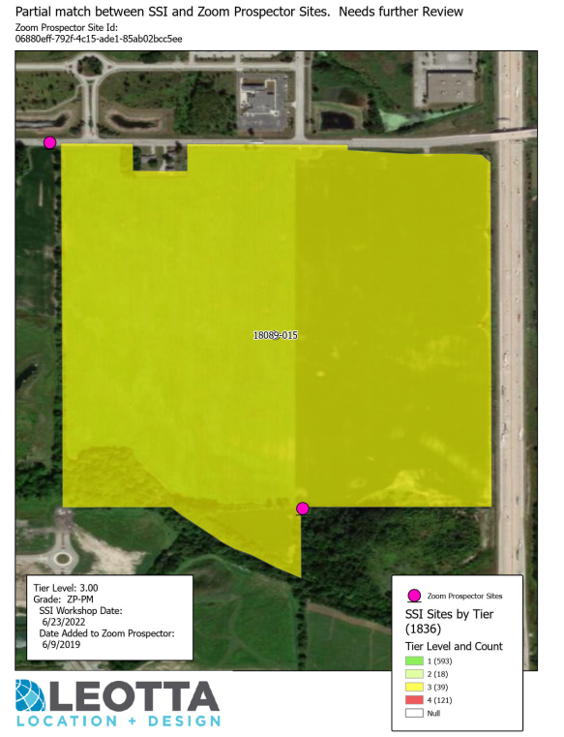
Findings Summary – Tier and Grade Samples
Tier 3
ZP-PM
(Partial Match)

Slide 10
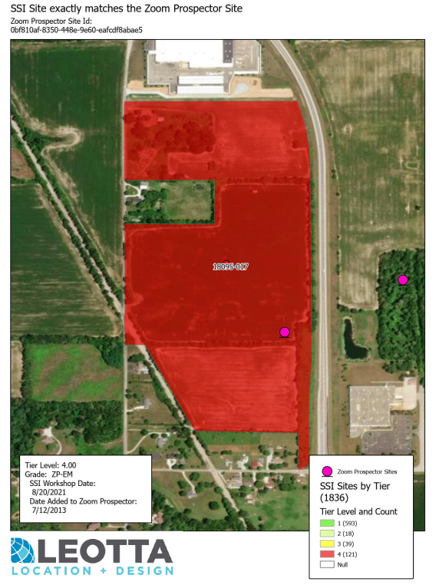
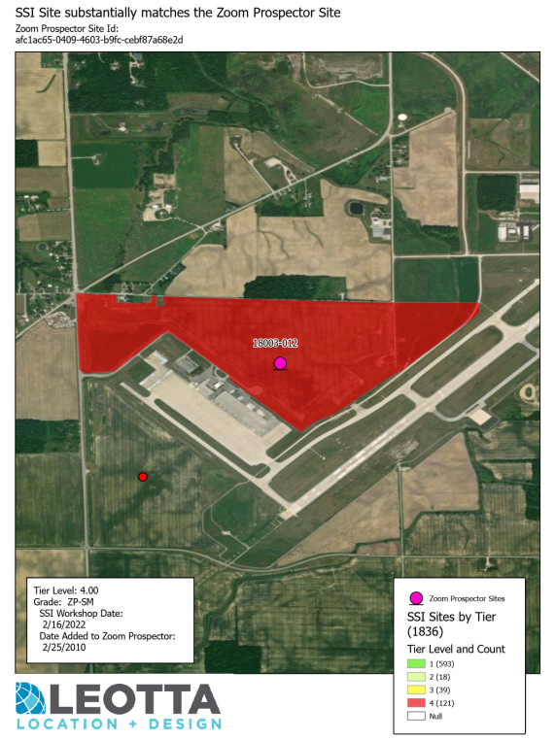
Findings Summary – Tier and Grade Samples
Tier 4
ZP-EM
(Exact Match)
Tier 4
ZP-SM
(Substantial Match)

Slide 11






Rough Order-of-Magnitude (ROM) Costs
SSI PI Sites
Ranked 4.0+
SSI PI Sites
with 250+ Acres
496
482
Summary Metrics
GRADE
GRADE
GRADE
GRADE
GRADE
EM
SM
PM
PR
NM
SSI Sites with
Exact
ZP Match
SSI Sites with
Substantial
ZP Match
SSI Sites with
Partial
ZP Match
SSI Sites within
1,000 ft
of ZP Site
SSI Sites not
within 1,000 ft
of ZP Site
122
120
56
53
1,473
TIER
TIER
TIER
TIER
I
II
III
IV
4.0+ Ranked SSI Sites not existing in
ZP Portal
4.0+ Ranked SSI Sites added to ZP Portal after local review
4.0+ Ranked SSI Sites
unreconciled w/ ZP
(further review)
4.0+ Ranked SSI Sites existing in ZP Portal before local review
1528
39
58
198
Acreage
Range
Average
Acres
Average
Buildable Acres
8–223.3
57.4
29.8

Slide 12


How this information may be used…
Demonstrate SSI Program ROI.
Derive an understanding of general site competitiveness for current ZoomProspector sites.
Provide incentive for LEDO’s to schedule their SSI Phase I local sites review workshop.

Slide 13



Anastasi Geminden Lowe
Manager, Site Marketing
Indiana Economic Development Corporation
Phone: (463) 214-0479
Email: ageminden@iedc.in.gov
www.iedc.in.gov
Victor Leotta
Principal
Leotta Location and Design, LLC
Phone: (225) 281-4202
Email: victor@location-design.com
Contact
Tina Morgan
Site Quality Analyst
Leotta Location and Design, LLC
Phone: (225) 978-7031
Email: tina@location-design.com
www.location-design.com

