Slide 1
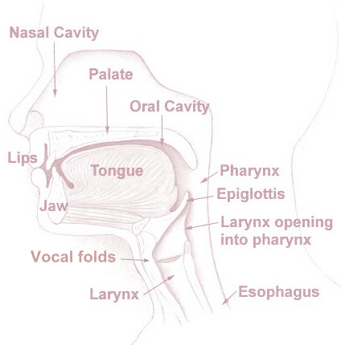
A
AA
A
æ
@
A
L
D
N
Z
T
ǁ
R
I
ж
J
ǀ
с
%
ɛ
zh
S
ə
$
ч
H
ch
as above (heaven)
E
so below (earth)
G
th
>
Θ
ʔ
?
K
ш
sh
*
ʘ
M
U
L
B
Y
P
V
F
W
O
(spiritual) inward
outward (not spiritual - temporal)
ж
ж
Developed by MJ Shaffer
Initial: 2022 October 16
Revision: 2024 October 5
https://www.ipachart.com/
basic whistle? Whooo (cold wind imitation)?

Slide 2






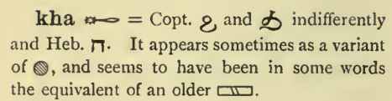














א
צ
/ts/
ל
ד
ט
/dj/
A
נ
ת
ר
י
L
D
N
Z
T
ǁ
R
I
J
ǀ
zh
ɛ
ה
ע
S
/ai/
H
ə
/ei/
ח
/a?/
ch
ג
G
E
th
ס
ק
ʔ
י
K
L
sh
שׁ
ʘ
M
U
ח, rarely ע or שׁ
B
Y
P
V
F
W
וּ
ו
מ
ב
O
פּ
(spiritual) inward
outward (not spiritual - temporal)
ף or ב (פ)?
Developed by MJ Shaffer
Initial: 2022 October 16
Revision: 2024 October 5
https://www.ipachart.com/
basic whistle? Whooo (cold wind imitation)?
Notes:
Maybe overlay a language, such as Hebrew or Russian or Egyptian?

